Slide 1
2027 Ancillary Service Methodology Discussion
Luis Hinojosa
Manager, Ancillary Services & Operations Analytics
ROS
July 9, 2026
Purpose
Provide an overview of the 2027 AS Methodology, changes ERCOT is considering, and provide a proposed timeline for market discussion.
Key Takeaways
Interested Stakeholders are requested to attend meetings to provide any feedback on the AS Methodology.

Slide 2
Introduction
ERCOT is reviewing the methodology to determine minimum Ancillary Service (AS) requirements.
Key review items:
  ERCOT continues to monitor the impacts of Large Load ramping relating to this methodology to determine if a new adjustment factor need to be introduced.
  NERC’s preliminary BAL-003 Interconnection Frequency Response Obligation (IFRO) assessment for ERCOT for the 2027 Operating Year (OY) has not yet been published. Therefore, this analysis used the minimum RRS-PFR limit of 1,377 MW assigned for 2026.
  The 2026 AS Methodology implemented a probabilistic method for ERCOT Contingency Reserve Service (ECRS) and Non-Spinning Reserve (Non-Spin).
  The 2027 review focuses on refining the model to find the appropriate criteria for AS procurement quantities. ERCOT plans to compare alternative criteria using AS quantity, estimated cost, and modeled reliability-risk metrics
Any AS quantities for 2027 contained in this presentation are based on the methodology that was approved in December 2025. The quantities for 2027 reflect moving forward the historic data on which these are based, unless otherwise noted.
2027 Methodology Review Timeline
May 19, 2026 – TAC Kickoff
June 01, 2026 – BOARD Preview
June 17, 2026 – PDCWG
June 29, 2026 – WMWG
July 08, 2026 – WMS
July 09, 2026 – ROS
July 22, 2026 – PDCWG (Proposed)
July 27, 2026 – WMWG (Proposed)
July 28, 2026 – OWG (Proposed)
August 05, 2026 – WMS (Vote)
August 06, 2026 – ROS (Vote)
August 26, 2026 – TAC (Vote)
September 15, 2026 – BoD
Nov, Dec 2026 – PUC

Slide 3
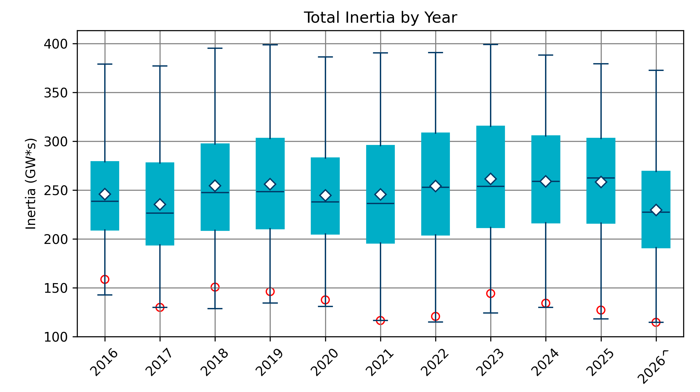
Regulation and Responsive Reserve Service
Regulation
ERCOT continues to monitor the impacts of Large Load ramping relating to this methodology to determine if a new adjustment factor needs to be introduced.
Responsive Reserve Service
RRS Methodology overall is unchanged. Changes to quantities are correlated to trend changes in Inertia
NERC’s preliminary BAL-003 Interconnection Frequency Response Obligation (IFRO) assessment for ERCOT for the 2027 Operating Year (OY) has not yet been published. Therefore, this analysis used the 2026 RRS table built using the minimum RRS-PFR limit of 1,377 MW for 2026.
 | 2027 Methodology
Data Input | 5-min SCED Netload Forecast Error (2-yr)
Calculation Method | 95th of 5-min SCED Netload Forecast Error
Wind/Solar Adjustment | GE Table - Increased wind/solar forecast error per 1,000 MW installed capacity increase
ACE Integral Component | Average of ACE Integral Change (2-yr)
Load Adjustment (LL Ramps) | TBD

Slide 4
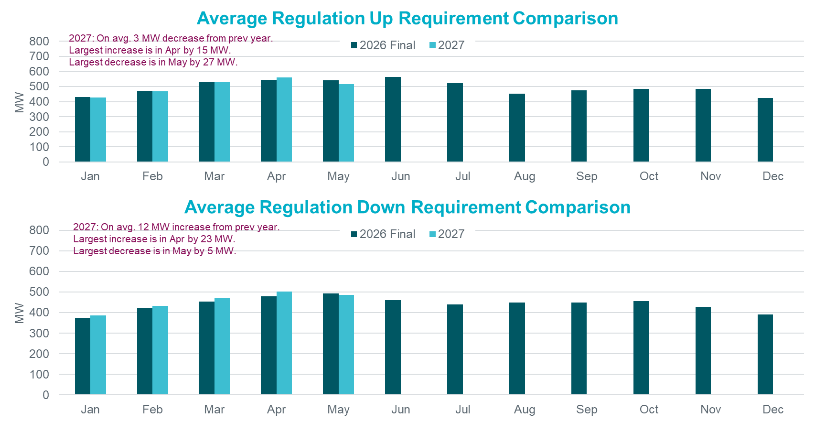
Hourly Average Regulation Comparison

Slide 5
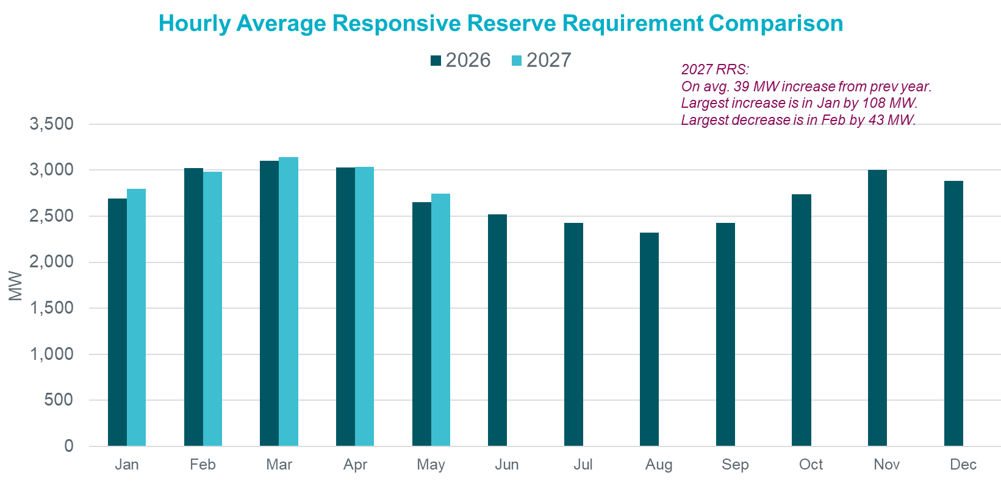
Monthly Average Responsive Reserve Service Comparison

Slide 6
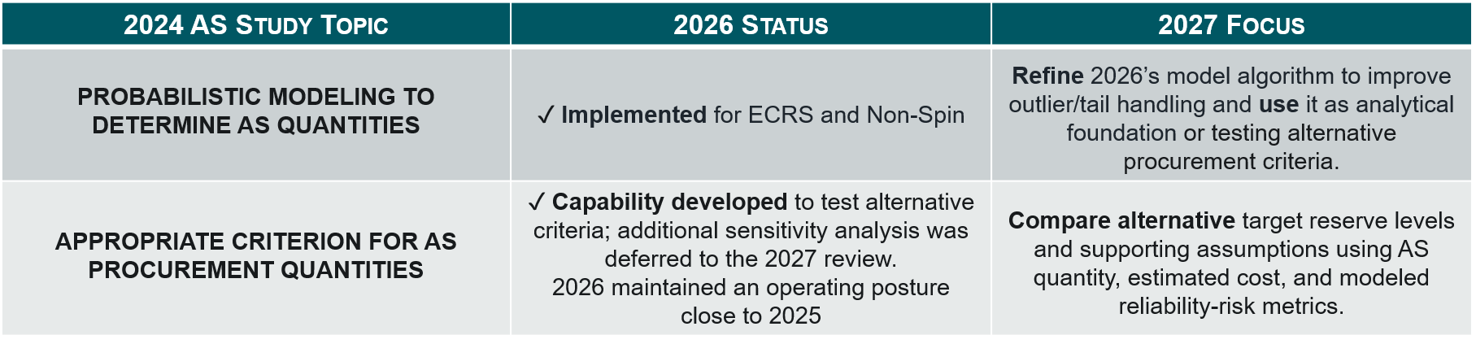
Probabilistic Framework Review
To fulfill ERCOT Protocols Section 3.16, ERCOT reviews its AS Methodology annually; the Board reviews and recommends approval; and the PUCT approves the methodology prior to implementation.
The following findings in the PUCT’s 2024 Ancillary Services Study are relevant to the 2027 AS Methodology work.
Key Takeaway: 2026 built the probabilistic engine for ECRS and Non-Spin; 2027 will refine that engine and use it to compare to support the Commission’s objective, data-based AS procurement criterion.

Slide 7
2026 Probabilistic Framework for ECRS and Non-Spin
2027 sensitivities will be applied to risk inputs, risk credits, and convergence criteria.
INPUTS
ENGINE
OUTPUTS
Risks
Net Load Forecast Error
Accumulated Forced Outages
Look-ahead period
Monte Carlo Optimization
ECRS Requirement (accounting for frequency recovery)
(12 Month x 24 Hour)
ECRS + Non-Spin
Requirement
(12 Month x 24 Hour)
Non-Spin Requirement
(12 Month x 24 Hour)
Net Risk
No
Risk Credits
Online sustainable headroom
Offline capacity
Duration
Convergence Criteria⁺ Met?
⁺Convergence Criteria: 1 in XX probability of operating reserves dropping below the sum of Reg Up plus RRS or target threshold, whichever is higher.
Yes
Key Takeaway: The 2027 review will test sensitivities within the existing probabilistic framework: risk inputs, risk credits, and convergence criteria.

Slide 8
Sensitivity Analysis and Methodology review
Topic | Conducting Analysis
Sensitivity to level of risk in the criterion when procuring AS to cover forecast error (on non-scarcity days). | Target reserve level: Watch, EEA1, EEA2 OR Load Shed Probability of violation: 1 in 10 year, 1 in 5 year, 1 in 1 year Restoration Criteria: Varying Reg Up + RRS criteria
Sensitivities to look ahead period when measuring forecast error and forced outage risk. | In hourly increments up to 6-hour (current setting) prior to operating hour beginning
Review impact of risk credits. How much should the AS quantities be discounted based on the “extra” headroom from resources that were historically committed by market? | Credit: Current credit approach, and higher credit levels Current: 60% for in night hours (HE23-HE5) and Y = 25% in day hours (HE6-HE22) Energy Duration: Current Protocols and lower-value sensitivities
Optimization is highly impacted by tail events when measuring risk. Evaluate the Net Load Forecast Error (NLFE) and Solar Adjustment logic to identify potential improvements. | Analyze distribution methods for errors as it applies reliable operations. Investigate the need to move to Gross Real-Time Power Potential (GRPP). How can this affect solar adjustment logic?
Adjacent hour impacts could cause large steps in quantities between hours. How can this be improved? | Improve methodology for adjacent hours and potential smoothing.
Other tuning improvements and RTC+B impacts to the probabilistic methodology | Review improvements for ESR growth, and RTC+B such as AS Plan procurement.

Slide 9
Summary
Based on the analysis ERCOT has conducted thus far,
  ERCOT is not considering any changes in the methodologies used to compute Responsive Reserve Service requirements for 2027.
  ERCOT continues to monitor large load ramping and potential changes to the methodology used to compute Regulation Service.
  ERCOT is evaluating several changes/improvements/tuning to the Probabilistic methodology to account for RTC+B impact along with accounting for stakeholder feedback and requested sensitives to compute the ECRS and Non-Spin requirements for 2027.
The proposed timeline for this review is included alongside.
Interested Stakeholders are requested to attend the upcoming meetings to provide any feedback on the proposed 2027 AS Methodology.
2027 Methodology Review Timeline
July 22, 2026 – PDCWG (Proposed)
July 27, 2026 – WMWG (Proposed)
July 28, 2026 – OWG (Proposed)
August 05, 2026 – WMS (Vote)
August 06, 2026 – ROS (Vote)
August 26, 2026 – TAC (Vote)
September 15, 2026 – BoD
Nov, Dec 2026 – PUC

Slide 10
Questions/Feedback?
JoseLuis.Hinojosa@ercot.com

Slide 11
Appendix

Slide 12
Regulation

Slide 13
Recap – Generation To Be Dispatched (GTBD)
ERCOT has incorporated intra-hour wind/solar forecast- based ramp into GTBD to give SCED an indication of how renewables may ramp.
  Predicted Wind Ramp Rate (PWRR) was incorporated in GTBD in Dec.2018
  Predicted Solar Ramp Rate (PSRR) was incorporated in GTBD in Jun.2021
In absence of PSRR/PWRR, SCED dispatches uncurtailed solar/wind units to their max output (HSL).
  This means that SCED assumes output of uncurtailed solar/wind units will persist for the next 5-min at the unit’s HSL that was telemetered at the start of the interval.
GTBD = Total Gen
+K3*5*PLDRR
+K4*Regulation Deployed
+ K5*ACE Integral
– K6*5*PWRR
+ K7*5*DCTRR
– K8*5*PSRR
5-min Load Ramp Forecast
Previous Reg Deployment
Historical Accumulated ACE
5-min Wind Ramp Forecast
5-min DC Tie Ramp Forecast
5-min Solar Ramp Forecast

Slide 14
Recap – Dynamic Predicted Solar Ramp Rate (PSRR) Threshold in GTBD
ERCOT started to apply a dynamic PSRR threshold in GTBD calculation on 6/12/2023
PSRR thresholds change with 4 pre-defined day periods - Night, Sunrise, Sunset and Other
ERCOT started with a threshold of 80MW/min for Sunrise and Sunset periods on 6/12/23. Today, the threshold is set to 280MW/min.
ERCOT continues to update the thresholds and the definition of day periods seasonally*
Night
* Seasons will be defined by shift in solar ramping patterns

Slide 15
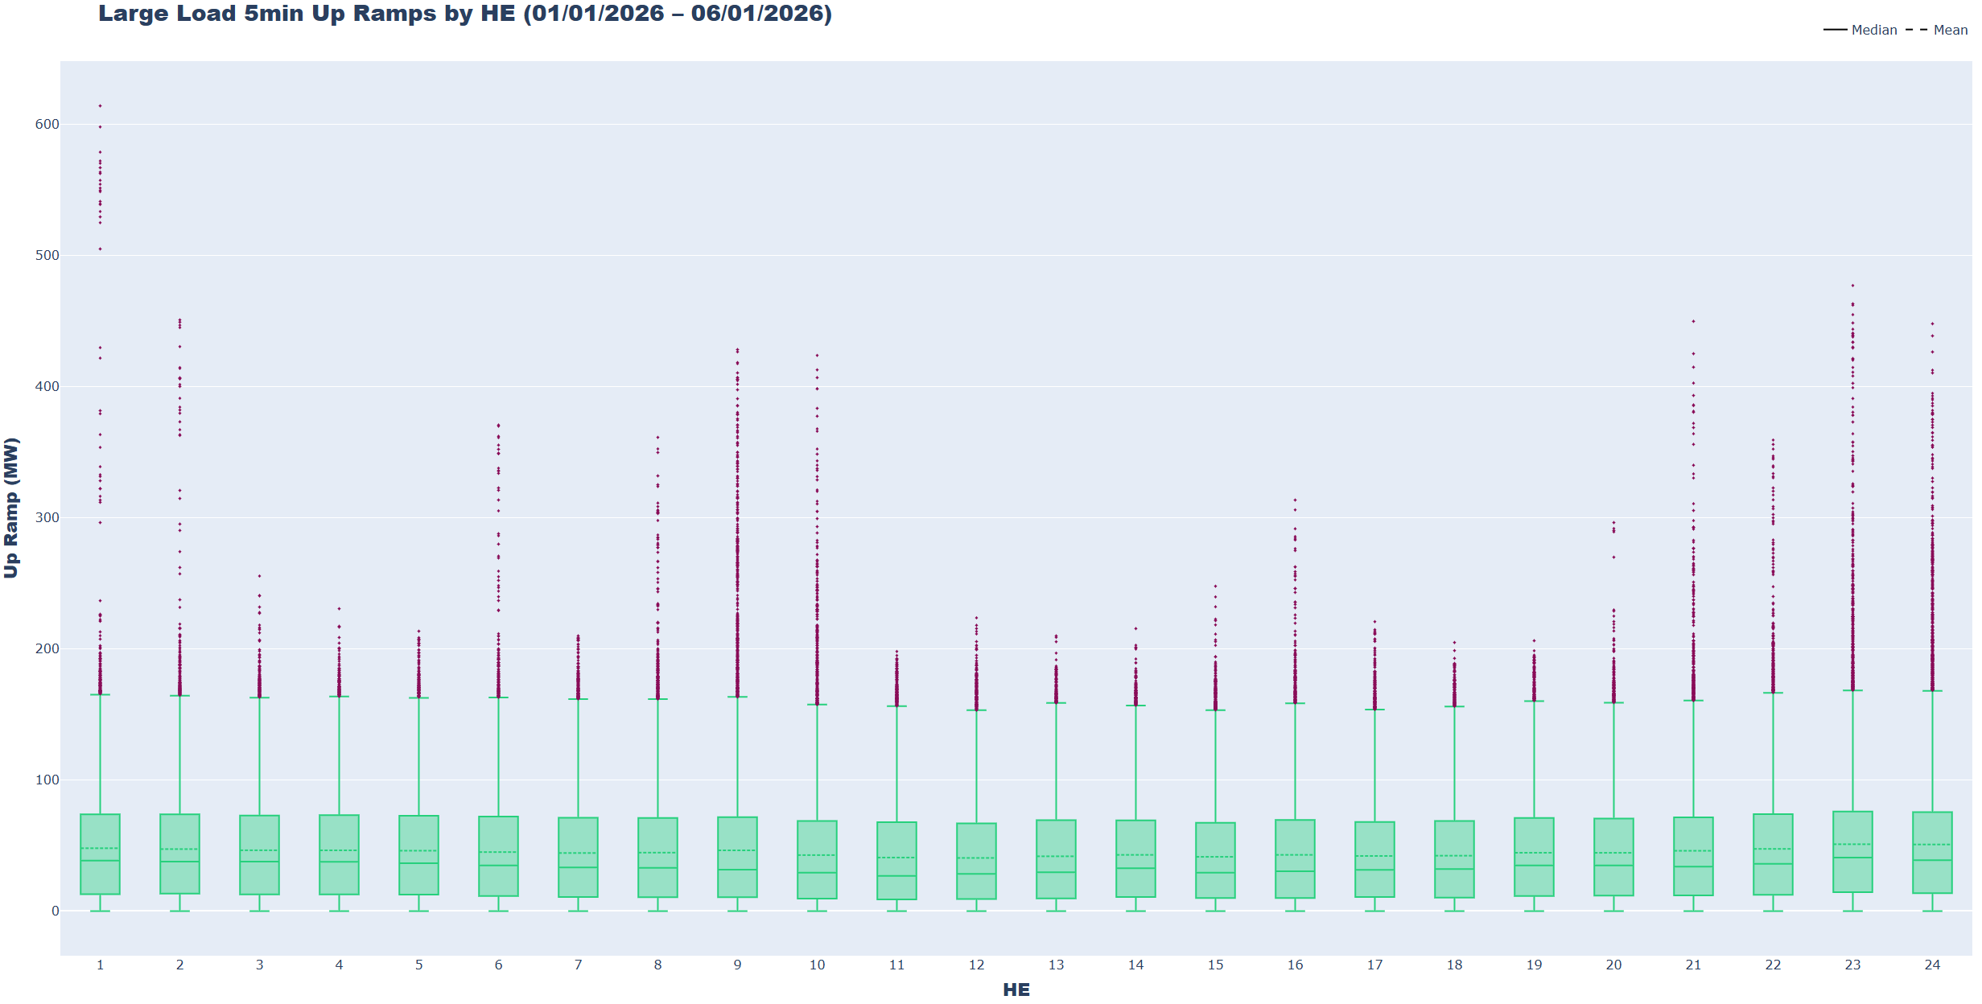
Large Load Ramping Trends
ERCOT is monitoring the aggregate ramping behavior of Large Loads and Non-Conforming loads. Ramping analysis revealed that 5-minute hourly average up ramps are between 41 MW (HE12) to 51 MW (HE23), however there are instances of ramps exceeding 400 MWs.

Slide 16
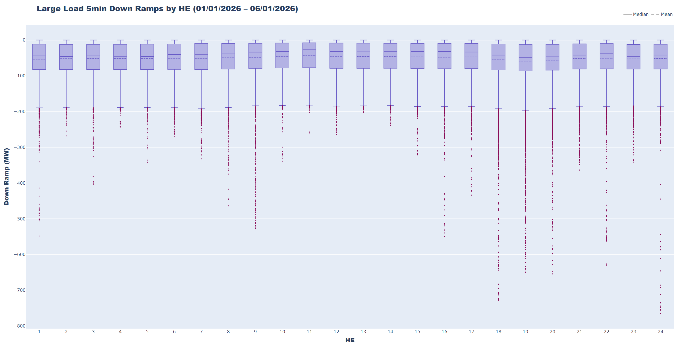
Large Load Ramping Trends
Ramping analysis revealed that 5-minute hourly average down ramps are between –44 MW (HE11) to –61 MW (HE19). Downward ramps tend to be more extreme, with greater quantities of large-magnitude outliers. Extreme ramps have the potential to impact frequency control and Regulation usage. In the current Regulation methodology, Large Load ramping is accounted for in the NLFE term, but a Large Load adjustment could be considered to combat the more extreme ramp scenarios.

Slide 17
RRS

Slide 18
2026 RRS Table
Scenario | 1 | 2 | 3 | 4 | 5 | 6 | 7 | 8 | 9 | 10 | 11 | 12
LR/PFR | 2.35:1 | 2.2:1 | 2.06:1 | 1.94:1 | 1.83:1 | 1.74:1 | 1.65:1 | 1.58:1 | 1.51:1 | 1.44:1 | 1.39:1 | 1.33:1
Inertia (GW∙s) | 130 | 140 | 150 | 160 | 170 | 180 | 190 | 200 | 210 | 220 | 230 | 240
PFR Req. (no LR) (MW) | 5,960 | 5,563 | 5,200 | 4,892 | 4,622 | 4,329 | 4,114 | 3,920 | 3,744 | 3,522 | 3,314 | 3,139
*RRS Curr IFRO (MW) | 3,320 | 3,273 | 3,227 | 3,183 | 3,145 | 3,068 | 3,031 | 2,982 | 2,941 | 2,863 | 2,767 | 2,699
**RRS Upd IFRO (MW) | - | - | - | - | - | - | - | - | - | - | - | -
Scenario | 13 | 14 | 15 | 16 | 17 | 18 | 19 | 20 | 21 | 22 | 23 | 24 | 25
LR/PFR | 1.28:1 | 1.24:1 | 1.19:1 | 1.15:1 | 1.12:1 | 1.08:1 | 1.04:1 | 1.01:1 | 1:1 | 1:1 | 1:1 | 1:1 | 1:1
Inertia (GW∙s) | 250 | 260 | 270 | 280 | 290 | 300 | 310 | 320 | 330 | 340 | 350 | 360 | 370
PFR Req. (no LR) (MW) | 3,004 | 2,890 | 2,784 | 2,686 | 2,595 | 2,510 | 2,421 | 2,353 | 2,290 | 2,230 | 2,173 | 2,119 | 2,068
*RRS Curr IFRO (MW) | 2,645 | 2,595 | 2,558 | 2,514 | 2,463 | 2,425 | 2,380 | 2,343 | 2,290 | 2,230 | 2,173 | 2,119 | 2,068
**RRS Upd IFRO (MW) | - | - | - | - | - | - | - | - | - | - | - | - | -
*RRS quantity is calculated for RCC of 2,805 with limit of 60% limit on LRs and min RRS-PFR limit of 1,377 MW.
**The 2027 IFRO assessment has not yet been reported back from NERC, preventing the calculation of RRS quantity.
***Red font in table above identifies study scenario where RRS needed < 2,300 MW. RRS requirement during these is based on the applicable floor.

Slide 19
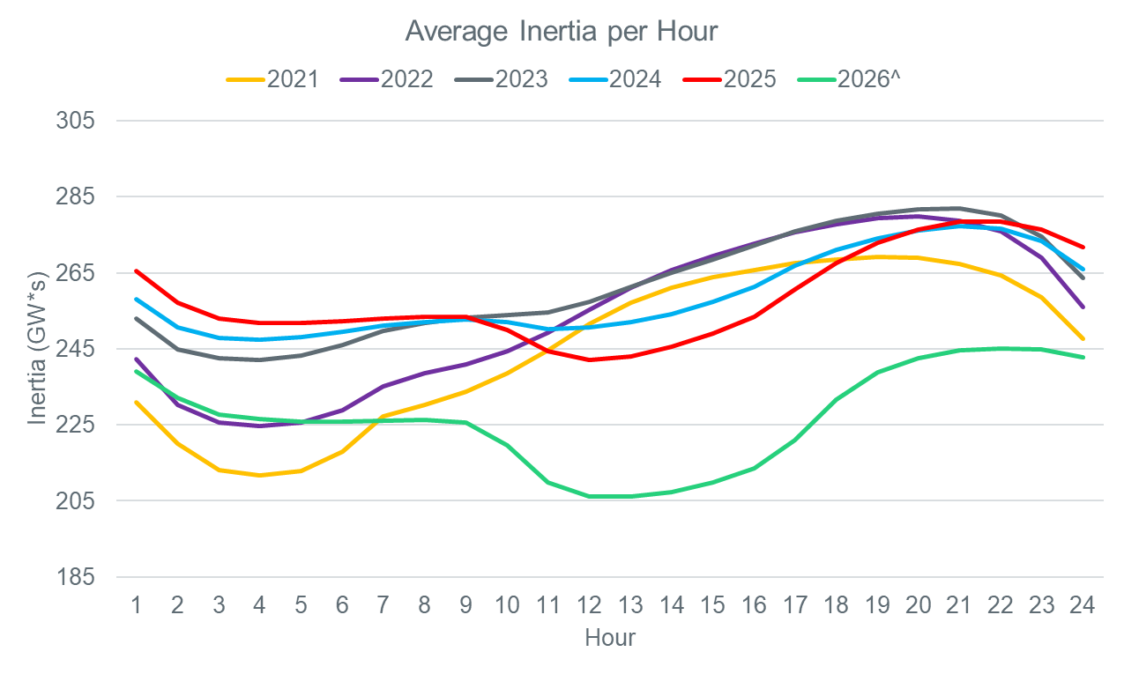
Average Inertia per Hour 2021-2026
From 2025 and onwards the lowest hours of inertia have moved from the night hours to the middle of the day.

Slide 20
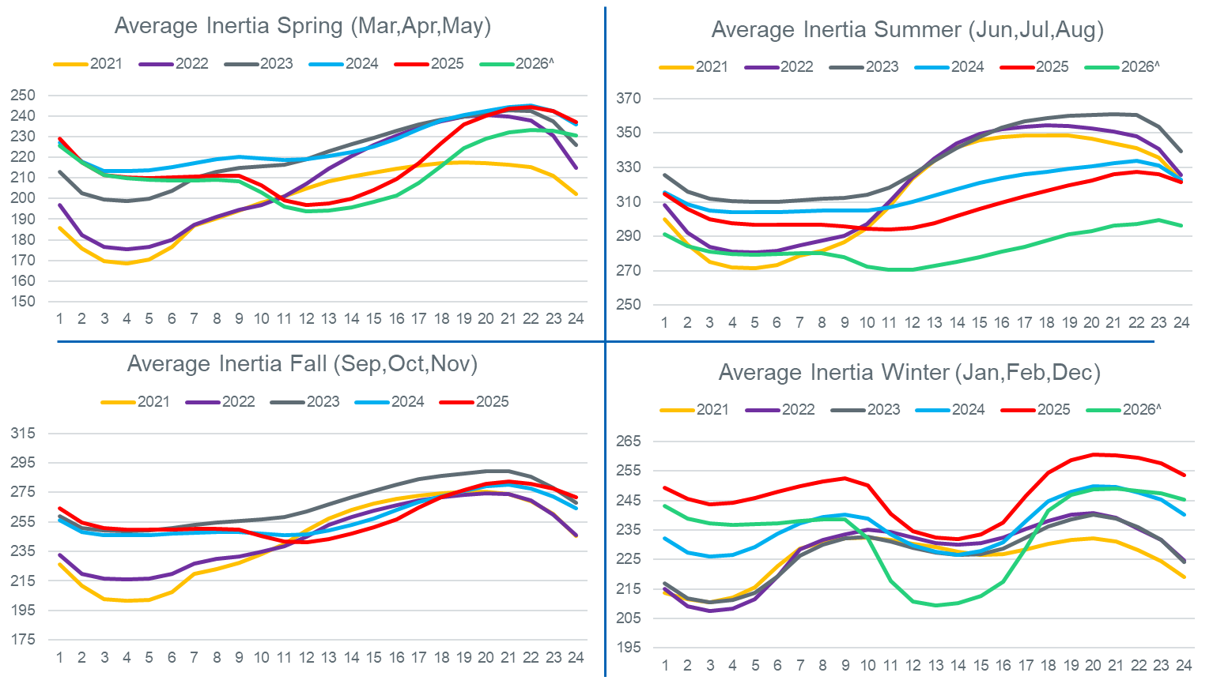
Average Inertia per Hour 2021-2026 (Seasonal)
Winter average Inertia contains previous year December data
Y-Axis scales are different in each chart

Slide 21
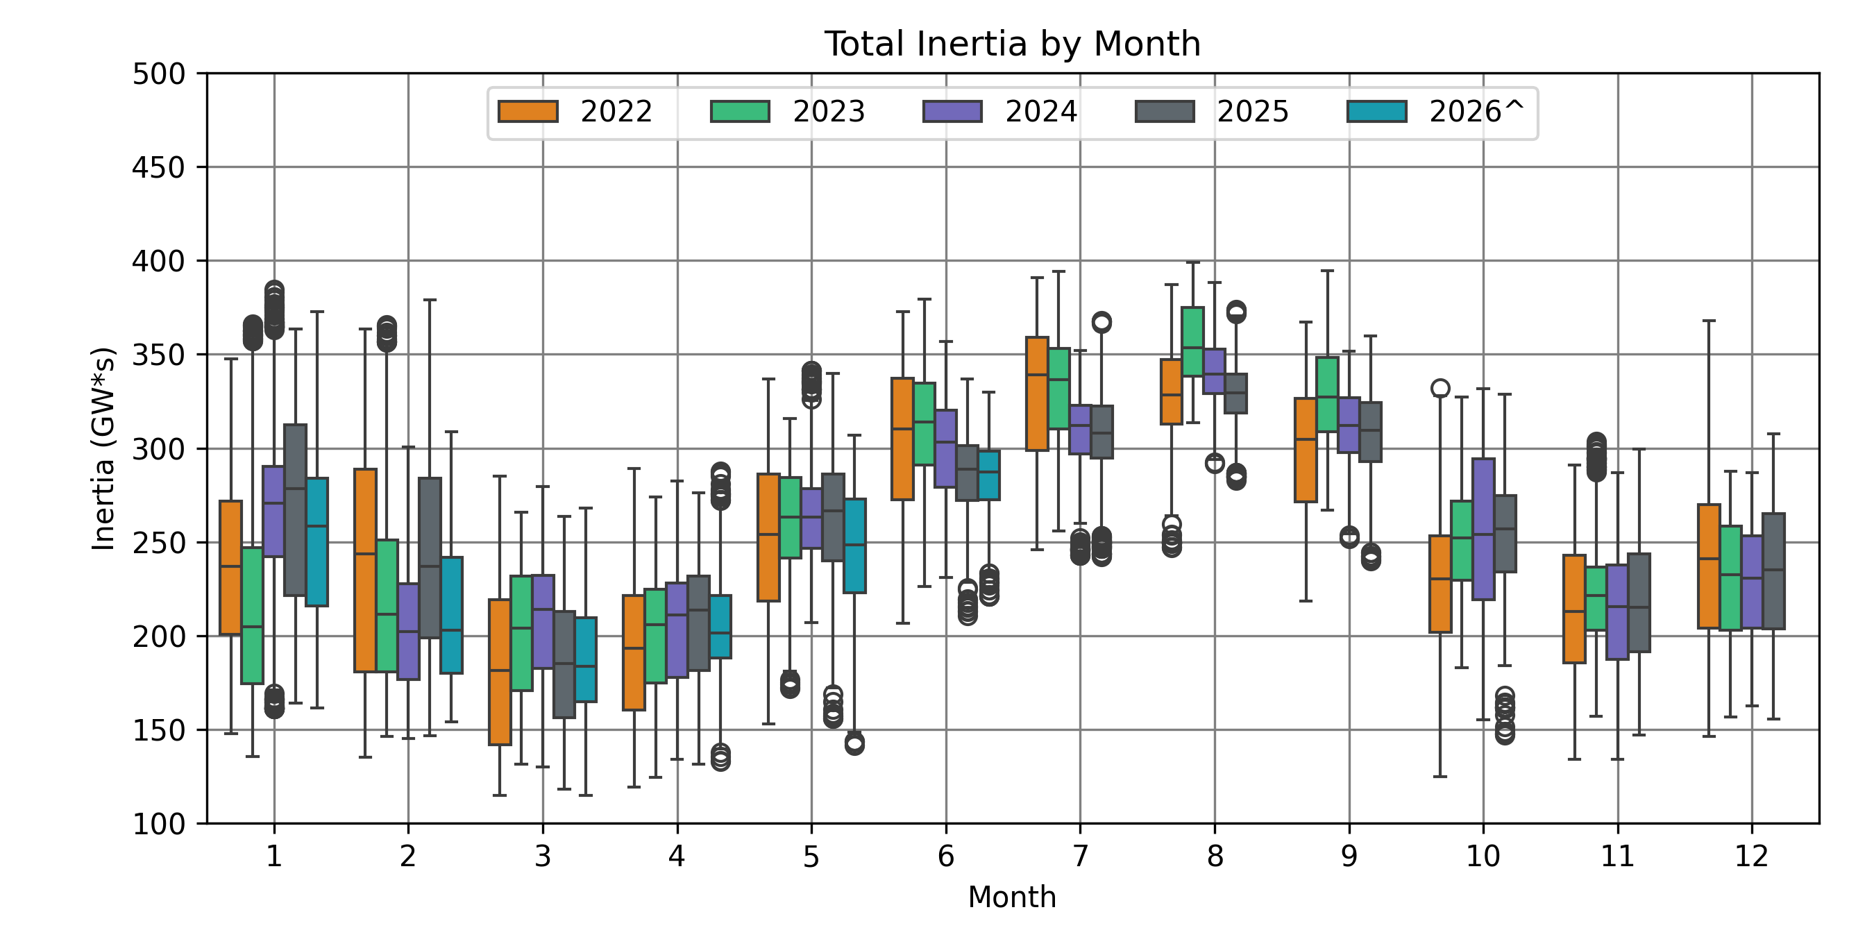
Monthly Inertia from 2022-2026*

Slide 22
Probabilistic

Slide 23
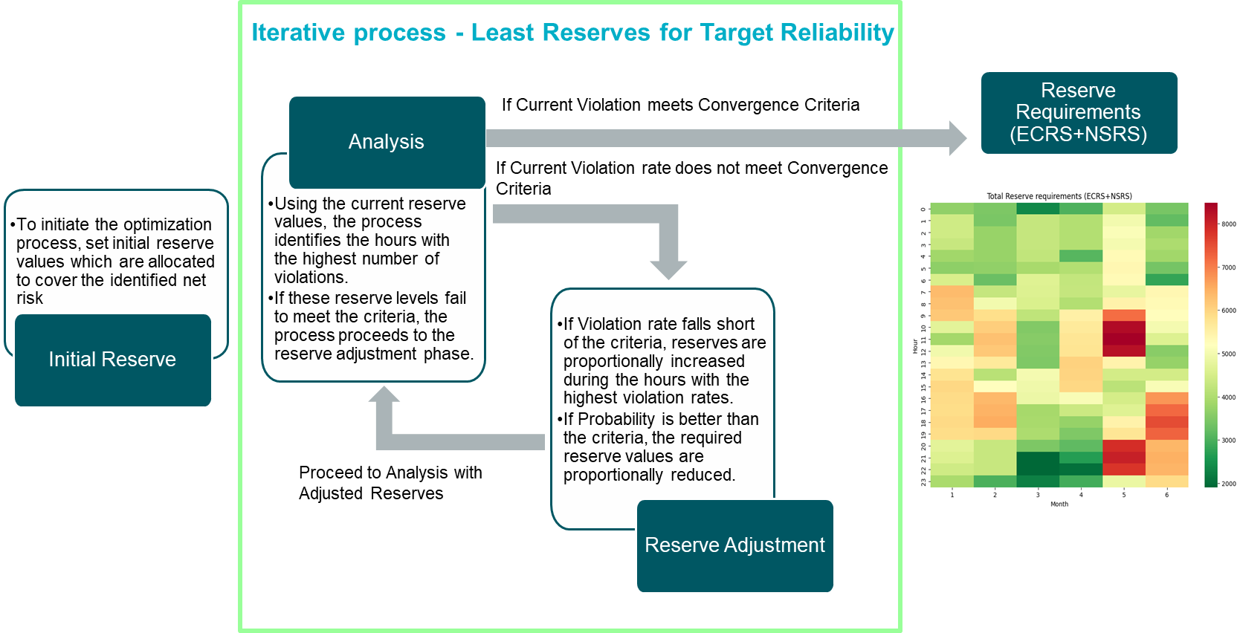
Optimization Workflow for Total (ECRS + NSRS) Reserve

Slide 24
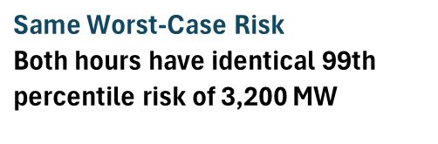
Simplified Optimization Example – Identical Maximum Risk Across Two Hours
Key Takeaway: Reserve requirements are set by both the magnitude and frequency of risk exceedances, not by the maximum risk alone.
*Not Real Data

Slide 25
Forced Outages (cont’d)
Hour of Interest
Hour - X
Hour
Hour + 1
06:00
12:00
13:00
Scenario 1
Hour – X ≤ Start Time ≤ Hour
Hour + 1 ≤ End Time
Start Time
Scenario 2
Hour – X ≤ Start Time ≤ Hour Hour < End Time ≤ Hour + 1
13:30
Scenario 3
Hour ≤ Start Time < Hour + 1
10:00
12:45
X Hour variable can be changed to desired time
12:15
12:45
13:35

Slide 26
Three Core Issues Expected to Remain Central in 2027
ERCOT has been collaborating with PUCT Staff and the IMM and expects the three core issues from the 2026 AS Methodology review to remain central in 2027. ERCOT plans to evaluate these issues through sensitivity analysis before bringing a September recommendation.
Issue | Sensitivities to be Tested | ERCOT’s Perspective
What level of risk should ERCOT try to avoid when procuring AS to cover forecast error (on non-scarcity days)? | Target reserve level: Watch, EEA1, EEA2 OR Load Shed Restoration Criteria: Varying Reg Up + RRS criteria | ERCOT expects to propose full restoration of deployed Reg Up + RRS. With that requirement, changing the target reserve level from Watch to EEA or Load Shed may not materially reduce quantities in many hours because Reg Up + RRS restoration often controls the requirement. Restoration of these fast-response reserves is critical to maintaining reliability and staying compliant with NERC BAL requirements.
How far ahead should ERCOT look when measuring forecast error and forced outage risk? | In hourly increments up to 6-hour prior to operating hour beginning | Lowering look-ahead period would reduce overall amount of ECRS + NSRS quantities but would likely increase number of RUCs needed.
How much should the AS quantities be discounted based on the “extra” headroom from resources that were historically committed by market? | Credit: Current credit approach, and higher credit levels Duration: Current Protocols and lower-value sensitivities | Historical headroom may reflect unit commitment inefficiencies that may not be available in future operating conditions, especially true with transition to RTC. ERCOT will test higher-credit sensitivities using updated data but does not expect to rely heavily on 100% of historically available headroom or depart from applicable Protocol-defined duration requirements.
Key Takeaway: The 2027 review will test the same three core parameter issues raised in 2026 and show the resulting quantity, cost, reliability-risk, and operational trade-offs.

Slide 27
Full Reg Up + RRS Restoration Is Core to the Criterion
ERCOT can evaluate lower ECRS + Non-Spin quantities under different assumptions, but the methodology should not leave deployed Reg Up + RRS unrestored. Those services provide ERCOT’s fast-response capability for frequency control and contingency response; ECRS and Non-Spin help restore that capability until additional Resources can be committed.
What This Means in the Probabilistic Model
ECRS and Non-Spin cover forecast error and forced outage risk.
ECRS and Non-Spin also restore/backfill deployed Reg Up and RRS.
The convergence criterion must explicitly preserve both functions as risk inputs, risk credits, and operating assumptions are tested.
If restoration is not explicit, the model may cover modeled uncertainty while leaving fast-response Reg Up and RRS reserves depleted after deployment.
Why ERCOT Expects to Maintain It
Shorter look-ahead periods or higher headroom credits may lower modeled ECRS + Non-Spin needs.
Lower ECRS + Non-Spin quantities should not compromise ERCOT’s frequency-control capability after deployment.
Historically available headroom may not be available, deliverable, or persistent when conditions are tight.
ERCOT is an electrical island and cannot rely on synchronously connected neighbors for replacement reserves after a frequency event.
NERC BAL standards establish performance obligations for frequency control, disturbance recovery, contingency reserve restoration, and frequency response.
Key Takeaway: Reg Up + RRS restoration is the reliability floor in the convergence criterion; sensitivities may change ECRS + Non-Spin quantities, but should not compromise ERCOT’s frequency-control capability.

Slide 28
Topics for September Recommendation and Related Work
ERCOT expects to return in September with a recommendation for the full annual AS Methodology, covering all four AS types. Most discussion is expected to focus on ECRS and Non-Spin because the sensitivity analysis will be run within the probabilistic framework. Related issues discussed below are important, but require additional modeling, RTC+B operating experience, or separate market-design evaluation.
Holistic Duration and Energy Modeling
IMM Items to Track Separately
Revisit ECRS + Non-Spin duration requirements with supporting analysis that considers:
  RTC+B operating experience;
  impacts to AS quantities and reliability outcomes;
  how DRRS layers with ECRS and Non-Spin; and
  how the probabilistic model should account for both MW and MWh needs.
  Why: Duration is no longer an isolated parameter. It is linked to product layering, AS quantities, reliability outcomes, and energy sufficiency. The probabilistic model does not yet fully account for MWh needs, and RTC+B operating history remains limited. Closing this gap will be important to maintaining reliability and ensuring energy needs are appropriately accounted for across ECRS, Non-Spin, and DRRS.
AS demand curve calibration / alignment with AS Plan;
Shortage pricing and broader price-formation concerns;
RUC / operator intervention impacts on market signals; and
Out-of-market programs and broader resource-adequacy design concerns.
Why: These issues are important, but they relate to price formation, market signals, and resource adequacy concerns.
Key Takeaway: The September recommendation will focus on the 2027 minimum AS quantity methodology; duration/energy modeling and IMM price-formation items remain important but require separate or follow-on evaluation

