Slide 1
July 8, 2026 WMS Meeting
NPRR1337, ERS Enhancements
ERCOT
Outline:
  Purpose of NPRR1337
  NPRR1337 ERCOT Comments
  Overview of Changes to the Suspension and Reinstatement Document
  Impacts to ERS Participation
  Appendix

Slide 2
Purpose of NPRR1337
Develop a new alternate baseline test and update the regulations related to ERS availability metrics to encourage behavioral changes aimed at minimizing the self-deployment of ERS resources before receiving an official ERS deployment instruction.

Slide 3
NPRR1337 ERCOT Comments
Summary of Proposed comments are as follows:
  Change that there is no longer a default baseline qualification but rather ERCOT will provide the QSE with the default baseline results for the QSE to use when selecting a default baseline. There will be minimum “Fit” criteria used that if any of the default baselines meet this criteria they must use one of the default baselines to participate in ERS.
  Language missed in the original filing. For availability purposes ERCOT will not longer apply the QSE first pass/fail as an initial review prior to evaluating the pass/fail for the individual resources within the QSEs portfolio. Language added to address ERS Resource availability evaluation for each ERS Time Period and how the availability factor will be adjusted for settlement purposes for time period availability failures.
  Change language addressing Performance Criteria for QSE’s representing Non-Weather-Sensitive ERS Resources to align with the proposed resource level availability and change the pass/fail metric for the QSE from ≥ 0.95 to ≥ 0.80.

Slide 4
Overview of Changes to the Suspensions and Reinstatement Document
ERS Resource Suspension penalties due to availability failures are noted in a separate Suspensions and Reinstatements Document posted to the ERS Webpage and currently not in the Protocols. Following the approval of NPRR1337 ERCOT plans to file a separate NPRR to move the suspension and reinstatement language into the protocols.
Resource suspensions due to availability failures will be based on the number of failures in a program year by risk factor category noted in the ERS RFP.
ERCOT has adjusted the number of proposed time period failures leading to suspensions based on discussions with various Market Participants.
Risk Factor Category | # of Time Period Failures | Suspension Length
High (80-100) | 12 | 1 SCT
High (80-100) | 23 | 2 SCT
High (80-100) | 34 or more | 3 SCT
Medium (30-79) | 23 | 1 SCT
Medium (30-79) | 34 or more | 2 SCT
Low (1-29) | 56 | 1 SCT
Low (1-29) | 67 or more | 2 SCT
Combination of High/Medium/Low | Follow high
Combination of Medium/Low | Follow medium
Also, due to the lengthy reinstatement process current used ERCOT is investigating process changes to reduce the reinstatement time associated with suspensions due to availability failures but that work is not available at this time.

Slide 5
Impacts to ERS Participation
Analyzed a total of 271 resources that had ALTERNATE baseline selected for the current June-September 2026 SCT (total ERS Capacity TP5 ~ 1473 MWs of 2158 total ERS capacity procured)
ABT step 1 (default baseline Fit test)
  52 Resources met the fit thresholds for at least one default baseline (TP5 impact ~ 82 MWs)
ABT step 2 (price responsive test)
  53 resources passed ABT (TP5 impact ~ 417 MWs)
  57 resources failed ABT (TP5 impact ~ 592 MWs)
9 resources had insufficient data (381 MWs in NOIE service territory, failed step 1 but not yet evaluated for step 2)
Total potential impact (82+592+X%381) = 674 – 1055 MWs

Slide 6
Appendix select slides from previous meeting

Slide 7
Alternate Baseline Test and
Resource Impacts
Alternate Baseline Test Whitepaper included in meeting materials

Slide 8
End-to-End Baseline Assignment Process
STEP 1: Evaluate each ERS Load against all five Default Baselines
5 Default baselines (M810, MDP, REG, MBMA, NEAR20) • P95 ≤ 20% AND |bias| ≤ 5%
Resources meet the minimal accepted “fit” thresholds for a default baseline
QSE receives default baseline data and selects one default baseline
YES
NO
STEP 2: Alternate Baseline Test (ABT) is applied only to resources that do not meet the fit threshold for any of the five default baseline methods
Passes ABT?
Resource may select an Alternate Baseline option
YES
NO
QSE receives all five default baseline stats and may select one default baseline or withdraw from ERS

Slide 9
The Alternate Baseline Test (ABT)
1. WHY: Alternate Baseline Test
Some MBL/Alternate resources are not genuinely variable — load reductions track market signals (e.g., price spikes, 4-CP response, etc.) most commonly price spikes. Because MBL/Alternate uses a “Drop-To” evaluation rather than a comparison to a predicted baseline, ERS deployments overlapping price spikes can credit normal price-chasing curtailment as ERS performance.
The ABT is a quality-control check that will run during ERID process on ERS Loads that do not meet the fit threshold for any of the five default baseline methods — ensuring MBL/Alternate eligibility reflects genuine operational variability.
2. WHEN & WHAT: A Two-Step Baseline Evaluation
Step 1 — Default Baseline Fit Check: All ERS Loads are evaluated against the five default baseline methods. A default method meets the fit threshold when P95 ≤ 20% AND |bias| ≤ 5%.
Step 2 — Alternate Baseline Test (ABT): ABT is applied only to resources that do not meet the fit threshold for any of the five default baseline methods.
3. OUTCOMES: Baseline selection for ERS Resources
If ERS Resource meet at least one default method threshold, ERCOT provides all five default baseline statistics to the QSE, and the QSE may select one default baseline.
PASS_ABT → Resource may select the Alternate baseline designation (variability is genuinely operational).
FAIL_ABT → QSE will be given all default baseline statistics and may select any one default option.
Exception — insufficient historical meter data: the resource may temporarily select the Alternate Baseline until sufficient history accumulates.

Slide 10
How the ABT Detects Price Chasing
1. Three-Step Detection Method
STEP 1
  Reference Load: The average load at that same interval-of-day across the 10 most recent same-daytype days, excluding any day with a qualifying price event. Weekdays compare to weekdays; weekends/holidays to weekends/holidays. E.g., for a 2:00 PM interval on a Tuesday, the reference is the average 2:00 PM load over the prior ten qualifying weekdays
  Reduced Interval: For each 15-minute interval, mark it "reduced" if actual load is ≤ 50% of the reference load
STEP 2
  Split intervals into two groups: Based on the real time Load Zone prices (currently considering $80/MWh but TBD) sort intervals into high price intervals vs. non-price intervals. Calculate high-price reduction rate & non-price reduction rate
STEP 3
  ABT metric: A resource fails ABT only when the high-price reduction rate is more than 50%, and the non-price reduction rate is less than 20%.
2. Trigger Logic and Worked Examples
Flagged FAIL_ABT only when BOTH hold: high-price reduction rate > 50% AND non-price reduction rate < 20%.
EXAMPLE A — Genuinely Variable Load (PASS)
High-price: 80 / 200 reduced = 40% (below 50% threshold)
Normal: 1100 / 5,000 reduced = 22% (above 20% threshold)
Result: PASS — keep MBL/Alternate
EXAMPLE B — Price responsive load (FAIL_ABT)
High-price: 130 / 200 reduced = 65% (above 50% threshold)
Normal: 200 / 5,000 reduced = 4% (below 20% threshold)
Result: FAIL_ABT — Alternate Baseline not an option
Key Takeaways:
The ABT measures the FREQUENCY of load reductions during high-price vs. normal periods. A large gap between the two is the indicator the resource is not a naturally dynamic load — and alternate baseline not an option.
ERCOT has tested the ABT against all ERS Category "Crypto Mining" loads that offered into the JunSep2026 SCT and most failed this test.

Slide 11
Summary of ABT impact on Resources on Alternate baseline in JunSep26 (high-price reduction rate > 50% AND non-price reduction rate < 20%)
We have analyzed a total of 271 resources that had ALTERNATE baseline selected when procured for JunSep26 SCT
52 Resources met the fit thresholds for at least one default baseline
153 resources passed ABT
57 resources failed ABT
9 resources had insufficient data
Load Desc | Pass_ABT | Fail_ABT | Default Baseline | Insufficient_Data | Total
Agriculture/Horticulture Facility | 2 | 0 | 1 | 0 | 3
Auto Dealership/Repair Shop | 1 | 0 | 0 | 0 | 1
Chemical Plant | 4 | 0 | 1 | 0 | 5
Conference Center/Entertainment Venue/Public Assembly | 3 | 0 | 0 | 0 | 3
Data Center (Crypto Mining) | 6 | 55 | 2 | 8 | 71
Data Center (Financial Processing) | 0 | 0 | 1 | 0 | 1
Data Center (Other) | 1 | 0 | 2 | 0 | 3
Distribution Center | 3 | 1 | 2 | 0 | 6
Education (School/University) | 8 | 0 | 1 | 0 | 9
Food Distribution Center | 13 | 0 | 5 | 0 | 18
Large Retail (Grocery) | 2 | 0 | 4 | 1 | 7
Large Retail/Big Box Retail (Non-Grocery) | 8 | 0 | 4 | 0 | 12
Manufacturing/Processing (Concrete) | 14 | 0 | 2 | 0 | 16
Manufacturing/Processing (Other) | 34 | 1 | 14 | 0 | 49
Manufacturing/Processing (Steel) | 5 | 0 | 0 | 0 | 5
Medical/Healthcare Facility (Non-Critical Load) | 1 | 0 | 0 | 0 | 1
Office Building | 3 | 0 | 0 | 0 | 3
Oil and Gas Extraction (Non-Critical Load) | 2 | 0 | 1 | 0 | 3
Oil and Gas Midstream Processing (Non-Critical Load) | 11 | 0 | 1 | 0 | 12
Oil and Gas Refinery (Non-Critical Load) | 9 | 0 | 2 | 0 | 11
Other | 10 | 0 | 5 | 0 | 15
Pharmaceutical Production | 1 | 0 | 0 | 0 | 1
Retirement Facility/Long-Term Health Care Center (Non-Critical Load) | 1 | 0 | 0 | 0 | 1
Waste Water/Municipal Water Services (Non-Critical Load) | 11 | 0 | 4 | 0 | 15
Grand Total | 153 | 57 | 52 | 9 | 271

Slide 12
ERS Availability Impacts

Slide 13
QSE Portfolio Level Availability Example : Analysis Assumptions
Data Source: All example slides are performed on data from the JunSep25 SCT.
Load Resource Baseline: All load resources are assumed to be on a default baseline. (Individual Resource ABT results not available to use in this analysis).
QSE Pass Criteria: QSE-level Availability Requirement ≥ 0.80.
Note: Data is presented by Risk Level and Time Period

Slide 14
Example of QSE Portfolio Level Availability Results: Risk Level – Low

Slide 15
Example of QSE Portfolio Level Availability Results : Risk Level – Medium

Slide 16
Example of QSE Portfolio Level Availability Results: Risk Level - High

Slide 17
During the June 15th joint meeting stakeholders requested ERCOT provide an impact analysis of the ERS resource level availability changes by ERS load type. That analysis is ongoing and will be available at a later meeting.

Slide 18
JunSep25 Resource Availability Failures (combined availability score)
Key Takeaway: For JunSep25 there were no resource suspensions for failures because there were no QSE Portfolio Level failures.

Slide 19
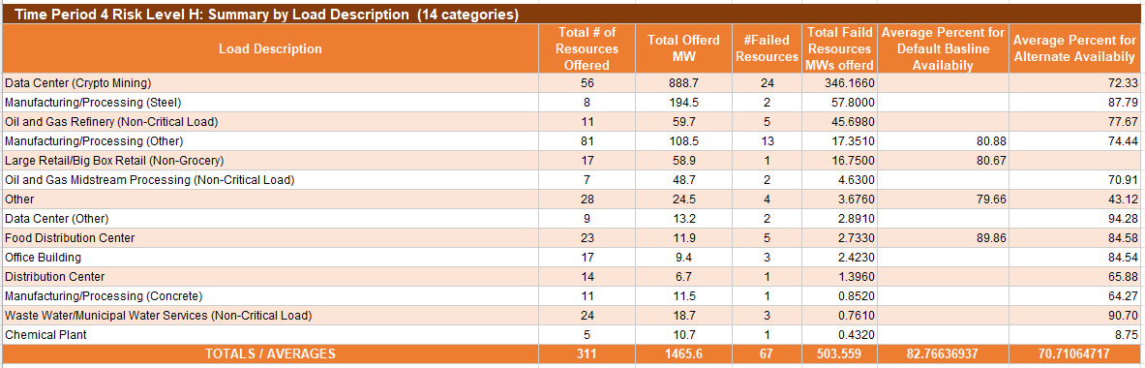
Availability Observation from JunSep2025 SCT
Availability Failure Metric
Default Baseline: The interval Load of the ERS Load was less than 95% of its contracted ERS MW capacity
Alternate Baseline: Average MW Load per interval / offer MW

Slide 20
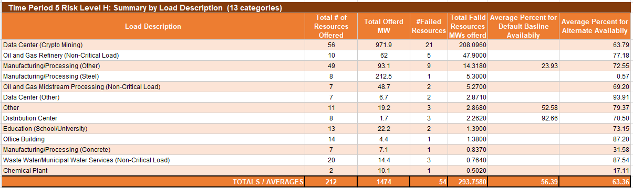
Availability Observation from JunSep2025 SCT
Availability Failure Metric
Default Baseline: The interval Load of the ERS Load was less than 95% of its contracted ERS MW capacity
Alternate Baseline: Average MW Load per interval / offer MW

Slide 21
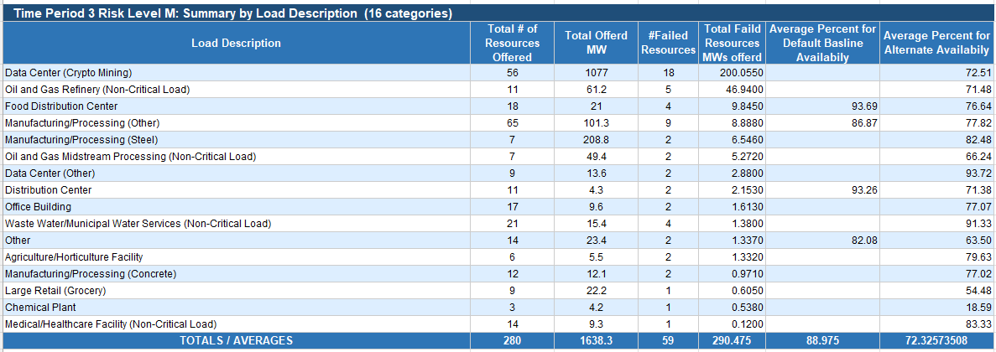
Availability Observation from JunSep2025 SCT
Availability Failure Metric
Default Baseline: The interval Load of the ERS Load was less than 95% of its contracted ERS MW capacity
Alternate Baseline: Average MW Load per interval / offer MW

Slide 22
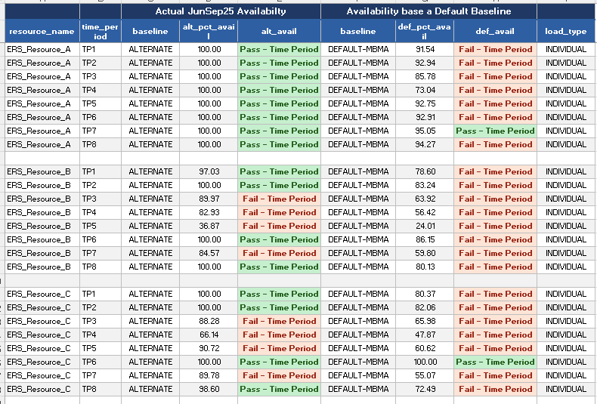
Examples – Availability Alternate Baseline vs Default Baseline (MBMA)
These 3 ERS Resources are single site (Load_type Individual)

Slide 23
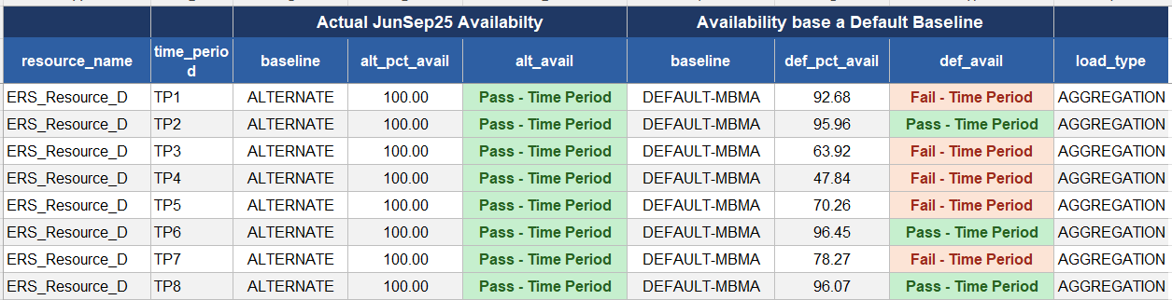
Examples – Availability Alternate Baseline vs Default Baseline (MBMA)
This resource is an aggregation of multiple sites (Load_type Aggregation)

