Slide 1

WMWG update to wms
July 8, 2026
Amanda Frazier, WMWG Chair

Slide 2

AGENDA
NPRRS ready for WMS vote:
  NPRR1328 – generation firming program
NPRRs Still with WMWG
  NPRR1278 - Establishing Advanced Grid Support Service as an Ancillary Service
Other Business
  2027 AS methodology
  Discussion on COP SOC and ASDFs
  Discussion on FPA §202(c) Orders
  ERS Enhancements (NPRR 1337)

Slide 3
Discussion of Revision Requests
  NPRR1328 – Generation Firming Program –
  ERCOT presented revisions to NPRR1328, Establishment of the Generation Firming Program, in response to stakeholder feedback and internal review ahead of filing official comments.
    ERCOT revised the firming capacity formulas to properly account for DAM exemptions, resource exemptions, and Generation Firming Transfers while preventing double counting and limiting penalties to applicable obligations.
    Additional revisions included updated attestation timelines, pre-season posting extension from 10 to 30 days, ramp-hour selection criteria, establishment of a 3% EUE threshold for high-risk hours, and clarification that exemptions do not extend to assumed firming transfers.
  Stakeholders expressed general support for the draft revisions and appreciation for ERCOT's collaborative efforts.
  ERCOT filed comments July 1, 2026 (after the WMWG meeting) for consideration at today’s WMS meeting.
  ERCOT is still targeting the September Board approval to meet the December 1, 2027 implementation deadline.

Slide 4
Discussion of Revision Requests
  NPRR1278 - Establishing Advanced Grid Support Service as an Ancillary Service – Tabled for additional discussion
  ENGIE and ERCOT met to discuss the interactions between NPRR1278 and NPRR1333, but no decisions were made. ENGIE will benchmark advanced grid support calculation methodologies in other markets and provide an update once that analysis is complete.

Slide 5
Other Business
  2027 AS Methodology
  ERCOT presented an update on the 2027 Ancillary Services methodology.
    For Regulation, Large Load ramp impacts remain under review but have not yet been added as a formal adjustment factor. Preliminary results show modest quantity changes, with slightly higher daytime Reg Down requirements driven primarily by forecast error.
    RRS methodology is unchanged but awaits a NERC frequency response obligation update for 2027. Lower 2026 inertia may increase RRS needs, though summer data may shift results.
    ECRS and Non-Spin sensitivities under review include risk level, look ahead period, risk credit assumptions, tail event impacts to Net Load Forecast Error, Gross Real Time Power Potential usage, adjacent hour methodology improvements, and further tuning of RTC+B impacts.
  ERCOT added NLFE distribution and sampling methods to the appendix slides posted to the 6/29 WMWG meeting page. ERCOT will present its proposed methodology in July.

Slide 6
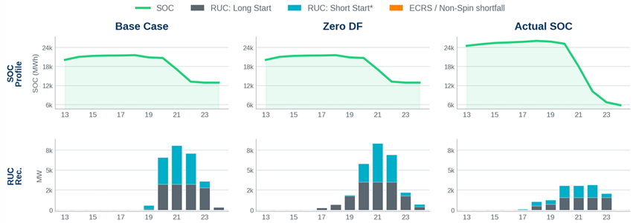
Other Business
  Discussion on COP SOC and ASDFs
  ERCOT analyzed the impact of ESR HBSOC and ASDFs on recent RUC recommendations using three May 2026 HRUC studies, with illustrative results from ERCOT’s presentation shown below.
    Flat COP HBSOC submissions understated real-time ESR discharge and reduced available energy in RUC, driving capacity-short commitments.
    ASDF sensitivities showed minimal impact on RUC outcomes and did not materially change total commitment levels during capacity short hours. Replacing COP HBSOC with telemetered SOC significantly reduced RUC recommendations by restoring available ESR energy.
  ERCOT will engage with QSEs to improve COP SOC accuracy and continue evaluation of potential methodological and protocol enhancements.

Slide 7
Other Business
  Discussion on COP SOC and ASDFs (cont.)
  Stakeholders expressed a range of concerns around the frequency of RUC instructions caused by inaccurate ESR SOCs, e.g.:
    Changing ASDFs would be helpful for cases where RUC is for A/S shortage rather than capacity shortage
    Using an optimization within the RUC engine might be preferable to relying on COP data for SOC forecasts
    Discrepancy between A/S duration in RUC engine compared with SCED engine should be resolved
    Resolving “flat” HBSOC may not solve problem if HBSOCs are still inaccurate
    Lack of consequence for inaccurate HBSOC information may cause the issue to be intractable
  Wide consensus that excessive RUC is an issue that should be high priority for resolution.

Slide 8
Other Business
  Discussion on FPA §202(c) Orders
  ERCOT discussed stakeholder requests to improve 202(c) emergency deployment transparency.
    ERCOT is generally supportive of providing market notices when DOE requests are submitted and approved, as requested by stakeholders.
    Additional requests included public operational messaging when ERCOT issues deployment directives, such as MW amounts and timing, which ERCOT is evaluating for feasibility.
    ERCOT is also assessing whether deployments would be all-call or selective and total available backup generation capacity but noted limitations in quantifying behind-the-meter resources.
    RDPA adjustments were also raised, with clearer understanding of capacity impacts needed before further consideration.

Slide 9
Other Business
  ERS Enhancements
  ERCOT reviewed NPRR 1337 following the joint DSWG/WMWG meeting on June 15th.
  ERCOT discussed a requirement that resources that meet minimum fit for any default baseline use a default baseline for ERS participation. The alternate baseline is only available when none of the defaults fit and if the resource passes the Alternate Baseline Test. Stakeholders raised concerns about limiting baseline choice.
    The ABT detects price chasing using historical reference loads and comparisons of high-price ($80/MWh) versus normal intervals. ERCOT found that most crypto loads failed this test.
  ERCOT reviewed the shift to resource-level, time-period availability evaluation and a reduction in QSE pass criteria to ≥0.80.
    QSE-level analysis showed reduced availability for price-responsive resources under a default baseline during high-risk hours. ERCOT’s resource-level availability impact analysis is ongoing.
  ERCOT also outlined updated suspension rules tying penalties to risk level and repeated failures, including possible multi-term suspensions and escalation to administrative actions.
  ERCOT filed comments July 1, 2026 (after the WMWG meeting) for consideration at today’s WMS meeting

Slide 10

THANK YOU

