Slide 1
NPRR1337, ERS Enhancements
ERCOT
Outline:
  Purpose of NPRR1337
  NPRR1337 Comments to File
  Alternate Baseline Test and Resource Impacts
  ERS Resource Availability Impacts - Backcast using JunSep2025 ERS Resources
  Draft of Revises Suspensions and Reinstatement Document

Slide 2
Purpose of NPRR1337
Develop a new alternate baseline test and update the regulations related to ERS availability metrics to encourage behavioral changes aimed at minimizing the self-deployment of ERS resources before receiving an official ERS deployment instruction.

Slide 3
NPRR1337 Comments to File
ERCOT will be filing comments to NPRR1337 no later than July 10 for consideration at the July 15 PRS meeting.
Proposed comments as they stand today are included in todays’ meeting materials.
Summary of Proposed comments are as follows:
  Change that there is no longer a default baseline qualification but rather ERCOT will provide the QSE with the default baseline results for the QSE to use when selecting a default baseline.
  Language missed in the original filing. For availability purposes ERCOT will not longer apply the QSE pass/fail as an initial review prior to evaluating the pass/fail for the individual resources within the QSEs portfolio. Language added to address ERS Resource availability evaluation for each ERS Time Period and how the availability factor will be adjusted for settlement purposes for time period availability failures.
  Change language addressing Performance Criteria for QSE’s representing Non-Weather-Sensitive ERS Resources to align with the proposed resource level availability and change the pass/fail metric for the QSE from ≥ 0.95 to ≥ 0.80.

Slide 4
Alternate Baseline Test and
Resource Impacts
Alternate Baseline Test Whitepaper included in meeting materials

Slide 5
End-to-End Baseline Assignment Process
STEP 1: Evaluate each ERS Load against all five Default Baselines
5 Default baselines (M810, MDP, REG, MBMA, NEAR20) • P95 ≤ 20% AND |bias| ≤ 5%
Resources meet the minimal accepted “fit” thresholds for a default baseline
QSE receives default baseline data and selects one default baseline
YES
NO
STEP 2: Alternate Baseline Test (ABT) is applied only to resources that do not meet the fit threshold for any of the five default baseline methods
Passes ABT?
Resource may select an Alternate Baseline option
YES
NO
QSE receives all five default baseline stats and may select one default baseline or withdraw from ERS

Slide 6
The Alternate Baseline Test (ABT)
1. WHY: Alternate Baseline Test
Some MBL/Alternate resources are not genuinely variable — load reductions track market signals (e.g., price spikes, 4-CP response, etc.) most commonly price spikes. Because MBL/Alternate uses a “Drop-To” evaluation rather than a comparison to a predicted baseline, ERS deployments overlapping price spikes can credit normal price-chasing curtailment as ERS performance.
The ABT is a quality-control check that will run during ERID process on ERS Loads that do not meet the fit threshold for any of the five default baseline methods — ensuring MBL/Alternate eligibility reflects genuine operational variability.
2. WHEN & WHAT: A Two-Step Baseline Evaluation
Step 1 — Default Baseline Fit Check: All ERS Loads are evaluated against the five default baseline methods. A default method meets the fit threshold when P95 ≤ 20% AND |bias| ≤ 5%.
Step 2 — Alternate Baseline Test (ABT): ABT is applied only to resources that do not meet the fit threshold for any of the five default baseline methods.
3. OUTCOMES: Baseline selection for ERS Resources
If ERS Resource meet at least one default method threshold, ERCOT provides all five default baseline statistics to the QSE, and the QSE may select one default baseline.
PASS_ABT → Resource may select the Alternate baseline designation (variability is genuinely operational).
FAIL_ABT → QSE will be given all default baseline statistics and may select any one default option.
Exception — insufficient historical meter data: the resource may temporarily select the Alternate Baseline until sufficient history accumulates.

Slide 7
How the ABT Detects Price Chasing
1. Three-Step Detection Method
STEP 1
  Reference Load: The average load at that same interval-of-day across the 10 most recent same-daytype days, excluding any day with a qualifying price event. Weekdays compare to weekdays; weekends/holidays to weekends/holidays. E.g., for a 2:00 PM interval on a Tuesday, the reference is the average 2:00 PM load over the prior ten qualifying weekdays
  Reduced Interval: For each 15-minute interval, mark it "reduced" if actual load is ≤ 50% of the reference load
STEP 2
  Split intervals into two groups: Based on the real time Load Zone prices (currently considering $80/MWh but TBD) sort intervals into high price intervals vs. non-price intervals. Calculate high-price reduction rate & non-price reduction rate
STEP 3
  ABT metric: A resource fails ABT only when the high-price reduction rate is more than 50%, and the non-price reduction rate is less than 20%.
2. Trigger Logic and Worked Examples
Flagged FAIL_ABT only when BOTH hold: high-price reduction rate > 50% AND non-price reduction rate < 5%.
EXAMPLE A — Genuinely Variable Load (PASS)
High-price: 80 / 200 reduced = 40% (below 50% threshold)
Normal: 1100 / 5,000 reduced = 22% (above 20% threshold)
Result: PASS — keep MBL/Alternate
EXAMPLE B — Price responsive load (FAIL_ABT)
High-price: 130 / 200 reduced = 65% (above 50% threshold)
Normal: 200 / 5,000 reduced = 4% (below 20% threshold)
Result: FAIL_ABT — Alternate Baseline not an option
Key Takeaways:
The ABT measures the FREQUENCY of load reductions during high-price vs. normal periods. A large gap between the two is the indicator the resource is not a naturally dynamic load — and alternate baseline not an option.
ERCOT has tested the ABT against all ERS Category "Crypto Mining" loads that offered into the JunSep2026 SCT and most failed this test.

Slide 8
Summary of ABT impact on Resources on Alternate baseline in JunSep26 (high-price reduction rate > 50% AND non-price reduction rate < 20%)
We have analyzed a total of 277 resources that had ALTERNATE baseline selected when procured for JunSep26 SCT
52 Resources met the fit thresholds for at least one default baseline (Step 1 of the ABT)
  2 resources are crypto mining load
156 resources passed ABT
  5 resources are crypto mining loads
68 resources failed ABT
  66 resources are crypto mining loads
1 resource was flagged for insufficient data

Slide 9
Summary of ABT impact on Resources on Alternate baseline in JunSep26 (high-price reduction rate > 50% AND non-price reduction rate < 20%)
We have analyzed a total of 277 resources that had ALTERNATE baseline selected when procured for JunSep26 SCT
52 Resources met the fit thresholds for atleast one default baseline , 153 resources passed ABT ,57 resources failed ABT
9 resources had insufficient data

Slide 10
ERS Availability Impacts

Slide 11
QSE Portfolio Level Availability Example : Analysis Assumptions
Data Source: All example slides are performed on data from the JunSep25 SCT.
Load Resource Baseline: All load resources are assumed to be on a default baseline. (Individual Resource ABT results not available to use in this analysis).
QSE Pass Criteria: QSE-level Availability Requirement ≥ 0.80.
Note: Data is presented by Risk Level and Time Period

Slide 12
Example of QSE Portfolio Level Availability Results: Risk Level – Low

Slide 13
Example of QSE Portfolio Level Availability Results : Risk Level – Medium

Slide 14
Example of QSE Portfolio Level Availability Results: Risk Level - High

Slide 15
During the June 15th joint meeting stakeholders requested ERCOT provide an impact analysis of the ERS resource level availability changes by ERS load type. That analysis is ongoing and will be available at a later meeting.

Slide 16
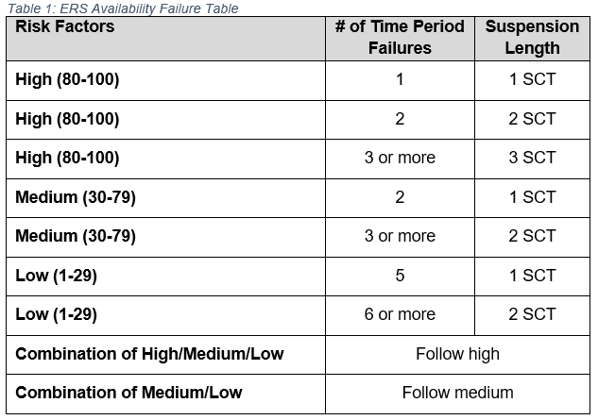
Overview of Changes to the Suspensions and Reinstatement Document
Draft version of the ERS Suspensions and Reinstatement Document included in meeting materials.
Two primary changes reflected in the document
  Resource suspensions due to availability failures will be based on the ERS Time Period risk category as noted in the RFP for each ERS standard contract term for which the failure(s) occurred and the number of failures.
  Added language to address QSE Availability Failures. “If ERCOT determines that the QSE portfolio-level availability failures are directly attributable to an action or in action of the QSE or if the QSE demonstrates a repeated occurrence of availability failures, then ERCOT may consider suspending the QSE from participating in ERS and the QSE may be subject to administrative penalties imposed by the PUCT. “
ERCOT is planning to revise the reinstatement process associated with suspensions due to availability failures but that work is not available at this time.

Slide 17
Appendix select slides from previous meeting

Slide 18
JunSep25 Resource Availability Failures (combined availability score)
Key Takeaway: For JunSep25 there were no resource suspensions for failures because there were no QSE Portfolio Level failures.

Slide 19
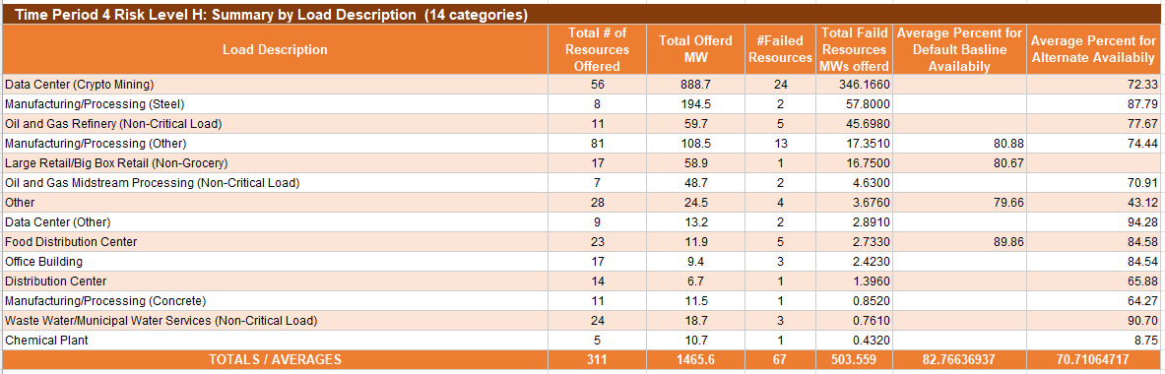
Availability Observation from JunSep2025 SCT
Availability Failure Metric
Default Baseline: The interval Load of the ERS Load was less than 95% of its contracted ERS MW capacity
Alternate Baseline: Average MW Load per interval / offer MW

Slide 20
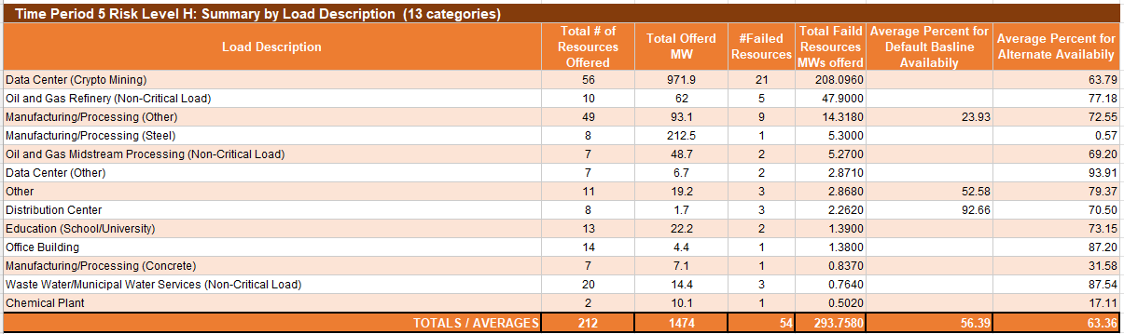
Availability Observation from JunSep2025 SCT
Availability Failure Metric
Default Baseline: The interval Load of the ERS Load was less than 95% of its contracted ERS MW capacity
Alternate Baseline: Average MW Load per interval / offer MW

Slide 21
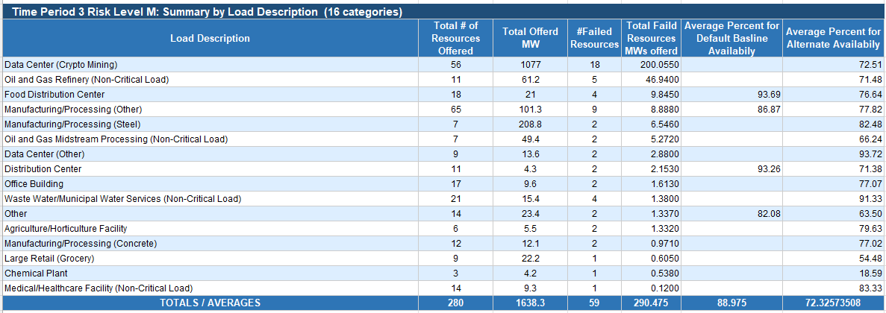
Availability Observation from JunSep2025 SCT
Availability Failure Metric
Default Baseline: The interval Load of the ERS Load was less than 95% of its contracted ERS MW capacity
Alternate Baseline: Average MW Load per interval / offer MW

Slide 22
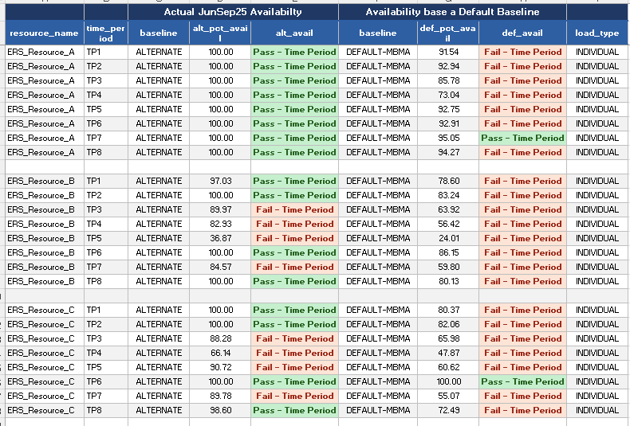
Examples – Availability Alternate Baseline vs Default Baseline (MBMA)
These 3 ERS Resources are single site (Load_type Individual)

Slide 23
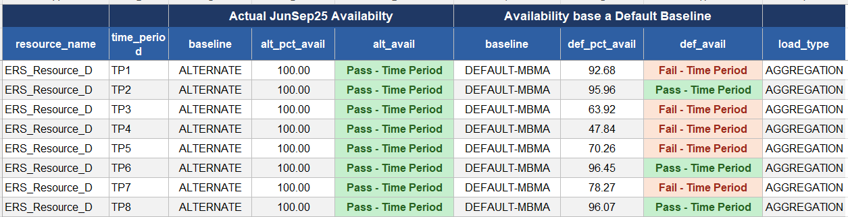
Examples – Availability Alternate Baseline vs Default Baseline (MBMA)
This resource is an aggregation of multiple sites (Load_type Aggregation)

