Slide 1
2027 Ancillary Service Methodology Discussion
Luis Hinojosa
Manager, Ancillary Services & Operations Analytics
WMWG
June 29, 2026
Purpose
Provide an overview of the 2027 AS Methodology, changes ERCOT is considering, and provide a proposed timeline for market discussion.
Key Takeaways
Interested Stakeholders are requested to attend meetings to provide any feedback on the AS Methodology.

Slide 2
Stakeholder Discussion Timeline
May 19, 2026 – TAC Kickoff
June 01, 2026 – BOARD Preview
June 17, 2026 – PDCWG
June 29, 2026 – WMWG
July 08, 2026 – WMS
July 09, 2026 – ROS
July 22, 2026 – PDCWG (Proposed)
July 27, 2026 – WMWG (Proposed)
July 28, 2026 – OWG (Proposed)
August 05, 2026 – WMS (Vote)
August 06, 2026 – ROS (Vote)
August 26, 2026 – TAC (Vote)
September 15, 2026 – BoD
Nov, Dec 2026 – PUC

Slide 3
Discussion Scope for Today
This presentation will discuss the approaches ERCOT is considering to determine Ancillary Service (AS) quantities for 2027.
  ERCOT is considering one change in the methodology used to compute the Regulation Service for 2027.
  NERC’s preliminary BAL-003 Interconnection Frequency Response Obligation (IFRO) assessment for ERCOT for the 2027 Operating Year (OY) has not yet been published. Therefore, this analysis used the minimum RRS-PFR limit of 1,377 MW for 2026.
  The 2026 AS Methodology implemented a probabilistic method for ERCOT Contingency Reserve Service (ECRS) and Non-Spinning Reserve (Non-Spin).
  The 2027 review focuses on refining the model to find the appropriate criteria for AS procurement quantities. ERCOT plans to compare alternative criteria using AS quantity, estimated cost, and modeled reliability-risk metrics.
Any Ancillary Service (AS) quantities for 2027 contained in this presentation are based on the methodology that was approved in December 2025. The quantities for 2027 reflect moving forward the historic data on which these are based, unless otherwise noted.

Slide 4
Regulation Service

Slide 5
Regulation Service Methodology Changes
Methodology
  ERCOT is considering one change in the methodology used to compute the minimum Regulation Service requirements in 2027.
  The preliminary Regulation quantities for January 2027 through May 2027 in subsequent slides have been computed using current methodology (2025 and 2026 five-minute net load variability), updated Wind Adjustment tables and the updated Solar Adjustment tables.
  ERCOT continues to monitor the impacts of Large Load ramping relating to this methodology to determine if a new adjustment factor needs to be introduced.

Slide 6
Regulation Up/Down Methodology 2027
 | 2026 Methodology | 2027 Methodology
Data Input | 5-min SCED Netload Forecast Error (2-yr) | No Change
Calculation Method | 95th of 5-min SCED Netload Forecast Error | No Change
Wind/Solar Adjustment | GE Table - Increased wind/solar forecast error per 1,000 MW installed capacity increase | No Change
ACE Integral Component | Average of ACE Integral Change (2-yr) | No Change
Load Adjustment (LFL Ramps) | Not considered | TBD

Slide 7
Recap – Generation To Be Dispatched (GTBD)
ERCOT has incorporated intra-hour wind/solar forecast- based ramp into GTBD to give SCED an indication of how renewables may ramp.
  Predicted Wind Ramp Rate (PWRR) was incorporated in GTBD in Dec.2018
  Predicted Solar Ramp Rate (PSRR) was incorporated in GTBD in Jun.2021
In absence of PSRR/PWRR, SCED dispatches uncurtailed solar/wind units to their max output (HSL).
  This means that SCED assumes output of uncurtailed solar/wind units will persist for the next 5-min at the unit’s HSL that was telemetered at the start of the interval.
GTBD = Total Gen
+K3*5*PLDRR
+K4*Regulation Deployed
+ K5*ACE Integral
– K6*5*PWRR
+ K7*5*DCTRR
– K8*5*PSRR
5-min Load Ramp Forecast
Previous Reg Deployment
Historical Accumulated ACE
5-min Wind Ramp Forecast
5-min DC Tie Ramp Forecast
5-min Solar Ramp Forecast

Slide 8
Recap – Dynamic Predicted Solar Ramp Rate (PSRR) Threshold in GTBD
ERCOT started to apply a dynamic PSRR threshold in GTBD calculation on 6/12/2023
PSRR thresholds change with 4 pre-defined day periods - Night, Sunrise, Sunset and Other
ERCOT started with a threshold of 80MW/min for Sunrise and Sunset periods on 6/12/23. Today, the threshold is set to 280MW/min.
ERCOT continues to update the thresholds and the definition of day periods seasonally*
Night
* Seasons will be defined by shift in solar ramping patterns

Slide 9
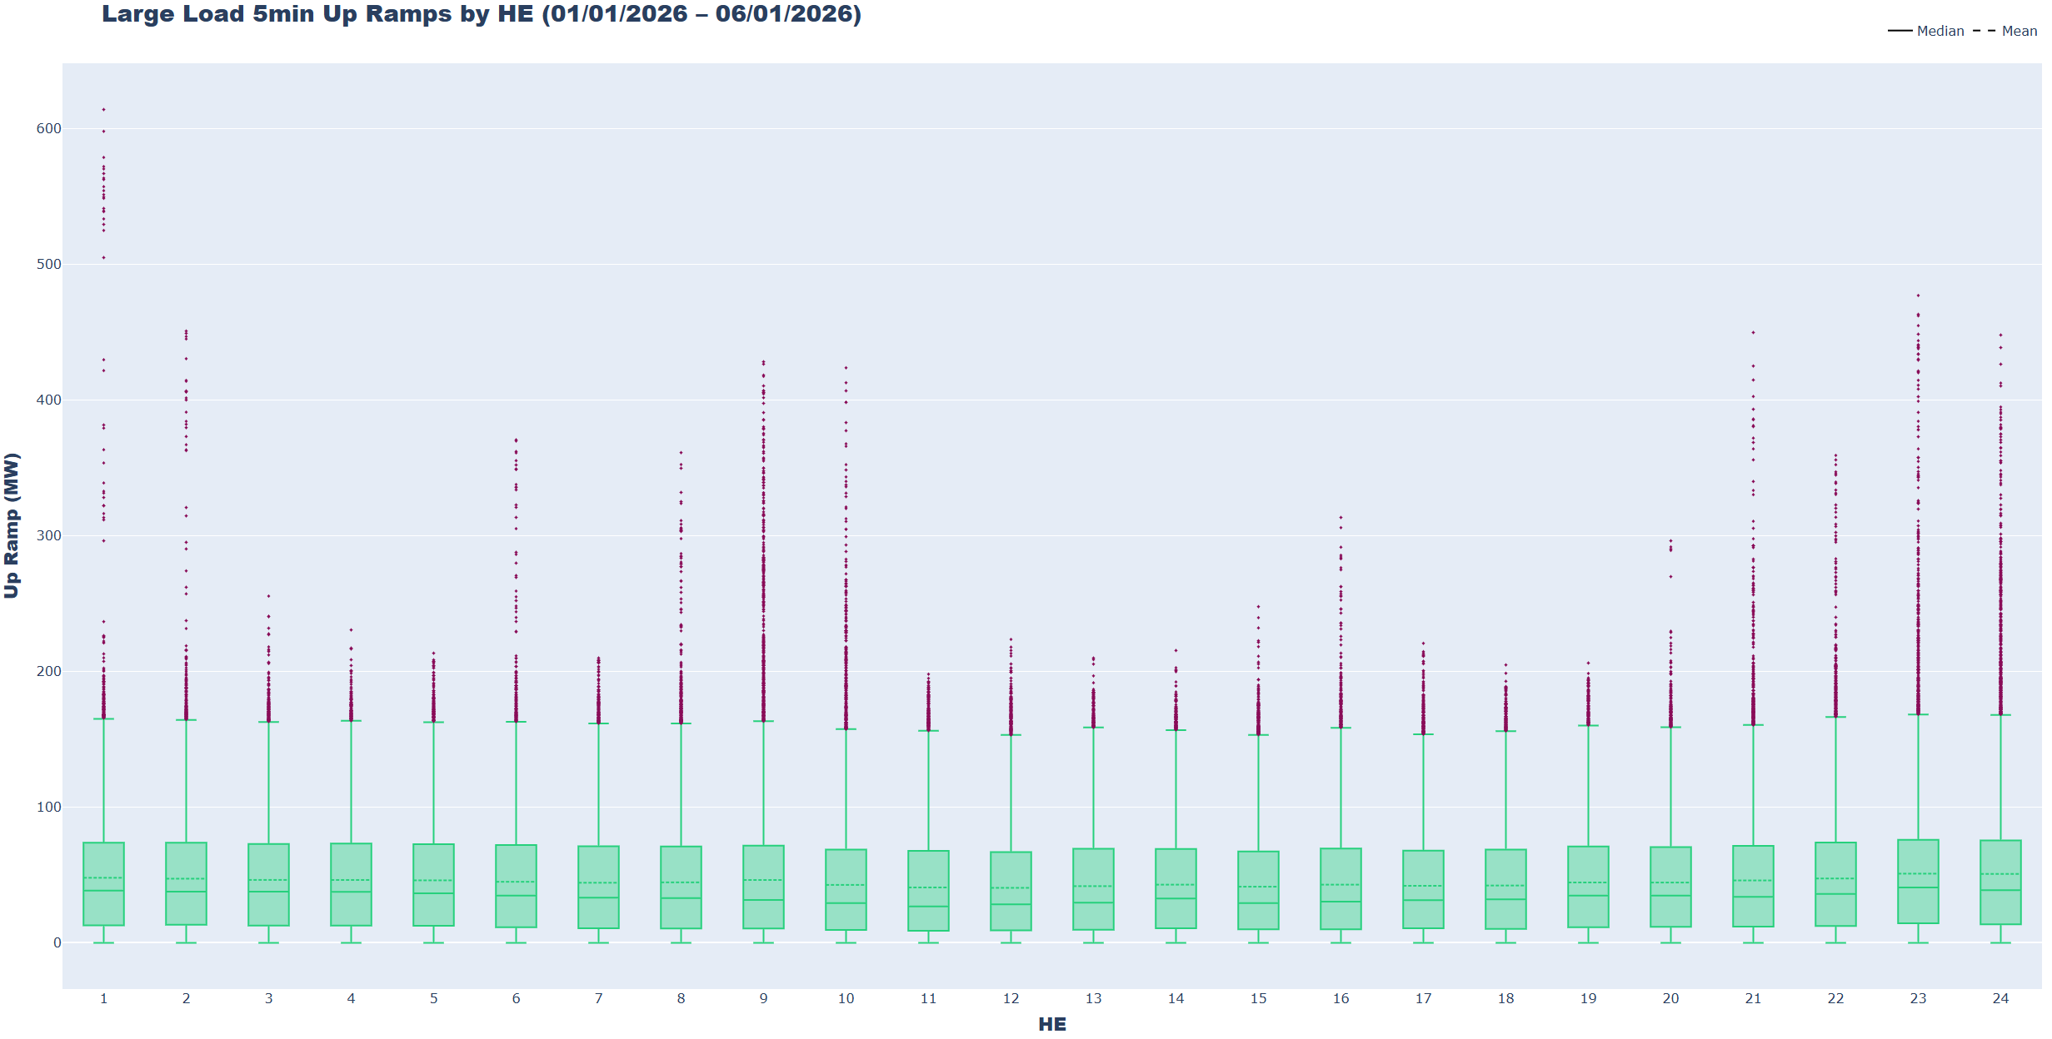
Large Load Ramping Trends
ERCOT is monitoring the aggregate ramping behavior of Large Loads and Non-Conforming loads. Ramping analysis revealed that 5-minute hourly average up ramps are between 41 MW (HE12) to 51 MW (HE23), however there are instances of ramps exceeding 400 MWs.

Slide 10
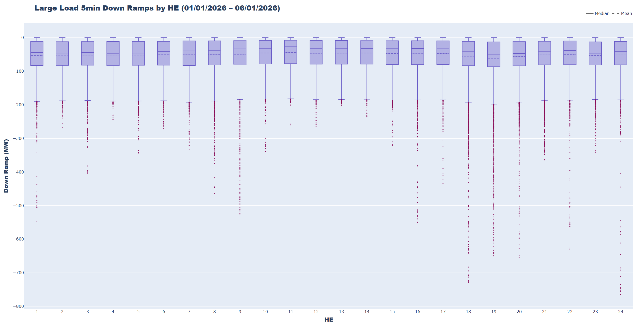
Large Load Ramping Trends
Ramping analysis revealed that 5-minute hourly average down ramps are between –44 MW (HE11) to –61 MW (HE19). Downward ramps tend to be more extreme, with greater quantities of large-magnitude outliers. Extreme ramps have the potential to impact frequency control and Regulation usage. In the current Regulation methodology, Large Load ramping is accounted for in the NLFE term, but a Large Load adjustment could be considered to combat the more extreme ramp scenarios.

Slide 11
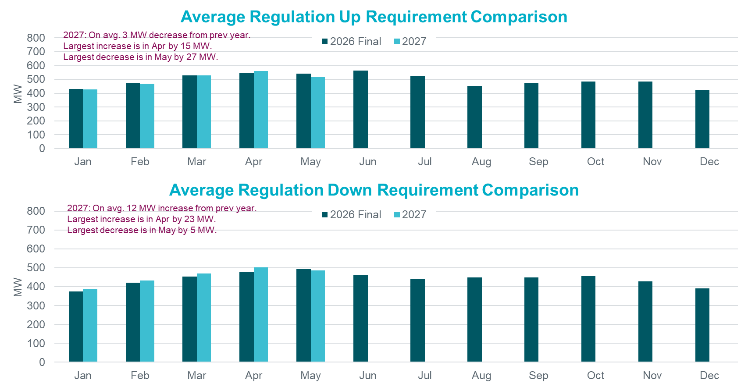
Hourly Average Regulation Comparison

Slide 12
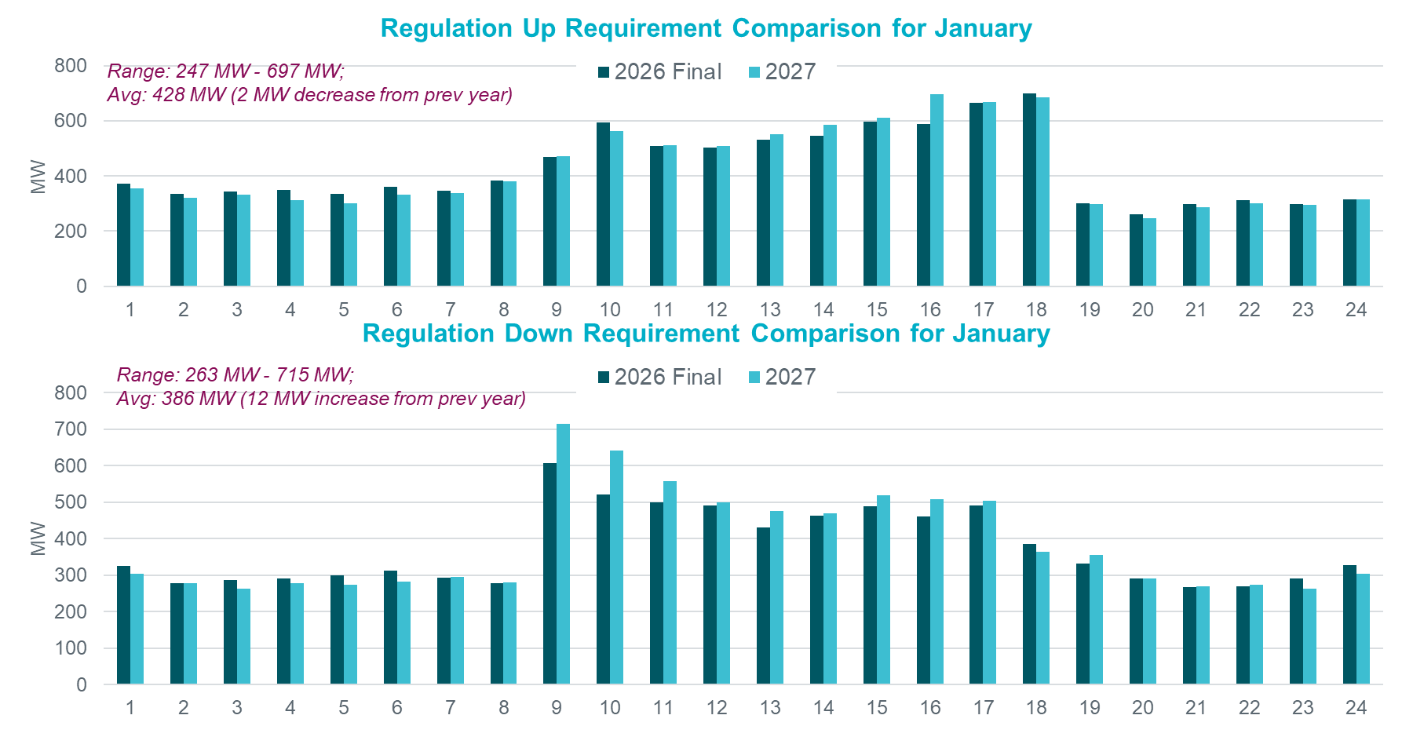
Regulation Comparison January

Slide 13
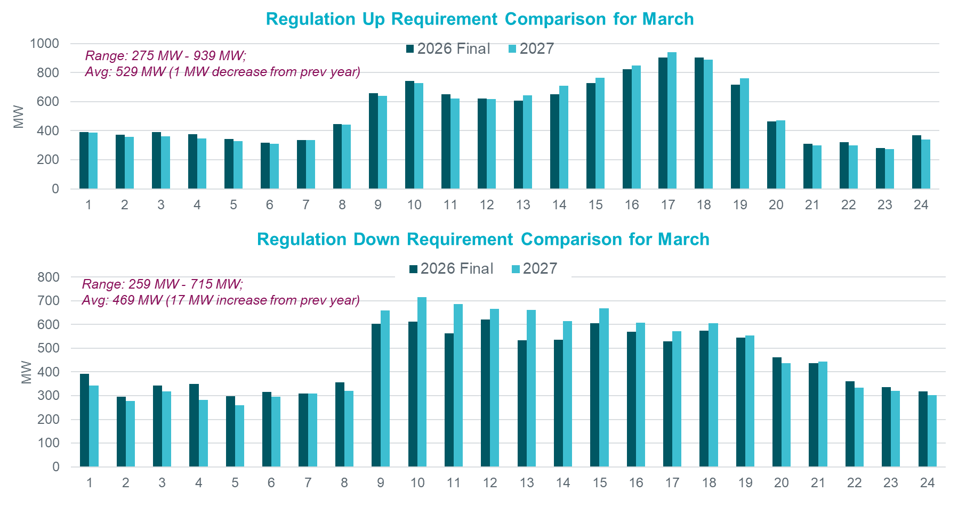
Regulation Comparison March

Slide 14
Responsive Reserve Service (RRS)

Slide 15
Responsive Reserve Service (RRS) Methodology
RRS Methodology overall is unchanged.
NERC’s preliminary BAL-003 Interconnection Frequency Response Obligation (IFRO) assessment for ERCOT for the 2027 Operating Year (OY) has not yet been published. Therefore, this analysis used the minimum RRS-PFR limit of 1,377 MW for 2026.
The preliminary RRS quantities for January 2027 through May 2027 in subsequent slides have been computed using 2025 and 2026 system inertia conditions and 2026 RRS table.
  The RRS table tracks RRS requirements for different inertia conditions. This table uses a minimum RRS-PFR limit of 1,377 MW for 2026, and the table will be updated for 2027.

Slide 16
2026 RRS Table
Scenario | 1 | 2 | 3 | 4 | 5 | 6 | 7 | 8 | 9 | 10 | 11 | 12
LR/PFR | 2.35:1 | 2.2:1 | 2.06:1 | 1.94:1 | 1.83:1 | 1.74:1 | 1.65:1 | 1.58:1 | 1.51:1 | 1.44:1 | 1.39:1 | 1.33:1
Inertia (GW∙s) | 130 | 140 | 150 | 160 | 170 | 180 | 190 | 200 | 210 | 220 | 230 | 240
PFR Req. (no LR) (MW) | 5,960 | 5,563 | 5,200 | 4,892 | 4,622 | 4,329 | 4,114 | 3,920 | 3,744 | 3,522 | 3,314 | 3,139
*RRS Curr IFRO (MW) | 3,320 | 3,273 | 3,227 | 3,183 | 3,145 | 3,068 | 3,031 | 2,982 | 2,941 | 2,863 | 2,767 | 2,699
**RRS Upd IFRO (MW) | - | - | - | - | - | - | - | - | - | - | - | -
Scenario | 13 | 14 | 15 | 16 | 17 | 18 | 19 | 20 | 21 | 22 | 23 | 24 | 25
LR/PFR | 1.28:1 | 1.24:1 | 1.19:1 | 1.15:1 | 1.12:1 | 1.08:1 | 1.04:1 | 1.01:1 | 1:1 | 1:1 | 1:1 | 1:1 | 1:1
Inertia (GW∙s) | 250 | 260 | 270 | 280 | 290 | 300 | 310 | 320 | 330 | 340 | 350 | 360 | 370
PFR Req. (no LR) (MW) | 3,004 | 2,890 | 2,784 | 2,686 | 2,595 | 2,510 | 2,421 | 2,353 | 2,290 | 2,230 | 2,173 | 2,119 | 2,068
*RRS Curr IFRO (MW) | 2,645 | 2,595 | 2,558 | 2,514 | 2,463 | 2,425 | 2,380 | 2,343 | 2,290 | 2,230 | 2,173 | 2,119 | 2,068
**RRS Upd IFRO (MW) | - | - | - | - | - | - | - | - | - | - | - | - | -
*RRS quantity is calculated for RCC of 2,805 with limit of 60% limit on LRs and min RRS-PFR limit of 1,377 MW.
**The 2027 IFRO assessment has not yet been reported back from NERC, preventing the calculation of RRS quantity.
***Red font in table above identifies study scenario where RRS needed < 2,300 MW. RRS requirement during these is based on the applicable floor.

Slide 17
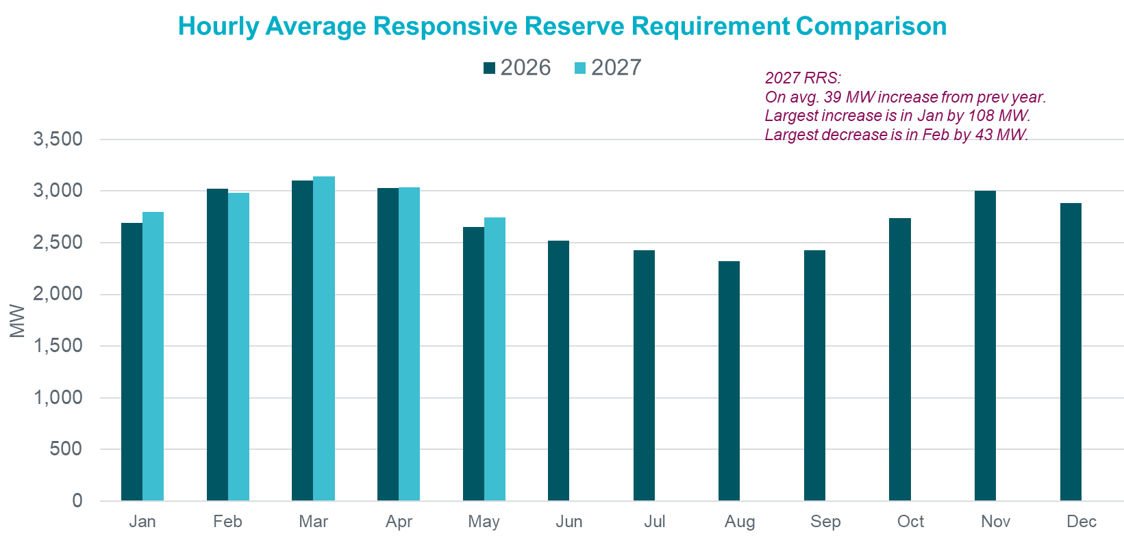
Monthly Average Responsive Reserve Service Comparison

Slide 18
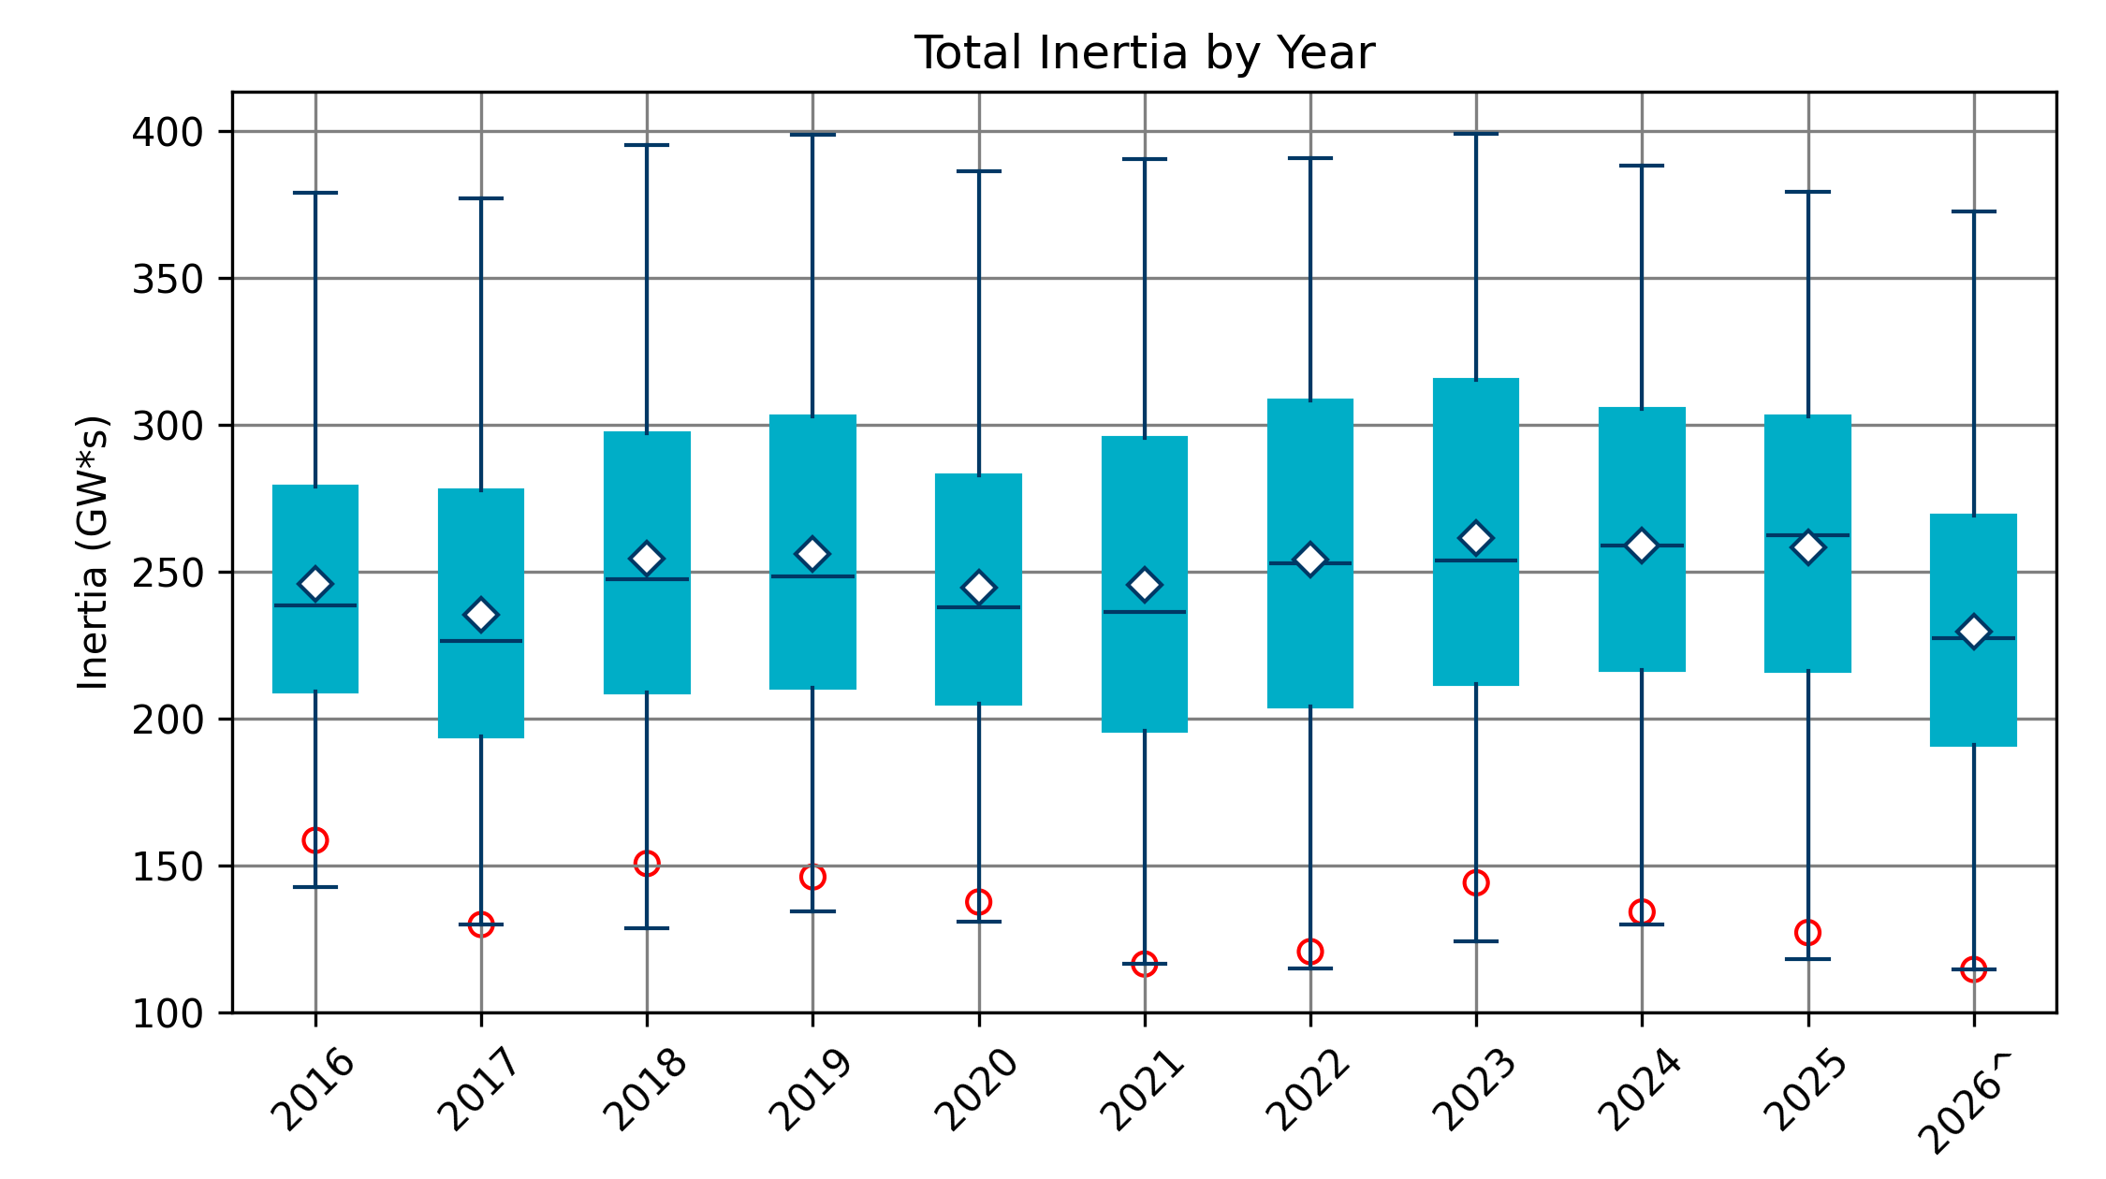
Total Inertia (2016 – 2026.6*)
The average inertia in 2025 was comparable to 2024, but currently 2026 is trending lower than in 2024. Summer months have not been included so far.
[Total inertia for 2016 - 2026.06*]

Slide 19
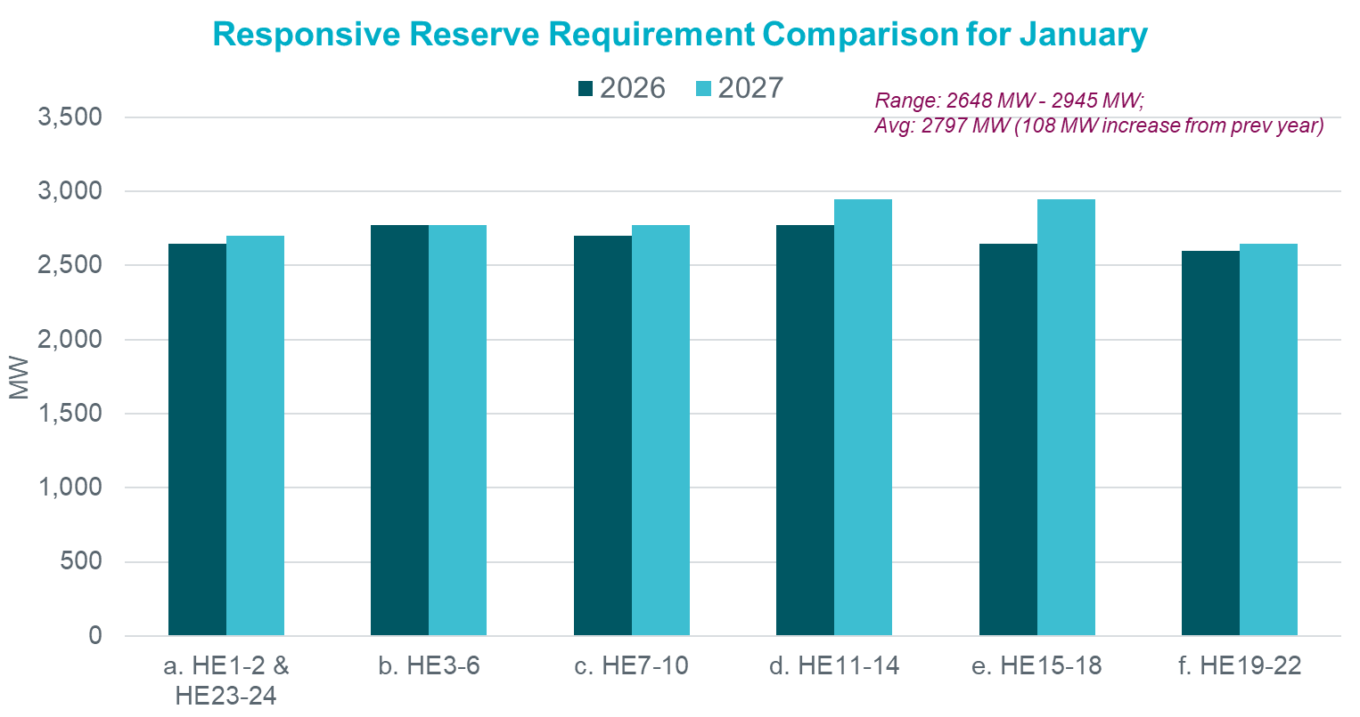
Responsive Reserve Service January

Slide 20
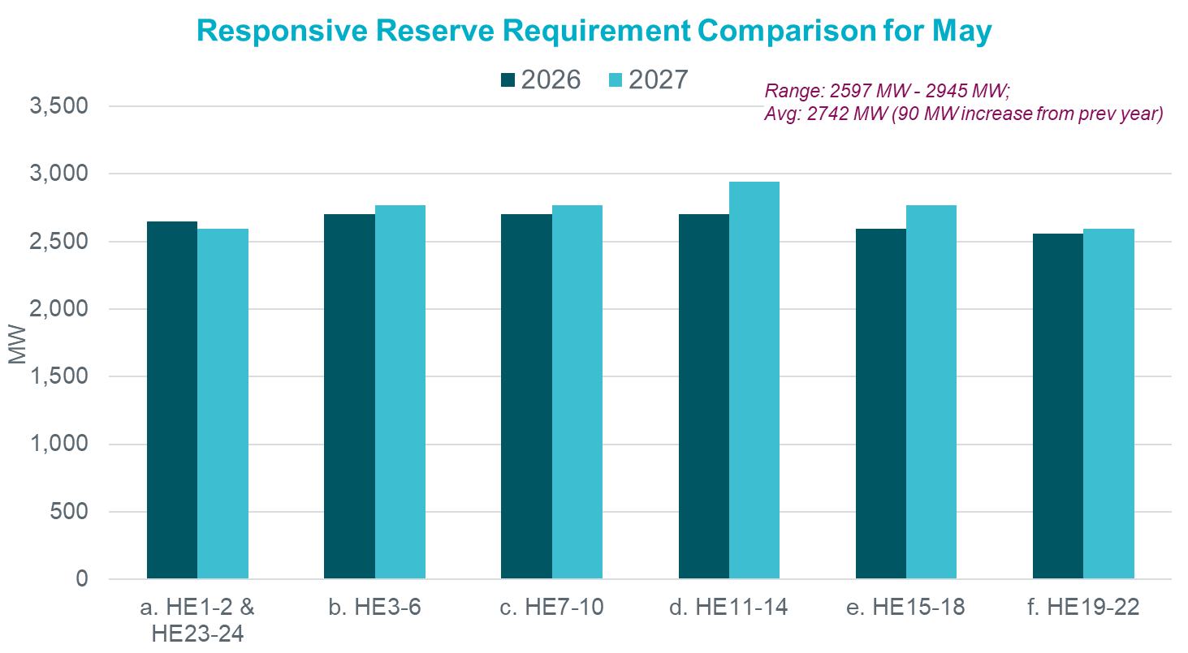
Responsive Reserve Service May

Slide 21
Probabilistic Framework Review
ERCOT Contingnecy Reserve Service (ECRS) & Non-Spinning Reserve (Non-Spin)

Slide 22
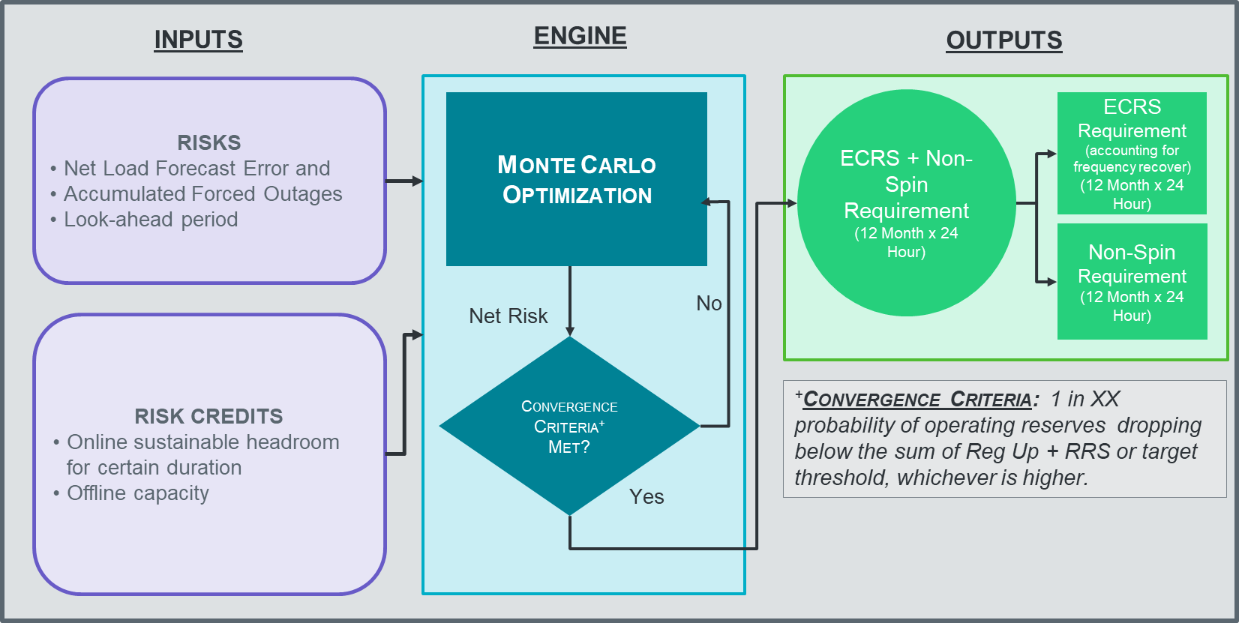
Flow Diagram for Probabilistic Methodology

Slide 23
Potential Tuning and Methodology changes for Probabilistic Methodology
Topic | Conducting Analysis
Sensitivity to level of risk in the criterion when procuring AS to cover forecast error (on non-scarcity days). | Target reserve level: Watch, EEA1, EEA2 OR Load Shed Probability of violation: 1 in 10 year, 1 in 5 year, 1 in 1 year Restoration Criteria: Varying Reg Up + RRS criteria
Sensitivities to look ahead period when measuring forecast error and forced outage risk. | In hourly increments up to 6-hour (current setting) prior to operating hour beginning
Review impact of risk credits. How much should the AS quantities be discounted based on the “extra” headroom from resources that were historically committed by market? | Credit: Current credit approach, and higher credit levels Current: 60% for in night hours (HE23-HE5) and Y = 25% in day hours (HE6-HE22) Energy Duration: Current Protocols and lower-value sensitivities
Optimization is highly impacted by tail events when measuring risk. Evaluate the Net Load Forecast Error (NLFE) and Solar Adjustment logic to identify potential improvements. | Investigate the need to move to Gross Real-Time Power Potential (GRPP). How can this affect solar adjustment logic?
Adjacent hour impacts could cause large steps in quantities between hours. How can this be improved? | Improve methodology for adjacent hours and potential smoothing.
Other tuning improvements and RTC+B impacts to the probabilistic methodology | Review improvements for ESR growth, and RTC+B such as AS Plan procurement

Slide 24
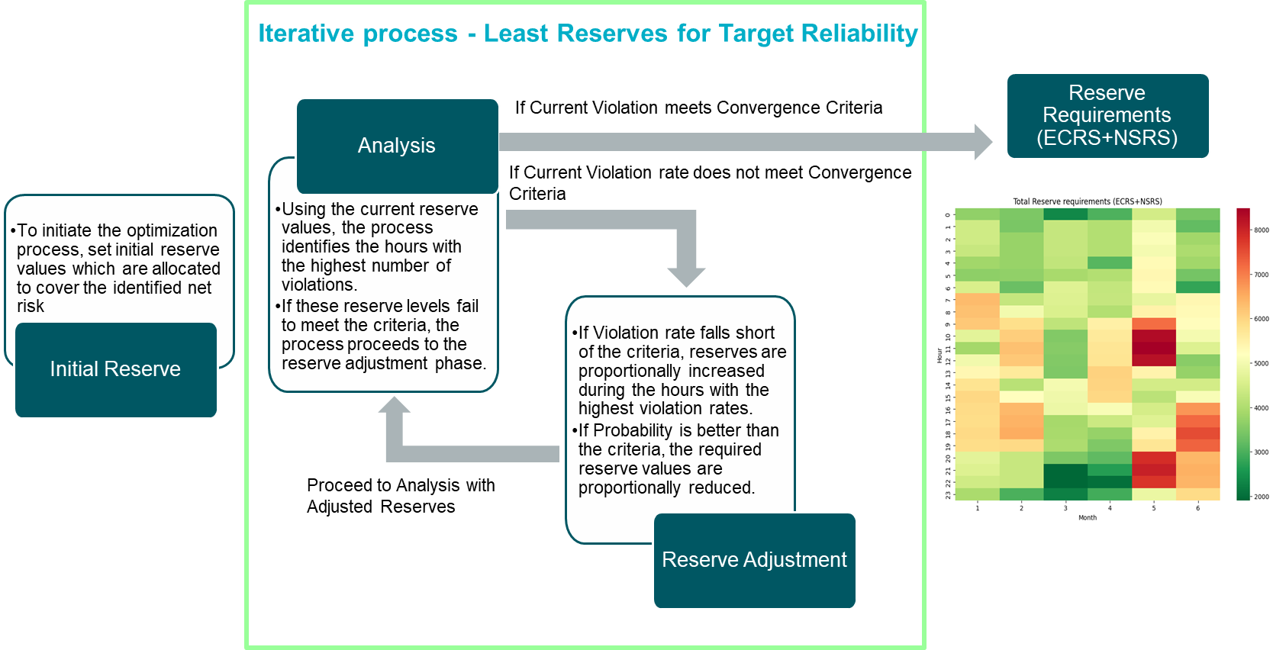
Optimization Workflow for Total (ECRS + NSRS) Reserve

Slide 25
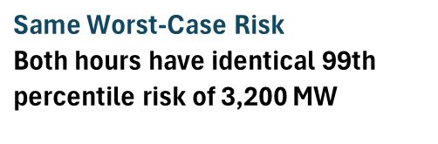
Simplified Optimization Example – Identical Maximum Risk Across Two Hours
Key Takeaway: Reserve requirements are set by both the magnitude and frequency of risk exceedances, not by the maximum risk alone.
*Not Real Data

Slide 26
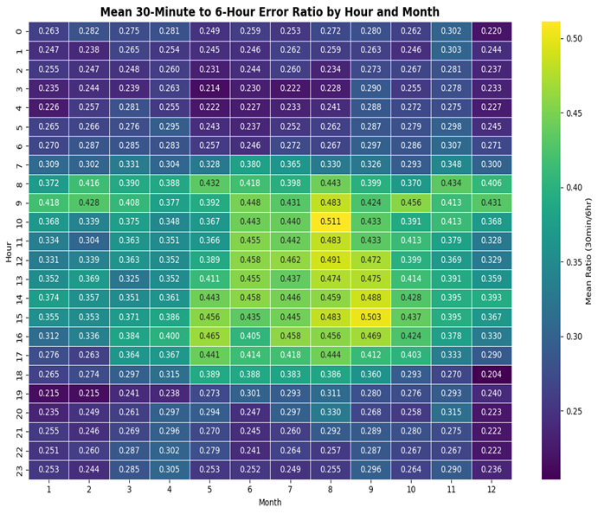
Allocating Individual ECRS and NSRS quantities from Total Reserves
Each hour has 12 five-minute X-min ahead errors and one Y-hour ahead error
For each X-min under-forecast error, calculate the ratio to the Y-hour ahead under-forecast error for that same hour
Group results by Month-Hour to compute average ratio for each Month-Hour
ECRS should be reserved to restore frequency following the trip of a large generator and/or provide supply during intra-hour net load forecast errors.
ECRS = max(ECRS Frequency Recovery Requirement, Total Reserves * ECRS Ratio %)
NSRS = Total Reserves * (1-ECRS Ratio %)

Slide 27
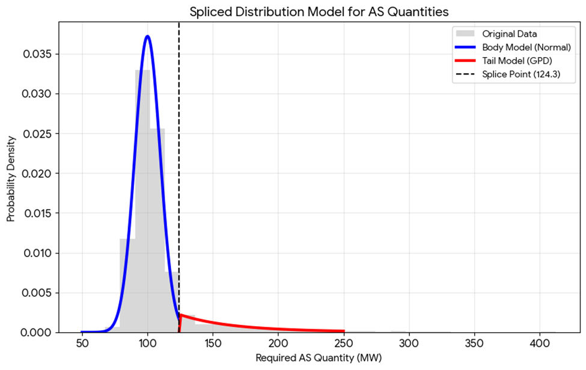
Improving The Over Reliance on NLFE tails
One takeaway from the 2026 methodology was that AS quantities are highly impacted by tail events. The current Empirical Distribution Function (ECDF) sampling method treats all the historical data points equally. However, the tails are the most extreme cases, should not be treated the same as other data points. We are exploring new distribution methods to better quantify AS needs.
Right figure is only a demonstration on modeling the tails distribution.

Slide 28
Risk
Net Load Forecast Error
Solar Adjustment
Forced Outages

Slide 29
Net Load Forecast Error (NLFE) and Gross Real-time Power Potential (GRPP)
Actual and forecasted data for solar, wind, and load is used to calculate NLFE. We are analyzing the impact of moving to a method that introduces GRPP for the Solar and Wind calculations rather than use the HSL method used previously.
GRPP is the power potential for a resource before co-located load consumption. With more loads being located behind existing wind and solar we believe GRPP should more accurately represent our vendor forecast and better reflect real-time error.
RTC+B introduced no changes to this process. This process uses a X-hour ahead variable that can be changed to look at different scenarios.
Key Takeaway: We are analyzing the error accounted for solar and wind data used in calculating NLFE by introduction of GRPP that takes the co-located load consumption into account.

Slide 30
Solar Adjustment
Due to the impact of load and renewable growth on forecast error we analyzed monthly forecast error trends over multiple years. The process uses standard deviation modeling, mean absolute percentage error (MAPE) trends, and installed capacity projections to generate normalized adjustment curves. The result enables adjusting solar production forecasts to account for expected error magnitudes.
ERCOT is analyzing impact of introducing GRPP for solar forecast error and review impact on solar adjustment calculations. Additionally, we are also reviewing modeling assumptions, performance, and testing new functionally to potentially improve the accuracy of solar adjustment.
This adjustment is applied only to solar forecasts, based on statistical significance; no adjustment made for load or wind.
RTC+B introduced no changes to this process. This process uses a X-hour ahead variable that can be changed to look at different scenarios.
Key Takeaway: Solar adjustment in previous years is required to account for future expected error magnitudes by analyzing trends and introducing GRPP to produce more accurate forecasting results.

Slide 31
Forced Outages
Forced generator outages as an input are needed to define the the uncertaintly that were unanticipated by the Operators and would not have been seen by RUC comitment proccess.
The current method only uses Forced (FR), and Forced Extended (FE) to align them by hour and only looks at outages that started within a window of observation for any particular hour.
RTC+B introduced single model batteries but had no impact on the core logic and functionality of the tool.
Doesn’t include equipment that have a nature or work of 'Mothballed’, ‘New Equipment Energization’, 'Retirement of Old Equipment’, or 'Seasonal Resource.’
The process uses a X-hour ahead variable that can be changed to look at different scenarios.
Outage overlaps are also accounted for by looking at individual units and removing any outage that was present during another outage.
  If an outage was found to be overlapping with another, the outage with a higher loss of HSL will take priority and overwrite the bigger outage, but only for its timeframe.
80 HSL Lost
80
80
100
100 HSL Lost
Key Takeaway: Battery outages are included and RTC+B brought no impacts to the core functions of the tool. The tool is flexible enough to look at X-hour ahead scenarios.

Slide 32
Risk Reducers
ESR Capacity
Conventional Online and Offline Capacity

Slide 33
Risk Credit RTC+B Impacts and Review
With the implementation of RTC+B, there was a need to align our methods with system changes such as, but not limited to, the following:
  Accounting for AS Award vs AS Responsibility
  HASL calculation removal
  Change in telemetered Resource Status
  SCED AS Duration Requirement Accounting
    Reg and RRS – 30 mins
    RRS-FFR – 15 mins
    ECRS – 1 hour
    Non-Spin – 4 hours
  AS Plan Awareness (Shortfall/Excess procurement of plan)
Additionally, ERCOT is reviewing potential impacts to online/offline/ESR energy available that is not awarded AS after implementation of RTC+B.
Key Takeaway: Although much of the probabilistic method was developed in the 2026 AS Methodology, much of the functionality needs review to ensure RTC+B impacts are accounted for.

Slide 34
Capacity Included in the Probabilistic Methodology
During grid operation, there are varying quantities of available power output that could be dispatched that is not reserved for ancillary services
This output helps to mitigate risk as it allows for SCED to dispatch further output to meet unforeseen increased load without having to dispatch ancillary services
The available power output that we are considering is the following:
  ESR Capacity:
      This capacity is specific to ESRs as it can only be dispatched according to the charge that is available and not reserved for ancillary services
  Online Headroom:
      Unit Type: Combined Cycles and other Thermal that are ON and SCED dispatchable
      Online headroom calculation for each resource, excluding any AS that is reserved.
        New_HASL = HSL – AS awards)
        Headroom = max(0, min(SCEDURR * 30 + Base Point, New_HASL) – Base Point)
  Offline Capacity:
      HSL capability of units that are OFF and are not awarded for Offline Non-Spin Reserve Service which can be online within 30 minutes.
Key Takeaway: There is available power output not reserved for ancillary services that can be used to mitigate load forecast. Capacity accounting is impacted by changes in RTC+B

Slide 35
ESR SOC Reserved for AS Accounting
ESRs vary in the amount of SOC they have available for dispatch that is not reserved for ancillary services (AS). The amount of SOC reserved for AS can be calculated based on Responsibility/Award and the duration required for each AS.
In the pre-RTC method, a 1 hour duration was being considered when accounting the amount of SOC that is reserved for AS for all AS types. For example:
In RTC+B, SCED is now 'SOC aware’ and now respects the AS durations when awarding AS:
Key Takeaway: In RTC+B, SCED is SOC aware and awards AS based on the defined AS durations. The SOC reserved for AS should be considered when accounting for ESR credit.

Slide 36
ESR Capacity Growth Factor and Sensitivity
We have seen large increases in ESR capacity year over year
The probabilistic method does not currently account for potential for increase in available energy
We are conducting analysis and testing methods to account for a growth factor based on the estimated future ESR installation
Additionally, as an alternative we are also assessing risk credit accounting and duration sensitivities to cover potential growth in ESR energy availability. Review of RTC+B impacts on ESR energy available is underway.
Key Takeaways: ERCOT has observed significant ESR growth year over year and is considering several methods to attempt and account for the change.

Slide 37
Offline Capacity RTC Observations
In RTC+B, units no longer have a specific status for carrying OFFNS. Instead, OFFNS is awarded, but the status of 'OFF' remains
These awards can now be changed every SCED interval. We are currently evaluating the impact of awards over an hourly period to align with the AS plan.
How should capacity be considered offline capacity be considered if it was only awarded for a few intervals in an hour? The majority of the hour but not all?
Key Takeaways: Resource status accounting change was reviewed and proper methodology for accounting for capacity is needed.

Slide 38
Summary
Based on the analysis ERCOT has conducted thus far,
  ERCOT is not considering any changes in the methodologies used to compute Responsive Reserve Service requirements for 2027.
  ERCOT is considering one change in the methodology used to compute the Regulation Service.
  ERCOT is evaluating several changes/improvements to the Probabilistic methodology to account for RTC+B impacts along with accounting for stakeholder feedback approach to compute the ECRS and Non-Spin requirements for 2027.
The proposed timeline for this review is included alongside.
Interested Stakeholders are requested to attend the upcoming meetings to provide any feedback on the proposed 2027 AS Methodology.
2027 Methodology Review Timeline
July 08, 2026 – WMS
July 09, 2026 – ROS
July 22, 2026 – PDCWG (Proposed)
July 27, 2026 – WMWG (Proposed)
July 28, 2026 – OWG (Proposed)
August 05, 2026 – WMS (Vote)
August 06, 2026 – ROS (Vote)
August 26, 2026 – TAC (Vote)
September 15, 2026 – BoD
Nov, Dec 2026 – PUC

Slide 39
Questions?
JoseLuis.Hinojosa@ercot.com

Slide 40
Appendix

Slide 41
Regulation

Slide 42
Regulation Service Flowchart
Historical forecast error
(load & renewables: forecast vs. actual)
Size REG-Up & REG-Down to cover
~95% of the typical hour-by-hour swing,
then adjust for the items at left
Monthly REG-Up / REG-Down
requirements by hour of day
Renewable growth
(more wind & solar = more variability)
Frequency-control buffer
(ACE)

Slide 43
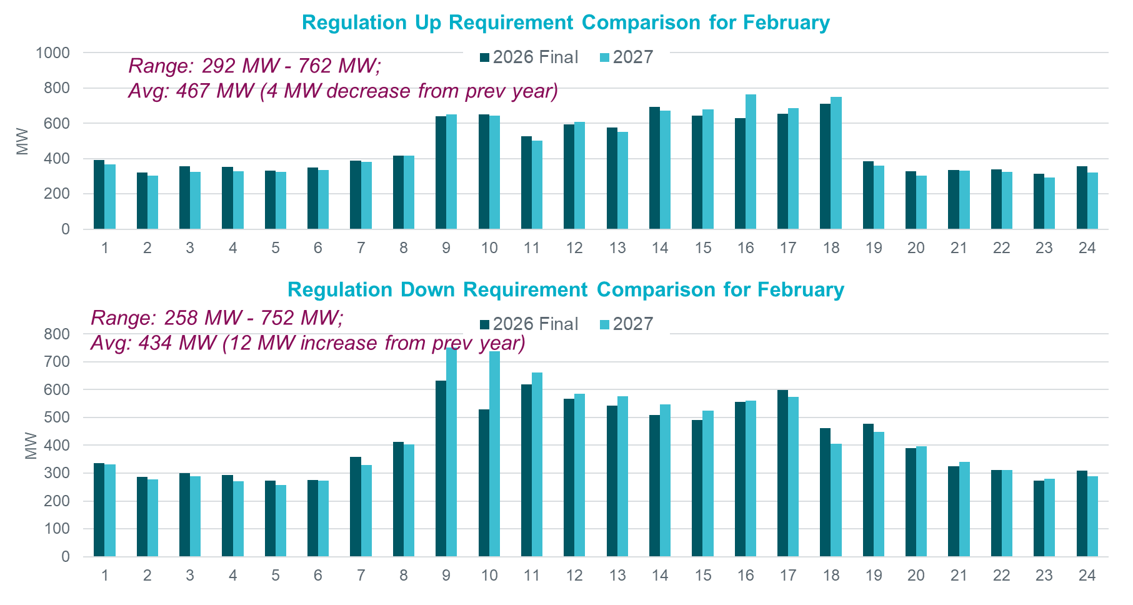
Regulation Comparison February

Slide 44
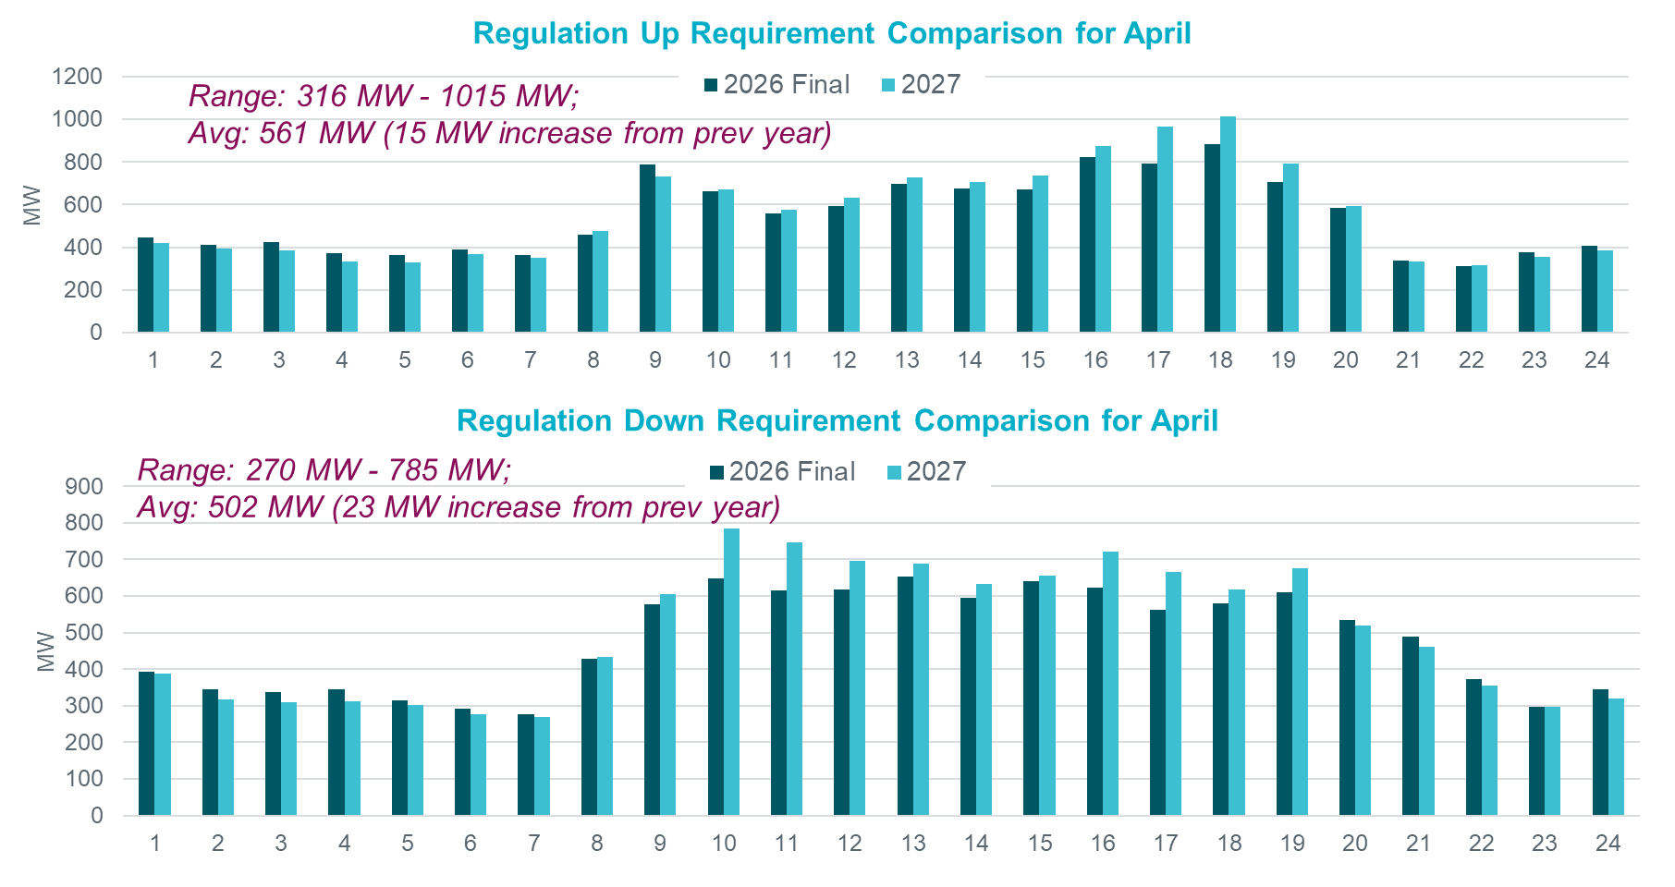
Regulation Comparison April

Slide 45
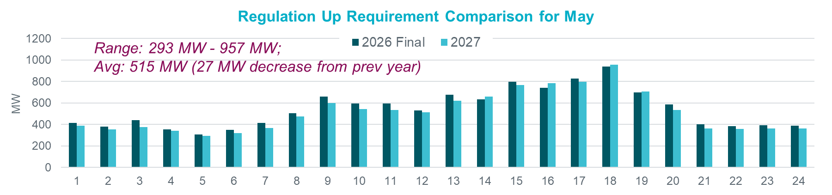
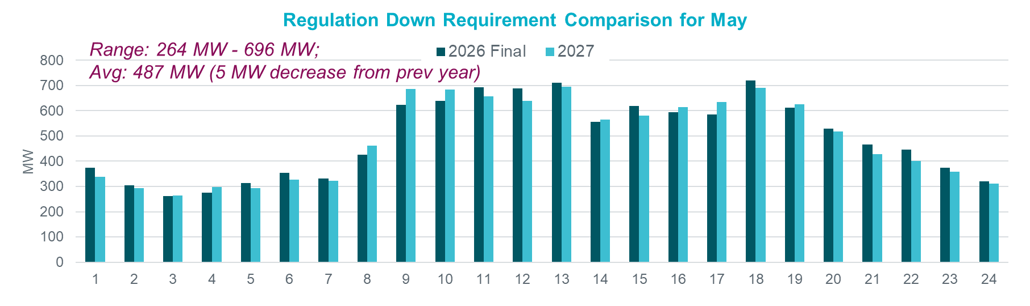
Regulation Comparison May

Slide 46
RRS

Slide 47
Responsive Reserve Service Flowchart
Responsive Reserve Service Methodology remains unchanged
Historical system inertia
(grid's resistance to frequency drops)
Project expected inertia
for each hour of next year
Look up reserve needed
(NERC / IFRO requirement table)
Apply minimum floor
(never below required baseline)
Monthly RRS requirement
by hour of day

Slide 48
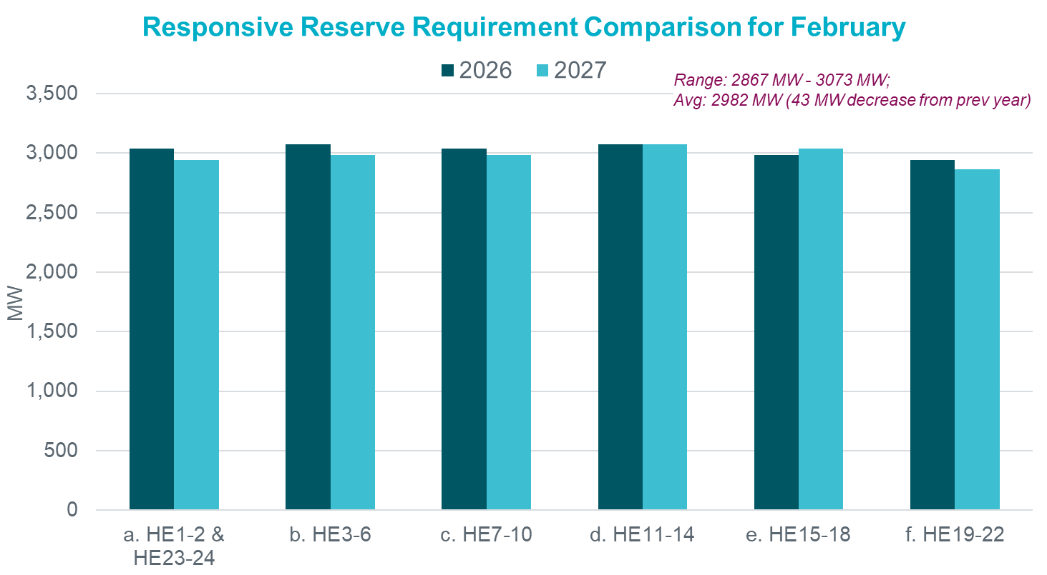
Responsive Reserve Service February

Slide 49
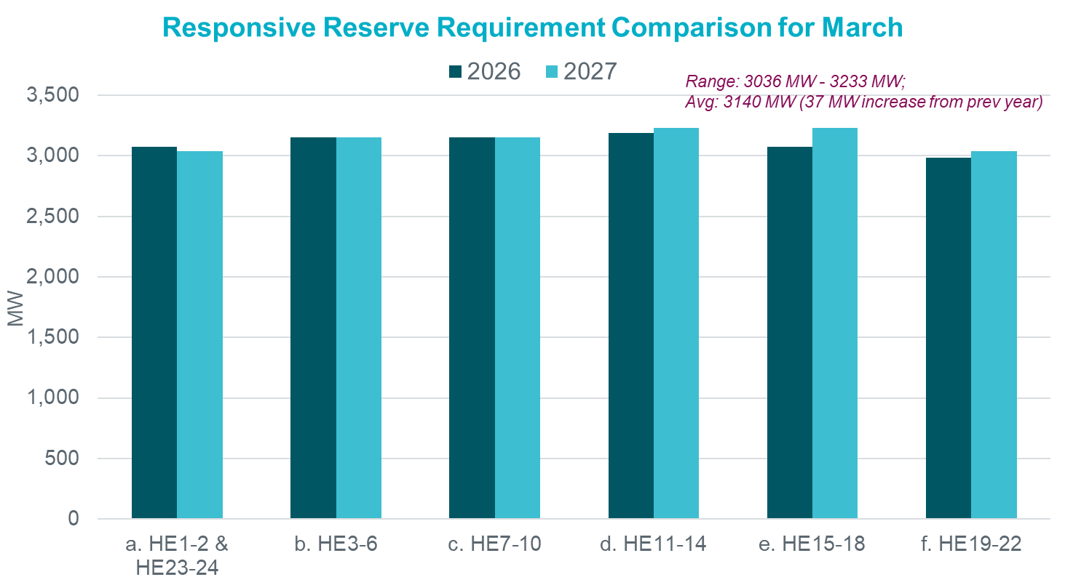
Responsive Reserve Service March

Slide 50
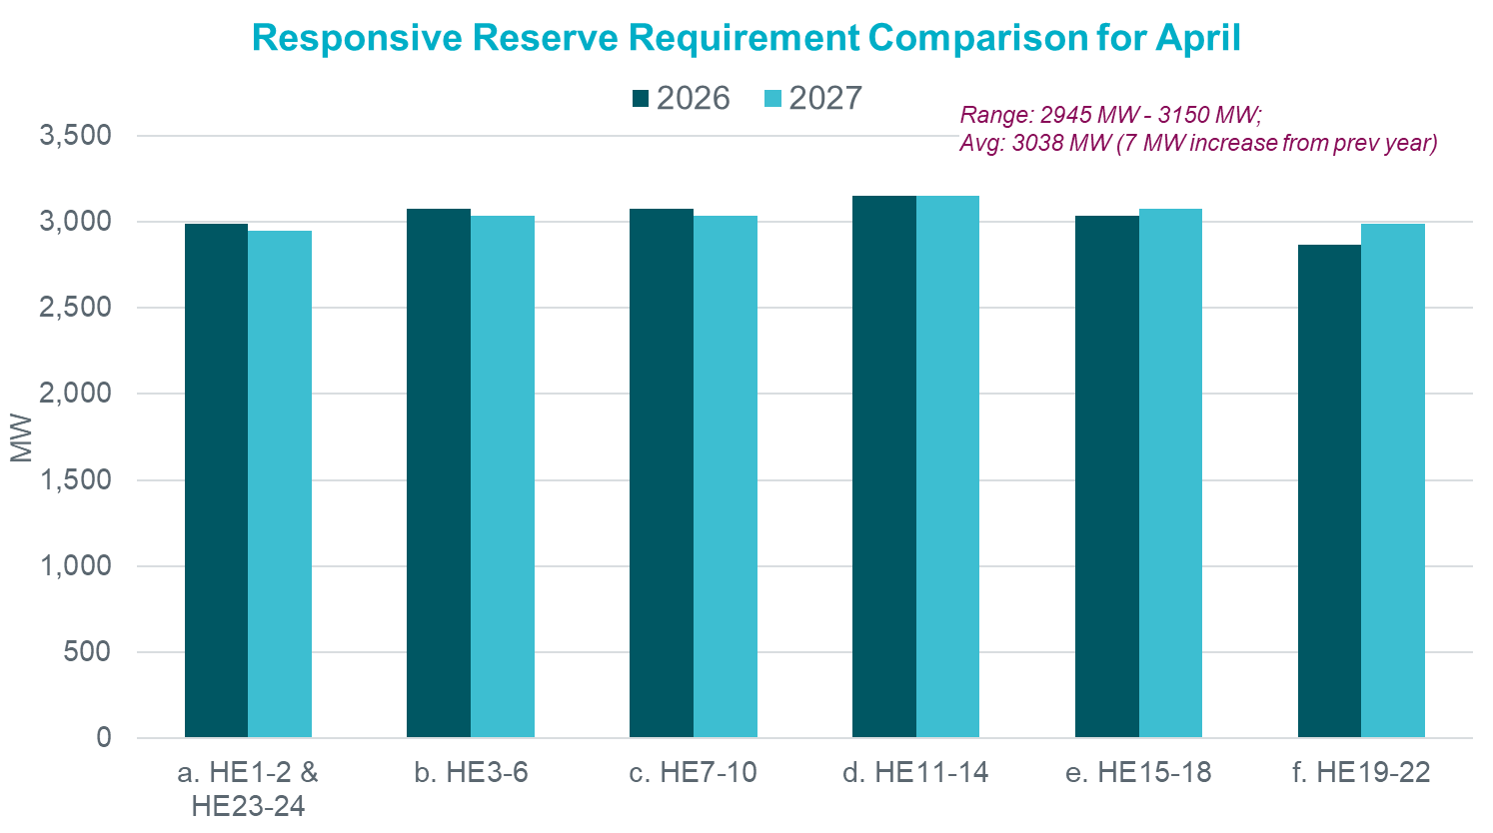
Responsive Reserve Service April

Slide 51
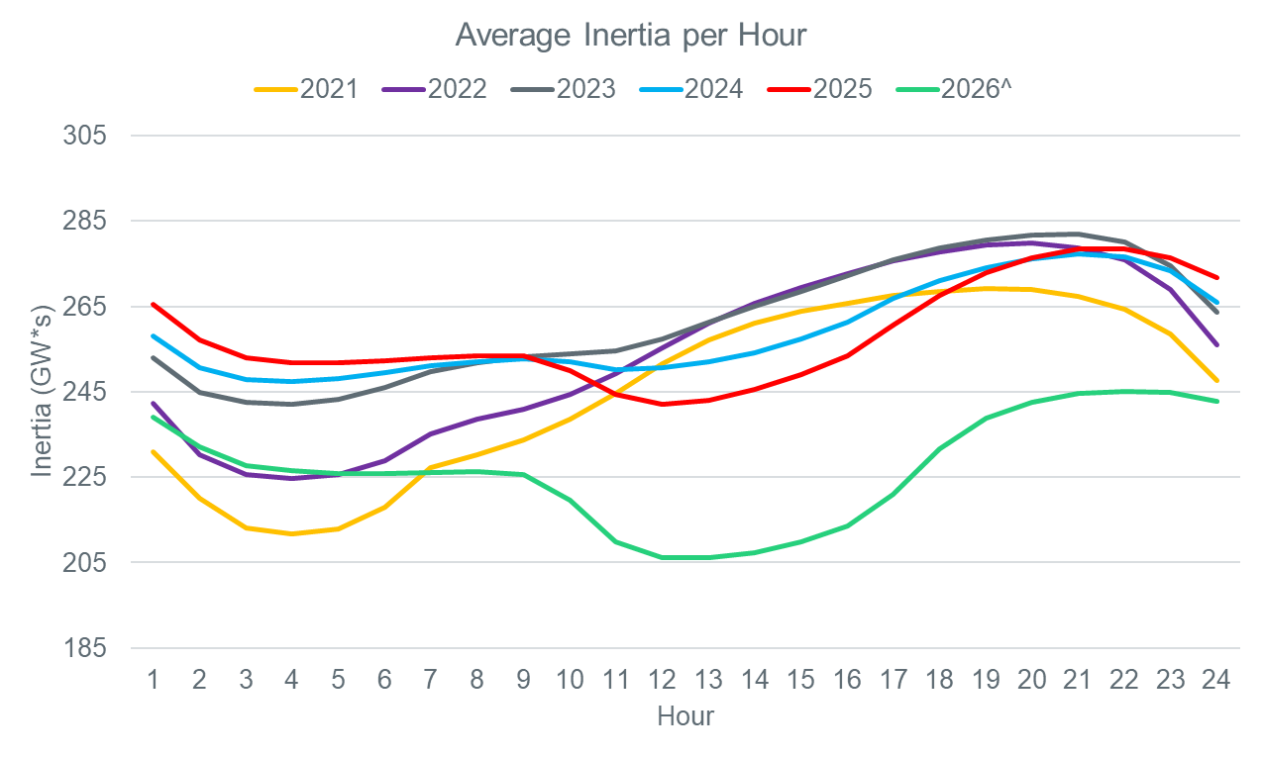
Average Inertia per Hour 2021-2026
From 2025 and onwards the lowest hours of inertia have moved from the night hours to the middle of the day.

Slide 52
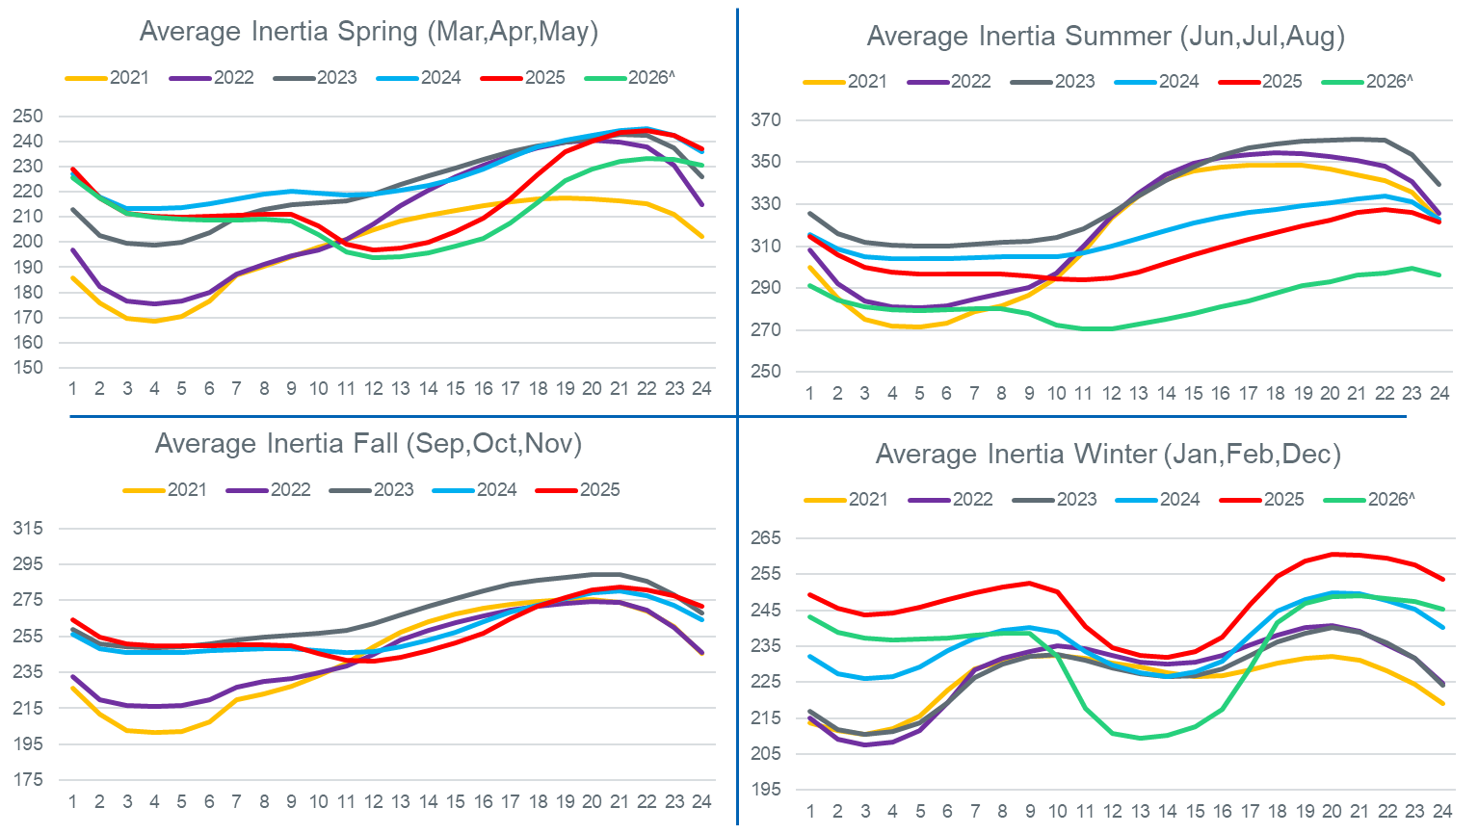
Average Inertia per Hour 2021-2026 (Seasonal)
Winter average Inertia contains previous year December data
Y-Axis scales are different in each chart

Slide 53
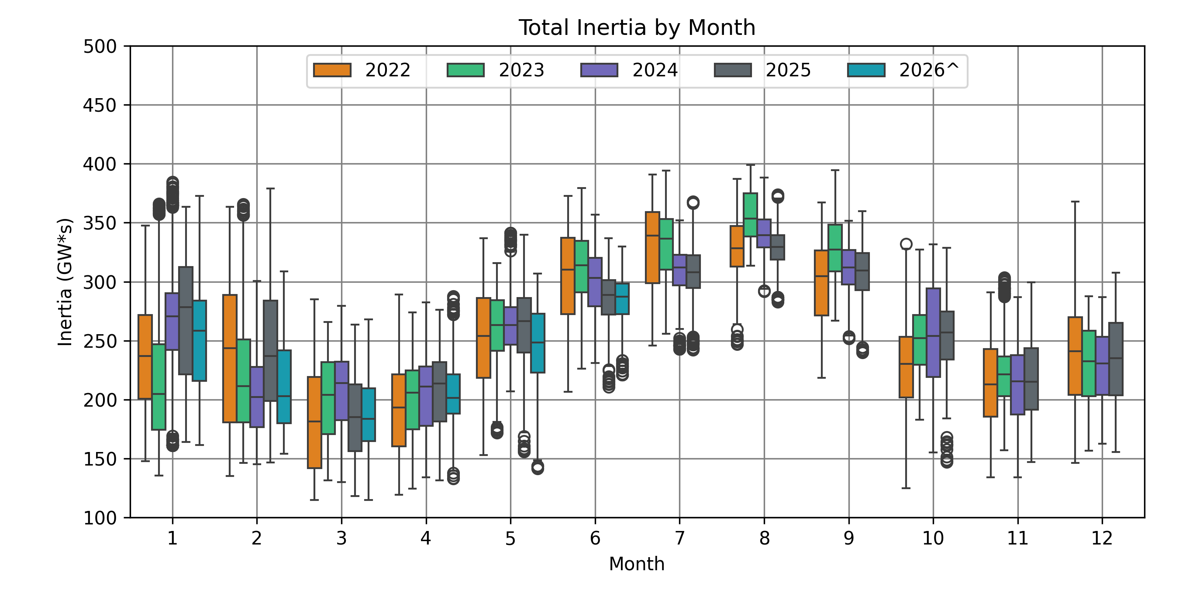
Monthly Inertia from 2022-2026*

Slide 54
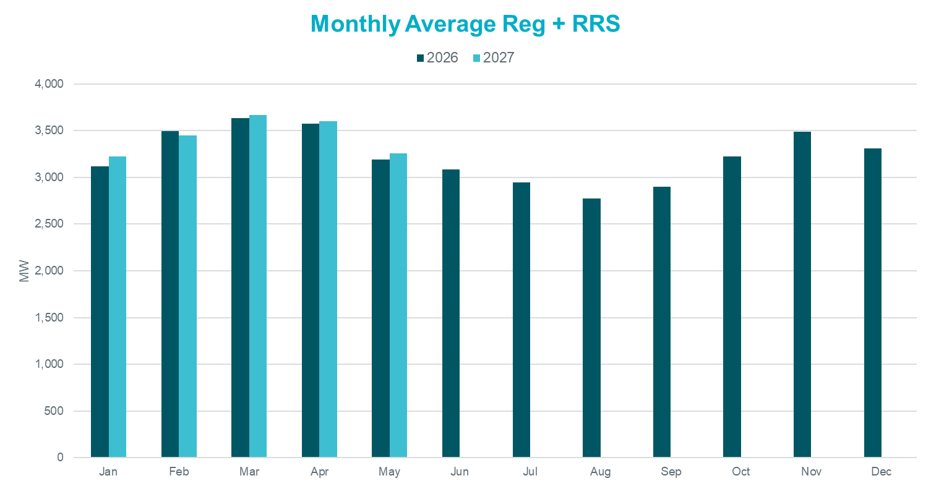
REG + RRS Monthly Average

Slide 55
Probabilistic

Slide 56
Risk and Risk Credits Details
Risk
Net Load Forecast Error (NLFE)
X hour ahead
30 min ahead
Accounting for Solar Capacity Growth
Forced Outages
New method developed pull X hour ahead rolling forced outage of conventional resources
Risk Credits
Online Headroom Capacity Sustainable for X hours
Conventional unit headroom that is available to SCED, but excluding Ancillary Service Capacity
System Hourly ESR Capability is calculated using historical Real-Time telemetered hourly average ESR data (SOC, MNOS, AS Responsibility/Awards)
Reliability Unit Commitment (RUC) Capacity excluded
Offline Capacity
Conventional unit capacity that can be started within 30 minutes excluding any capacity reserved for Ancillary Services
Net Risk = Risk – Risk Credit*Y where the variable is configurable
  Y represents optimal multipliers on how many percent risk credit being applied

Slide 57
Forced Outages (cont’d)
Hour of Interest
Hour - X
Hour
Hour + 1
06:00
12:00
13:00
Scenario 1
Hour – X ≤ Start Time ≤ Hour
Hour + 1 ≤ End Time
Start Time
Scenario 2
Hour – X ≤ Start Time ≤ Hour Hour < End Time ≤ Hour + 1
13:30
Scenario 3
Hour ≤ Start Time < Hour + 1
10:00
12:45
X Hour variable can be changed to desired time
12:15
12:45
13:35

Slide 58
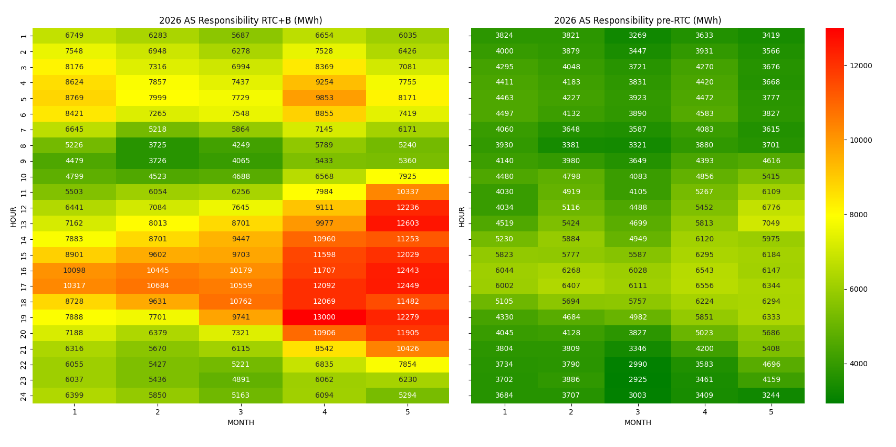
ESR SOC Reserved for AS Pre vs Post-RTC

Slide 59
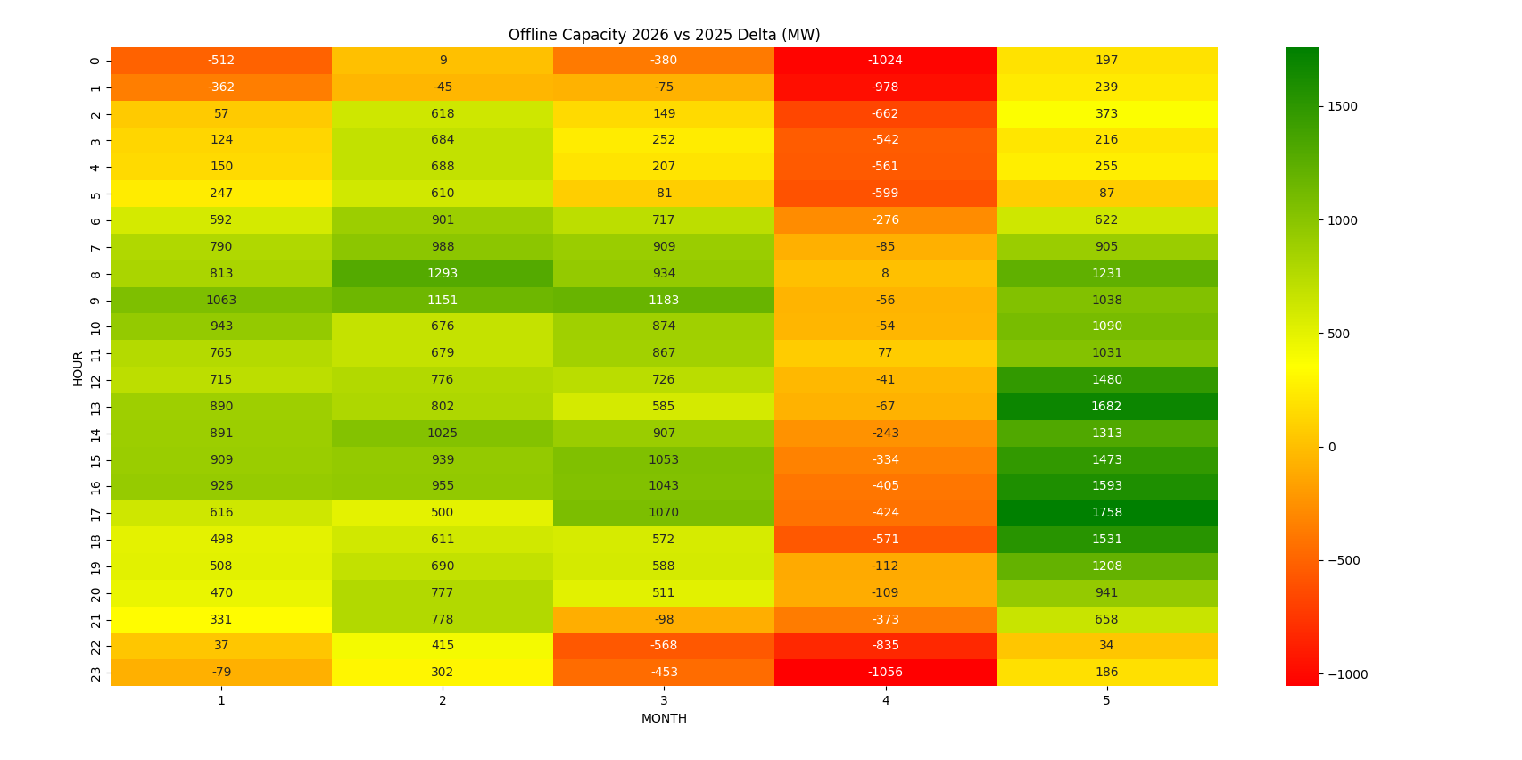
Offline Capacity Delta Pre vs Post-RTC

