Slide 1


TDTMS Update to RMS
June 2026
Leadership 2026
Chair - Sheri Wiegand, Vistra
Vice Chair – Monica Jones, CNP
Vice Chair - Rob Bevill, TNMP

Slide 2
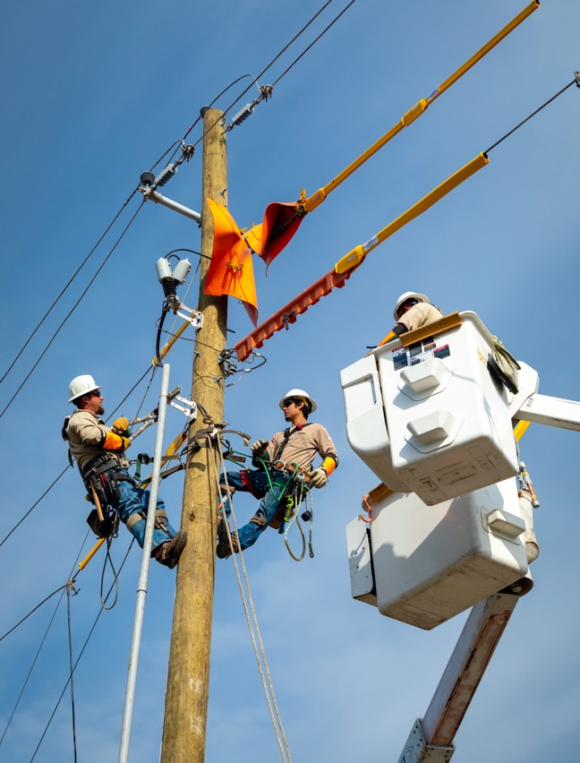
TDTMS Met on June 15
          WebEx Only
          21 participants

Slide 3
2026 Service Level Agreements
  Retail Market IT Systems
    5/10/26 Site Failover
  ListServ IT Services
    6/07/26 Site Failover
  Market Data Transparency
    Downtime <30 min not counted
    New platform should address this gap
  SLA Documents: https://www.ercot.com/services/sla/

Slide 4
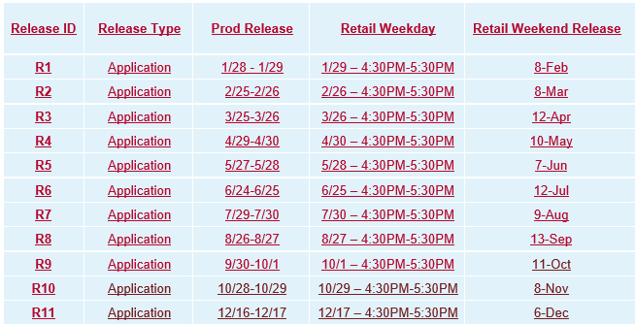
2026 Retail Release Schedule

Slide 5
ERCOT IT Projects
  MarkeTrak API Rewrite
    Testing available in RMTE
    New WSDL Required (no URL change)
    6/28 Go-Live
  Public Website Cipher Security Update
    Upgrading from TLS v1.2 to v1.3
    MPs should confirm with their IT dept.
    Market Notices will be sent
    Effective sometime this summer
  Multi-Factor Authentication
    Digital Certs being mostly retired
    Revision Requests approved by Board
    Timeline is TBD
  MIS Retail API & GUI
    MIS application upgrade under consideration
    Timeline is TBD (2027 ish)

Slide 6
MarkeTrak (& FlighTrak)
Future Enhancements
  You’re invited to the Other Business session today to discuss these ideas and more.
    AI enabled database / analysis
    Expanded reporting tool
    API expansions
    Increased automation
    Instant escalation
    Wildcard searches

Slide 7
MarkeTrak – Inadvertent Gain Analysis 2025(2)
OTRAN to Begin Working
Over 60% submitted within 7 days; sweet spot is 1-3 days
12% submitted over 30 days
Top 3 REPs submit 41% of IAG (REPs #3, #1, & #6)- same as 2025(1)
Highest volume of IAGs submitted in July & September
Highest volume of IALs submitted same months with highest in December
3% of IAGs unexecuted; 1% of IALs unexecuted
Top Unexecutable reasons:
  IAGs: New Transaction Completed – 61%
  IALs: Authorized Enrollment Confirmed – 70%
  REP #4 has the highest # of unexecutables
Anomalies evident with spike in volumes on particular days from REP 48 & REP 202

Slide 8
MarkeTrak – Inadvertent Gain Analysis 2025(2)
Submit Date to Begin Working
View of Losing REP for IAGs, View of Gaining REP for IALs
50-55% of MTs are acknowledged same day
Consistent “front loading” activity amongst all REPs – REP 4 and REP 15 responded 100% to all MTs within 3 days
Begin Working to Agree
View of Gaining REP- how long for Gaining REP to review and agree with Losing REP
95% of MTs, REPs reach agreement within 7 days once acknowledged
IALs – REP 2 and REP 161 have highest same day % at 73% & 75%; REP 12 has addressed 100% of MTs within 7 days

Slide 9
MarkeTrak – Inadvertent Gain Analysis 2025(2)
Losing REP to send BDMVI
Continued success with TXSET v5.0 changes
For IALs, view of submitting REP or Losing REP
IAGs – 66% are sent same day as agreement
IAGs – 96% are sent within 7 days
IALs – 34% are sent same day as agreement
IALs- 91 % are sent within 7 days
Of Top 10 submitting REPs: highest % of BDMVIs within 7 days is REP 24 @ 100 % and lowest % is REP 13 @ 87%
Sweet spot is 6 – 7 days for submittal of BDMVI
REP 168 and REP 176 have highest % submitted within 8 – 21 days of agreement @ 24% and 29% respectively

Slide 10
MarkeTrak – Inadvertent Gain Analysis 2025(2)
Total Resolution Timeline:
98% of IAGs resolved within 21 days, 84% within 7 days
IAGs: REP 19 and REP 24 complete 90% within 7 days; REP 48 has highest % over 7 days at 31%
Top 2 REPs represent 42% of all IAG MTs and 47% of IAL MTs
IALs – sweet spot is 6 – 7 days, volume drops significantly after 29 days
High / Low % of REPs submitting over 100 MTs:
 | HIGH % | LOW %
Within 7 days | REP 24 – 83% | REP 43 – 38%
> 7 days | REP 43 – 62% | REP 24 – 17%
0 – 21 days | REP 7, REP 19, REP14 – 99% | REP 13, REP 6 – 93%
Within 15 days | REP 19 – 97% | REP 6 – 85%

Slide 11
Upcoming TDTMS Meetings
August 4th (w/ TXSET/LP – tentative)
September 21st
October 19th
November 16th
December – no meeting
The End

Slide 12
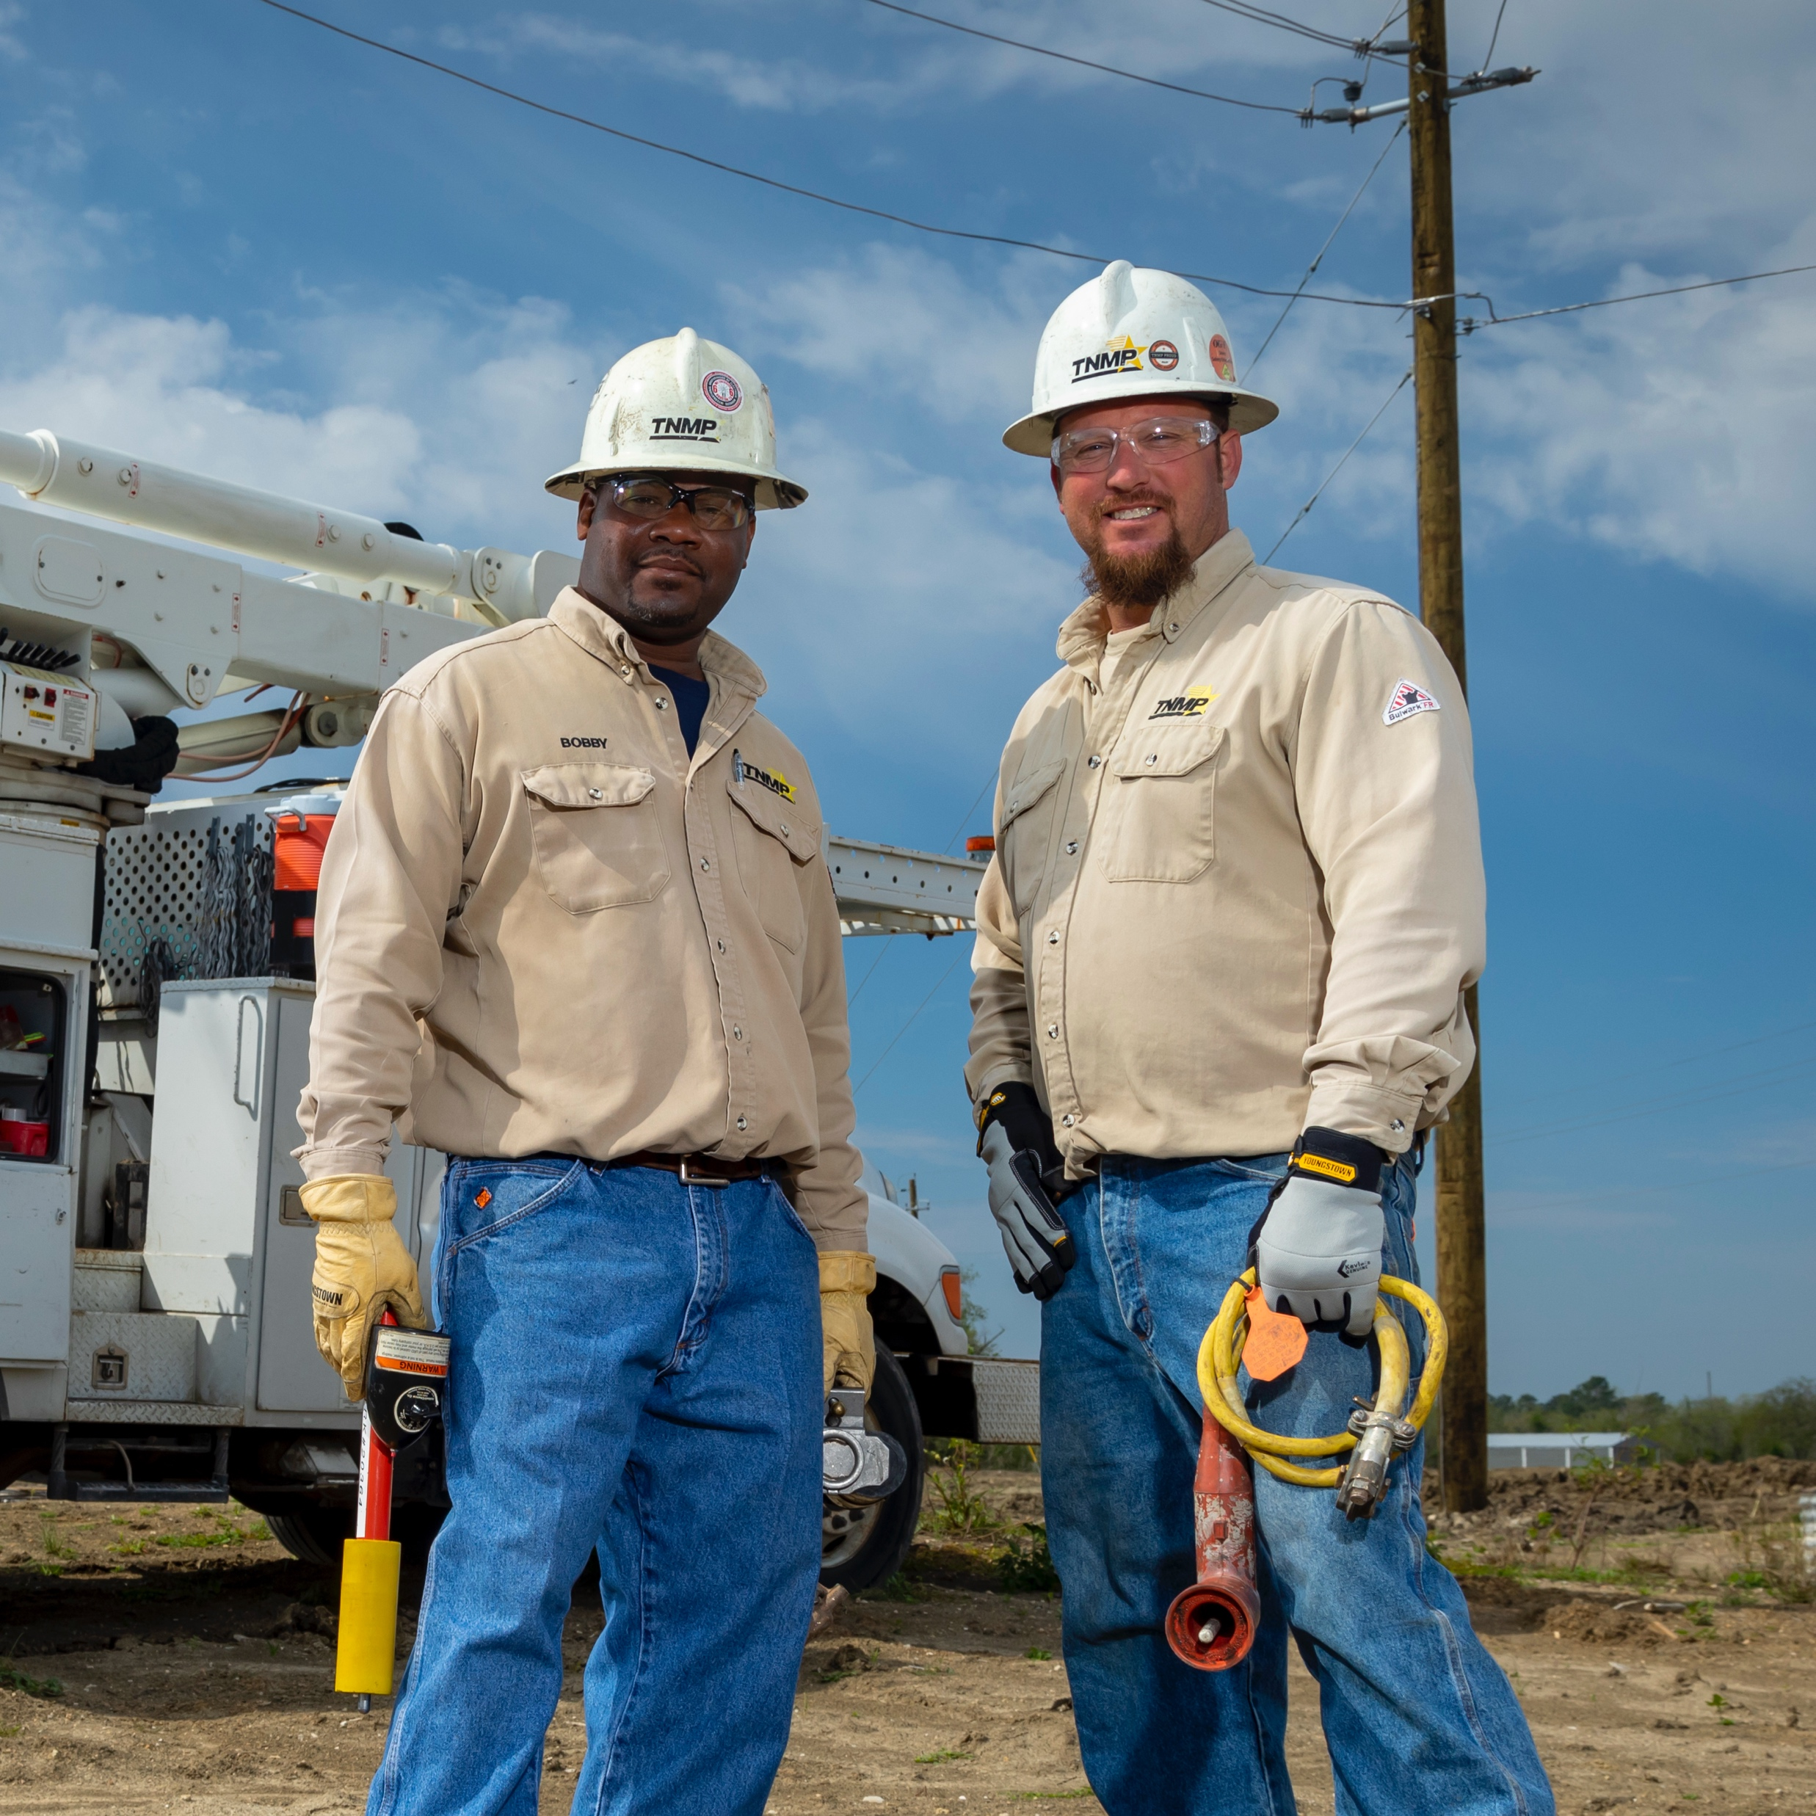
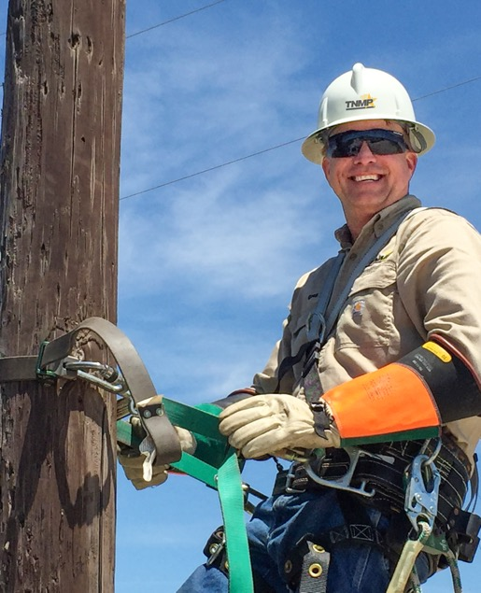


Upcoming TDTMS Meetings
August 4th (w/ TXSET/LP – tentative)
September 21st
October 19th
November 16th
December – no meeting
Thank you

