Slide 1
RMTTF
Tomas Fernandez NRG
Debbie McKeever ONCOR
Melinda Earnest AEP Texas

Slide 2
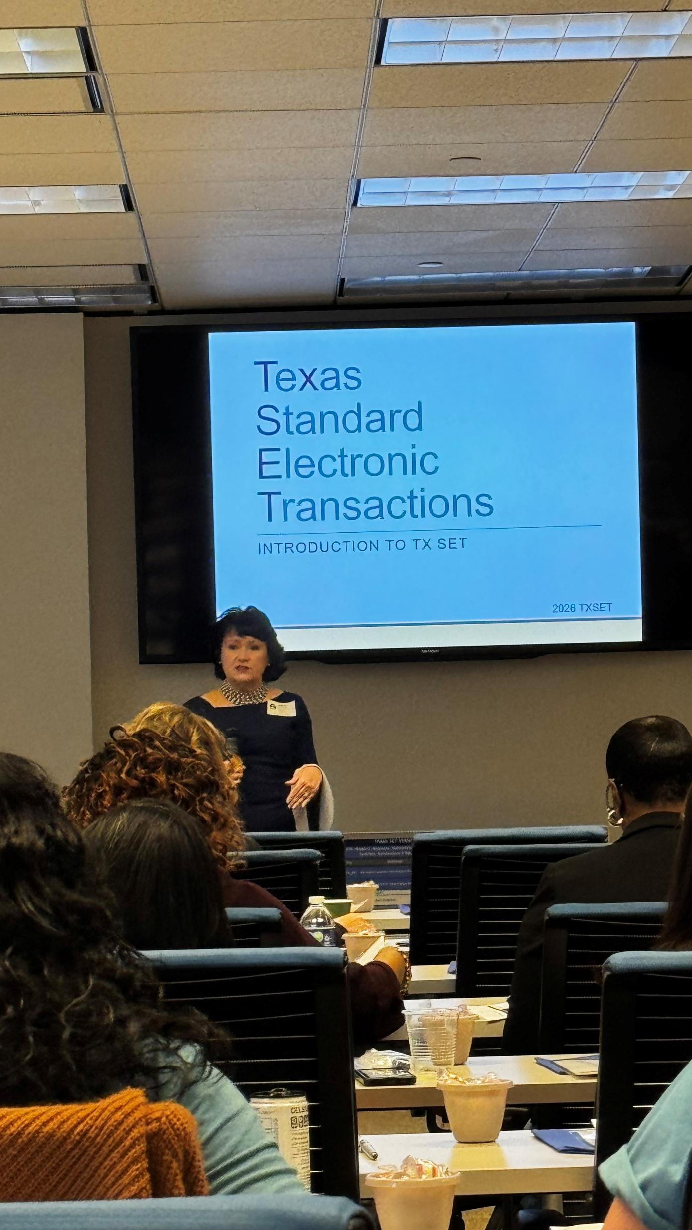
Recent Trainings Held
MarkeTrak Part 1
June 3rd
June 4th
TxSet 5.0 (June 11th) – WebEx
June 11th
WebEx
MarkeTrak Part 2
WebEx
Over 35 Market Participants
8am to 12pm
8am to 12pm
WebEx
Over 35 Market Participants
Over 35 Market Participants
Survey Results to Come…

Slide 3
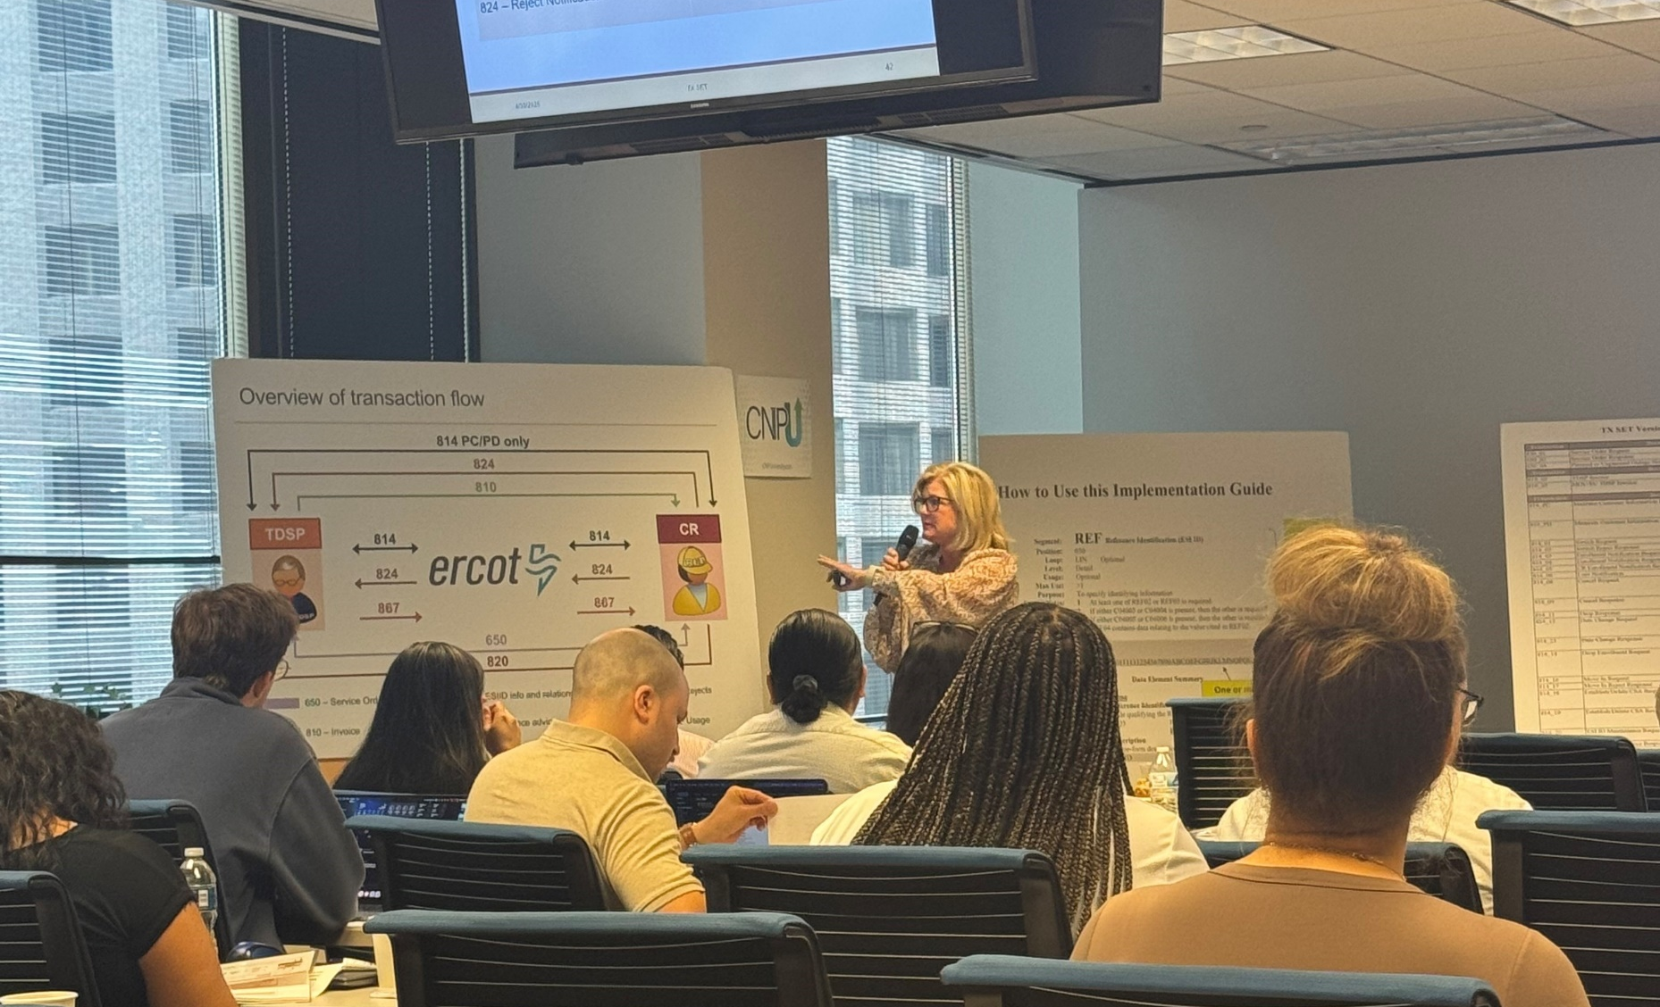
Upcoming Retail Training Opportunities
Retail 101
Wednesday, July 15th – WebEx only
  Open for registration on ERCOT.com
    Retail 101
TX SET 5.0 Training - WebEx
Thursday, September 17th – WebEx only
  Open for registration on ERCOT.com
    Texas SET Standard Electronic Transactions

Slide 4

On-Demand ERCOT Retail Training Modules Available 24/7
    MarkeTrak Online Training Modules -
      MarkeTraks Overview
      Switch Hold Removal
      Cancel With/Without Approvals
      Inadvertent Gains/Losses & Rescissions
      Usage and Billing
      Other D2D Subtypes
      Bulk Insert
      MarkeTrak Admin Functionality
      Data Extract Variances (DEV) LSE Subtypes
      Data Extract Variances (DEV) Non-LSE Subtypes
      Emails and Notifications
      Reporting – Background & GUI
    Additional Retail Online Training Modules
      Retail 101
      TXSET
      Mass Transition

Slide 5
Upcoming RMTTF Meeting
Thursday, August 6th 9:30 AM
WebEx Only
If you have questions or suggestions for training, please contact one of the RMTTF co-chairs listed below.
Tomas Fernandez, NRG tomas.fernandez@nrg.com
Melinda Earnest, AEP mdearnest@aep.com
Debbie McKeever, Oncor deborah.mckeever@Oncor.com
Thank you!

