Slide 1

RETAIL ELECTRIC MARKET · ERCOT
TEXAS SET/LP
UPDATE
Retail Market Subcommittee
June 25, 2026

Slide 2
UPDATE
ERCOT Updates
LPGRR
Annual Validation Business Update
Flight
TMTP
  ERCOT updated that NPRR is being prepared for the July PRS meeting. ERCOT will notify Texas SET LP leadership once the NPRR has been posted.
Leadership send draft to ERCOT
May 22–29
For language review at RMS
July meeting

Slide 3
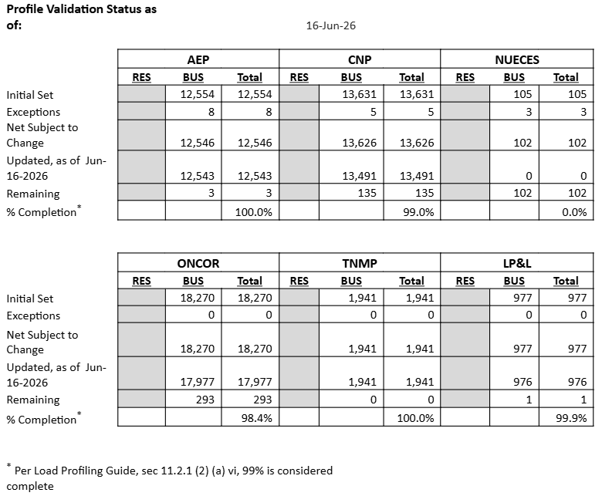
BUSINESS Annual Validation UPDATE
TDSPs are progressing in submitting their BUS profile changes to ERCOT
CenterPoint, AEP & TNMP have completed their updates
ERCOT will be reaching out to Nueces to confirm their status
Oncor is nearly complete
AV is due Sept 30th

Slide 4
Flightrak Workshop
REQUEST
TEXAS SET/LP is requesting a workshop/forum with ERCOT to discuss FlighTrak
REASON
TEXAS SET/LP wants to be clear about what works and does not work well with the FlighTrak tool and wants to provide/suggest requirements to ERCOT in advance of any replacement being selected
WORKING GROUP
Texas SET LP with TDTMS drafted matrix of market participants feedback for improvements to the FlighTrak tool during the June working group meeting

Slide 5

UP NEXT
NEXT MEETING
Tentative August 4 (Possible late July meeting)
9:30am
In-Person & via WebEx

