Slide 1
Annual Distributed Generator Estimate
Thinesh Devadhas Mohanadhas
Principal Engineer, Emerging Technologies
ERCOT
Supply Analysis Working Group (SAWG)
June 26, 2026

Slide 2
ERCOT Estimated Total DG Growth 2015-2025 (MW)
Year | Annual Estimates (MW)
2015 | 650
2016 | 800
2017 | 1050
2018 | 1400
2019 | 1710
2020 | 2180
2021 | 2920
2022 | 3850
2023 | 4770
2024 | 6050
2025 | 7230
Notes:
Major areas of DG growth in ERCOT
Solar PV <1 MW
DGR Energy Storage> 1 MW
Natural gas > 1 MW
Detail for Systems > 1 MW
New applications for Energy Storage/Increased Growth in Distribution connected batteries
Continuation of upward trend for Nat Gas
Limited growth for solar > 1 MW
Declining Landfill Gas, Hydro, Wind
Detail for Systems < 1 MW
Steady Solar PV trend in line with projections
Increased Growth in Distribution connected batteries
Unboxed NPRR 1265 which align with House Bill 3390 (HB 3390) to address DG reporting of Unregistered DG. This NPRR establishes procedures for UDG reporting to ERCOT and UDG reporting requirements from ERCOT. This will help with tracking and reporting UDG in the ERCOT region and aligns to allow the utilities to share information with ERCOT.

Slide 3
Settlement-Only Distribution Generator in ERCOT 2010-2025
SODGs | # Units | MW
Non-Renewable | 375 | 785
Renewable + Storage | 67 | 361
TOTALS | 442 | 1145

Slide 4
NPRR1265 Unregistered Distributed Generator Update
NPRR1265 establishes a definition for Unregistered Distributed Generators (≤1 MW) and introduces new reporting requirements for DSPs and TSPs to support improved system modeling and reliability.
  HB 3390 → Enables ERCOT to collect UDG data via TSPs.
  RTF / NPRR 1265 → UDG Definition
  UDG Workshops → Implementation + Stakeholder Alignment

Slide 5
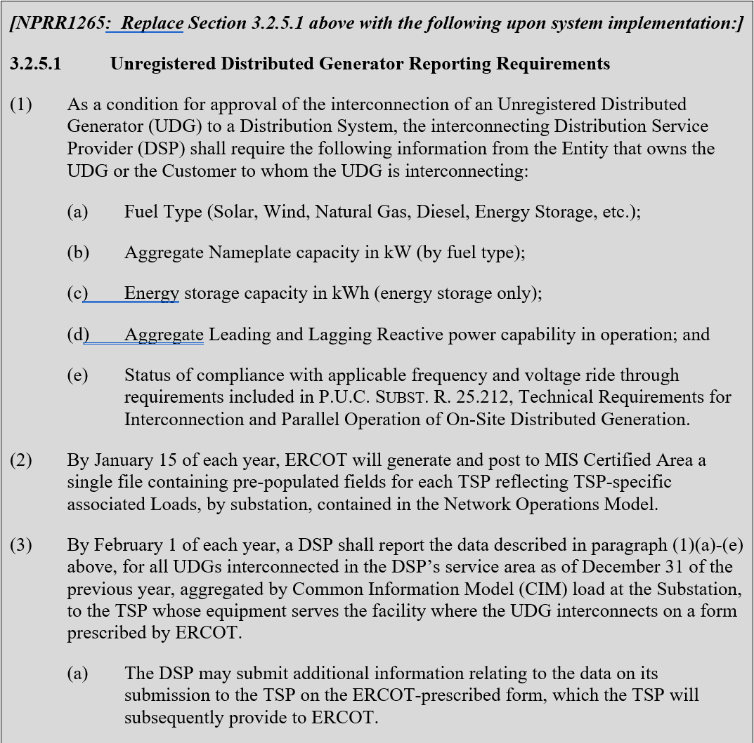
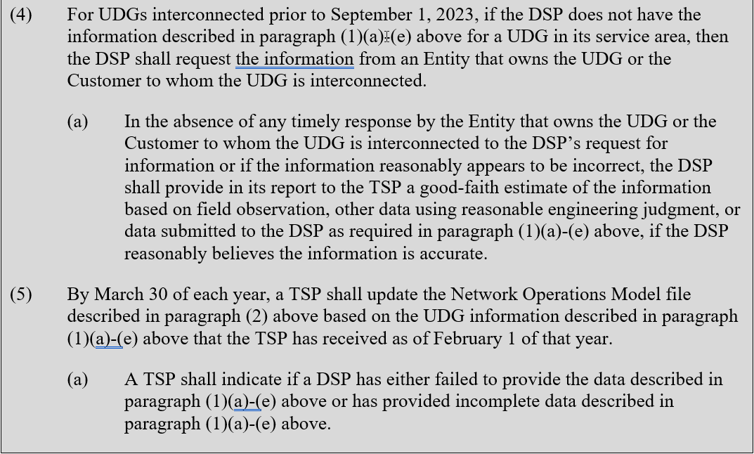
NPRR1265 Language Unboxed on June 1 – Section 3.2.5.1
3.2.5.1 describes the process to collect UDG information from DSPs, pass to TSPs, and provide to ERCOT

Slide 6
Timeline: NPRR1265 Unboxing and Data Collection
Complete – April 30 - UDG Workshop #3
Complete – May 20- Market Notice : Implementation Details of NPRR1265, Unregistered Distributed Generator
Complete - June 1 – Unboxed NPRR1265 items
  Includes 3.2.5.1 Unregistered Distributed Generator Reporting Requirements
Protocol-Driven Dates
  By Jan. 15, 2027 – ERCOT posts pre-populated UDG template to ERCOT MIS
  By Feb 1, 2027 – DSP provides aggregated UDG information to TSP
  By March 30, 2027 – TSP submits updated UDG information to ERCOT
May 1, 2027 – ERCOT posts UDG report
October 2027 – UDG Information in ERCOT Planning Cases
By Jan.15, 2028 – ERCOT posts pre-populated UDG template containing previous year’s response to ERCOT MIS

Slide 7
Next Steps
Download the draft pre-populated UDG template from the ERCOT MIS
  Unregistered Distributed Generator (UDG) Template
Review template and provide feedback at upcoming NDSWG meetings
  NDSWG Schedule Link
Discuss implementation in Planning cases at SSWG meetings
Monitor Market Notices for Updated Templates and Potential Additional Meetings

Slide 8
Thank you!
Thinesh.DevadhasMohanadhas@ercot.com

