Slide 1
Large Load Interconnection Status Update
Large Load Integration Team
June 19, 2026

Slide 2
Notes on the Content of this Presentation
All data presented on the following slides is current as of June 18, 2026 unless otherwise noted.
All charts on the following slides that contain references to Sections 9.4 and 9.5 of the ERCOT Planning Guide also include Large Loads that met the equivalent requirements under the interim Large Load process established in March 2022.
Since the May update, ERCOT has been reviewing the LLIS data in preparation for Batch Zero. This resulted in some LLI tickets being identified as cancelled or duplicate. These tickets were removed. Additionally, some tickets representing multiple stages of the same load request being combined into a single LLI number.
  These changes are reflected on the subsequent graphs.
  The decrease in 9.4/9.5 approved load between May and June on slide 6 is a result of the removal of duplicate tickets.
This month’s update also adds a table to the Batch Zero status data on slide 17.

Slide 3
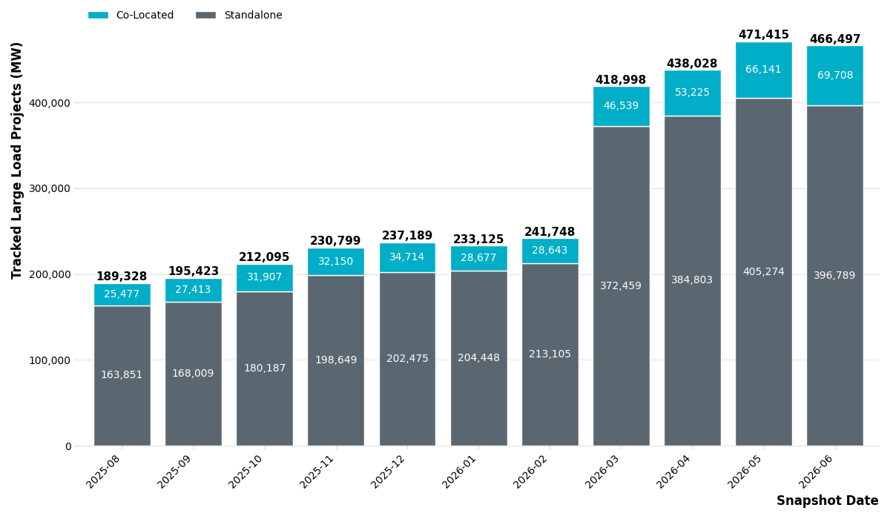
Large Load Queue – Past 12 Months

Slide 4
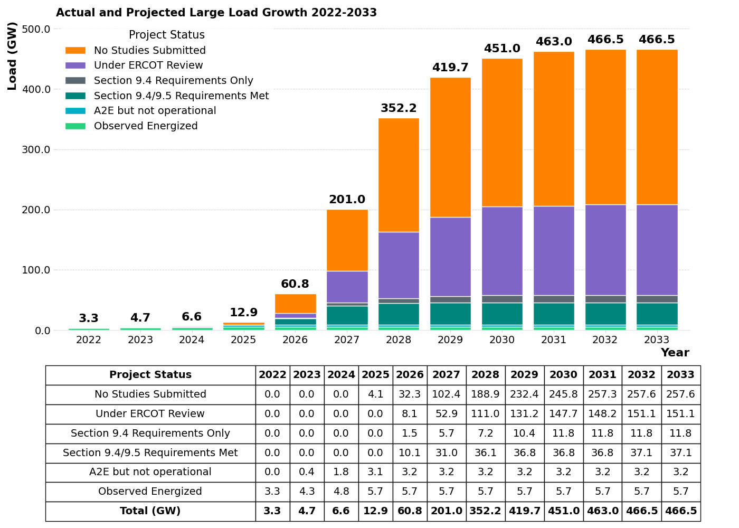
Status of Current LLIS Requests
No Studies Submitted – Projects that are tracked by ERCOT but that have not yet met the requirements to start the study kick-off process under Section 9.3.2 of the Planning Guide.
Under ERCOT Review – Projects that have are in the study process described in Section 9.3.3 of the Planning Guide.
Section 9.4 Requirements Only – Projects that have completed all required elements of the LLIS as described in Section 9.4 but have not yet met the commitment criteria in Section 9.5. These projects are subject to restudy in the event a material change impacting study assumptions occurs before the requirements of Section 9.5 are met.
Section 9.4/9.5 Requirements Met – Projects that have completed all required elements of the LLIS as described in Section 9.4 and met the commitment criteria in Section 9.5.
Approved to Energized but Not Operational – MWs that have received Approval to Energize from ERCOT Operations but are not yet observed to be operational.
Observed Energized – MWs that have received Approval to Energize from ERCOT Operations and are observed to be operational. Represented by all time non-simultaneous peak load consumption.

Slide 5
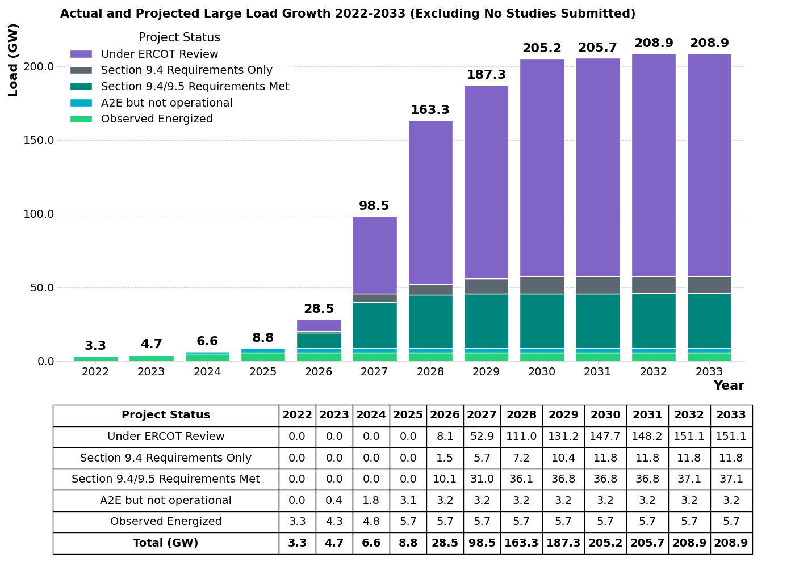
Status of Current LLIS Requests with Studies In Progress or Complete
Under ERCOT Review – Projects that have are in the study process described in Section 9.3.3 of the Planning Guide.
Section 9.4 Requirements Only – Projects that have completed all required elements of the LLIS as described in Section 9.4 but have not yet met the commitment criteria in Section 9.5. These projects are subject to restudy in the event a material change impacting study assumptions occurs before the requirements of Section 9.5 are met.
Section 9.4/9.5 Requirements Met – Projects that have completed all required elements of the LLIS as described in Section 9.4 and met the commitment criteria in Section 9.5.
Approved to Energized but Not Operational – MWs that have received Approval to Energize from ERCOT Operations but are not yet observed to be operational.
Observed Energized – MWs that have received Approval to Energize from ERCOT Operations and are observed to be operational. Represented by all time non-simultaneous peak load consumption.

Slide 6
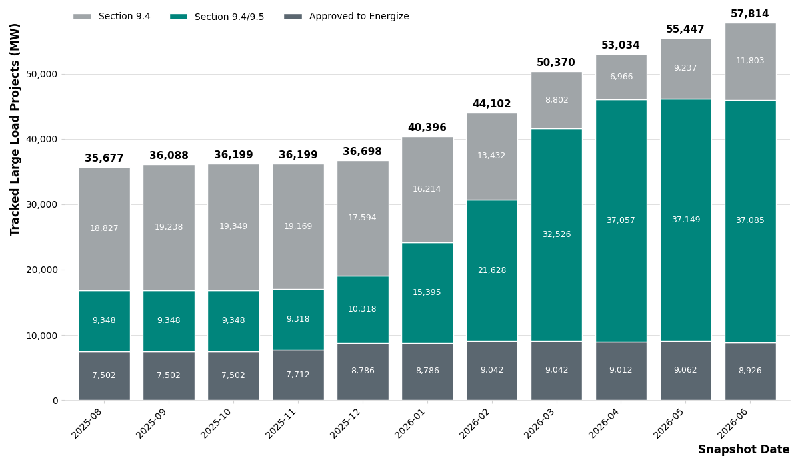
ERCOT Approvals – Past 12 Months

Slide 7
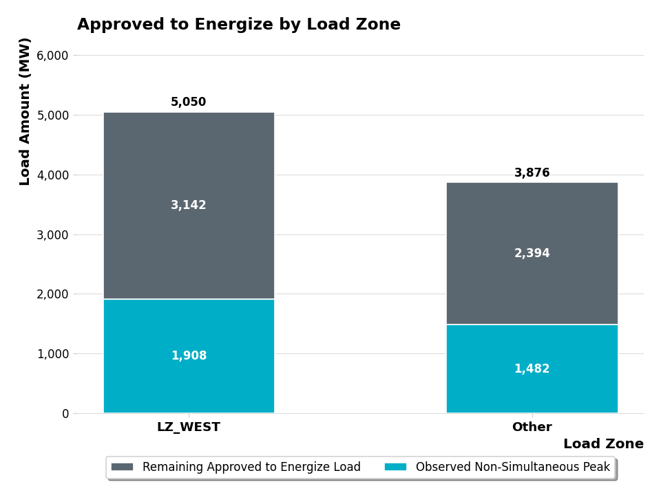
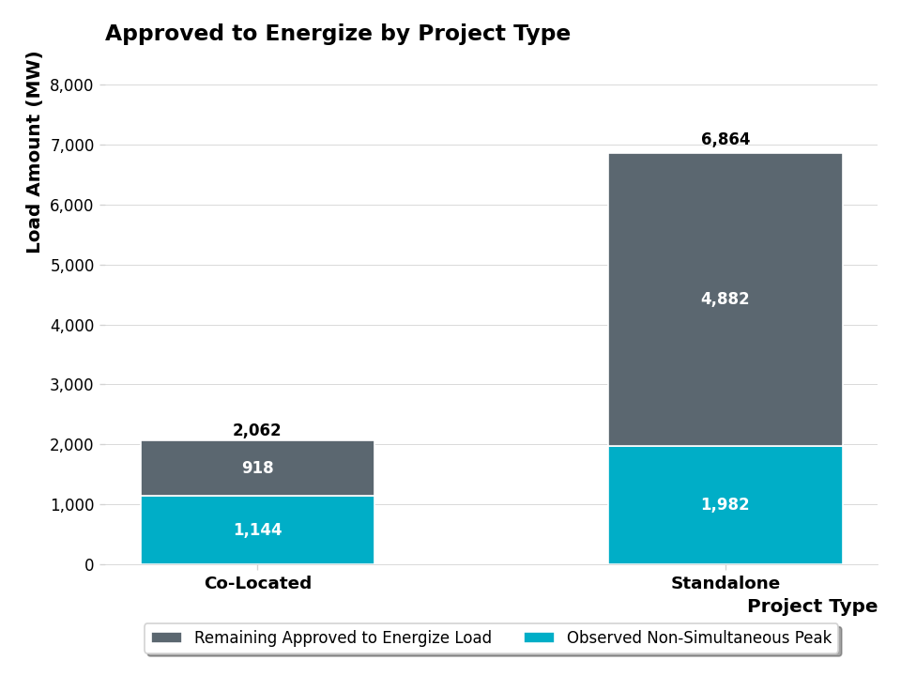
Loads Approved to Energize – By Zone & Project Type

Slide 8
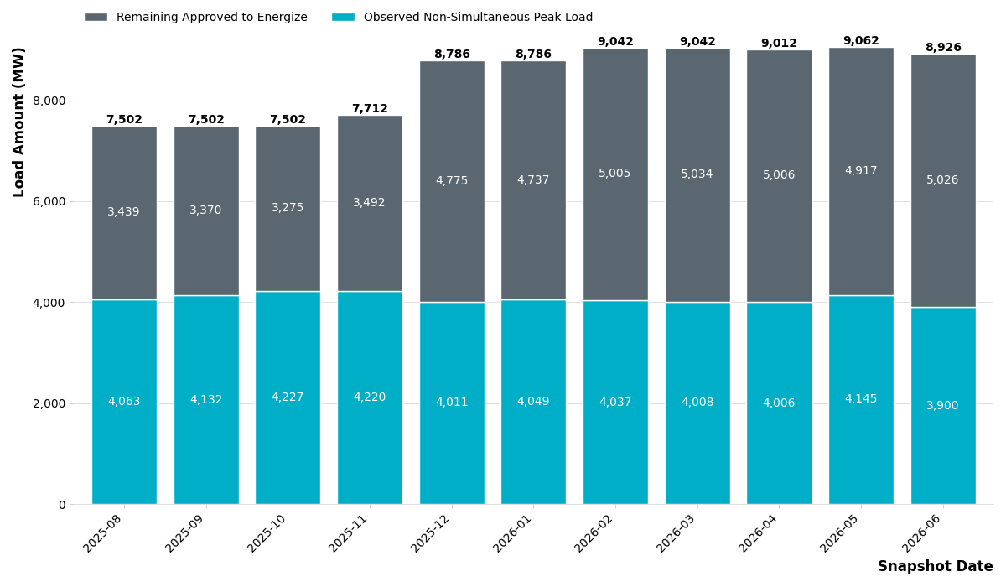
Loads Approved to Energize – Observations 1
Of the 8927 MW that have received Approval to Energize, ERCOT has observed a non-simultaneous monthly peak consumption of 3900 MW in June 2026 which is a slight decrease since May 2026.
  This is calculated as the sum of the maximum value for each individual load per month
  This value represents how much approved load ERCOT believes is now operational

Slide 9
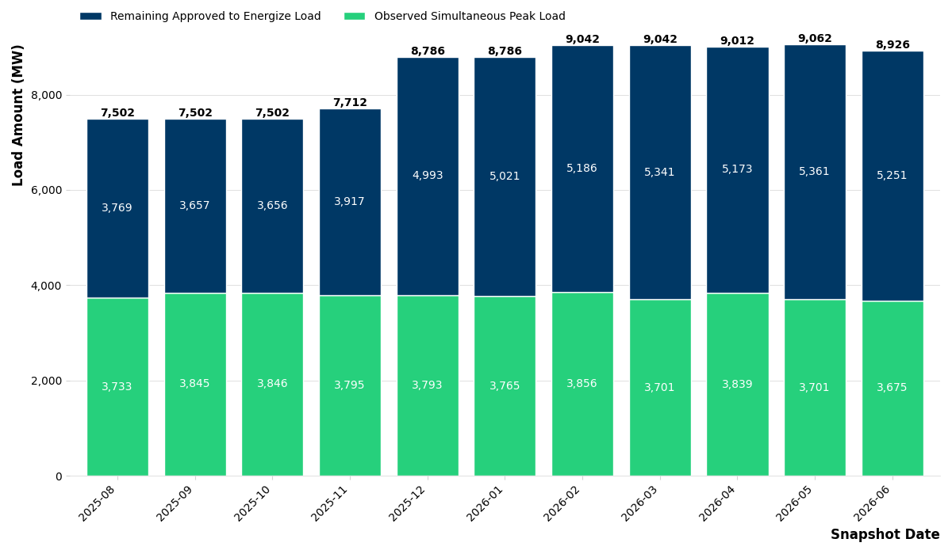
Loads Approved to Energize – Observations 2
ERCOT has observed a simultaneous monthly peak consumption of 3675 MW in June 2026 which is a slight decrease since May 2026.
  This is the maximum value of the sum of all the individual loads per month
  This value is the maximum amount of large load that ERCOT has had to serve at a single point in time

Slide 10
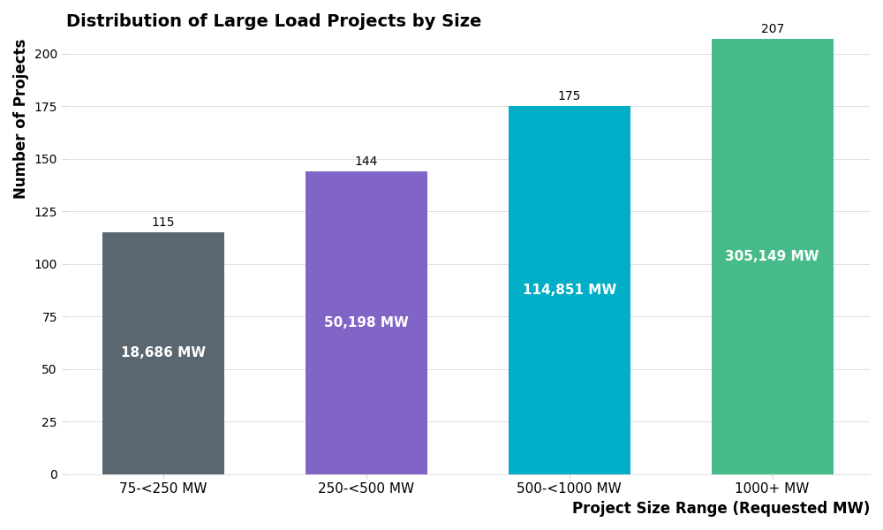
Large Load Project Distribution - Size

Slide 11
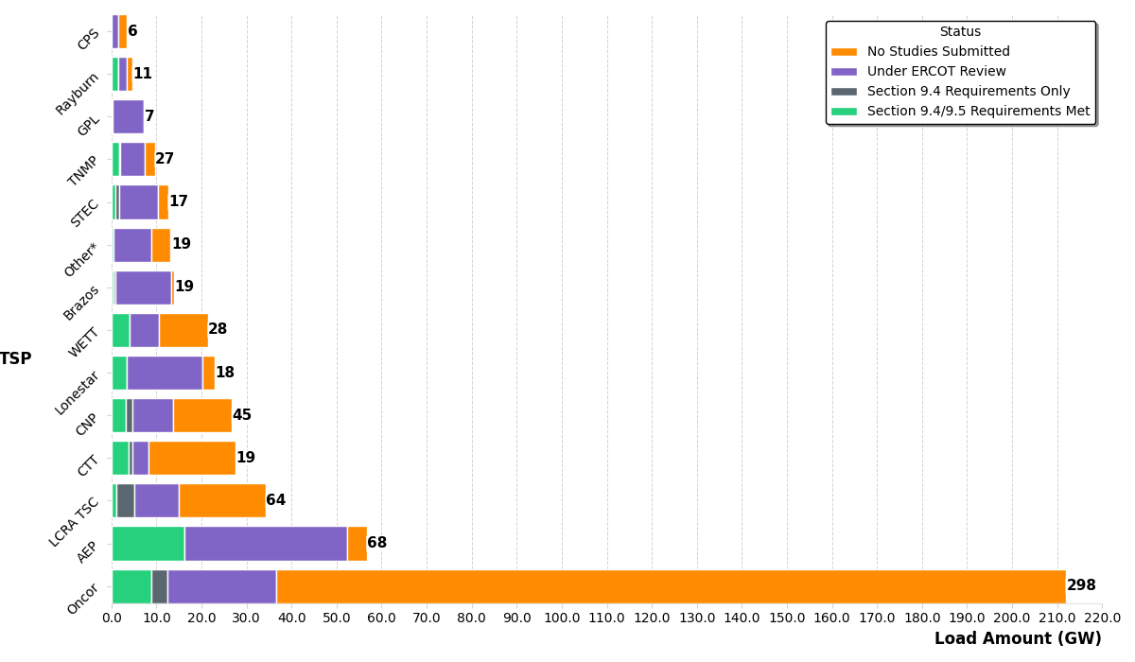
Large Load Project Distribution - TSP

Slide 12
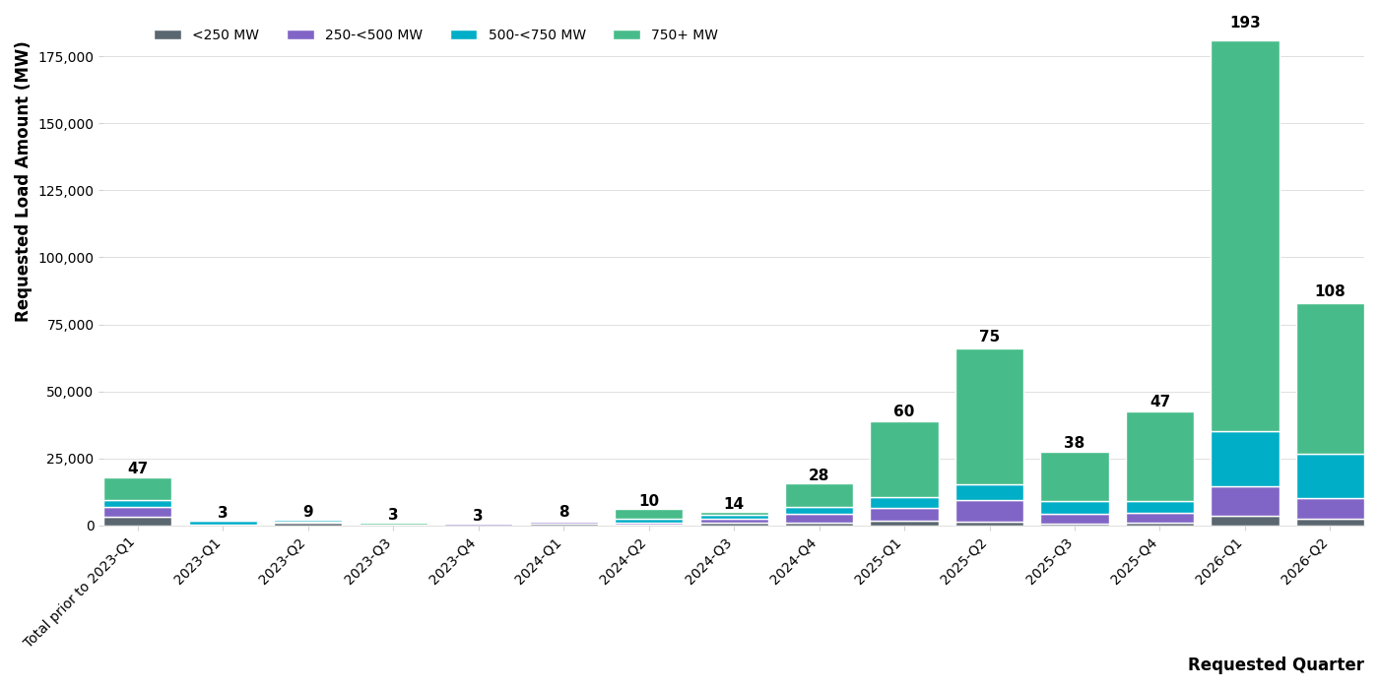
Large Load Project Submittal Date

Slide 13
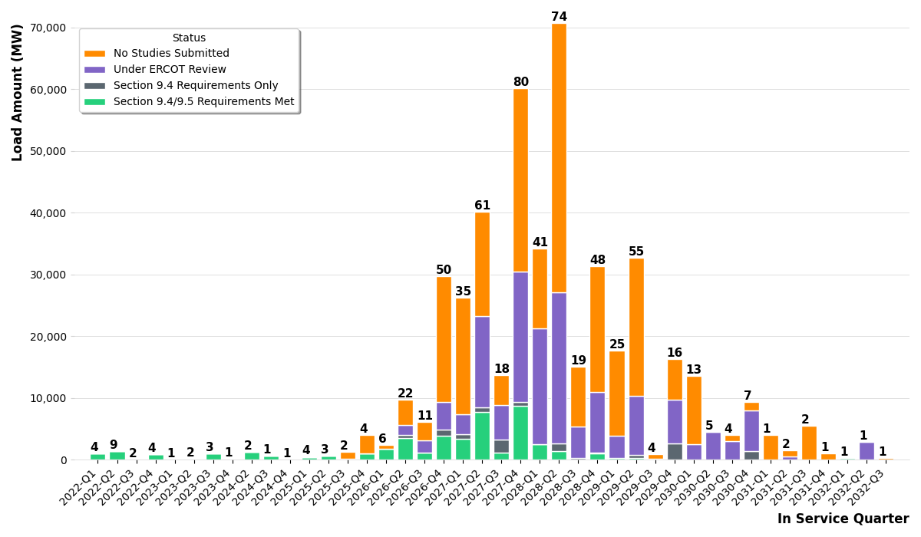
Large Load Project In Service Date

Slide 14
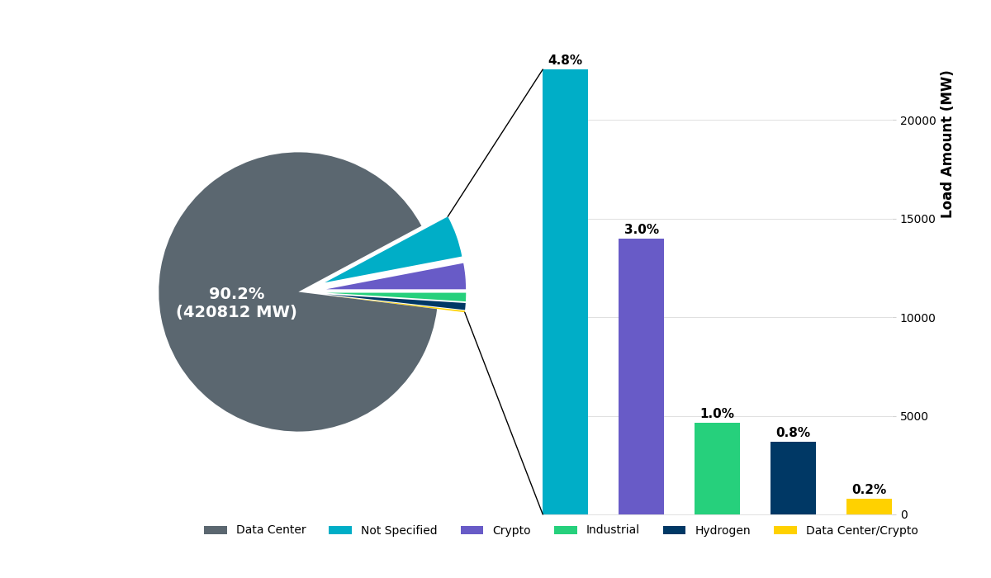
Large Load Project Distribution by Type

Slide 15
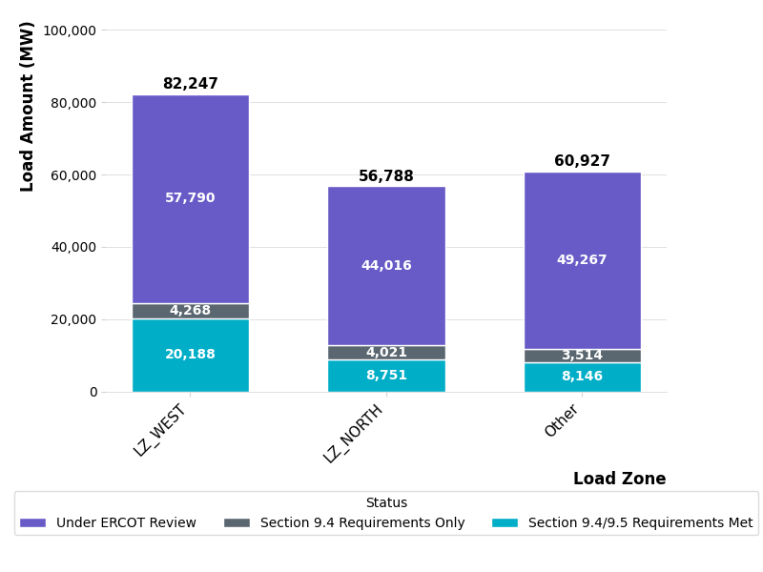
Large Load Project Distribution by Load Zone

Slide 16
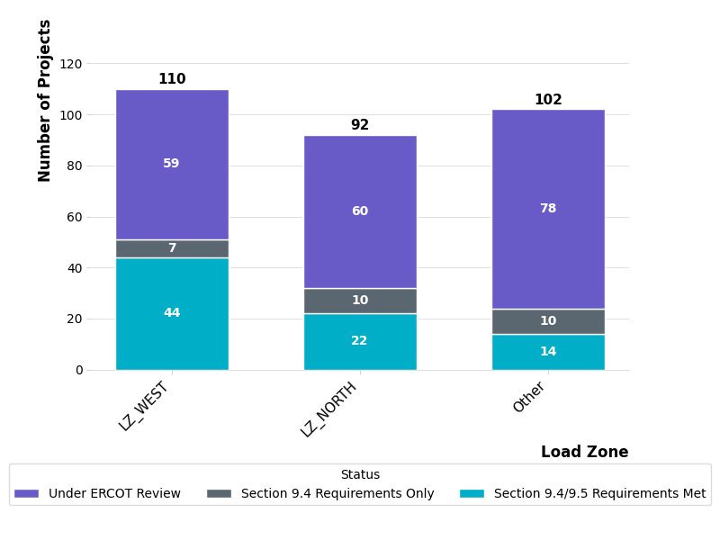
Large Load Project Distribution by Load Zone

Slide 17
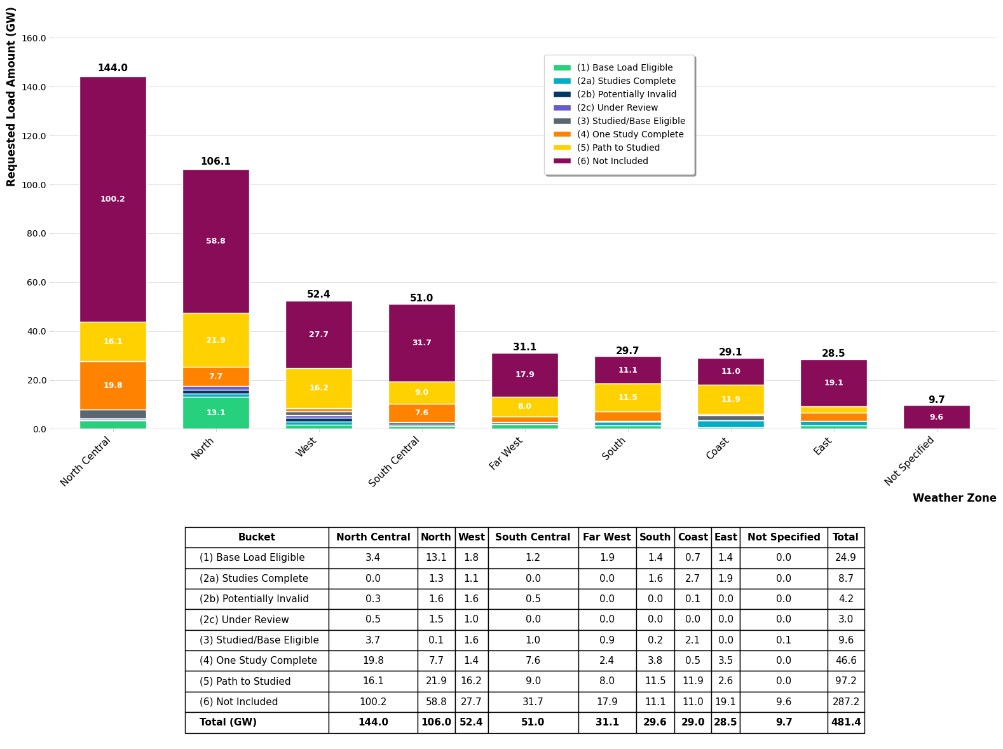
Batch Zero Tracking by Weather Zone (GWs)
Validated
Validated
Note: loads with validated studies (bucket 2a) are also eligible for inclusion as base load
Generated on 6-2-2026

Slide 18
Questions/Comments?
LargeLoadInterconnection@ercot.com

