Slide 1
Project Update
Troy Anderson
ERCOT Portfolio Management
June 10, 2026
Outline:
Recent / Upcoming Project Highlights
2026 Release Targets
Other Project Updates
Priority / Rank Recommendations
Technology Working Group (TWG)
Aging Revision Request Prioritization
Key Takeaways
Monthly project status update for ERCOT Portfolio Management presented to PRS on June 10, 2026
Covers 2026 release highlights, project updates, priority/rank recommendations, TWG update, and project planning

Slide 2
Project Update Agenda
Recent / Upcoming Project Highlights
2026 Release Targets
Other Project Updates
Priority/Rank Recommendations for Revision Requests with Impacts
    NPRR1292 – Granular Product Type for CRR TOU
Technology Working Group (TWG)
  Next meeting is 6/18/2026
Aging Revision Request Review and Prioritization
Location of Revision Request Project Information: http://www.ercot.com/services/projects
Notes:
Delete this slide before presenting

Slide 3
Recent / Upcoming Project Highlights
2026 June Off-Cycle Release – 6/1/2026 Complete
  NPRR1265 – Unregistered Distributed Generator
  OBDRR055 – Revisions to Non-Spinning Reserve Deployment and Recall Procedure for RTC+B
2026 June Off-Cycle Release – 6/18/2026 In Flight
  SCR820 – Operator Real-Time Messaging During Emergency
    Deploying to Production for testing over the coming months
    NPRR in progress to allow Control Room to use the tool in addition to the Hotline call
    Go-live to occur in 2027 when the NPRR is approved
2026 June Release – 6/24/2026-6/25/2026 In Flight
  7 data products added to ERCOT Data Portal for public API access
    See 6/3/2026 market notice for details
    Additional market-facing changes will be delivered over the remaining releases in 2026
Note: Projected Go-Live dates are subject to change.
Please watch for market notices as the effective dates approach.

Slide 4
2026 Release Targets - Approved NPRRs / SCRs / xGRRs
R1
R3
R5
January 1/28-1/29 | February 2/25-2/26 | March 3/25-3/26 | April 4/29-4/30 | May 5/27-5/28 | June 6/24-6/25
NPRR1234(c) PGRR131 NPRR1283 NPRR1285 NPRR1299 | NPRR1266 NPRR1277 | NPRR1287 Add’l Public Data Products in ERCOT Data Portal | CRR Historical Data Removal | NPRR1265 OBDRR055 | SCR820
R2
R4
R6
ü
ü
ü
ü
ü
ü
ü
E
4/24
1/1
ü
ü
3/1
ü
6/1
ü
ü
2/1
3/2
SCR820 TO/QSE Testing (see TWG meetings)
Cipher Security Upgrades (see TWG meetings)
RTC+B Stabilization
R7
R9
1281 moved to R9
July 7/29-7/30 | August 8/26-8/27 | September 9/30-10/1 | October 10/28-10/29 |  | December 12/16-12/17
DPC Automation | NPRR1290 NPRR1323 | NPRR1198 NPRR1303 | NPRR1281 |  | NPRR936 NPRR1201 NPRR1288
R8
R10
R11
E
P
P
NS
E
P
P
NS
P
Go-live dates can differ from Protocol effective dates – Please refer to market notices for more details
APPENDIX
Red Text: New additions and target release changes
Strike-Through Text: Previous target release
(a), (b), etc.: Multiple phase release
Project Status Codes
NS = Not Started
I = Initiation
P = Planning
E = Execution
H = On Hold
NPRR1234(c) – RIOO changes for End-Use
Industry Classification to Loads
Release targets are subject to change

Slide 5
Other Project Updates
NPRR1188 – Implement Nodal Dispatch and Energy Settlement for Controllable Load Resources – and – NPRR1244 – Clarification of Controllable Load Resource Primary Frequency Response Responsibilities
  Go-live target = 2027 R1 (January)
NPRR1238 – Voluntary Registration of Loads with Curtailable Load Capabilities
  Part of Large Load Curtailment Manager project (Initiated February 2026)
  Targeting partial implementation by summer 2026, full scope by end of 2026
  NPRR1238 portion expected to go-live late in 2026
PGRR145 – Batch Zero Process for Large Load Interconnections
  Approved by Board last week – pending PUCT approval
  $300k-$400k project to implement PCLR functionality in 2027
  Project to deliver NPRR1188 and NPRR1244 is in Execution with a target delivery of January 2027
    This project is foundational for PCLR
    Development for several systems is well underway

Slide 6
Priority / Rank Recommendations for Revision Requests with Impacts
Recommendations for…
Revision Request | Description | Priority | Rank | Comments
NPRR1292 | Granular Product Type for CRR TOU | 2027 | 4930 | $1.2M-$1.6M, 12-18 months Impacted Systems: CRR, S&B, CMM, Reporting Candidate to be bundled with NPRR1338
NPRR1326 | Add Energy Storage Resource (ESR) State of Charge (SOC) Information to the Ancillary Services Capacity Monitor | TBD | TBD | One more month needed to complete IA
NPRR1329 | Resource Entity Requirements for Self-Limiting Facilities | TBD | TBD | One more month needed to complete IA
PPL Rank Information
Next 2026 Rank in Business Strategy = 4830 Next 2029 Rank in Business Strategy = 5300
Next 2027 Rank in Business Strategy = 4930 Next Rank in Regulatory = 450
Next 2028 Rank in Business Strategy = 5110

Slide 7
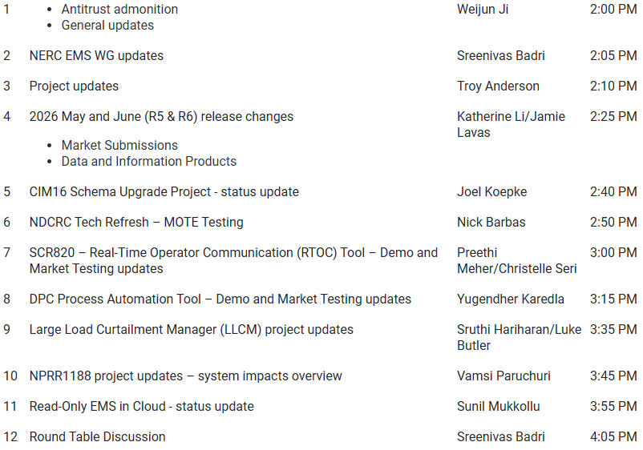
Technology Working Group (TWG) - 5/21/2026 Meeting
Next TWG scheduled for 6/18/2026

Slide 8
2026 Project Planning
ERCOT understands that Market Participants need lead time to implement changes in their systems for many Revision Requests
Approved Revision Request Project Starts
  NPRR936 – CRR Account Holder Limits
  NPRR1188 – Implement Nodal Dispatch and Energy Settlement for Controllable Load Resources
  NPRR1198 – Congestion Mitigation Using Topology Reconfigurations
  NPRR1201 – Limitations on Resettlement Timeline & Default Uplift Exposure Adj
  NPRR1238 – Voluntary Registration of Loads with Curtailable Load Capabilities
  NPRR1244 – Clarification of CLR Primary Frequency Response Responsibilities
  NPRR1277 – Revisions to EAL Formula
  NPRR1281 – Improvements to Alternate FFSS Resource Designation
  NPRR1288 – Remove Multiple Month Transactions in CRR Auctions
  NPRR1290 Phase 2 – Gap Resolutions and Clarifications for RTC+B + NPRR1323
  NPRR1323 – Correction to Inadvertent Removal of Real-Time MCPC Capping for NPRR1290 Phase 2
  SCR829 – API for the NDCRC Application
Revision Request Projects with Starts Delayed to Early 2027
  SCR818 Phase 2 – Changes to Incorporate GIC Modeling Data into Existing Modeling Applications
  SCR831 – Short Circuit Model Integration
Other priority Review Request projects may start in 2026 with a future year Go-Live
  DRRS (NPRR1309), Residential Demand (NPRR1296), Firming (NPRR1328)
Green Text: Deemed “High Priority” at 2025 Prioritization Workshop

Slide 9
Aging Revision Request Project Prioritization Approach
Categorize RRs into “Tiers”
  Tier 1 Critical Must-have items (PUCT/Board directives, etc.)
  Tier 2 High Priority Highest priority after Tier 1
  Tier 3 Medium Priority Fit in without impacting Tier 1 and 2 projects
  Tier 4 No Action Not ready for immediate action
  Tier 5 Candidate for Removal New Revision Request required to strike gray boxes
Important Point
  Some aging RRs are expected to require language changes to bring them up to current market or system constructs
    Language updates would be made with a new RR
    ERCOT suggests this analysis be limited to aging items that are prioritized high enough to be queued for implementation

Slide 10
Aging Revision Request Project Prioritization Approach – Stats
Posted Excel file details
  Retained notes from prior year prioritization discussions
  Updated for latest status
  Column added to capture “ 2026 Tier”
  V2 posted with updates
All 67 items will be reviewed
  Not Started
  On Hold
General approach:
  Review Excel file contents
    Comment on items highlighted in yellow
  Assign Tier to new items
  Determine if any items from last year’s review need to have a revised Tier assigned
  As needed, assign action items for reporting back to PRS in July
Tier | June 2026
1 – Critical | 3
2 – High Priority | 2
3 – Medium Priority | 1
4 – No Action | 9
5 – Candidate for Removal | 2
TBD | 50
Total | 67

Slide 11
Questions/Comments?
Troy.Anderson@ercot.com

