Slide 1
Upcoming RIOO Changes to support Future Repower Project
Prudhvi Gurlinka
Grid and Market Solutions (GMS)
June 18, 2026
Outline:
INR Workflow Enhancement
Operational Substations from RS in the INR Process
Key Milestones
Key Takeaways
MPs will be able to select any operational substation for INR creation and add equipment on top of it after it is deployed into Production on 07/10/2026.
The RIOO changes serve as a foundation for the upcoming Repower project. This project is scheduled for delivery in October of this year, positioning the team for a successful transition and implementation.

Slide 2
INR Workflow Enhancement – RS Substation Selection
IS handles initial Interconnection Requests; RS manages operational equipment via RSCR
Previously, INR only allowed selection of substations created in IS
New Enhancement allows selecting operational substations from RS
RS Substation details auto-populate during INR submission
Users can add new equipment, but cannot modify existing generators(RSCR only)
Repowering and unit modification will be supported with the October release
Notes:
Delete this slide before presenting

Slide 3
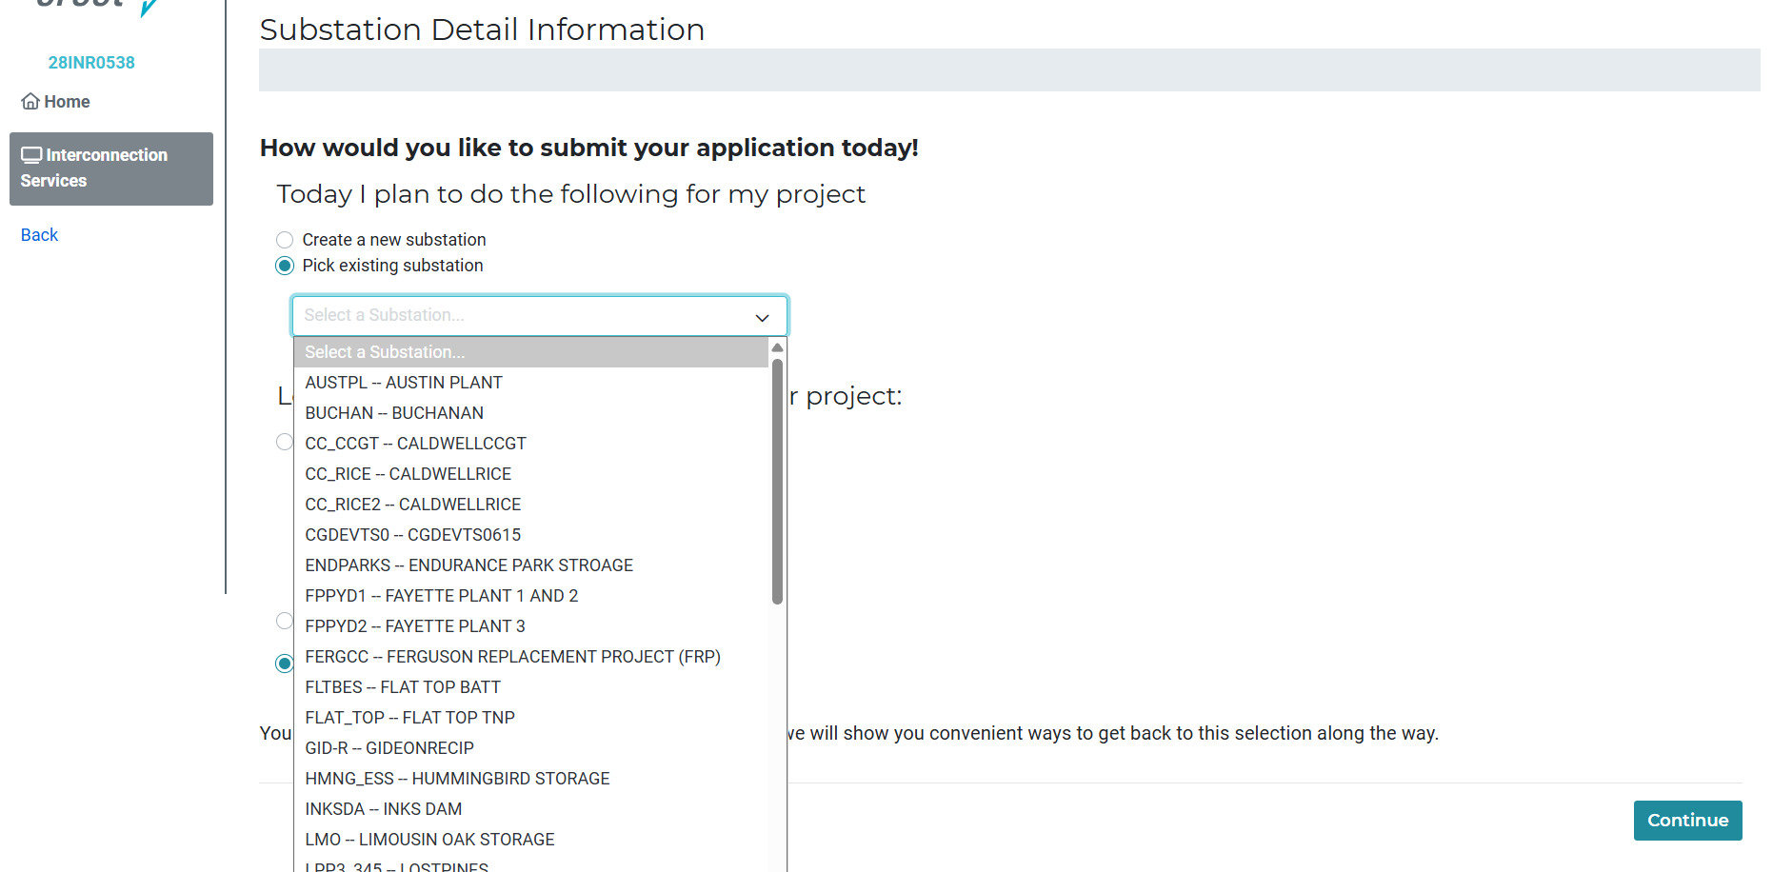
Selecting Operational Substations from RS in the INR Process

Slide 4
RIOO Repower – Key Milestones
Production Deployment Date: 07/10/2026 - Operational substation selection becomes available in INR workflow
October Release: Repower functionality will be delivered

Slide 5
Questions/Comments?
Srinath.Gurlinka@ercot.com
Sreenivas.badri@ercot.com

