Slide 1
QSE ICCP Telemetry Points Modeling Process Automation
Kai Kaur/Kevin McGarrahan
Grid and Market Solutions (GMS)
June 18, 2026
Outline:
Review current process
Review Future Process with Automation
Impacts and Benefits to QSEs
Key Takeaways:
Automates the currently manual QSE ICCP telemetry point modeling process, significantly reducing human errors and processing delays.
Streamlines and standardizes telemetry point modeling through improved workflows and enforced ICCP objects naming conventions.

Slide 2
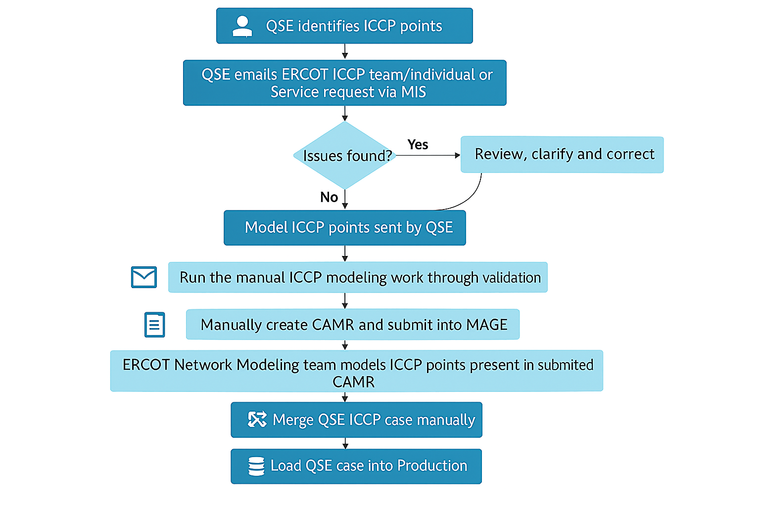
Current QSE ICCP Telemetry Points Modeling Process

Slide 3
Future Process with Automation
ERCOT is evaluating multiple approaches to automate the QSE ICCP telemetry point modeling process and reduce manual effort.
One option under consideration is enabling QSEs to submit telemetry point modeling requests through the Market Participant Service Portal (MPSP).
This solution would:
  Use standardized templates that enforce ICCP object naming conventions
  Reduce modeling errors associated with the current manual email-based process
  Provide direct integration with the Network Model Management System (NMMS/MAGE) for submitting model change requests
Another approach being explored is for ERCOT to directly model QSE telemetry points in the network modeling system and provide the modeled point information to QSEs via the same MPSP platform.
Additional solution paths are also being assessed to determine the most efficient and reliable workflow.
Any selected automation approach will embed QSE ICCP telemetry points into the Full CIM/XML network model. QSE ICCP cases can then be generated automatically from the network model using the EMS CIM Importer during the weekly model load process.
  This will be a shift from the current practice, where telemetry points are manually entered into a local ICCP database and QSE ICCP cases are manually generated from that database.
Note: These concepts are currently under review and discussion. ERCOT will provide updates to QSEs at future TWG meetings as the solution is finalized.
Notes:
Delete this slide before presenting

Slide 4
Impacts and Benefits to Market Participants
QSEs will transition away from the current email-based ICCP telemetry point submission process to a new automated workflow (via MPSP or ERCOT‑modeled process or other automated process).
Standardized ICCP naming conventions ensure consistency and reduce modeling errors.
Eliminates manual errors and improves accuracy of telemetry point ownership and modeling.
Simplifies unit/device transitions from one QSE to another QSE - only permissions need updating instead of remodeling.
Enhances tracking and traceability of telemetry point modeling activities.

Slide 5
QSE Feedback and Timelines
ERCOT will conduct a pilot with selected QSEs to gather feedback.
Implementation Timelines: TBD.

Slide 6
Questions/Comments?
Kai.Kaur@ercot.com
Kevin.McGarrahan@ercot.com
Sandip.Bhattacharya@ercot.com

