Slide 1
ERCOT
Technology Working Group (TWG)
Weijun Ji
Sreenivas Badri
June 18, 2026
Outline:
Antitrust Admonition
Agenda
Sequence of discussion Items

Slide 2
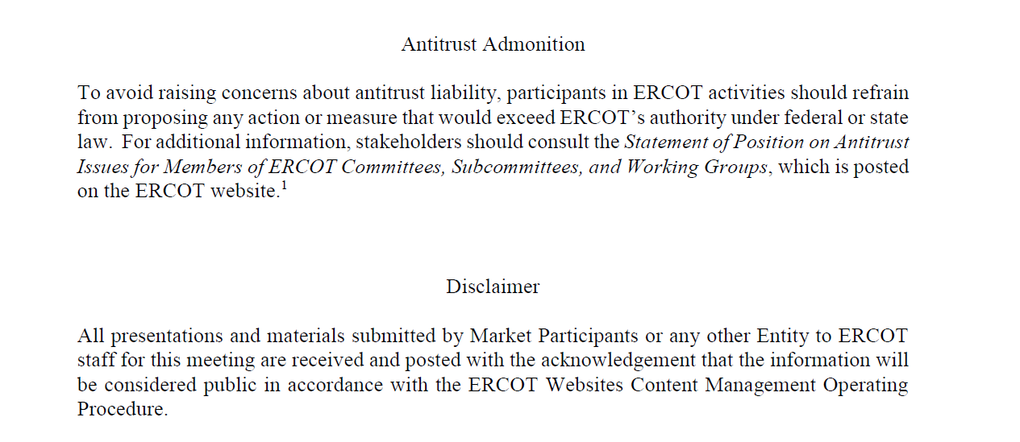
ERCOT TWG

Slide 3
Webex Meeting Reminders
Webex Meeting Reminders - Same as other ERCOT forums
Please keep line muted
If you have a question, please use the Webex chat feature to either:
Type in your question, or
Type in “Question” and wait to be recognized to state question
Your question will be addressed either during the presentation or at the end. If time does not permit, ERCOT SMEs will provide a response through Webex chat before the meeting concludes or respond to you via email after the meeting.
Presenters are requested to complete their presentation within allotted time and give time to participants to ask questions.
The meeting facilitator will provide time checks to remind presenters and participants of the remaining time for each agenda item.

Slide 4
Agenda
Item # | Item Description | Presenter | Start Time
1 | Antitrust admonition General updates | Sreenivas Badri | 2:00 PM
2 | Project updates | Troy Anderson | 2:05 PM
3 | 2026 June and July (R6 & R7) release changes Market and Outage Scheduler Submissions Data and Information Products | Katherine Li Jamie Lavas | 2:20 PM
4 | SCR820 – Real-Time Operator Communication (RTOC) Tool – Market Testing and Timelines updates | Preethi Meher | 2:40 PM
5 | DPC Process Automation Tool updates | Yugendher Karedla | 2:50 PM
6 | Large Load Curtailment Manager (LLCM) project updates | Sruthi Hariharan/Luke Butler | 3:10 PM
7 | Secure API Pilot updates | Brandon Johnson | 3:20 PM
8 | Market Participant Service Portal (MPSP) Update | Amy Loera | 3:30 PM
9 | Upcoming RIOO Changes to Support Future Repower Project | Prudhvi Gurlinka | 3:40 PM
10 | QSE ICCP Telemetry Points Submission Process change – Concept | Kai Kaur/ Kevin McGarrahan | 3:50 PM
11 | Round Table Discussion | Weijun Ji | 4:00 PM
12 | Adjourn | Weijun Ji | 4:10 PM

Slide 5
Project Updates
  Project updates – Troy Anderson

Slide 6
2026 June and July (R6 & R7) Release changes
      Market and Outage Scheduler Submissions – Katherine Li
      Data and Information Products – Jamie Lavas

Slide 7
SCR820 – Real-Time Operator Communications (RTOC) Tool
SCR820 – Real-Time Operator Communication Tool (RTOC) – Market Testing and Timelines updates -
Preethi Meher

Slide 8
DPC Process Automation Project
DPC Process Automation Tool updates - Yugendher Karedla

Slide 9
Large Load Curtailment Manager (LLCM)
Large Load Curtailment Manager (LLCM) Project updates -
Sruthi Hariharan/Luke Butler

Slide 10
Secure API Pilot Updates
        Secure API Pilot Updates – Brandon Johnson

Slide 11
Market Participant Service Portal (MPSP) update
  Market Participant Service Portal (MPSP) update
  – Amy Loera

Slide 12
RIOO Changes
Upcoming RIOO Changes to Support Future Repower Project – Prudhvi Gurlinka

Slide 13
QSE ICCP Telemetry Points Submission Process change – Concept
QSE ICCP Telemetry Points Submission Process change – Concept –
Kai Kaur/ Kevin McGarrahan

Slide 14
ERCOT TWG – Round Table Discussion
ERCOT TWG – Round Table Discussion
  Future Topics of Interest
  Topics and presentations from TWG members

Slide 15
Thank You
Questions/Comments/Feedback?
You can reach Sreenivas at
Sreenivas.Badri@ercot.com and Weijun at weijun.ji@lcra.org

