Slide 1
2026 June & July(R6 & R7) Releases – Market & Outage Scheduler Submission Changes
Katherine Li
Grid and Market Solutions (GMS)
June 18, 2026
Outline:
2026 June (R6) Release
2026 July (R7) Release
Key Takeaways
  No Market facing submission change in June & July (R6 & R7) releases.
  Outage Scheduler submission changes are planned for June (R6) releases.

Slide 2
2026 June (R6) Release – Market and Outage Schedule Submission Changes
2026 June (R6) Release will be deployed into Production on 06/25/2026.
  June (R6) release does not have Market submissions changes planned that may impact Market Participants.
  June (R6) release does have Outage Scheduler submissions changes planned that may impact Market Participants.
2026 June (R7) Release will be deployed into Production on 07/30/2026.
  June (R7) release may not have any Market or Outage Scheduler submission changes planned that may impact Market Participants.

Slide 3
2026 June (R6) Release – Outage Scheduler Submission Changes
Removing some special characters from Warning messages on Outage Scheduler User Interface (OSUI) when “Nature of Work” is unknown
Allowing “Nature of Work” dropdown to be editable when the “Nature of Work” is set to “Other" or “Unknown" during the initial submission for all outage types
Allowing selection of "Other“ or "Uknown" for “Nature of Work” while outage is in Received at Ercot (RatE) status
Providing Resource Planned Outage Limit (RPOL) Warning message when one of the recurrences in a recurrence outage has RPOL violation
Improving warning messages for allowed conflicting outages submission
  warning message will be provided ONLY at the initial submission
  warning messages will not be provided throughout the lifecycle of the outages (including when entering a new Planned End, changing the Planned outage to an Unavoidable Extension, Actual Start Date, or Actual End Date)
Removing some redundant text when issuing warning messages for conflicting outages

Slide 4
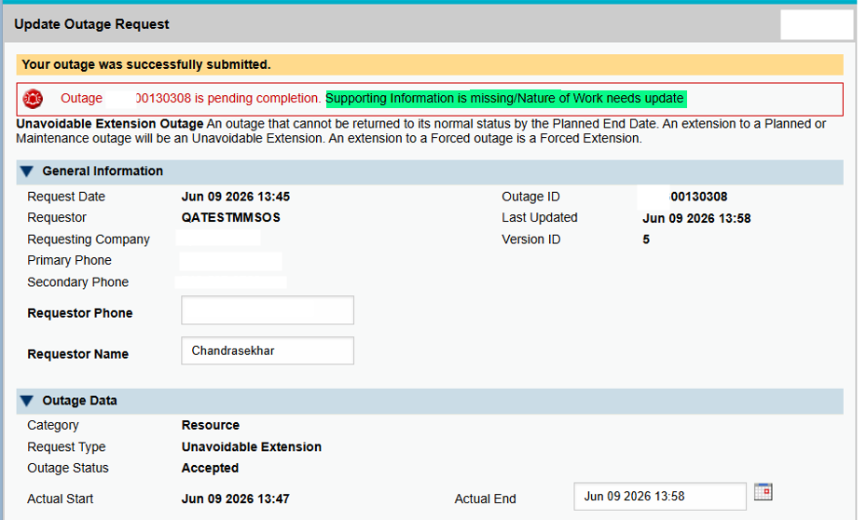
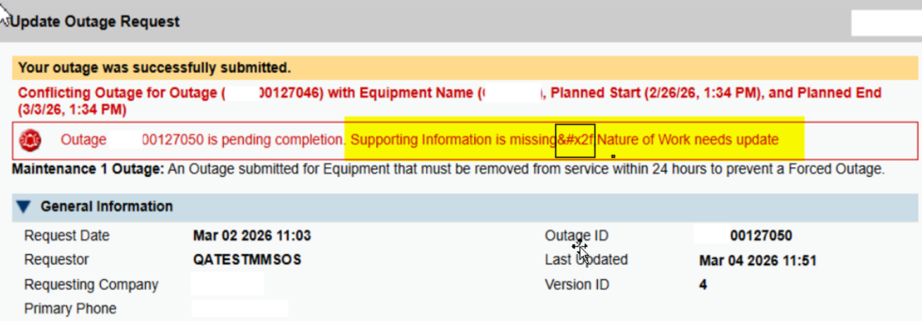
2026 June (R6) Release – Outage Scheduler Submission Changes
Remove special characters from warnings
Without the fix

Slide 5
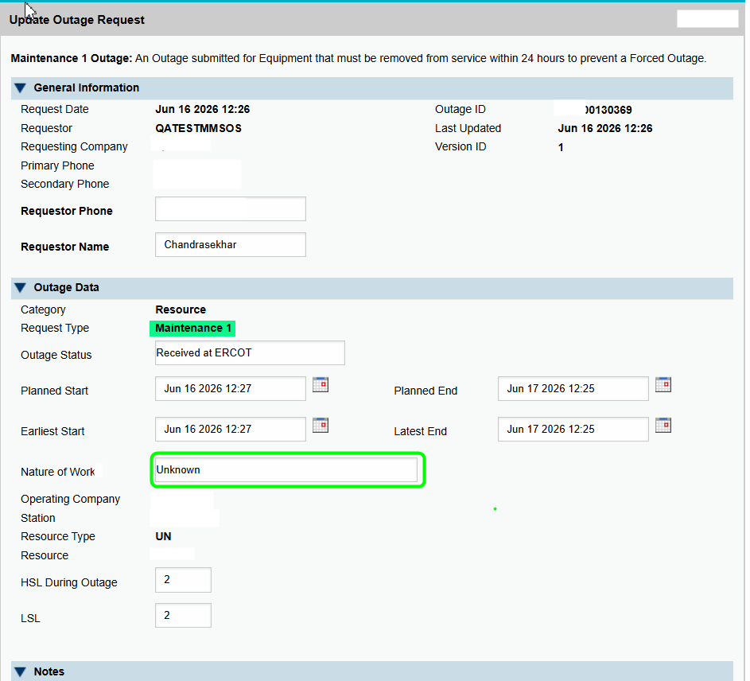
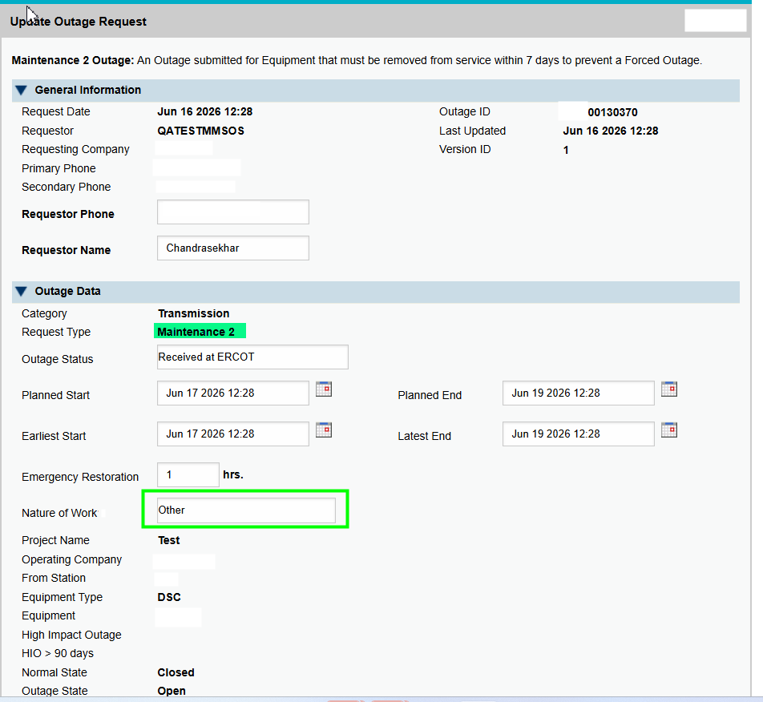
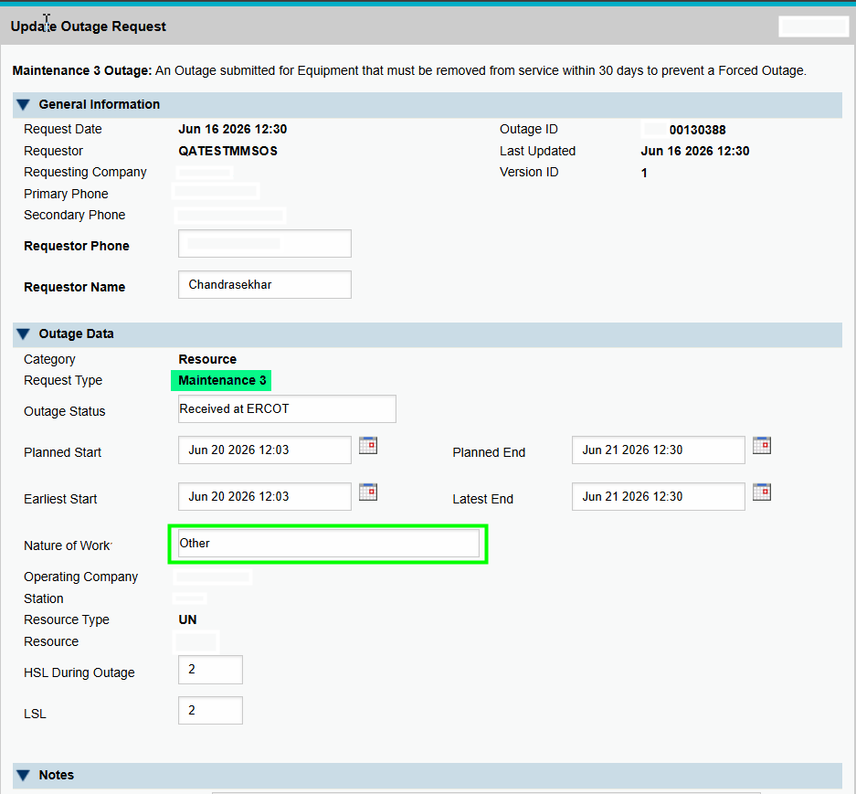
2026 June (R6) Release – Outage Scheduler Submission Changes
Nature of Work can be changed when it is other / unknown, for all outage types

Slide 6
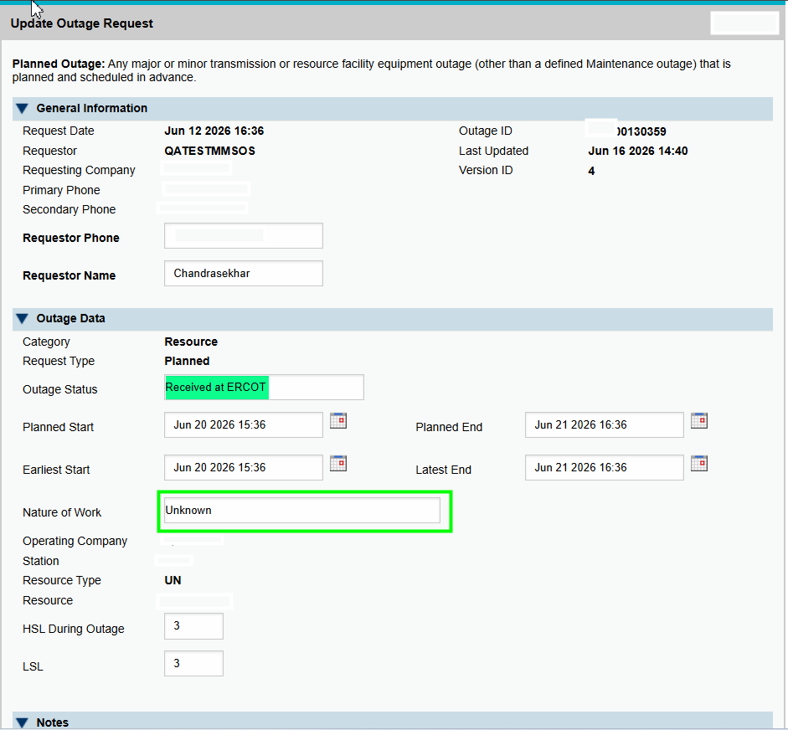
2026 June (R6) Release – Outage Scheduler Submission Changes
Nature of Work can be changed when it is other / unknown, and the outage is in RatE status

Slide 7
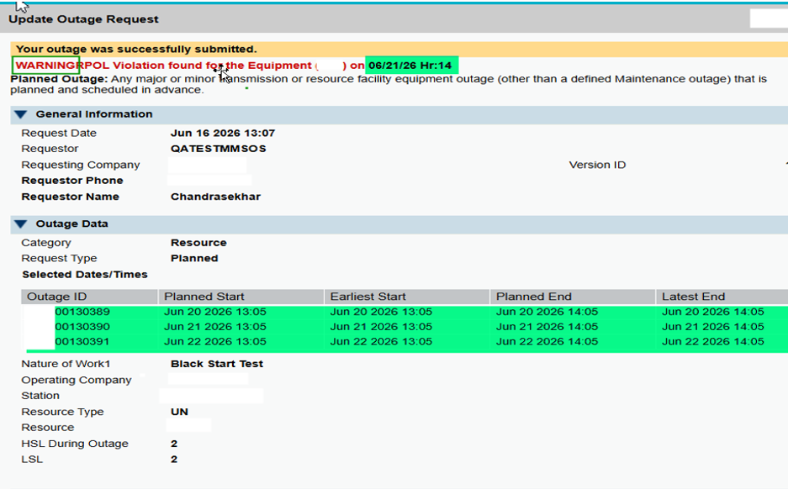
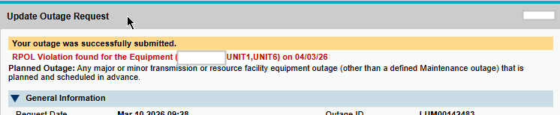
2026 June (R6) Release – Outage Scheduler Submission Changes
Warning Message Improvement – Sample 1
  “WARNING” should be shown at the beginning of the warning message for ROPL violation
Without the fix

Slide 8
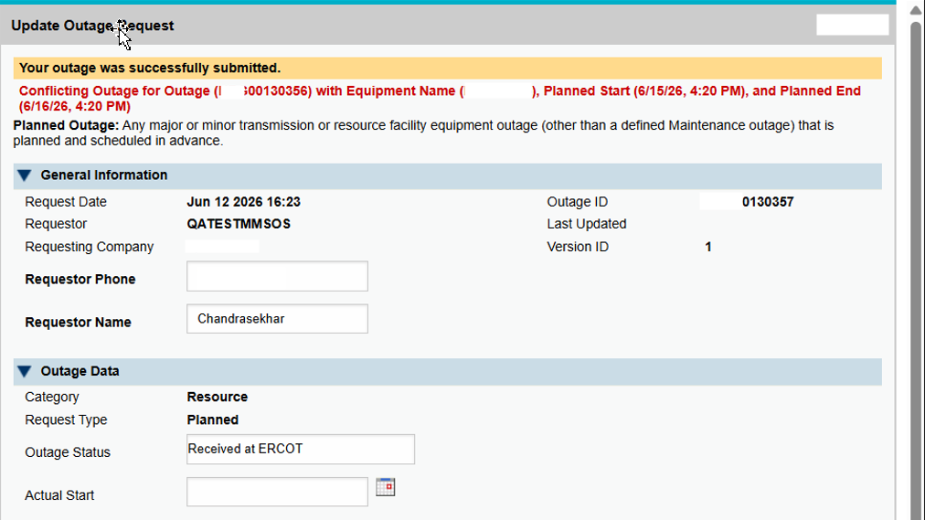
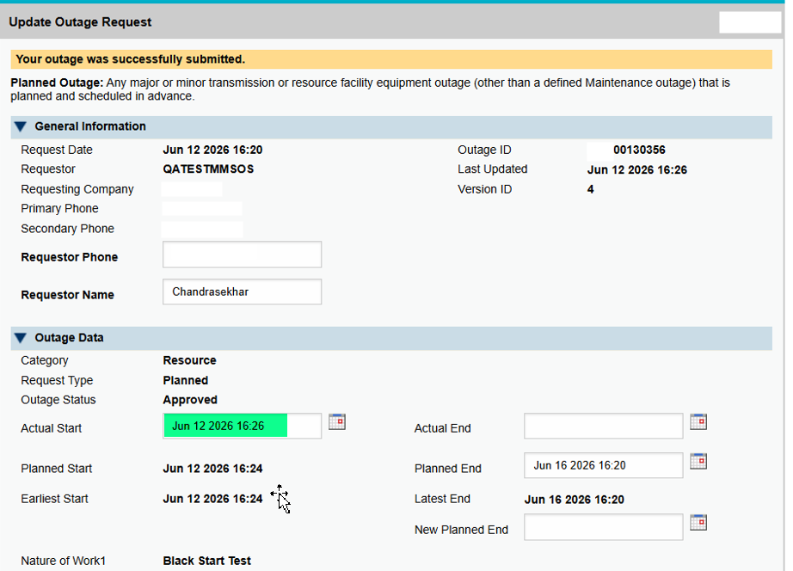
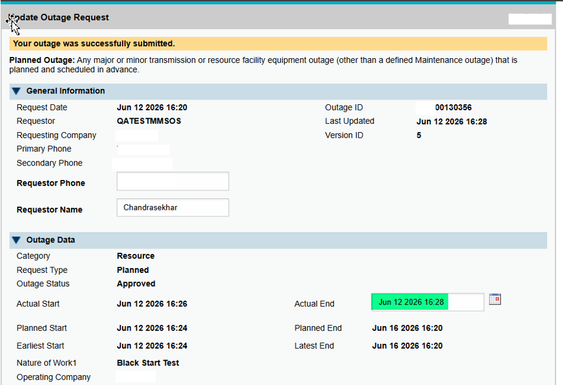
2026 June (R6) Release – Outage Scheduler Submission Changes
Warning Message Improvement – Sample 2
  Conflicting Outages warning is provided at the time of outage submission. They are not
  provided during the life cycle changes of the outage like Actual Start Time update, Actual End Time update etc.…

Slide 9
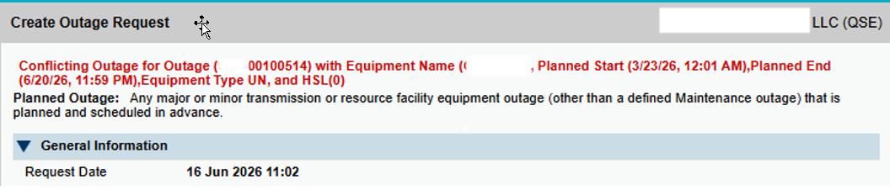
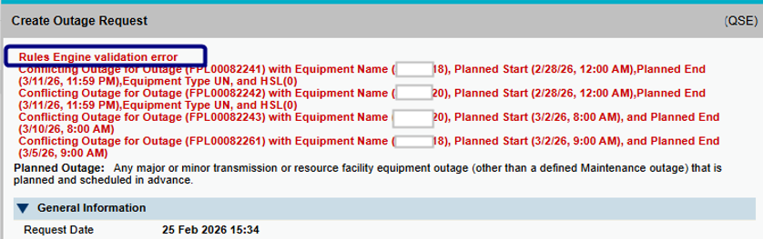
2026 June (R6) Release – Outage Scheduler Submission Changes
Warning Message Improvement – Sample 3
  Removing redundant text
Without the fix

Slide 10
Update on Overlapping Outages Question from April TWG Meeting
Question:
  Will a new outage submission, for example with 8:00-10:00 as start/end time, be considered as 'overlapping' with an approved existing outage of the same equipment with start time = 10:00?
ERCOT Response:
  We have tested and confirmed that an outage with a start/end time of 8:00–10:00 is considered as “overlapping” with an existing approved outage for the same equipment that begins at 10:00.
  This behavior is part of the current system design from the beginning, and the OS Enhancements project did not introduce any changes related to this logic.
  We have discussed the possibility of enhancing this functionality. However, such a change would not be minor. It would impact both TSPs and QSEs and would require extensive testing by ERCOT and Market Participants.

Slide 11
Questions/Comments?
Katherine.Li@ercot.com
Sreenivas.Badri@ercot.com

