Slide 1
ERCOT Frequency Events
May 2026
ERCOT
Operations Planning
PDCWG Meeting
June 17, 2026

Slide 2
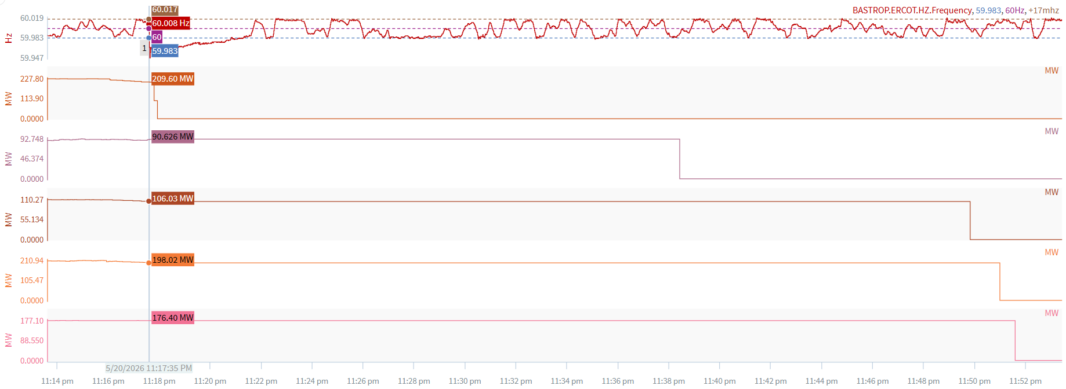
5/20/2026 23:17:35 (FME)
Notes:
Multiple units tripped offline for a total of ~780 MW
Starting Frequency: 60.008 Hz
Minimum Frequency: 59.948 Hz
A-C Time : 3 seconds
Recovery Time(back to deadband): 3 minutes 43 seconds
ECRS Released: 0 MW
Trip Reason: Unknown at this time.
Contextual Information: A total of 387 MW of regulation Up was deployed during the event. Multiple units experienced data quality issues at the time of the event.

Slide 3
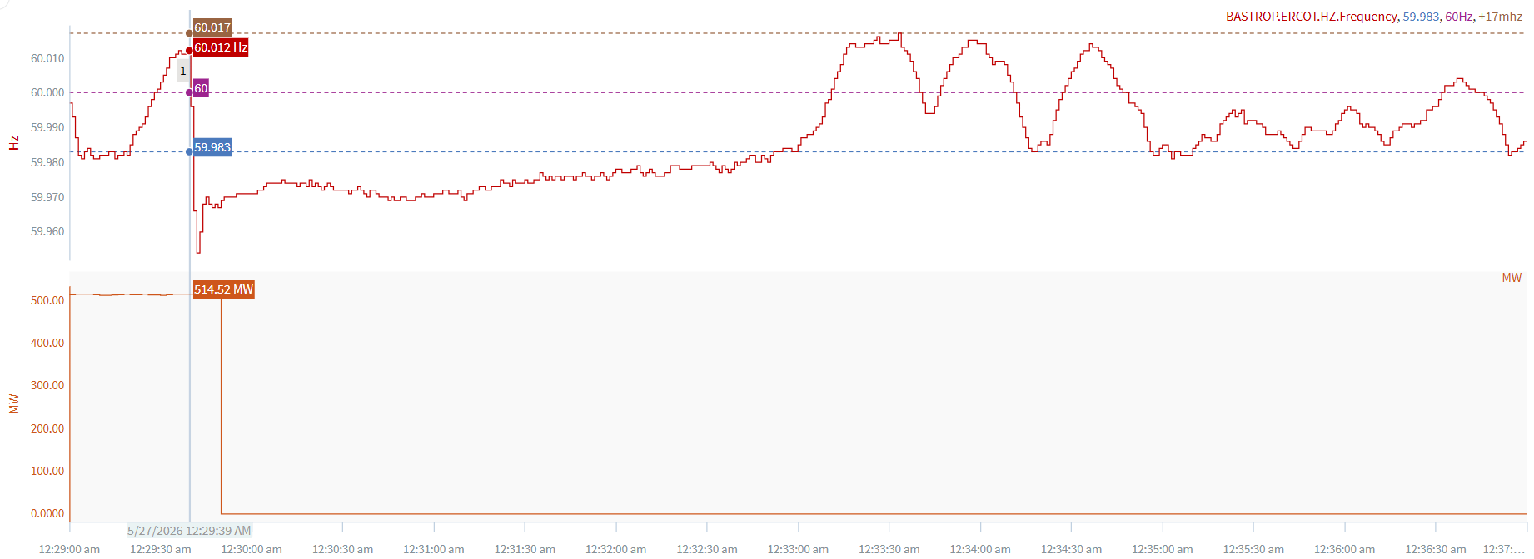
5/27/2026 12:29:39 (Non-FME)
Notes:
A unit tripped offline for ~515 MW
Starting Frequency: 60.012 Hz
Minimum Frequency: 59.954 Hz
A-C Time : 3 seconds
Recovery Time(back to deadband): 3 minutes 12 seconds
ECRS Released: 0 MW
Trip Reason: Lightning struck GSU
Contextual Information: A total of 381 MW of regulation Up was deployed during the event.
Reason for no selection: Inertia caused A-B frequency value of .289 Hz

Slide 4
Questions/Comments?

