Slide 1
Contingency Overview
Network Modeling Maintenance
June 16, 2026

Slide 2
Contingency Overview
Network Modeling Maintenance
June 16, 2026
Outline:
Contingency Process Overview
Single Contingencies – PGC’s by Auto Tracer
Double Contingencies
Manual Contingencies
Manual Contingencies Simple Examples
Manual Contingencies Case Studies
Downstream Production Change (DPC)
Equipment and Contingency Cleanup
Good Practices and Reminders
Questions/Comments NOMCRHelp@ercot.com
Key Takeaway
Standardize contingency modeling and coordination between ERCOT and TSPs

Slide 3

Definition and Importance
In an electrical grid, a contingency refers to the power system’s capacity to handle the unexpected failure of a single key component without affecting overall operations.
The term emphasizes that even a single fault can rapidly destabilize the system, leaving operators little time to react.
Defensive measures are designed in advance so that every disturbance is anticipated and accounted for. Well defined contingencies are crucial to prevent cascading outages that could compromise the entire power grid’s functionality.
Notes:
ERCOT uses contingency analysis software in its evaluation of system reliability.
This can include
Outage Evaluation,
Hour-, Day- and Season-Ahead studies,
Real-Time Security Analysis,
Voltage and Transient Stability Analysis studies.
The contingency database used by these applications must be correctly defined and as up-to-date as possible to ensure the Network Operations Model properly models the physical effect of the loss of Generation and Transmission Elements on the ERCOT Transmission Grid equipment loading, voltage, and stability.
EMS model has all model changes up until the last minute of interim period 4 end, but Field energization date is fluid.

Slide 4

Contingency Classifications
Types of contingency classifications in ERCOT:
Single Contingency/PGC contingencies:
  Loss of one piece of equipment and begin with a ‘S, Q, X, U’
  Programmatically defined per database load by ERCOT’s Auto tracer
Double Circuit Contingencies:
  Loss of two or more lines and begin with a ‘D’
  TSP provided via a CAMR and modeled and maintained by ERCOT
  Auto-traced based on the seed elements defined in the CAMR
Manual Contingencies: begin with a ‘M’
  Temporary in nature
  Consist of pseudo switching
  Change the power flows
  Manually modeled via a CAMR similar to double ckt contingencies
Notes:
In the ERCOT network model, we have multiple types of contingencies, most of which are pragmatically-generated based on seed elements.
However, the challenge arises when we introduce open-ended devices, like normally open switches, that will close to energize alternate paths.
The auto-tracer does not anticipate these toggles, so no contingencies are created.
Transmission Service Providers (TSPs) must request manual contingencies to enable on energization.

Slide 5
Contingency Process Overview
  Before field energization (~3 business days)
  Approval to Energize Process(A2E)
  TSP creates DPC CAMR
      Manual Contingencies are enabled
      Single contingencies are disabled
Field Energization
Prior to PLD
  At least 90-days out from PLD
  NOMCR for topology changes for new equipment or clearing devices submitted
  After NOMCR is created (and by IP2 at the latest)
  Contingency CAMR is created targeting the same PLD
  Manual and manual double contingencies are created as disabled
  The sooner the contingency CAMR is proposed the more time to review and model
  Snapshot day (~2 weeks before the PLD)
    The Contingency Maintainer (Tracer) tool generates the single contingencies (PGCs)
      Double Contingency definitions are populated based on the seed elements
Clean Up
  Submit two change requests for clean-up by IP2 date (same PLD)
  Submit a NOMCR for topology changes for the clean-up of old equipment or clearing devices submitted
      Pseudo Switches and retired equipment is removed from the model
  Propose a CAMR for Contingency Clean-up
    Manual and manual double contingencies are deleted
      Single contingencies are enabled
      Permanent double Contingencies are enabled (and created) if needed
Notes:
To prevent conflicts with DPCs, clean up NOMCRs should be submitted after the equipment is energized in the field.

Slide 6
Contingency Definitions or Path Checking
MAGE (Contingencies_and_RASs → Contingencies)
View complete contingency definitions
Best source for validating new contingencies
ERCOT MIS (ERCOT MIS → Data Products → Grid → Generation)
Standard Contingency List
Verify contingency names and published definitions
EMS SOTE
Trace contingency paths
Verify operational contingency definitions
GridGeo
Visualize contingency paths on the network
Updated after model loads; new contingencies may not appear immediately
Validate new contingency definitions in MAGE before relying on MIS, EMS, or GridGeo.
Use model auditing tab to capture all submitted change requests
When old equipment is removed, any contingencies using that equipment must be cleaned up too.
Notes:
The “Show other end” defect is being worked on by Siemens.

Slide 7
Single Contingencies
Programmatic Generated by ERCOT’s Auto Tracer

Slide 8
Single Contingency Coverage Expectations
Single contingencies are the baseline single-element coverage in the ERCOT model.
Each database snapshot re-evaluates contingency definitions to reflect the current network configuration
Applicable transmission elements should be covered by a contingency or have a documented reason for exclusion
Auto Tracer creates single contingencies as enabled by default
Manual contingencies may temporarily replace singles during construction or topology transitions
When manuals are disabled or deleted, affected singles must be enabled again
Single contingencies are managed automatically by the auto tracer and should not be deleted manually
Goal: avoid missing contingency coverage in RTCA, outage studies, and planning/study cases.
Notes:
The following equipment may be excluded from being modeled as a contingency, though adequate documentation should be provided explaining why the equipment is being excluded:
AC Transmission lines whose length is less than a half mile
Zero Impedance lines or AC Transmission lines with very low impedance
Phase Shifting Transformers if in parallel with an AC Transmission line or Autotransformer
AC Transmission lines, Zero Impedance Lines, or Autotransformers behind the Point of Interconnection or EPS Meter

Slide 9
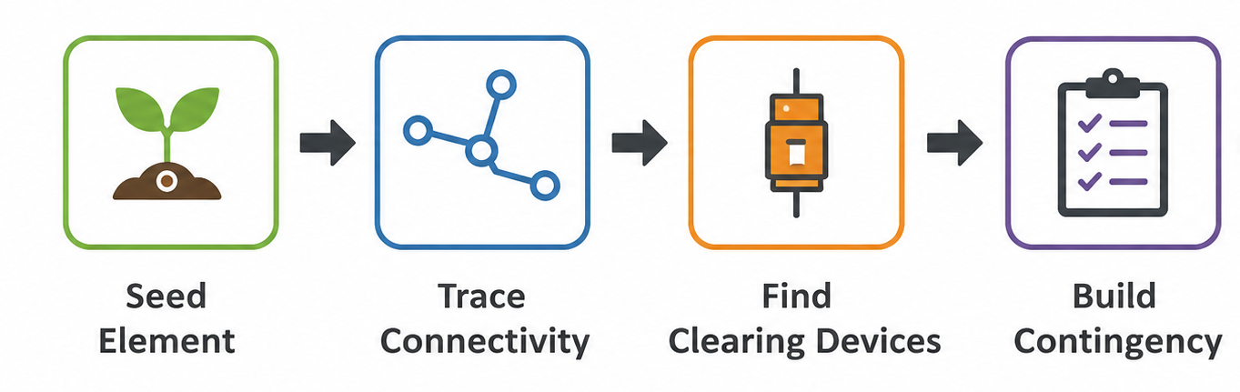
ERCOT’s Auto Tracer (Contingency Maintainer)
  Automatically defines the contingency based on seed elements
  Runs every database load to capture new devices and contingency changes/additions
  Starts by pulling the grid connectivity for a given data set
  Identifies equipment that can open under a contingency situation also called as seed elements
      Seed equipment in ERCOT:
      Lines (S) | Transformers (X) | Shunts (Q) | SVCs (Q) | Series Compensators (S) | Units (U)
  Sets boundaries for tracing as the seed equipment and includes all the equipment in the trace
  Incorrect device status or Contingency Component flags can result in incomplete contingency definitions
Notes:
- Auto Tracer only knows what exists in the model at the time of the last second of the snapshot.
- It follows modeled connectivity and device attributes.
- It does not predict future switching actions or pseudo-switch state changes.
- This limitation is the primary reason manual contingencies are required for many construction and energization projects.
- If a breaker, switch, or CC flag is modeled incorrectly, the resulting contingency may also be incorrect.

Slide 10
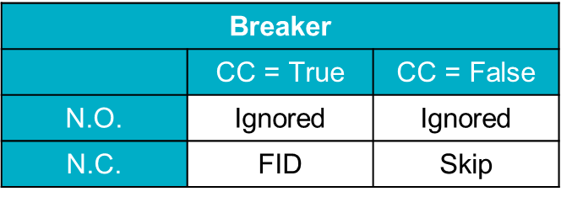


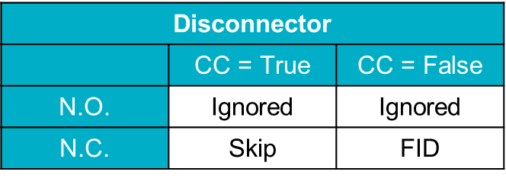
What Controls Auto Tracer Behavior
Device Status
Normally Closed (N.C.): Included in connectivity tracing (default values)
Normally Open (N.O.): Acts as a tracing boundary
Contingency Component Flag (CC)
CC = True → Tracer performs its normal tracing function
Breakers are included as fault-interrupting devices
Disconnectors act as tracing path
CC = False → Device tracing behavior is reversed
Breakers act as a tracing path
Disconnectors are included as fault-interrupting devices
  FID = Fault Interrupting Device
  Ignored = The Tracer stops the trace and ignores to include the device of the contingency definition.
  Skip = The Tracer skips over the device and continues tracing.
Notes:
Auto Tracer does not "know" what equipment should operate, it follows the model.
Normally open devices often become tracing boundaries.
CC flags determine whether a device participates in the contingency definition.
Most contingency issues investigated by ERCOT Modeling are ultimately traced back to:
incorrect device status,
incorrect CC flags,
or topology changes not represented by Auto Tracer.

Slide 11
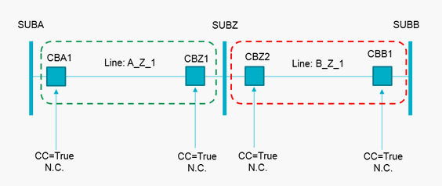
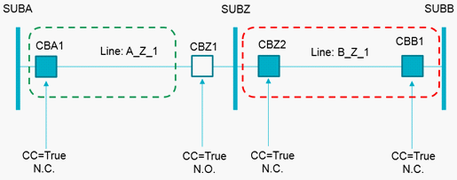
Auto Tracer Examples
Example 1 – N.C. Breakers
All Breakers are Normally Closed (N.C.)
All Contingency Component flags are true
A single contingency is created for each line
Contingencies follow complete breaker-to-breaker path
Auto Tracer behaves as expected when all breakers are closed and eligible for tracing.
Example 2 – N.O. Breaker
Breaker CBZ1 is a Normally Open (N.O.) device
Line A_Z_1: Contingency with CBA1 as FID and CBZ1 ignored
Line B_Z_1: Contingency follows complete breaker-to-breaker path
Normally Open devices stop the trace.
Notes:
This is the baseline Auto Tracer scenario.
All breakers are available for fault clearing.
No normally open devices or CC flag changes affect the trace.
The contingency definition contains the line and the appropriate remote-end clearing devices.
This is what most single contingencies look like in the ERCOT model.

Slide 12
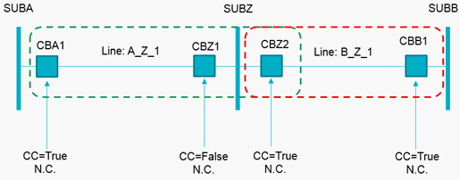

Auto Tracer Examples
Example 3 – N.C. Breaker & C.C. = False
All Breakers are Normally Closed (N.C.)
Breaker CBZ1 has Contingency Component flag set to false
Line A_Z_1: Contingency with CBA1 and CBZ2 as FID
Line B_Z_1: Contingency follows complete breaker-to-breaker path
Auto Tracer behaves as expected when all breakers are closed and eligible for tracing.
Example 4 – N.O. Breaker & C.C. = False
Breaker CBZ1 is a Normally Open (N.O.) device
Breaker CBZ1 has Contingency Component flag set to false
Line A_Z_1: Contingency with CBA1 as FID and CBZ1 ignored
Line B_Z_1: Contingency follows complete breaker-to-breaker path
Normally Open devices stop the trace (regardless of the C.C. flag).

Slide 13
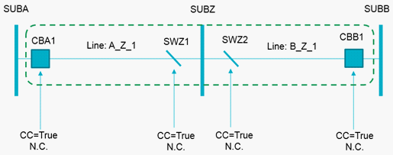
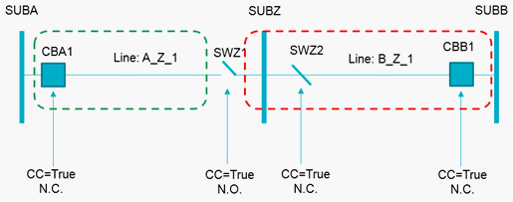
Auto Tracer Examples
Example 5 – N.C. Breakers & Disconnectors
Breaker-to-breaker path exists through two N.C. disconnectors
Disconnectors are closed in the normal topology
Breakers remain the fault-interrupting devices
Auto Tracer continues across the NC disconnectors
Normally Closed disconnectors allow the trace to continue, but they do not clear the fault.
Example 6 – N.O. Disconnector
One path starts at a breaker and stops at a N.O. disconnector
Second path starts at a breaker, passes through a N.C. disconnector, then stops at a N.O. disconnector
N.O. disconnectors are treated as open boundaries
Auto Tracer follows the normal device state: N.C. disconnectors pass the trace, N.O. disconnectors stop the trace.
Notes:
Example 5 shows a normal closed path. The disconnectors are closed, so Auto Tracer can trace through them and continue until it reaches the breaker on the opposite end. The breakers are still the devices that clear the fault; the disconnectors are just part of the closed connectivity path.
Example 6 shows what changes when a disconnector is Normally Open. Auto Tracer will not assume that open device closes. On one side, the trace starts at the breaker and stops at the NO disconnector. On the other side, the trace can pass through the NC disconnector, but once it reaches the NO disconnector, the trace stops there. This is why correct NC/NO device status is important for contingency definitions.”

Slide 14
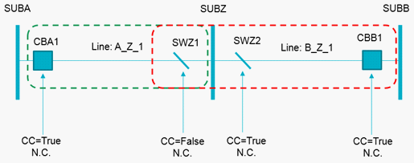
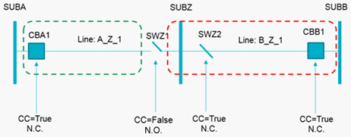
Auto Tracer Examples
Example 7 – N.C. Disconnector & C.C. = False
All Devices are Normally Closed (N.C.)
Disconnector SWZ1 has Contingency Component flag set to false
Line A_Z_1: Contingency with CBA1 and SWZ1 as FID
Line B_Z_1: Contingency with CBB1 and SWZ1 as FID
For disconnectors, CC=False makes the device behave like a fault interrupting device in the Auto Tracer path.
Example 8 – N.O. Disconnector & C.C. = False
Disconnector SWZ1 is a Normally Open (N.O.) device
Disconnector SWZ1 has Contingency Component flag set to false
Line A_Z_1: Contingency with CBA1 as FID and N.O. SWZ1 ignored
Line B_Z_1: Contingency with CBB1 as FID and N.O. SWZ1 ignored
A Normally Open disconnector remains a tracing boundary, even when CC=False.

Slide 15
Double Contingencies
Seed Elements Provided by TSPs,
Definitions Populated by ERCOT’s Auto Tracer

Slide 16

Double Circuit Contingencies
Represents loss of two or more transmission circuits from one common event
Typically applies to shared structures, shared right-of-way, or other common-mode exposure
TSP provides seed elements and supporting documentation through a CAMR
ERCOT maintains the DCKT; Auto Tracer completes the full contingency definition
Review/update DCKTs when NOMCRs add, split, retire, or reroute affected circuits
Temporary topology may require a manual contingency until cleanup is complete
ERCOT performs an annual double contingency review and requests inputs from the TSP
Notes:
A double circuit contingency represents a common-mode outage where more than one transmission circuit is lost at the same time. The most common example is two lines sharing structures or having another physical relationship where one event could remove both circuits.
For modeling, the TSP is responsible for identifying the affected circuits and providing the seed elements in the CAMR. ERCOT then uses those seed elements so the Contingency Maintainer can trace the full contingency definition.
The important maintenance point is that double contingencies can be affected by normal model changes. If a NOMCR adds a new station, splits a line, retires a segment, changes breakers, or introduces temporary pseudo equipment, the existing DCKT may need to be updated. ERCOT reviews CAMRs for new, modified, or broken double-circuit contingencies, but the TSP should also identify these impacts when submitting the model change.

Slide 17
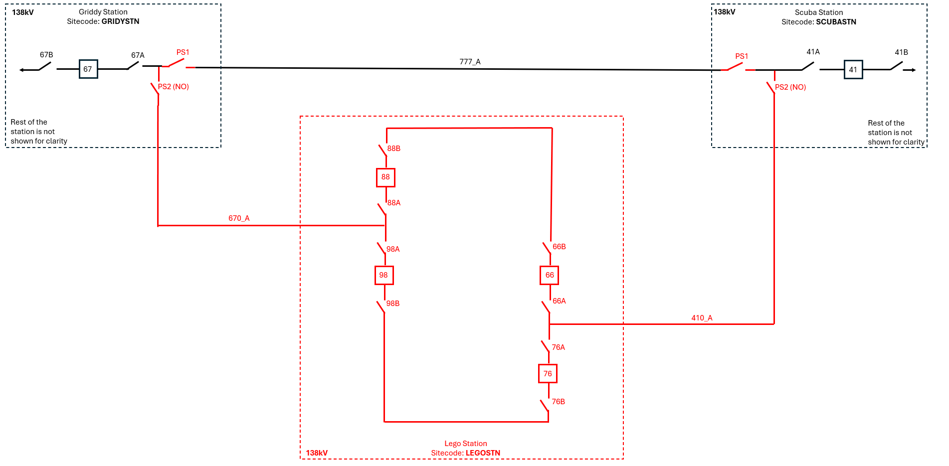
Example of Double Circuit Contingency
MGRILEG8
  670_A
  GRIDYSTN 67
  GRIDYSTN PS1
  GRIDYSTN PS2
  LEGOSTN 88
  LEGOSTN 98
MSCULEG8
  410_A
  SCUBASTN 41
  SCUBASTN PS1
  SCUBASTN PS2
  LEGOSTN 66
  LEGOSTN 76

Slide 18
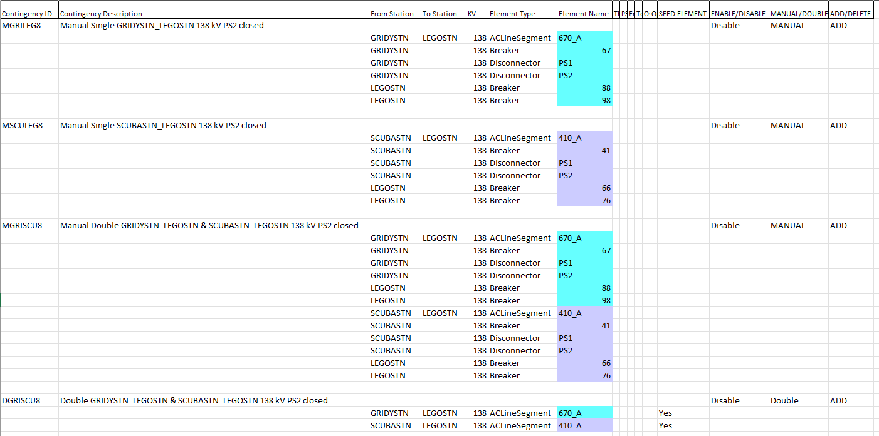
Example of Double Circuit Contingency Spreadsheet

Slide 19
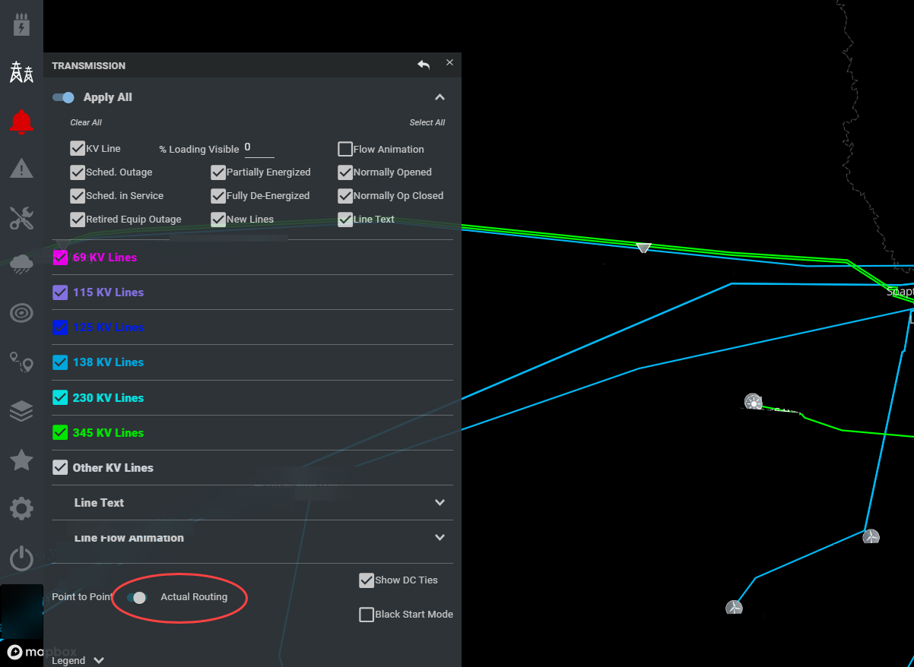
Example of Double Circuit Contingency
GridGeo Actual Routing Setting
Notes:
ERCOT relies on the TSP to provide accurate seed elements for double contingencies.
Using the Actual Routing setting on Grid Geo, there is minimal visibility on some new lines and routing.

Slide 20
Manual Contingencies
Full Definitions Provided by TSPs,
Verified and Modeled by ERCOT

Slide 21
Manual Contingencies: When Auto Tracer Needs Help
What are manual contingencies?
Manually defined contingency paths used when Auto Tracer cannot fully represent the expected topology
Often temporary and tied to construction, energization, or pseudo-switch configurations
May represent a single path or multiple paths, depending on the equipment impacted
When do we need them?
New equipment creates an alternate power-flow path
Pseudo-switches model both existing and future configurations
Existing line/transformer contingencies are impacted by the topology change
Auto Tracer would bypass, miss, or incorrectly define the intended breaker-to-breaker path
How are they submitted?
TSP provides the manual contingency definition through a CAMR
ERCOT reviews, models, and validates before implementation
Manual contingencies are used when the modeled topology needs a contingency definition that Auto Tracer cannot create correctly on its own.
Notes:
A manual contingency fills that gap. The TSP provides the intended contingency definition through a CAMR, including the devices needed to represent the correct clearing path. ERCOT reviews and models that definition so the contingency analysis tools evaluate the correct topology.
These manual contingencies are often temporary. Once the equipment is fully energized and the cleanup NOMCR removes the pseudo equipment or retired configuration, Auto Tracer can usually generate the appropriate single contingencies automatically. At that point, the manual contingencies should be disabled or deleted, and the singles should be enabled.
The main takeaway is: manual contingencies are needed when the field configuration changes before Auto Tracer can correctly build the final contingency definition from the permanent model. The pseudo-switch example in the reference material shows exactly this situation: the future paths are closed at energization, the old path is opened, and manual contingencies are needed until cleanup is complete.

Slide 22
When Manual Contingencies Are Not Needed
New equipment does not change existing clearing paths
No existing line or transformer contingency is impacted
New station/equipment is radial
Only one source path exists for power flow
Auto Tracer can create the correct single contingencies upon snapshot
After the site has been energized and the clean-up NOMCR has been submitted
ERCOT’s annual manual contingency review aims to keep the model cleaned-up
New process to address devices for cleanup may need cleanup of manual contingencies
If the topology change does not create an alternate path or change how faults are cleared, a manual contingency is usually not needed.
We can help!
Email NOMCRhelp@ERCOT.com to ask questions about contingency needs for unique topology or verification of a contingency.
Notes:
Not every NOMCR needs a manual contingency. Manuals are mainly needed when new topology changes the expected contingency path. If the new equipment is radial, does not affect existing fault-isolating devices, and does not create a new power-flow path, Auto Tracer should be able to handle the single contingencies through the normal model build process. When the topology is unique, TSPs could contact NOMCRHelp before proposing the CAMR.

Slide 23
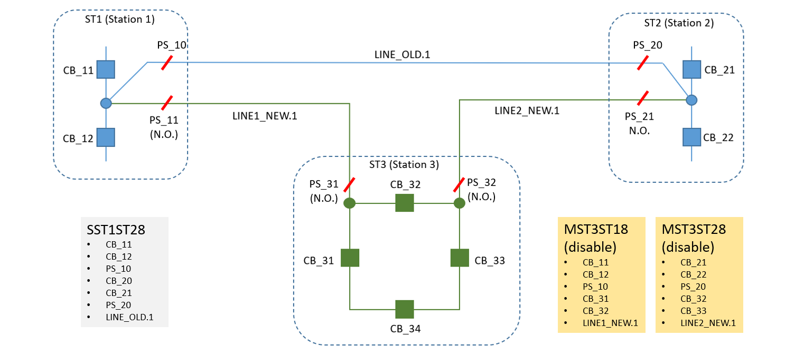
Pseudo Switches allow Existing and Future Topology
Notes:
Model both existing and future configuration
Normally open pseudo-switches for future path
Normally close pseudo-switches for existing path
Advantages
Better situational awareness
Better contingency management

Slide 24
Pseudo Switches: Existing Single Contingency Elements
SST1ST28
  LINE_OLD.1
  ST1 CB_11
  ST1 CB_12
  ST2 CB_21
  ST2 CB_22
Notes:
Model both existing and future configuration
Normally open pseudo-switches for future path
Normally close pseudo-switches for existing path
Advantages
Better situational awareness
Better contingency management

Slide 25
Pseudo Switches: Future Topology Contingency Elements
MST1ST38
  LINE1_NEW.1
  ST1 CB_11
  ST1 CB_12
  ST1 PS_10
  ST1 PS_11
  ST3 CB_31
  ST3 CB_32
MST2ST38
  LINE2_NEW.1
  ST2 CB_21
  ST2 CB_22
  ST2 PS_20
  ST2 PS_21
  ST3 CB_32
  ST3 CB_33
Notes:
Model both existing and future configuration
Normally open pseudo-switches for future path
Normally close pseudo-switches for existing path
Advantages
Better situational awareness
Better contingency management

Slide 26
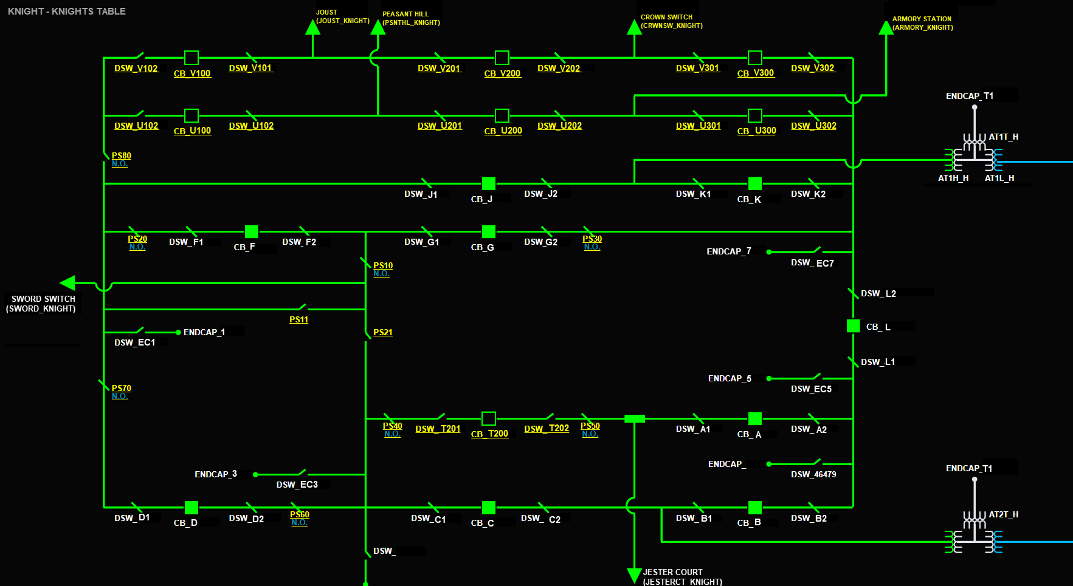
Pseudo Switches Usage
Use pseudo switches where the clearing devices are easy to understand and verify
Notes:
Can you tell what is going on in this station?
This model is difficult for the shift engineers and control room to see the work that is happening in the field.

Slide 27
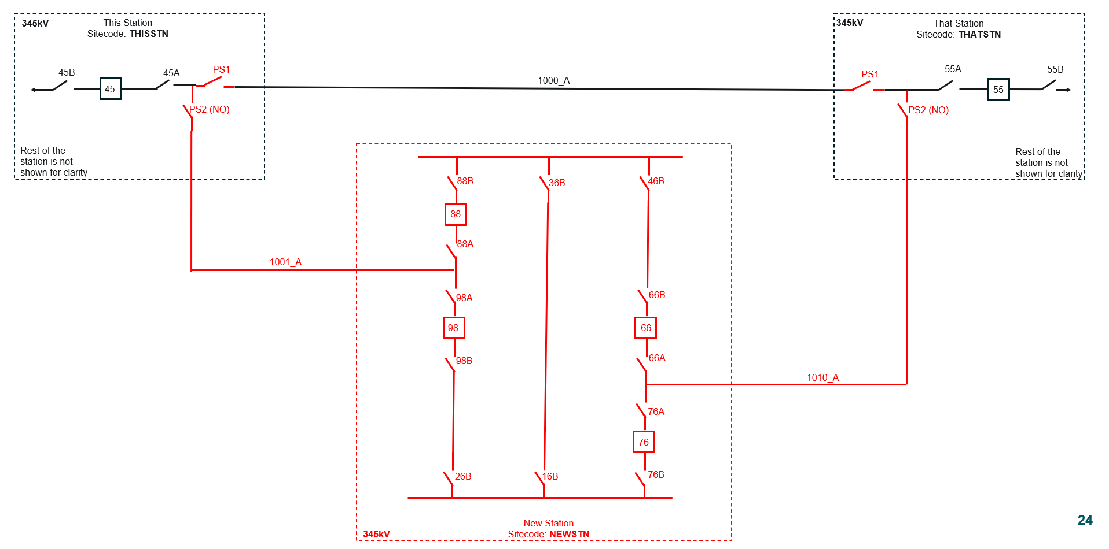
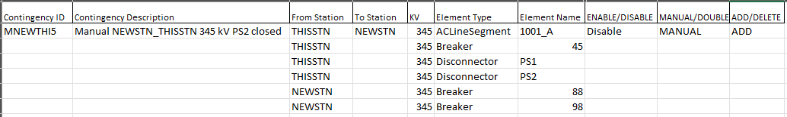
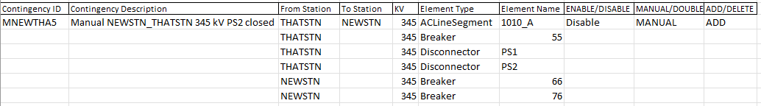
Sample Manual Contingencies
------------------ Black – Existing Equipment
------------------ Green – Existing but Retiring Equipment
------------------ Red – New Equipment

Slide 28
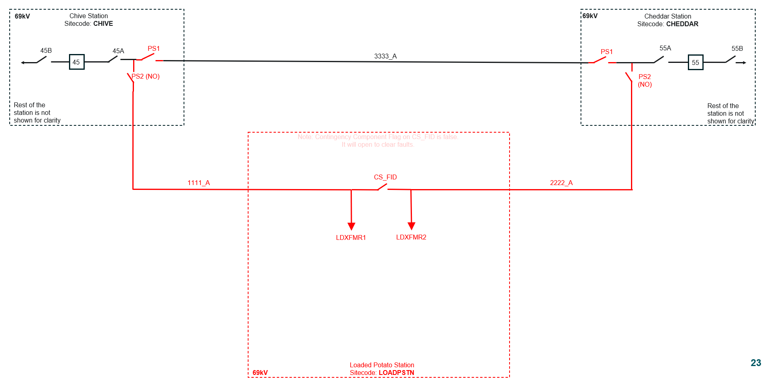
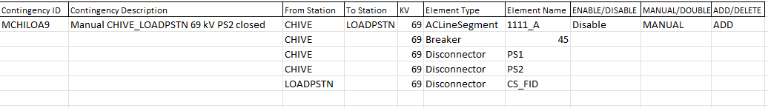
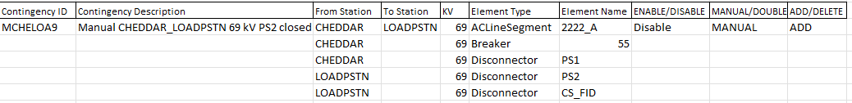
Manual Contingency Example: Disconnector CC = False
------------------ Black – Existing Equipment
------------------ Green – Existing but Retiring Equipment
------------------ Red – New Equipment
Notes:
With the Contingency Component Flag set to ‘False’ on CS_FID

Slide 29
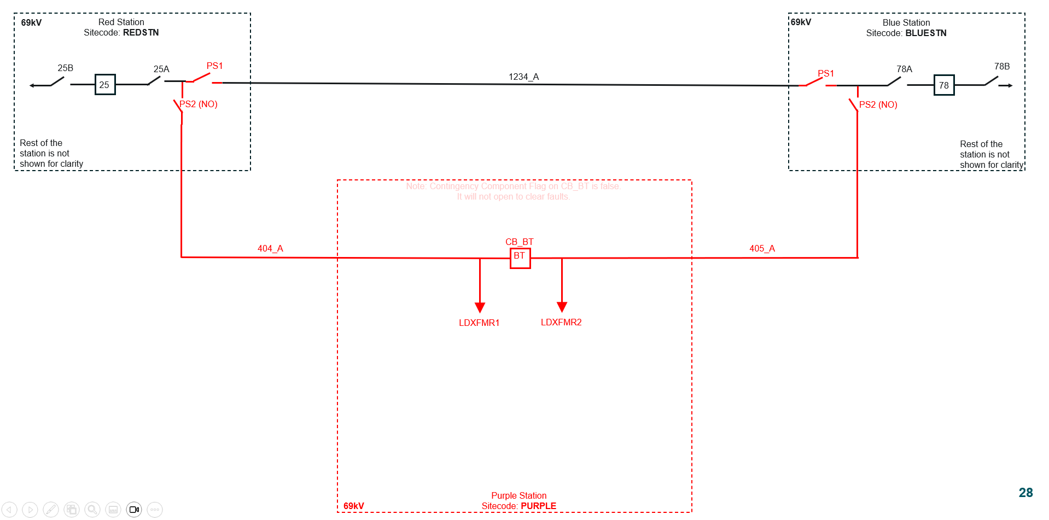
Sample Manual Contingencies – Bus Tie Breaker
------------------ Black – Existing Equipment
------------------ Green – Existing but Retiring Equipment
------------------ Red – New Equipment
Notes:
Clearing devices are not changing, a manual contingency is not needed for the new station.
The existing single for 1234_A will cover the same clearing path.

Slide 30
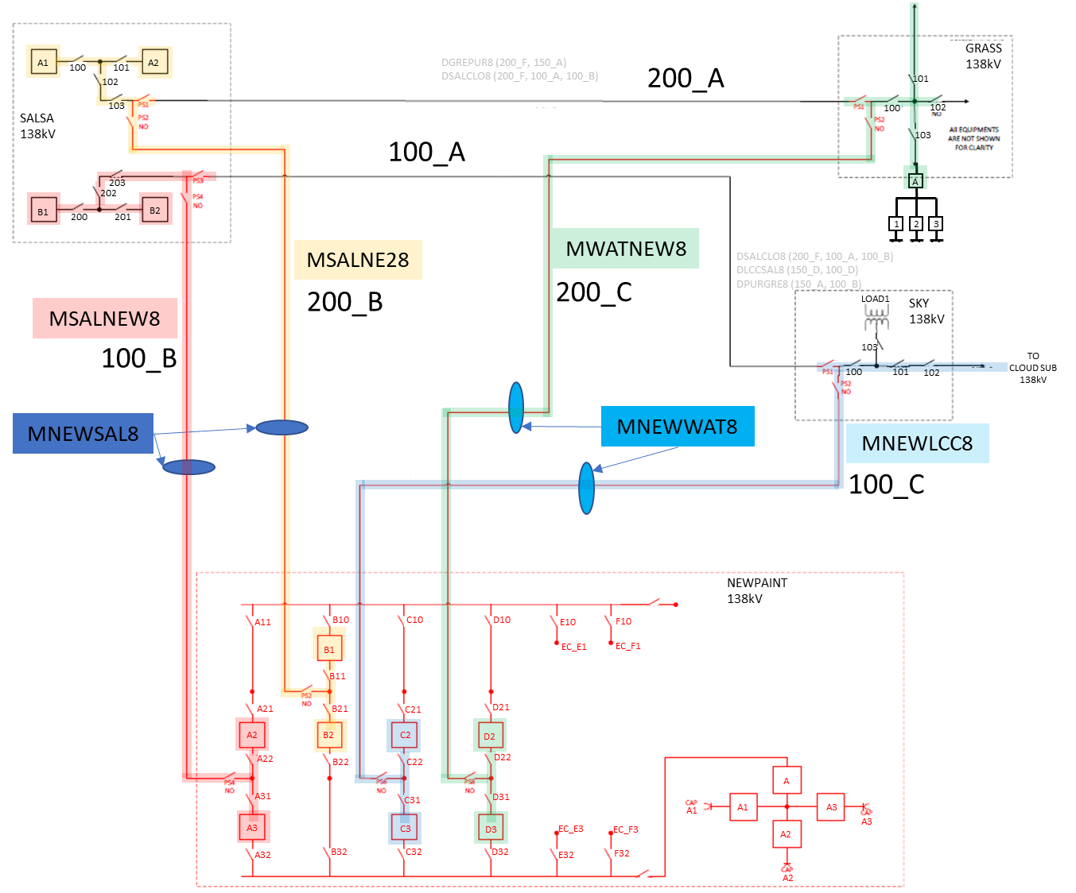
Examples and Case Studies
New Equipment:
Four new manual singles
Two new manual doubles

Slide 31
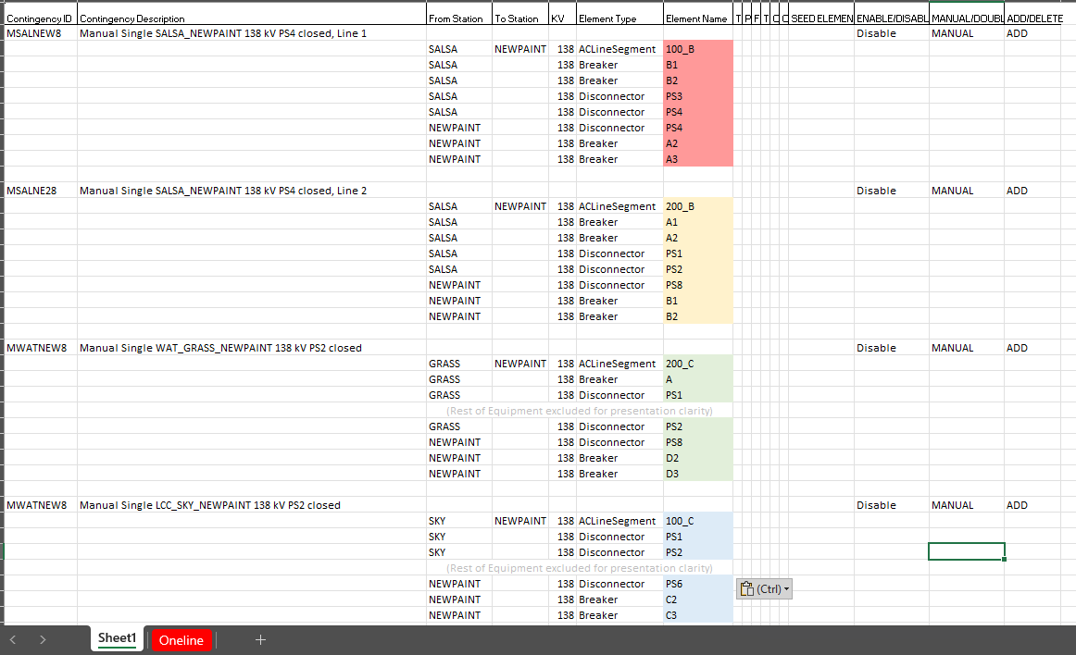
Four New Manual Singles

Slide 32
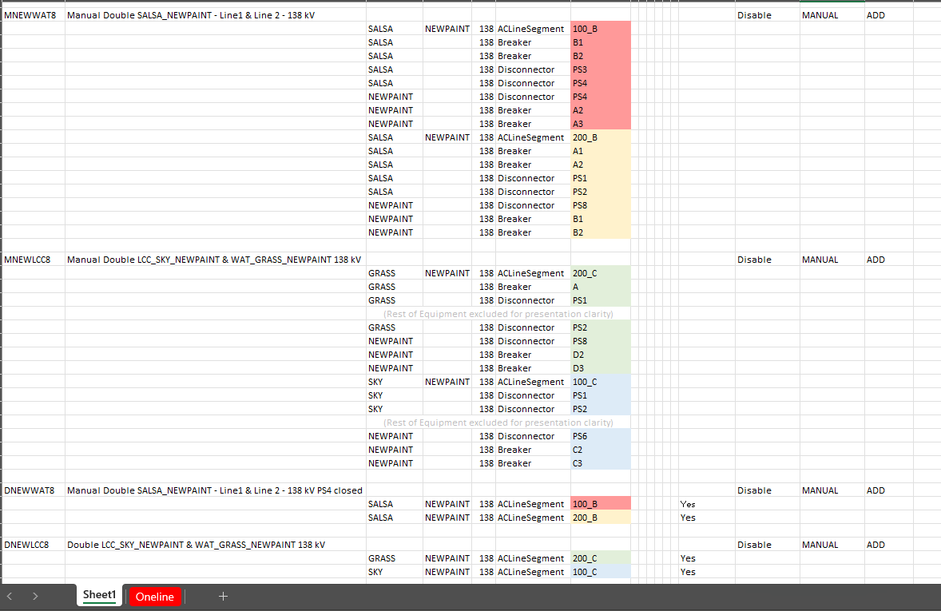
Two New Manual Doubles and Permanent Doubles

Slide 33
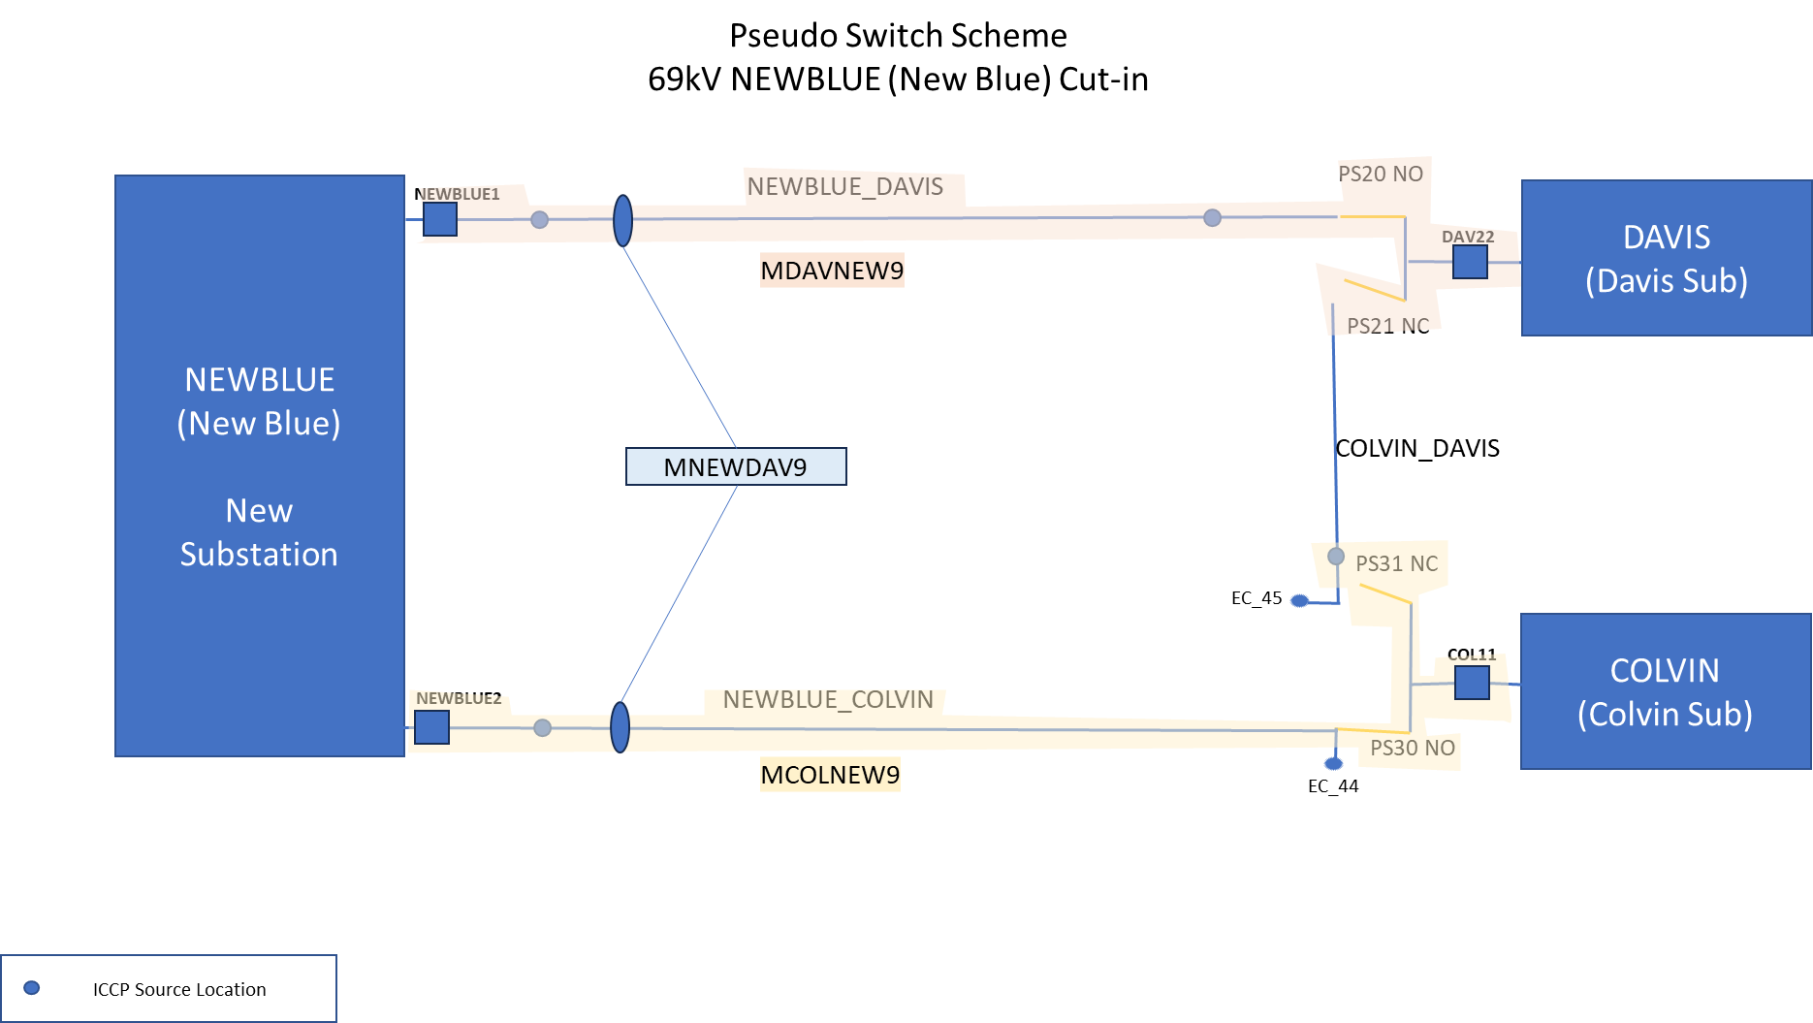
Examples and Case Studies
New Equipment:
Two new manual singles
One new manual double

Slide 34
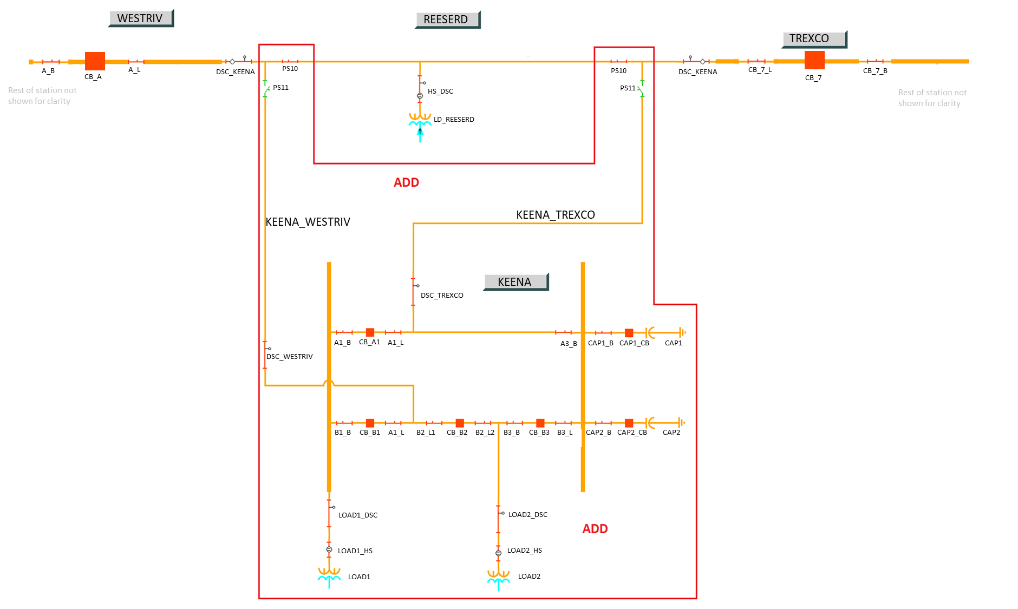
Examples and Case Studies
New Equipment:
Two new manual singles

Slide 35
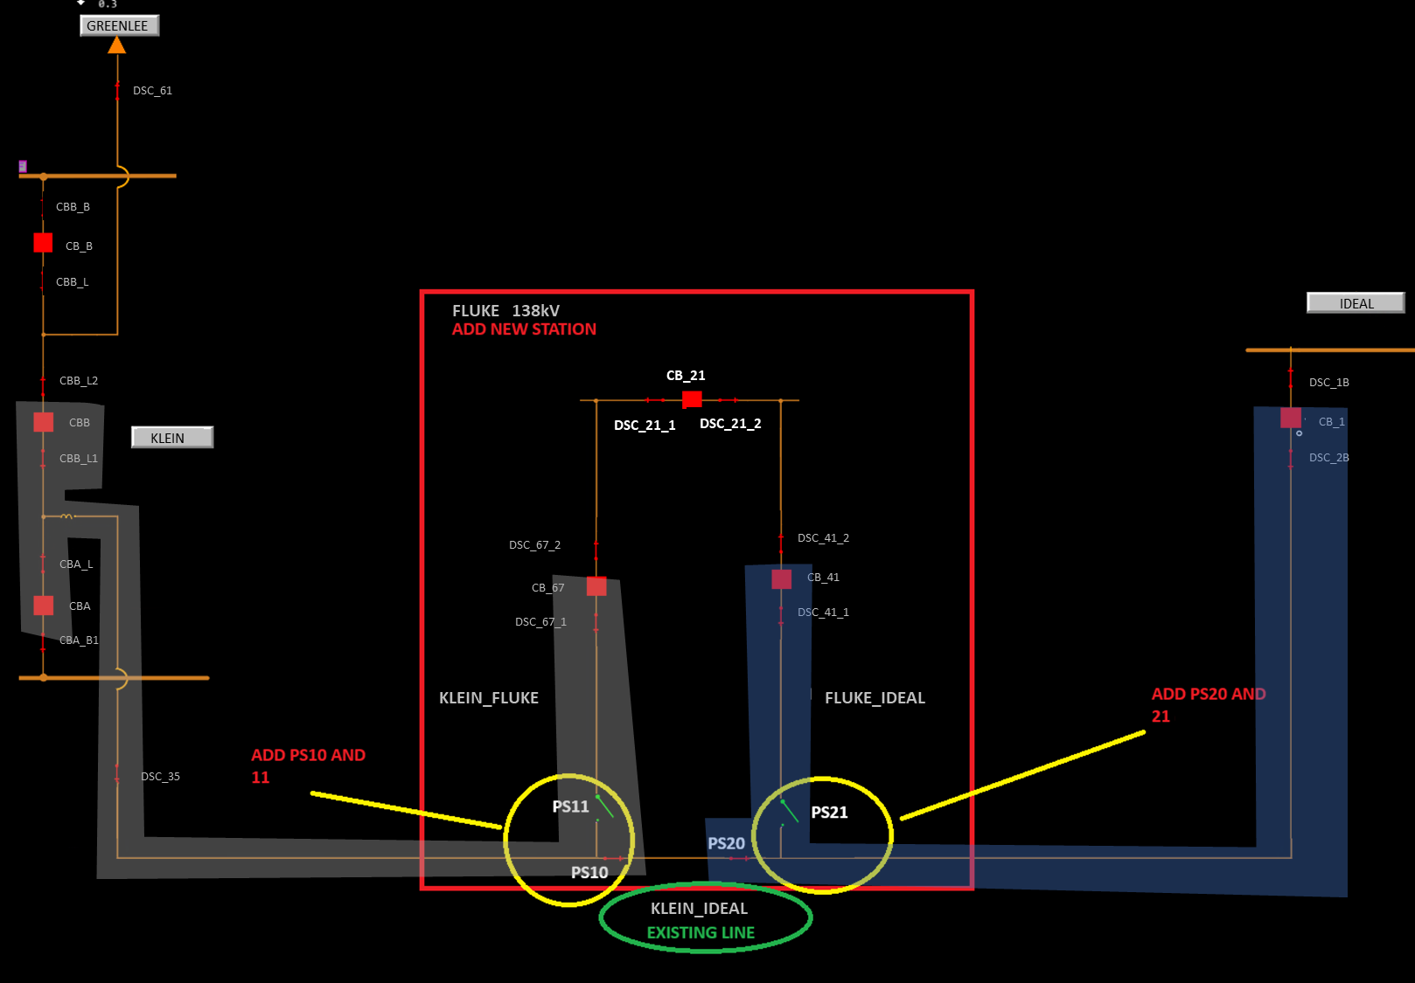
Examples and Case Studies
New Equipment:
Two new manual singles

Slide 36
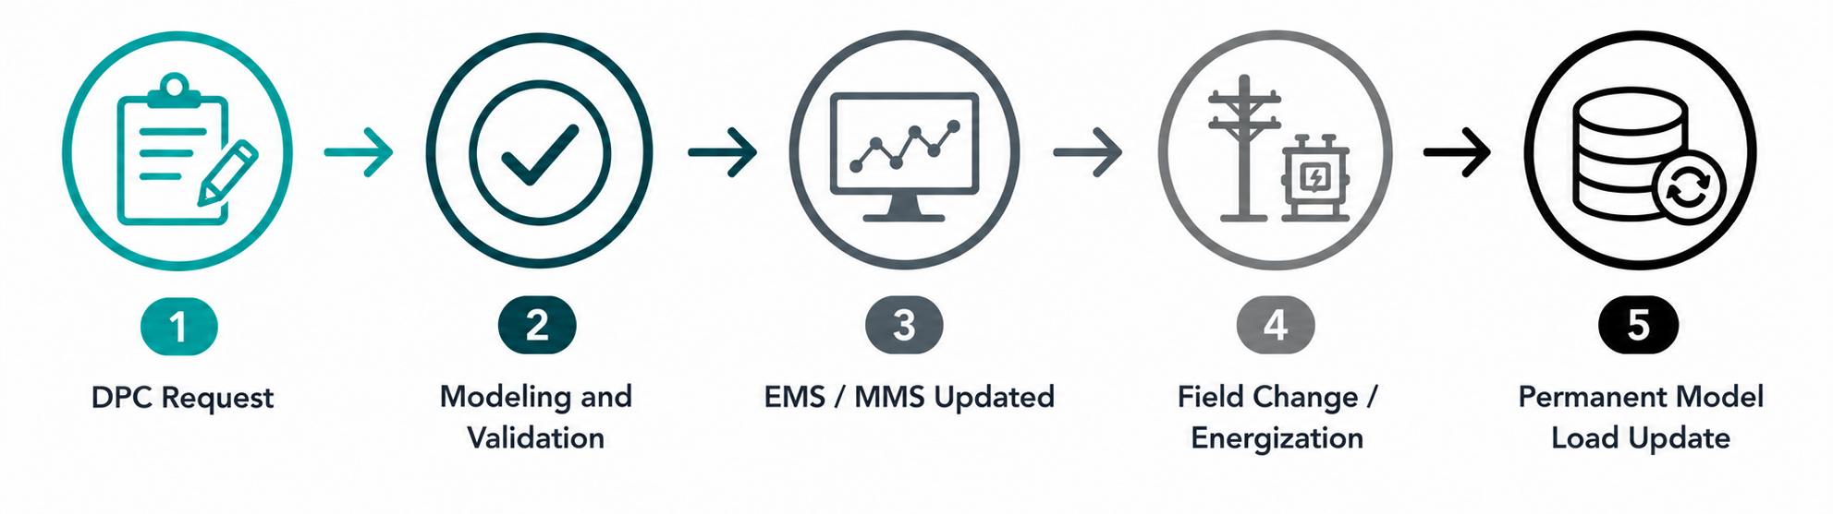
Contingencies as a Downstream Production Change (DPC)
Used when contingency changes must be applied before the next database load
Supports real-time system operations and equipment energizations
Changes are manually implemented in EMS and other operational systems
Commonly used for contingency enable/disable actions associated with switching activities
Model updates typically follow in a future database load (often 2–3 weeks later)
Future contingency tool allows temporary contingency enable/disable changes without submitting a NOMCR.
  Limited to status changes only.
  New contingencies and contingency modifications still require the standard NOMCR/CAMR process.
Notes:
A DPC is used when contingency changes need to be reflected in operations before they can be incorporated through the normal model build process.
This commonly occurs during equipment energizations, topology changes, or other field activities where contingency status must change immediately.
Because the database load schedule may be several weeks away, ERCOT manually applies the required contingency changes in operational systems until the permanent model update is available.

Slide 37
Contingencies as DPCs - Cont’d
Actions After DPC Initial Implementation
After a DPC has been implemented into ERCOT’s systems, the changes need to be implemented with every database load till the change in included in database load
ERCOT’s GMS and others verify the changes prior to the database load
ERCOT’s GMS re-applies all DPCs before each database load into the EMS and MMS
      This can take up to 3 weeks or more due to how the database loads were scheduled
Post Submission Pains
Missing contingencies to enable/disable or new contingencies
Missing elements from contingencies
No communication from TSP to Shift Engineer Supervisor or Control Room
Delays in work
Switching prior to DPC implementation
Notes:
An expedited level of Validation is performed by ERCOT Modeling on the DPC.
After it passes all of Network Modeling’s validation, Coordinators sends the DPC Request to the Shift Engineer Supervisor for approval.
Shift Engineer Supervisor coordinates with the TO.
With the expectation of communication from the TO when switching needs to take place.
Shift Engineer Supervisor approves and notifies Grid and Market Solution (GMS) team and others to implement.
After approval the Energy Management System, Market Management System, Short Term Outage Cases and Study cases are updated with the approved changes.
Due to the time needed to verify, model, and test contingency DCPs, Please try to allow a minimum of 4-6 business hours to process contingency CAMRs adding or modifying contingencies.
MAGE will not allow change requests to be submitted for a time in the past.
For example: If a DPC is submitted in the afternoon for the next day, please use a time closer to lunch.

Slide 38
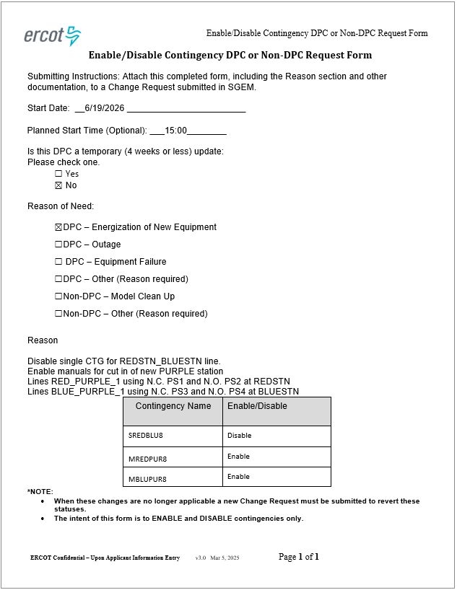
DPC Contingency Enable/Disable Form
Date and Time must match the Effective date and time on the CAMR
Use the reason field on the Enable/Disable form to describe the work and the pseudo switches changing status
If the contingency is currently in the correct state, do not include it on the E/D form

Slide 39
DPC Contingency Best Practices (Summary)
  Add ‘DPC’ in the Project / Name Field(s)
  Send a DPC email after the CAMR is proposed
  The more information you provide in the description better to model and validate
      Use the reason field on the Enable/Disable form to describe the work and the pseudo switches changing status
  Include a Breaker-to-breaker oneline with highlighted paths
      Use the second tab of the Spreadsheet to add the oneline
      This will allow you to only have to upload one attachment in MAGE
  Contingency Spreadsheet is not needed if the only changes are enable/disable of existing contingencies
  For new Manual Contingencies, all pseudo switches and devices that will be relevant to clearing a fault must be included
  Singles are enabled by default, if a manual is being enabled or disabled, verify the status of singles on existing and new lines
  Contingencies are not deleted by DPC
  Trace new contingencies for the DPC in MAGE (view-only) model or Model Auditing to confirm the contingency definition
      Substation Code
      Voltage Level
      Element Type (Breaker, Disconnector, ACLineSegment, SeriesDevice, Winding)
      Element Name
Notes:
An expedited level of Validation is performed by ERCOT Modeling on the DPC.
After it passes all of Network Modeling’s validation, Coordinators sends the DPC Request to the Shift Engineer Supervisor for approval.
Shift Engineer Supervisor coordinates with the TO.
With the expectation of communication from the TO when switching needs to take place.
Shift Engineer Supervisor approves and notifies Grid and Market Solution (GMS) team and others to implement.
After approval the Energy Management System, Market Management System, Short Term Outage Cases and Study cases are updated with the approved changes.
Due to the time needed to verify, model, and test contingency DCPs, Please try to allow a minimum of 4-6 business hours to process contingency CAMRs adding or modifying contingencies.
MAGE will not allow change requests to be submitted for a time in the past.
For example: If a DPC is submitted in the afternoon for the next day, please use a time closer to lunch.

Slide 40
Equipment and Contingency Cleanup
After Substation Energization,
Model Cleanup is Needed

Slide 41
Cleanup Pseudo-Switches & Contingencies After Energization
Cleanup NOMCR removes retired equipment, old topology, and pseudo switches
Submit cleanup CAMR in the same model load when manual contingencies were used
Cleanup CAMR should disable/delete temporary manuals
Re-enable applicable single contingencies so Auto Tracer can maintain them
Review impacted manual, double, and single contingencies before cleanup submission
Singles of deleted lines should be enabled so the contingency maintainer can make the necessary updates
Goal: keep EMS, studies, and onelines aligned with the actual field configuration
After cleanup, temporary manual contingencies should retire and Auto Tracer singles should take over.

Slide 42
Periodic Cleanup: Obsolete Equipment and Contingencies
ERCOT identifies obsolete equipment using Outage Scheduler end dates
Cleanup targets old equipment, pseudo switches, and related contingencies
Goal: keep EMS displays and onelines aligned with the field
Reduces unnecessary pseudo equipment and contingency noise
ERCOT sends TSPs a cleanup list every other month
TSPs respond with:
      Existing NOMCR/CAMR already submitted, or
      Planned cleanup NOMCR/CAMR and target model load
      Requested response time: 30 days
Contingencies tied to deleted equipment must be reviewed, disabled, or deleted
When old equipment is removed, any contingencies using that equipment must be cleaned up too.

Slide 43
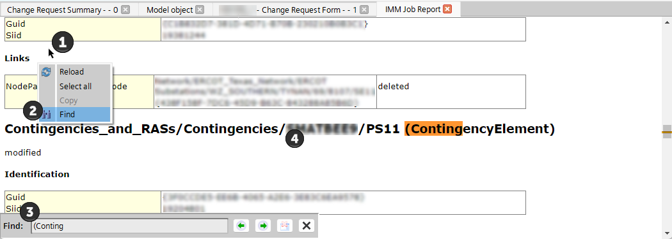
Searching the NOMCR Changelog for Contingency Elements
How to Identify Contingency Impacts in a Cleanup NOMCR
Open the NOMCR Changelog
Right-click anywhere in the Change Log and Select Find
Search for: (ContingencyElement)
Review the modified contingencies listed in the cleanup NOMCR
Confirm whether related manuals should be updated or disabled/deleted and singles re-enabled

Slide 44
Good Practices and Reminders
Contingency ID (name) Format
Unique 8-character ID for each contingency, in the form of ABBBCCC#, where:
  A represents the type of contingency (S for Single, D for Double, M for Manual, Q for shunt, X for transformer, U for unit)
  BBB represents the first three letters in the beginning substation’s mnemonic in the ERCOT Network Operations Model
  CCC represents the first three letters in the ending substation’s mnemonic in the ERCOT Network Operations Model and in the case of double circuit contingencies involving different voltage levels, the last C together with # will represent the voltage class (example:DBBBCC58/DBBBCC89)
  # represents the voltage class (5 for 345 kV, 8 for 138 kV, 9 for 69 kV)
The following equipment may be excluded from being modeled as a contingency
(adequate documentation should be provided explaining why the equipment is being excluded)
  AC Transmission lines whose length is less than a half mile
  Zero Impedance lines or AC Transmission lines with very low impedance
  Phase Shifting Transformers if in parallel with an AC Transmission line or Autotransformer
  AC Transmission lines, Zero Impedance Lines, or Autotransformers behind the Point of Interconnection or EPS Meter

Slide 45
Questions/Comments: NOMCRHelp@ercot.com
Thank you!

