Slide 1
NPRR1337, ERS Enhancements
ERCOT
Outline:
  Purpose of NPRR1337
  Proposed ERS Design Changes
  Naturally Dynamic vs Price Responsive Load Patterns
  Alternate Baseline Test
  Current Availability Metric and Results
  Proposed Availability Changes

Slide 2
Purpose of NPRR1337
Develop a new alternate baseline test and update the regulations related to ERS availability metrics to encourage behavioral changes aimed at minimizing the self-deployment of ERS resources before receiving an official ERS deployment instruction.

Slide 3
Proposed ERS Design Changes to Minimize Self Deployment Behavior
Proposed Changes:
Implement an Alternate Baseline Test - The Alternate baseline was originally created to allow loads with a highly fluctuating load shape to participate in the service (e.g. Streel Mills). These loads, due to their load shape, cannot be baselined using any of the default baselines. This test will determine if a load has a “naturally” fluctuating load shape. If a prospective ERS load fails this test it will not be allowed to use the alternate baseline and must select one of the default baselines to participate in ERS.
Change the availability metric to evaluate each ERS Time period independently for performance – This will change the availability from a single time and capacity weighted value across an entire contract period to evaluate each ERS Time period separately for availability evaluation.
  Consider making suspensions for availability failures dependent on the risk level assigned to each time period.
  The suspension details will be defined in the Emergency Response Service Suspension and Reinstatement Procedures for Non-Weather Sensitive Resource document posted to the ERS webpage.

Slide 4
Proposed ERS Design Changes to Minimize Self Deployment Behavior
Why these proposed changes:
Implement an Alternate Baseline Test
  The alternate baseline is a “drop to” methodology designed to allow highly fluctuating loads to participate in ERS. It was not intended to be used as a methodology to measure performance for loads that have a fluctuating load shape because they frequently respond to price signals.
  This change will allow only loads that have “naturally” fluctuating load shape to use the alternate baseline.
Change the availability metric to evaluate each ERS Time period independently
  The current design uses a single resource level availability factor metric that is calculated as a time and capacity weighted value from each ERS time period.
  This allows time periods with high availability to help offset time periods with poor availability.
  Making the change to require a resource to meet an availability metric for each time period will significantly reduce price responsive behavior prior to a deployment instruction.

Slide 5
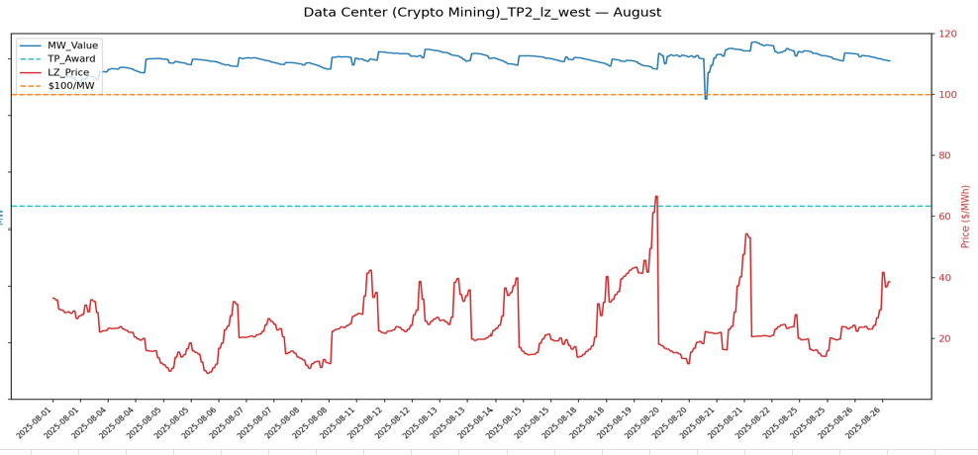
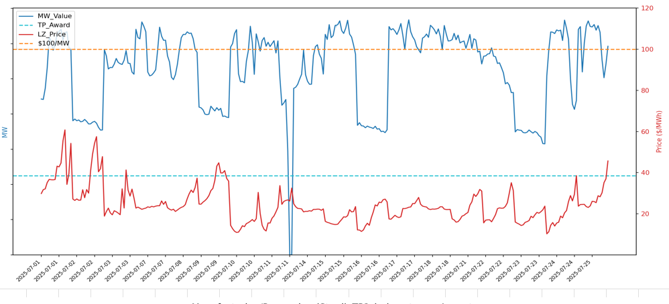
Naturally Dynamic Load vs Price Responsive Load
Crypto Mining load remains relatively flat during non-pricing periods
Manufacturing/Processing (Steel)_TP2- July
Steel Mill load is fluctuating even during non-Pricing periods

Slide 6
The Alternate Baseline Test (ABT)
1. WHY: Alternate Baseline Test
Some resources that currently are evaluated on the Alternate Baseline are not genuinely variable — they reduce load during various market signals (e.g., price spikes, 4-CP response, etc.) but price response is the most common cause. Because MBL/Alternate uses a "Drop-To" evaluation (a QSE-declared maximum base load threshold) and not a comparison to a predicted baseline, an ERS deployment overlapping a price spike would credit normal price-chasing curtailment as ERS performance.
The ABT is a quality-control check that will run during ERID process on each ERS Load to identify price-responsive behavior — ensuring MBL/Alternate eligibility reflects genuine operational variability.
2. WHEN & WHAT: How the ABT Fits into the Baseline Process
Resources that do not meet the minimal accepted “fit” thresholds for a default baseline are subject to be evaluated on the Alternate baseline test. The acceptable “fit” thresholds are: P95 ≤ 20% and |bias| ≤ 5%.
Uses existing ERCOT inputs only — resource interval meter data + real-time settlement-point prices.
Resources that meet the minimal “fit” thresholds for any of the default baselines will not be evaluated by the ABT entirely
3. OUTCOMES: What Happens After the ABT
PASS → Resource may select the Alternate baseline designation (variability is genuinely operational).
FAIL_ABT → QSE will be given all default baseline statistics and may select any one default option.
The only exceptions to this will be if there is not sufficient historical meter data available for any of the default baselines then the load will be allowed to temporarily select the Alternate Baseline until a time when sufficient historical meter data become available.

Slide 7
How the ABT Detects Price Chasing
1. Three-Step Detection Method
STEP 1 — Define a reduction. For each 15-minute interval, mark it "reduced" if actual load is ≤ 50% of the reference
  the reference — is the average load for that same interval-of-day across the most recent ten same-daytype days. Weekdays are compared only to other weekdays, and weekends/holidays only to other weekends/holidays. So if we are looking at the 2:00 PM interval on a Tuesday, the reference is the average 2:00 PM load over the prior ten weekdays.
STEP 2 — Split intervals into two groups. Sort intervals by what was happening on the grid — high real-time price periods (currently considering $80/MWh but TBD) vs. normal periods.
STEP 3 — Compute and compare reduction rates. A resource whose behavior is modified during high price periods reduces load far more often during high-price periods than at other times.
2. Trigger Logic and Worked Examples
A resource is flagged FAIL_ABT only when BOTH conditions hold: high-price reduction rate ≥ 50% AND normal-hour reduction rate ≤ 5%. (exact thresholds TBD)
EXAMPLE A — Genuinely Variable Load (PASS)
High-price: 80 / 200 reduced = 40% (below 50% threshold)
Normal: 600 / 5,000 reduced = 12% (above 5% threshold)
Result: PASS — keep MBL/Alternate
EXAMPLE B — Price responsive load (FAIL_ABT)
High-price: 130 / 200 reduced = 65% (above 50% threshold)
Normal: 200 / 5,000 reduced = 4% (below 5% threshold)
Result: FAIL_ABT — Alternate Baseline not an option
Key Takeaways:
The ABT measures the FREQUENCY of load reductions during high-price vs. normal periods. A large gap between the two is the indicator the resource is not a naturally dynamic load — and alternate baseline not an option.
ERCOT has tested the ABT against all ERS Category "Crypto Mining" loads that offered into the JunSep2026 SCT and most failed this test.

Slide 8
End-to-End Baseline Assignment Process
STEP 1: All ERS Loads evaluated against the Default Baseline
5 Default baselines (M810, MDP, REG, MBMA, NEAR20) • P95 ≤ 20% AND |bias| ≤ 5%
Resources meet the minimal accepted “fit” thresholds for a default baseline
Default Baseline Assigned
YES
NO
STEP 2: Alternate Baseline Test (ABT)
Naturally Dynamic Load evaluation
Passes ABT?
Resource may select an Alternate Baseline option
YES
NO
Resource will be given all default baseline data and may select any one option

Slide 9
Current Availability Metric and Results

Slide 10
Availability-Payment Reductions and Suspensions (Currently)
If QSE portfolio-level passes:
ERSAFCOMB/ERSAF
A QSE with a portfolio-level availability factor of equal or greater than 0.95 is deemed to have meet its performance requirement. The resources are not reviewed for pass or fail.
Failing resources are put back on the test list.
If QSE portfolio-level fails:
ERSAFCOMB/ERSAF
A QSE with a portfolio-level availability factor of less than 0.95 is deemed to have failed to meet its performance requirement. The failing resources within the failing portfolio are now reviewed for pass/fail.
If an ERS Resource achieves an availability factor of less than 0.85, the ERS Resource’s availability factor shall be squared; and if the availability factor for one or more ERS Resources is squared ERCOT shall compute the QSE’s final portfolio-level availability factor using that modified availability factor.
Additional Consequences- Resource is suspended for 1 Standard Contract Term but not allowed to participate in ERS until the reinstatement process is completed which includes a test. Reinstatement process can not begin until suspension period is completed. Reported to ERCOT Compliance

Slide 11
JunSep25 Resource Availability Failures (combined availability score)
Key Takeaway: For JunSep25 there were no resource suspensions for failures because there were no QSE Portfolio Level failures.

Slide 12
Proposed Availability Changes

Slide 13
Availability-Payment Reductions (Proposed)
Resource Availability Factor:
ERSAF: ERS Availability Factor
For all non-weather-sensitive ERS Resources, an ERSAF is calculated for each contracted ERS Time Period for a Standard Contract Term (SCT). ERSAF for each ERS Resource will be capped at 1.0.
All Resources for that QSE are subject to availability review for each the ERS Time Period. Any resource achieving an ERSAF of ≥0.95 passes the availability metric and is not subject to further action. Any resource achieving an ERSAF of <0.95 fails the availability metric and its availability factor is squared. The modified availability factor will be used to calculate QSE’s portfolio-level availability for each contracted Time Period.
QSE portfolio-level:
ERSAFTOTTP: ERS Availability Factor Total per Time Period
A QSE will have a portfolio-level availability for each contracted Time Period for a SCT and are calculated using ERS Resource availability factor (ERSAF) as mentioned above.
A QSE is deemed have met its availability requirements if its portfolio-level availability factor meets the ≥0.95 threshold per ERS Time Period; otherwise, the QSE shall be deemed to have failed to meet this requirement.

Slide 14
Availability-Payment Reductions and Suspensions (Proposed)
An ERS Resource’s availability will be determined for each ERS Time Period in the Standard Contract Term (ERSAF)
The passing metric for a resource is ERSAF ≥ .95
Suspensions will be based on the number of availability failures by risk category assigned to the ERS Time Period in the RFP
Risk Factors | # of Time Period Failures | Suspension
High (80-100) | 1 | 1 SCT
High (80-100) | 2 | 2 SCT
High (80-100) | 3 or more | 3 SCT
Medium (30-79) | 2 | 1 SCT
Medium (30-79) | 3 or more | 2 SCT
Low (1-29) | 5 | 1 SCT
Low (1-29) | 6 or more | 2 SCT
Combination of High/Medium/Low | Follow high
Combination of Medium/Low | Follow medium
Note:
Since going to the 4SCTs (2022) AprMay and OctNov have been all Low-Risk TPs.
JunSep25 – 2 Highs, 2 Medium, 4 Lows
DecMar25 - 1 High, 3 Medium, 4 Lows
JunSep26 – 3 Highs, 1 Medium, 4 Lows
DecMar26 – 1 High, 3 Medium, 4 Lows

Slide 15
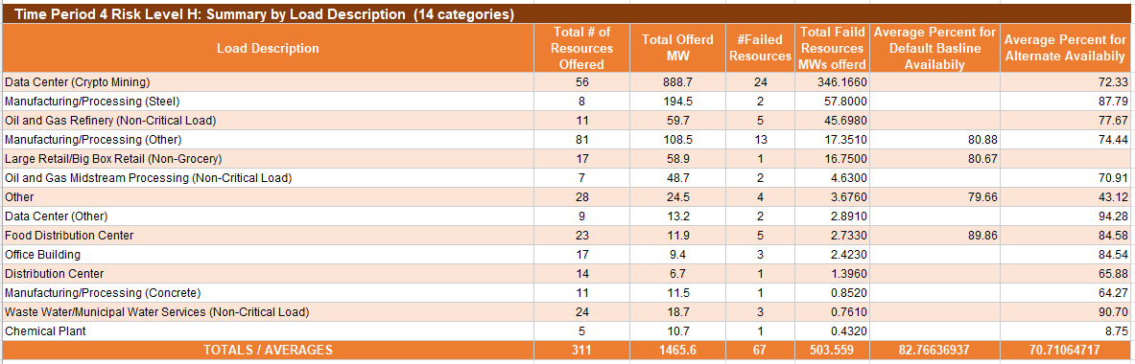
Availability Observation from JunSep2025 SCT
Availability Failure Metric
Default Baseline: The interval Load of the ERS Load was less than 95% of its contracted ERS MW capacity
Alternate Baseline: Average MW Load per interval / offer MW

Slide 16
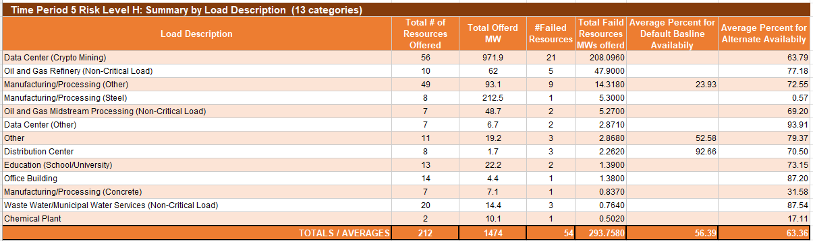
Availability Observation from JunSep2025 SCT
Availability Failure Metric
Default Baseline: The interval Load of the ERS Load was less than 95% of its contracted ERS MW capacity
Alternate Baseline: Average MW Load per interval / offer MW

Slide 17
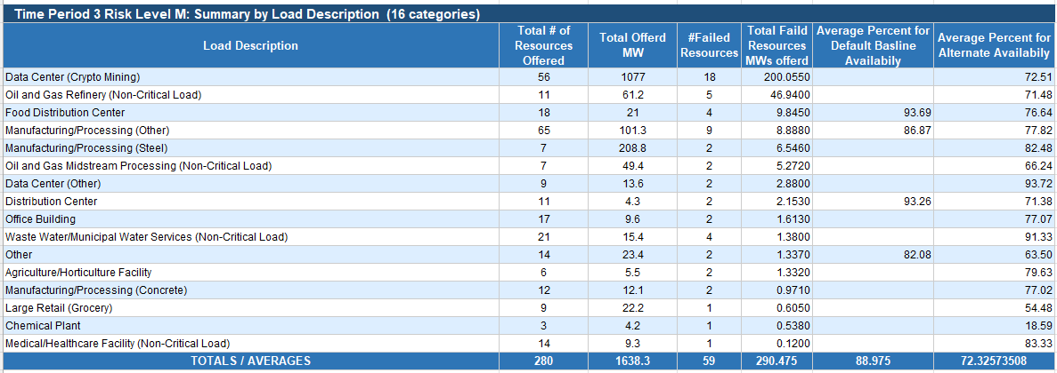
Availability Observation from JunSep2025 SCT
Availability Failure Metric
Default Baseline: The interval Load of the ERS Load was less than 95% of its contracted ERS MW capacity
Alternate Baseline: Average MW Load per interval / offer MW

Slide 18
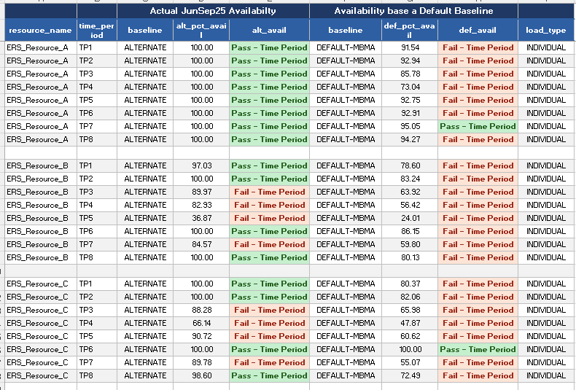
Examples – Availability Alternate Baseline vs Default Baseline (MBMA)
These 3 ERS Resources are single site (Load_type Individual)

Slide 19
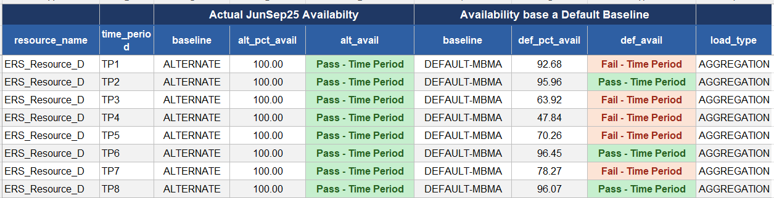
Examples – Availability Alternate Baseline vs Default Baseline (MBMA)
This resource is an aggregation of multiple sites (Load_type Aggregation)

