Slide 1
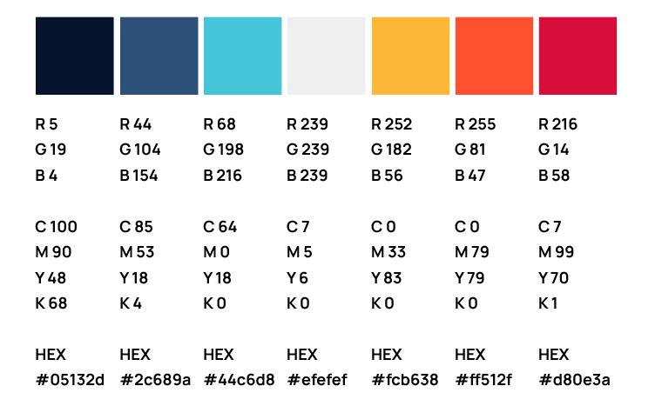


ERCOT IBRWG Industry Updates
Julia Matevosyan, Associate Director and Chief Engineer, ESIG (ERCOT IBRWG chair)
June 15, 2026
ERCOT IBRWG Meeting
Energy Systems Integration Group 2026

Slide 2
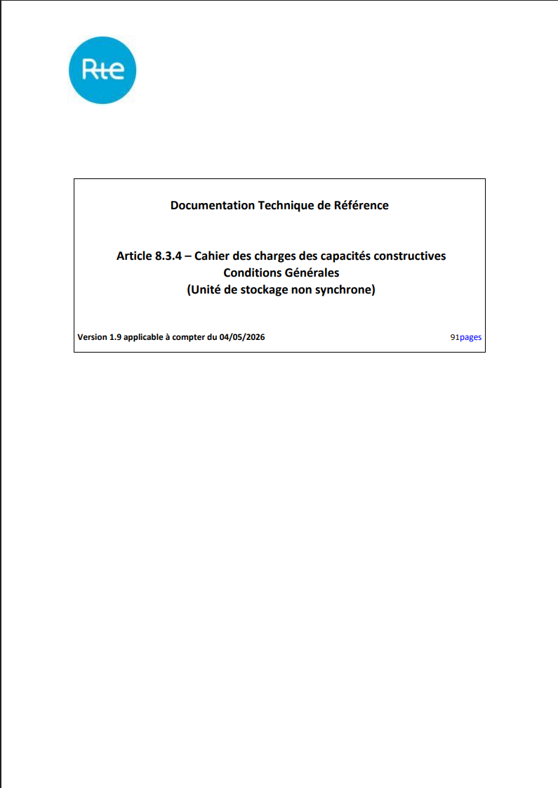
GFM Requirement for all Future BESS in France
All BESS between 18-75 MW (Type C) connected below 110 kV and all BESS ≥75 MW connected at or above 100 kV (Type D) applying for connection on or after 5/4/2026 are required to be GFM
Technical requirements: with a dedicated section on GFM are here (in French)
Performance validation procedure: with a specific requirements on GFM tests are here (in French)
Similarly to ERCOT’s approach the requirements are performance –based and verified through tests applied to models, rather than prescribing any specific controls.

Slide 3
GFM Requirement for Future BESS in Mexico
Grid Forming (GFM) technology is now an official requirement for energy storage systems.
Published by Mexico’s energy regulator CNE on April 16, 2026
The document spells out other rules and participation models for storage in general
Summary is available here
Technical specifications are still to be work out by CENACE

Slide 4


i2X Studies, Tools, and Interconnection Consistency and Harmonization
i2X STITCH| 06/23/2026
Regional Studies: ERCOT & MISO
A DOE initiative supported by the Office of Critical Minerals and Energy Innovation (CMEI)

Slide 5

Key Goals and Outcomes from i2X STITCH
To advance interconnection study practices across U.S. regions by identifying opportunities for harmonization, standardization, and automation to improve the speed, transparency, and reliability of generation and storage interconnections.
The Forum will convene the industry stakeholders and synthesize insights from meetings into a technical whitepaper that defines actionable pathways for consistent and efficient interconnection study processes nationwide.
The presentation portion of these meetings will be recorded and posted, and presentation slides will be shared.
Regional study processes, challenges and gaps, recommended practices and harmonization opportunities will be summarized in the whitepaper, published by the end of the meeting series, in February 2027
Notes:
[DOE]

Slide 6
i2X STITCH Meetings – Preliminary Agenda
May 26th, 2026, 11 a.m.- 1 p.m. ET: Kick-Off Meeting
June 23rd, 2026, 11 a.m.- 1 p.m. ET: Regional Study Process (MISO, ERCOT)
July 28th, 2026, 11 a.m.- 1 p.m. ET: Regional Study Process Cont. (CAISO, WECC utility)
August 18th, 2026, 11 a.m.- 1 p.m. ET: Regional Study Process Cont. (NYISO, ISO-NE, non-ISO utility)
September 22nd, 2026, 11 a.m.- 1 p.m. ET: Regional Study Process Cont. (SPP, PJM)
October 20th, 2026, 11 a.m.- 1 p.m. ET: Automation and Data Harmonization
November 17th, 2026, 11 a.m.- 1 p.m. ET: Industry Advisor Perspectives and Other Topics
January 26th, 2026, 11 a.m.- 1 p.m. ET: Final Paper Presentation
March 22nd, 2026, hybrid 1-day event during ESIG Spring Workshop, San Diego, California: Interconnection Studies and Harmonization Workshop
Follow ESIG i2X STITCH website: https://www.esig.energy/i2x-initiatives/#i2x-STITCH for meeting materials & recordings and for future meeting details, agendas, and to register!

Slide 7
i2X STITCH June 23rd Regional Studies: ERCOT & MISO – Agenda
Meeting Introduction : Julia Matevosyan, ERCOT
MISO Interconnection Study Process: Alyssa Hickey, MISO
Developer Perspective on MISO Interconnection Study Process: Michael Russ, STRATA
ERCOT Interconnection Study Process: Jenifer Fernandes, ERCOT
Developer Perspective on ERCOT Interconnection Study Process: Vish Sankaran, Engie
Audience Q&A and Discussion, led by Julia Matevosyan, ESIG

Slide 8





Forum for the Implementation of Reliability Standards for Transmission (i2X FIRST)| 06/04/26
A DOE initiative supported by the Office of Critical Minerals and Energy Innovation (CMEI)

Slide 9
Key Goals and Outcomes from i2X FIRST
To facilitate understanding and adoption of new and recently updated standards relevant for existing and newly interconnecting inverter-based resources.
The Forum will convene the industry stakeholders to enable practical and more harmonized implementation of these interconnection standards.
The presentation portion of the meeting will be recorded and posted, and presentation slides will be shared.
Additionally, the leadership team will produce a summary of each meeting capturing:
Recommended best practices
Challenges
Gaps that require future work
Notes:
[DOE]

Slide 10
i2X FIRST, Season 3 Meetings – Preliminary Topics
June 4, 2026, 11 a.m. - 1 p.m. ET: Deep Dive NERC PRC-029 Implementation Updates
August 6, 2026, 11 a.m.- 1 p.m. ET: NERC Milestone 4 Projects and NERC Project 2022-04 EMT Modeling
October 2026 hybrid session during ESIG Fall Technical Workshop – IEEE 2800.2 Deep Dive
January 14, 2027: IEEE 2800 Updates Session
Follow ESIG i2X FIRST website: https://www.esig.energy/i2x-initiatives/#i2X-Season-3 for meeting materials & recordings and for future meeting details, agendas, and to register!

Slide 11
i2X FIRST June 4th: Deep Dive NERC PRC-029 Implementation Updates – Agenda
Meeting Introduction: Julia Matevosyan, ESIG
Project 2025-05 Ride-Through Revisions: Eugen Starschich, Siemens Energy and Rajat Majumder, Invenergy
Developer / Generator Owner Perspective on Challenges and Solutions with PRC-029 Compliance Assessment: Katie Iversen, AES
How PRC-029-01 Compliance Can Be Assessed Using IEEE 2800.2 Tools: Jens Boemer, EPRI
Implementation Guidance for PRC-029-01: Tim Taylor, SEIA and Ryan Quint, Elevate Energy Consulting
Audience Q&A and Structured Discussion, led by Julia Matevosyan, ESIG

Slide 12

i2X Technical Assistance Hours
i2x Technical Assistance Hours – provide technical assistance to interconnection stakeholders focused on adoption of a harmonized and/or comprehensive interconnection requirements or standards. One-one sessions with ESIG and Elevate Energy Consulting staff for key interconnection stakeholders.
https://www.esig.energy/i2x-initiatives/#Office-Hours

Slide 13

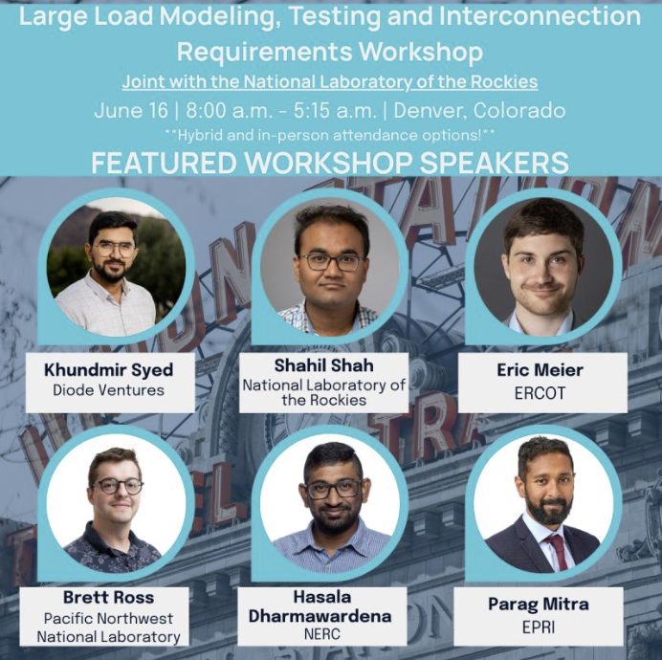
LL Modeling, Testing and Requirements Workshop
ESIG and the National Laboratory of the Rockies are co-hosting a one-day hybrid workshop on large load modeling, testing, and interconnection requirements in Denver on 6/16.
What matters most when modeling large loads for phasor domain and EMT impact studies?
How do you validate large load models to the accuracy reliability assessments require?
How are interconnection requirements for large loads being shaped — and by whom?
How can modeling and studies be used to ensure compliance?
The workshop draws on findings from the DOE-funded Foundational Studies and Technical Solutions for Large Dynamic Digital Loads project and brings together ISOs, RTOs, utilities, large load developers, battery developers, and researchers.
https://www.esig.energy/large-load-modeling-testing-and-interconnection-requirements-workshop/

Slide 14
Interconnection Studies Short Course
Energy Systems Integration Group 2026
June 15th-17th, 2026
Venue
Donated by The Bonneville Power Association:
US General Service Administration
1220 SW Third Avenue
Portland, Oregon 97204
This three-day in-person training is intended to enhance the knowledge and ability of the current workforce through coursework focused on best practices for performing the study work necessary to interconnect inverter-based resources to the bulk power system reliably. Training participants will learn practical methods and best practices that can be leveraged into enhanced study practices across the industry. These training modules will focus on the expected day-to-day needs of engineers performing interconnection studies, model quality tests, or inverter-based resource model and simulation work as well as managing study practices within their organization.
Topics
An example agenda can be found on the training page on the ESIG website. This agenda is representative of the course but the course will be fine tuned based on attendee needs.
Accommodations
ESIG has a special room rate of $179/night at The Porter Portland, Curio Collection by Hilton, 1355 S W 2nd Avenue, Portland, about a two-minute walk to the meeting.
Materials from Fall 2025 Course Here
Explore Here

Slide 15
Electromagnetic Transient Training
Energy Systems Integration Group 2026
Week of October 5th, 2026
Training page coming soon!!
Venue
Donated by The Texas Reliability Entity:
8000 Metropolis Drive
Building A Suite 300
Austin, TX 78744
This 3-day in-person training is intended to enhance the knowledge and ability of the current workforce through coursework focused on performing EMT simulations in the current interconnection and planning paradigm. Training participants will learn practical methods and best practices that can be leveraged into enhanced study practices across the industry. These training modules will focus on the expected day-to-day needs of engineers performing EMT analysis as well as managing EMT study practices within their organization.
Topics
An example agenda will be posted on the training page on the ESIG website. This agenda is representative of the course but the course will be fine tuned based on attendee needs.
Accommodations
Hotel block details coming soon!!
Materials from Fall 2025 Course Here
Explore Here

Slide 16
Advanced EMT Training
Energy Systems Integration Group 2026
Training page coming soon!!
Venue
December 10th-12th, 2026
Donated by The New England Independent System Operator:
ISO-NE Windsor CT Office
This training is intended to expand upon the material and concepts presented in the ESIG EMT Fundamentals training. The coursework will provide deeper dive into special studies, focusing on issues such as modeling complex IBR plants, control interactions between multiple generation resources on the network or within a specific plant, sub-synchronous resonance issues, and other advanced topics necessary to move the paradigm forward. These topic areas, as a starting point in the training, will provide holistic view of EMT modeling in the new study paradigm and this knowledge will be used as a basis to tackle practical topics like ensuring design evaluation changes are implemented through pre-commissioning checks and model verification, commissioning best practices, and post-commissioning model validation based on actual event data.
Topics
An example agenda will be posted on the training page on the ESIG website. This agenda is representative of the course but the course will be fine tuned based on attendee needs.
Accommodations
Hotel block details coming soon!!
Explore Here

Slide 17

julia@esig.energy

