Slide 1
DAM PTP Bid Fee NPRR Update
CMWG
Nathan Smith
ERCOT Forward Markets
June 15, 2026
Outline
Background
PTP Bid Impact on DAM Execution Time
Awarded vs Unawarded PTP Bids by Day
Defining Absolute and Relative Deltas for Unawarded Bids
Inefficient bids can be defined by two criteria
Visualizing Inefficient Bids
Quantifying Inefficient Bids
Next Steps

Slide 2
PTP Bid Fee Discussion Recap
Why a DAM PTP Bid Fee?
The increased volume of PTP bids submitted into DAM negatively affect its execution time
Assessing a fee will disincentivize a large number of inefficient PTP Bids
Recommended by IMM to explore options of implementing a bid fee
What are the options for implementing this fee?
Two options have been discussed at previous CMWG meetings
  Option 1 : Flat fee per interval assessed to all PTP Bids
  Option 2 : Fee targets inefficient PTP bids that are unawarded in the DAM
    The inefficiency of a PTP would be determined based on the difference between path clearing price and the PTP bid price
    Preferred option so far

Slide 3
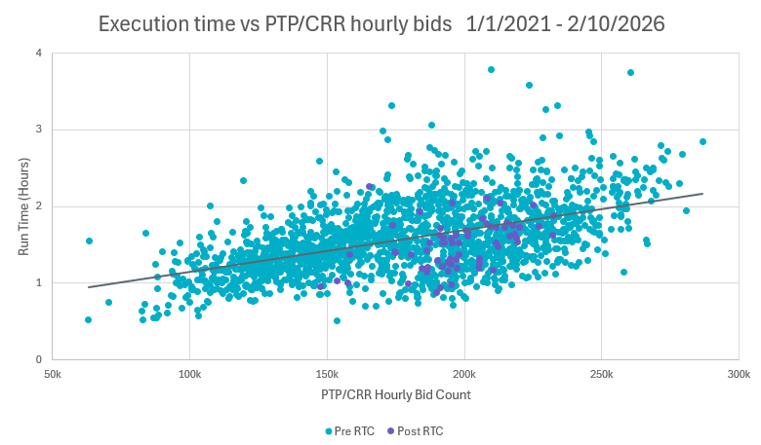
PTP Bid Impact on DAM Execution Time
Execution time vs PTP/CRR Bid Count (1/1/2021 – 2/10/2026)
KEY TAKEAWAY
The volume of PTP bids submitted into DAM affect its execution time
ERCOT has 3:30hr between the time between DAM executes (10:00) and the target posting time (13:30)
ERCOT would ideally want DAM to execute in <2:30hr to leave time for extraordinary events and other processing
Days with over 200k PTP bids are at greater risk of DAM execution times over 2:30hr (orange line) and sometimes over 3:30hr (red line)

Slide 4
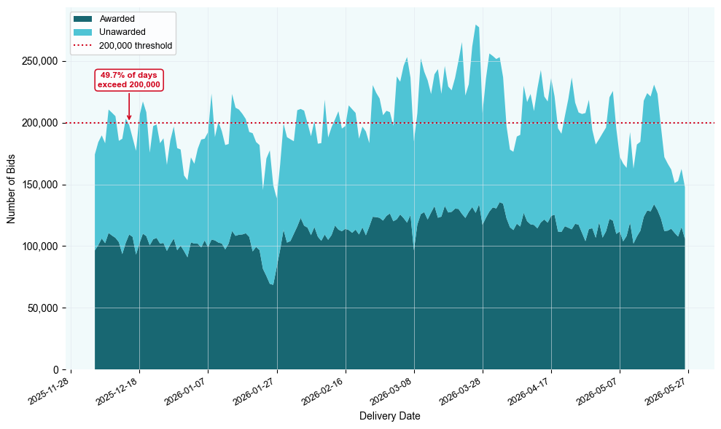
Awarded vs Unawarded PTP Bids by Day
Total Daily DAM PTP Bids (12/5/25 – 5/26/26)
 | Awarded | Unawarded | Total
Avg Per Day | 112,451 | 90,576 | 203,027
% of Total | 55.4% | 44.6% | 100%
KEY TAKEAWAY
Since RTC+B, half of all DAM runs have processed over 200,000 PTP bids
Approximately 45% of PTP bids go unawarded, meaning the submitted not-to-exceed price fell below the market clearing price
This awarded/unawarded split (55%/45%) has remained stable across all months since RTC+B implementation

Slide 5
Defining Absolute and Relative Deltas for Unawarded Bids
Absolute and Relative Delta Calculation - Example
KEY TAKEAWAY
Unawarded bids vary in efficiency. (i.e., “how close the bid was to being awarded”)
Efficiency can be understood by comparing bids in absolute and relative terms
  “Absolute deltas” refer to the dollar amount by which the bid’s NTE price is less than the award price (e.g., a bid with an NTE of $5 against an award price of $10 has an absolute delta of -$5)
  “Relative deltas” refer to the percent by which the bid’s NTE price is less than the award price (e.g., a bid with an NTE of $5 against an award price of $10 has a relative delta of -50%)
Award Price
Unawarded
Awarded
$0
NTE = $5
$10
$15
-$5 Absolute Delta
-50% Relative Delta

Slide 6
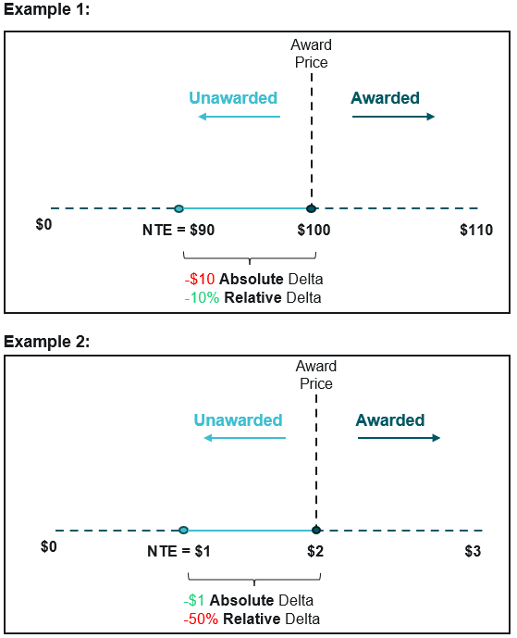
Inefficient bids can be defined by two criteria
Inefficient bid concept with 2 Criteria – Example using $5 absolute / 20% relative as thresholds
Absolutely Inefficient (>$5), Relatively Efficient(<=20%)
KEY TAKEAWAY
For PTP bid intervals with large source-to-sink price spreads (award prices), the spread itself is inherently difficult to forecast in dollar terms; as a result, a bid may deviate by a substantial dollar amount while remaining accurate on a percentage basis (Example 1).
On narrow-spread paths, the opposite holds: a bid may diverge sharply in percentage terms while the dollar miss is negligible (Example 2).
At the April 13th CMWG, ERCOT proposed classifying an unawarded bid as inefficient when its absolute and relative deltas exceed a threshold.
Absolutely Efficient (<=$5), Relatively Inefficient (>20%)

Slide 7
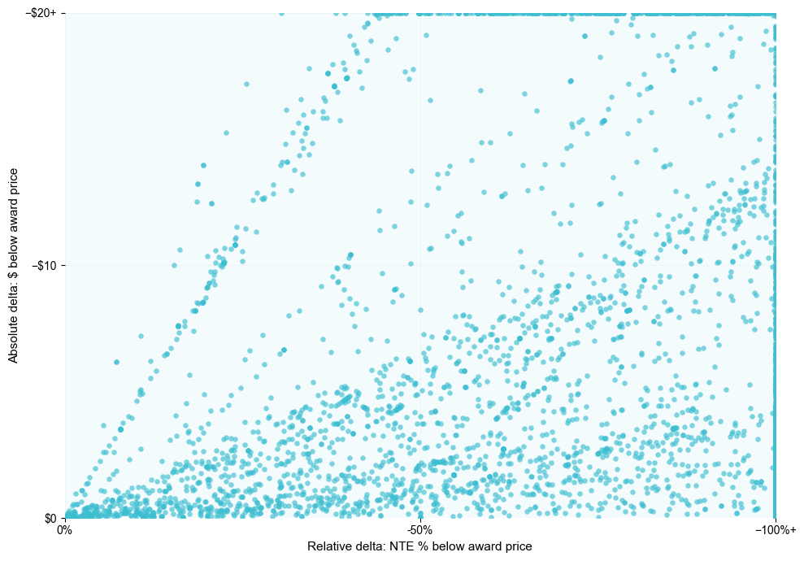
Visualizing Inefficient Bids
Unawarded Bids by Absolute vs. Relative Delta¹
Example “Inefficient” Zone
KEY TAKEAWAY
In both absolute and relative terms, unawarded bids tend to cluster into two groups: near misses concentrated close to the origin, or distant outliers at the edges of the chart.
The "inefficient" zone, defined by absolute and relative delta thresholds, captures only bids that miss on both measures at once: a large dollar gap and a large percentage gap.
Example Relative Delta Threshold
Example Absolute Delta Threshold
¹Based on a single randomly selected bid interval (delivery date and hour) drawn from the analysis window of 12/5/2025–5/26/2026. This randomly selected distribution is representative of general trends as indicated by the absolute delta and relative delta distributions in the appendix.

Slide 8
Quantifying Inefficient Bids
Avg Daily Unawarded Bids Captured by Threshold (12/5/25 – 5/26/26)
KEY TAKEAWAY
The range of threshold combinations captures anywhere from roughly 18k to 68k of unawarded bids, depending on how the relative and absolute cutoffs are set.
These figures are presented for informational purposes only. ERCOT does not have a recommendation on a specific threshold combination at this time; the tables are intended to illustrate the sensitivity of the results to the chosen cutoffs.
 |  | Absolute Delta Threshold
 |  | <-$1 | <-$3 | <-$5
Relative Delta Threshold | <-10%
 | <-20%
 | <-30%
 | <-40%
 | <-50%
 | <-60%
 | <-70%
 | <-80%
 | <-90%
 | <-100%
68,579 | 54,074 | 45,381
66,530 | 53,021 | 44,836
63,822 | 48,916 | 43,616
60,586 | 48,916 | 41,821
56,881 | 46,104 | 39,558
52,613 | 42,767 | 36,784
47,767 | 38,823 | 33,465
42,320 | 34,238 | 29,482
36,195 | 28,746 | 24,669
27,963 | 21,763 | 18,405
Notes:
daily unawarded bids captured by threshold = sum of all bids on all bid intervals in that day that were x% and $y below their respective award price
Avg daily unawarded bids captured by threshold = daily unawarded bids captured by threshold / number of days in the study
% of unawarded bids captured by threshold = sum of all bids on all bid intervals that were x% and $y below their respective award price/total unawarded bids

Slide 9
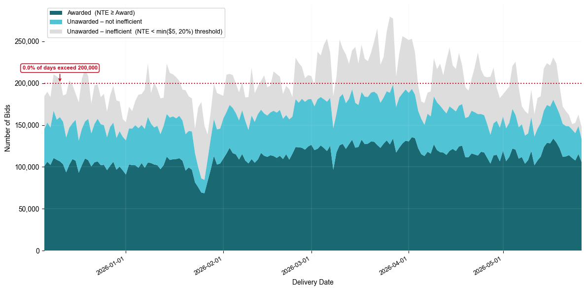
Unawarded vs Awarded bids with Uncompetitive Removed
Total Daily DAM PTP Bids – Inefficient Bids (<-20%, <-$5 thresholds) (12/5/25 – 5/26/26)

Slide 10
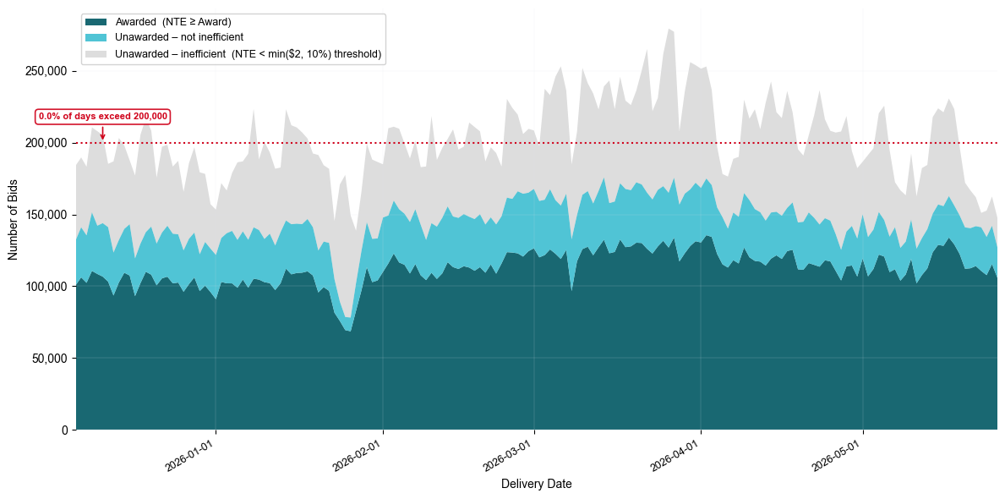
Unawarded vs Awarded bids with Uncompetitive Removed
Total Daily DAM PTP Bids – Inefficient Bids (<-10%, <-$2 thresholds) (12/5/25 – 5/26/26)

Slide 11
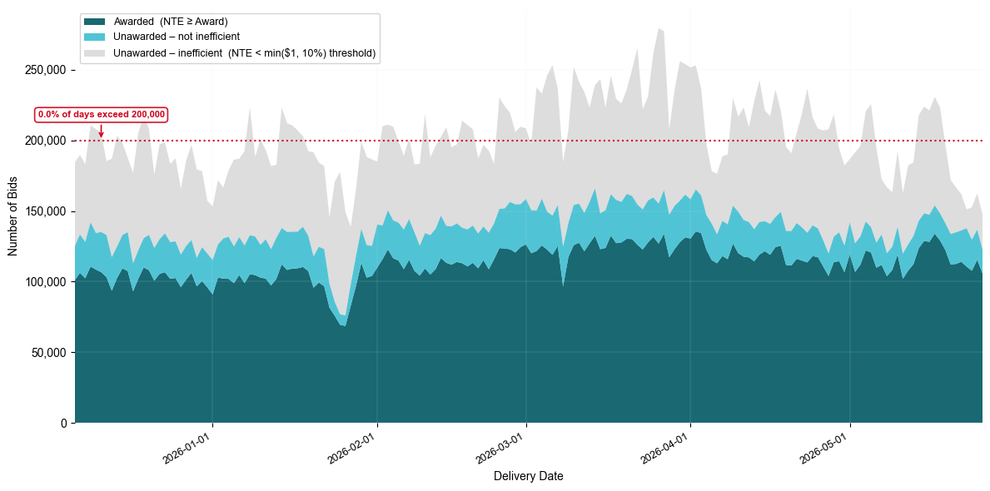
Unawarded vs Awarded bids with Uncompetitive Removed
Total Daily DAM PTP Bids – Inefficient Bids (<-10%, <-$1 thresholds) (12/5/25 – 5/26/26)

Slide 12
Next Steps/Wrap-up
Next steps:
Work on values of absolute/relative thresholds
Consider benefit/impact of ‘Safe Harbor’
Proposal to go to PRS in following months

Slide 13
Questions/Comments?
Alfredo.Moreno@ercot.com

