Slide 1
Batch Zero Readiness Meeting #4
June 11, 2026
Disclaimer: This presentation is provided solely for informational and discussion purposes and does not constitute a binding interpretation of the ERCOT Protocols, Planning Guide, or any other governing authority. In the event of any conflict between this presentation and the ERCOT Protocols, Planning Guide, or other applicable governing documents, the governing documents shall prevail.

Slide 2
Agenda
Batch Zero Readiness Discussion Schedule
Batch Zero Process Flow and updated LIF
Batch Zero Frequently Asked Questions (FAQ)
Appendix

Slide 3
Weekly Batch Zero Readiness Discussions (see ERCOT Meeting Calendar)
Monday
Tuesday
Wednesday
Thursday
Friday
June
1
2
3
4
5
Board Meeting
Board Meeting
Batch Readiness Meeting
2-3PM
Also:
ERCOT is currently sending weekly emails to TSPs by end of day Tuesday on current LLIS Batch Zero status (final LLIS status is subject to PUCT approval of PGRR145 requirements, expected Jun 18)
ERCOT is developing an FAQ to assist with implementation questions
8
9
10
11
12
Batch Readiness Meeting
2-3PM
15
16
17
18
19
LLWG/Batch Readiness
Time TBD
22
23
24
25
26
Batch Readiness Meeting
2-3PM
29
30
July
1
2
3
Batch Readiness Meeting
2-3PM
6
7
8
9
10
Batch Readiness Meeting
2-3PM
LLIS Submission
Process ends
13
14
15
16
17
20
21
22
23
24
TSP Due date for Batch Zero
27
28
29
30
31

Slide 4
Batch Zero key submission deadlines and main responsibilities
Note: timeline assumes PUCT approval on June 18th
X
Detailed next
1
July 10
2
July 24
August 7
August 31
ILLE
Deadline for ILLE to submit required Batch Zero eligibility materials to the Interconnecting TSP/DSP and, where required, directly to ERCOT (e.g., dynamic load models)
Deadline for ILLEs to resolve identified dynamic model and technical data deficiencies and submit corrected materials
TSP/DSP
Deadline for TSPs/DSPs to submit complete Batch Zero eligibility packages and supporting materials to ERCOT
ERCOT
Last day ERCOT will review and approve LLIS studies under the legacy process
Deadline for ERCOT to notify TSPs/DSPs of Batch Zero classification results, including eligibility determinations and identified dynamic model or data deficiencies
Early submission encouraged prior to July 10: Interconnecting DSPs/TSPs and ILLEs are encouraged to begin submitting Batch Zero eligibility materials and supporting documentation as early as practicable in advance of the July 10, 2026 milestone. ERCOT may review submitted materials on a rolling basis and provide preliminary feedback regarding completeness, potential deficiencies, or additional information needs
Source: ERCOT discussions

Slide 5
1
July 10 Batch Zero milestone: activities required
  Lead role
ILLE
TSP/DSP
ERCOT
  Working with the TSP/DSP, identify the applicable Batch Zero eligibility pathway within the LIF
  Prepare required attestations, technical documentation, and supporting evidence
  Submit dynamic load models and supporting technical materials to ERCOT and the Interconnecting TSP, where applicable
  Resolve known documentation or technical gaps prior to TSP/DSP validation review
  Coordinate review responsibilities between TSP and DSP, as applicable
  Begin preliminary review of submitted ILLE materials and supporting evidence
  Align on the designated entity responsible for final ERCOT package submission
  Finalize LLIS study review activities under the legacy process

Slide 6
2
July 24 Batch Zero milestone: activities required
  Lead role
ILLE
TSP/DSP
ERCOT
  Respond to TSP/DSP validation questions and resolve identified submission deficiencies, as applicable
  Provide supplemental technical materials or clarifications needed to support package completeness
  Complete review and validation of ILLE submission materials against applicable eligibility requirements
  Resolve outstanding package deficiencies and confirm submission completeness within the LIF
  Finalize the coordinated Batch Zero eligibility package and submit required materials to ERCOT
  Prepare for formal completeness, classification, and eligibility review of submitted Batch Zero packages
  Clarification: the post–July 10 validation period is intended to address administrative corrections, clarification requests, and minor submission errors identified during TSP/DSP review (e.g., typos or incorrect references). It is not intended to allow submission of materially missing eligibility items or satisfaction of requirements that were not completed by the applicable July 10 deadline (e.g., posting financial security, executing required commitments, or completing required attestations)

Slide 7
Batch Zero eligibility submission and validation process
Performed by ILLE
Performed by TSP/DSP
Performed by ERCOT
1
Eligibility Path Identification
Working with TSP/DSP, ILLE uses the Load Information Form (LIF) to identify the applicable Batch Zero eligibility pathway and the associated submission requirements and documentation
Until Jul 10
2
Preparation of Submission Materials
ILLE executes the required attestations, and prepares technical documentation, forms, and supporting evidence applicable to the selected eligibility pathway
3
Submission of Materials
ILLE submits the applicable materials and supporting evidence to the Interconnecting TSP/DSP and, where required, directly to ERCOT (e.g., dynamic load models and supporting documentation)
4
Review Coordination
Interconnecting TSP/DSP coordinate responsibility for reviewing submission materials, determine the applicable Eligibility/Entry Path, and prepare the LCP². Review responsibility and completion status are tracked within the LIF
5
Validation and Completeness Review
Interconnecting TSP/DSP, as applicable, review submitted materials, validate completeness against the applicable eligibility requirements, and document status/comments in the LIF
Jul 10- Jul 24
6
Package Reconciliation and Follow-up
ILLE provides administrative corrections, clarifications, or non-material supplemental information to address issues identified during TSP/DSP review¹
7
Final Package Assembly
Interconnecting TSP/DSP, as applicable, finalize the coordinated eligibility package and confirm all applicable items are complete within the LIF
8
Submission to ERCOT
Interconnecting TSP submits the final coordinated eligibility package to ERCOT via email with the Interconnecting DSP and ILLE copied, where applicable
Jul 24-Aug 7
9
ERCOT Initial Eligibility Assessment
ERCOT performs validation of the Batch Zero eligibility package, including attestations, TSP/DSP confirmations, and submission completeness
10
Dynamic Model Deficiency Resolution
ERCOT notifies ILLEs of identified dynamic model or data deficiencies. ILLEs submit corrected models, updated parameters, or supplemental technical information during the cure period
Aug 7-Aug 31
11
ERCOT Final Eligibility Validation
ERCOT finalizes Batch Zero eligibility determinations following resolution of outstanding dynamic model and data deficiencies
1. The post–July 10 validation period is intended to address administrative corrections, clarification requests, and minor submission errors identified during TSP/DSP review (e.g., typos or incorrect references). It is not intended to allow submission of materially missing eligibility items or satisfaction of requirements that were not completed by the applicable July 10 deadline (e.g., posting financial security, executing required commitments, or completing required attestations) | 2. Including selection of the applicable Entry Path, incorporation of LLIS/RPG/PBRP study information, transmission upgrade and TPIT data, and calculation of the resulting modeled load schedule
Source: ERCOT discussions

Slide 8
Batch Zero ERCOT communications and submission channels
LLWG_Feedback@ercot.com for General Batch Zero Questions
Channel for general implementation questions, stakeholder feedback, and process clarification requests related to the Batch Zero Large Load interconnection framework
LargeLoadInterconnection@ercot.com for Existing LLIS Process Questions
Channel for questions related to the legacy LLIS process (e.g., ongoing study reviews, dynamic model submissions, and existing interconnection study coordination)
BatchZero@ercot.com for Formal Batch Zero Submissions
Channel for submission of completed Batch Zero eligibility packages by the designated Interconnecting TSP, with notification to the applicable DSP and ILLE through copied submission correspondence, as appropriate
NOTE: ERCOT plans to assign a new unique Batch Zero identifier (“BZ ID”) to each submitted Large Load project for Batch Zero intake and tracking purposes. These identifiers will serve as the primary reference number for Batch Zero implementation activities
Supporting materials and forms will be published on the Large Load Integration webpage

Slide 9
Questions about Dynamic Model Submissions
Current ongoing LLIS submittals
LargeLoadInterconnection@ercot.com
Dynamic model submission
Batch Zero submittals with Batch Zero ID#
BatchZero@ercot.com

Slide 10
Agenda
Batch Zero Readiness Discussion Schedule
Batch Zero Process Flow and updated LIF
Batch Zero Frequently Asked Questions (FAQ)
Appendix

Slide 11
Batch Zero eligibility submission and validation process
Performed by ILLE
Performed by TSP/DSP
Performed by ERCOT
  Detailed next
1
Eligibility Path Identification
Working with TSP/DSP, ILLE uses the Load Information Form (LIF) to identify the applicable Batch Zero eligibility pathway and the associated submission requirements and documentation
Until Jul 10
2
Preparation of Submission Materials
ILLE executes the required attestations, and prepares technical documentation, forms, and supporting evidence applicable to the selected eligibility pathway
3
Submission of Materials
ILLE submits the applicable materials and supporting evidence to the Interconnecting TSP/DSP and, where required, directly to ERCOT (e.g., dynamic load models and supporting documentation)
4
Review Coordination
Interconnecting TSP/DSP coordinate responsibility for reviewing submission materials, determine the applicable Eligibility/Entry Path, and prepare the LCP². Review responsibility and completion status are tracked within the LIF
5
Validation and Completeness Review
Interconnecting TSP/DSP, as applicable, review submitted materials, validate completeness against the applicable eligibility requirements, and document status/comments in the LIF
Jul 10- Jul 24
6
Package Reconciliation and Follow-up
ILLE provides administrative corrections, clarifications, or non-material supplemental information to address issues identified during TSP/DSP review¹
7
Final Package Assembly
Interconnecting TSP/DSP, as applicable, finalize the coordinated eligibility package and confirm all applicable items are complete within the LIF
8
Submission to ERCOT
Interconnecting TSP submits the final coordinated eligibility package to ERCOT via email with the Interconnecting DSP and ILLE copied, where applicable
Jul 24-Aug 7
9
ERCOT Initial Eligibility Assessment
ERCOT performs validation of the Batch Zero eligibility package, including attestations, TSP/DSP confirmations, and submission completeness
10
Dynamic Model Deficiency Resolution
ERCOT notifies ILLEs of identified dynamic model or data deficiencies. ILLEs submit corrected models, updated parameters, or supplemental technical information during the cure period
Aug 7-Aug 31
11
ERCOT Final Eligibility Validation
ERCOT finalizes Batch Zero eligibility determinations following resolution of outstanding dynamic model and data deficiencies
1. The post–July 10 validation period is intended to address administrative corrections, clarification requests, and minor submission errors identified during TSP/DSP review (e.g., typos or incorrect references). It is not intended to allow submission of materially missing eligibility items or satisfaction of requirements that were not completed by the applicable July 10 deadline (e.g., posting financial security, executing required commitments, or completing required attestations) | 2. Including selection of the applicable Entry Path, incorporation of LLIS/RPG/PBRP study information, transmission upgrade and TPIT data, and calculation of the resulting modeled load schedule
Source: ERCOT discussions

Slide 12
Batch Zero Numbers
By the end of the week, ERCOT will issue new Batch Zero unique identifier numbers to all Large Loads currently being tracked and provide these numbers to the appropriate TSP.
These numbers will use the format BZ-####
The BZ number is randomly generated and does not indicate inclusion status in Batch Zero.
Records of previous LLIS and RPG numbers will be retained and associated with the new BZ number.
BZ numbers will be required to complete the LIF and all attestations.
In the event a Large Load request is issued multiple BZ numbers, the ILLE should use the lower number to complete the forms and notify the TSP of the duplicate.
RPG
yyRPG###
LLIS
LLI-####
Energized Load
Batch Zero Number
BZ-####
Permian Reliability Plan
SB6 NMA
QSA / IVRT
On or before May 1

Slide 13
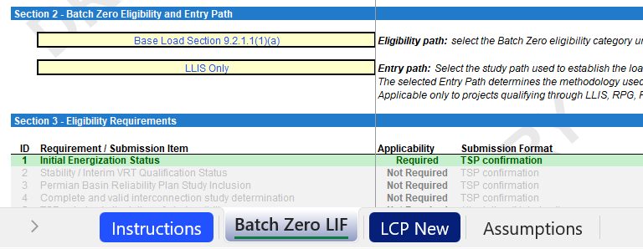
LIF Updated to Incorporate Entry Path Selection and Dynamic LCP Logic (1/2)
Updated LIF screenshot
Key highlights
1
Updated LIF now captures both the Eligibility Path and Entry Path: the Eligibility Path determines the applicable Batch Zero requirements, while the Entry Path determines the methodology used to construct the modeled load schedule
The Interconnecting TSP/DSP is responsible for completing the LCP: based on the selected Entry Path, the TSP/DSP populates the applicable LCP information and applies the corresponding modeling methodology
Seven Entry Paths are currently supported in the workbook: LLIS Only, RPG Only, RPG + Complete and Valid LLIS, PBRP Only, PBRP + Complete and Valid LLIS, Studied Load / PCLR / WLPUN, and Energized / QSA / IVRT
Different Entry Paths require different inputs and calculations: study-based pathways use LLIS, RPG, PBRP, TPIT, and Interconnection Agreement information, while Energized / QSA / IVRT and Studied Load / PCLR / WLPUN pathways use simplified modeling methodologies based on existing LCPs, RTP RFI information, and/or Interconnection Agreements
1
2
2
Source: DRAFT Batch Zero Load Information Form 05222026_v12

Slide 14
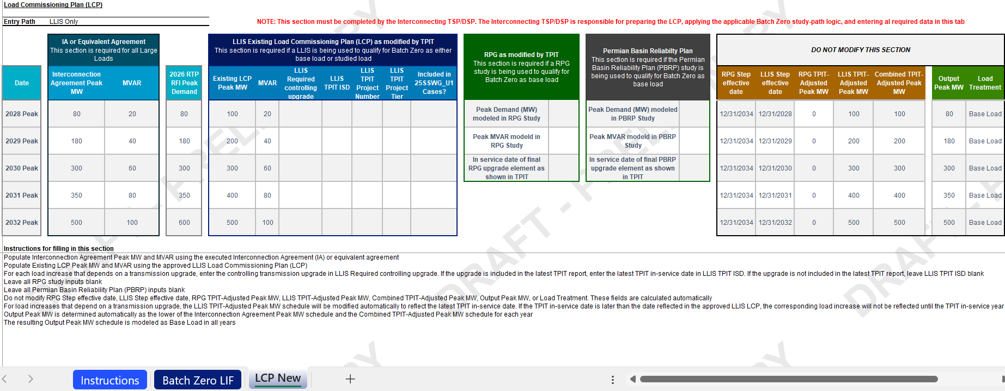
LIF Updated to Incorporate Entry Path Selection and Dynamic LCP Logic (2/2)
Updated LIF screenshot
“LCP New” sheet layout redesigned to improve usability: sections were reorganized, color-coded inputs and calculated fields were introduced, and pathway-specific instructions were added to help TSPs/DSPs complete the workbook more efficiently and consistently
Source: DRAFT Batch Zero Load Information Form 05222026_v12

Slide 15
Qualifying Study: Complete and valid LLIS ONLY
Obtain the LCP from the approved LLIS study
Review TPIT and modify any dates in the LCP according to 9.2.1.1(2)(c)(ii)(B)
Obtain the ramp schedule in the executed IA for the load.
Compare the modified LCP and the executed IA. Use the lower value for each year.
Load is base load in all years according to this schedule

Slide 16
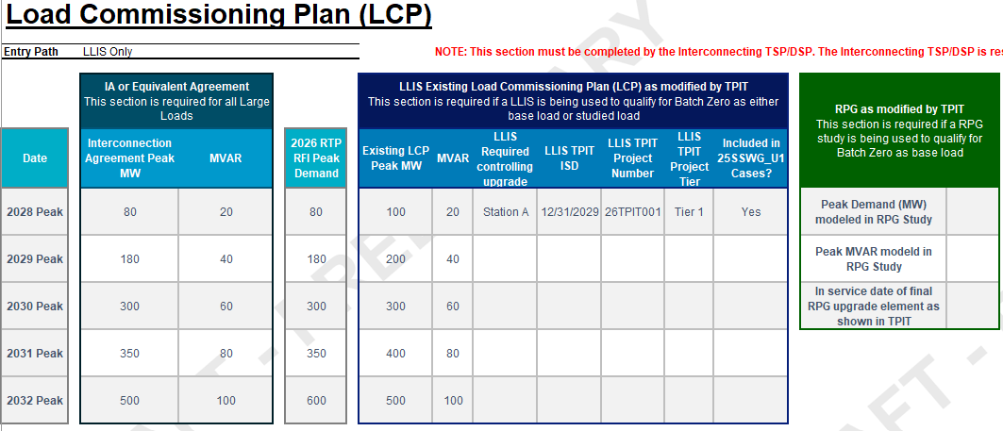

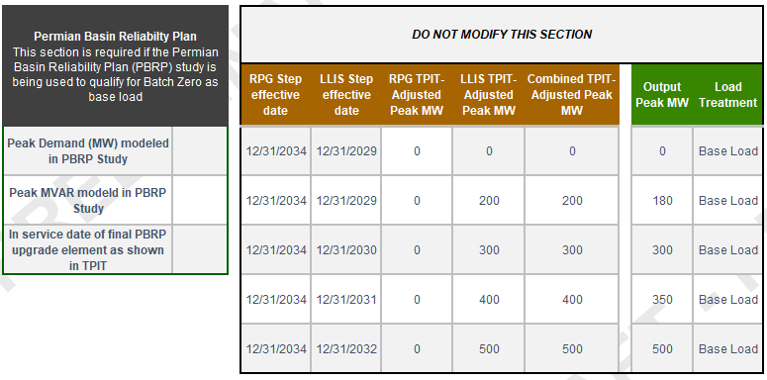
Case Study (1/7): Complete and valid LLIS ONLY
Populate Interconnection Agreement Peak MW using the executed IA
Supporting screenshots
Process description
  Populate Interconnection Agreement Peak MW and MVAR using the executed Interconnection Agreement (IA) or equivalent agreement
  Enter the maximum load level contractually permitted in each annual model year
  These values are used later to determine the final Output Peak MW schedule
Source: DRAFT Batch Zero Load Information Form 05222026_v12

Slide 17
Case Study (2/7): Complete and valid LLIS ONLY
Populate Existing LCP Peak MW and MVAR
Supporting screenshots
Process description
  Populate Existing LCP Peak MW and MVAR using the approved LLIS Load Commissioning Plan (LCP)
  For each annual model year, enter the load level reflected in the approved LLIS schedule
Source: DRAFT Batch Zero Load Information Form 05222026_v12

Slide 18
Case Study (3/7): Complete and valid LLIS ONLY
Enter LLIS upgrades and TPIT dates
Supporting screenshots
Process description
  For each load increase that depends on a transmission upgrade, enter the controlling upgrade in LLIS Required Controlling Upgrade
  If the upgrade appears in the latest TPIT report, enter the latest TPIT in-service date in LLIS TPIT ISD
  If a load increase depends on a transmission upgrade but the upgrade is not included in the latest TPIT report, enter the controlling transmission upgrade in LLIS Required Controlling Upgrade and leave LLIS TPIT ISD blank
  These entries determine whether the LLIS load increase remains available in the original year or is deferred to a later year
Source: DRAFT Batch Zero Load Information Form 05222026_v12

Slide 19
Case Study (4/7): Complete and valid LLIS ONLY
Populate LLIS supporting information
Supporting screenshots
Process description
  For each LLIS load increase that depends on a transmission upgrade, identify the associated TPIT project
  Populate the applicable TPIT Project Number, TPIT Project Tier, and indicate whether the upgrade is reflected in the 25SSWG_U1 cases
  This information is provided for reference and validation purposes and supports ERCOT review of the TPIT assumptions
Source: DRAFT Batch Zero Load Information Form 05222026_v12

Slide 20
Case Study (5/7): Complete and valid LLIS ONLY
Review the LLIS TPIT-Adjusted Peak MW
Supporting screenshots
Process description
  No user input is required in this section
  The LLIS TPIT-Adjusted Peak MW schedule is modified automatically to reflect the latest TPIT in-service date for each LLIS-controlled step
  If a required upgrade enters service later than assumed in the LLIS, the associated load increase is automatically deferred until the TPIT in-service year
Source: DRAFT Batch Zero Load Information Form 05222026_v12

Slide 21
Case Study (6/7): Complete and valid LLIS ONLY
Review the Combined TPIT-Adjusted Peak MW
Supporting screenshots
Process description
  No user input is required in this section
  Under the LLIS Only Entry Path, the Combined TPIT-Adjusted Peak MW schedule is equal to the LLIS TPIT-Adjusted Peak MW schedule
  Combined TPIT-Adjusted Peak MW reflects the load levels available after applying TPIT adjustments
Source: DRAFT Batch Zero Load Information Form 05222026_v12

Slide 22
Case Study (7/7): Complete and valid LLIS ONLY
Review the Output Peak MW
Supporting screenshots
Process description
  No user input is required in this section
  The workbook automatically calculates Output Peak MW as the lower of:
    the Interconnection Agreement Peak MW schedule; and
    the Combined TPIT-Adjusted Peak MW schedule
  The resulting Output Peak MW schedule represents the final Batch Zero modeled load schedule
  Under the LLIS Only Entry Path, the resulting schedule is modeled as Base Load in all years
Source: DRAFT Batch Zero Load Information Form 05222026_v12

Slide 23
Qualifying Study: RPG ONLY
Review the RPG report and identify the in-service date of the last upgrade in the project.
Use the ramp schedule from the IA
Load is base load in all years according to this schedule
IA
Compare the modified LCP and the executed IA. Which is lower?
Construct LCP for the load that is 0 MW for all years prior to the in-service of the last upgrade
Review TPIT and modify any dates in the LCP according to 9.2.1.1(2)(c)(ii)(A)
Obtain the ramp schedule in the executed IA for the load.
Modified RPG
Modify the RPG ramp according to the rules in 9.2.1.2(3) to set limits on studied amount
Load is a hybrid load
- Studied in years before RPG in-service
- Base load after that

Slide 24
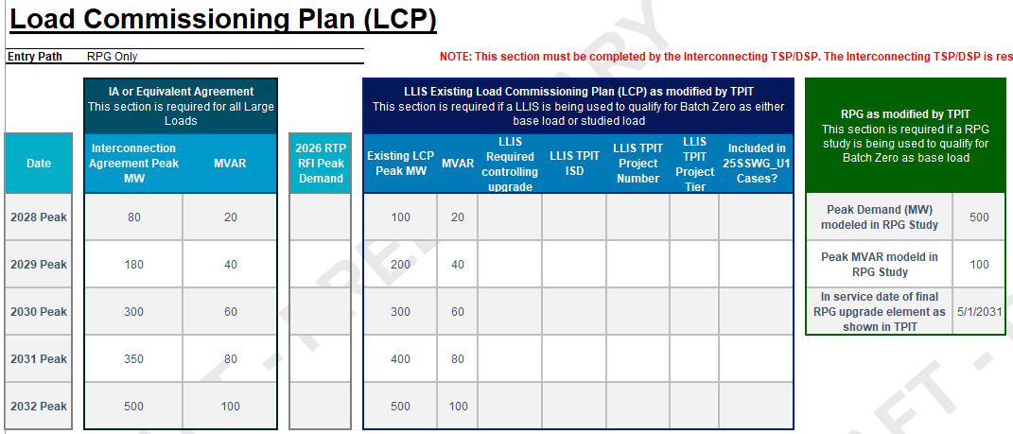
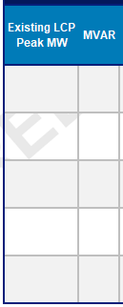
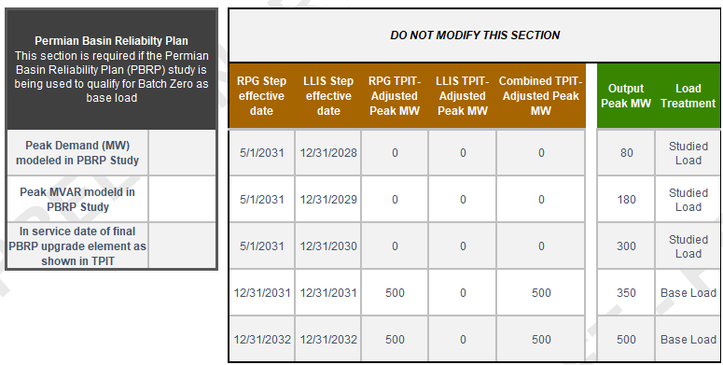
Case Study (1/6): RPG ONLY
Populate Interconnection Agreement Peak MW using the executed IA
Supporting screenshots
Process description
  Populate Interconnection Agreement Peak MW and MVAR using the executed Interconnection Agreement (IA) or equivalent agreement
  Enter the maximum load level contractually permitted in each annual model year
  These values are used later to determine the final Output Peak MW schedule
Source: DRAFT Batch Zero Load Information Form 05222026_v12

Slide 25
Case Study (2/6): RPG ONLY
Populate RPG study information
Supporting screenshots
Process description
  Populate Peak Demand (MW) modeled in RPG Study and Peak MVAR modeled in RPG Study using the RPG study that qualified the Large Load for Batch Zero
  These values represent the load level determined to be supportable once all required RPG transmission upgrades are in service
  The workbook uses these values together with the TPIT in-service date to construct the RPG-supported schedule
Source: DRAFT Batch Zero Load Information Form 05222026_v12

Slide 26
Case Study (3/6): RPG ONLY
Enter RPG TPIT ISD
Supporting screenshots
Process description
  Populate In-service Date of Final RPG Upgrade Element as shown in TPIT using the latest TPIT in-service date for the final RPG upgrade required to support the Large Load
  The workbook uses this date to determine when the RPG-supported load becomes available for modeling
Source: DRAFT Batch Zero Load Information Form 05222026_v12

Slide 27
Case Study (4/6): RPG ONLY
Leave PBRP and LLIS fields blank
Supporting screenshots
Process description
  Under the RPG Only Entry Path, PBRP and LLIS information is not used in the modeling methodology
  Leave Existing LCP Peak MW, Existing LCP MVAR, PBRP Peak MW, LLIS Required Controlling Upgrade, LLIS TPIT ISD, LLIS TPIT Project Number, LLIS TPIT Project Tier, and Included in 25SSWG_U1 Cases? blank
  No PBRP- or LLIS-related calculations are performed under this pathway
Source: DRAFT Batch Zero Load Information Form 05222026_v12

Slide 28
Case Study (5/6): RPG ONLY
Review RPG TPIT-Adjusted Peak MW
Supporting screenshots
Process description
  No user input is required in this section
  The workbook automatically constructs the RPG-supported schedule using the RPG study Peak Demand and the TPIT in-service date
  Prior to the RPG TPIT in-service date, the modeled amount is 0 MW. Beginning in the RPG TPIT in-service year, the modeled amount reflects the RPG study Peak Demand
Source: DRAFT Batch Zero Load Information Form 05222026_v12

Slide 29
Case Study (6/6): RPG ONLY
Review Output Peak MW and Load Treatment
Supporting screenshots
Process description
  No user input is required in this section
  Output Peak MW is automatically calculated as the lower of:
    the Interconnection Agreement Peak MW schedule; and
    the Combined TPIT-Adjusted Peak MW schedule
  The resulting Output Peak MW schedule determines the applicable load treatment. Prior to RPG availability, the load is modeled as Studied Load; after RPG availability, the load is modeled as Base Load
Source: DRAFT Batch Zero Load Information Form 05222026_v12

Slide 30
Qualifying Study: RPG AND a complete and valid LLIS
Review the RPG report and identify the in-service date of the last upgrade in the project.
Construct LCP for the load that is 0 MW for all years prior to the in-service of the last upgrade
Review TPIT and modify any dates in the RPG LCP according to 9.2.1.1(2)(c)(ii)(A)
Load is base load in all years according to this schedule
Use the ramp schedule from the IA
IA
Compare the modified LCP and the executed IA in each year. Which is lower?
Obtain the LCP from the approved LLIS study
Review TPIT and modify any dates in the LLIS LCP according to 9.2.1.1(2)(c)(ii)(B)
For each year prior to the in-service of last upgrade, take the greater value between the modified RPG LCP and the modified LLIS LCP
Obtain the ramp schedule in the executed IA for the load.
Modified RPG
Load is base load in all years according to this schedule
Use the RPG/LLIS mash-up ramp schedule as modified by TPIT
30

Slide 31
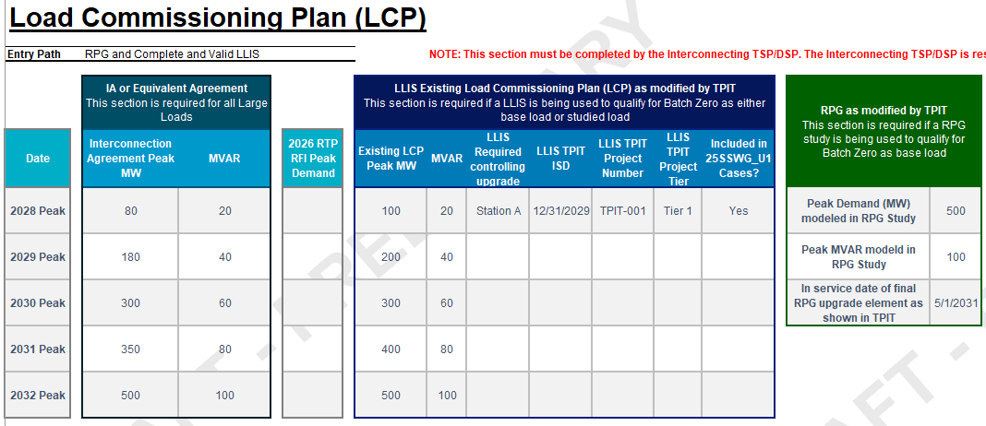
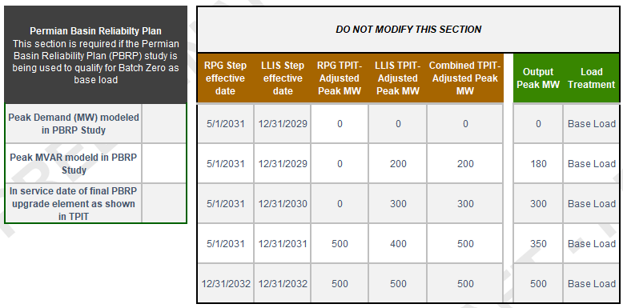
Case Study (1/8): RPG AND a complete and valid LLIS
Populate Interconnection Agreement Peak MW using the executed IA
Supporting screenshots
Process description
  Populate Interconnection Agreement Peak MW and MVAR using the executed Interconnection Agreement (IA) or equivalent agreement
  Enter the maximum load level contractually permitted in each annual model year
  These values are used later to determine the final Output Peak MW schedule
Source: DRAFT Batch Zero Load Information Form 05222026_v12

Slide 32
Case Study (2/8): RPG AND a complete and valid LLIS
Populate Existing LCP Peak MW and MVAR
Supporting screenshots
Process description
  Populate Existing LCP Peak MW and MVAR using the approved LLIS Load Commissioning Plan (LCP)
  These values establish the baseline LLIS-supported load schedule used throughout the example
  The LLIS schedule is subsequently adjusted using TPIT information for any required transmission upgrades
Source: DRAFT Batch Zero Load Information Form 05222026_v12

Slide 33
Case Study (3/8): RPG AND a complete and valid LLIS
Enter LLIS upgrades and TPIT dates
Supporting screenshots
Process description
  For each load increase that depends on a transmission upgrade, enter the controlling upgrade in LLIS Required Controlling Upgrade
  If the upgrade appears in the latest TPIT report, enter the latest TPIT in-service date in LLIS TPIT ISD
  If a load increase depends on a transmission upgrade but the upgrade is not included in the latest TPIT report, enter the controlling transmission upgrade in LLIS Required Controlling Upgrade and leave LLIS TPIT ISD blank
  These entries determine whether the LLIS load increase remains available in the original year or is deferred to a later year
Source: DRAFT Batch Zero Load Information Form 05222026_v12

Slide 34
Case Study (4/8): RPG AND a complete and valid LLIS
Populate LLIS supporting information
Supporting screenshots
Process description
  For each LLIS load increase that depends on a transmission upgrade, identify the associated TPIT project
  Populate the applicable TPIT Project Number, TPIT Project Tier, and indicate whether the upgrade is reflected in the 25SSWG_U1 cases
  This information is provided for reference and validation purposes and supports ERCOT review of the TPIT assumptions
Source: DRAFT Batch Zero Load Information Form 05222026_v12

Slide 35
Case Study (5/8): RPG AND a complete and valid LLIS
Populate RPG Study Information
Supporting screenshots
Process description
  Populate Peak Demand (MW) modeled in RPG Study and Peak MVAR modeled in RPG Study using the qualifying RPG study
  Populate the In-service date of final RPG upgrade element as shown in TPIT
  These values define the load level supportable through the RPG process and when that load becomes available
Source: DRAFT Batch Zero Load Information Form 05222026_v12

Slide 36
Case Study (6/8): RPG AND a complete and valid LLIS
Leave PBRP Inputs Blank
Supporting screenshots
Process description
  This example follows the RPG + Complete and Valid LLIS Entry Path and does not rely on the PBRP study pathway
  Leave all PBRP-related fields blank
  No PBRP adjustments are applied in this example
Source: DRAFT Batch Zero Load Information Form 05222026_v12

Slide 37
Case Study (7/8): RPG AND a complete and valid LLIS
Review Combined TPIT-Adjusted Peak MW
Supporting screenshots
Process description
  No user input is required in this section
  The workbook automatically calculates both the RPG TPIT-Adjusted Peak MW schedule and the LLIS TPIT-Adjusted Peak MW schedule
  Combined TPIT-Adjusted Peak MW reflects the higher of the RPG TPIT-Adjusted Peak MW schedule and the LLIS TPIT-Adjusted Peak MW schedule for each year
Source: DRAFT Batch Zero Load Information Form 05222026_v12

Slide 38
Case Study (8/8): RPG AND a complete and valid LLIS
Review the Output Peak MW
Supporting screenshots
Process description
  No user input is required in this section
  The workbook compares the Combined TPIT-Adjusted Peak MW schedule against the Interconnection Agreement schedule
  Output Peak MW is determined automatically as the lower of the Interconnection Agreement Peak MW schedule and the Combined TPIT-Adjusted Peak MW schedule for each year
  The resulting Output Peak MW schedule is modeled as Base Load in all years
Source: DRAFT Batch Zero Load Information Form 05222026_v12

Slide 39
Qualifying Study: PBRP ONLY
Use the ramp schedule from the IA
Load is base load in all years according to this schedule
IA
Compare the modified LCP and the executed IA. Which is lower?
Construct LCP for the load that is 0 MW for all years prior to 2030 and PBRP modeled amount after that.
Review TPIT and modify any dates in the LCP according to 9.2.1.1(2)(c)(ii)(A)
Obtain the ramp schedule in the executed IA for the load.
Modified PBRP
Use the PBRP ramp schedule as modified by TPIT
Load is a hybrid load
- Studied in years before 2030
- Base load after that
NOTE: PBRP Only follows the same LCP construction methodology as RPG Only

Slide 40
Qualifying Study: PBRP AND a complete and valid LLIS
Construct LCP for the load that is 0 MW for all years prior to 2030 and PBRP modeled amount after that.
Review TPIT and modify any dates in the RPG LCP according to 9.2.1.1(2)(c)(ii)(A)
Load is base load in all years according to this schedule
Use the ramp schedule from the IA
IA
Compare the modified LCP and the executed IA. Which is lower?
Obtain the LCP from the approved LLIS study
Review TPIT and modify any dates in the LLIS LCP according to 9.2.1.1(2)(c)(ii)(B)
For each year, take the greater value between the modified PBRP LCP and the modified LLIS LCP
Obtain the ramp schedule in the executed IA for the load.
Modified PBRP
Load is base load in all years according to this schedule
Use the PBRP/LLIS mash-up ramp schedule as modified by TPIT
NOTE: PBRP + Complete and Valid LLIS follows the same modeling methodology as RPG + Complete and Valid LLIS
40

Slide 41
Path to Batch Zero
May 21
Initial preview of implementation process, new LIF, and attestation templates
May 28
More detailed preview of process, new LIF, and attestation templates
First weeks of June
Official LIF and attestations being posted to the Large Load Integration section of the ERCOT website
New email inbox goes live to receive Batch Zero submission packages
July 24
Last day for Interconnecting TSPs/DSPs, as applicable, to submit completed Batch Zero submission packages to ERCOT
Request for feedback and questions
ERCOT will start accepting submissions and provide preliminary feedback but will not provide final answer unless and until PUCT approves PGRR145 and NPRR1325

Slide 42
Agenda
Batch Zero Readiness Discussion Schedule
Batch Zero Process Flow and updated LIF
Batch Zero Frequently Asked Questions (FAQ)
Appendix

Slide 43
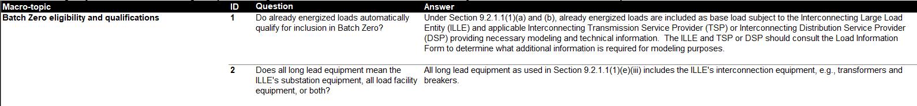
Batch Zero Frequently Asked Questions (FAQ)
ERCOT has posted the Batch Zero FAQ with this meeting (currently 27 items)
The FAQ will be posted when updated with each Batch Zero Readiness meeting and will continue to evolve over time.
Disclaimer: This question-and-answer document is provided solely for informational purposes. In the event of any conflict with the ERCOT Protocols or Planning Guide, those authorities shall govern. ERCOT may update or revise answers as it receives additional questions and information. Nothing in this document constitutes an interpretation or guidance by ERCOT, or is otherwise binding, in proceedings at the PUCT, including Project No. 58481, Rulemaking to Implement Large Load Interconnection Standards Under PURA § 37.0561. Unless otherwise noted, capitalized terms are defined consistent with the ERCOT Protocols.

Slide 44
Batch Zero Readiness Next Meetings
Thursday June 19 (approx. 10-11:30): LLWG - Batch Zero Update/Weekly Readiness (Met and WebEx)
Thursday June 25 (2-3pm): Batch Readiness Meeting #5 WebEx only
Wednesday July 1 (2-3pm): Batch Readiness Meeting #6 WebEx only
Thursday July 9 (2-3pm): Batch Readiness Meeting #7 WebEx only

Slide 45
Questions?
LLWG_Feedback@ERCOT.com

Slide 46
Agenda
Batch Zero Readiness Discussion Schedule
Batch Zero Process Flow and updated LIF
Batch Zero FAQ
Appendix

Slide 47
Key Deadlines for Batch Zero
July 10
Last day for ERCOT to review and approve LLIS studies
July 24
Deadline for required information for inclusion in Batch Zero to be submitted to ERCOT
August 7
Deadline for ERCOT to notify TSPs and DSPs of Large Load inclusion and classification in Batch Zero
As drafted in PGRR145, the current Large Load Interconnection Study (LLIS) process will cease operation after July 10, 2026
This means July 10 is the last day ERCOT is able to review and approve LLIS studies
Starting on July 11, the Batch Zero Interconnection Study will be the only path to connect a Large Load to the ERCOT system
The inclusion and treatment of Large Loads in Batch Zero will be determined by the status of qualifying studies as they stand at the end of the day on July 10, 2026

Slide 48
Review of PGRR115 Process Timelines – Kick-off and Study Scoping
Per Section 9.3.2 of the current Planning Guide, all LLIS studies must be preceded by a kick-off meeting and defined study scope agreed on by ERCOT, the lead TSP, and any affected TSPs. This meeting is required under the Planning Guide and cannot be waived.
The lead TSP is responsible for scheduling the kick-off meeting. ERCOT does not control when a meeting is scheduled.
ERCOT will continue to attend kick-off meetings and to support the study scoping process through July 10.
As described in the Planning Guide, it can take up to 35 Business Days to finalize a study scope after a kick-off meeting is held.
Key Takeaways
The existing kick-off and scoping process remains in effect.
ERCOT continues to attend kick-off meetings and review study scopes.
However, it may not be possible to scope a LLIS study with a kick-off meeting held after May 21, 2026.

Slide 49
Review of PGRR115 Process Timelines – Study Reviews and Approvals
Per Section 9.4 of the current Planning Guide, all LLIS studies must be submitted to ERCOT for review and approval.
ERCOT will continue to review studies under this process through July 10.
As described in the Planning Guide, it can take up to 30 Business Days for ERCOT to review a submitted study.
ERCOT review is not guaranteed to result in an approval. Any required updates to a submitted study are treated as a new submission, which restarts the timeline for review.
ERCOT does not have visibility into the amount of time needed by TSPs to perform a LLIS study. Please reach out to your lead TSP with questions about the status of a study that has not yet been submitted to ERCOT for review.
Key Takeaways
The existing study review process remains in effect through July 10.
ERCOT continues to review submitted study reports as quickly as possible once submitted.
ERCOT cannot guarantee a new or updated study report submitted after May 28, 2026 will be reviewed by July 10.

Slide 50
Summary of Key Dates
July 10
Last day for ERCOT to review submitted studies under the current LLIS Process
August 7
ERCOT notifies TSPs/DSPs of Batch Zero classifications
LLIS study reviews continue
May
June
July
August
May 28 (today)
Last day a study submitted to ERCOT is guaranteed a review by July 10
July 24
Batch Zero information for qualifying loads due to ERCOT

Slide 51
Additional notes on base loads in Batch Zero
The design of PGRR145 is intended to allow for loads that qualify as base load in Batch Zero to continue moving toward energization prior to Batch Zero or while Batch Zero is in progress.
For example, base loads are still able to qualify for the quarterly stability assessment (QSA) appropriate for their planned Initial Energization date while Batch Zero is in progress. They are also eligible to be added to the ERCOT Network Operations Model during that time.

Slide 52
Dynamic Models for the Batch Zero – Key Deadlines
July 10, 2026
July 10, 2026
LL projects not submitting models and required information by this deadline will be excluded from Batch Zero.
ILLE Model Submission Deadline
ILLE Must Submit to ERCOT and the Interconnecting TSP by July 10⁽¹⁾:
August 7, 2026
Dynamic models
Model parameters
Supporting technical documentation
Completed ERCOT Dynamic Working Group Large Load Data Survey⁽²⁾
ERCOT will notify ILLE of any identified deficiencies in submitted models or required information.
August 31, 2026
Any LL projects with incomplete data or unresolved model issues remaining after this date will also be excluded from Batch Zero.
(1). LargeLoadInterconnection@ercot.com
(2). https://www.ercot.com/files/docs/2025/12/19/ERCOT-Dynamics-Working-Group-Large-Load-Data-Survey_v2.docx

Slide 53
Dynamic Models for the Batch Zero – Key Deadlines
July 24, 2026
TSP Determination Deadline
TSP Must Submit to ERCOT by July 24 (if applicable) ⁽¹⁾:
If a dynamic stability study has previously been performed for a Large Load, the interconnecting TSP must submit a written determination indicating whether the submitted dynamic data is expected to adversely impact prior stability study results.
(1). LargeLoadInterconnection@ercot.com

Slide 54
Large Load Dynamic Model Submission Elements
Model Compatibility
Data Survey Completion
All submissions must be compatible with the planning and operations model software version specified in the Dynamic Working Group Procedure Manual in effect on March 4, 2026.
All model submissions must include completion of the latest ERCOT Dynamic Working Group Large Load Data Survey⁽¹⁾.
Updated / Improved Models
ERCOT Defaults
ILLEs are expected to submit updated or improved models that properly represent load behavior — especially where enhanced models are available.
For operational loads not providing dynamic models or updating models, ERCOT will use the available models previously provided or assume minimum ride-through capability where no model is provided.
(1). https://www.ercot.com/files/docs/2025/12/19/ERCOT-Dynamics-Working-Group-Large-Load-Data-Survey_v2.docx

Slide 55
Applicability for Batch-0 Dynamic Model Submission
PGRR 145 Section | Criteria | Submission Required
9.2.1.1(1)(a) | Energized before March 25, 2022 | No⁽¹⁾
9.2.1.1(1)(b) | Energized between March 25, 2022, and July 10, 2026 | No⁽¹⁾
9.2.1.1(1)(c) | Qualified for QSA or included in interim VRT by May 1, 2026 | No⁽¹⁾
9.2.1.1(1)(d) | Included in the 2024 Permian Basin Reliability Plan Study and contributed to transmission needs | Yes⁽¹⁾⁽²⁾
9.2.1.1(1)(e) | Not energized as of July 10, 2026, and meets specified requirements | Yes
9.2.1.1(1)(f) | Not energized as of July 10, 2026, and meets specified requirements | Yes
9.2.1.1(1)(g) | Not energized as of July 10, 2026, and meets specified requirements | Yes
9.2.1.2(1) | Meets criteria (a)-(d) and subject to reliability assessment and allocation | Yes
(1). If an updated model if available, the ILLE should supply a version that more accurately represents the LL.
(2). No submission is needed if meeting criteria in 9.2.1.1(1)(a)-(c).

Slide 56
Model Review
Voltage Ride-Through (VRT) Testing
ERCOT will perform VRT testing for applicable Large Computational Loads (LCLs) subject to NOGRR282.
If a model does NOT meet NOGRR282 requirements:
ERCOT will notify the interconnecting TSP and ILLE
The load remains in Batch Zero with no impact to allocation
The ILLE should coordinate with the TSP to update the model

Slide 57
Objectives for today
Review eligibility requirements by Batch Zero pathway
Review the proposed eligibility requirements, submission materials, and validation responsibilities applicable to each Batch Zero eligibility pathway, including distinctions between ILLE and TSP/DSP requirements
Review proposed attestations, and supporting materials
Review the proposed submission toolkit supporting the Batch Zero process, including standardized attestation templates and TSP/DSP confirmation templates
Review proposed submission and validation process
Walk through the proposed E2E2 Batch Zero submission and validation process, including a representative example illustrating how submission materials are prepared, reviewed, validated, and transmitted

Slide 58
Eligibility Requirements by Batch Zero Pathway (1/4)
Eligibility requirements
Eligibility path
For the ILLE¹
For the TSP/DSP
Base Load § 9.2.1.1(1)(a)
(Energized before 3/25/2022)
Optional updated dynamic load models (if enhanced or updated models are available) to ERCOT and the Interconnecting TSP
Written acknowledgement of change notification obligations
List of already energized loads
Confirmation that the Large Load satisfies the applicable requirements of Base Load Section 9.2.1.1(1)(a)
Base Load § 9.2.1.1(1)(b)
(Energized between 3/25/2022 and 7/10/26)
Optional updated dynamic load models (if enhanced or updated models are available) to ERCOT and the Interconnecting TSP
Written acknowledgement of change notification obligations
List of already energized loads
2026 RTP load information
Most recent LCP
Confirmation that the Large Load satisfies the applicable requirements of Base Load Section 9.2.1.1(1)(b)
Base Load § 9.2.1.1(1)(c)
(QSA or IVRT Assessment))
Optional updated dynamic load models (if enhanced or updated models are available) to ERCOT and the Interconnecting TSP
Written acknowledgement of change notification obligations
List of Large Loads qualifying under the quarterly stability assessment / interim VRT pathway (working with ERCOT)
2026 RTP load information
Most recent LCP
Confirmation that the Large Load satisfies the applicable requirements of Base Load Section 9.2.1.1(1)(c)
Base Load § 9.2.1.1(1)(d)
(Permian Basin Reliability Plan Study Load)
Dynamic load model to ERCOT and the Interconnecting TSP
Written acknowledgement of change notification obligations
List of Large Loads qualifying under the Permian Basin Reliability Plan Study pathway (working with ERCOT)
Most recent LCP/Preliminary LCP
Executed interconnection agreement or equivalent agreement
Confirmation that the Large Load satisfies the applicable requirements of Base Load Section 9.2.1.1(1)(d)
1. Unless otherwise specified, ILLE needs to provide the required documentation to the interconnecting TSP/DSP
Source: ERCOT PGRR145, ERCOT NPRR1325

Slide 59
Eligibility Requirements by Batch Zero Pathway (2/4)
Eligibility requirements
Eligibility path
For the ILLE¹
For the TSP/DSP
Base Load § 9.2.1.1(1)(e)
(Advancing Large Load)
One notarized attestation accompanying § 9.7 disclosures:
  Substantially similar request
  Site studies and engineering progress
  Permitting progress
  Phased energization schedule (consistent with any LCP)
  On-site backup generation information
  Power procurement plans, including on-site generation
Notarized attestation for Equipment with 18-month lead time
Notarized attestation for Notice to proceed (NTP)
Notarized attestation for End-use customer
Notarized attestation and evidence for Site control
Dynamic load model to ERCOT and the Interconnecting TSP
Written acknowledgement of change notification obligations
Confirmation of complete and valid set of interconnection studies (working with ERCOT)
Confirmation ILLE has provided financial security for system upgrades
Confirmation ILLE has satisfied direct interconnection cost (CIAC) responsibility
Confirmation that the Large Load has attested to other applicable requirements of Base Load Section 9.2.1.1(1)(e)
Base Load § 9.2.1.1(1)(f)
(Committed Large Load)
One notarized attestation accompanying § 9.7 disclosures:
  Substantially similar request
  Site studies and engineering progress
  Permitting progress
  Phased energization schedule (consistent with any LCP)
  On-site backup generation information
  Power procurement plans, including on-site generation
Notarized attestation for Site approvals or no approvals plus statement supporting conclusion
Notarized attestation and evidence for Site control
Notarized attestation for General contractor contract
Notarized attestation for Substation contractor contract
Dynamic load model to ERCOT and the Interconnecting TSP
Written acknowledgement of change notification obligations
Confirmation of complete and valid set of interconnection studies (working with ERCOT)
Confirmation ILLE has provided financial security for system upgrades
Confirmation ILLE has satisfied direct interconnection cost (CIAC) responsibility
Confirmation that the Large Load has attested to other applicable requirements of Base Load Section 9.2.1.1(1)(f)
1. Unless otherwise specified, ILLE needs to provide the required documentation to the interconnecting TSP/DSP
Source: ERCOT PGRR145, ERCOT NPRR1325

Slide 60
Eligibility Requirements by Batch Zero Pathway (3/4)
Eligibility requirements
Eligibility path
For the ILLE¹
For the TSP/DSP
Base Load § 9.2.1.1(1)(g)
(PURA §39.169 Net Metering Proceeding Load)
One notarized attestation accompanying § 9.7 disclosures:
  Substantially similar request
  Site studies and engineering progress
  Permitting progress
  Phased energization schedule (consistent with any LCP)
  On-site backup generation information
  Power procurement plans, including on-site generation
Dynamic load model to ERCOT and the Interconnecting TSP
Confirmation ILLE has provided financial security for system upgrades
Confirmation that the Large Load is associated with a qualifying PURA §39.169 net metering proceeding
Confirmation that the Large Load satisfies the applicable requirements of Base Load Section 9.2.1.1(1)(g)
Studied Load § 9.2.1.2(1)
Full technical data package required to perform steady-state, short circuit, dynamic, and transient stability analyses
Notarized attestation and evidence for Site control
One notarized attestation accompanying § 9.7 disclosures:
  Substantially similar request
  Site studies and engineering progress
  Permitting progress
  Phased energization schedule (consistent with any LCP)
  On-site backup generation information
  Power procurement plans, including on-site generation
Preliminary LCP to the Interconnecting TSP
Dynamic load model to ERCOT and the Interconnecting TSP
Written acknowledgement of change notification obligations
Confirmation of study requirement (working with ERCOT)
Confirmation ILLE has provided financial security for system upgrades equal to $50k/MW of peak Demand
Confirmation of receipt of written acknowledgement of change notification obligations
If needed, Prior stability-study impact determination
Confirmation that the Large Load satisfies the applicable requirements of Studied Load
1. Unless otherwise specified, ILLE needs to provide the required documentation to the interconnecting TSP/DSP
Source: ERCOT PGRR145, ERCOT NPRR1325

Slide 61
Eligibility Requirements by Batch Zero Pathway (4/4)
Eligibility requirements
Eligibility path
For the ILLE¹
For the TSP/DSP
PCLR §§ 9.2.1.2 and 9.2.2.1(2)
(Provisional Controllable Load Resource)
Full technical data package required to perform steady-state, short circuit, dynamic, and transient stability analyses
Notarized attestation and evidence for Site control
One notarized attestation accompanying § 9.7 disclosures:
  Substantially similar request
  Site studies and engineering progress
  Permitting progress
  Phased energization schedule (consistent with any LCP)
  On-site backup generation information
  Power procurement plans, including on-site generation
Preliminary LCP to the Interconnecting TSP
Dynamic load model to ERCOT and the Interconnecting TSP
Written acknowledgement of change notification obligations
Notarized Form W – Part A
Confirmation of Transmission upgrade financial security
Confirmation of receipt of written acknowledgement of change notification obligations
If needed, Prior stability-study impact determination
Confirmation that the Large Load satisfies the applicable requirements of PCLR
WLPUN §§ 9.2.1.2 and 9.2.2.1(2)
(Withdrawal-Limited Private Use Network)
Full technical data package required to perform steady-state, short circuit, dynamic, and transient stability analyses
Notarized attestation and evidence for Site control
One notarized attestation accompanying § 9.7 disclosures:
  Substantially similar request
  Site studies and engineering progress
  Permitting progress
  Phased energization schedule (consistent with any LCP)
  On-site backup generation information
  Power procurement plans, including on-site generation
Preliminary LCP to the Interconnecting TSP
Dynamic load model to ERCOT and the Interconnecting TSP
Written acknowledgement of change notification obligations
Notarized Form X
Confirmation of Transmission upgrade financial security
Confirmation of receipt of written acknowledgement of change notification obligations
If needed, Prior stability-study impact determination
Confirmation of Generator FIS request and associated generation information for the WLPUN
Confirmation that the Large Load satisfies the applicable requirements of Studied Load – WLPUN
1. Unless otherwise specified, ILLE needs to provide the required documentation to the interconnecting TSP/DSP
Source: ERCOT PGRR145, ERCOT NPRR1325

Slide 62
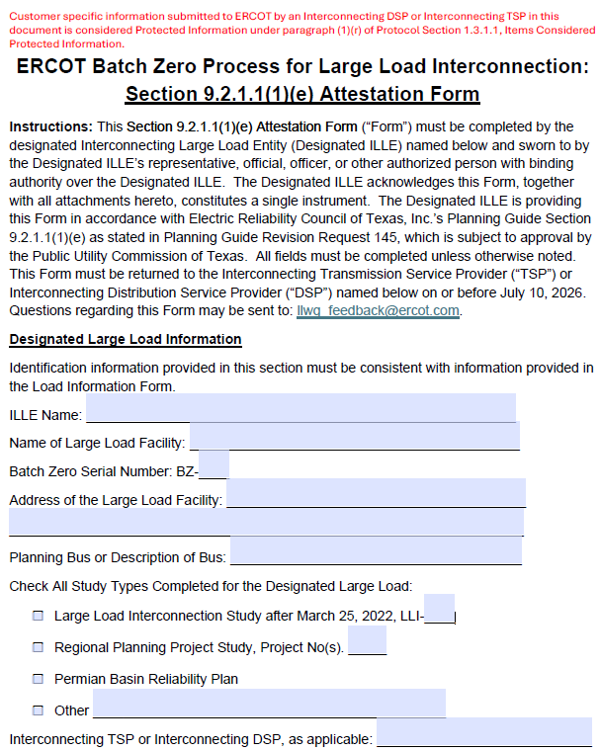
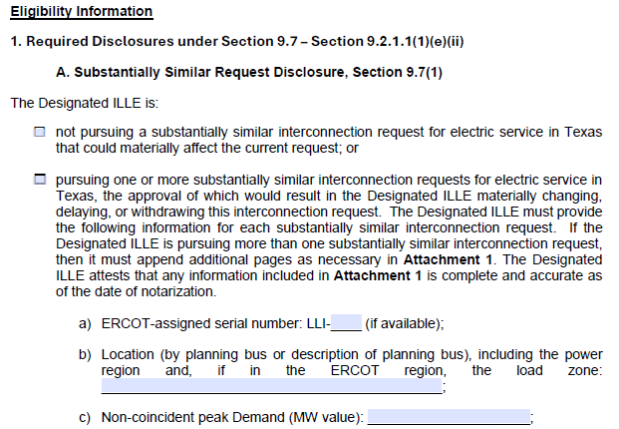
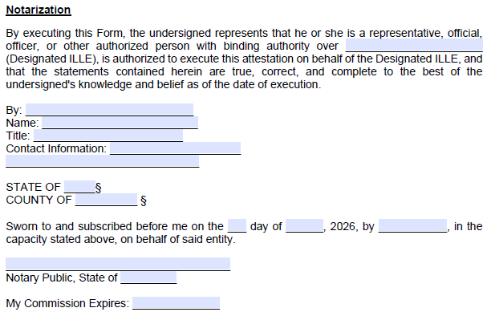
Deep-dive: Batch Zero ILLE Attestation
Representative attestation template
Key attestation elements
2
1
Project identification information
Includes the core project information required to associate the attestation with the applicable Batch Zero request, including ILLE name, facility name, and project location¹
1
2
Eligibility certification and attestation
ILLE representative certifies that the project satisfies the applicable eligibility criteria and that the submitted information is complete and accurate at the time of execution
3
3
Notarization and authorized execution
Authorized ILLE representative executes the attestation before a notary public, confirming authority to bind the entity and certify the submission under oath
1. ERCOT plans to assign a new unique Batch Zero identifier (“BZ ID”) to each submitted Large Load project for Batch Zero intake and tracking purposes. These identifiers will serve as the primary reference number for Batch Zero implementation activities and may differ from existing LLI numbers, RPG references, PBRP references, or other project identifiers currently used in ERCOT processes.
Source: Batch Zero Readiness Meeting #3 - Webex Only materials

Slide 63
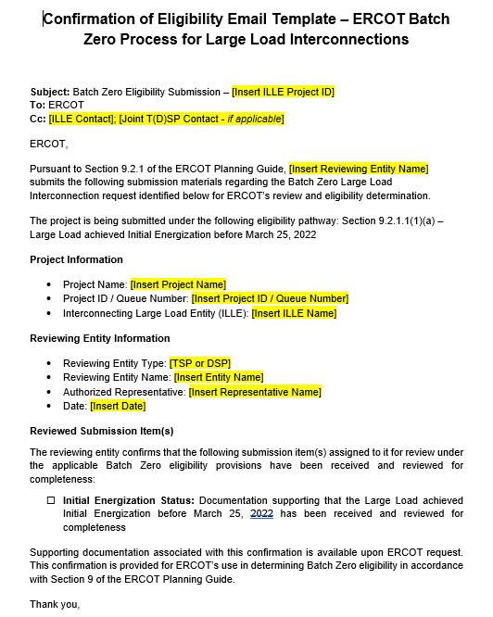
Deep-dive: TSP/DSP Email confirmation template by eligibility path
Representative email confirmation template
Key highlights
1
Project identification and eligibility pathway confirmation
TSP/DSP identifies the applicable Batch Zero project and confirms the eligibility pathway associated with the submission, including the ILLE name, project name, and queue/project identifier
2
Reviewing entity and authorized representative information
TSP/DSP identifies the reviewing entity, authorized representative, and confirmation date associated with the submission to ERCOT
1
2
3
Confirmation of reviewed submission materials
TSP/DSP confirms that the required submission materials and supporting documentation for the selected eligibility pathway have been received and reviewed for completeness prior to ERCOT submission
3

