Slide 1
Batch Zero Readiness Meeting #3
June 4, 2026
Disclaimer: This presentation is provided solely for informational and discussion purposes and does not constitute a binding interpretation of the ERCOT Protocols, Planning Guide, or any other governing authority. In the event of any conflict between this presentation and the ERCOT Protocols, Planning Guide, or other applicable governing documents, the governing documents shall prevail.

Slide 2
Agenda
Batch Zero Readiness Discussion Schedule
Batch Zero Eligibility, Attestations & Process Flow
Appendix

Slide 3
Weekly Batch Zero Readiness Discussions (see ERCOT Meeting Calendar)
Monday
Tuesday
Wednesday
Thursday
Friday
June
1
2
3
4
5
Board Meeting
Board Meeting
Batch Readiness Meeting
2-3PM
Also:
ERCOT is currently sending weekly emails to TSPs by end of day Tuesday on current LLIS Batch Zero status (final LLIS status is subject to PUCT approval of PGRR145 requirements, expected Jun 18)
ERCOT is developing an FAQ to assist with implementation questions
8
9
10
11
12
Batch Readiness Meeting
2-3PM
15
16
17
18
19
LLWG/Batch Readiness
Time TBD
22
23
24
25
26
Batch Readiness Meeting
2-3PM
29
30
July
1
2
3
Batch Readiness Meeting
2-3PM
6
7
8
9
10
Batch Readiness Meeting
2-3PM
LLIS Submission
Process ends
13
14
15
16
17
20
21
22
23
24
TSP Due date for Batch Zero
27
28
29
30
31

Slide 4
Batch Zero key submission deadlines and main responsibilities
Note: timeline assumes PUCT approval on June 18th
X
Detailed next
1
July 10
2
July 24
August 7
August 31
ILLE
Deadline for ILLE to submit required Batch Zero eligibility materials to the Interconnecting TSP/DSP and, where required, directly to ERCOT (e.g., dynamic load models)
Deadline for ILLEs to resolve identified dynamic model and technical data deficiencies and submit corrected materials
TSP/DSP
Deadline for TSPs/DSPs to submit complete Batch Zero eligibility packages and supporting materials to ERCOT
ERCOT
Last day ERCOT will review and approve LLIS studies under the legacy process
Deadline for ERCOT to notify TSPs/DSPs of Batch Zero classification results, including eligibility determinations and identified dynamic model or data deficiencies
Early submission encouraged prior to July 10: Interconnecting DSPs/TSPs and ILLEs are encouraged to begin submitting Batch Zero eligibility materials and supporting documentation as early as practicable in advance of the July 10, 2026 milestone. ERCOT may review submitted materials on a rolling basis and provide preliminary feedback regarding completeness, potential deficiencies, or additional information needs
Source: ERCOT discussions

Slide 5
1
July 10 Batch Zero milestone: activities required
  Lead role
ILLE
TSP/DSP
ERCOT
  Working with the TSP/DSP, identify the applicable Batch Zero eligibility pathway within the LIF
  Prepare required attestations, technical documentation, and supporting evidence
  Submit dynamic load models and supporting technical materials to ERCOT and the Interconnecting TSP, where applicable
  Resolve known documentation or technical gaps prior to TSP/DSP validation review
  Coordinate review responsibilities between TSP and DSP, as applicable
  Begin preliminary review of submitted ILLE materials and supporting evidence
  Align on the designated entity responsible for final ERCOT package submission
  Finalize LLIS study review activities under the legacy process

Slide 6
2
July 24 Batch Zero milestone: activities required
  Lead role
ILLE
TSP/DSP
ERCOT
  Respond to TSP/DSP validation questions and resolve identified submission deficiencies, as applicable
  Provide supplemental technical materials or clarifications needed to support package completeness
  Complete review and validation of ILLE submission materials against applicable eligibility requirements
  Resolve outstanding package deficiencies and confirm submission completeness within the LIF
  Finalize the coordinated Batch Zero eligibility package and submit required materials to ERCOT
  Prepare for formal completeness, classification, and eligibility review of submitted Batch Zero packages
  Clarification: the post–July 10 validation period is intended to address administrative corrections, clarification requests, and minor submission errors identified during TSP/DSP review (e.g., typos or incorrect references). It is not intended to allow submission of materially missing eligibility items or satisfaction of requirements that were not completed by the applicable July 10 deadline (e.g., posting financial security, executing required commitments, or completing required attestations)

Slide 7
Batch Zero eligibility submission and validation process
ILLUSTRATIVE
HIGHLY PRELIMINARY
Performed by ILLE
Performed by TSP/DSP
Performed by ERCOT
1
Eligibility Path Identification
Working with TSP/DSP, ILLE uses the Load Information Form (LIF) to identify the applicable Batch Zero eligibility pathway and the associated submission requirements and documentation
Until Jul 10
2
Preparation of Submission Materials
ILLE executes the required attestations, and prepares technical documentation, forms, and supporting evidence applicable to the selected eligibility pathway
3
Submission of Materials
ILLE submits the applicable materials and supporting evidence to the Interconnecting TSP/DSP and, where required, directly to ERCOT (e.g., dynamic load models and supporting documentation)
4
Review Coordination
Interconnecting TSP/DSP coordinate responsibility for reviewing submission materials, determine the applicable Eligibility/Entry Path, and prepare the LCP². Review responsibility and completion status are tracked within the LIF
5
Validation and Completeness Review
Interconnecting TSP/DSP, as applicable, review submitted materials, validate completeness against the applicable eligibility requirements, and document status/comments in the LIF
Jul 10- Jul 24
6
Package Reconciliation and Follow-up
ILLE provides administrative corrections, clarifications, or non-material supplemental information to address issues identified during TSP/DSP review¹
7
Final Package Assembly
Interconnecting TSP/DSP, as applicable, finalize the coordinated eligibility package and confirm all applicable items are complete within the LIF
8
Submission to ERCOT
Interconnecting TSP submits the final coordinated eligibility package to ERCOT via email with the Interconnecting DSP and ILLE copied, where applicable
Jul 24-Aug 7
9
ERCOT Initial Eligibility Assessment
ERCOT performs validation of the Batch Zero eligibility package, including attestations, TSP/DSP confirmations, and submission completeness
10
Dynamic Model Deficiency Resolution
ERCOT notifies ILLEs of identified dynamic model or data deficiencies. ILLEs submit corrected models, updated parameters, or supplemental technical information during the cure period
Aug 7-Aug 31
11
ERCOT Final Eligibility Validation
ERCOT finalizes Batch Zero eligibility determinations following resolution of outstanding dynamic model and data deficiencies
1. The post–July 10 validation period is intended to address administrative corrections, clarification requests, and minor submission errors identified during TSP/DSP review (e.g., typos or incorrect references). It is not intended to allow submission of materially missing eligibility items or satisfaction of requirements that were not completed by the applicable July 10 deadline (e.g., posting financial security, executing required commitments, or completing required attestations) | 2. Including selection of the applicable Entry Path, incorporation of LLIS/RPG/PBRP study information, transmission upgrade and TPIT data, and calculation of the resulting modeled load schedule
Source: ERCOT discussions

Slide 8
Batch Zero ERCOT communications and submission channels
LLWG_Feedback@ercot.com for General Batch Zero Questions
Channel for general implementation questions, stakeholder feedback, and process clarification requests related to the Batch Zero Large Load interconnection framework
LargeLoadInterconnection@ercot.com for Existing LLIS Process Questions
Channel for questions related to the legacy LLIS process (e.g., ongoing study reviews, dynamic model submissions, and existing interconnection study coordination)
BatchZero@ercot.com (under development) for Formal Batch Zero Submissions
Channel for submission of completed Batch Zero eligibility packages by the designated Interconnecting TSP, with notification to the applicable DSP and ILLE through copied submission correspondence, as appropriate
NOTE: ERCOT plans to assign a new unique Batch Zero identifier (“BZ ID”) to each submitted Large Load project for Batch Zero intake and tracking purposes. These identifiers will serve as the primary reference number for Batch Zero implementation activities
Supporting materials and forms will be published on the Large Load Integration webpage

Slide 9
Agenda
Batch Zero Readiness Discussion Schedule
Batch Zero Eligibility, Attestations & Process Flow
Appendix

Slide 10
Objectives for today
Review eligibility requirements by Batch Zero pathway
Review the proposed eligibility requirements, submission materials, and validation responsibilities applicable to each Batch Zero eligibility pathway, including distinctions between ILLE and TSP/DSP requirements
Review proposed attestations, and supporting materials
Review the proposed submission toolkit supporting the Batch Zero process, including standardized attestation templates and TSP/DSP confirmation templates
Review proposed submission and validation process
Walk through the proposed E2E2 Batch Zero submission and validation process, including a representative example illustrating how submission materials are prepared, reviewed, validated, and transmitted
Today’s objective is to review the revised Draft Batch Zero materials and ERCOT’s plan for submission and validation of information ahead of publication of the finalized versions following Board approval. ERCOT has also scheduled recurring weekly Batch Readiness meetings to review stakeholder questions, discuss feedback, and provide process updates.
Please submit any questions or comments to llwg_feedback@ercot.com

Slide 11
Eligibility Requirements by Batch Zero Pathway (1/4)
Eligibility requirements
Eligibility path
For the ILLE¹
For the TSP/DSP
Base Load § 9.2.1.1(1)(a)
(Energized before 3/25/2022)
Optional updated dynamic load models (if enhanced or updated models are available) to ERCOT and the Interconnecting TSP
Written acknowledgement of change notification obligations
List of already energized loads
Confirmation that the Large Load satisfies the applicable requirements of Base Load Section 9.2.1.1(1)(a)
Base Load § 9.2.1.1(1)(b)
(Energized between 3/25/2022 and 7/10/26)
Optional updated dynamic load models (if enhanced or updated models are available) to ERCOT and the Interconnecting TSP
Written acknowledgement of change notification obligations
List of already energized loads
2026 RTP load information
Most recent LCP
Confirmation that the Large Load satisfies the applicable requirements of Base Load Section 9.2.1.1(1)(b)
Base Load § 9.2.1.1(1)(c)
(QSA or IVRT Assessment))
Optional updated dynamic load models (if enhanced or updated models are available) to ERCOT and the Interconnecting TSP
Written acknowledgement of change notification obligations
List of Large Loads qualifying under the quarterly stability assessment / interim VRT pathway (working with ERCOT)
2026 RTP load information
Most recent LCP
Confirmation that the Large Load satisfies the applicable requirements of Base Load Section 9.2.1.1(1)(c)
Base Load § 9.2.1.1(1)(d)
(Permian Basin Reliability Plan Study Load)
Dynamic load model to ERCOT and the Interconnecting TSP
Written acknowledgement of change notification obligations
List of Large Loads qualifying under the Permian Basin Reliability Plan Study pathway (working with ERCOT)
Most recent LCP/Preliminary LCP
Executed interconnection agreement or equivalent agreement
Confirmation that the Large Load satisfies the applicable requirements of Base Load Section 9.2.1.1(1)(d)
1. Unless otherwise specified, ILLE needs to provide the required documentation to the interconnecting TSP/DSP
Source: ERCOT PGRR145, ERCOT NPRR1325

Slide 12
Eligibility Requirements by Batch Zero Pathway (2/4)
Eligibility requirements
Eligibility path
For the ILLE¹
For the TSP/DSP
Base Load § 9.2.1.1(1)(e)
(Advancing Large Load)
One notarized attestation accompanying § 9.7 disclosures:
  Substantially similar request
  Site studies and engineering progress
  Permitting progress
  Phased energization schedule (consistent with any LCP)
  On-site backup generation information
  Power procurement plans, including on-site generation
Notarized attestation for Equipment with 18-month lead time
Notarized attestation for Notice to proceed (NTP)
Notarized attestation for End-use customer
Notarized attestation and evidence for Site control
Dynamic load model to ERCOT and the Interconnecting TSP
Written acknowledgement of change notification obligations
Confirmation of complete and valid set of interconnection studies (working with ERCOT)
Confirmation ILLE has provided financial security for system upgrades
Confirmation ILLE has satisfied direct interconnection cost (CIAC) responsibility
Confirmation that the Large Load has attested to other applicable requirements of Base Load Section 9.2.1.1(1)(e)
Base Load § 9.2.1.1(1)(f)
(Committed Large Load)
One notarized attestation accompanying § 9.7 disclosures:
  Substantially similar request
  Site studies and engineering progress
  Permitting progress
  Phased energization schedule (consistent with any LCP)
  On-site backup generation information
  Power procurement plans, including on-site generation
Notarized attestation for Site approvals or no approvals plus statement supporting conclusion
Notarized attestation and evidence for Site control
Notarized attestation for General contractor contract
Notarized attestation for Substation contractor contract
Dynamic load model to ERCOT and the Interconnecting TSP
Written acknowledgement of change notification obligations
Confirmation of complete and valid set of interconnection studies (working with ERCOT)
Confirmation ILLE has provided financial security for system upgrades
Confirmation ILLE has satisfied direct interconnection cost (CIAC) responsibility
Confirmation that the Large Load has attested to other applicable requirements of Base Load Section 9.2.1.1(1)(f)
1. Unless otherwise specified, ILLE needs to provide the required documentation to the interconnecting TSP/DSP
Source: ERCOT PGRR145, ERCOT NPRR1325

Slide 13
Eligibility Requirements by Batch Zero Pathway (3/4)
Eligibility requirements
Eligibility path
For the ILLE¹
For the TSP/DSP
Base Load § 9.2.1.1(1)(g)
(PURA §39.169 Net Metering Proceeding Load)
One notarized attestation accompanying § 9.7 disclosures:
  Substantially similar request
  Site studies and engineering progress
  Permitting progress
  Phased energization schedule (consistent with any LCP)
  On-site backup generation information
  Power procurement plans, including on-site generation
Dynamic load model to ERCOT and the Interconnecting TSP
Confirmation ILLE has provided financial security for system upgrades
Confirmation that the Large Load is associated with a qualifying PURA §39.169 net metering proceeding
Confirmation that the Large Load satisfies the applicable requirements of Base Load Section 9.2.1.1(1)(g)
Studied Load § 9.2.1.2(1)
Full technical data package required to perform steady-state, short circuit, dynamic, and transient stability analyses
Notarized attestation and evidence for Site control
One notarized attestation accompanying § 9.7 disclosures:
  Substantially similar request
  Site studies and engineering progress
  Permitting progress
  Phased energization schedule (consistent with any LCP)
  On-site backup generation information
  Power procurement plans, including on-site generation
Preliminary LCP to the Interconnecting TSP
Dynamic load model to ERCOT and the Interconnecting TSP
Written acknowledgement of change notification obligations
Confirmation of study requirement (working with ERCOT)
Confirmation ILLE has provided financial security for system upgrades equal to $50k/MW of peak Demand
Confirmation of receipt of written acknowledgement of change notification obligations
If needed, Prior stability-study impact determination
Confirmation that the Large Load satisfies the applicable requirements of Studied Load
1. Unless otherwise specified, ILLE needs to provide the required documentation to the interconnecting TSP/DSP
Source: ERCOT PGRR145, ERCOT NPRR1325

Slide 14
Eligibility Requirements by Batch Zero Pathway (4/4)
Eligibility requirements
Eligibility path
For the ILLE¹
For the TSP/DSP
PCLR §§ 9.2.1.2 and 9.2.2.1(2)
(Provisional Controllable Load Resource)
Full technical data package required to perform steady-state, short circuit, dynamic, and transient stability analyses
Notarized attestation and evidence for Site control
One notarized attestation accompanying § 9.7 disclosures:
  Substantially similar request
  Site studies and engineering progress
  Permitting progress
  Phased energization schedule (consistent with any LCP)
  On-site backup generation information
  Power procurement plans, including on-site generation
Preliminary LCP to the Interconnecting TSP
Dynamic load model to ERCOT and the Interconnecting TSP
Written acknowledgement of change notification obligations
Notarized Form W – Part A
Confirmation of Transmission upgrade financial security
Confirmation of receipt of written acknowledgement of change notification obligations
If needed, Prior stability-study impact determination
Confirmation that the Large Load satisfies the applicable requirements of PCLR
WLPUN §§ 9.2.1.2 and 9.2.2.1(2)
(Withdrawal-Limited Private Use Network)
Full technical data package required to perform steady-state, short circuit, dynamic, and transient stability analyses
Notarized attestation and evidence for Site control
One notarized attestation accompanying § 9.7 disclosures:
  Substantially similar request
  Site studies and engineering progress
  Permitting progress
  Phased energization schedule (consistent with any LCP)
  On-site backup generation information
  Power procurement plans, including on-site generation
Preliminary LCP to the Interconnecting TSP
Dynamic load model to ERCOT and the Interconnecting TSP
Written acknowledgement of change notification obligations
Notarized Form X
Confirmation of Transmission upgrade financial security
Confirmation of receipt of written acknowledgement of change notification obligations
If needed, Prior stability-study impact determination
Confirmation of Generator FIS request and associated generation information for the WLPUN
Confirmation that the Large Load satisfies the applicable requirements of Studied Load – WLPUN
1. Unless otherwise specified, ILLE needs to provide the required documentation to the interconnecting TSP/DSP
Source: ERCOT PGRR145, ERCOT NPRR1325

Slide 15
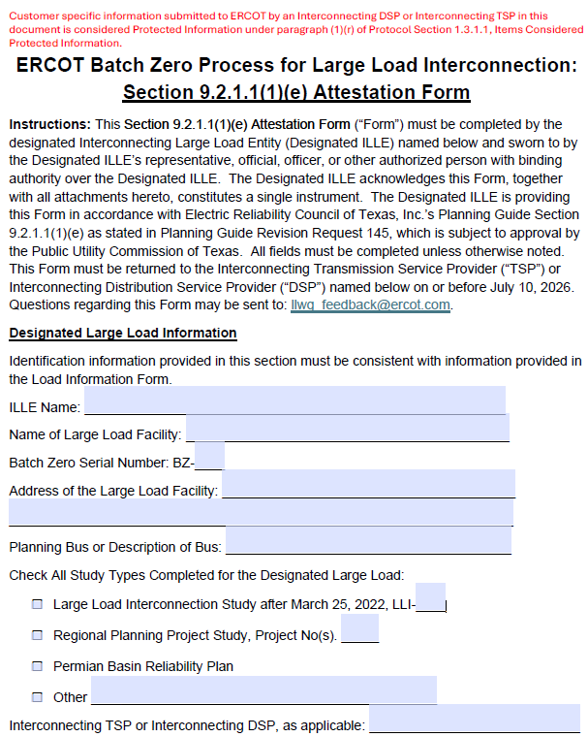
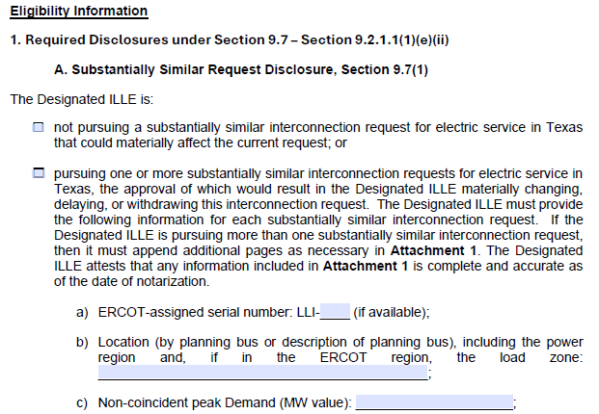
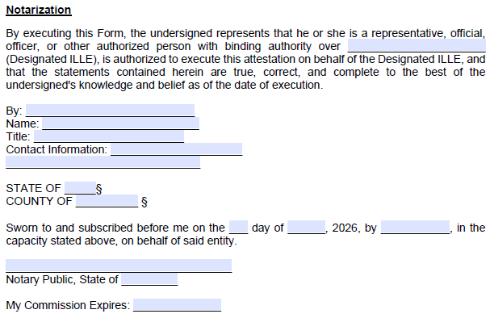
Deep-dive: Batch Zero ILLE Attestation
Representative attestation template
Key attestation elements
2
1
Project identification information
Includes the core project information required to associate the attestation with the applicable Batch Zero request, including ILLE name, facility name, and project location¹
1
2
Eligibility certification and attestation
ILLE representative certifies that the project satisfies the applicable eligibility criteria and that the submitted information is complete and accurate at the time of execution
3
3
Notarization and authorized execution
Authorized ILLE representative executes the attestation before a notary public, confirming authority to bind the entity and certify the submission under oath
1. ERCOT plans to assign a new unique Batch Zero identifier (“BZ ID”) to each submitted Large Load project for Batch Zero intake and tracking purposes. These identifiers will serve as the primary reference number for Batch Zero implementation activities and may differ from existing LLI numbers, RPG references, PBRP references, or other project identifiers currently used in ERCOT processes.
Source: Batch Zero Readiness Meeting #3 - Webex Only materials

Slide 16
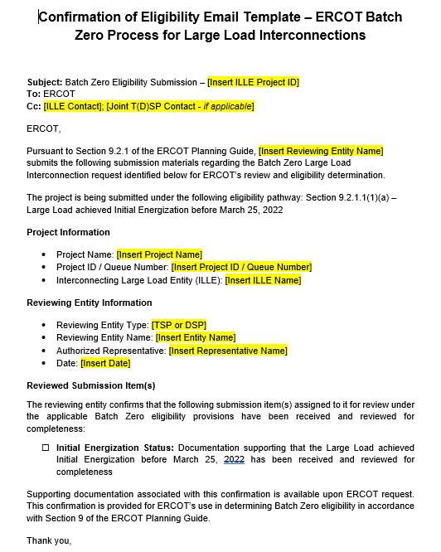
Deep-dive: TSP/DSP Email confirmation template by eligibility path
PRELIMINARY
Representative email confirmation template
Key highlights
1
Project identification and eligibility pathway confirmation
TSP/DSP identifies the applicable Batch Zero project and confirms the eligibility pathway associated with the submission, including the ILLE name, project name, and queue/project identifier
2
Reviewing entity and authorized representative information
TSP/DSP identifies the reviewing entity, authorized representative, and confirmation date associated with the submission to ERCOT
1
2
3
Confirmation of reviewed submission materials
TSP/DSP confirms that the required submission materials and supporting documentation for the selected eligibility pathway have been received and reviewed for completeness prior to ERCOT submission
3

Slide 17
Batch Zero eligibility submission and validation process
PRELIMINARY
Performed by ILLE
Performed by TSP/DSP
Performed by ERCOT
  Detailed next
1
Eligibility Path Identification
Working with TSP/DSP, ILLE uses the Load Information Form (LIF) to identify the applicable Batch Zero eligibility pathway and the associated submission requirements and documentation
Until Jul 10
2
Preparation of Submission Materials
ILLE executes the required attestations, and prepares technical documentation, forms, and supporting evidence applicable to the selected eligibility pathway
3
Submission of Materials
ILLE submits the applicable materials and supporting evidence to the Interconnecting TSP/DSP and, where required, directly to ERCOT (e.g., dynamic load models and supporting documentation)
4
Review Coordination
Interconnecting TSP/DSP coordinate responsibility for reviewing submission materials, determine the applicable Eligibility/Entry Path, and prepare the LCP². Review responsibility and completion status are tracked within the LIF
5
Validation and Completeness Review
Interconnecting TSP/DSP, as applicable, review submitted materials, validate completeness against the applicable eligibility requirements, and document status/comments in the LIF
Jul 10- Jul 24
6
Package Reconciliation and Follow-up
ILLE provides administrative corrections, clarifications, or non-material supplemental information to address issues identified during TSP/DSP review¹
7
Final Package Assembly
Interconnecting TSP/DSP, as applicable, finalize the coordinated eligibility package and confirm all applicable items are complete within the LIF
8
Submission to ERCOT
Interconnecting TSP submits the final coordinated eligibility package to ERCOT via email with the Interconnecting DSP and ILLE copied, where applicable
Jul 24-Aug 7
9
ERCOT Initial Eligibility Assessment
ERCOT performs validation of the Batch Zero eligibility package, including attestations, TSP/DSP confirmations, and submission completeness
10
Dynamic Model Deficiency Resolution
ERCOT notifies ILLEs of identified dynamic model or data deficiencies. ILLEs submit corrected models, updated parameters, or supplemental technical information during the cure period
Aug 7-Aug 31
11
ERCOT Final Eligibility Validation
ERCOT finalizes Batch Zero eligibility determinations following resolution of outstanding dynamic model and data deficiencies
1. The post–July 10 validation period is intended to address administrative corrections, clarification requests, and minor submission errors identified during TSP/DSP review (e.g., typos or incorrect references). It is not intended to allow submission of materially missing eligibility items or satisfaction of requirements that were not completed by the applicable July 10 deadline (e.g., posting financial security, executing required commitments, or completing required attestations) | 2. Including selection of the applicable Entry Path, incorporation of LLIS/RPG/PBRP study information, transmission upgrade and TPIT data, and calculation of the resulting modeled load schedule
Source: ERCOT discussions

Slide 18
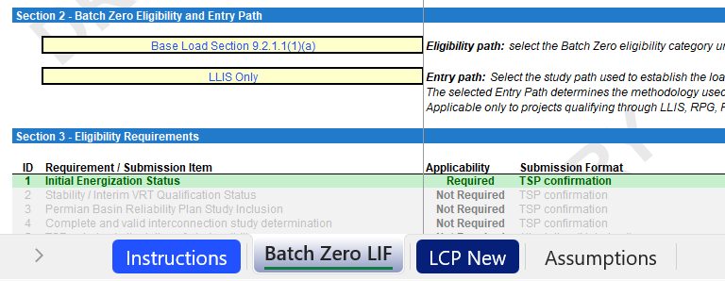
LIF Updated to Incorporate Entry Path Selection and Dynamic LCP Logic
PRELIMINARY
  Detailed next
Updated LIF screenshot
Key highlights
1
Updated LIF now captures both the Eligibility Path and Entry Path: Entry Path section was added to determine the methodology used to construct the LCP and resulting modeled load schedule
The Interconnecting TSP/DSP is responsible for completing the LCP: based on the selected Entry Path, the TSP/DSP must populate the required study information, transmission upgrades, TPIT in-service dates, and Interconnection Agreement schedules used to develop the modeled load schedule
Five Entry Paths are currently supported in the workbook: the updated LIF currently supports LLIS Only, RPG Only, RPG + Complete and Valid LLIS, PBRP Only, and PBRP + Complete and Valid LLIS pathways
Different Entry Paths require different information and calculations: depending on the selected pathway, the TSP/DSP may need to incorporate LLIS schedules, RPG/PBRP study results, TPIT adjustments, and transmission upgrade dependencies into the LCP
1
2
2
NOTE: LIF published today is still DRAFT and a finalized version will be published next week
Source: ERCOT discussions

Slide 19
Qualifying Study: Complete and valid LLIS ONLY
PRELIMINARY
Obtain the LCP from the approved LLIS study
Review TPIT and modify any dates in the LCP according to 9.2.1.1(2)(c)(ii)(B)
Obtain the ramp schedule in the executed IA for the load.
Compare the modified LCP and the executed IA. Use the lower value for each year.
Load is base load in all years according to this schedule

Slide 20
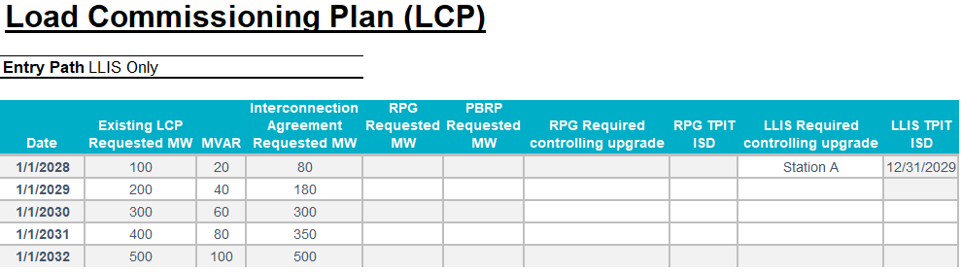
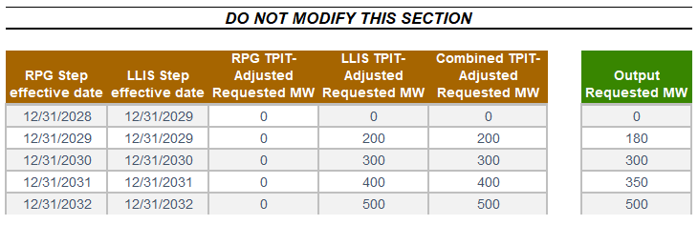
Case Study (1/7): Complete and valid LLIS ONLY
PRELIMINARY
Populate Existing LCP Requested MW and MVAR using the approved LLIS LCP
Supporting screenshots
Process description
  The Existing LCP Requested MW and MVAR fields establish the baseline load schedule from the approved LLIS
  This schedule represents the amount of load determined to be supportable through the LLIS process and serves as the starting point for all subsequent TPIT and Interconnection Agreement adjustments
Source: DRAFT Batch Zero Load Information Form

Slide 21
Case Study (2/7): Complete and valid LLIS ONLY
PRELIMINARY
Populate Interconnection Agreement Requested MW using the executed IA
Supporting screenshots
Process description
  The Interconnection Agreement (IA) Requested MW schedule establishes the maximum load level contractually permitted in each year
  ERCOT compares the TPIT-adjusted LLIS schedule against the IA and uses the lower value when determining the final modeled load schedule
Source: DRAFT Batch Zero Load Information Form

Slide 22
Case Study (3/7): Complete and valid LLIS ONLY
PRELIMINARY
Leave RPG/PBRP Requested MW, RPG upgrades and RPG TPIT blank
Supporting screenshots
Process description
  Because this project is modeled using the LLIS Only Entry Path, RPG- and PBRP-related fields are not used in the load modeling methodology
  These fields should remain blank and the modeled schedule will be derived solely from the LLIS, TPIT, and Interconnection Agreement information
Source: DRAFT Batch Zero Load Information Form

Slide 23
Case Study (4/7): Complete and valid LLIS ONLY
PRELIMINARY
Enter LLIS upgrades and TPIT dates
Supporting screenshots
Process description
  For each LLIS load step that depends on a transmission upgrade, identify the controlling upgrade and its latest TPIT in-service date
  If TPIT indicates that an upgrade enters service later than assumed in the approved LLIS, the associated load increase is delayed until the upgrade becomes available
Source: DRAFT Batch Zero Load Information Form

Slide 24
Case Study (5/7): Complete and valid LLIS ONLY
PRELIMINARY
Review the LLIS TPIT-Adjusted Requested MW
Supporting screenshots
Process description
  The LLIS TPIT-Adjusted Requested MW schedule is calculated automatically based on the approved LLIS and the TPIT in-service dates entered above
  Load increases associated with upgrades that are not yet in service are deferred until the applicable TPIT year
Source: DRAFT Batch Zero Load Information Form

Slide 25
Case Study (6/7): Complete and valid LLIS ONLY
PRELIMINARY
Review the Combined TPIT-Adjusted Requested MW
Supporting screenshots
Process description
  Under the LLIS Only Entry Path, the Combined TPIT-Adjusted Requested MW schedule is equal to the TPIT-adjusted LLIS schedule
  This value represents the maximum load level supportable through the LLIS pathway after application of TPIT adjustments
Source: DRAFT Batch Zero Load Information Form

Slide 26
Case Study (7/7): Complete and valid LLIS ONLY
PRELIMINARY
Review the Output Requested MW
Supporting screenshots
Process description
  ERCOT compares the TPIT-adjusted LLIS schedule against the Interconnection Agreement schedule and uses the lower value in each year
  The resulting Output Requested MW schedule represents the final modeled load schedule used for Batch Zero purposes and is treated as base load in all years
Source: DRAFT Batch Zero Load Information Form

Slide 27
Qualifying Study: RPG ONLY
PRELIMINARY
Review the RPG report and identify the in-service date of the last upgrade in the project.
Use the ramp schedule from the IA
Load is base load in all years according to this schedule
IA
Compare the modified LCP and the executed IA. Which is lower?
Construct LCP for the load that is 0 MW for all years prior to the in-service of the last upgrade
Review TPIT and modify any dates in the LCP according to 9.2.1.1(2)(c)(ii)(A)
Obtain the ramp schedule in the executed IA for the load.
Modified RPG
Modify the RPG ramp according to the rules in 9.2.1.2(3) to set limits on studied amount
Load is a hybrid load
- Studied in years before RPG in-service
- Base load after that

Slide 28
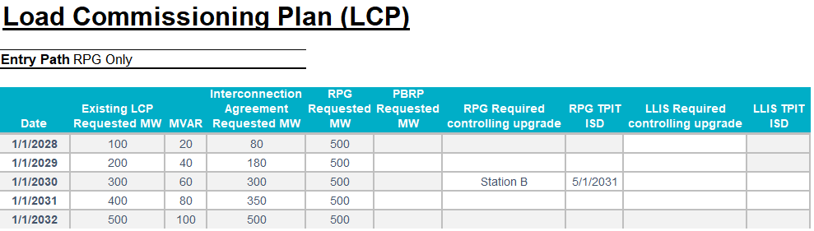
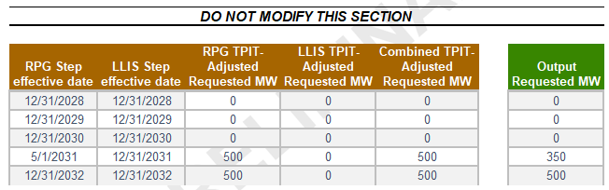
Case Study (1/7): RPG ONLY
PRELIMINARY
Populate Existing LCP Requested MW and MVAR using the approved LLIS LCP
Supporting screenshots
Process description
  The Existing LCP Requested MW and MVAR fields establish the annual load schedule used throughout this example
  These values provide the reference load levels that are ultimately compared against the RPG-supported load schedule and the Interconnection Agreement
Source: DRAFT Batch Zero Load Information Form

Slide 29
Case Study (2/7): RPG ONLY
PRELIMINARY
Populate Interconnection Agreement Requested MW using the executed IA
Supporting screenshots
Process description
  The Interconnection Agreement (IA) establishes the maximum load level contractually permitted in each year
  ERCOT compares the RPG-adjusted schedule against the IA and uses the lower value when determining the final modeled load schedule
Source: DRAFT Batch Zero Load Information Form

Slide 30
Case Study (3/7): RPG ONLY
PRELIMINARY
Populate RPG Requested MW using the qualifying RPG study
Supporting screenshots
Process description
  The qualifying RPG study establishes the maximum load level supportable once all required RPG upgrades are in service
  For modeling purposes, the RPG-supported load level is entered in each annual row and later adjusted using TPIT information
Source: DRAFT Batch Zero Load Information Form

Slide 31
Case Study (4/7): RPG ONLY
PRELIMINARY
Leave PBRP Requested MW, LLIS upgrade and LLIS TPIT ISD blank
Supporting screenshots
Process description
  This example follows the RPG Only Entry Path and therefore does not rely on PBRP or LLIS study information
  PBRP- and LLIS-related fields are not used in the modeling methodology and should remain blank
Source: DRAFT Batch Zero Load Information Form

Slide 32
Case Study (5/7): RPG ONLY
PRELIMINARY
Enter the last required RPG upgrade and its TPIT in-service date
Supporting screenshots
Process description
  The RPG pathway assumes the load cannot be treated as available until the last required RPG transmission upgrade is in service
  Enter the controlling upgrade and its latest TPIT in-service date in the year in which the RPG-supported load first becomes available
  TPIT is then used to determine when the RPG-supported load may be reflected in the modeled schedule
Source: DRAFT Batch Zero Load Information Form

Slide 33
Case Study (6/7): RPG ONLY
PRELIMINARY
Review the Combined TPIT-Adjusted Requested MW
Supporting screenshots
Process description
  Under the RPG Only Entry Path, the Combined TPIT-Adjusted Requested MW schedule is equal to the TPIT-adjusted RPG schedule
  Prior to the TPIT-adjusted RPG in-service year, the modeled amount is 0 MW. Beginning in the RPG in-service year, the modeled amount reflects the RPG-supported load level
Source: DRAFT Batch Zero Load Information Form

Slide 34
Case Study (7/7): RPG ONLY
PRELIMINARY
Review the Output Requested MW
Supporting screenshots
Process description
  ERCOT compares the TPIT-adjusted RPG schedule against the Interconnection Agreement schedule and uses the lower value in each year
  Load Treatment: If the Interconnection Agreement schedule is more restrictive than the RPG-adjusted schedule, the resulting Output Requested MW schedule is modeled as base load in all years. Otherwise, the load is treated as a hybrid load, with studied-load treatment prior to the RPG in-service year and base-load treatment thereafter, consistent with Section 9.2.1.2(3)
Source: DRAFT Batch Zero Load Information Form

Slide 35
Qualifying Study: RPG AND a complete and valid LLIS
PRELIMINARY
Review the RPG report and identify the in-service date of the last upgrade in the project.
Construct LCP for the load that is 0 MW for all years prior to the in-service of the last upgrade
Review TPIT and modify any dates in the RPG LCP according to 9.2.1.1(2)(c)(ii)(A)
Load is base load in all years according to this schedule
Use the ramp schedule from the IA
IA
Compare the modified LCP and the executed IA in each year. Which is lower?
Obtain the LCP from the approved LLIS study
Review TPIT and modify any dates in the LLIS LCP according to 9.2.1.1(2)(c)(ii)(B)
For each year prior to the in-service of last upgrade, take the greater value between the modified RPG LCP and the modified LLIS LCP
Obtain the ramp schedule in the executed IA for the load.
Modified RPG
Load is base load in all years according to this schedule
Use the RPG/LLIS mash-up ramp schedule as modified by TPIT
35

Slide 36
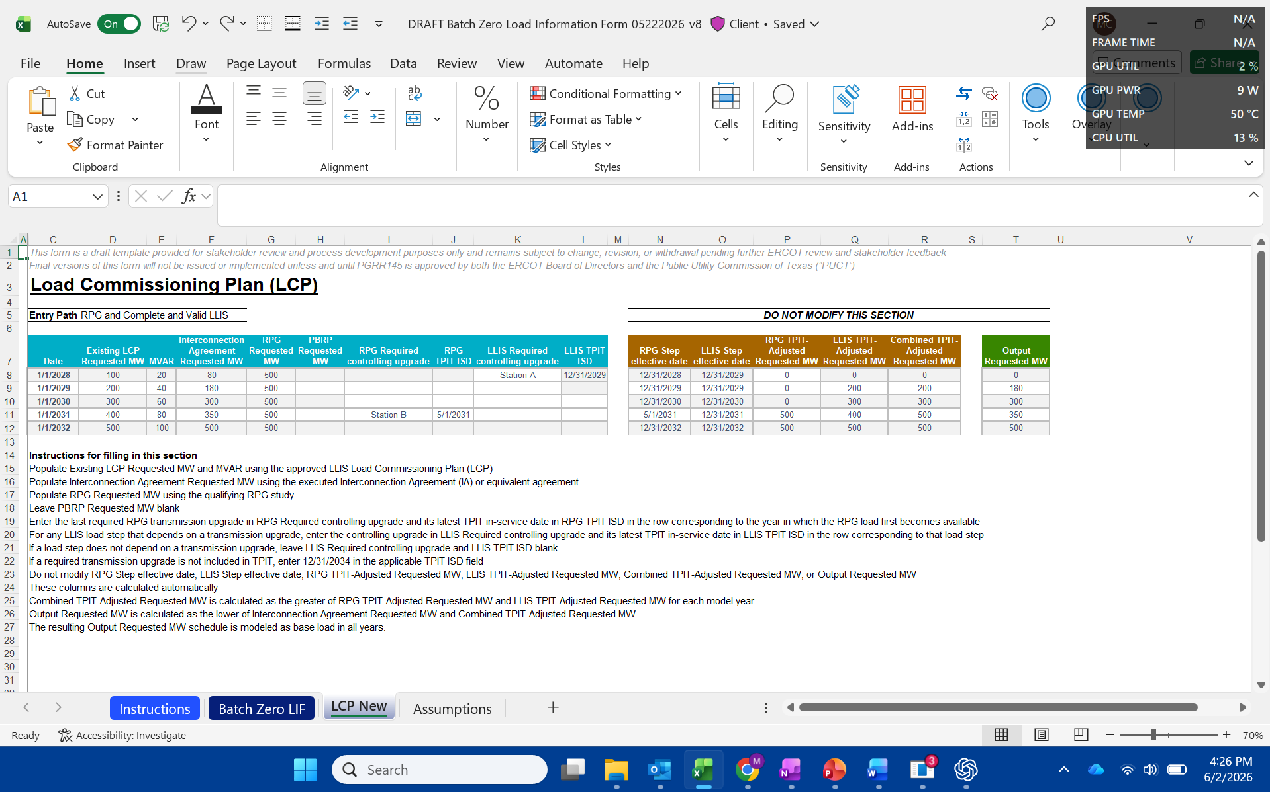
Case Study (1/8): RPG AND a complete and valid LLIS
PRELIMINARY
Populate Existing LCP Requested MW and MVAR using the approved LLIS LCP
Supporting screenshots
Process description
  The Existing LCP Requested MW and MVAR fields establish the load ramp from the approved LLIS and serve as the starting point for the LLIS component of this pathway
  These values represent the load levels that may be modeled absent any TPIT adjustments associated with required transmission upgrades
Source: DRAFT Batch Zero Load Information Form

Slide 37
Case Study (2/8): RPG AND a complete and valid LLIS
PRELIMINARY
Populate Interconnection Agreement Requested MW using the executed IA
Supporting screenshots
Process description
  The Interconnection Agreement (IA) establishes the maximum load level contractually permitted in each year
  ERCOT compares the TPIT-adjusted schedule against the IA and uses the lower value when determining the final modeled load schedule
Source: DRAFT Batch Zero Load Information Form

Slide 38
Case Study (3/8): RPG AND a complete and valid LLIS
PRELIMINARY
Populate RPG Requested MW using the qualifying RPG study
Supporting screenshots
Process description
  The qualifying RPG study establishes the maximum load level supportable once all required RPG upgrades are in service
  For modeling purposes, the RPG-supported load level is entered in each annual row and later adjusted based on the TPIT in-service date of the last required RPG upgrade
Source: DRAFT Batch Zero Load Information Form

Slide 39
Case Study (4/8): RPG AND a complete and valid LLIS
PRELIMINARY
Leave PBRP Requested MW blank
Supporting screenshots
Process description
  This example follows the RPG and Complete and Valid LLIS Entry Path and therefore does not rely on the PBRP study pathway
  PBRP-related fields are not used in this modeling methodology and should remain blank
Source: DRAFT Batch Zero Load Information Form

Slide 40
Case Study (5/8): RPG AND a complete and valid LLIS
PRELIMINARY
Enter the last required RPG upgrade and its TPIT in-service date
Supporting screenshots
Process description
  Enter the last required RPG transmission upgrade and its TPIT in-service date in the row corresponding to the year in which the RPG-supported load first becomes available
  The RPG-supported load cannot be modeled until the last required RPG upgrade enters service. In this example, TPIT indicates that the final RPG upgrade enters service in 2031
Source: DRAFT Batch Zero Load Information Form

Slide 41
Case Study (6/8): RPG AND a complete and valid LLIS
PRELIMINARY
Enter LLIS upgrades and TPIT dates
Supporting screenshots
Process description
  For each LLIS load step that depends on a transmission upgrade, identify the controlling upgrade and its latest TPIT in-service date
  If TPIT indicates that an upgrade enters service later than assumed in the approved LLIS, the associated LLIS load increase is deferred until the upgrade becomes available
Source: DRAFT Batch Zero Load Information Form

Slide 42
Case Study (7/8): RPG AND a complete and valid LLIS
PRELIMINARY
Review the Combined TPIT-Adjusted Requested MW
Supporting screenshots
Process description
  ERCOT compares the TPIT-adjusted RPG schedule and TPIT-adjusted LLIS schedule and uses the greater value in each year
  ERCOT compares the TPIT-adjusted RPG schedule and TPIT-adjusted LLIS schedule and uses the greater value in each year
Source: DRAFT Batch Zero Load Information Form

Slide 43
Case Study (8/8): RPG AND a complete and valid LLIS
PRELIMINARY
Review the Output Requested MW
Supporting screenshots
Process description
  ERCOT compares the Combined TPIT-Adjusted Requested MW schedule against the executed Interconnection Agreement and uses the lower value in each year
  In this example, the Interconnection Agreement is more restrictive than the combined schedule in multiple years, resulting in an Output Requested MW schedule of 80, 180, 300, 350, and 500 MW
  Load Treatment: The resulting Output Requested MW schedule is modeled as base load in all years because the Interconnection Agreement schedule is more restrictive than the combined RPG/LLIS schedule
Source: DRAFT Batch Zero Load Information Form

Slide 44
Qualifying Study: PBRP ONLY
PRELIMINARY
Use the ramp schedule from the IA
Load is base load in all years according to this schedule
IA
Compare the modified LCP and the executed IA. Which is lower?
Construct LCP for the load that is 0 MW for all years prior to 2030 and PBRP modeled amount after that.
Review TPIT and modify any dates in the LCP according to 9.2.1.1(2)(c)(ii)(A)
Obtain the ramp schedule in the executed IA for the load.
Modified PBRP
Use the PBRP ramp schedule as modified by TPIT
Load is a hybrid load
- Studied in years before 2030
- Base load after that
NOTE: PBRP Only follows the same LCP construction methodology as RPG Only

Slide 45
Qualifying Study: PBRP AND a complete and valid LLIS
PRELIMINARY
Construct LCP for the load that is 0 MW for all years prior to 2030 and PBRP modeled amount after that.
Review TPIT and modify any dates in the RPG LCP according to 9.2.1.1(2)(c)(ii)(A)
Load is base load in all years according to this schedule
Use the ramp schedule from the IA
IA
Compare the modified LCP and the executed IA. Which is lower?
Obtain the LCP from the approved LLIS study
Review TPIT and modify any dates in the LLIS LCP according to 9.2.1.1(2)(c)(ii)(B)
For each year, take the greater value between the modified PBRP LCP and the modified LLIS LCP
Obtain the ramp schedule in the executed IA for the load.
Modified PBRP
Load is base load in all years according to this schedule
Use the PBRP/LLIS mash-up ramp schedule as modified by TPIT
NOTE: PBRP + Complete and Valid LLIS follows the same modeling methodology as RPG + Complete and Valid LLIS
45

Slide 46
Path to Batch Zero
May 21
Initial preview of implementation process, new LIF, and attestation templates
May 28
More detailed preview of process, new LIF, and attestation templates
First weeks of June∗
Official LIF and attestation templates posted to the Large Load Integration section of the ERCOT website
New email inbox goes live to receive Batch Zero submission packages
July 24
Last day for Interconnecting TSPs/DSPs, as applicable, to submit completed Batch Zero submission packages to ERCOT
Request for feedback and questions
ERCOT will start accepting submissions and provide preliminary feedback but will not provide final answer unless and until PUCT approves PGRR145 and NPRR1325
*ERCOT will release the official LIF and attestation templates only if the ERCOT Board approves PGRR145

Slide 47
Batch Zero Readiness Next Meetings
Thursday June 11 (2-3pm): Batch Readiness Meeting #4 WebEx only
Thursday June 19 (TBD): LLWG - Batch Zero Update/Weekly Readiness (Met and WebEx)
Thursday June 25 (2-3pm): Batch Readiness Meeting #5 WebEx only
Wednesday July 1 (2-3pm): Batch Readiness Meeting #6 WebEx only
Thursday July 9 (2-3pm): Batch Readiness Meeting #7 WebEx only

Slide 48
Questions?
LLWG_Feedback@ERCOT.com

Slide 49
Agenda
Batch Zero Readiness Discussion Schedule
Batch Zero Eligibility, Attestations & Process Flow
Appendix

Slide 50
Key Deadlines for Batch Zero
July 10
Last day for ERCOT to review and approve LLIS studies
July 24
Deadline for required information for inclusion in Batch Zero to be submitted to ERCOT
August 7
Deadline for ERCOT to notify TSPs and DSPs of Large Load inclusion and classification in Batch Zero
As drafted in PGRR145, the current Large Load Interconnection Study (LLIS) process will cease operation after July 10, 2026
This means July 10 is the last day ERCOT is able to review and approve LLIS studies
Starting on July 11, the Batch Zero Interconnection Study will be the only path to connect a Large Load to the ERCOT system
The inclusion and treatment of Large Loads in Batch Zero will be determined by the status of qualifying studies as they stand at the end of the day on July 10, 2026

Slide 51
Review of PGRR115 Process Timelines – Kick-off and Study Scoping
Per Section 9.3.2 of the current Planning Guide, all LLIS studies must be preceded by a kick-off meeting and defined study scope agreed on by ERCOT, the lead TSP, and any affected TSPs. This meeting is required under the Planning Guide and cannot be waived.
The lead TSP is responsible for scheduling the kick-off meeting. ERCOT does not control when a meeting is scheduled.
ERCOT will continue to attend kick-off meetings and to support the study scoping process through July 10.
As described in the Planning Guide, it can take up to 35 Business Days to finalize a study scope after a kick-off meeting is held.
Key Takeaways
The existing kick-off and scoping process remains in effect.
ERCOT continues to attend kick-off meetings and review study scopes.
However, it may not be possible to scope a LLIS study with a kick-off meeting held after May 21, 2026.

Slide 52
Review of PGRR115 Process Timelines – Study Reviews and Approvals
Per Section 9.4 of the current Planning Guide, all LLIS studies must be submitted to ERCOT for review and approval.
ERCOT will continue to review studies under this process through July 10.
As described in the Planning Guide, it can take up to 30 Business Days for ERCOT to review a submitted study.
ERCOT review is not guaranteed to result in an approval. Any required updates to a submitted study are treated as a new submission, which restarts the timeline for review.
ERCOT does not have visibility into the amount of time needed by TSPs to perform a LLIS study. Please reach out to your lead TSP with questions about the status of a study that has not yet been submitted to ERCOT for review.
Key Takeaways
The existing study review process remains in effect through July 10.
ERCOT continues to review submitted study reports as quickly as possible once submitted.
ERCOT cannot guarantee a new or updated study report submitted after May 28, 2026 will be reviewed by July 10.

Slide 53
Summary of Key Dates
July 10
Last day for ERCOT to review submitted studies under the current LLIS Process
August 7
ERCOT notifies TSPs/DSPs of Batch Zero classifications
LLIS study reviews continue
May
June
July
August
May 28 (today)
Last day a study submitted to ERCOT is guaranteed a review by July 10
July 24
Batch Zero information for qualifying loads due to ERCOT

Slide 54
Additional notes on base loads in Batch Zero
The design of PGRR145 is intended to allow for loads that qualify as base load in Batch Zero to continue moving toward energization prior to Batch Zero or while Batch Zero is in progress.
For example, base loads are still able to qualify for the quarterly stability assessment (QSA) appropriate for their planned Initial Energization date while Batch Zero is in progress. They are also eligible to be added to the ERCOT Network Operations Model during that time.

Slide 55
Dynamic Models for the Batch Zero – Key Deadlines
July 10, 2026
July 10, 2026
LL projects not submitting models and required information by this deadline will be excluded from Batch Zero.
ILLE Model Submission Deadline
ILLE Must Submit to ERCOT and the Interconnecting TSP by July 10⁽¹⁾:
August 7, 2026
Dynamic models
Model parameters
Supporting technical documentation
Completed ERCOT Dynamic Working Group Large Load Data Survey⁽²⁾
ERCOT will notify ILLE of any identified deficiencies in submitted models or required information.
August 31, 2026
Any LL projects with incomplete data or unresolved model issues remaining after this date will also be excluded from Batch Zero.
(1). LargeLoadInterconnection@ercot.com
(2). https://www.ercot.com/files/docs/2025/12/19/ERCOT-Dynamics-Working-Group-Large-Load-Data-Survey_v2.docx

Slide 56
Dynamic Models for the Batch Zero – Key Deadlines
July 24, 2026
TSP Determination Deadline
TSP Must Submit to ERCOT by July 24 (if applicable) ⁽¹⁾:
If a dynamic stability study has previously been performed for a Large Load, the interconnecting TSP must submit a written determination indicating whether the submitted dynamic data is expected to adversely impact prior stability study results.
(1). LargeLoadInterconnection@ercot.com

Slide 57
Large Load Dynamic Model Submission Elements
Model Compatibility
Data Survey Completion
All submissions must be compatible with the planning and operations model software version specified in the Dynamic Working Group Procedure Manual in effect on March 4, 2026.
All model submissions must include completion of the latest ERCOT Dynamic Working Group Large Load Data Survey⁽¹⁾.
Updated / Improved Models
ERCOT Defaults
ILLEs are expected to submit updated or improved models that properly represent load behavior — especially where enhanced models are available.
For operational loads not providing dynamic models or updating models, ERCOT will use the available models previously provided or assume minimum ride-through capability where no model is provided.
(1). https://www.ercot.com/files/docs/2025/12/19/ERCOT-Dynamics-Working-Group-Large-Load-Data-Survey_v2.docx

Slide 58
Applicability for Batch-0 Dynamic Model Submission
PGRR 145 Section | Criteria | Submission Required
9.2.1.1(1)(a) | Energized before March 25, 2022 | No⁽¹⁾
9.2.1.1(1)(b) | Energized between March 25, 2022, and July 10, 2026 | No⁽¹⁾
9.2.1.1(1)(c) | Qualified for QSA or included in interim VRT by May 1, 2026 | No⁽¹⁾
9.2.1.1(1)(d) | Included in the 2024 Permian Basin Reliability Plan Study and contributed to transmission needs | Yes⁽¹⁾⁽²⁾
9.2.1.1(1)(e) | Not energized as of July 10, 2026, and meets specified requirements | Yes
9.2.1.1(1)(f) | Not energized as of July 10, 2026, and meets specified requirements | Yes
9.2.1.1(1)(g) | Not energized as of July 10, 2026, and meets specified requirements | Yes
9.2.1.2(1) | Meets criteria (a)-(d) and subject to reliability assessment and allocation | Yes
(1). If an updated model if available, the ILLE should supply a version that more accurately represents the LL.
(2). No submission is needed if meeting criteria in 9.2.1.1(1)(a)-(c).

Slide 59
Model Review
Voltage Ride-Through (VRT) Testing
ERCOT will perform VRT testing for applicable Large Computational Loads (LCLs) subject to NOGRR282.
If a model does NOT meet NOGRR282 requirements:
ERCOT will notify the interconnecting TSP and ILLE
The load remains in Batch Zero with no impact to allocation
The ILLE should coordinate with the TSP to update the model before the completion of Batch Zero

Slide 60
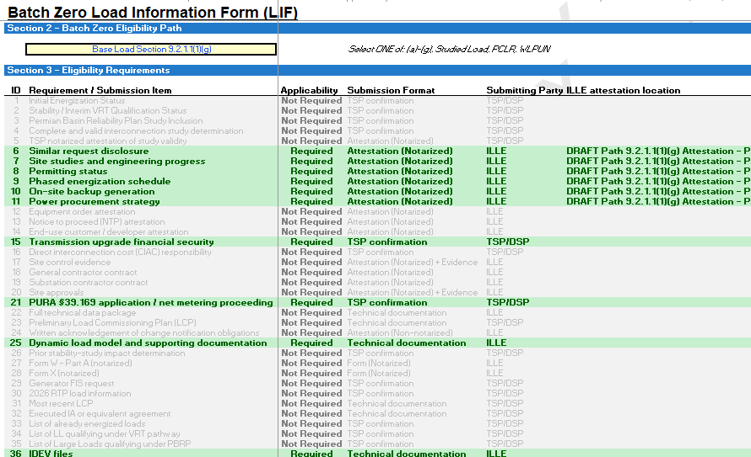
Case Study (1/8): ILLE selects eligibility pathway and identifies applicable submission requirements
ILLUSTRATIVE
HIGHLY PRELIMINARY
Supporting screenshots
Process description
1
ILLE selects the applicable Batch Zero eligibility pathway in Section 2 of the LIF (e.g., Base Load Section 9.2.1.1(1)(g))
Based on the selected pathway, the LIF automatically identifies which submission items are Required, Conditional, or Not Required within Section 3
The LIF also identifies the expected submission format for each item (e.g., notarized attestation, evidence, TSP confirmation, technical documentation, or form)
1
2
3
2
3
Source: ERCOT discussions

Slide 61
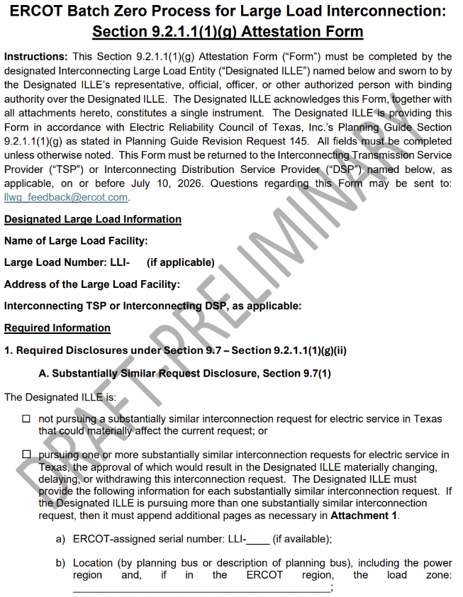
Case Study (2/8): ILLE prepares required submission package using standardized ERCOT templates
ILLUSTRATIVE
HIGHLY PRELIMINARY
Supporting screenshots
Process description
2
1
Based on the selected eligibility pathway, the ILLE prepares the applicable submission items identified in Section 3 of the LIF
  Required submission items may include notarized attestations, supporting evidence, and technical materials
ILLE uses standardized ERCOT attestation templates when available for applicable notarized submission items
1
2
Source: ERCOT discussions

Slide 62
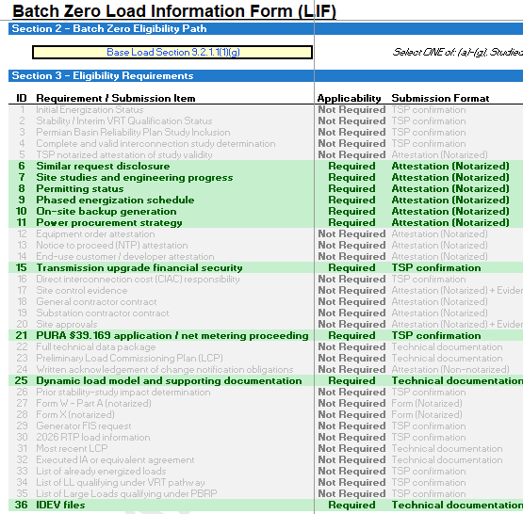
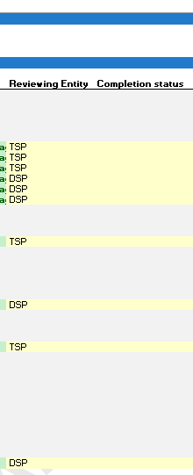
Case Study (3/8): TSP/DSP coordinate validation responsibilities for submission package
ILLUSTRATIVE
HIGHLY PRELIMINARY
Supporting screenshots
Process description
The Interconnecting TSP and DSP, as applicable, coordinate review responsibility for each applicable submission item identified in the LIF
Responsibility for review and coordination is assigned in the “Reviewing Entity” column of Section 3 of the LIF
The LIF becomes the central coordination and tracking tool used throughout the review and validation process
The ILLE with TSP and DSP, as applicable, use the LIF to coordinate review activities and track submission completeness, review status, and outstanding items
1
2
1
2
Source: ERCOT discussions

Slide 63
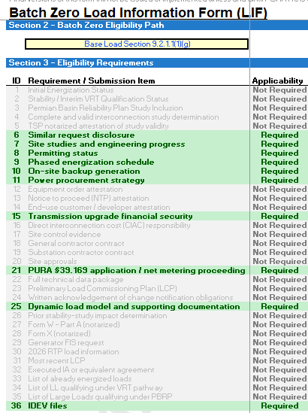
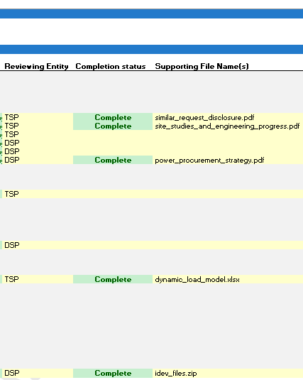
Case Study (4/8): TSP/DSP review applicable submission materials
ILLUSTRATIVE
HIGHLY PRELIMINARY
Supporting screenshots
Process description
The responsible Interconnecting TSP/DSP, as applicable, reviews each required submission item
Submission items are reviewed for completeness, internal consistency, and alignment with the applicable eligibility requirements
The Completion Status field within the LIF is updated as each submission item is reviewed
Supporting file names and associated documentation references are recorded directly within the LIF
1
2
1
2
Source: ERCOT discussions

Slide 64
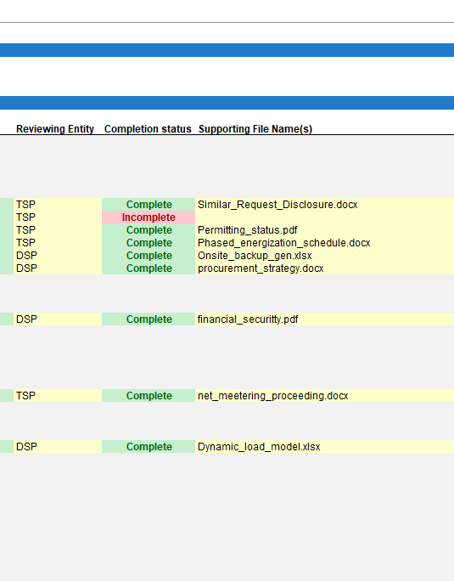
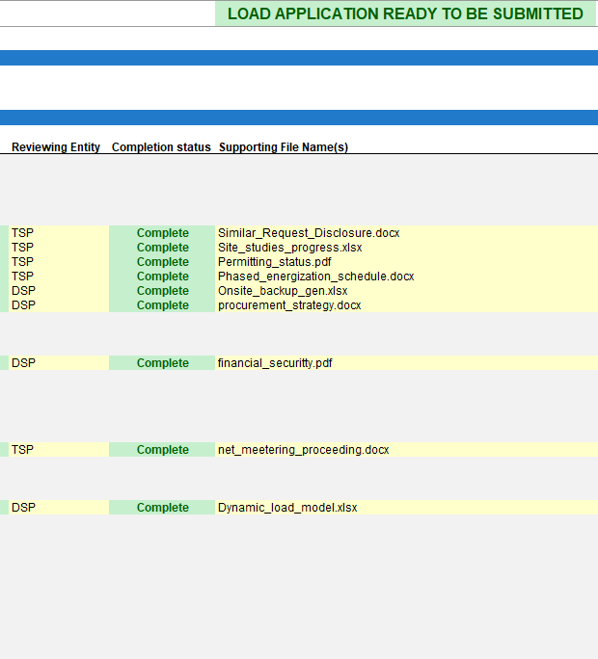
Case Study (5/8): Outstanding submission items tracked and resolved through the LIF
ILLUSTRATIVE
HIGHLY PRELIMINARY
Supporting screenshots
Process description
1
If the applicable TSP/DSP identifies missing, incomplete, or inconsistent submission items, the applicable item remains marked incomplete in the LIF
The ILLE provides revised or supplemental materials to address identified deficiencies and follow-up requests
The responsible TSP/DSP re-reviews updated submission items and updates the Completion Status field within the LIF
The submission package is not considered ready for ERCOT submission until all required submission items are marked “Complete” in the LIF
3
1
2
2
3
Source: ERCOT discussions

Slide 65
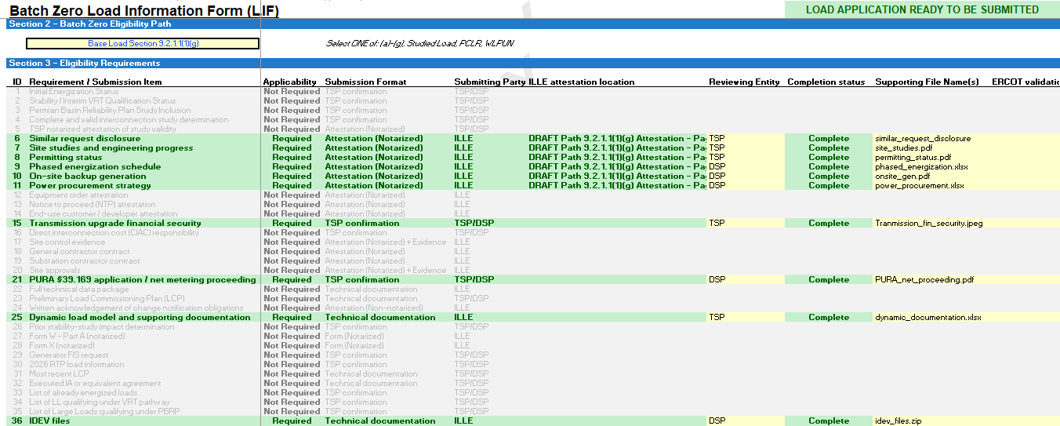
Case Study (6/8): Submission package is confirmed ready for ERCOT submission
ILLUSTRATIVE
HIGHLY PRELIMINARY
Supporting screenshots
Process description
2
Source: ERCOT discussions
1
All required submission items associated with the selected eligibility pathway should show “Complete” within the LIF
Once all required submission items have been received, reviewed, and validated, the LIF indicates “LOAD APPLICATION READY TO BE SUBMITTED” for ERCOT submission
The Interconnecting TSP and DSP, as applicable, coordinate and align on the final submission package prior to ERCOT submission
1
2

Slide 66
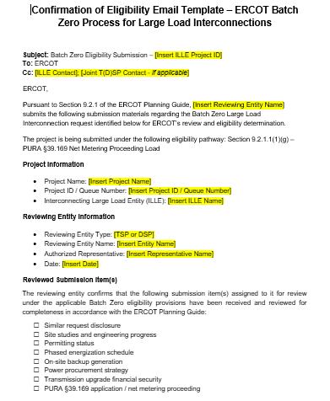
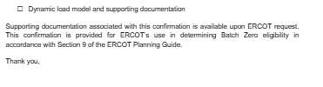
Case Study (7/8): Final submission package transmitted to ERCOT
ILLUSTRATIVE
HIGHLY PRELIMINARY
Supporting screenshots
Process description
1
1
The submitting entity (generally the Interconnecting TSP, with the Interconnecting DSP and ILLE copied where applicable) transmits the final coordinated submission package to ERCOT using the standardized email template
The final package may include:
  Completed LIF
  Supporting evidence and disclosures
  ILLE attestations/forms where applicable
  Supporting technical materials
2
2
Source: ERCOT discussions

Slide 67
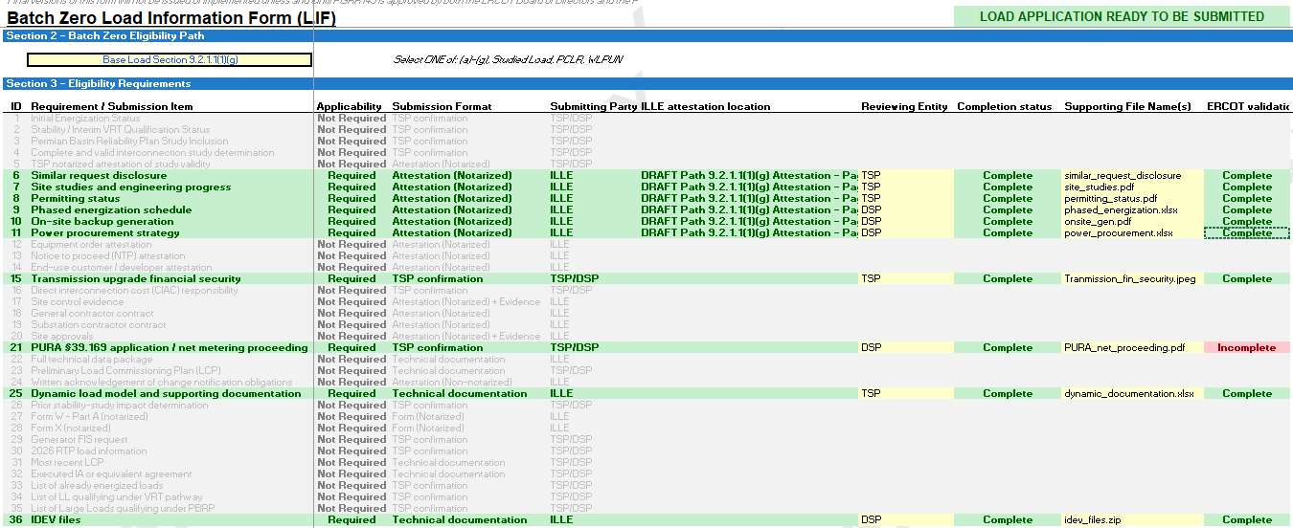
Case Study (8/8): ERCOT performs final review of submission materials and supporting documents
ILLUSTRATIVE
HIGHLY PRELIMINARY
Supporting screenshots
Process description
1
Upon receipt of the submission package, ERCOT performs a final review of the submitted materials and supporting documentation
If ERCOT identifies deficiencies, inconsistencies, or missing information, ERCOT may request clarification or supplemental materials from the submitting TSP/DSP and/or ILLE
Final Batch Zero eligibility determinations remain subject to ERCOT review and approval
1
2
2
Source: ERCOT discussions

