Slide 1
Firm Fuel Supply Service Workshop
ERCOT
June 3, 2026
Outline:
PUCT Rule Governing Firm Fuel Supply
Resource Categories: Quick Comparison
Offer Caps
  Equation and Fuel Prices
  Heat Rate Inputs
Budget Allocation
Clearing Prices
Offer Submission Requirements
Category 3 Qualification Checklist
Procurement Process
Documents
  Attachment F: Firm Fuel Supply Service Agreement
  Firm Fuel Supply Service RFP
  Firm Fuel Supply Service Capability Demonstration Form
  Firm Fuel Supply Service Offer Submission Form Offer Submission Form
  FFSS Annual Schedule for 2026/2027 Season
  Appendix and Reference Materials

Slide 2
PUCT Rule Governing Firm Fuel Supply
Public Utility Commission of Texas’ (PUCT) recent adoption of a rule to govern Firm Fuel Supply Service (FFSS): 16 Texas Administrative Code (TAC) § 25.520.
PUCT Project Number: 58434
Program Annual Budget: $54M
FFSS Obligation Period: Nov 15 – March 15

Slide 3
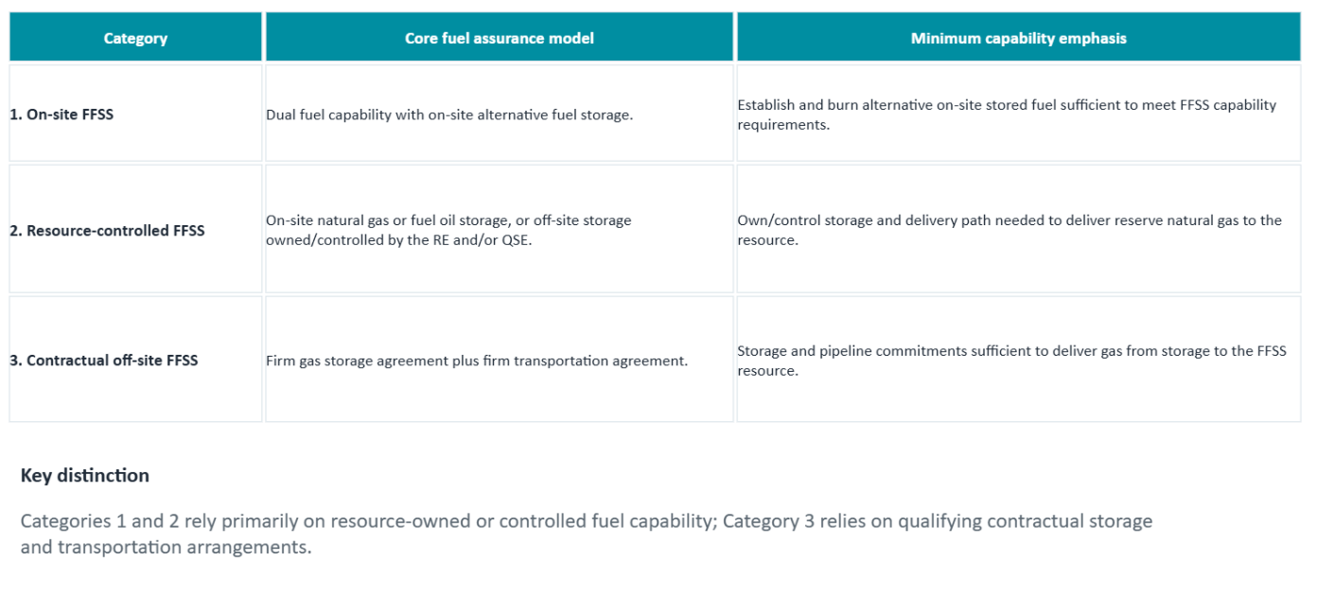
Resource Categories: Quick Comparison

Slide 4
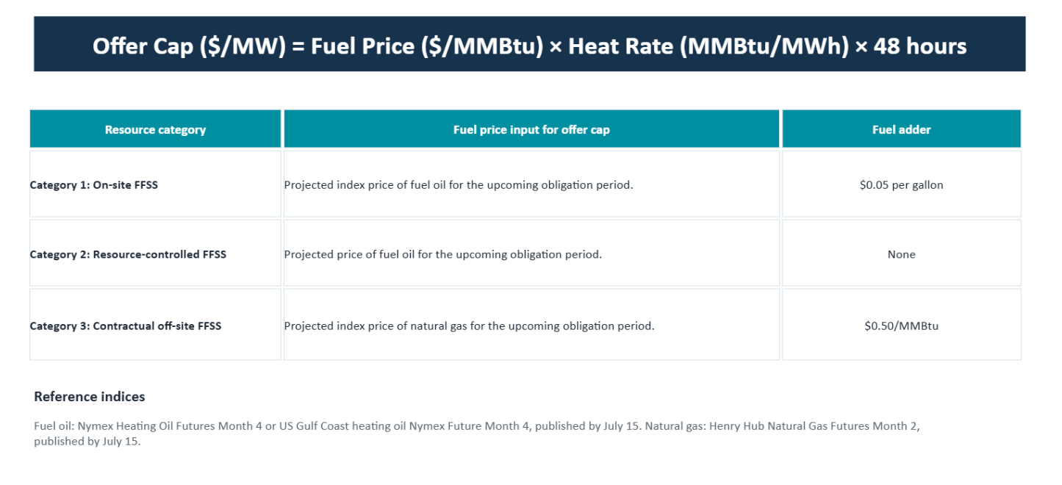
Offer Caps – Equation and Fuel Prices

Slide 5
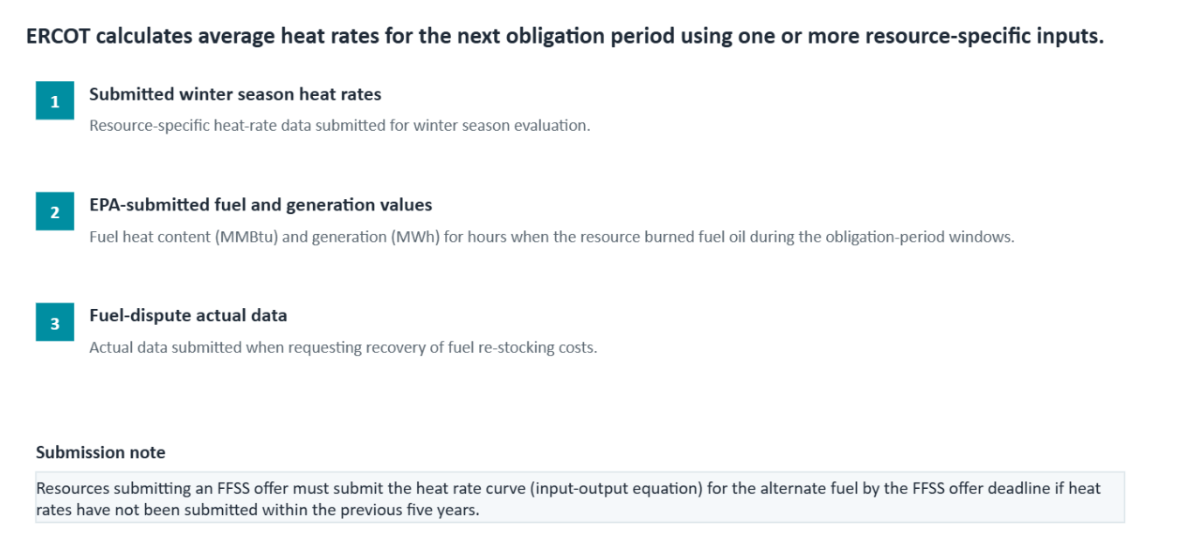
Offer Caps – Heat Rate Inputs

Slide 6
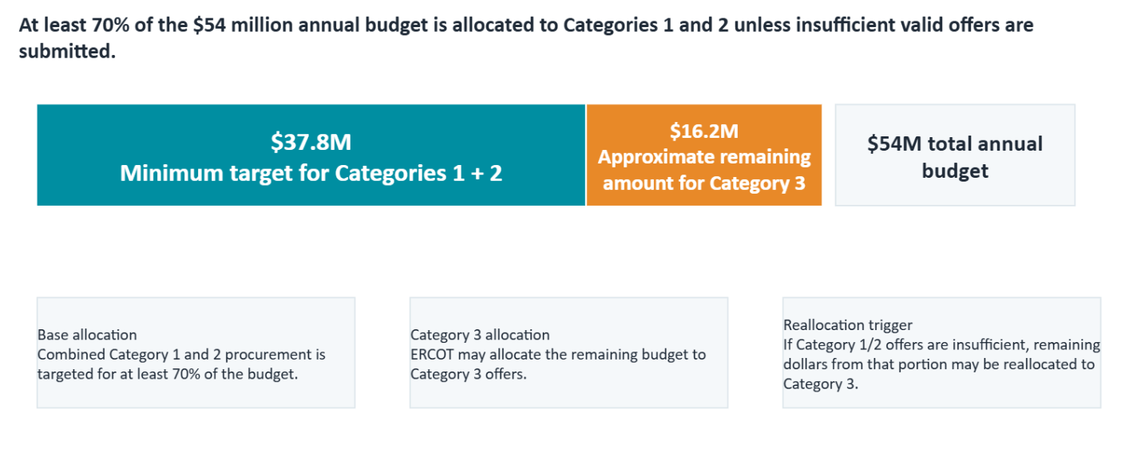
Budget Allocation

Slide 7
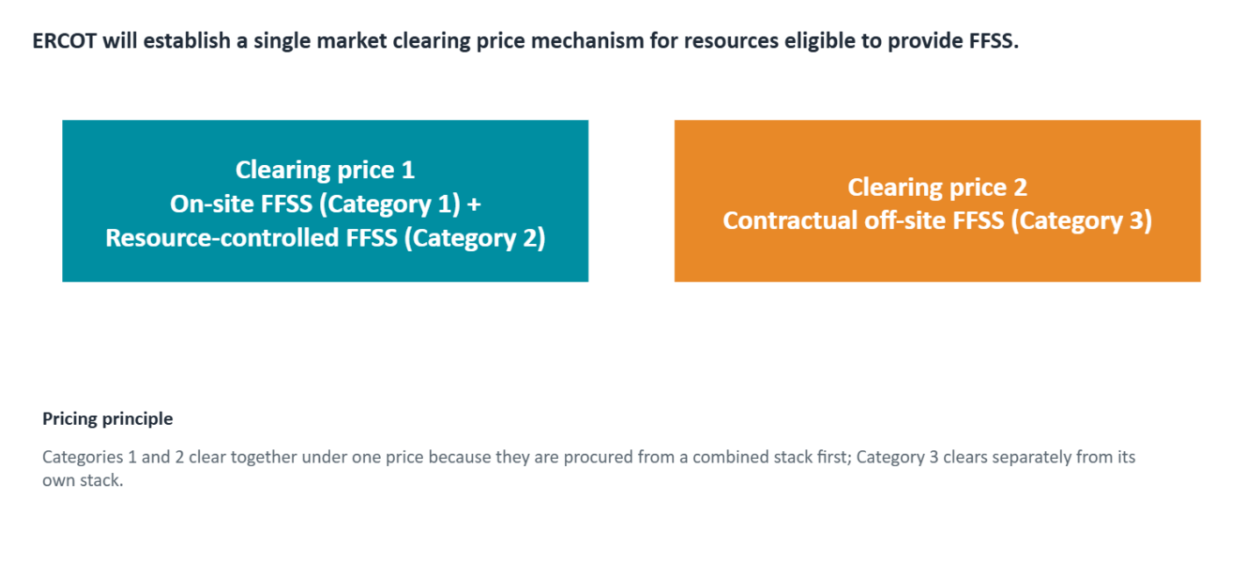
Clearing Prices

Slide 8
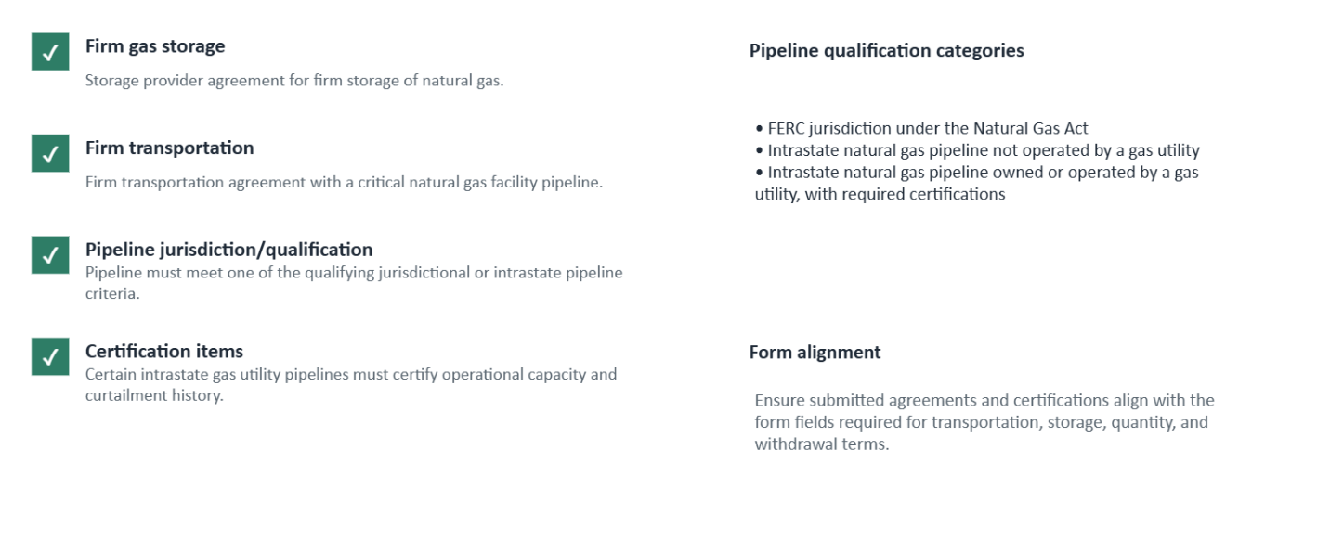
Category 3 Qualification Checklist

Slide 9
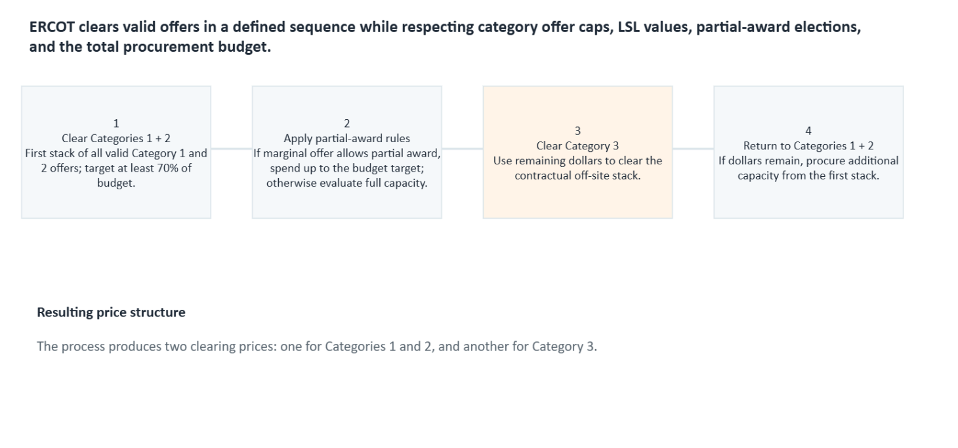
Procurement Process

Slide 10
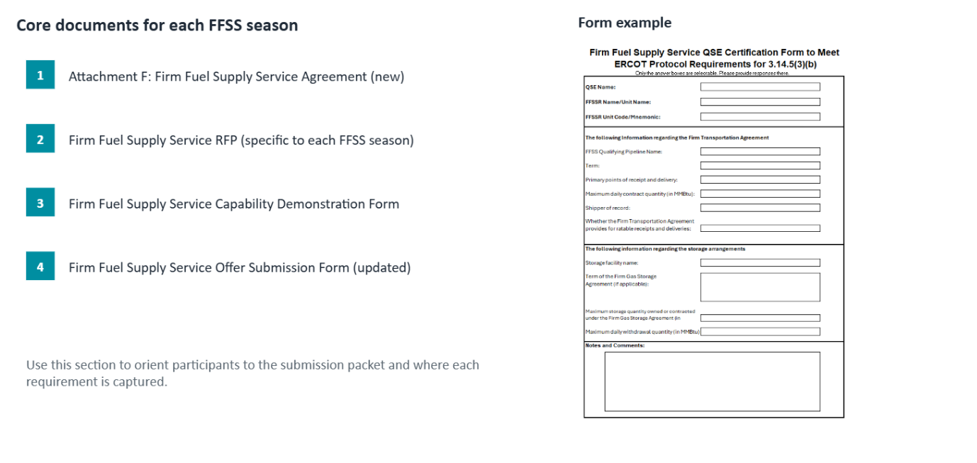
FFSS Documents

Slide 11
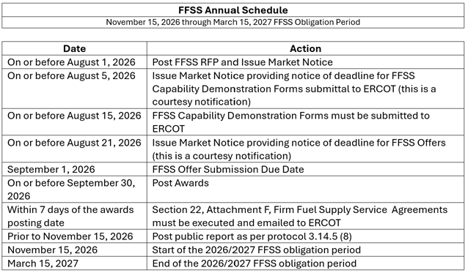
FFSS Annual Schedule for 2026/2027 Season

Slide 12
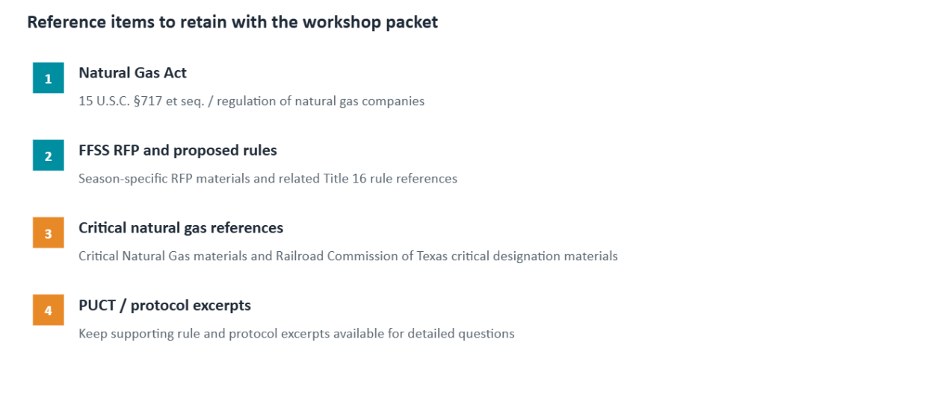
Appendix and Reference Materials

Slide 13
Resource Categories
On-site FFSS Category - (category 1)
An FFSS Resource under this category must successfully demonstrates dual fuel capability, have the ability to establish and burn an alternative on-site stored fuel, and have onsite fuel storage capability in an amount that satisfies the minimum FFSS capability requirements.
2. Resource-controlled FFSS Category - (category 2)
An FFSS Resource under this category must have an on-site natural gas or fuel oil storage capability or off-site natural gas storage where the Resource Entity and/or QSE owns and controls the natural gas storage and pipeline to deliver the required amount of reserve natural gas to the Generation Resource from the storage facility in an amount that satisfies the minimum FFSS capability requirements
3. Contractual off-site FFSS Category - (category 3)
An FFSS Resource under this category must have a firm gas storage agreement with a storage provider for firm storage of the natural gas at the storage facility and have a firm transportation agreement with a natural gas pipeline that is a critical natural gas facility, as defined in 16 Texas Administrative Code (TAC) § 25.52 for firm transportation of the natural gas from the storage facility to the FFSS resource.

Slide 14
Requirements of Contractual off-site FFSS category (category 3)
The following requirements must be met to qualify to submit offers for Resources under category 3
  Must have a firm gas storage agreement with a storage provider for firm storage of the natural gas at the storage facility.
  Must have a firm transportation agreement with a natural gas pipeline that is a critical natural gas facility - defined in subsection (c)(2) of 16 Tex. Admin. Code § 25.52.
  The natural gas pipeline providing firm transportation of the natural gas from the storage facility to the FFSS resource must be:
    Subject to the jurisdiction of the Federal Energy Regulatory Commission under the Natural Gas Act (15 U.S.C. §717 et seq);
    An intrastate natural gas pipeline that is not operated by a gas utility, as defined in Title 3 of the Texas Utilities Code; or
    An intrastate natural gas pipeline that is owned or operated by a gas utility, as defined in Title 3 of the Texas Utilities Code. An intrastate natural gas pipeline that is owned or operated by a gas utility must:
      provide only transmission service in accordance with its gas utility tariff;
      certify that, if the gas utility reduces firm deliveries to customers pursuant to §7.455 of this title (relating to Curtailment Standards), the intrastate pipeline will have sufficient operational capacity, including sufficient pipeline pressure, to provide the volume of gas required for the transportation path between the storage facility and FFSS resource to provide continuous service in the event of a curtailment; and
      certify that the pipeline has not curtailed deliveries of gas, under §7.455 of Title 3 of the Texas Utilities Code or an order issued by the Railroad Commission of Texas, to a resource that was subject to a firm transportation agreement during a curtailment event that occurred after January 1, 2021.

Slide 15
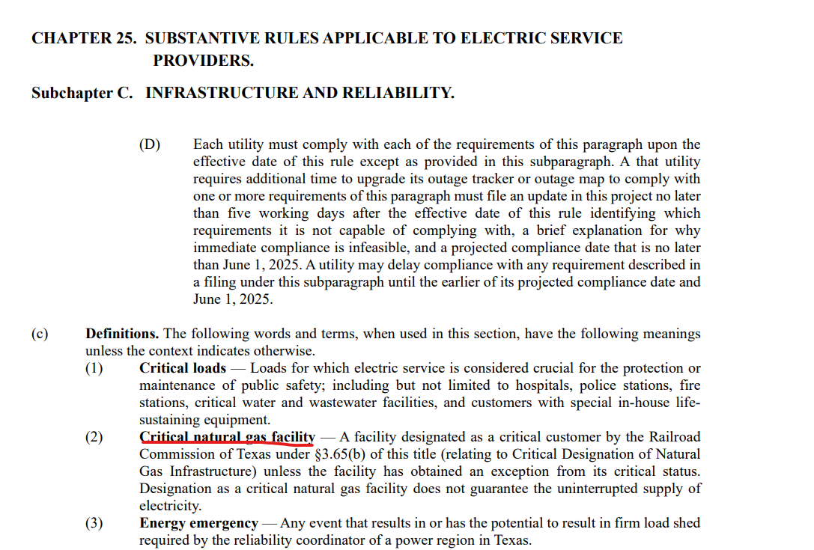
Appendix -continue

Slide 16
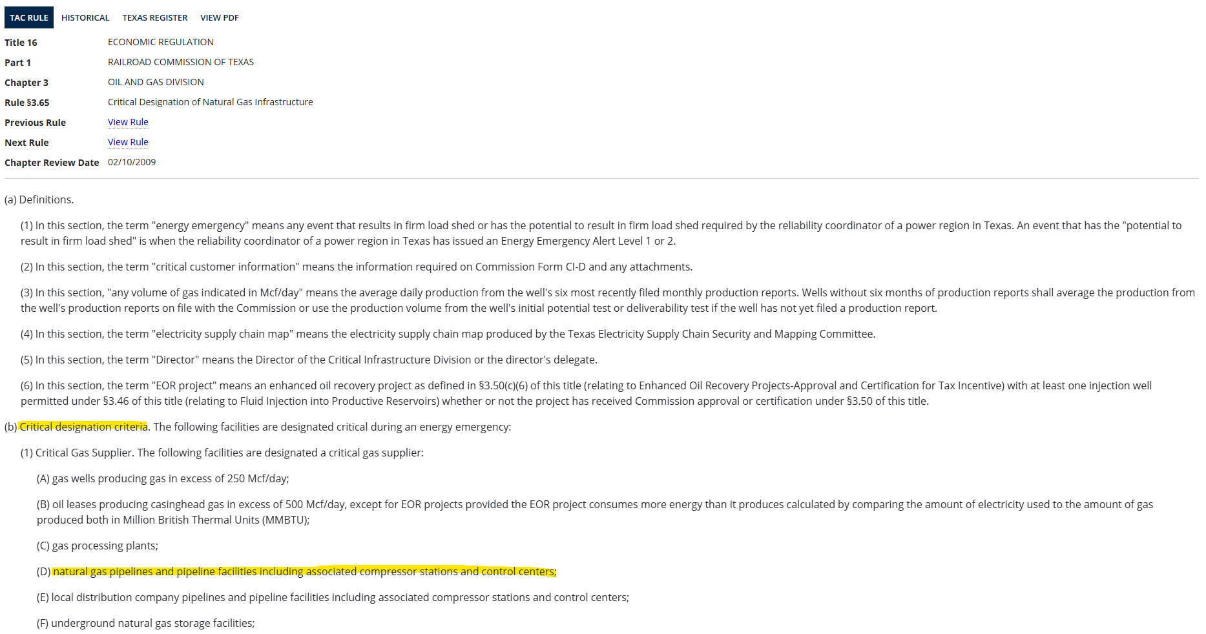
Appendix -continue

