Slide 1
Batch Zero Readiness Meeting #2
May 28, 2026
Disclaimer: This presentation is provided solely for informational and discussion purposes and does not constitute a binding interpretation of the ERCOT Protocols, Planning Guide, or any other governing authority. In the event of any conflict between this presentation and the ERCOT Protocols, Planning Guide, or other applicable governing documents, the governing documents shall prevail.

Slide 2
Agenda
Batch Zero Readiness Discussion Schedule
Batch Zero Eligibility, Attestations & Process Flow
Appendix

Slide 3
Weekly Batch Zero Readiness Discussions (see ERCOT Meeting Calendar)
Monday
Tuesday
Wednesday
Thursday
Friday
June
1
2
3
4
5
Board Meeting
Board Meeting
Batch Readiness Meeting
2-3PM
Also:
ERCOT is currently sending weekly emails to TSPs by end of day Tuesday on current LLIS Batch Zero status (final LLIS status is subject to PUCT approval of PGRR145 requirements, expected July 9)
ERCOT is developing an FAQ to assist with implementation questions
8
9
10
11
12
Batch Readiness Meeting
2-3PM
15
16
17
18
19
LLWG/Batch Readiness
Time TBD
22
23
24
25
26
Batch Readiness Meeting
2-3PM
29
30
July
1
2
3
Batch Readiness Meeting
2-3PM
6
7
8
9
10
Batch Readiness Meeting
2-3PM
LLIS Submission
Process ends
13
14
15
16
17
20
21
22
23
24
TSP Due date for Batch Zero
27
28
29
30
31

Slide 4
Batch Zero key submission deadlines and main responsibilities
Note: timeline assumes PUCT approval on July 9th
X
Detailed next
1
July 10
2
July 24
August 7
August 31
ILLE
Deadline for ILLE to submit required Batch Zero eligibility materials to the Interconnecting TSP/DSP and, where required, directly to ERCOT (e.g., dynamic load models)
Deadline for ILLEs to resolve identified dynamic model and technical data deficiencies and submit corrected materials
TSP/DSP
Deadline for TSPs/DSPs to submit complete Batch Zero eligibility packages and supporting materials to ERCOT
ERCOT
Last day ERCOT will review and approve LLIS studies under the legacy process
Deadline for ERCOT to notify TSPs/DSPs of Batch Zero classification results, including eligibility determinations and identified dynamic model or data deficiencies
Early submission encouraged prior to July 10: Interconnecting DSPs/TSPs and ILLEs are encouraged to begin submitting Batch Zero eligibility materials and supporting documentation as early as practicable in advance of the July 10, 2026 milestone. ERCOT may review submitted materials on a rolling basis and provide preliminary feedback regarding completeness, potential deficiencies, or additional information needs
Source: ERCOT discussions

Slide 5
1
July 10 Batch Zero milestone: activities required
  Lead role
ILLE
TSP/DSP
ERCOT
  Working with the TSP/DSP, identify the applicable Batch Zero eligibility pathway within the LIF
  Prepare required attestations, technical documentation, and supporting evidence
  Submit dynamic load models and supporting technical materials to ERCOT and the Interconnecting TSP, where applicable
  Resolve known documentation or technical gaps prior to TSP/DSP validation review
  Coordinate review responsibilities between TSP and DSP, as applicable
  Begin preliminary review of submitted ILLE materials and supporting evidence
  Align on the designated entity responsible for final ERCOT package submission
  Finalize LLIS study review activities under the legacy process

Slide 6
2
July 24 Batch Zero milestone: activities required
  Lead role
ILLE
TSP/DSP
ERCOT
  Respond to TSP/DSP validation questions and resolve identified submission deficiencies, as applicable
  Provide supplemental technical materials or clarifications needed to support package completeness
  Complete review and validation of ILLE submission materials against applicable eligibility requirements
  Resolve outstanding package deficiencies and confirm submission completeness within the LIF
  Finalize the coordinated Batch Zero eligibility package and submit required materials to ERCOT
  Prepare for formal completeness, classification, and eligibility review of submitted Batch Zero packages
  Clarification: the post–July 10 validation period is intended to address administrative corrections, clarification requests, and minor submission errors identified during TSP/DSP review (e.g., typos or incorrect references). It is not intended to allow submission of materially missing eligibility items or satisfaction of requirements that were not completed by the applicable July 10 deadline (e.g., posting financial security, executing required commitments, or completing required attestations)

Slide 7
Batch Zero eligibility submission and validation process
ILLUSTRATIVE
HIGHLY PRELIMINARY
Performed by ILLE
Performed by TSP/DSP
Performed by ERCOT
1
Eligibility Path Identification
Working with TSP/DSP, ILLE uses the Load Information Form (LIF) to identify the applicable Batch Zero eligibility pathway and the associated submission requirements and documentation
Until Jul 10
2
Preparation of Submission Materials
ILLE executes the required attestations, and prepares technical documentation, forms, and supporting evidence applicable to the selected eligibility pathway
3
Submission of Materials
ILLE submits the applicable materials and supporting evidence to the Interconnecting TSP/DSP and, where required, directly to ERCOT (e.g., dynamic load models and supporting documentation)
4
Review Coordination
Interconnecting TSP/DSP, as applicable, coordinate responsibility for reviewing submission materials and track review responsibility and completion status within the LIF
5
Validation and Completeness Review
Interconnecting TSP/DSP, as applicable, review submitted materials, validate completeness against the applicable eligibility requirements, and document status/comments in the LIF
Jul 10- Jul 24
6
Package Reconciliation and Follow-up
ILLE provides administrative corrections, clarifications, or non-material supplemental information to address issues identified during TSP/DSP review¹
7
Final Package Assembly
Interconnecting TSP/DSP, as applicable, finalize the coordinated eligibility package and confirm all applicable items are complete within the LIF
8
Submission to ERCOT
Interconnecting TSP submits the final coordinated eligibility package to ERCOT via email with the Interconnecting DSP and ILLE copied, where applicable
Jul 24-Aug 7
9
ERCOT Initial Eligibility Assessment
ERCOT performs validation of the Batch Zero eligibility package, including attestations, TSP/DSP confirmations, and submission completeness
10
Dynamic Model Deficiency Resolution
ERCOT notifies ILLEs of identified dynamic model or data deficiencies. ILLEs submit corrected models, updated parameters, or supplemental technical information during the cure period
Aug 7-Aug 31
11
ERCOT Final Eligibility Validation
ERCOT finalizes Batch Zero eligibility determinations following resolution of outstanding dynamic model and data deficiencies
1. The post–July 10 validation period is intended to address administrative corrections, clarification requests, and minor submission errors identified during TSP/DSP review (e.g., typos or incorrect references). It is not intended to allow submission of materially missing eligibility items or satisfaction of requirements that were not completed by the applicable July 10 deadline (e.g., posting financial security, executing required commitments, or completing required attestations)
Source: ERCOT discussions

Slide 8
Batch Zero ERCOT communications and submission channels
LLWG_Feedback@ercot.com for General Batch Zero Questions
Channel for general implementation questions, stakeholder feedback, and process clarification requests related to the Batch Zero Large Load interconnection framework
LargeLoadInterconnection@ercot.com for Existing LLIS Process Questions
Channel for questions related to the legacy LLIS process (e.g., ongoing study reviews, dynamic model submissions, and existing interconnection study coordination)
BatchZero@ercot.com (under development) for Formal Batch Zero Submissions
Channel for submission of completed Batch Zero eligibility packages by the designated Interconnecting TSP, with notification to the applicable DSP and ILLE through copied submission correspondence, as appropriate
NOTE: ERCOT plans to assign a new unique Batch Zero identifier (“BZ ID”) to each submitted Large Load project for Batch Zero intake and tracking purposes. These identifiers will serve as the primary reference number for Batch Zero implementation activities
Supporting materials and forms will be published on the Large Load Integration webpage

Slide 9
Agenda
Batch Zero Readiness Discussion Schedule
Batch Zero Eligibility, Attestations & Process Flow
Appendix

Slide 10
Objectives for today
Review eligibility requirements by Batch Zero pathway
Review the proposed eligibility requirements, submission materials, and validation responsibilities applicable to each Batch Zero eligibility pathway, including distinctions between ILLE and TSP/DSP requirements
Review proposed attestations, and supporting materials
Review the proposed submission toolkit supporting the Batch Zero process, including standardized attestation templates and TSP/DSP confirmation templates
Review proposed submission and validation process
Walk through the proposed E2E2 Batch Zero submission and validation process, including a representative example illustrating how submission materials are prepared, reviewed, validated, and transmitted
Today’s objective is to review the revised Draft Batch Zero materials and ERCOT’s plan for submission and validation of information ahead of publication of the finalized versions following Board approval. ERCOT has also scheduled recurring weekly Batch Readiness meetings to review stakeholder questions, discuss feedback, and provide process updates.
Please submit any questions or comments to llwg_feedback@ercot.com

Slide 11
Eligibility Requirements by Batch Zero Pathway (1/4)
Eligibility requirements
Eligibility path
For the ILLE¹
For the TSP/DSP
Base Load § 9.2.1.1(1)(a)
(Energized before 3/25/2022)
Optional updated dynamic load models (if enhanced or updated models are available) to ERCOT and the Interconnecting TSP
Written acknowledgement of change notification obligations
List of already energized loads
Confirmation that the Large Load satisfies the applicable requirements of Base Load Section 9.2.1.1(1)(a)
Base Load § 9.2.1.1(1)(b)
(Energized between 3/25/2022 and 7/10/26)
Optional updated dynamic load models (if enhanced or updated models are available) to ERCOT and the Interconnecting TSP
Written acknowledgement of change notification obligations
List of already energized loads
2026 RTP load information
Most recent LCP
Confirmation that the Large Load satisfies the applicable requirements of Base Load Section 9.2.1.1(1)(b)
Base Load § 9.2.1.1(1)(c)
(QSA or IVRT Assessment))
Optional updated dynamic load models (if enhanced or updated models are available) to ERCOT and the Interconnecting TSP
Written acknowledgement of change notification obligations
List of Large Loads qualifying under the quarterly stability assessment / interim VRT pathway (working with ERCOT)
2026 RTP load information
Most recent LCP
Confirmation that the Large Load satisfies the applicable requirements of Base Load Section 9.2.1.1(1)(c)
Base Load § 9.2.1.1(1)(d)
(Permian Basin Reliability Plan Study Load)
Dynamic load model to ERCOT and the Interconnecting TSP
Written acknowledgement of change notification obligations
List of Large Loads qualifying under the Permian Basin Reliability Plan Study pathway (working with ERCOT)
Most recent LCP/Preliminary LCP
Executed interconnection agreement or equivalent agreement
Confirmation that the Large Load satisfies the applicable requirements of Base Load Section 9.2.1.1(1)(d)
1. Unless otherwise specified, ILLE needs to provide the required documentation to the interconnecting TSP/DSP
Source: ERCOT PGRR145, ERCOT NPRR1325

Slide 12
Eligibility Requirements by Batch Zero Pathway (2/4)
Eligibility requirements
Eligibility path
For the ILLE¹
For the TSP/DSP
Base Load § 9.2.1.1(1)(e)
(Advancing Large Load)
One notarized attestation accompanying § 9.7 disclosures:
  Substantially similar request
  Site studies and engineering progress
  Permitting progress
  Phased energization schedule (consistent with any LCP)
  On-site backup generation information
  Power procurement plans, including on-site generation
Notarized attestation for Equipment with 18-month lead time
Notarized attestation for Notice to proceed (NTP)
Notarized attestation for End-use customer
Notarized attestation and evidence for Site control
Dynamic load model to ERCOT and the Interconnecting TSP
Written acknowledgement of change notification obligations
Confirmation of complete and valid set of interconnection studies (working with ERCOT)
Confirmation ILLE has provided financial security for system upgrades
Confirmation ILLE has satisfied direct interconnection cost (CIAC) responsibility
Confirmation that the Large Load has attested to other applicable requirements of Base Load Section 9.2.1.1(1)(e)
Base Load § 9.2.1.1(1)(f)
(Committed Large Load)
One notarized attestation accompanying § 9.7 disclosures:
  Substantially similar request
  Site studies and engineering progress
  Permitting progress
  Phased energization schedule (consistent with any LCP)
  On-site backup generation information
  Power procurement plans, including on-site generation
Notarized attestation for Site approvals or no approvals plus statement supporting conclusion
Notarized attestation and evidence for Site control
Notarized attestation for General contractor contract
Notarized attestation for Substation contractor contract
Dynamic load model to ERCOT and the Interconnecting TSP
Written acknowledgement of change notification obligations
Confirmation of complete and valid set of interconnection studies (working with ERCOT)
Confirmation ILLE has provided financial security for system upgrades
Confirmation ILLE has satisfied direct interconnection cost (CIAC) responsibility
Confirmation that the Large Load has attested to other applicable requirements of Base Load Section 9.2.1.1(1)(f)
1. Unless otherwise specified, ILLE needs to provide the required documentation to the interconnecting TSP/DSP
Source: ERCOT PGRR145, ERCOT NPRR1325

Slide 13
Eligibility Requirements by Batch Zero Pathway (3/4)
Eligibility requirements
Eligibility path
For the ILLE¹
For the TSP/DSP
Base Load § 9.2.1.1(1)(g)
(PURA §39.169 Net Metering Proceeding Load)
One notarized attestation accompanying § 9.7 disclosures:
  Substantially similar request
  Site studies and engineering progress
  Permitting progress
  Phased energization schedule (consistent with any LCP)
  On-site backup generation information
  Power procurement plans, including on-site generation
Dynamic load model to ERCOT and the Interconnecting TSP
Confirmation ILLE has provided financial security for system upgrades
Confirmation that the Large Load is associated with a qualifying PURA §39.169 net metering proceeding
Confirmation that the Large Load satisfies the applicable requirements of Base Load Section 9.2.1.1(1)(g)
Studied Load § 9.2.1.2(1)
Full technical data package required to perform steady-state, short circuit, dynamic, and transient stability analyses
Notarized attestation and evidence for Site control
One notarized attestation accompanying § 9.7 disclosures:
  Substantially similar request
  Site studies and engineering progress
  Permitting progress
  Phased energization schedule (consistent with any LCP)
  On-site backup generation information
  Power procurement plans, including on-site generation
Preliminary LCP to the Interconnecting TSP
Dynamic load model to ERCOT and the Interconnecting TSP
Written acknowledgement of change notification obligations
Confirmation of study requirement (working with ERCOT)
Confirmation ILLE has provided financial security for system upgrades equal to $50k/MW of peak Demand
Confirmation of receipt of written acknowledgement of change notification obligations
If needed, Prior stability-study impact determination
Confirmation that the Large Load satisfies the applicable requirements of Studied Load
1. Unless otherwise specified, ILLE needs to provide the required documentation to the interconnecting TSP/DSP
Source: ERCOT PGRR145, ERCOT NPRR1325

Slide 14
Eligibility Requirements by Batch Zero Pathway (4/4)
Eligibility requirements
Eligibility path
For the ILLE¹
For the TSP/DSP
PCLR §§ 9.2.1.2 and 9.2.2.1(2)
(Provisional Controllable Load Resource)
Full technical data package required to perform steady-state, short circuit, dynamic, and transient stability analyses
Notarized attestation and evidence for Site control
One notarized attestation accompanying § 9.7 disclosures:
  Substantially similar request
  Site studies and engineering progress
  Permitting progress
  Phased energization schedule (consistent with any LCP)
  On-site backup generation information
  Power procurement plans, including on-site generation
Preliminary LCP to the Interconnecting TSP
Dynamic load model to ERCOT and the Interconnecting TSP
Written acknowledgement of change notification obligations
Notarized Form W – Part A
Confirmation of Transmission upgrade financial security
Confirmation of receipt of written acknowledgement of change notification obligations
If needed, Prior stability-study impact determination
Confirmation that the Large Load satisfies the applicable requirements of PCLR
WLPUN §§ 9.2.1.2 and 9.2.2.1(2)
(Withdrawal-Limited Private Use Network)
Full technical data package required to perform steady-state, short circuit, dynamic, and transient stability analyses
Notarized attestation and evidence for Site control
One notarized attestation accompanying § 9.7 disclosures:
  Substantially similar request
  Site studies and engineering progress
  Permitting progress
  Phased energization schedule (consistent with any LCP)
  On-site backup generation information
  Power procurement plans, including on-site generation
Preliminary LCP to the Interconnecting TSP
Dynamic load model to ERCOT and the Interconnecting TSP
Written acknowledgement of change notification obligations
Notarized Form X
Confirmation of Transmission upgrade financial security
Confirmation of receipt of written acknowledgement of change notification obligations
If needed, Prior stability-study impact determination
Confirmation of Generator FIS request and associated generation information for the WLPUN
Confirmation that the Large Load satisfies the applicable requirements of Studied Load – WLPUN
1. Unless otherwise specified, ILLE needs to provide the required documentation to the interconnecting TSP/DSP
Source: ERCOT PGRR145, ERCOT NPRR1325

Slide 15
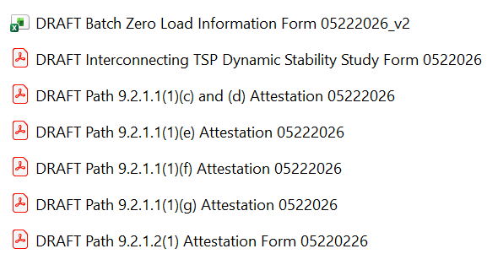
Batch Zero submission and validation toolkit
DRAFT Batch Zero Attestations and Forms_05-23-2026¹
Batch Zero Load Information Form (LIF)
Central workbook identifying applicable eligibility requirements and submission materials by Batch Zero pathway
Serves as the primary coordination and tracking tool across ILLEs, Interconnecting TSPs/DSPs, and ERCOT throughout the submission and validation process
ILLE attestation forms
Standardized notarized attestation templates aligned to Batch Zero eligibility and readiness requirements
Used by ILLEs to certify project status, disclosures, milestones, and supporting evidence
ERCOT preparing attestation templates
1. Materials uploaded in the Key Documents section of May 28 ERCOT Batch Zero Readiness Meeting, in ERCOT meeting calendar
Source: https://www.ercot.com/calendar/05282026-Batch-Zero-Readiness-Meeting

Slide 16
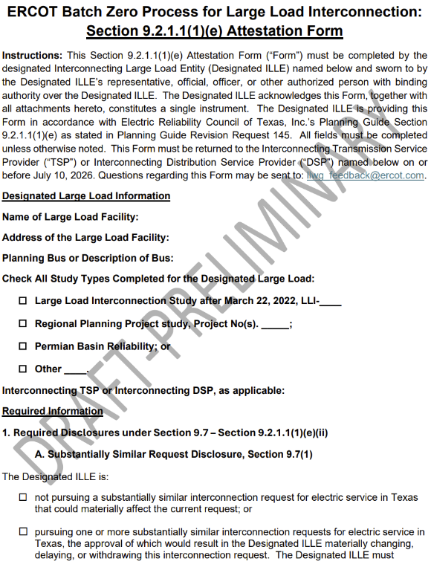
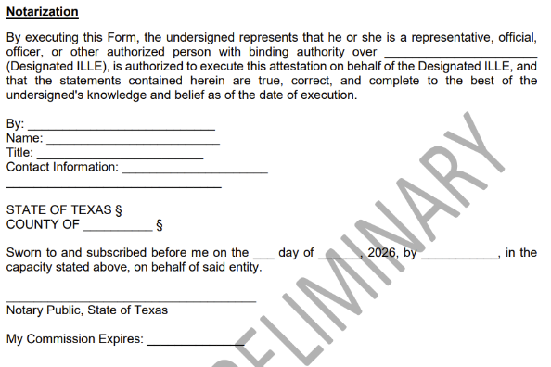
Deep-dive: Sample Batch Zero ILLE Attestation
ILLUSTRATIVE
HIGHLY PRELIMINARY
Representative attestation template
Key attestation elements
3
1
Project identification information
Includes the core project information required to associate the attestation with the applicable Batch Zero request, including ILLE name, facility name, and project location¹
1
2
Eligibility certification and attestation
ILLE representative certifies that the project satisfies the applicable eligibility criteria and that the submitted information is complete and accurate at the time of execution
2
3
Notarization and authorized execution
Authorized ILLE representative executes the attestation before a notary public, confirming authority to bind the entity and certify the submission under oath
1. ERCOT plans to assign a new unique Batch Zero identifier (“BZ ID”) to each submitted Large Load project for Batch Zero intake and tracking purposes. These identifiers will serve as the primary reference number for Batch Zero implementation activities and may differ from existing LLI numbers, RPG references, PBRP references, or other project identifiers currently used in ERCOT processes.
Source: Batch Zero Readiness Meeting #2 - Webex Only materials

Slide 17
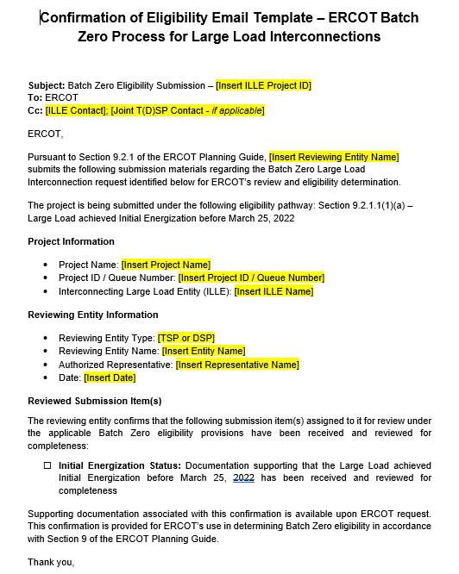
Deep-dive: TSP/DSP Email confirmation template by eligibility path
ILLUSTRATIVE
HIGHLY PRELIMINARY
Representative email confirmation template
Key highlights
1
Project identification and eligibility pathway confirmation
TSP/DSP identifies the applicable Batch Zero project and confirms the eligibility pathway associated with the submission, including the ILLE name, project name, and queue/project identifier
2
Reviewing entity and authorized representative information
TSP/DSP identifies the reviewing entity, authorized representative, and confirmation date associated with the submission to ERCOT
1
2
3
Confirmation of reviewed submission materials
TSP/DSP confirms that the required submission materials and supporting documentation for the selected eligibility pathway have been received and reviewed for completeness prior to ERCOT submission
3

Slide 18
Batch Zero eligibility submission and validation process
ILLUSTRATIVE
HIGHLY PRELIMINARY
Performed by ILLE
Performed by TSP/DSP
Performed by ERCOT
1
Eligibility Path Identification
Working with TSP/DSP, ILLE uses the Load Information Form (LIF) to identify the applicable Batch Zero eligibility pathway and the associated submission requirements and documentation
Until Jul 10
2
Preparation of Submission Materials
ILLE executes the required attestations, and prepares technical documentation, forms, and supporting evidence applicable to the selected eligibility pathway
3
Submission of Materials
ILLE submits the applicable materials and supporting evidence to the Interconnecting TSP/DSP and, where required, directly to ERCOT (e.g., dynamic load models and supporting documentation)
4
Review Coordination
Interconnecting TSP/DSP, as applicable, coordinate responsibility for reviewing submission materials and track review responsibility and completion status within the LIF
5
Validation and Completeness Review
Interconnecting TSP/DSP, as applicable, review submitted materials, validate completeness against the applicable eligibility requirements, and document status/comments in the LIF
Jul 10- Jul 24
6
Package Reconciliation and Follow-up
ILLE provides administrative corrections, clarifications, or non-material supplemental information to address issues identified during TSP/DSP review¹
7
Final Package Assembly
Interconnecting TSP/DSP, as applicable, finalize the coordinated eligibility package and confirm all applicable items are complete within the LIF
8
Submission to ERCOT
Interconnecting TSP submits the final coordinated eligibility package to ERCOT via email with the Interconnecting DSP and ILLE copied, where applicable
Jul 24-Aug 7
9
ERCOT Initial Eligibility Assessment
ERCOT performs validation of the Batch Zero eligibility package, including attestations, TSP/DSP confirmations, and submission completeness
10
Dynamic Model Deficiency Resolution
ERCOT notifies ILLEs of identified dynamic model or data deficiencies. ILLEs submit corrected models, updated parameters, or supplemental technical information during the cure period
Aug 7-Aug 31
11
ERCOT Final Eligibility Validation
ERCOT finalizes Batch Zero eligibility determinations following resolution of outstanding dynamic model and data deficiencies
1. The post–July 10 validation period is intended to address administrative corrections, clarification requests, and minor submission errors identified during TSP/DSP review (e.g., typos or incorrect references). It is not intended to allow submission of materially missing eligibility items or satisfaction of requirements that were not completed by the applicable July 10 deadline (e.g., posting financial security, executing required commitments, or completing required attestations)
Source: ERCOT discussions

Slide 19
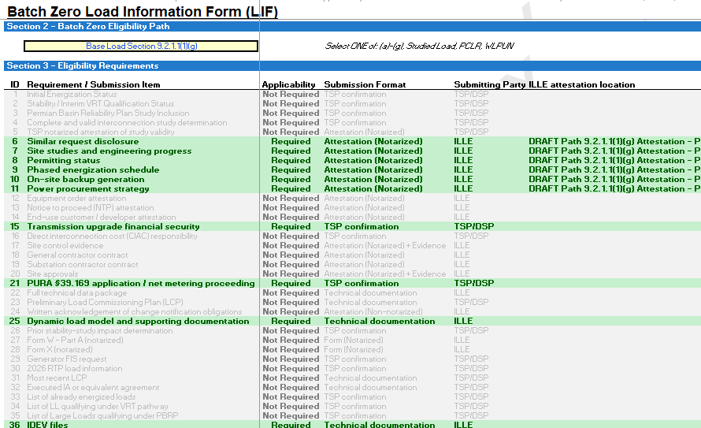
Case Study (1/8): ILLE selects eligibility pathway and identifies applicable submission requirements
ILLUSTRATIVE
HIGHLY PRELIMINARY
Supporting screenshots
Process description
1
ILLE selects the applicable Batch Zero eligibility pathway in Section 2 of the LIF (e.g., Base Load Section 9.2.1.1(1)(g))
Based on the selected pathway, the LIF automatically identifies which submission items are Required, Conditional, or Not Required within Section 3
The LIF also identifies the expected submission format for each item (e.g., notarized attestation, evidence, TSP confirmation, technical documentation, or form)
1
2
3
2
3
Source: ERCOT discussions

Slide 20
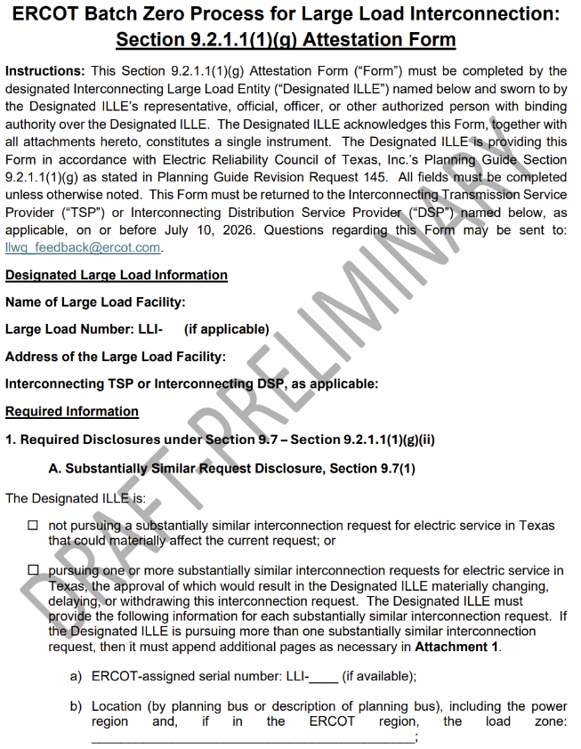
Case Study (2/8): ILLE prepares required submission package using standardized ERCOT templates
ILLUSTRATIVE
HIGHLY PRELIMINARY
Supporting screenshots
Process description
2
1
Based on the selected eligibility pathway, the ILLE prepares the applicable submission items identified in Section 3 of the LIF
  Required submission items may include notarized attestations, supporting evidence, and technical materials
ILLE uses standardized ERCOT attestation templates when available for applicable notarized submission items
1
2
Source: ERCOT discussions

Slide 21
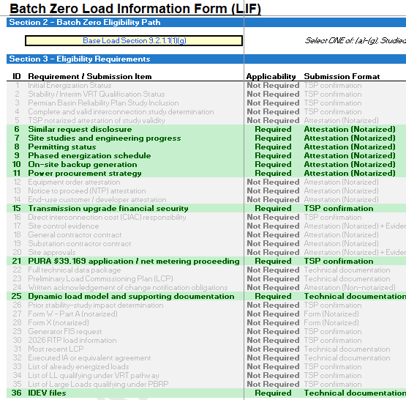
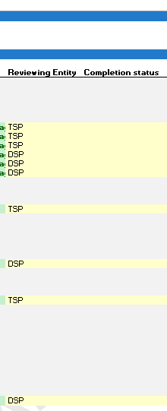
Case Study (3/8): TSP/DSP coordinate validation responsibilities for submission package
ILLUSTRATIVE
HIGHLY PRELIMINARY
Supporting screenshots
Process description
The Interconnecting TSP and DSP, as applicable, coordinate review responsibility for each applicable submission item identified in the LIF
Responsibility for review and coordination is assigned in the “Reviewing Entity” column of Section 3 of the LIF
The LIF becomes the central coordination and tracking tool used throughout the review and validation process
The ILLE with TSP and DSP, as applicable, use the LIF to coordinate review activities and track submission completeness, review status, and outstanding items
1
2
1
2
Source: ERCOT discussions

Slide 22
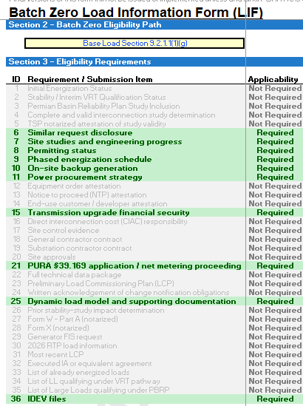
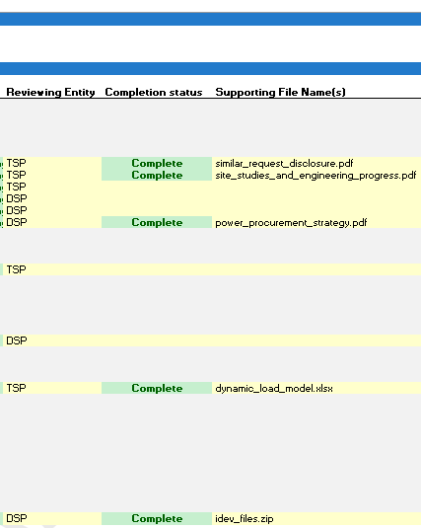
Case Study (4/8): TSP/DSP review applicable submission materials
ILLUSTRATIVE
HIGHLY PRELIMINARY
Supporting screenshots
Process description
The responsible Interconnecting TSP/DSP, as applicable, reviews each required submission item
Submission items are reviewed for completeness, internal consistency, and alignment with the applicable eligibility requirements
The Completion Status field within the LIF is updated as each submission item is reviewed
Supporting file names and associated documentation references are recorded directly within the LIF
1
2
1
2
Source: ERCOT discussions

Slide 23
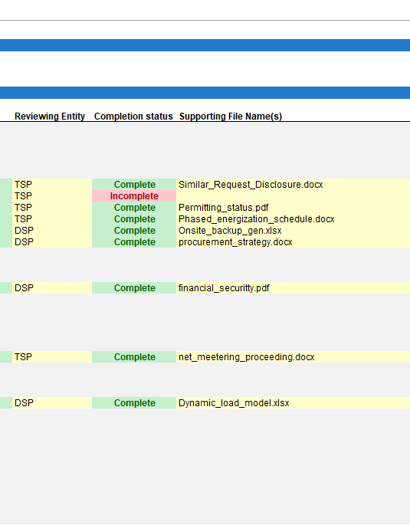
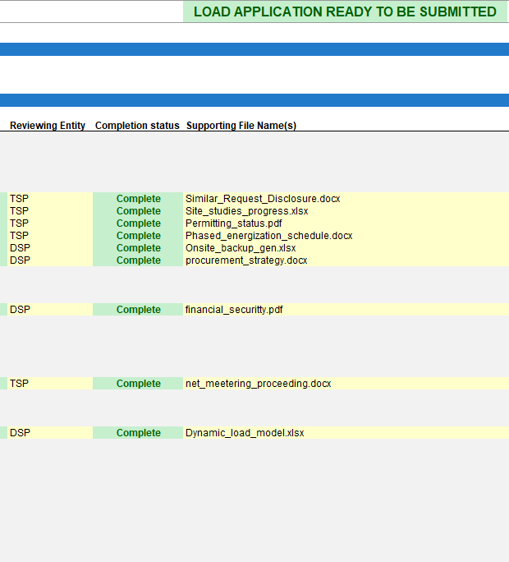
Case Study (5/8): Outstanding submission items tracked and resolved through the LIF
ILLUSTRATIVE
HIGHLY PRELIMINARY
Supporting screenshots
Process description
1
If the applicable TSP/DSP identifies missing, incomplete, or inconsistent submission items, the applicable item remains marked incomplete in the LIF
The ILLE provides revised or supplemental materials to address identified deficiencies and follow-up requests
The responsible TSP/DSP re-reviews updated submission items and updates the Completion Status field within the LIF
The submission package is not considered ready for ERCOT submission until all required submission items are marked “Complete” in the LIF
3
1
2
2
3
Source: ERCOT discussions

Slide 24
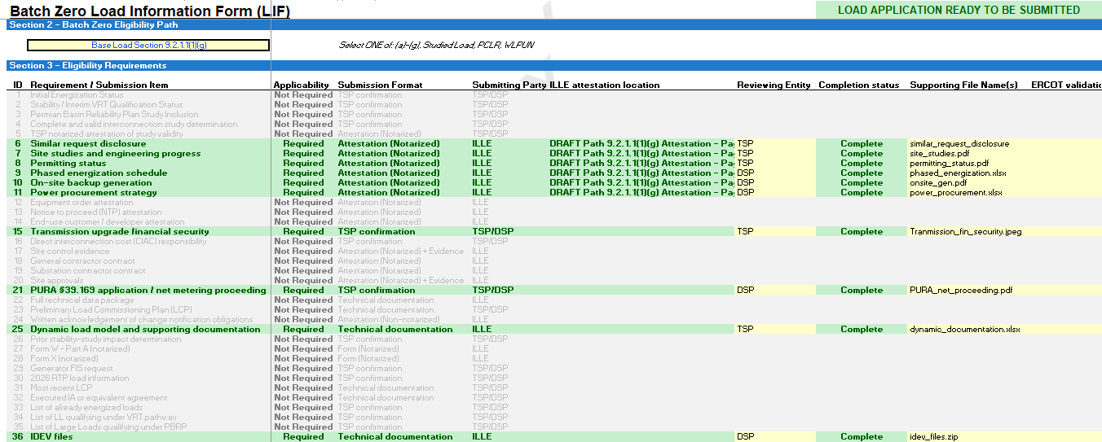
Case Study (6/8): Submission package is confirmed ready for ERCOT submission
ILLUSTRATIVE
HIGHLY PRELIMINARY
Supporting screenshots
Process description
2
Source: ERCOT discussions
1
All required submission items associated with the selected eligibility pathway should show “Complete” within the LIF
Once all required submission items have been received, reviewed, and validated, the LIF indicates “LOAD APPLICATION READY TO BE SUBMITTED” for ERCOT submission
The Interconnecting TSP and DSP, as applicable, coordinate and align on the final submission package prior to ERCOT submission
1
2

Slide 25
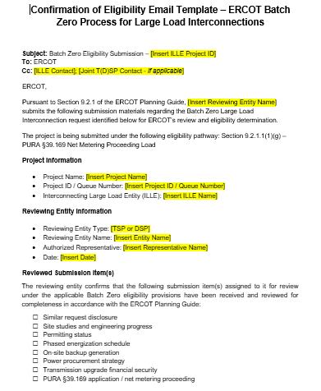
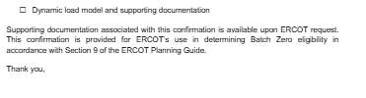
Case Study (7/8): Final submission package transmitted to ERCOT
ILLUSTRATIVE
HIGHLY PRELIMINARY
Supporting screenshots
Process description
1
1
The submitting entity (generally the Interconnecting TSP, with the Interconnecting DSP and ILLE copied where applicable) transmits the final coordinated submission package to ERCOT using the standardized email template
The final package may include:
  Completed LIF
  Supporting evidence and disclosures
  ILLE attestations/forms where applicable
  Supporting technical materials
2
2
Source: ERCOT discussions

Slide 26
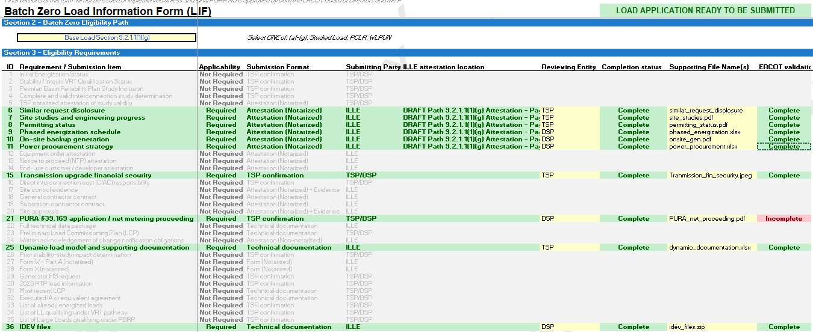
Case Study (8/8): ERCOT performs final review of submission materials and supporting documents
ILLUSTRATIVE
HIGHLY PRELIMINARY
Supporting screenshots
Process description
1
Upon receipt of the submission package, ERCOT performs a final review of the submitted materials and supporting documentation
If ERCOT identifies deficiencies, inconsistencies, or missing information, ERCOT may request clarification or supplemental materials from the submitting TSP/DSP and/or ILLE
Final Batch Zero eligibility determinations remain subject to ERCOT review and approval
1
2
2
Source: ERCOT discussions

Slide 27
Path to Batch Zero
May 21
Initial preview of implementation process, new LIF, and attestation templates
May 28 (today)
More detailed preview of process, new LIF, and attestation templates
First week of June∗
Official LIF and attestation templates posted to the Large Load Integration section of the ERCOT website
New email inbox goes live to receive Batch Zero submission packages
July 24
Last day for Interconnecting TSPs/DSPs, as applicable, to submit completed Batch Zero submission packages to ERCOT
Request for feedback and questions
ERCOT will start accepting submissions and provide preliminary feedback but will not provide final answer unless and until PUCT approves PGRR145 and NPRR1325
*ERCOT will release the official LIF and attestation templates only if the ERCOT Board approves PGRR145

Slide 28
Batch Zero Readiness Next Meetings
    Thursday June 4 (2-3pm): Batch Readiness Meeting #3 WebEx only
Thursday June 11 (2-3pm): Batch Readiness Meeting #4 WebEx only
Thursday June 19 (TBD): LLWG - Batch Zero Update/Weekly Readiness (Met and WebEx)
Thursday June 25 (2-3pm): Batch Readiness Meeting #5 WebEx only
Wednesday July 1 (2-3pm): Batch Readiness Meeting #6 WebEx only
Thursday July 9 (2-3pm): Batch Readiness Meeting #7 WebEx only

Slide 29
Questions?
LLWG_Feedback@ERCOT.com

Slide 30
Agenda
Batch Zero Readiness Discussion Schedule
Batch Zero Eligibility, Attestations & Process Flow
Appendix

Slide 31
Key Deadlines for Batch Zero
July 10
Last day for ERCOT to review and approve LLIS studies
July 24
Deadline for required information for inclusion in Batch Zero to be submitted to ERCOT
August 7
Deadline for ERCOT to notify TSPs and DSPs of Large Load inclusion and classification in Batch Zero
As drafted in PGRR145, the current Large Load Interconnection Study (LLIS) process will cease operation after July 10, 2026
This means July 10 is the last day ERCOT is able to review and approve LLIS studies
Starting on July 11, the Batch Zero Interconnection Study will be the only path to connect a Large Load to the ERCOT system
The inclusion and treatment of Large Loads in Batch Zero will be determined by the status of qualifying studies as they stand at the end of the day on July 10, 2026

Slide 32
Review of PGRR115 Process Timelines – Kick-off and Study Scoping
Per Section 9.3.2 of the current Planning Guide, all LLIS studies must be preceded by a kick-off meeting and defined study scope agreed on by ERCOT, the lead TSP, and any affected TSPs. This meeting is required under the Planning Guide and cannot be waived.
The lead TSP is responsible for scheduling the kick-off meeting. ERCOT does not control when a meeting is scheduled.
ERCOT will continue to attend kick-off meetings and to support the study scoping process through July 10.
As described in the Planning Guide, it can take up to 35 Business Days to finalize a study scope after a kick-off meeting is held.
Key Takeaways
The existing kick-off and scoping process remains in effect.
ERCOT continues to attend kick-off meetings and review study scopes.
However, it may not be possible to scope a LLIS study with a kick-off meeting held after May 21, 2026.

Slide 33
Review of PGRR115 Process Timelines – Study Reviews and Approvals
Per Section 9.4 of the current Planning Guide, all LLIS studies must be submitted to ERCOT for review and approval.
ERCOT will continue to review studies under this process through July 10.
As described in the Planning Guide, it can take up to 30 Business Days for ERCOT to review a submitted study.
ERCOT review is not guaranteed to result in an approval. Any required updates to a submitted study are treated as a new submission, which restarts the timeline for review.
ERCOT does not have visibility into the amount of time needed by TSPs to perform a LLIS study. Please reach out to your lead TSP with questions about the status of a study that has not yet been submitted to ERCOT for review.
Key Takeaways
The existing study review process remains in effect through July 10.
ERCOT continues to review submitted study reports as quickly as possible once submitted.
ERCOT cannot guarantee a new or updated study report submitted after May 28, 2026 will be reviewed by July 10.

Slide 34
Summary of Key Dates
July 10
Last day for ERCOT to review submitted studies under the current LLIS Process
August 7
ERCOT notifies TSPs/DSPs of Batch Zero classifications
LLIS study reviews continue
May
June
July
August
May 28 (today)
Last day a study submitted to ERCOT is guaranteed a review by July 10
July 24
Batch Zero information for qualifying loads due to ERCOT

Slide 35
Additional notes on base loads in Batch Zero
The design of PGRR145 is intended to allow for loads that qualify as base load in Batch Zero to continue moving toward energization prior to Batch Zero or while Batch Zero is in progress.
For example, base loads are still able to qualify for the quarterly stability assessment (QSA) appropriate for their planned Initial Energization date while Batch Zero is in progress. They are also eligible to be added to the ERCOT Network Operations Model during that time.

Slide 36
Dynamic Models for the Batch Zero – Key Deadlines
July 10, 2026
July 10, 2026
LL projects not submitting models and required information by this deadline will be excluded from Batch Zero.
ILLE Model Submission Deadline
ILLE Must Submit to ERCOT and the Interconnecting TSP by July 10⁽¹⁾:
August 7, 2026
Dynamic models
Model parameters
Supporting technical documentation
Completed ERCOT Dynamic Working Group Large Load Data Survey⁽²⁾
ERCOT will notify ILLE of any identified deficiencies in submitted models or required information.
August 31, 2026
Any LL projects with incomplete data or unresolved model issues remaining after this date will also be excluded from Batch Zero.
(1). LargeLoadInterconnection@ercot.com
(2). https://www.ercot.com/files/docs/2025/12/19/ERCOT-Dynamics-Working-Group-Large-Load-Data-Survey_v2.docx

Slide 37
Dynamic Models for the Batch Zero – Key Deadlines
July 24, 2026
TSP Determination Deadline
TSP Must Submit to ERCOT by July 24 (if applicable) ⁽¹⁾:
If a dynamic stability study has previously been performed for a Large Load, the interconnecting TSP must submit a written determination indicating whether the submitted dynamic data is expected to adversely impact prior stability study results.
(1). LargeLoadInterconnection@ercot.com

Slide 38
Large Load Dynamic Model Submission Elements
Model Compatibility
Data Survey Completion
All submissions must be compatible with the planning and operations model software version specified in the Dynamic Working Group Procedure Manual in effect on March 4, 2026.
All model submissions must include completion of the latest ERCOT Dynamic Working Group Large Load Data Survey⁽¹⁾.
Updated / Improved Models
ERCOT Defaults
ILLEs are expected to submit updated or improved models that properly represent load behavior — especially where enhanced models are available.
For operational loads not providing dynamic models or updating models, ERCOT will use the available models previously provided or assume minimum ride-through capability where no model is provided.
(1). https://www.ercot.com/files/docs/2025/12/19/ERCOT-Dynamics-Working-Group-Large-Load-Data-Survey_v2.docx

Slide 39
Applicability for Batch-0 Dynamic Model Submission
PGRR 145 Section | Criteria | Submission Required
9.2.1.1(1)(a) | Energized before March 25, 2022 | No⁽¹⁾
9.2.1.1(1)(b) | Energized between March 25, 2022, and July 10, 2026 | No⁽¹⁾
9.2.1.1(1)(c) | Qualified for QSA or included in interim VRT by May 1, 2026 | No⁽¹⁾
9.2.1.1(1)(d) | Included in the 2024 Permian Basin Reliability Plan Study and contributed to transmission needs | Yes⁽¹⁾⁽²⁾
9.2.1.1(1)(e) | Not energized as of July 10, 2026, and meets specified requirements | Yes
9.2.1.1(1)(f) | Not energized as of July 10, 2026, and meets specified requirements | Yes
9.2.1.1(1)(g) | Not energized as of July 10, 2026, and meets specified requirements | Yes
9.2.1.2(1) | Meets criteria (a)-(d) and subject to reliability assessment and allocation | Yes
(1). If an updated model if available, the ILLE should supply a version that more accurately represents the LL.
(2). No submission is needed if meeting criteria in 9.2.1.1(1)(a)-(c).

Slide 40
Model Review
Voltage Ride-Through (VRT) Testing
ERCOT will perform VRT testing for applicable Large Computational Loads (LCLs) subject to NOGRR282.
If a model does NOT meet NOGRR282 requirements:
ERCOT will notify the interconnecting TSP and ILLE
The load remains in Batch Zero with no impact to allocation
The ILLE should coordinate with the TSP to update the model before the completion of Batch Zero

