Slide 1
Monthly Review of Reliability Unit Commitment Market Impacts – April 2026
Wholesale Market Working Group
ERCOT Market Analysis
May 2026

Slide 2
RUC Resource-Hours
April 2026 | Total | Capacity |  | Congestion
 |  | Opt-Out | Non-Opt-Out | Opt-Out | Non-Opt-Out
Instructed Resource-Hours
Total Count | 62.0 | 0.0 | 20.0 | 4.0 | 38.0
Effective Resource-Hours*
Total Count | 50.9 | 0.0 | 17.2 | 4.0 | 29.8
Average Megawatts (MW) for Effective Resource-Hours
Average LSL | 124.0 | 0.0 | 185.2 | 120.0 | 90.4
Average LDL | 151.6 | 0.0 | 185.2 | 323.5 | 110.5
Average BP | 163.1 | 0.0 | 185.2 | 400.0 | 120.1
Average HSL | 320.6 | 0.0 | 457.3 | 435.0 | 229.6
* The difference between “Instructed” and “Effective” values is a result of Resources starting up, shutting down, receiving partial hour instructions, or otherwise not being dispatchable by SCED.

Slide 3
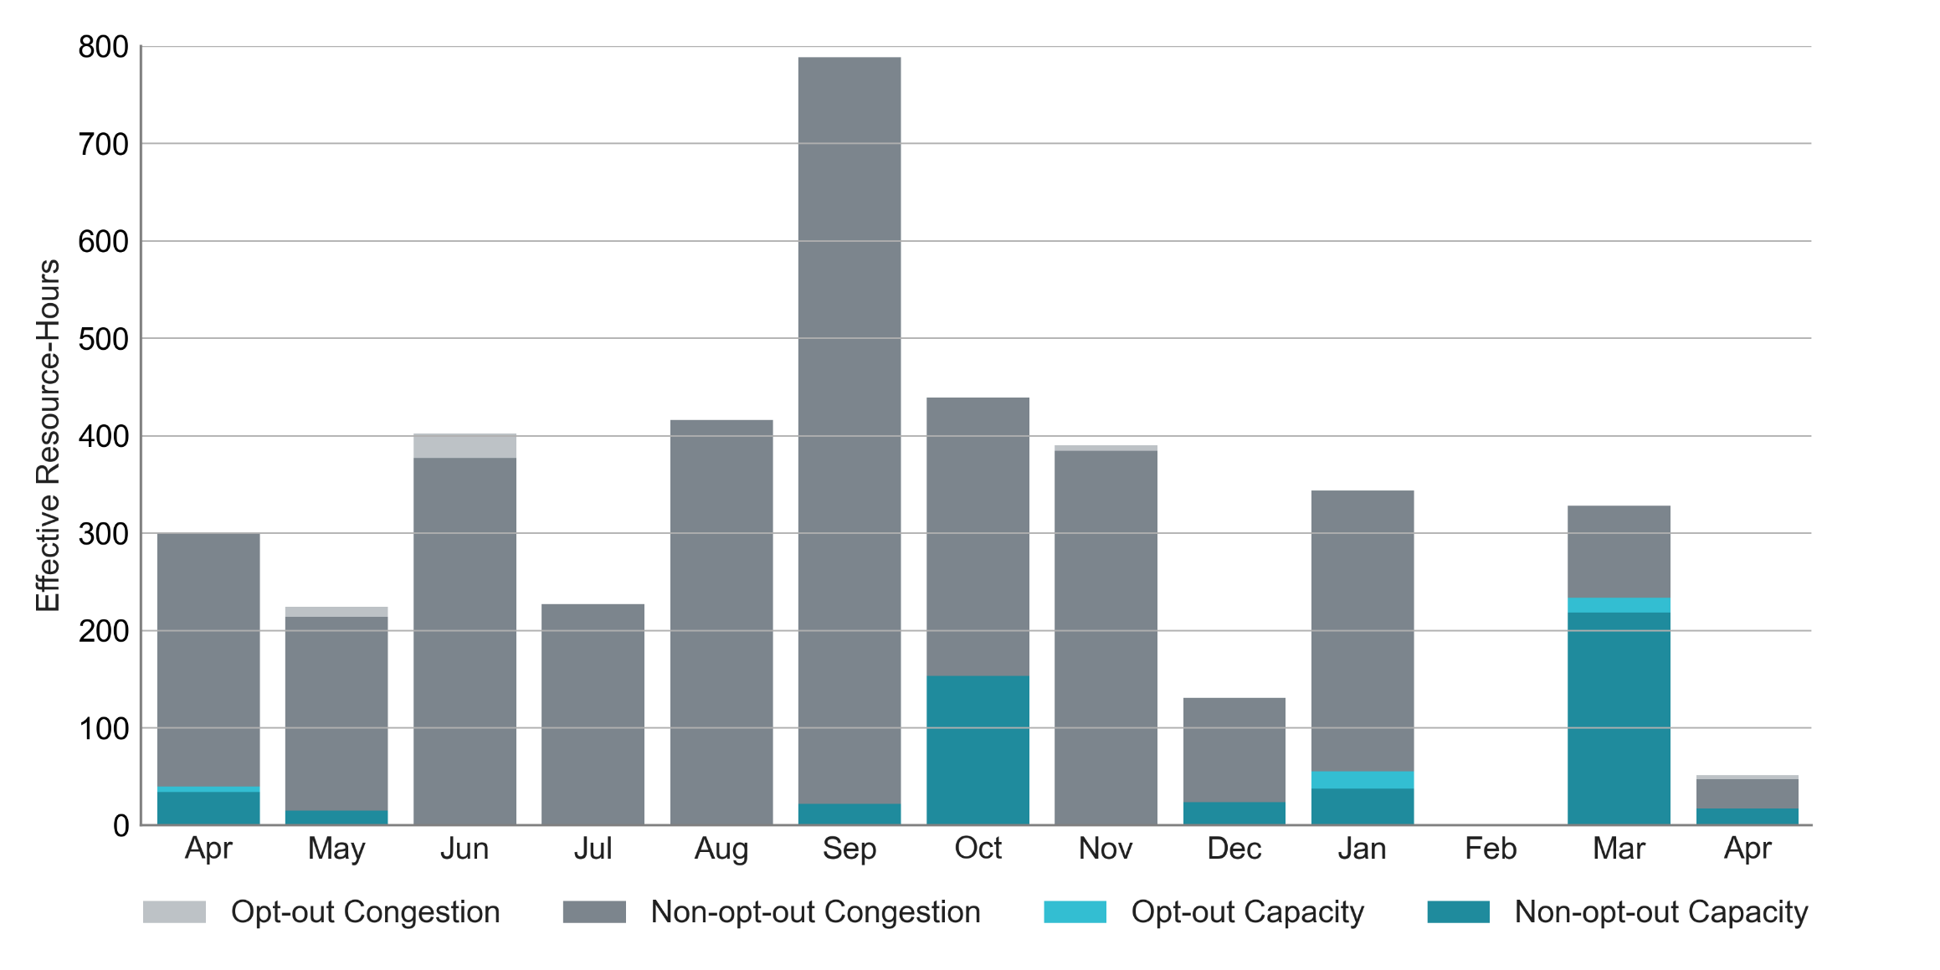
RUC Instruction Reasons: Last 13 Months
RUC activity decreased in April compared to March.
66% of RUC effective Resource-hours in April 2026 were nominally attributed to address congestion concerns.

Slide 4
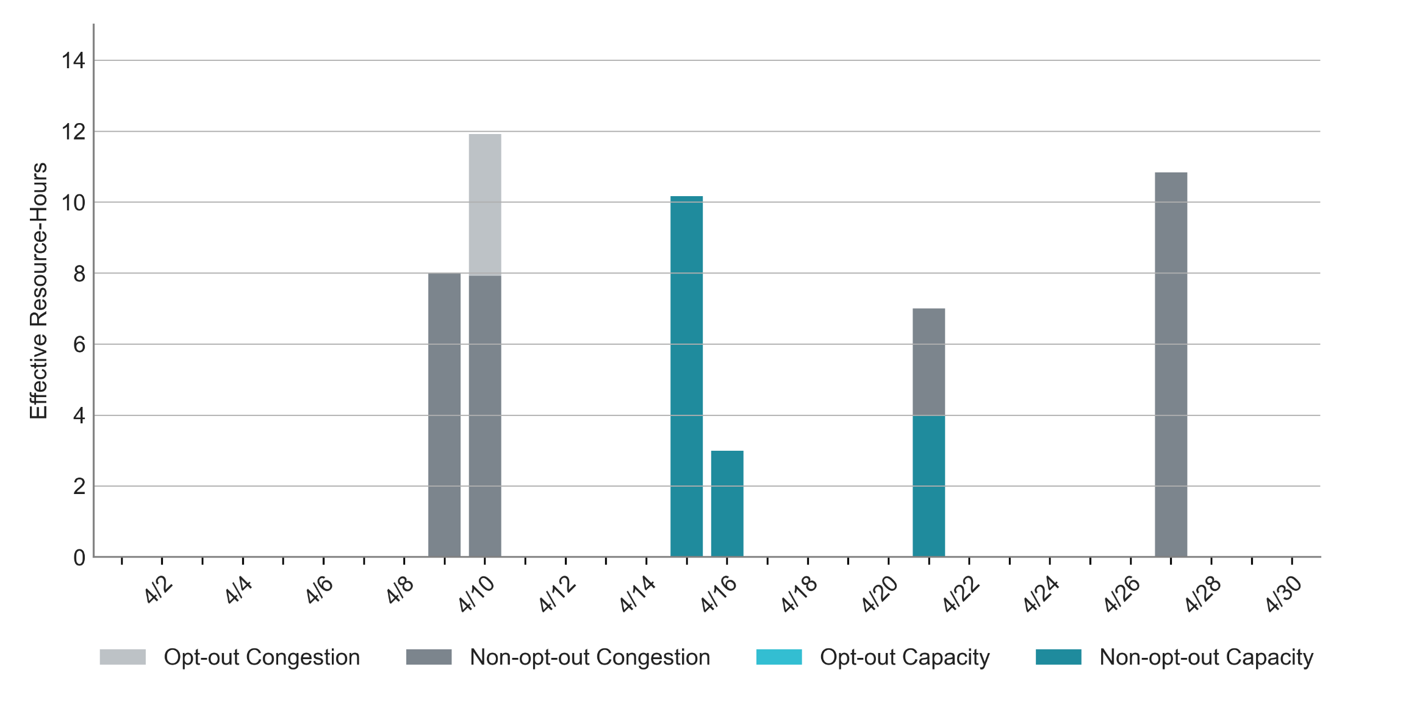
RUC Instruction Reasons in April 2026
There were 50.9 RUC total effective Resource-hours in April and 33.8 hours (66%) were committed to address congestion needs.
The highest effective Resource-hours in April occurred on April 10th for congestion needs.

Slide 5
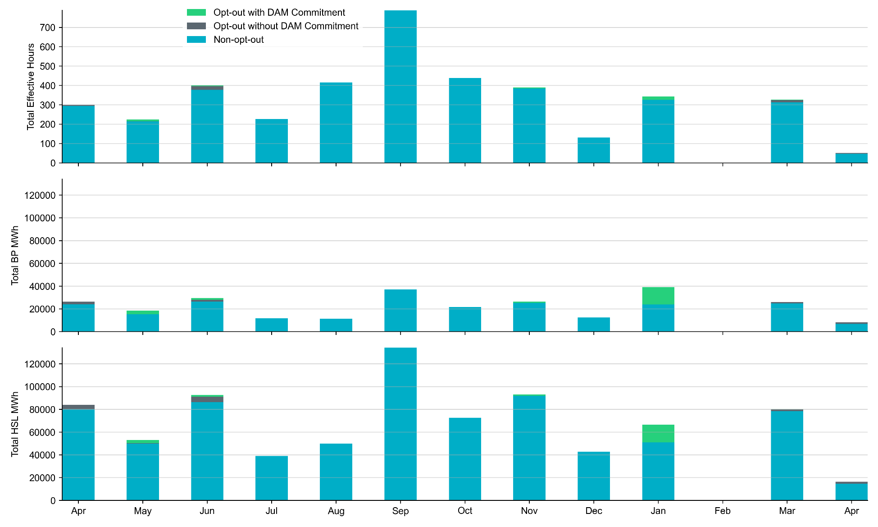
Non-opt-out and Opt-out Totals: Last 13 Months
April 2026 had a total of 46.9 non-opt-out effective Resource-hours (92%) and 4.0 opt-out effective Resource-hours (8%).

Slide 6
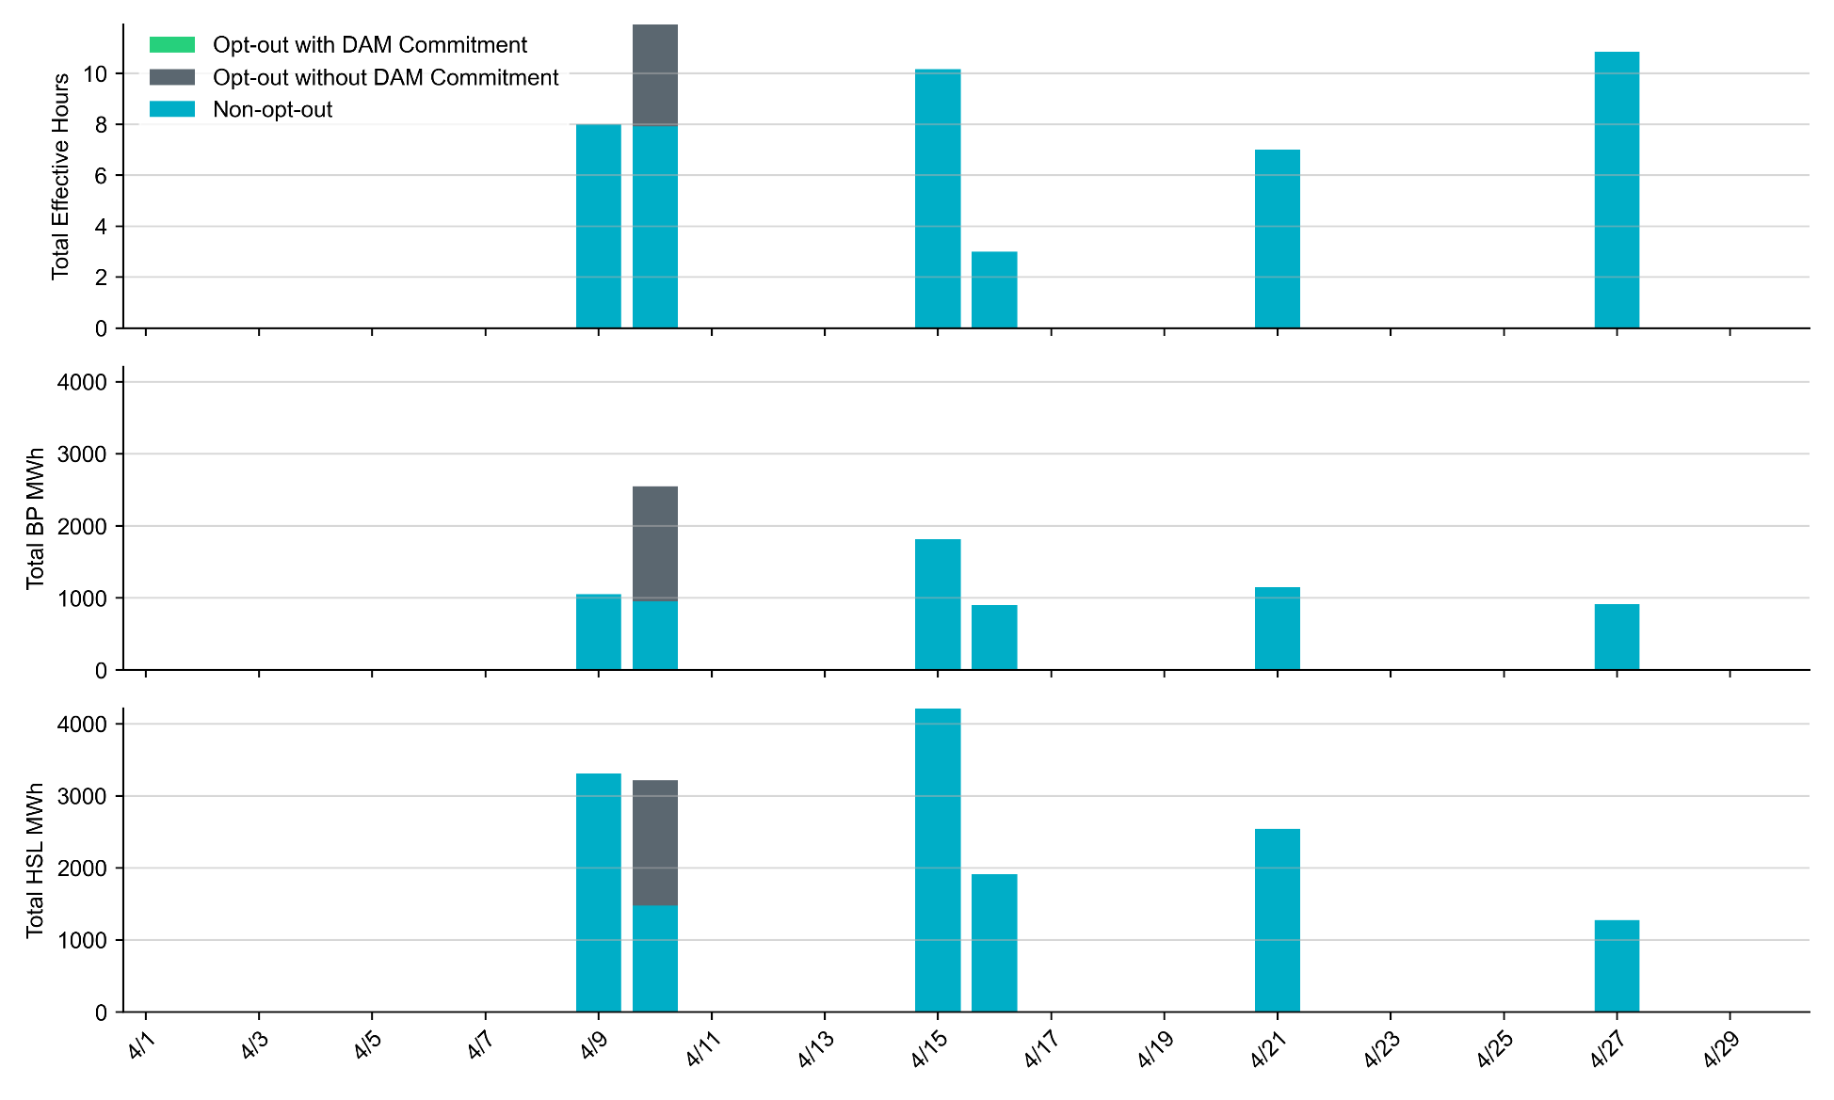
Non-opt-out and Opt-out Totals: April 2026
On April 10th, some resources successfully opted-out of RUC settlement. There were no opt-out effective Resource-hours on any other day in April 2026.

Slide 7
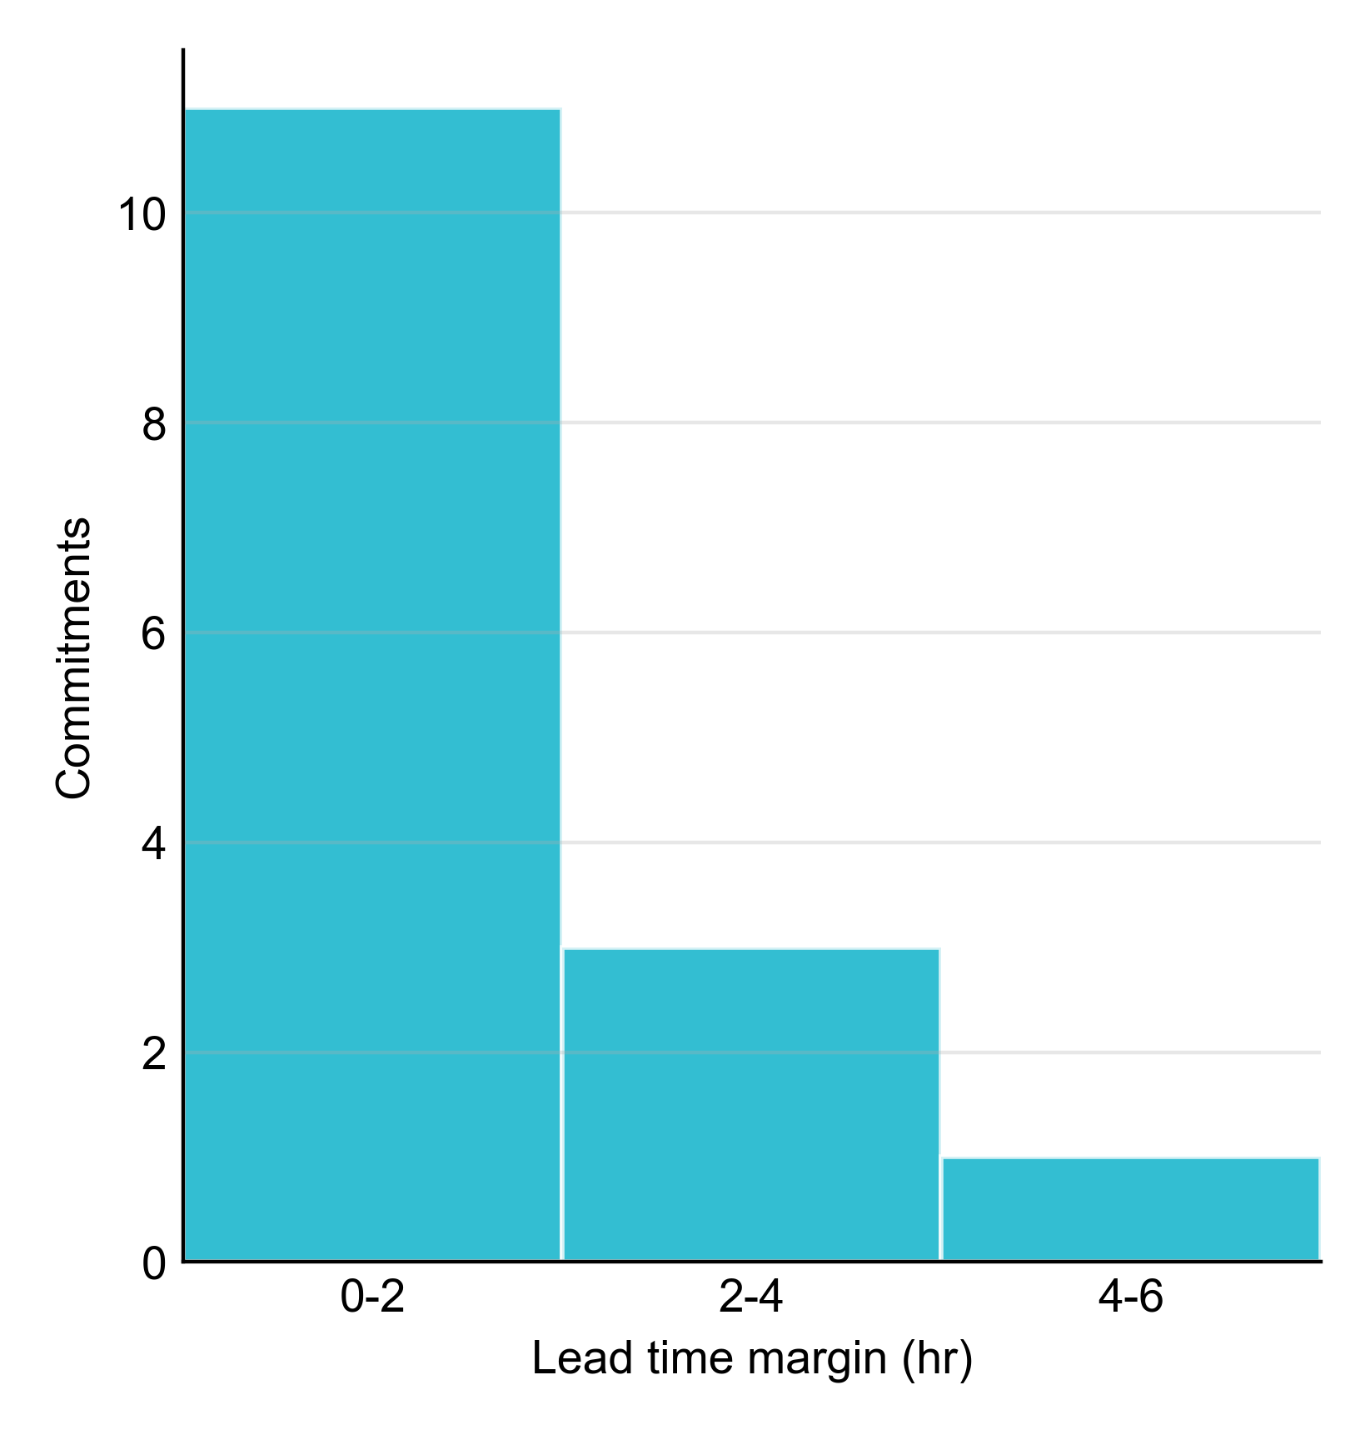
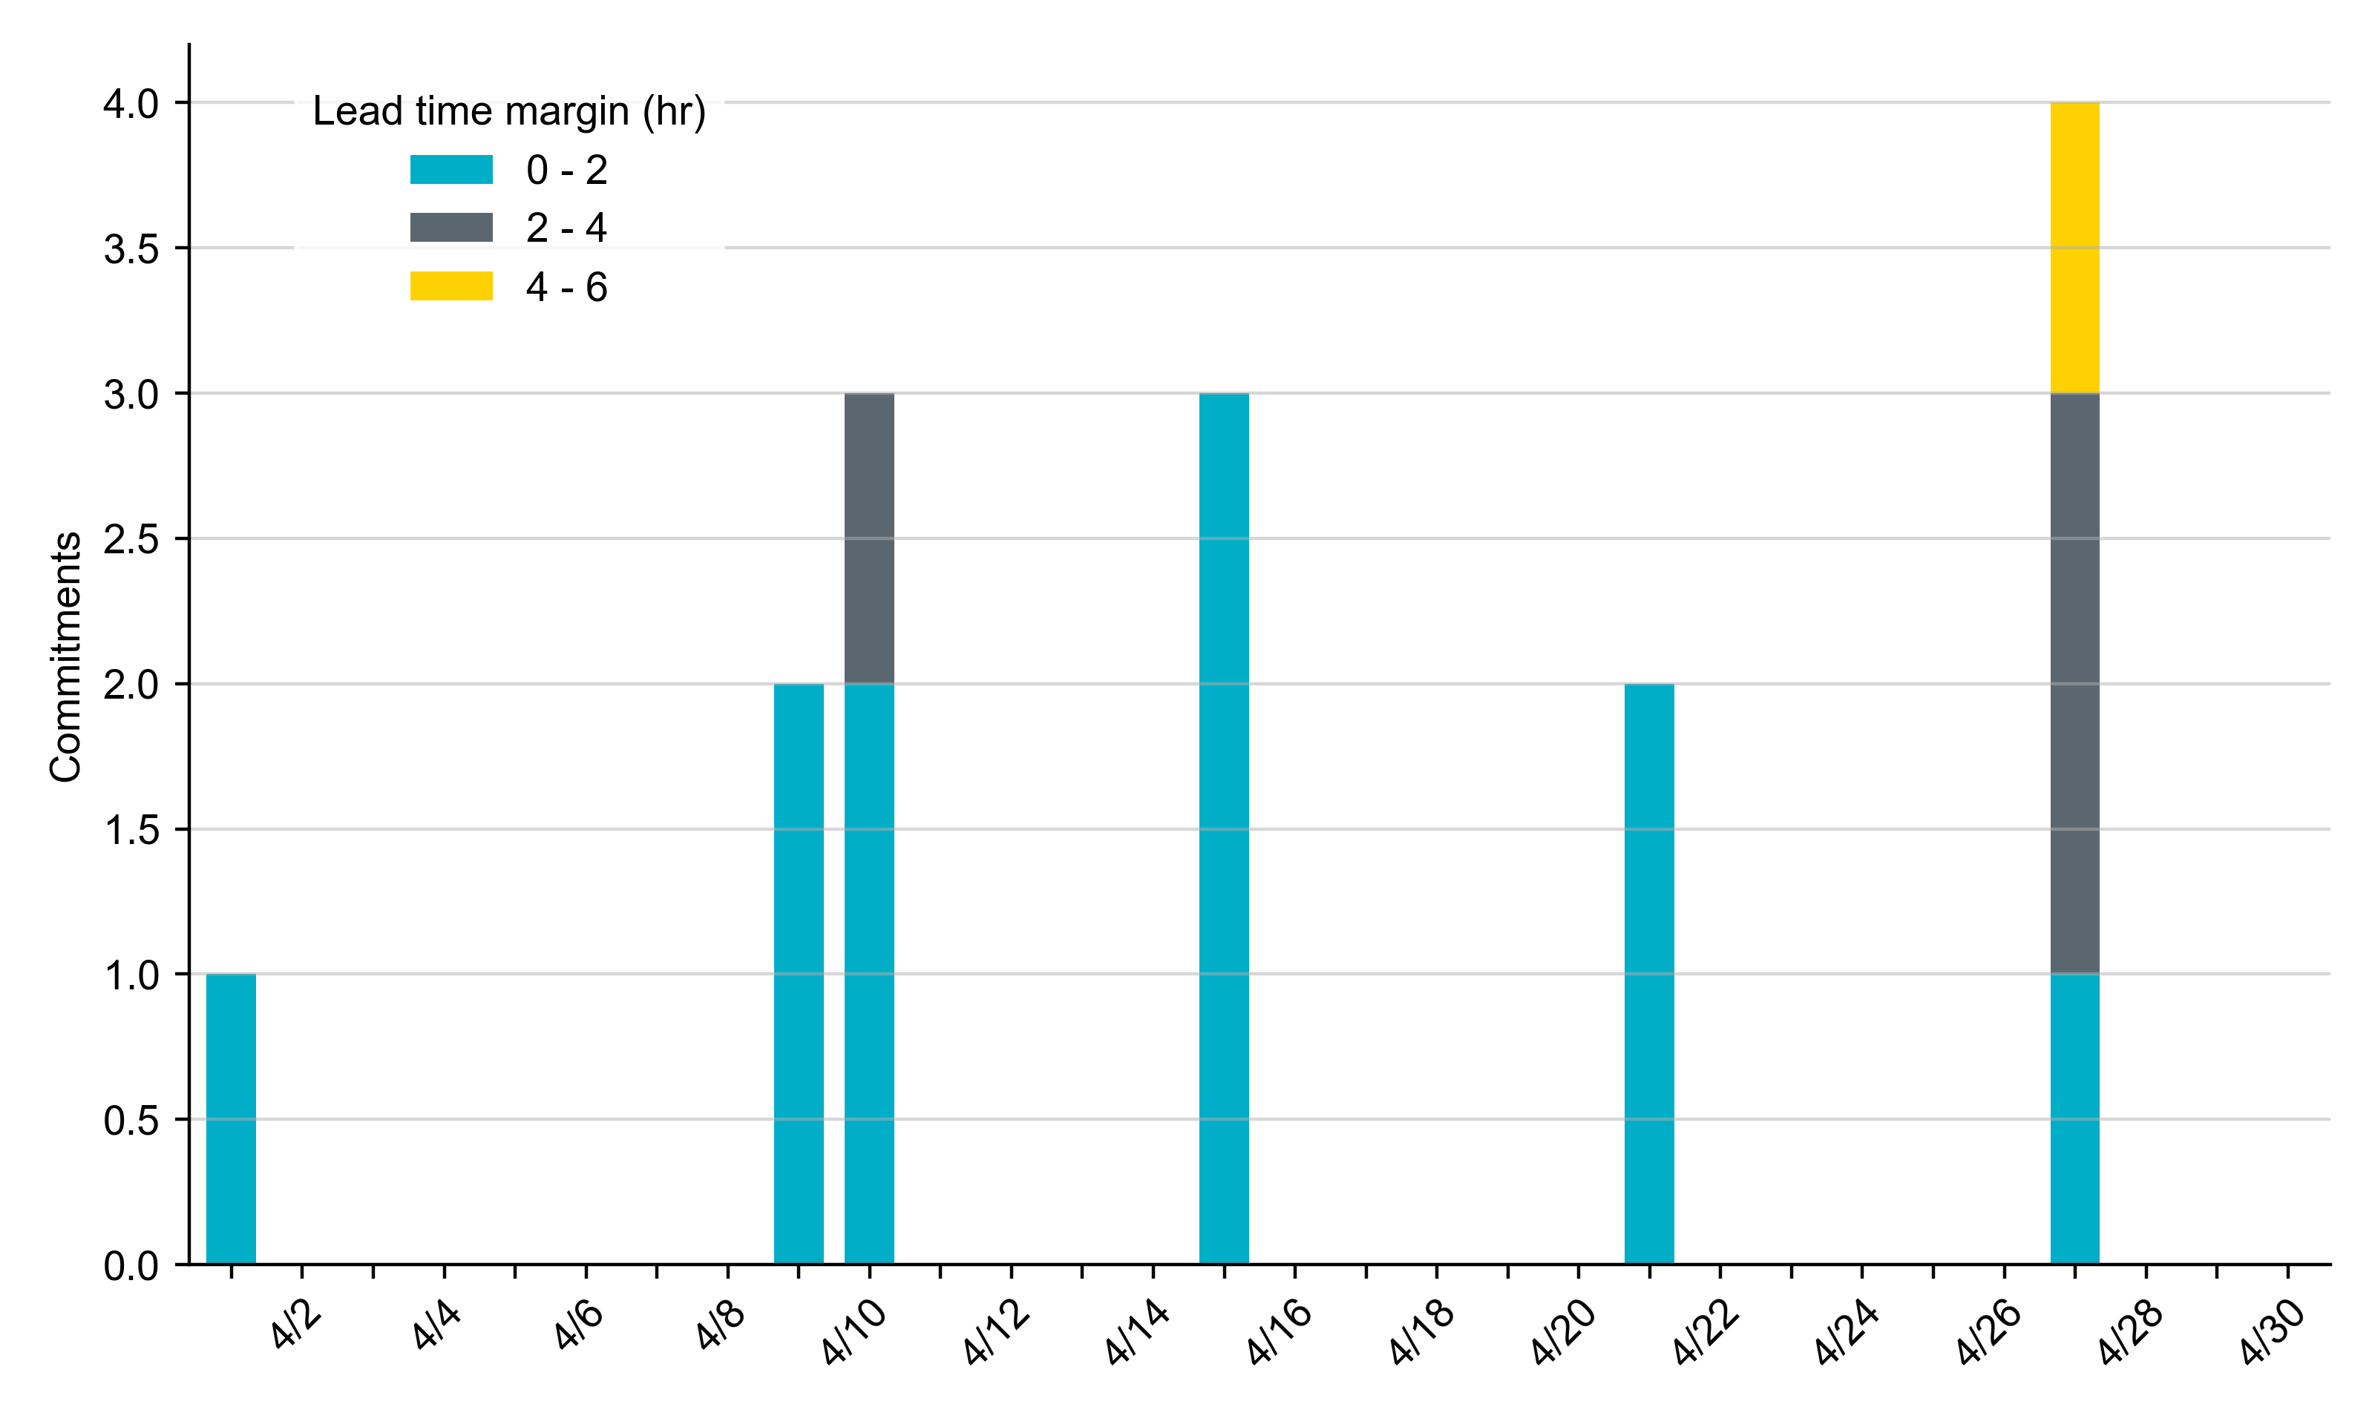
RUC Lead Time Margin: April 2026
Most RUC commitment windows (73%) had a lead time margin of 2 hours or less.
“Lead time” refers to the length of time between a RUC instruction and the start of the commitment window.
“Lead time margin” is the difference between lead time and the Resource’s startup time.
  In cases where a Resource is committed for multiple back-to-back time blocks, lead time margin is calculated from the first instruction.

Slide 8
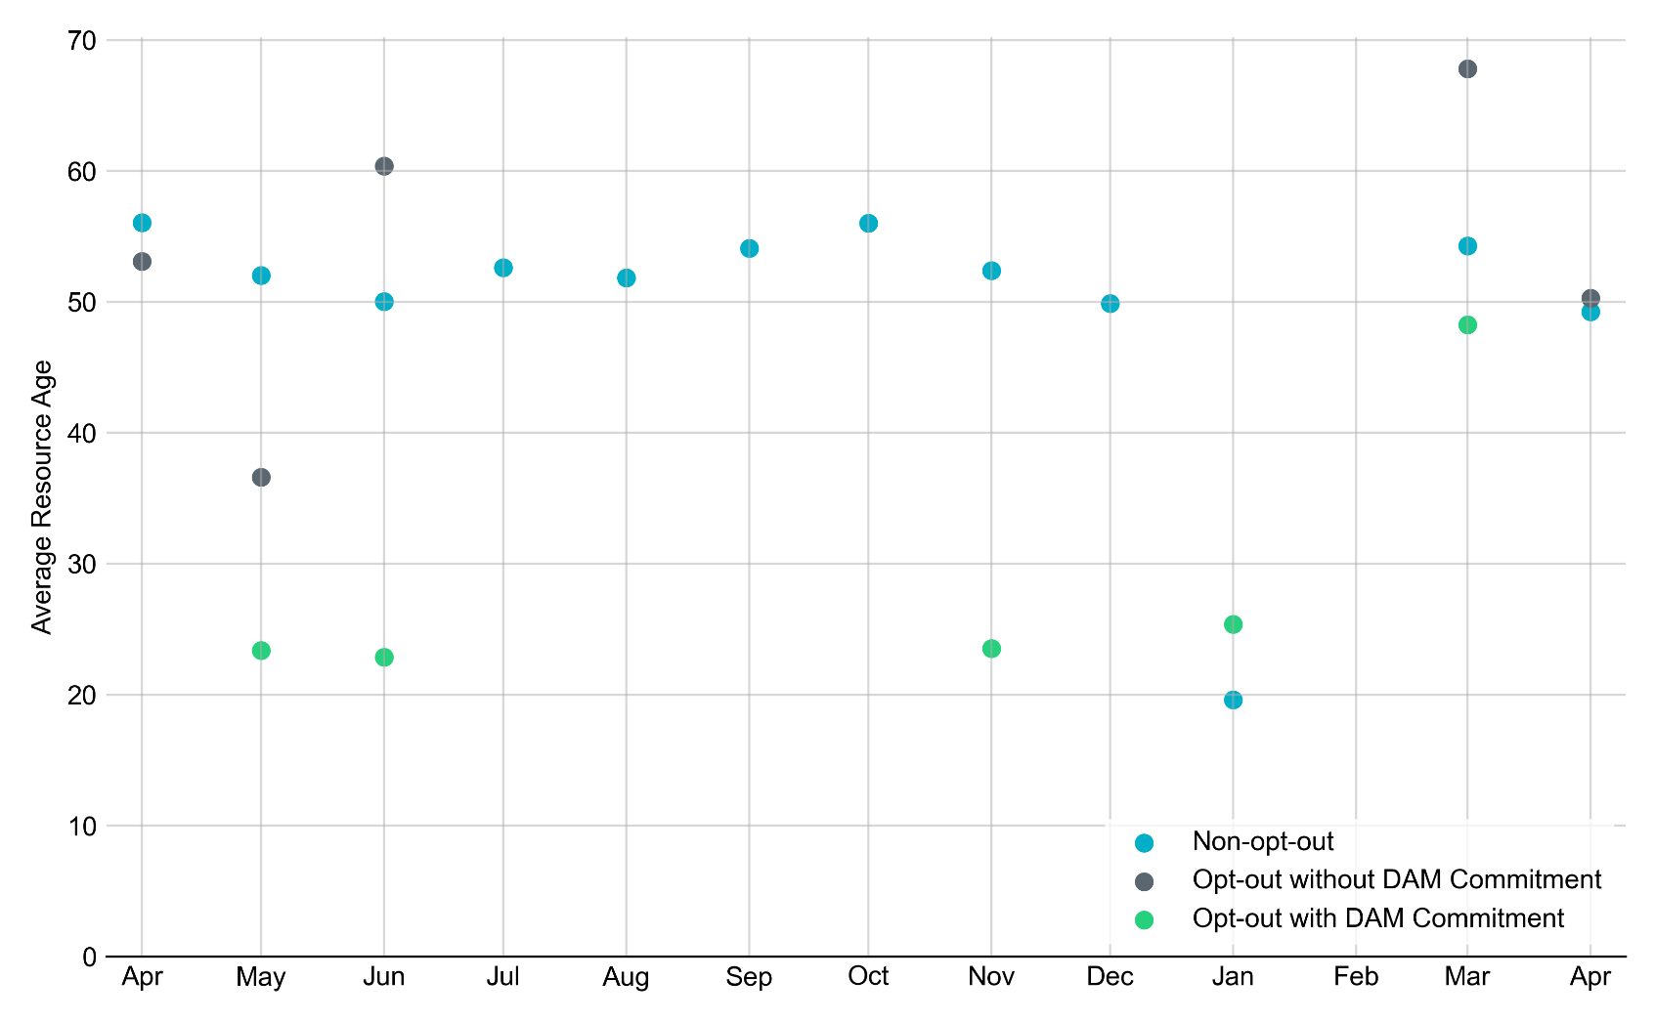
Average Resource Age: Last 13 Months
In April 2026, the average age of RUC-committed Resources was 49.2 years for non-opt-out Resource-hours.
Note: For Resource configurations with multiple physical generators, the age of the oldest generator is used.

Slide 9
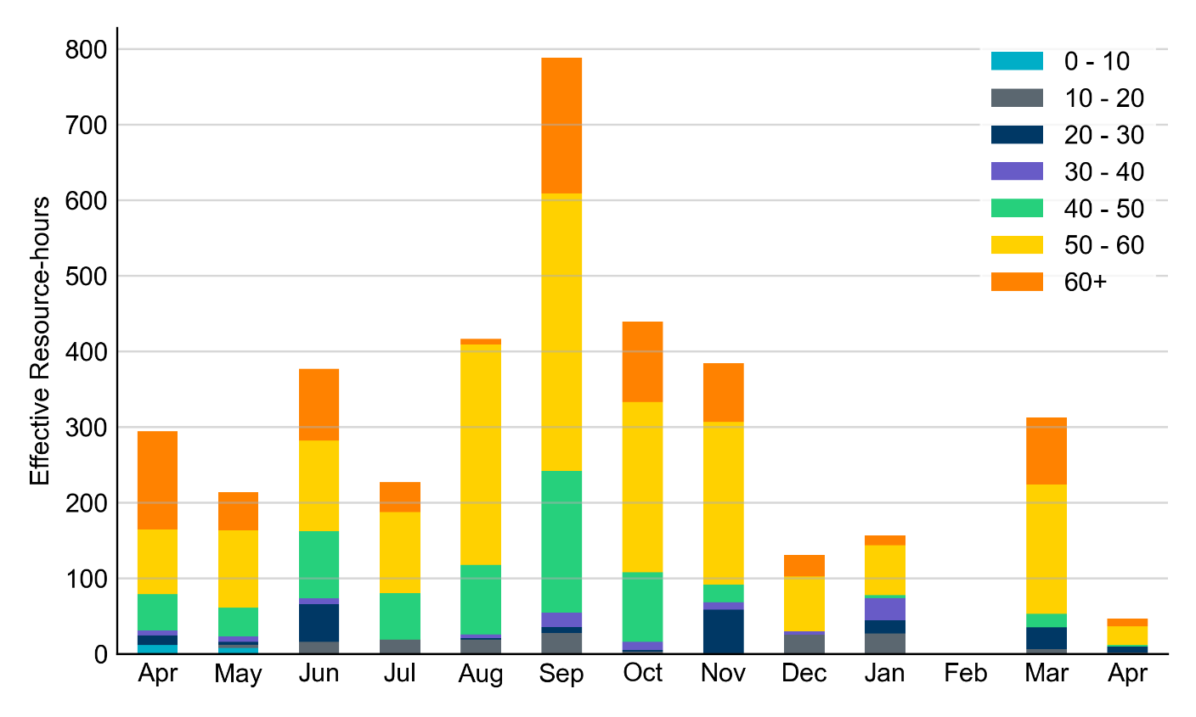
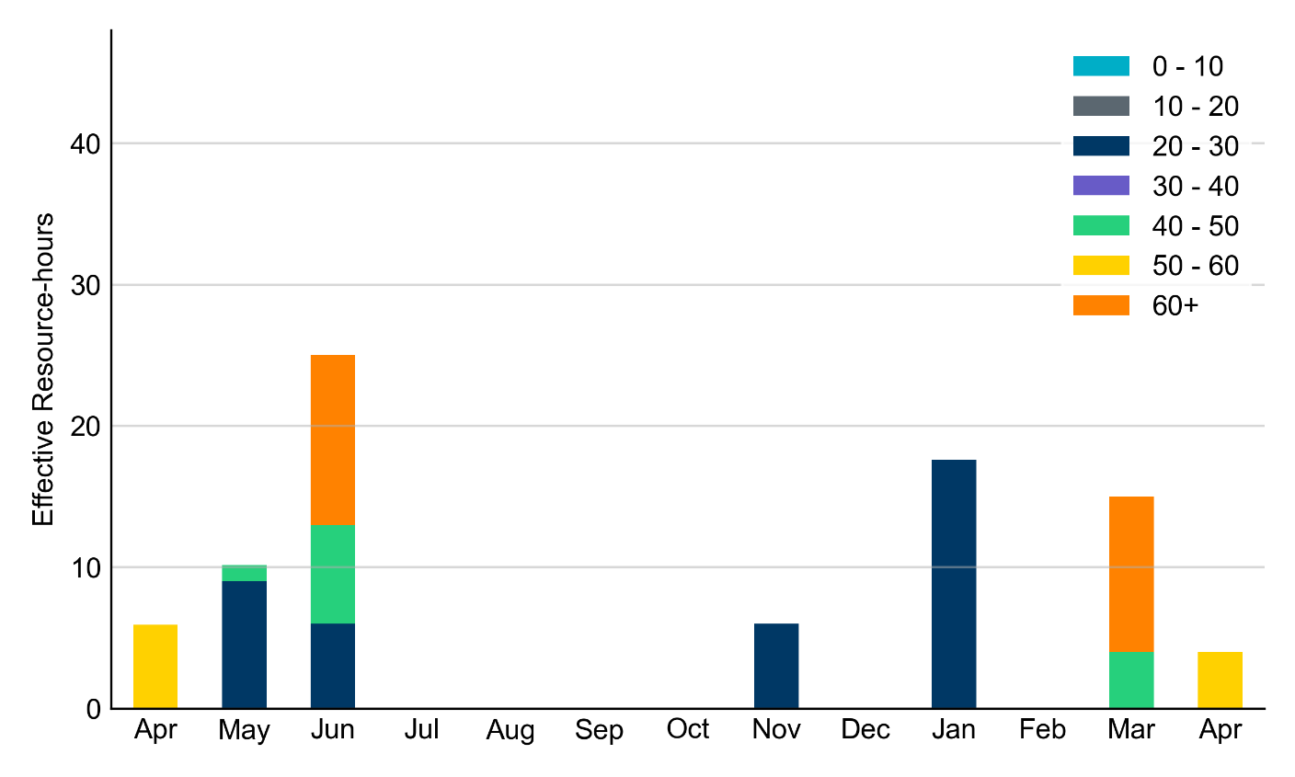
Age Category: Last 13 Months
Non-Opt-Out
Opt-Out
In April 2026, 70% of RUC effective Resource-hours were provided by Resources that were at least 50 years old.
Note: For Resource configurations with multiple physical generators, the age of the oldest generator is used.

Slide 10
RUC-Instructed Resource Dispatch above Low Dispatch Limit (LDL) in Non-Opt-Out Hours
Out of all 46.9 non-opt-out effective Resource-hours, RUC-instructed Resources were dispatched above their LDL for 7.6 resource-hours.
  In 2.3 of these Resource-hours, the Locational Marginal Price (LMP) for the RUC-instructed Resource exceeded the RUC offer floor.
  In 5.3 of these Resource-hours, the LMP for the RUC-instructed Resource fell below the RUC offer floor, and the RUC-instructed Resource was mitigated.
There were no Exceptional Fuel Cost submissions for any Resources committed by RUC.

Slide 11
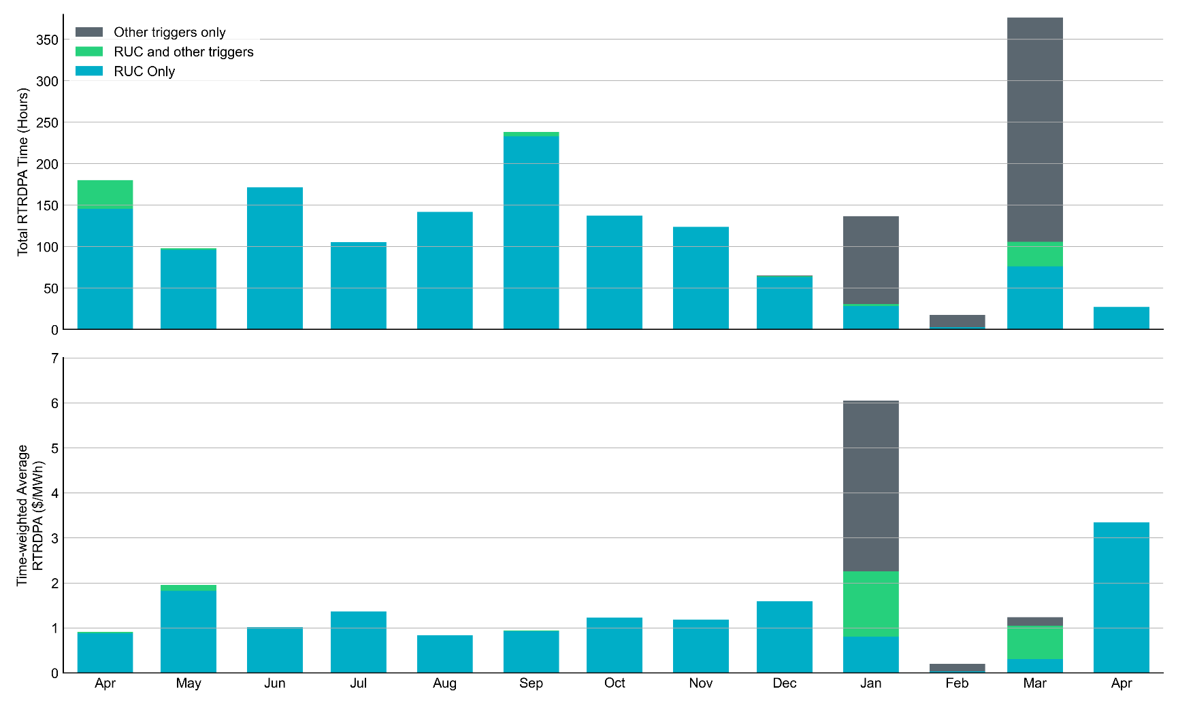
Reliability Deployment Price Adder for Energy: Last 13 Months
April 2026 had a total of 27.0 RTRDPA hours with a time-weighted average value of $3.34/MWh.
These graphs show RTRDPA instances by reliability action: 'RUC Only' for instances triggered solely by Reliability Unit Commitment, 'RUC and other triggers' for instances with RUC and additional triggers, and 'Other triggers only' for instances with non-RUC triggers. The daily average RTRDPA is calculated using the total duration across all categories. See ERCOT protocol section 6.5.7.3.1 for details.

Slide 12
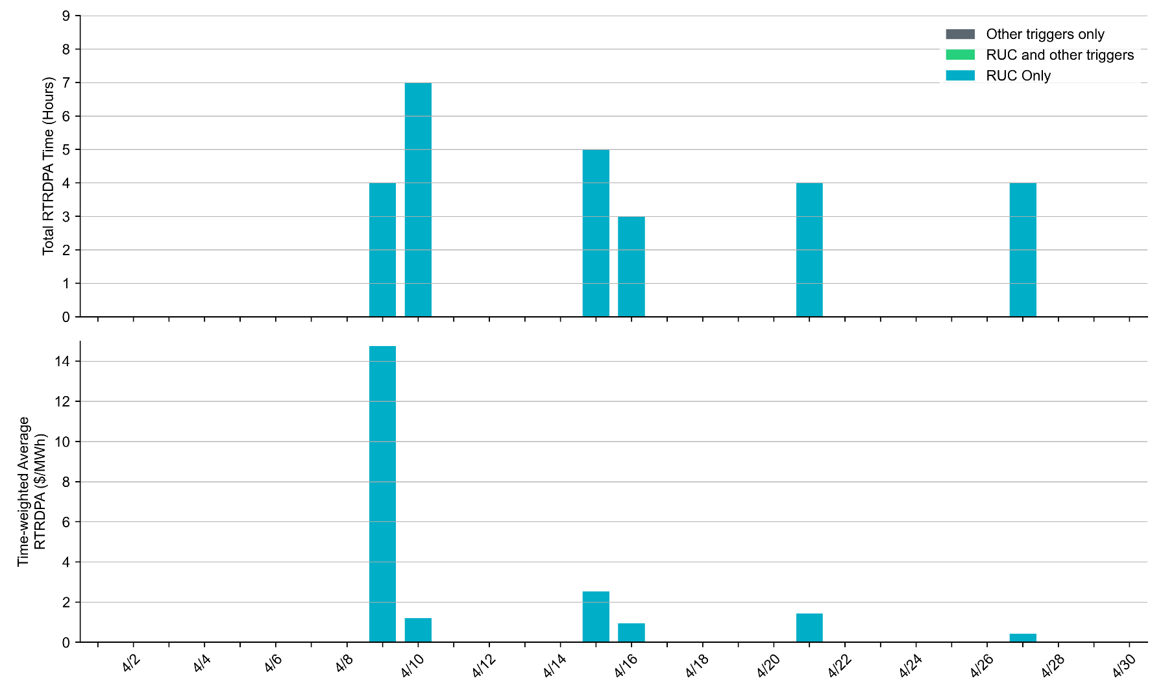
Reliability Deployment Price Adder for Energy: April 2026
April 9th had the highest daily time-weighted average RTRDPA of $14.75/MWh.
These graphs show RTRDPA instances by reliability action: 'RUC Only' for instances triggered solely by Reliability Unit Commitment, 'RUC and other triggers' for instances with RUC and additional triggers, and 'Other triggers only' for instances with non-RUC triggers. The daily average RTRDPA is calculated using the total duration across all categories. See ERCOT protocol section 6.5.7.3.1 for details.

Slide 13
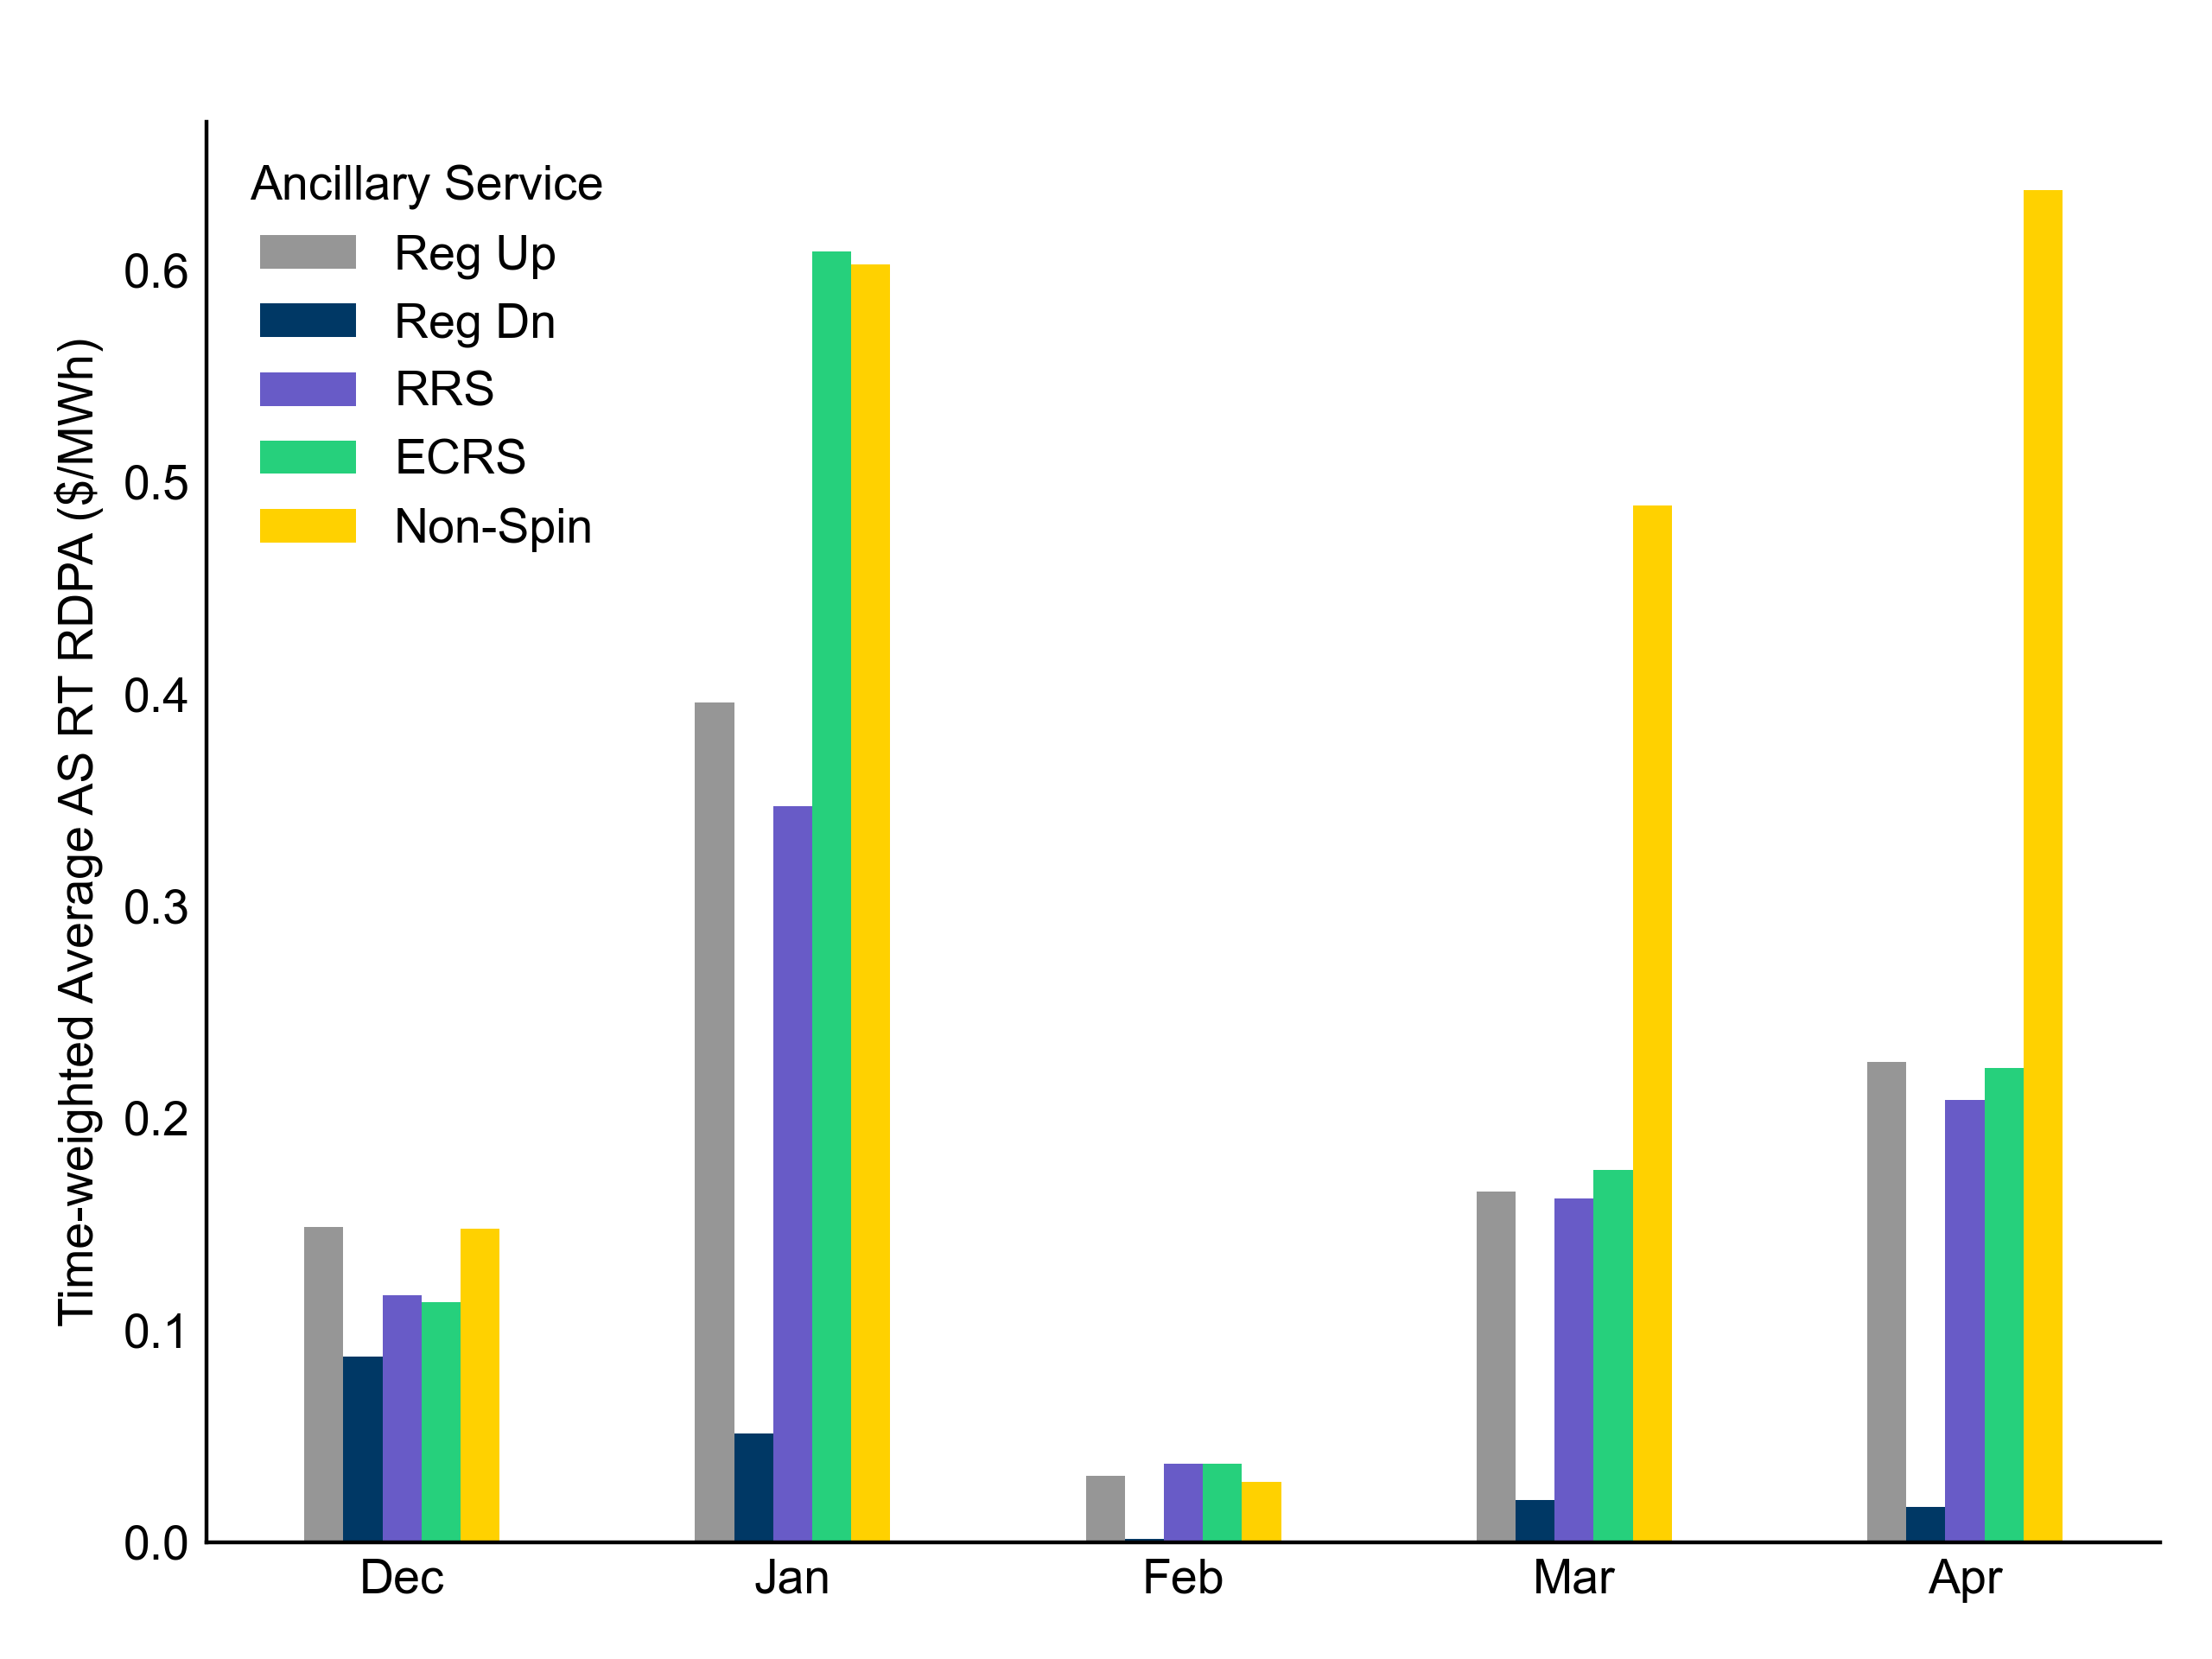
Reliability Deployment Price Adders for Ancillary Services: Last 5 Months
In April 2026, Non-Spin price adders reached their highest point, surpassing even the elevated January levels, while all other AS types remained relatively stable throughout the period.
The average values are calculated as time-weighted average Real-Time Reliability Deployment Price Adders for each Ancillary Service during SCED intervals with RDPA active for any reliability event trigger. RDPAs for Ancillary Services are only available after RTC+B implementation on December 5, 2025

Slide 14
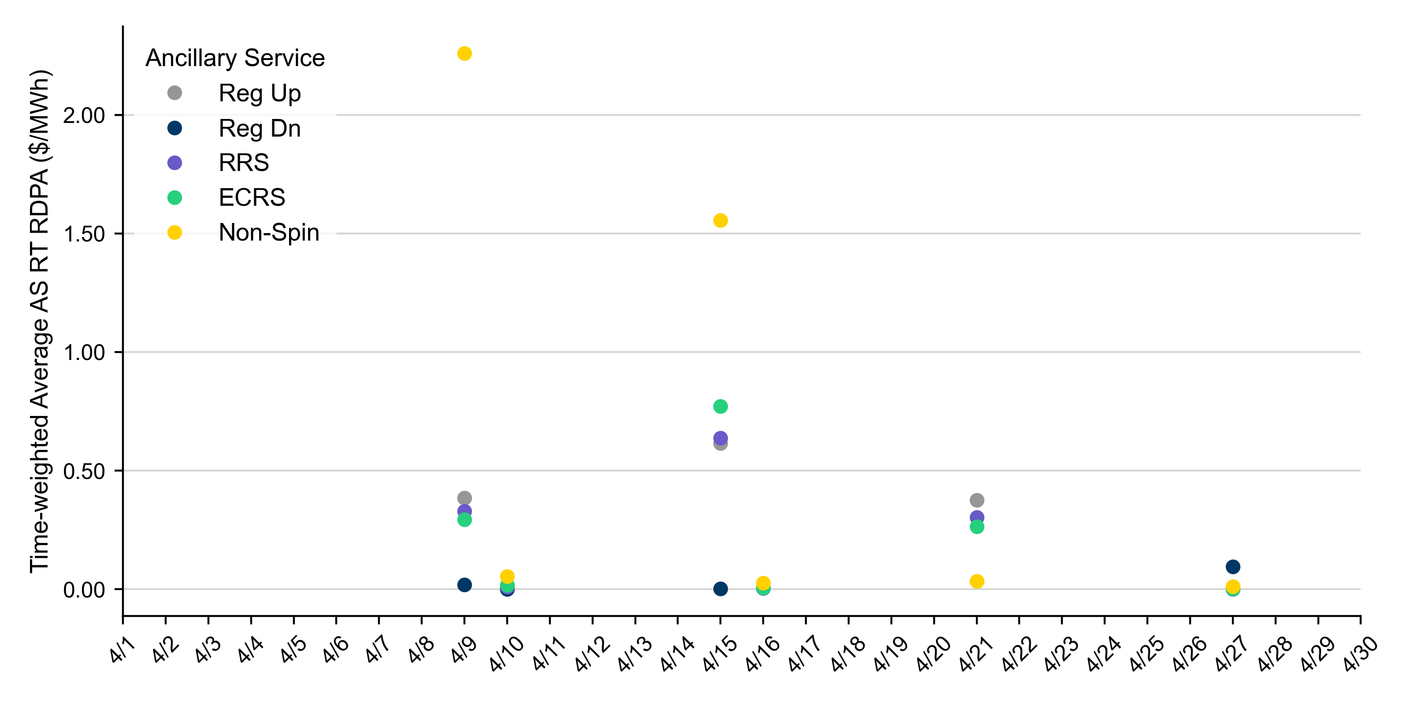
Reliability Deployment Price Adder for Ancillary Services: April 2026
RDPA | Monthly Time Weighted Average ($/MWh)*
Regulation Up (Reg-Up) | 0.23
Regulation Down (Reg-Down) | 0.02
Responsive Reserve Service (RRS) | 0.21
ERCOT Contingency Reserve Service (ECRS) | 0.22
Non-Spinning Reserves (Non-Spin) | 0.64
April 2026’s elevated monthly average RDPAs were driven by daily spikes on April 9th and April 15th.
The daily average values are calculated as time-weighted average Real-Time Reliability Deployment Price Adders (RDPA) for each Ancillary Service during SCED intervals with RDPA active for any reliability event trigger.
For details on the triggers for reliability price adders, please refer to the previous slide titled “Reliability Deployment Price Adder for Energy: April 2026”

Slide 15
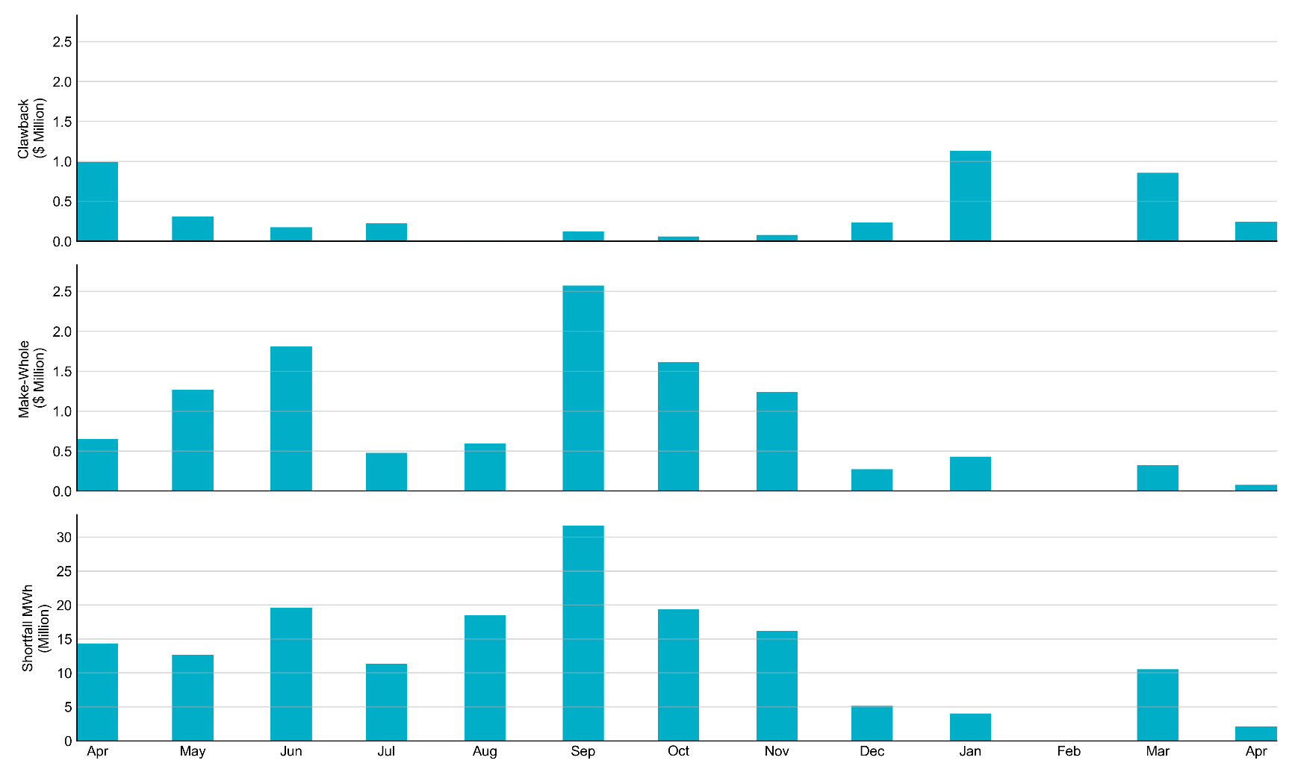
RUC Clawback, Make-Whole, and Shortfall
For April 2026, the total Clawback charge was $242,784. The total Make-Whole payment was $76,725.
Of the $76,725 in Make-Whole payments made in April 2026, $0.60 was uplifted to load due to rounding. The remaining amount was collected through Capacity-Short charges.

Slide 16
RUC Clawback by Settlement Type
Month | Initial Settlement ($) | Final Settlement Change ($) | True-up Settlement Change ($) | Net ($)
Apr ‘25 | 993,459 | 0 | 0 | 993,459
May ‘25 | 574,643 | 0 | -268,846 | 305,797
Jun ‘25 | 173,176 | 0 | 0 | 173,176
Jul ‘25 | 246,479 | 0 | -18,991 | 227,488
Aug ‘25 | 12,319 | 0 | -2,121 | 10,198
Sep ‘25 | 122,634 | 0 | 0 | 122,634
Oct ‘25 | 128,343 | 0 | -68,059 | 60,284
Nov ‘25 | 80,805 | 0 | -18,872 | 61,932
Dec ‘25 | 233,500 | - | - | -
Jan ‘26 | 1,130,396 | - | - | -
Feb ‘26 | 0 | - | - | -
Mar ‘26 | 856,743 | - | - | -
Apr ‘26 | 242,784 | - | - | -
Negative dollars represent a payment from ERCOT to a market participant
“-” indicates settlement has yet to be completed.
Net figures may differ slightly due to rounding.

Slide 17
RUC Make-Whole by Settlement Type
Month | Initial Settlement ($) | Final Settlement Change ($) | True-up Settlement Change ($) | Net ($)
Apr ‘25 | -598,557 | 0 | -53,081 | -651,639
May ‘25 | -493,728 | 0 | -773,264 | -1,266,992
Jun ‘25 | -1,285,661 | 0 | -522,765 | -1,808,427
Jul ‘25 | -382,887 | 0 | -95,893 | -478,780
Aug ‘25 | -487,773 | 0 | -110,640 | -598,413
Sep ‘25 | -2,035,251 | 0 | -538,306 | -2,573,557
Oct ‘25 | -1,016,193 | 0 | -596,880 | -1,613,073
Nov ‘25 | -1,151,712 | 0 | -853,348 | -2,005,060
Dec ‘25 | -271,995 | - | - | -
Jan ‘26 | -431,896 | - | - | -
Feb ‘26 | 0 | - | - | -
Mar ‘26 | -324,968 | - | - | -
Apr ‘26 | -76,725 | - | - | -
Negative dollars represent a payment from ERCOT to a market participant
“-” indicates settlement has yet to be completed.
Net figures may differ slightly due to rounding.

Slide 18
Questions/Comments

