Slide 1
Large Load Interconnection Status Update
Large Load Integration Team
May 21, 2026

Slide 2
Notes on the Content of this Presentation
All data presented on the following slides is current as of May 20, 2026 unless otherwise noted.
All charts on the following slides that contain references to Sections 9.4 and 9.5 of the ERCOT Planning Guide also include Large Loads that met the equivalent requirements under the interim Large Load process established in March 2022.
This update adds a new slide providing an overview of how existing Large Load Interconnection Study (LLIS) requests are tracking for inclusion in the upcoming Batch Zero established by PGRR145 (slide 17).
  The data in this chart is preliminary and is subject to change as ERCOT’s ongoing review of study completeness and validity continues.
  This chart covers only LLIS loads. Loads seeking to qualify for Batch Zero via another path (e.g. inclusion in a valid RPG study or the Permian Basin Reliability Plan) are not included at this time.
  ERCOT notes PGRR145 is not yet approved by the PUCT.
This update also segments loads with completed LLIS studies into loads that have met only Section 9.4 of the Planning Guide and loads that have met both Sections 9.4 and 9.5.

Slide 3
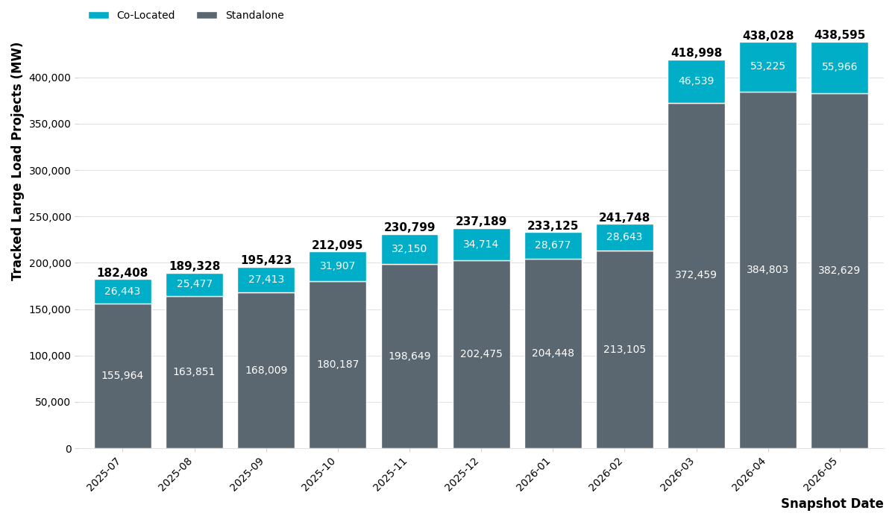
Large Load Queue – Past 12 Months

Slide 4
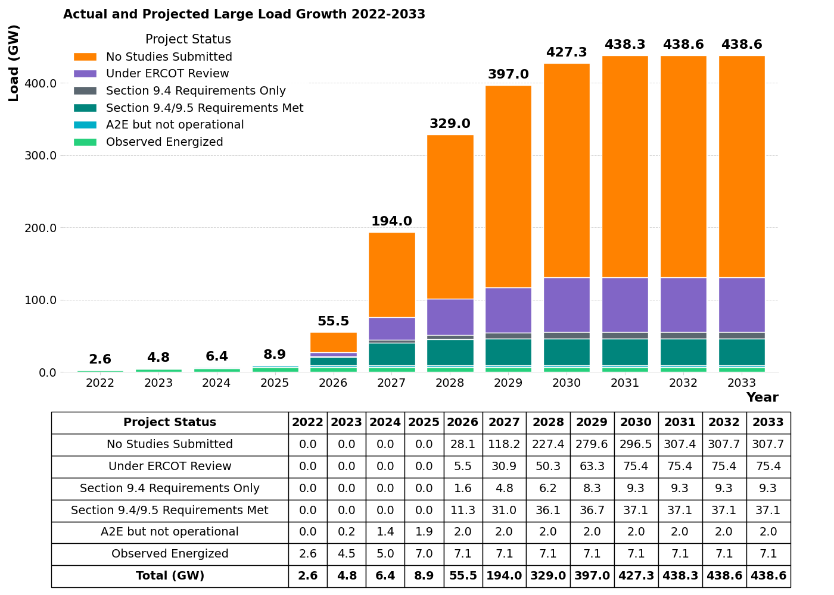
Status of Current LLIS Requests
No Studies Submitted – Projects that are tracked by ERCOT but that have not yet met the requirements to start the study kick-off process under Section 9.3.2 of the Planning Guide.
Under ERCOT Review – Projects that have are in the study process described in Section 9.3.3 of the Planning Guide.
Section 9.4 Requirements Only – Projects that have completed all required elements of the LLIS as described in Section 9.4 but have not yet met the commitment criteria in Section 9.5. These projects are subject to restudy in the event a material change impacting study assumptions occurs before the requirements of Section 9.5 are met.
Section 9.4/9.5 Requirements Met – Projects that have completed all required elements of the LLIS as described in Section 9.4 and met the commitment criteria in Section 9.5.
Approved to Energized but Not Operational – MWs that have received Approval to Energize from ERCOT Operations but are not yet observed to be operational.
Observed Energized – MWs that have received Approval to Energize from ERCOT Operations and are observed to be operational. Represented by all time non-simultaneous peak load consumption.

Slide 5
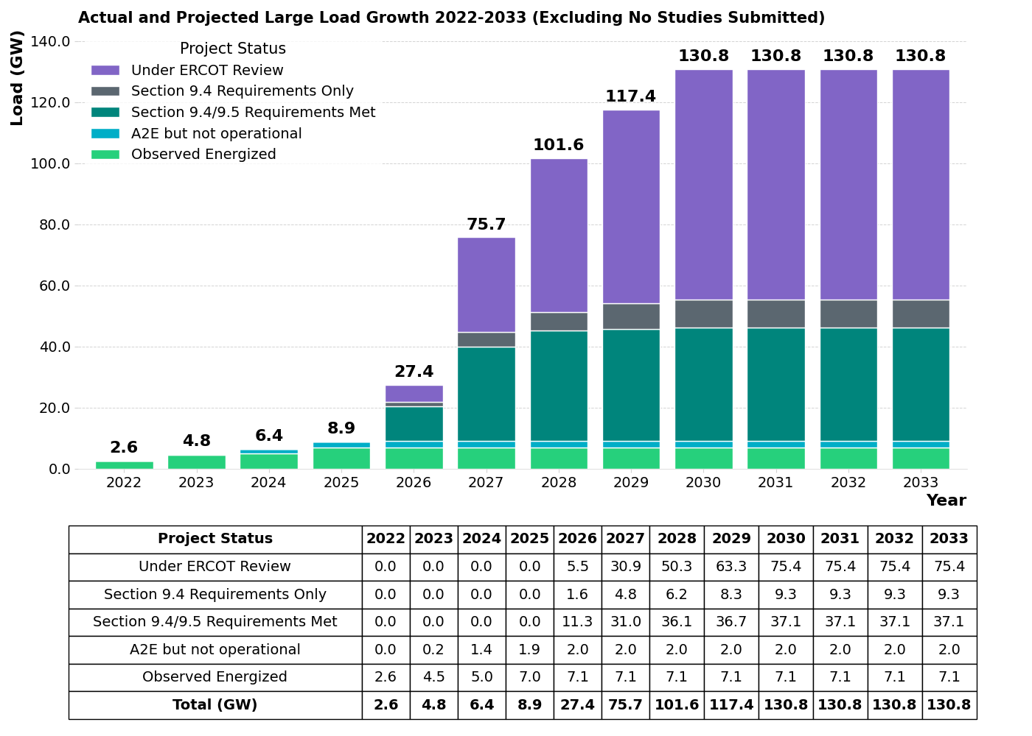
Status of Current LLIS Requests with Studies In Progress or Complete
Under ERCOT Review – Projects that have are in the study process described in Section 9.3.3 of the Planning Guide.
Section 9.4 Requirements Only – Projects that have completed all required elements of the LLIS as described in Section 9.4 but have not yet met the commitment criteria in Section 9.5. These projects are subject to restudy in the event a material change impacting study assumptions occurs before the requirements of Section 9.5 are met.
Section 9.4/9.5 Requirements Met – Projects that have completed all required elements of the LLIS as described in Section 9.4 and met the commitment criteria in Section 9.5.
Approved to Energized but Not Operational – MWs that have received Approval to Energize from ERCOT Operations but are not yet observed to be operational.
Observed Energized – MWs that have received Approval to Energize from ERCOT Operations and are observed to be operational. Represented by all time non-simultaneous peak load consumption.

Slide 6
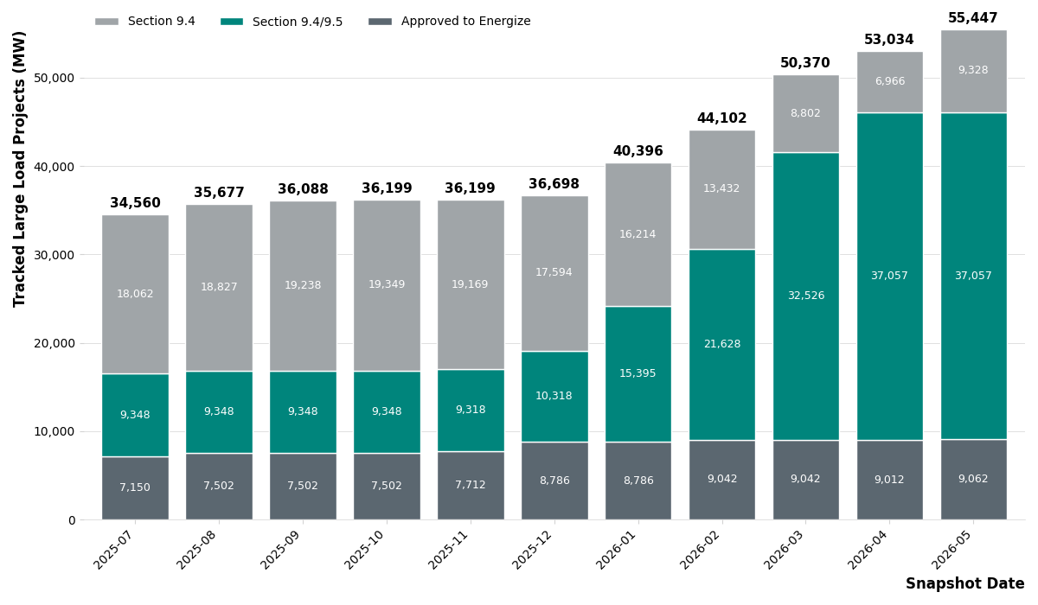
ERCOT Approvals – Past 12 Months

Slide 7
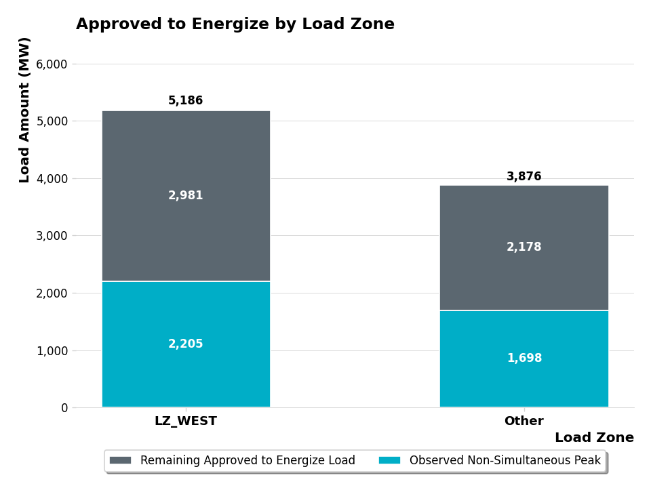
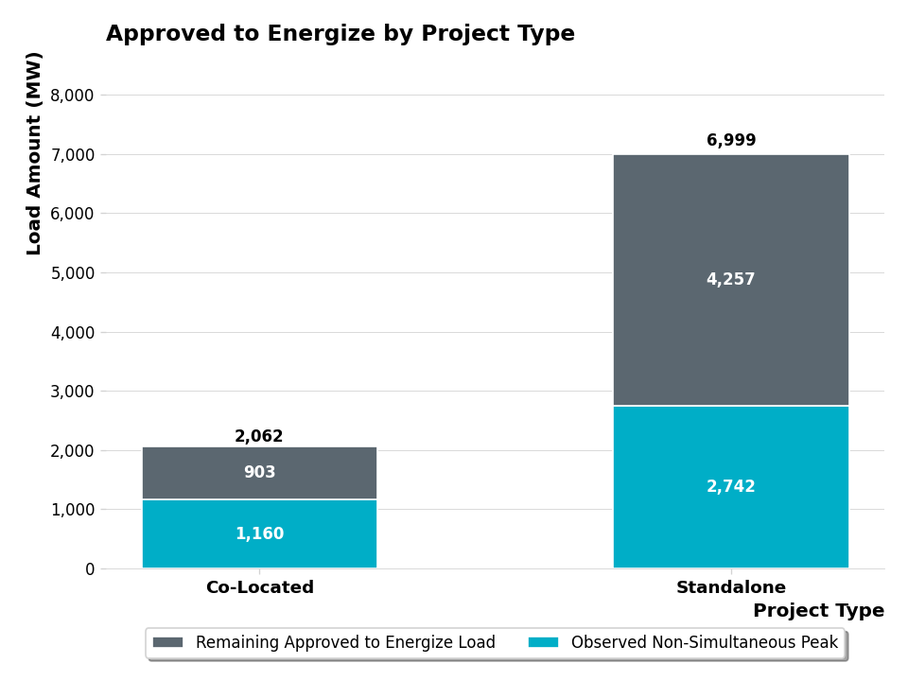
Loads Approved to Energize – By Zone & Project Type

Slide 8
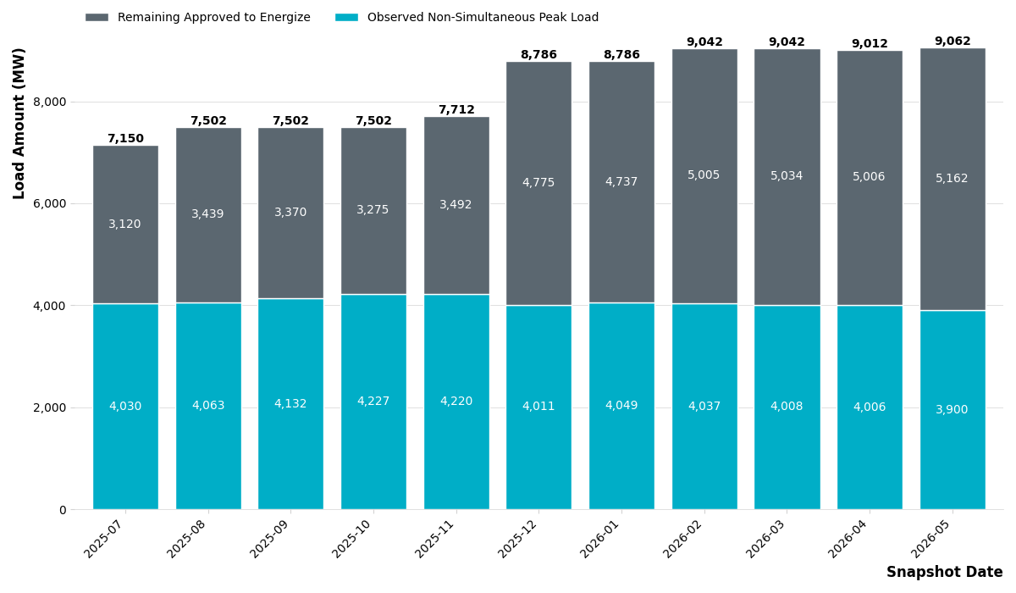
Loads Approved to Energize – Observations 1
Of the 9062 MW that have received Approval to Energize, ERCOT has observed a non-simultaneous monthly peak consumption of 3900 MW in May 2026 which is a slight decrease since April 2026.
  This is calculated as the sum of the maximum value for each individual load per month
  This value represents how much approved load ERCOT believes is now operational

Slide 9
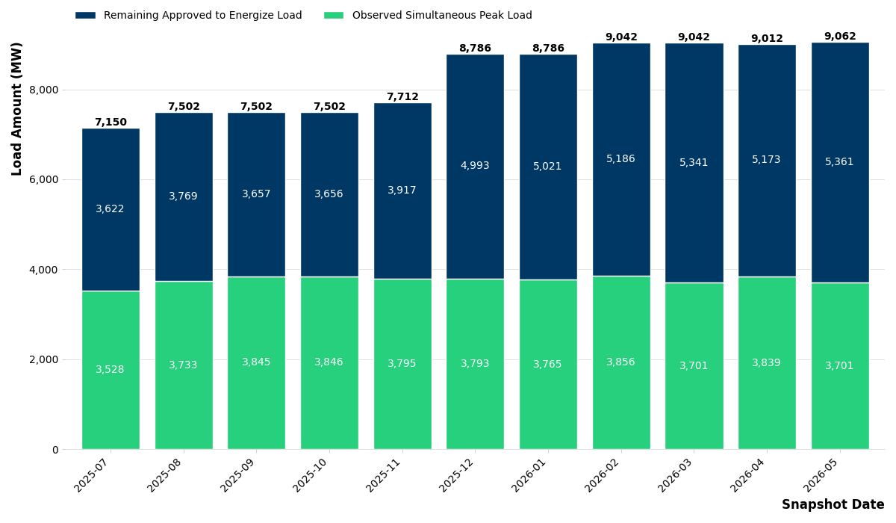
Loads Approved to Energize – Observations 2
ERCOT has observed a simultaneous monthly peak consumption of 3701 MW in May 2026 which is a slight decrease since April 2026.
  This is the maximum value of the sum of all the individual loads per month
  This value is the maximum amount of large load that ERCOT has had to serve at a single point in time

Slide 10
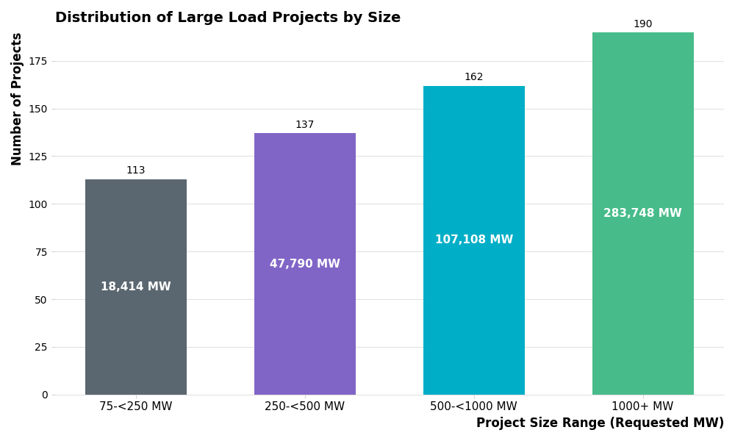
Large Load Project Distribution - Size

Slide 11
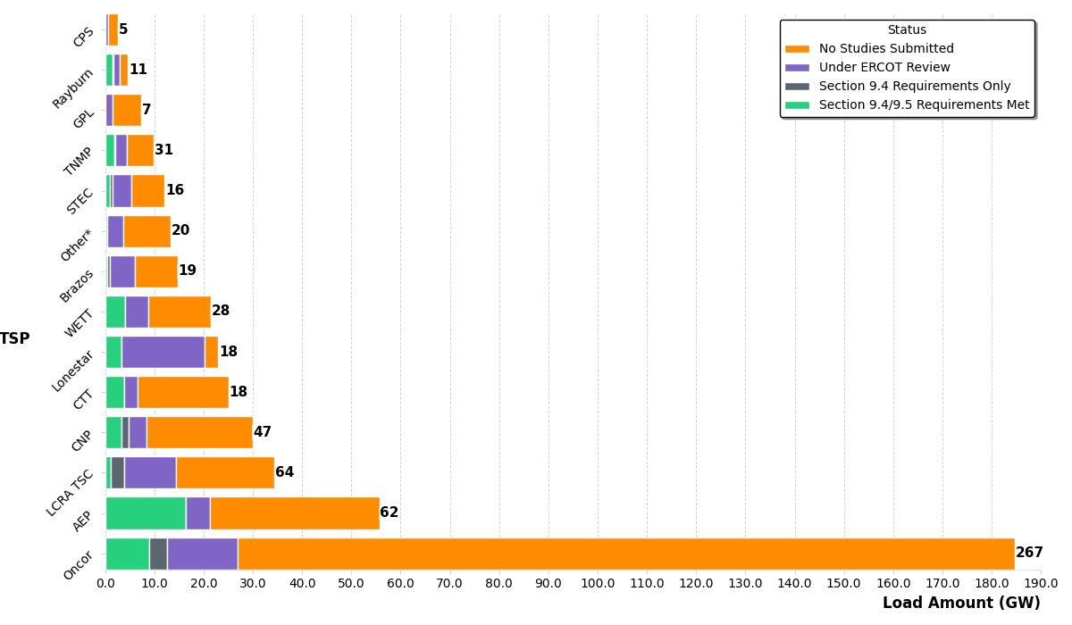
Large Load Project Distribution - TSP

Slide 12
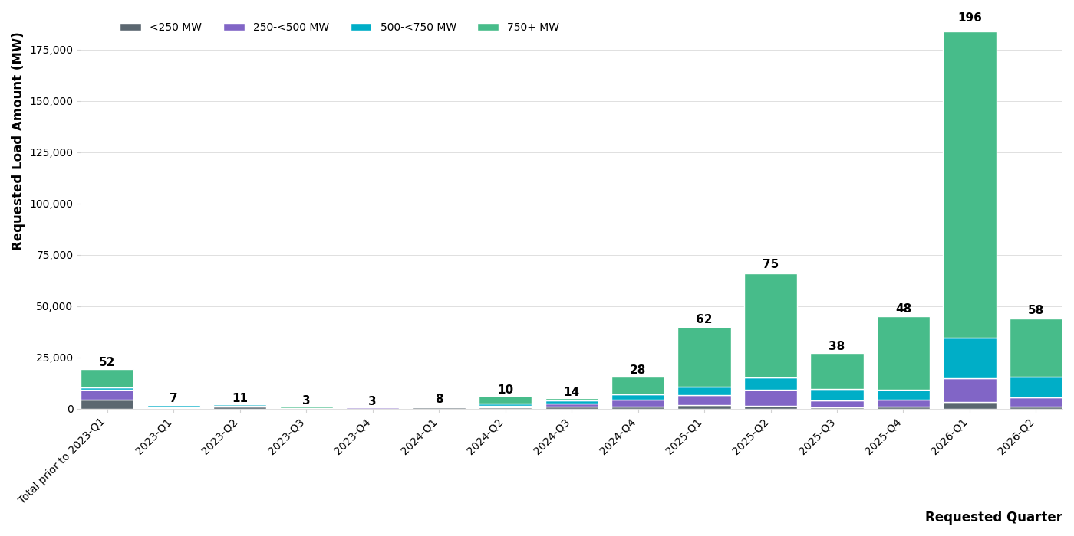
Large Load Project Submittal Date

Slide 13
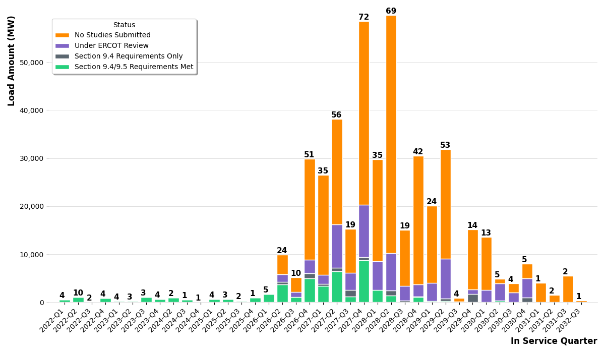
Large Load Project In Service Date

Slide 14
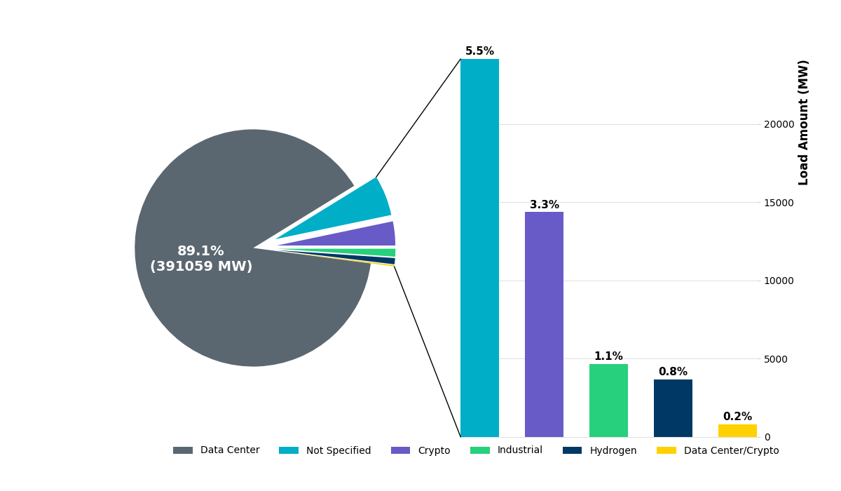
Large Load Project Distribution by Type

Slide 15
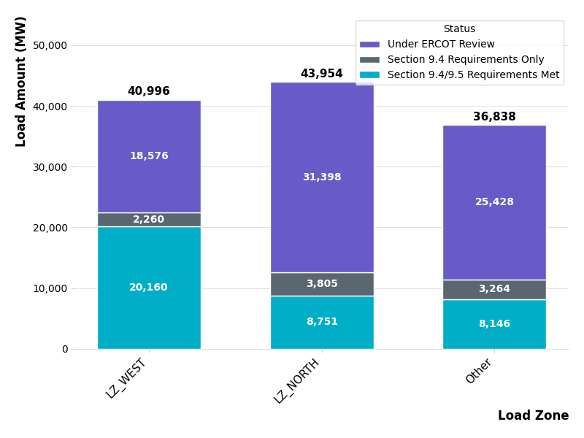
Large Load Project Distribution by Load Zone

Slide 16
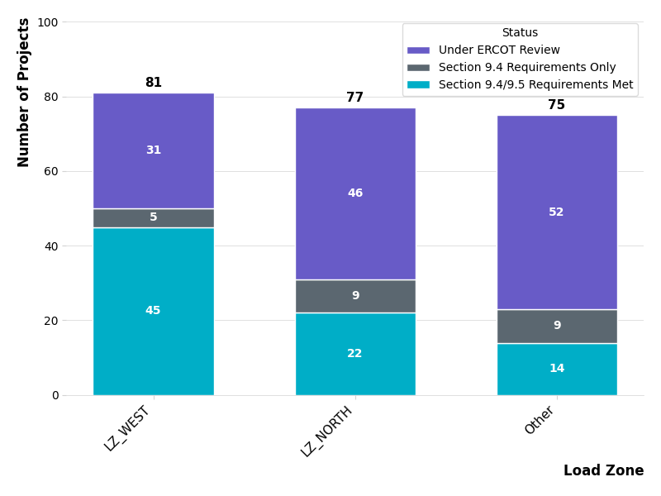
Large Load Project Distribution by Load Zone

Slide 17
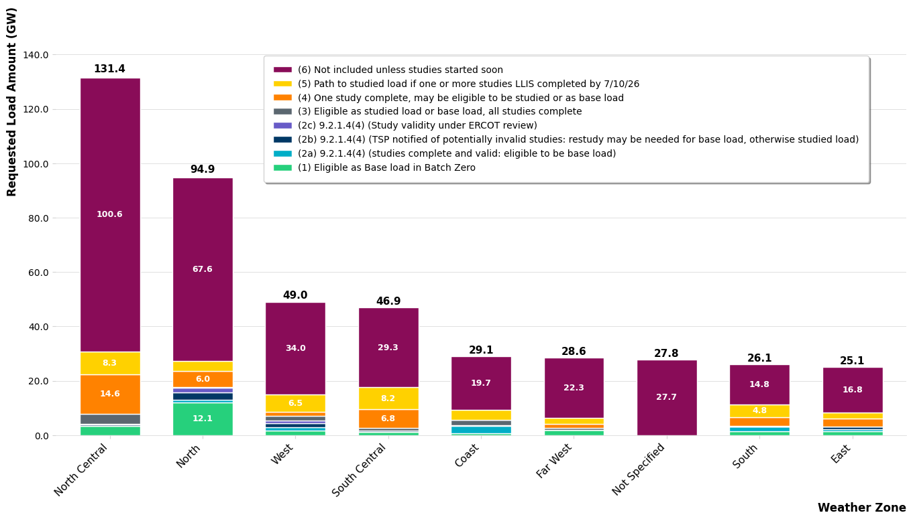
LLIS Projects by Weather Zone (GWs)
Generated on 5-19-2026

Slide 18
Questions/Comments?
LargeLoadInterconnection@ercot.com

