Slide 1
Project Update
Troy Anderson
ERCOT Portfolio Management
May 6, 2026
Outline:
Recent / Upcoming Project Highlights
2026 Release Targets
Other Project Updates
Priority / Rank Recommendations
Technology Working Group (TWG)
2026 Project Planning
Key Takeaways
Monthly project status update for ERCOT Portfolio Management presented to PRS on May 6, 2026
Covers 2026 release highlights, project updates, priority/rank recommendations, TWG update, and project planning

Slide 2
Project Update Agenda
Recent / Upcoming Project Highlights
2026 Release Targets
Other Project Updates
Priority/Rank Recommendations for Revision Requests with Impacts
    NPRR1264 - Creation of a New Energy Attribute Certificate Program
    NPRR1307 - Revised Definition of Mitigation Plan
Technology Working Group (TWG)
  Next meeting is 5/21/2026
Prioritization Update
  2026 Project Planning
Location of Revision Request Project Information: http://www.ercot.com/services/projects
Reports at Upcoming PRS Meetings
  June: Aging Revision Request Prioritization
Notes:
Delete this slide before presenting

Slide 3
Recent / Upcoming Project Highlights
2026 April Release – 4/29/2026-4/30/2026 Complete
  8 data products added to ERCOT Data Portal for public API access
    See 4/3/2026 market notice for details
    Additional market-facing changes will be delivered over the remaining releases in 2026
2026 May Release – 5/27/2026-5/28/2026 In Flight
  7 data products added to ERCOT Data Portal for public API access
    See 4/29/2026 market notice for details
    Additional market-facing changes will be delivered over the remaining releases in 2026
2026 June Off-Cycle Release – 6/1/2026 In Flight
  NPRR1265 – Unregistered Distributed Generator
2026 June Release – 6/24/2026-6/25/2026 In Flight
  SCR820 – Operator Real-Time Messaging During Emergency
Note: Projected Go-Live dates are subject to change.
Please watch for market notices as the effective dates approach.

Slide 4
2026 Release Targets - Approved NPRRs / SCRs / xGRRs
R1
R3
R5
January 1/28-1/29 | February 2/25-2/26 | March 3/25-3/26 | April 4/29-4/30 | May 5/27-5/28 | June 6/24-6/25
NPRR1234(c) PGRR131 NPRR1283 NPRR1285 NPRR1299 | NPRR1266 NPRR1277 | NPRR1287 Add’l Public Data Products in ERCOT Data Portal | CRR Historical Data Removal | NPRR1265 | SCR820
R2
R4
R6
ü
ü
ü
ü
ü
ü
ü
E
4/24
1/1
ü
ü
3/1
ü
6/1
2/1
3/2
E
SCR820 TO/QSE Testing (see TWG meetings)
Cipher Security Upgrades (see TWG meetings)
RTC+B Stabilization
R7
R8
R9
R10
R11
July 7/29-7/30 | August 8/26-8/27 | September 9/30-10/1 | October 10/28-10/29 |  | December 12/16-12/17
DPC Automation |  | NPRR1198 NPRR1303 | NPRR1281
E
NS
E
P
Go-live dates can differ from Protocol effective dates – Please refer to market notices for more details
APPENDIX
Red Text: New additions and target release changes
Strike-Through Text: Previous target release
(a), (b), etc.: Multiple phase release
Project Status Codes
NS = Not Started
I = Initiation
P = Planning
E = Execution
H = On Hold
NPRR1234(c) – RIOO changes for End-Use
Industry Classification to Loads
Release targets are subject to change

Slide 5
Other Project Updates
NPRR1188 - Implement Nodal Dispatch and Energy Settlement for Controllable Load Resources – and – NPRR1244 – Clarification of Controllable Load Resource Primary Frequency Response Responsibilities
  Go-live target = 2027 R1 (January)
NPRR1290 Phase 2 - Gap Resolutions and Clarifications for RTC+B - EDIT
  Stand-alone project - Adding NPRR1323 to scope (pending PUCT approval)
  Still working on a target go-live date in mid-2026
NPRR1201 - Limitations on Resettlement Timeline & Default Uplift Exposure Adjustments
  Targeting July 2026 start with go-live in late 2026
NPRR1238 - Voluntary Registration of Loads with Curtailable Load Capabilities
  Part of Large Load Curtailment Manager project (Initiated February 2026)
  Targeting partial implementation by summer 2026, full scope by end of 2026
  NPRR1238 portion expected to go-live late in 2026
NPRR936 / NPRR1288 - CRR Enhancements Project
  Gate to Execution late May / early June 2026
  Targeting go-live in Q4 2026

Slide 6
Priority / Rank Recommendations for Revision Requests with Impacts
Recommendations for…
Revision Request | Description | Priority | Rank | Comments
NPRR1264 | Creation of a New Energy Attribute Certificate Program | 2027 | 4910 | Phase 1: No project required Phase 2: $150k-$200k, 4-6 months Impacted System: Reporting
NPRR1292 | Granular Product Type for CRR TOU | TBD | TBD | One more month needed to complete IA
NPRR1307 | Revised Definition of Mitigation Plan | 2026 2027 | 4830 4920 | $200k-$300k, 7-10 months Impacted Systems: EMS, MMS, Reporting Discuss project timing (2026 or 2027)
NPRR1316 | Implement an Annual ERCOT RFI Process to Gather Information Related to Retirement and Mothballing Plans of Select Resources | N/A | N/A | <$10k O&M – no project needed
PPL Rank Information
Next 2026 Rank in Business Strategy = 4830 Next 2029 Rank in Business Strategy = 5300
Next 2027 Rank in Business Strategy = 4910 Next Rank in Regulatory = 450
Next 2028 Rank in Business Strategy = 5110

Slide 7
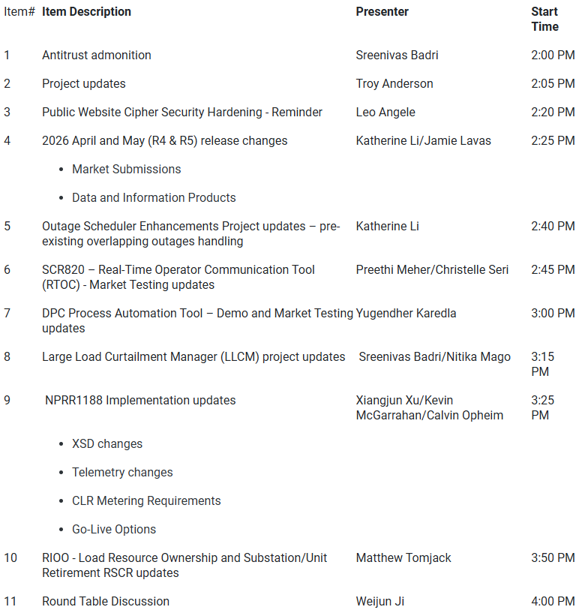
Technology Working Group (TWG) - 4/23/2026 Meeting
Next TWG scheduled for 5/21/2026

Slide 8
2026 Project Planning
ERCOT understands that Market Participants need lead time to implement changes in their systems for many Revision Requests
Approved Revision Request Project Starts
  NPRR936 – CRR Account Holder Limits
  NPRR1188 – Implement Nodal Dispatch and Energy Settlement for Controllable Load Resources
  NPRR1198 – Congestion Mitigation Using Topology Reconfigurations
  NPRR1201 – Limitations on Resettlement Timeline & Default Uplift Exposure Adj
  NPRR1238 – Voluntary Registration of Loads with Curtailable Load Capabilities
  NPRR1244 – Clarification of CLR Primary Frequency Response Responsibilities
  NPRR1277 – Revisions to EAL Formula
  NPRR1281 – Improvements to Alternate FFSS Resource Designation
  NPRR1288 – Remove Multiple Month Transactions in CRR Auctions
  NPRR1290 Phase 2 – Gap Resolutions and Clarifications for RTC+B + NPRR1323
  SCR829 – API for the NDCRC Application
Revision Request Projects with Starts Delayed to Early 2027
  SCR818 Phase 2 – Changes to Incorporate GIC Modeling Data into Existing Modeling Applications
  SCR831 – Short Circuit Model Integration
Other priority Review Request projects may start in 2026 with a future year Go-Live
  DRRS (NPRR1309), Residential Demand (NPRR1296), Firming (NPRR1328)
Green Text: Deemed “High Priority” at 2025 Prioritization Workshop

Slide 9
Questions/Comments?
Troy.Anderson@ercot.com

