Slide 1
NDSWG Meeting
May 2026

Slide 2
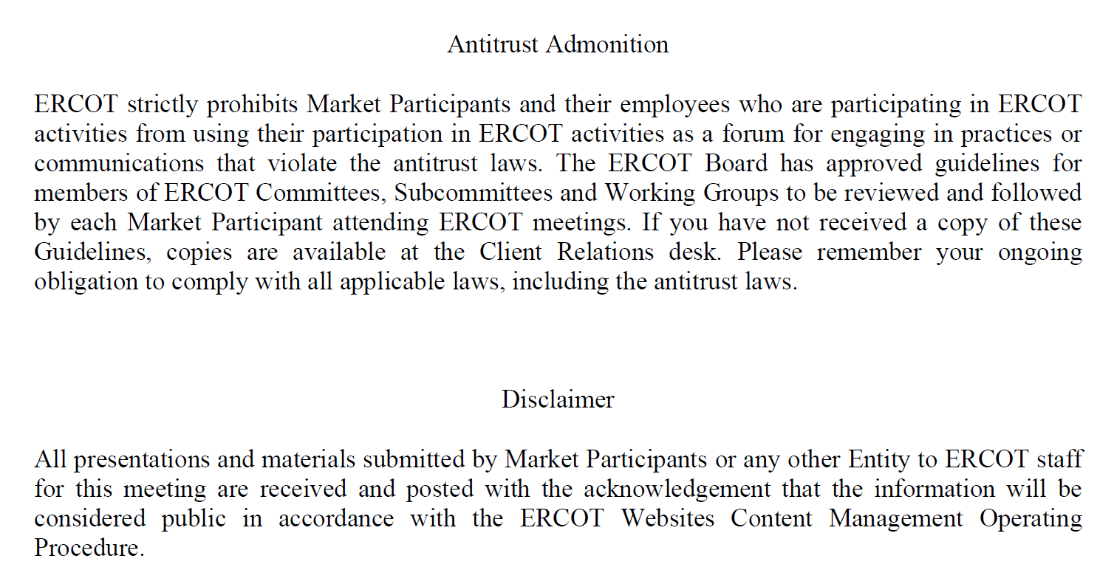

Slide 3
Topics
DPC Tool Overview
UDG workshop Overview
NDSWG Vice-Chair position
Requests:
  Response to chronic congestion report emails
Reminders:
  Production release addressing the “show other end” issue on the line
  Contingency overview training

Slide 4
Topics
Pending and upcoming work:
  Annual review for Manual Contingency
  Three Winding Transformer modeling
  Reports to be updated as requested from the previous meeting
  ICCP Handbook update
Presentation by AEP related to prior IRO – 010 audit(ICCP data)

Slide 5
Other Topics
  Open discussion

