Slide 1
Frequency Measurable Events(FME) selection Criteria
PDCWG | May 20, 2026
ERCOT
Operations Planning

Slide 2
Introduction
In recent years, ERCOT has observed significant grid performance improvements, resulting in fewer qualifying FMEs under the current selection criteria.
This decline has pushed annual FME counts well below the target range of 20–35 events, which has limited the data available to meaningfully assess performance.
With too few events to evaluate, Primary Frequency Response (PFR) performance monitoring per BAL‑001‑TRE standard and oversight of Responsive Reserve Service (RRS) providers has nearly stalled.
ERCOT continues to experience Non-FMEs that are good clean events to evaluate performance, but many of them do not meet our current criteria.
ERCOT is proposing updates to the FME selection criteria to select clean events that are falling off from the current selection criteria. This will strengthen compliance monitoring per BAL‑001‑TRE and improve the performance monitoring of the RRS providers.
Following slide will work through the current criteria and an analysis of Non-FMEs from 2022-2025 to suggest FME criteria changes moving forward.

Slide 3
Overview of Current FME Selection Criteria
Frequency Deviation (A-B Frequency) that has a pre-perturbation(A) [the 14-second period of time ending 2 seconds before t(0)] average frequency to post-perturbation(B) [the 32-second period of time starting 20 seconds after t(0)] average frequency absolute deviation greater than 60 mHz.
A cumulative change in generating unit/generating facility, DC tie and/or firm load pre-perturbation megawatt value to post-perturbation megawatt value absolute deviation greater than 550 MW.
The time from the start of the rapid change in frequency until the point at which Frequency has stabilized within a narrow range should be less than 18 seconds.
Pre-perturbation frequency [computed as an average over the 14-second period of time ending 2 seconds before t(0)] should be relatively steady and near 60.000 Hz at t(0).
Key Takeaway: Due to the evolving grid, ERCOT has observed the current criteria used is resulting in fewer FMEs than the desired 20 to 35 events per year. ERCOT is proposing minor modifications to this criteria based on the frequency analysis in the following slides.

Slide 4
Other Quality Checks
In addition, ERCOT uses following quality checks when selecting an FME
MW loss from Generating unit/DC-Import or Load Resources/DC_Export should be instantaneous in nature.
  Significant unit runback prior to the unit trip, that impacts the pre-perturbation frequency will be ignored.
  Events resulting from partial unit trips or runback following a partial trip will be ignored.
The post-perturbation frequency should be outside the deadbands.
  For a low frequency event, the post-perturbation frequency should be less than 59.983 Hz
  For a high frequency event, the post-perturbation frequency should be greater than 60.017 Hz
ERCOT retains discretion when selecting FMEs. While the criteria provides a consistent framework, ERCOT may designate an event as an FME even if it does not meet every element of the criteria, when overall characteristics indicate it is a strong candidate for performance monitoring under BAL‑001‑TRE.

Slide 5
Analysis – Events selected
  ERCOT has compiled 44 Non-FME events to conduct analysis to identify changes in event selection criteria from 2022 to 2025 based on the following criteria:
  Events are selected from the existing pool of non FMEs
  MW Loss is greater or equal to approximately 550 MW
  Event is a clean trip
  Pre-peturbation frequency is within the deadbands
Key Takeaway: Based on this criteria, there are 44 events to evaluate from 2022 – 2025.

Slide 6
FME Events from 2021-2026
Year over year, ERCOT is seeing improvement in the grid’s ability to arrest and recover frequency for similar MW loss and similar inertia levels. As a result, number of FME events are declining.

Slide 7
A-B Frequency for Non-FME events from 2022 - 2025
“A Point” is the last stable frequency value before a frequency disturbance.
“B Point” is the “recovery” frequency value after the C Point.
“C Point” is the lowest frequency value during the first five seconds of the event
The charts includes all variations of A-B frequency over the course of 4 years and shows an average decrease over each year.
The A-B range for each year are as followed:
  2022: 0.0600 – 0.0720 mHz
  2023: 0.0290 – 0.0630 mHz
  2024: 0.0310 – 0.0560 mHz
  2025: 0.0160 – 0.0520 mHz
Key Takeaway: This trend suggests that current A-B threshold may be too restrictive, as the A-B several clean events fall below existing threshold.

Slide 8
A-B vs Average MW Loss 2022 - 2025
This chart shows the relationship between A-B frequency deviation and average MW loss from 2022-2025, for approximately similar MW loss events the A-B distribution is widespread, and the results shows that many clean, valid events are excluded under current threshold, indicating that A-B is still a valid criteria and may be restrictive.

Slide 9
A-C Frequency for Non-FME events from 2022 - 2025
“A Point” is the last stable frequency value before a frequency disturbance.
“B Point” is the “recovery” frequency value after the C Point.
“C Point” is the lowest frequency value during the first five seconds of the event.
The charts includes all variations of A-C frequency over the course of 4 years and shows an average decrease over each year.
The A-C range for each year are as followed:
  2022: 0.0660 – 0.1300 mHz
  2023: 0.0570 – 0.1070 mHz
  2024: 0.0580 – 0.0890 mHz
  2025: 0.0370 – 0.0850 mHz
Key Takeaway: From this observation, the A-C frequency is consistently decreasing year by year. Indicating that A-C frequency is not a good indicator for FME selection.

Slide 10
Number of FMEs with different A-B thresholds
Key Takeaway: Lowering the A-B threshold increases the number of additional FME’s we would have selected from the current Non-FME pool. Increase in events range from 1 to 14.

Slide 11
Number of FMEs with different A-B thresholds (Including Current FMEs)
Key Takeaway: The total number of FMEs we would have selected for different A-B thresholds over last 3 years

Slide 12
Revised FME Criteria
Frequency Deviation (A-B Frequency) that has a pre-perturbation [the 14-second period of time ending 2 seconds before t(0)] average frequency to post-perturbation [the 32-second period of time starting 20 seconds after t(0)] average frequency absolute deviation greater than 40 mHz.
A cumulative change in generating unit/generating facility, DC tie and/or firm load pre-perturbation megawatt value to post-perturbation megawatt value absolute deviation greater than 550 MW.
The time from the start of the rapid change in frequency until the point at which Frequency has stabilized within a narrow range should be less than 18 seconds.
Pre-perturbation frequency [computed as an average over the 14-second period of time ending 2 seconds before t(0)] should be relatively steady and near 60.000 Hz at t(0). For example, given the choice of the two events below, the one on the right is preferred as the pre-disturbance frequency is stable and also closer to 60 Hz.
Key Takeaway: To increase the number of FMEs, ERCOT is proposing revised criteria by changing the A-B threshold to 40 mHz. ERCOT will continue to use the additional quality checks described in slide 3.
ERCOT has discretion when selecting FME’s and PDCWG feedback will be considered

Slide 13
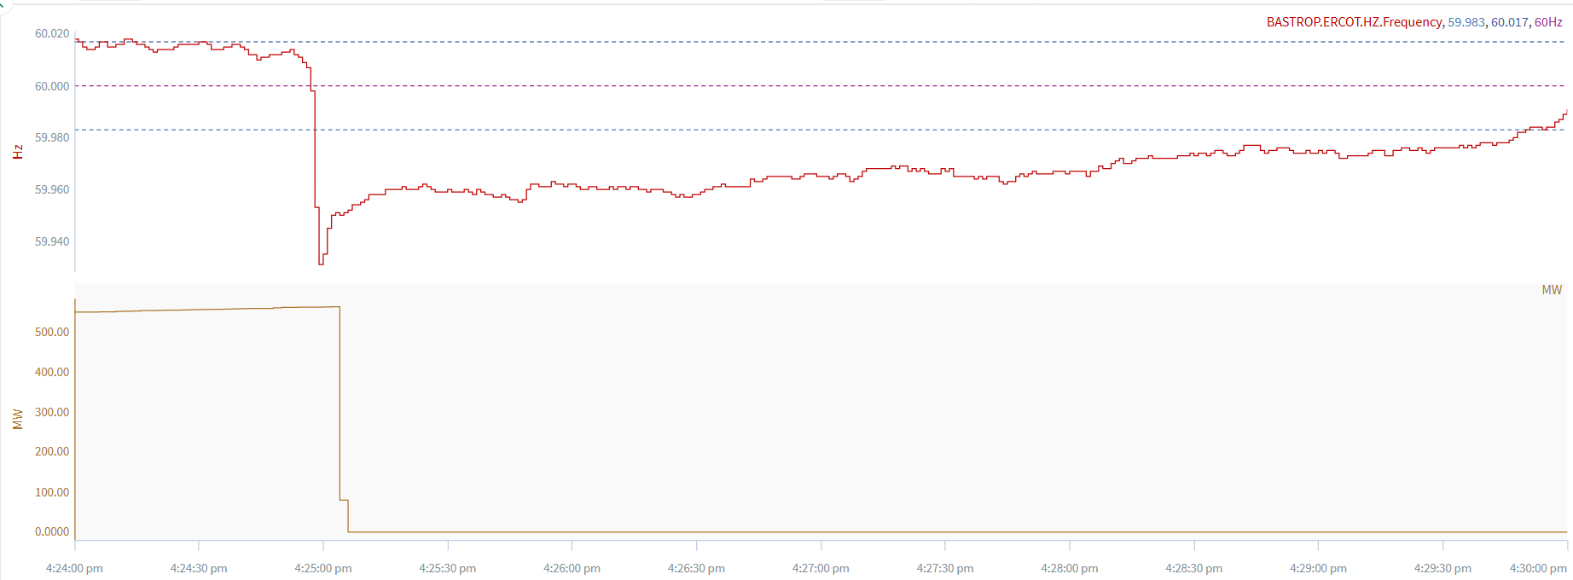
Example of a FME using revised criteria
3/1/2025 16:24:56 Event
This is an example of an event that would count under the new FME standard
A Point: 60.0060 Hz
B Point: 59.9600 Hz
C Point: 59.9310 Hz
A-B: 0.0460 Hz
A-C: 0.0750 Hz
MW Loss: 560 MW

Slide 14
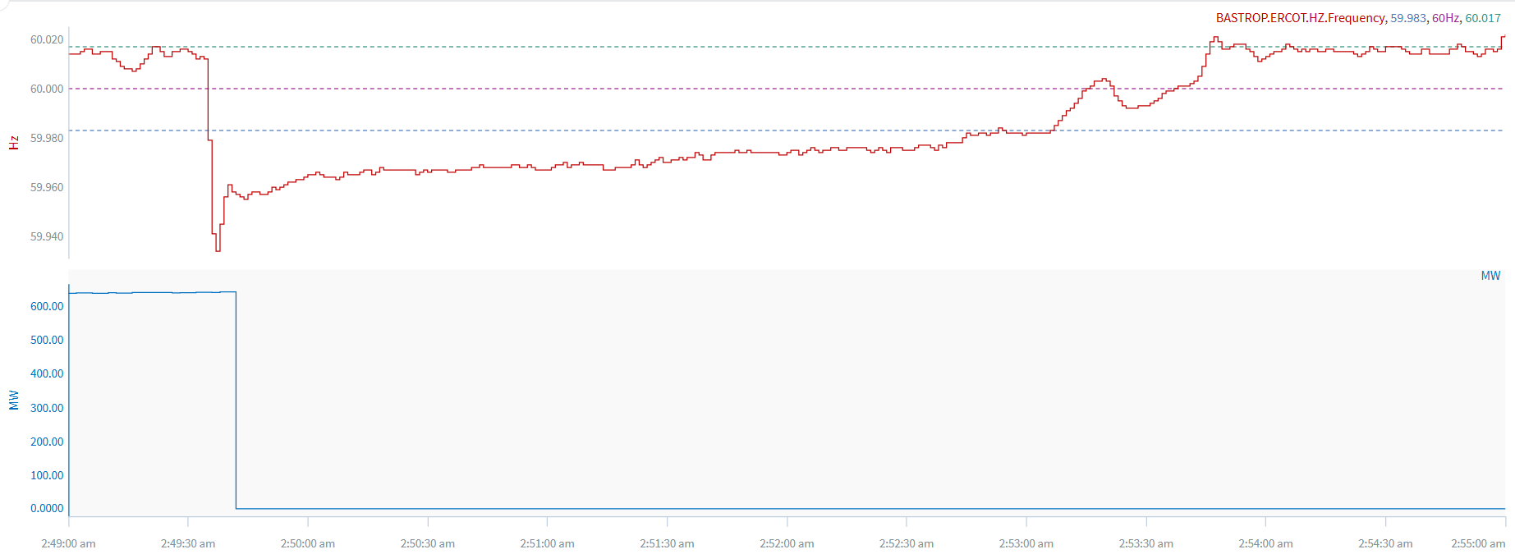
Example of a FME using revised criteria
6/2/2025 2:49:34 Event
This is another example of an event that would count under the new FME standard
A Point: 60.0130 Hz
B Point: 59.9640 Hz
C Point: 59.9350 Hz
A-B: 0.0490 Hz
A-C: 0.0780 Hz
MW Loss: 643 MW

Slide 15
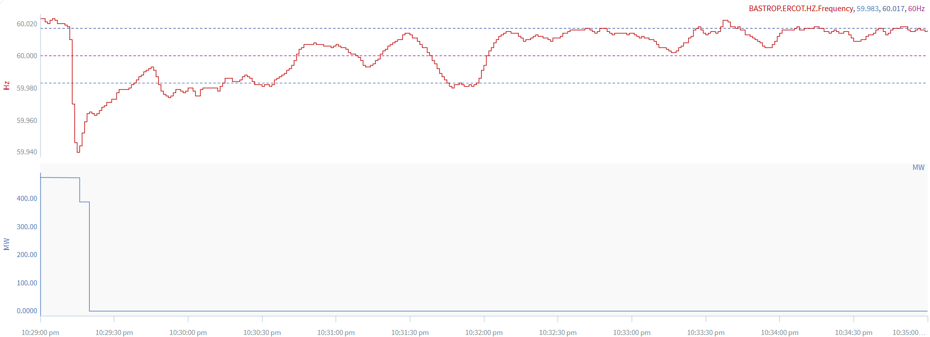
Example of a Non-FME using revised criteria
4/8/2024 22:29:11 Event
This is an example of an event that would NOT count under the new FME standard
A Point: 60.0180 Hz
B Point: 59.9770 Hz
C Point: 59.9400 Hz
A-B: 0.0410 Hz
A-C: 0.0780 Hz
MW Loss: 472 MW
Reason for no FME Selection:
A point is above the deadband, and frequency recovered above low deadband.

Slide 16
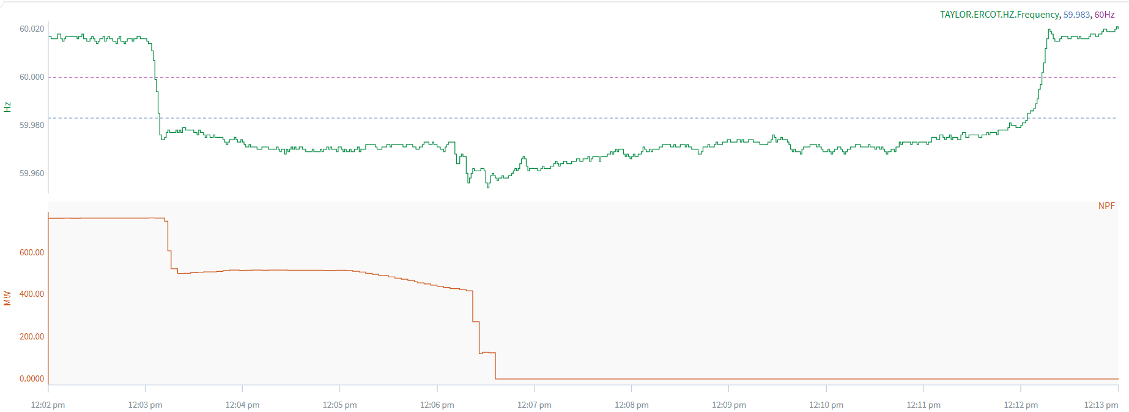
Example of a Non-FME using revised criteria
8/1/2025 12:03:03 Event
This is another example of an event that would NOT count under the new FME standard
A Point: 60.0140 Hz
B Point: 59.9780 Hz
C Point: 59.9740 Hz
A-B: 0.0360 Hz
A-C: 0.0400 Hz
MW Loss: 759 MW
Reason for no FME Selection:
Unit tripped in steps and A point is above the deadband

Slide 17
Next Steps
ERCOT has provided the analysis for FME selection criteria change for PDCWG review.
If there are no objections, ERCOT will update internal process to reflect the new FME selection criteria and begin using the revised criteria going forward immediately when selecting the FME’s.

Slide 18
Questions/Comments?

Slide 19
Appendix

Slide 20
A-C vs Average MW Loss 2022 - 2025
Key Takeaway: The charts includes A-C frequency vs average MW Loss over the course of 4 years and shows an A-C decrease over each year for similar MW loss.

Slide 21
C Point vs Average MW Loss 2022 - 2025
Key Takeaway: C point has decreased on average over the years, which causes more units to be excluded from the FME selection.

