Slide 1
Unregistered Distribution Generation Data Collection and Maintenance
Joel Koepke
April 2026

Slide 2
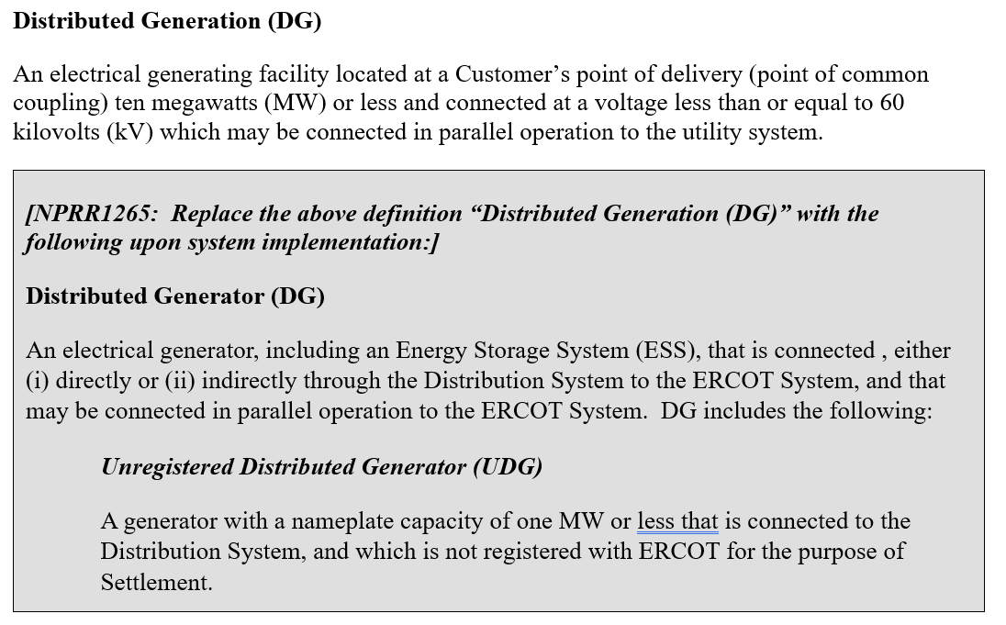
NPRR1265 Language to be Unboxed on June 1 – Section 2

Slide 3
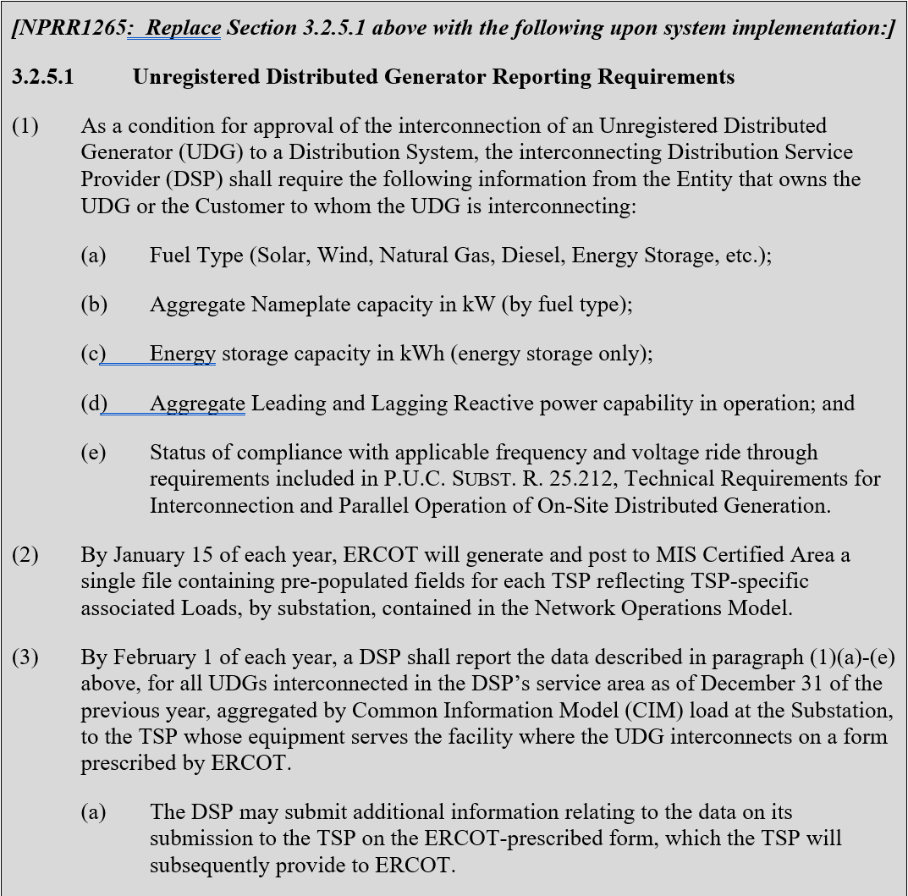
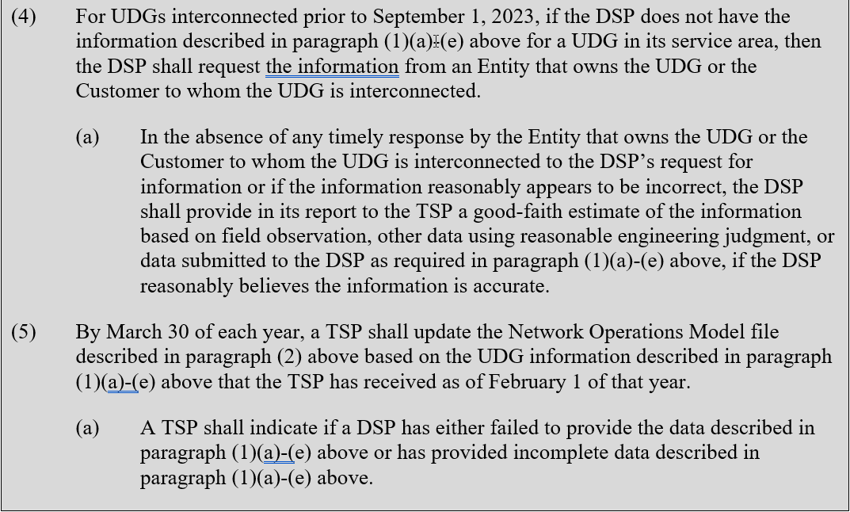
NPRR1265 Language to be Unboxed on June 1 – Section 3.2.5.1
3.2.5.1 describes the process to collect UDG information from DSPs, pass to TSPs, and provide to ERCOT

Slide 4
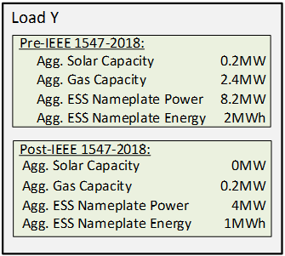
Additional UDG Attributes for CIM Loads
Transformers between the transmission system and distribution system are modeled as individual load points
In the field
In the model
Example UDG attributes for loads in the model
Transmission
Distribution
Transformers represented as load points
These “CIM loads” will be given new attributes quantifying the UDG characteristics of the connected distribution system

Slide 5
UDG Data for Operations and Planning Use Cases
The ERCOT Network Operations Model (NOM) will be extended to hold Unregistered Distribution Generation (UDG) data
Energy Management System
Market Management System
Forecasting
SSWG Case Building
RPG and LTSA Activities
UDG Data
UDG Data
UDG Data
UDG Data submitted within the NOM can be incorporated into the planning case builds where needed
The NOM, containing the new UDG data, will be used in operations and as the starting point for each planning build cycle

Slide 6
UDG in Planning Models and Studies
UDG will be included in the Planning cases as discrete generators and not embedded in the load forecast.
A script will synchronize the UDG information in NMMS with MOD like we do for SODG.
They will be aggregated by fuel type on a bus.
The bus will be in the 800,000 range.
Dispatching
  Wind and Solar UDG will be dispatched at the same value of transmission wind and solar
  All other UDG will be offline
UDGs will be modeled at unity PF.

Slide 7
Timeline: NPRR1265 Unboxing and Data Collection
Complete – ERCOT posts draft pre-populated UDG template to MIS
Complete – UDG Workshop #3
June 1 – Unbox NPRR1265 items
  Includes 3.2.5.1 Unregistered Distributed Generator Reporting Requirements
Protocol-Driven Dates
  By Jan. 15, 2027 – ERCOT posts pre-populated UDG template to ERCOT MIS
  By Feb 1, 2027 – DSP provides aggregated UDG information to TSP
  By March 30, 2027 – TSP submits updated UDG information to ERCOT
May 1, 2027 – ERCOT posts UDG report
October 2027 – UDG Information in ERCOT Planning Cases
By Jan.15, 2028 – ERCOT posts pre-populated UDG template containing previous year’s response to ERCOT MIS

Slide 8
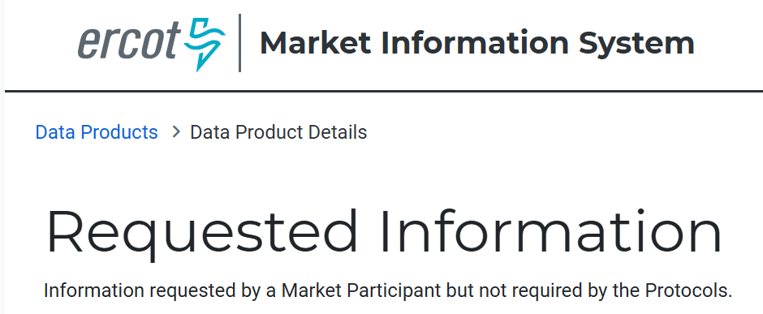
Draft Pre-Populated Template
ERCOT has posted a draft pre-populated UDG template to the MIS website
  Prior to unboxing, the template will reside in the Requested Information location
    https://mis.ercot.com/secure/data-products/data-product-details?id=np12-230
  Post unboxing, a new MIS location will be created
    EMIL-ID and URL will be announced via Market Notice
Notes:
Note that when the meeting content is posted, the pre-populated template may not yet be in the Requested Information location. The information will available prior to the UDG workshop.

Slide 9
UDG Data Update Process
ERCOT will facilitate a yearly process to request, collect, and incorporate updates to UDG information into the model
ERCOT
Transmission Service Provider
Corrections
requested
Operations Modeling
Updated UDG
4.
An updated worksheet will be submitted to ERCOT
Application
Changes
Worksheet
(NMMS)
imported
Worksheet submitted to
ERCOT
Pre-populated files will be generated containing all associated loads
Pre
DSP
-
1.
Populated
Pre
-
UDG
Populated
Pre
-
UDG
Populated
Worksheet
UDG
Files generated
Worksheet
for each TSP
Updated UDG
Worksheet
Worksheet
ERCOT MIS
Worksheets posted
Final URL TBD
to MIS
(TSP
-
Specific Location)
Via internal processes the TSP will update the UDG data within the spreadsheet
A single file will be provided to each TSP via the MIS
Pre
-
2.
Populated
Download
3.
UDG
Internal Processes
Worksheet

Slide 10
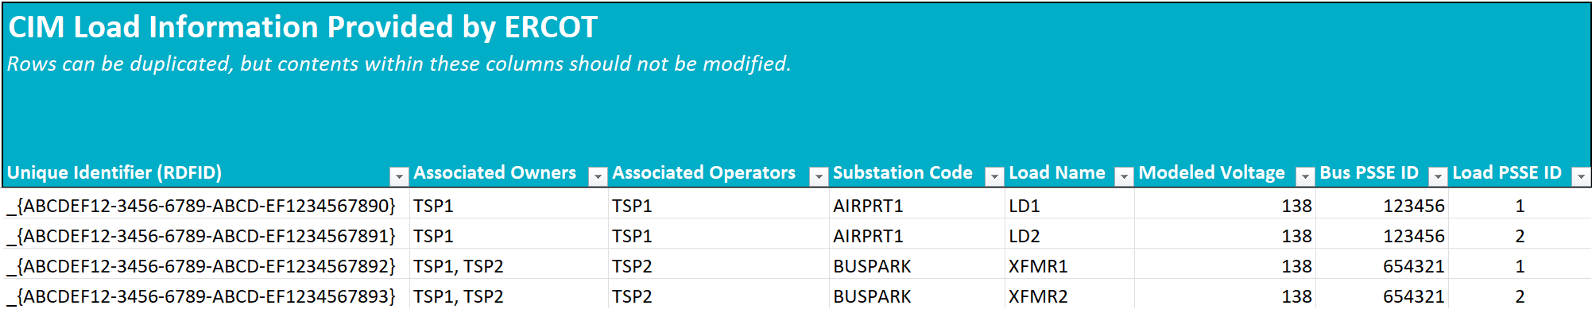
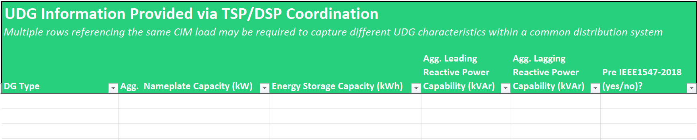
Draft Pre-Populated UDG Worksheet
ERCOT has posted a pre-populated template worksheet containing all loads associated to TDSPs.
The initial columns of the worksheet are populated by ERCOT, and the contents should not be modified.
Subsequent columns are to be updated, if necessary, by TSPs/DSPs with the required UDG information

Slide 11
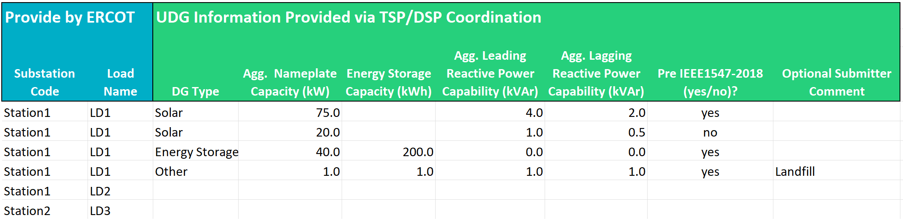
Example: Different UDG Characteristics at One CIM Load
To accommodate UDG that cannot be aggregated together, additional rows have been added
Common types cannot be combined if they have a different 1547 vintage
Different UDG types cannot be aggregated into a single row

Slide 12
Draft UDG Types
Draft form allows the following UDG types (captured from the protocols):
  Solar
  Wind
  Natural Gas
  Diesel
  Energy Storage, and
  Other
ERCOT is open to additional DG types if need is present

Slide 13
Next Steps
Download the draft pre-populated template from the ERCOT MIS
  Requested Information Link
Review template and provide feedback at upcoming NDSWG meetings
  NDSWG Schedule Link
Discuss implementation in Planning cases at SSWG meetings
Monitor Market Notices for Updated Templates and Potential Additional Meetings

