Slide 1
SCR820 – Real-Time Operator Communications System (RTOC) Preethi Meher May 20, 2026
Outline:
Status updates
Market Testing Updates
Recap Tool Access
Primary Contacts
Demo
Key Takeaways
RTOC project updates, timeline discussion and demo of new displays

Slide 2
Status Updates
Project updates
TO testing has started, and we received acknowledgments from most of the companies
The tool was successfully utilized during Week 4 of the ERCOT BlackStart training.
Control Room Operations is planning to send communications through RTOC tool for testing purpose in parallel with hotline calls for routine tasks
Internal discussions are underway to draft NPRR to update Protocols that allow Control Room to use this tool in addition to current Hotline Call
Development updates
The first version of the SOL Exceedance data displays has been developed and deployed to staging environment.
Development of the default dashboard is in progress (demoed in 04/23 TWG meeting)
defects and enhancement requests identified in the initial communications release are planned to be addressed in R5 and R6.

Slide 3
RTOC Tool – Project Timelines
Project Timeline
Phase | Milestone | Target Date
Planning | Requirements & Design Finalized | Complete
Development | Development & Internal ERCOT Testing | Apr 2026
TOs Testing | Market Testing | Apr – June 2026
QSE Testing | Market Testing | June – Aug 2026
Parallel Operation | TOs/QSEs Parallel Operation | Q4 2026 – Q1 2027*
Go Live | TOs/QSEs Go Live | Q1 2027 – Q2 2027*
Key Takeaway: The timelines for QSE market testing have been added.
Please note that certain dates are subject to change pending the implementation of a nodal protocol revision request (NPRR).
We have determined that protocol updates are necessary so the control room can use the tool and start parallel operations. An updated market notice with revised timelines will be sent. (Original market notice for your reference: M-A032326-01A Access and familiarization of the Real- Time Operation Communications (RTOC) tool)
ERCOT is developing draft NPRR to update the protocols to use this tool in addition to current Hotline Call
Parallel Operations - ERCOT and TO/QSE primary point of contacts will test and verify RTOC messages in conjunction with Hotline Calls and any daily communications test. RTOC will NOT be a designated communication medium for control rooms. Hotline and voice communication will be the primary medium for Realtime system activities.
Go-Live* - RTOC is introduced into control rooms as a monitored 24x7 communication tool during normal and emergency operations.
*Coordinated with final approval of any NPRR changes

Slide 4
Market Testing Updates
Companies onboarded and logged into the application during market testing
TOs – 18 – Total Users – 94
QSEs – 8 – Total Users - 21
We are following up with few remaining TOs to start testing as well
18 TOs and 8 QSEs users were able to successfully login and navigate through all the displays
ERCOT Control room/Project team is gathering primary contacts from TO’s control rooms in preparation for the next milestones
No major issues were reported by TOs/QSEs so far.
We are planning to send another Market Notice to onboard QSEs for testing.
TOs Testing period ends – June 12th.

Slide 5
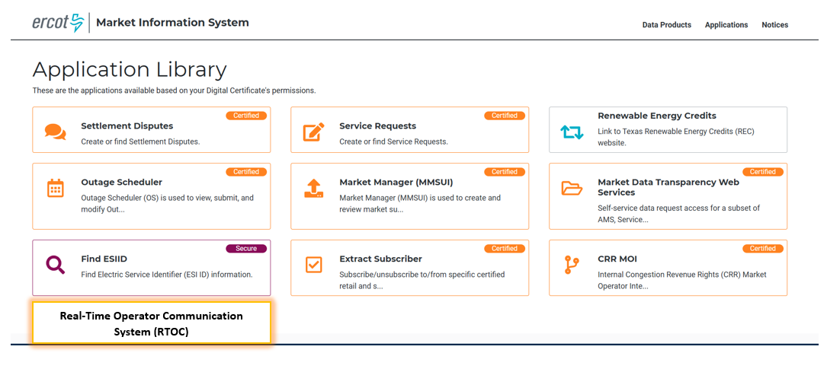
RTOC Tool Access
Access control
Application access will be granted via digital certificates
New roles must be added to the certificate for authorization
Operator (RTOC_M_OPERATOR)
ReadOnly (RTOC_M_VIEW)
Link will be available on mis.ercot.com application library (It will be enabled after the completion of the market testing)
Available to request

Slide 6
Provide Primary Contact Information
We need your help to streamline communication for RTOC Market Testing.
Please share the following details for your organization:
Primary Contact Name
Email Address
Role/Designation
Why?
To provide testing-related communications
Share application URL, updates, and instructions promptly
How to Submit:
Email your details to: ERCOTRTOCSupport@ercot.com

Slide 7
RTOC Tool changes in May Release
Enhancements:
RTOC-188 Communication - Change the styling for unread messages in inbox
RTCA Displays - Provides SOL Exceedance data
RTOC-110 Communications - Scan Attachments
Defects:
RTOC-199 Communication - Acknowledge button displaying even when recipient not required to acknowledge
RTOC-189 Communication - Advance Search for QSE/TSP is not working for acknowledged status
RTOC-195 Communication - validate the message length
RTOC-205 Enhance Communication Screen design to use full screen
May Release (R5) will go into RTOC Production system on 05/28/2026 and available for Market Testing.

Slide 8
RTOC Tool
RTCA SOL Exceedances display demo

Slide 9
Questions/Comments?

