Slide 1
Read-Only EMS in Cloud Sunil Mukkollu Manager, Enterprise Architecture May 21, 2026
Outline:
Background - Extended loss of EMS
Read-Only EMS in Cloud – Objectives and Scope
Scenarios
Architecture
Implementation Timelines
Closing
Key Takeaways
Extended loss of EMS is rare but a high‑impact Tier 1 risk, improving control room visibility and backup strategies essential for grid reliability.
The cloud‑based Read‑Only EMS delivers limited grid visibility during extended EMS outages.

Slide 2
Background – Extended loss of EMS
ERCOT’s Enterprise risk assessment elevates “extended loss of EMS” to a Tier 1 risk due to increased grid complexity and a growing cyber-threat landscape.
EMS has built‑in redundancy, and most hardware or application issues are resolved automatically. When EMS fails, IT restores service at the active site or fails over to the backup. If both sites are impacted, IT provides restoration timelines to the Control Room for mitigation.
Established procedures allow the Control Room to transfer frequency control to a regulating QSE and operate in Constant Frequency Control (CFC) mode. During CFC, visibility of the grid is limited across entities, as defined in Nodal Operating Guide 2.2.4.3.
Although unlikely, extended EMS loss remains a high‑impact risk. ERCOT last entered CFC mode on 7/7/2016, when frequency control was handed to a QSE.
Key Takeaway:
Extended loss of EMS is rare but a high‑impact Tier 1 risk, improving control room visibility and backup strategies essential for grid reliability.

Slide 3
Read-Only EMS in Cloud - Objectives and Scope
A small‑scale “Read‑Only EMS” will run in the cloud, giving the Control Room and Grid Operations visibility into the grid during extended EMS outages when a QSE is managing frequency in CFC mode.
Read-Only EMS instance in Cloud will have ICCP (QSE/TSP), SCADA, state estimator (SE), real-time contingency analysis (RTCA), AGC (monitor mode) and study network applications setup and running.
Read-Only EMS does not provide control capability. EMS outputs and control signals are not sent to QSEs
The cloud setup includes lightweight TSP/QSE ICCP servers and real‑time/study EMS servers. Telemetry is fed from on‑prem EMS to Cloud EMS operational all the time.
Control Room does not use this instance of EMS in Cloud for RTA/RTM to be compliant with NERC CIP and Reliability standards.
The ERCOT Board approved developing the cloud‑based Read‑Only EMS as a mitigation for this Tier 1 risk.
Key Takeaways: The cloud‑based Read‑Only EMS delivers limited grid visibility during extended EMS outages.

Slide 4
Scenarios
This effort will validate three key scenarios to ensure Read‑Only EMS in Cloud functions as expected.
Scenario 1 – WAN Up, EMS Down
In this scenario, Control Room uses “Read-Only EMS in Cloud” and we will Utilize Cloud foundation private network to reroute the WAN traffic to “EMS in Cloud” over dedicated secure connections.
This scenario does not have hard dependency on market participants system changes. Only testing support is needed from QSEs/TSPs during initial setup
Scenario 2 – WAN Down, EMS Up
Control Room continues using on‑prem EMS, bypassing the WAN and using Internet or other secure paths for ICCP telemetry per Nodal Operating Guide 7.1.(5).
Requires ICCP and possible hardware changes for QSEs/TSPs.
Scenario 3 – WAN Down, EMS Down
Control Room uses the Read‑Only EMS in Cloud and bypassing the WAN and using Internet or other secure paths for ICCP telemetry per Nodal Operating Guide 7.1.(5).
Also requires ICCP and potential hardware changes for QSEs/TSPs.
ERCOT is having discussions with Major QSEs/TSPs to finalize the solution for Scenarios 2 and 3.
Key Takeaways: Validating these three scenarios ensures ERCOT Control Room can continue to have visibility into grid when WAN, On-Prem EMS, or both are unavailable—by reliably falling back to the Read‑Only EMS in Cloud when needed.

Slide 5
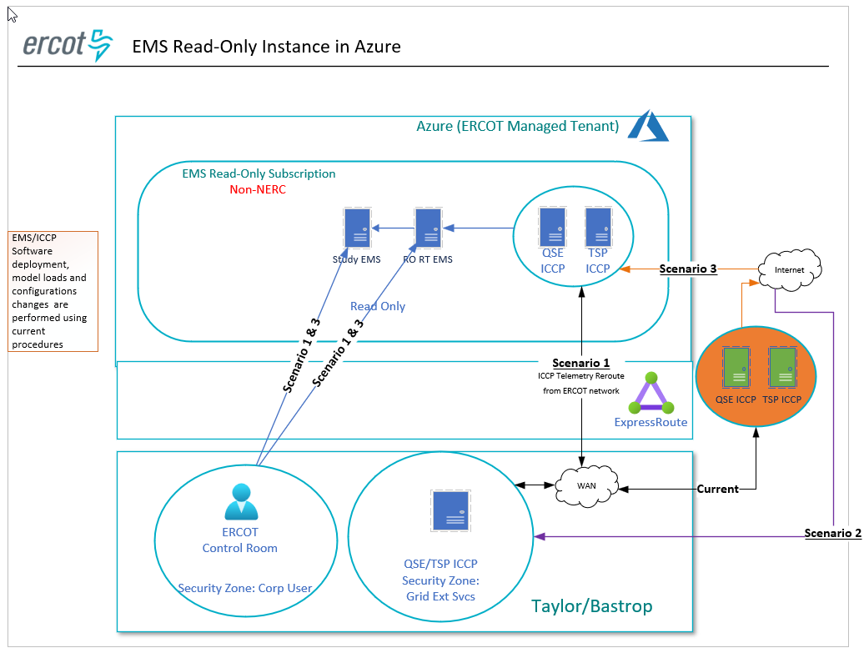
Architecture

Slide 6
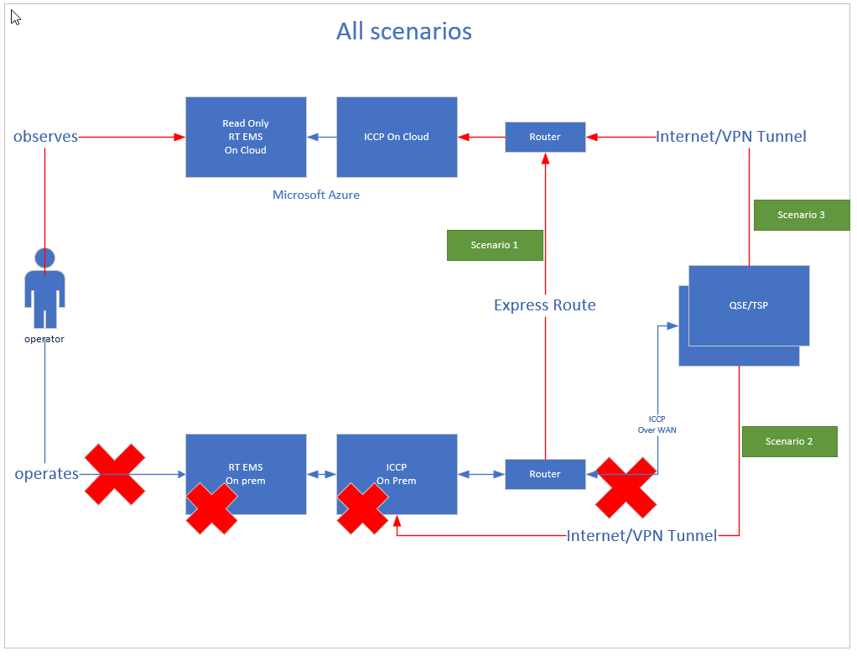
Architecture - Simplified

Slide 7
Current Status and Implementation Timelines
ERCOT had detailed discussions with selected major QSEs/TSPs over last 3 months on all scenarios, potential solutions for Scenario 2 & 3 and collected their feedback. General feedback has been positive and supports this initiative.
Scenario 1
Project is initiated for Scenario 1.
Plan to stand up Read-Only EMS in Cloud and complete testing by End of this year.
Testing will be performed using one of the site (either Taylor or Bastrop) ERCOT network layer to reroute telemetry to Cloud ICCP. No impacts are expected to QSEs/TSPs.
Testing will be coordinated with each major QSEs/TSPs separately.
Testing period will be around 15 -20 minutes per each major QSE/TSP.
Other site (either Taylor or Bastrop) Telemetry will continue to feed On-Prem EMS during this testing period.
Scenarios 2 & 3
We are having internal discussions with Network/Telecom/Cyber/Compliance teams on potential solutions ( one of them is Ipsec VPN Tunnel over Public Internet) for these two scenarios.
We are incorporating QSEs/TSPs feedback into solution design.
We are planning to have another round of discussions with selected major QSEs/TSPs in Q3 this year to finalize the solution for scenario 2 & 3 and request effort and timelines by Q4 this year to implement the solution in 2027.
Key Takeaways: Scenario 1 will be implemented this year, while Scenarios 2 & 3 are progressing through internal design and QSE/TSP engagement, with solution finalization targeted for Q3.

Slide 8
Thank you Questions/Comments?
Sunil.mukkollu@ercot.com
Sreenivas.Badri@ercot.com

