Slide 1
NPRR 1188 – System Impacts Overview Vamsi Paruchuri May 21,2026
Outline:
NPRR 1188 overview
SCED and DAM changes
Market Manager UI & External webservice changes
Report Changes
Key Takeaways
NPRR 1188 project is in design and development phase, impacts QSEs Market Submissions EWS APIs
Requires Meters installations in the field for CLRs and go through qualification process before Go-Live.

Slide 2
NPRR 1188 Overview
NPRR 1188 enables nodal dispatch for Controllable Load Resources (CLR) that are not ALR’s
Aggregate Load Resources (ALR) will continue to be settled at Load Zones (LZ)
New Resource Nodes (RN) and ERCOT-Polled Settlement (EPS) meters will be added for CLR’s that are not ALR’s.
CLRs should have the Meters installed in the field and go through qualification process to be able to participate in the market from the Go-Live date.
Go-Live date: Jan 2027

Slide 3
SCED and DAM Changes for CLR’s that are not ALR’s
SCED
Changed from LZ to nodal dispatch
EPS meters and RN’s will be added
New telemetry: ONTEST and ONHOLD – basepoint will be set to telemetry MW
OUTL status – not consuming energy, telemetry MW = 0
DAM
Can submit energy bids for DAM Ahead Market
RN’s will be added
DAM LPC = 0, dispatch range will be [0, MPC-LPC] in DAM

Slide 4
External Webservice XSD Changes
RTMEnergyBid will be renamed to EnergyBidCurve, as it will be used for both Realtime and Day Ahead Markets:
api-specs/ews/xsds at ews_NPRR1188 · ercot/api-specs · GitHub
ErcotTransaction.xsd
ErcotTransactionTypes.xsd

Slide 5
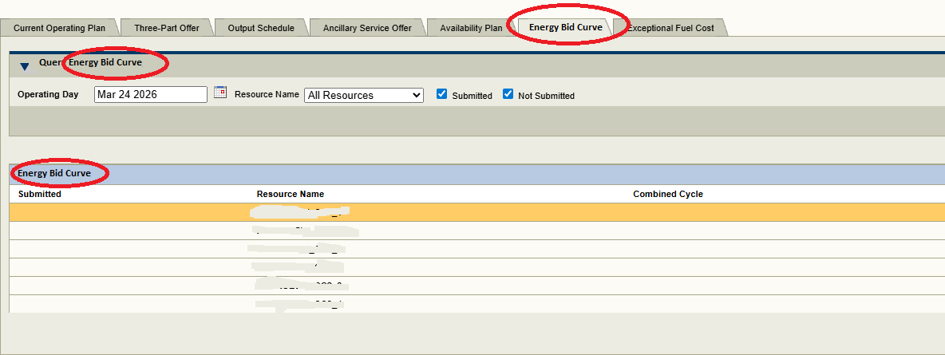
Market Manager (MMS UI) Changes

Slide 6
Report Changes
CDR
DAM Aggregate Credit Exposure
This will have XSD changes
Timelines for when the XSD changes will be made available to the market will be communicated in future TWG meetings.
Extracts and Disclosures
2-Day DAM Energy Curves
2-Day SCED Energy Curves
2-Day DAM Bids and Offers Reports
60-Day DAM Disclosure Reports
60-Day SCED Disclosure Reports

Slide 7
Questions/Comments?
Xiangjun.Xu@ercot.com

