Slide 1
ERCOT
Technology Working Group (TWG)
Weijun Ji
Sreenivas Badri
May 21, 2026
Outline:
Antitrust Admonition
Agenda
Sequence of discussion Items

Slide 2
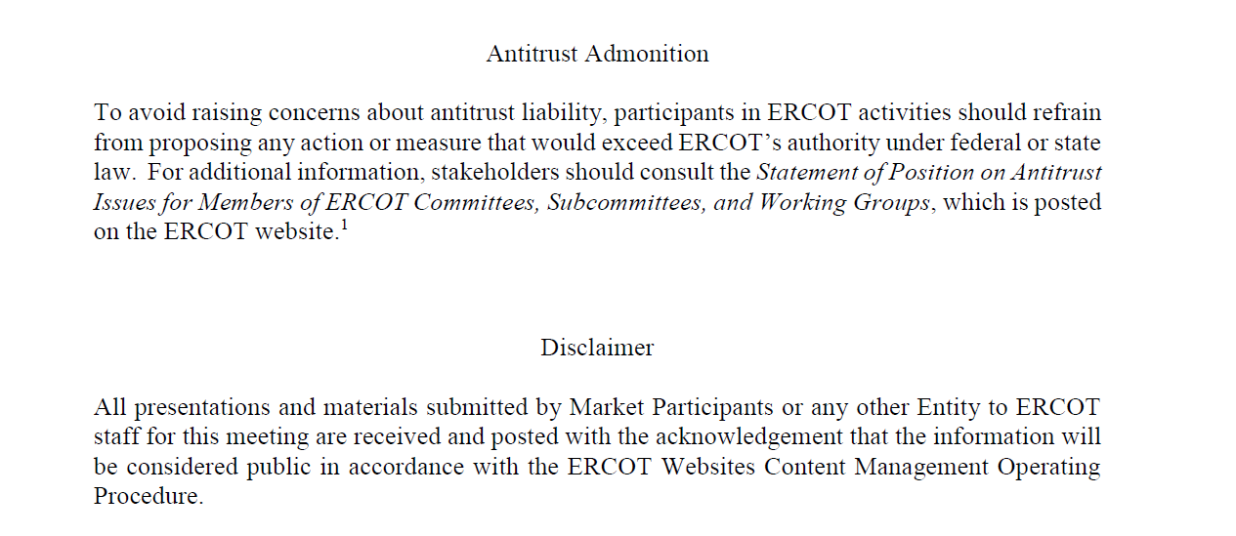
ERCOT TWG

Slide 3
Webex Meeting Reminders
Webex Meeting Reminders - Same as other ERCOT forums
Please keep line muted
If you have a question, please use the Webex chat feature to either:
Type in your question, or
Type in “Question” and wait to be recognized to state question
Your question will be addressed either during the presentation or at the end. If time does not permit, ERCOT SMEs will provide a response through Webex chat before the meeting concludes or respond to you via email after the meeting.
Presenters are requested to complete their presentation within allotted time and give time to participants to ask questions.
The meeting facilitator will provide time checks to remind presenters and participants of the remaining time for each agenda item.

Slide 4
Agenda
Item # | Item Description | Presenter | Start Time
1 | Antitrust admonition General updates | Weijun Ji | 2:00 PM
2 | NERC EMS WG updates | Sreenivas Badri | 2:05 PM
3 | Project updates | Troy Anderson | 2:10 PM
4 | 2026 May and June (R5 & R6) release changes Market Submissions Data and Information Products | Katherine Li/Jamie Lavas | 2:25 PM
5 | CIM16 Schema Upgrade Project - status update | Joel Koepke | 2:40 PM
6 | NDCRC Tech Refresh – MOTE Testing | Nick Barbas | 2:50 PM
7 | SCR820 – Real-Time Operator Communication (RTOC) Tool – Demo and Market Testing updates | Preethi Meher/Christelle Seri | 3:00 PM
8 | DPC Process Automation Tool – Demo and Market Testing updates | Yugendher Karedla | 3:15 PM
9 | Large Load Curtailment Manager (LLCM) project updates | Sruthi Hariharan/Luke Butler | 3:35 PM
10 | NPRR1188 project updates – system impacts overview | Vamsi Paruchuri | 3:45 PM
11 | Read-Only EMS in Cloud - status update | Sunil Mukkollu | 3:55 PM
12 | Round Table Discussion | Sreenivas Badri | 4:05 PM
13 | Adjourn | Sreenivas Badri | 4:15 PM

Slide 5
NERC EMS WG updates
  NERC EMS WG updates – Sreenivas Badri

Slide 6
Project Updates
  Project updates – Troy Anderson

Slide 7
2026 May and June (R5 & R6) Release changes
      Market Submissions – Katherine Li
      Data and Information Products – Jamie Lavas

Slide 8
CIM16 Schema Upgrade Project
  CIM16 Schema Upgrade Project - status update
  – Joel Koepke

Slide 9
NDCRC Tech Refresh Effort
      NDCRC Tech Refresh – MOTE Testing – Nick Barbas

Slide 10
SCR820 – Real-Time Operator Communications (RTOC) Tool
SCR820 – Real-Time Operator Communication Tool (RTOC) – Market Testing updates and Demo -
Preethi Meher/Christelle Seri

Slide 11
DPC Process Automation Project
DPC Process Automation Tool updates – Market Testing updates and Demo
-Yugendher Karedla

Slide 12
Large Load Curtailment Manager (LLCM)
Large Load Curtailment Manager (LLCM) Project updates -
Sruthi Hariharan/Luke Butler

Slide 13
NPRR1188 Project
        NPRR1188 Project - System Impacts Overview – Vamsi Paruchuri

Slide 14
Read-Only EMS in Cloud
Read-Only EMS in Cloud – status updates – Sunil Mukkollu

Slide 15
ERCOT TWG – Round Table Discussion
ERCOT TWG – Round Table Discussion
  Future Topics of Interest
  Topics and presentations from TWG members

Slide 16
Thank You
Questions/Comments/Feedback?
You can reach Sreenivas at
Sreenivas.Badri@ercot.com and Weijun at weijun.ji@lcra.org

