Slide 1
Large Load Curtailment Manager (LLCM)
Sruthi Hariharan/Luke Butler
May 21, 2026

Slide 2
Large Load Curtailment Manager (LLCM) - Overview
Background
Recently a few separate efforts have brought to fore policies (ex. SB6), operating limits and/or protocols (ex. NPRR1238) that require ERCOT to have the ability to instruct curtailment or interruption of certain Large Loads. In parallel to these market policy development efforts, ERCOT is preparing to build a Control Room facing tool named, Large Load Curtailment Manager, that will provide ERCOT Operators a single tool to identify conditions when curtailment is needed and instruct the responsible entities to take actions. A tool like this this will ensure operational efficiency and reliability, reduce the risk of human error, and enhance the overall stability of the power grid.
Timeline
Phase 1 – minimum viable product by June 2026
Full scope implementation - later in 2026
On-going effort
ERCOT to present and file Market Rules that codify the registration requirements for large loads and curtailment actions that ERCOT may undertake in context of SB6 in parallel to this effort.

Slide 3
Large Load Curtailment Manager (LLCM) – Summer 2026
Planned scope for Phase 1 MVP (Planned for Prod 2026-R6 release):
CIM model changes including telemetry modeling for Large Loads
Increased situational awareness based on forward-looking assessment of margin to identify when a Large Load curtailment under SB6 may be initiated
Large Load Curtailment Manager tool that can instruct selected Large Load (with MVP limited to those with net-metering arrangements that fall under SB6) via an XML instruction which includes information like deployment start time, deployment end time and deployed MW. (EIP External Interfaces Specifications document will be impacted, XSD should not be impacted)
Accounting of (SB6) Large Load that is instructed to curtail in SCED reliability deployment price adder.
Telemetry changes
Report changes
Market notification when large load curtailment instructions are issued/ended from LLCM.

Slide 4
ICCP Telemetry modeling
The Large Load Curtailment Manager (LLCM) tool is designed to consume MW and MVAR telemetry from Large loads as inputs for the curtailment logic.
The new ICCP object names for these points will follow the format described below:
MW: ACMQLL_STATION_LL1_MW
MVAR: ACMQLL_STATION_LL1_ MV

Slide 5
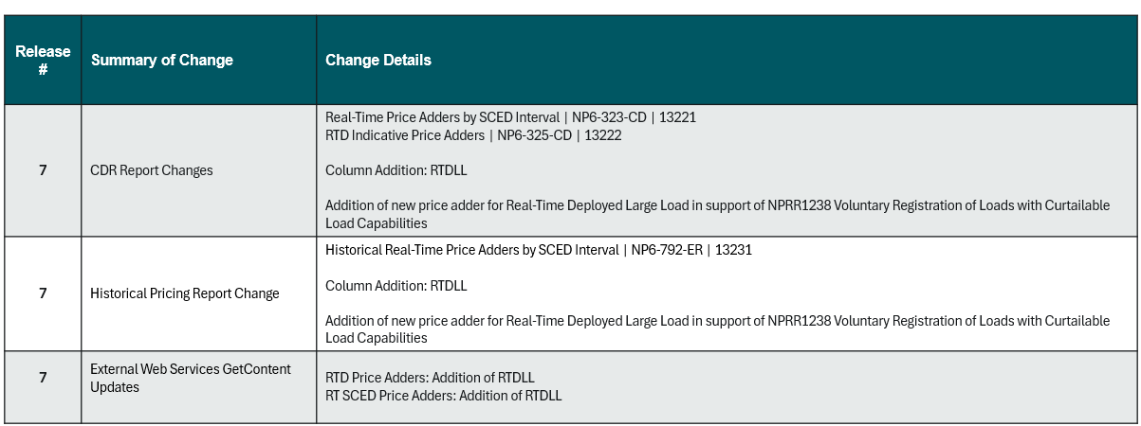
Market Report Changes
A new column will be added to the reports below to show the Real-Time Reliability Deployment Price Adders for LLCM:
Real-Time Price Adders by SCED Interval (EMIL ID: np6-323-cd)
Historical Real-Time Price Adders by SCED Interval (EMIL ID: np6-792-er)
This requires XSD changes, details below:

Slide 6
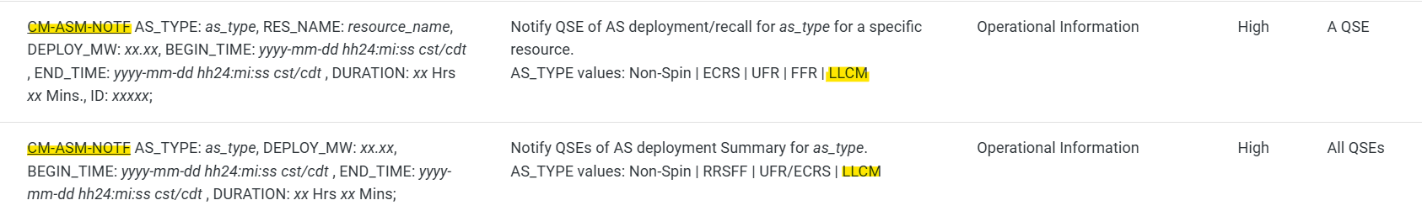
ERCOT External Web Services Changes
The CM-ASM-NOTF notification will have an additional AS_TYPE value of LLCM. Please note that this is not a EWS XSD change, it is only EIP External Interfaces Specifications document change.
This document changes can be viewed on the Developer Portal under MMS System Generated Notices: ERCOT Developer Portal
Reminder: EIP External Interfaces Specifications word document on ERCOT.com (https://www.ercot.com/services/mdt/userguides) will no longer be maintained and will be deleted in near future.

Slide 7
Questions?
You can reach following contacts for any questions and feedback
Sruthi Hariharan at Sruthi.Hariharan@ercot.com
or
Sreenivas Badri at Sreenivas.Badri@ercot.com

