Slide 1
Downstream Production Changes (DPC)- Process Automation
Yugendher Karedla / Yong Ma
May 21, 2026

Slide 2
Downstream Production Changes (DPC) – Process Automation - Updates
Objectives of Today’s Discussion
Refresher on DPC Automation concept
Implementation Timelines
DPC Submission forms UI- Demo
This effort provides new tool to Market Participants to facilitate DPC submission process for Temporary DPCs.

Slide 3
Downstream Production Changes (DPC)
Downstream Production Change (DPC) is a standard process that makes changes to the Network Model in production in between the weekly model loads without having to load a new model (database load).
This process is managed by the multiple teams at ERCOT (Network Modeling, GMS, Shift Engineers, Operations etc.).
DPC process helps update the network model in both Energy and Market Management systems (EMS and MMS) incorporating the changes submitted by the transmission operators that are critical to maintaining the reliability of the system.
The DPC process allows ERCOT to make specific data modifications in real-time including:
Static Line / Transformers Ratings
Dynamic Line Ratings
Line / Transformer Impedance
Contingency Definition updates
Enabling and Disabling of Contingencies
GTC updates
RAP and RAS changes
GTC and RAP/RAS definition updates related DPCs are submitted by ERCOT Operations team.

Slide 4
Downstream Production Changes (DPC)
DPC process is intended to make model changes in production between weekly model loads as necessary, not for model changes that can follow normal NOCMR timelines.
Current High level DPC Process
MP
(Submits Model changes for DPC)
NMMS
Review Model and Create DPC
Jira Process
1. Review and Approve by Operations team
2. Track DPC implementation in EMS/MMS systems across multiple models
EMS/MMS
DPC process demands significant collaboration efforts between several departments within ERCOT and market participants. It requires significant amount of manual effort to create, validate, track and implement DPCs in multiple environments across multiple weekly model loads.
The manual nature of DPC tasks often leads to inefficiencies, delays, and increased resource loading across several departments within ERCOT. This multifaceted process demands extensive time and resources to ensure accuracy and efficiency.

Slide 5
Summary of feedback received from TOs
TSP initiates new DPC submission
when an operational line or transformer ratings / Impedances that gets published from their engineering team, is different from ERCOT Model ratings / Impedances.
Based on rating comparisons done every month at TSP side & if they see discrepancy with ERCOT Model ratings.
Current DPC NOMCR submission process involves
Submitting DPC NOMCRs into ERCOT modeling system
Send out email to notify ERCOT network modeling group
Attach a DPC request form and reason for DPC with NOMCR
After DPC is processed into ERCOT system, update TSPs EMS model to reflect the change.
Current DPC CAMR submission process involves
For equipment outages / reclosures, submit a DPC CAMR to enable Manual contingencies within 3 business days of effective date.
If a new CTG is needed to reflect new configuration, attach an excel sheet with proposed CTG definition in CAMR.
Submit a separate DPC CAMR within 3 business days of configuration returning to Normal.
When active CTGs are found to be incorrect, CAMR DPC submitted to disable or edit incorrect CTGs.

Slide 6
Distinction between Permanent and Temporary DPC type updates
Permanent DPC types
DPC updates that will be done in Production , but they also will need to go into Network Model
These DPC updates will continue to be applied in Production for few more model loads, before they are included within NMMS CIM XML file.
All DPC types are eligible for Permanent DPCs.
Continue to follow the current process of submitting Permanent DPC NOMCRs into ERCOT modeling system.
Temporary DPC types
DPC updates that does not need to go into Network Model.
DPC updates that requests ERCOT control room to make a temporary update to model data due to a field outage / field work, that can last for up to 2 weeks.
Below are the 2 major Temporary DPC types that ERCOT receives from MPs
Static Line / Transformers Ratings
Enabling and Disabling of Contingencies
New DPC UI Tool is developed to provide ability for MPs to quickly submit temporary DPCs, with effective dates to ERCOT production system.
A new DPC Dashboard will be developed that provides full list of DPCs (both permanent and temporary DPCs) with their status (planned / Implemented) with a historian for past DPCs implemented.

Slide 7
New DPC Tool – High Level Implementation Details
New displays and dash boards will be added in current Outage Scheduler UI (OS UI) to allow Market Participants to submit Temporary DPCs with start and end times.
Currently QSEs with resources and TOs have the access to OS UI through ERCOT MIS website
A new role will be created to TOs to access these displays using OS UI.
ERCOT Operations will review and approve Temporary DPCs.
Upon approval, Temporary DPCs get implemented in ERCOT real-time systems (EMS/MMS) automatically and provides status back to DPC tool.
Thereafter, DPCs get implemented automatically in EMS/MMS systems during every week model load until end time of DPCs.
This new DPC tool will provide visibility to Market Participants on DPC implementation status in ERCOT EMS/MMS systems. Dashboards will be developed to meet this requirement along with ability to sorting and filtering capabilities

Slide 8
New DPC Tool – High Level Implementation Details
If a Temporary DPC submitted through DPC UI, is not yet implemented, TOs will have an option to Withdraw the DPC from their DPC Dashboard, using “Withdraw” status option.
Once a Temporary DPC is approved at ERCOT and is Implemented in EMS / MMS Applications, TOs will not be able to “Withdraw” their submitted DPC. If this scenario arises, TOs can submit another new Temporary DPC to revert the implemented DPC TOs have to update the planned end date which eventually would close the DPC by reverting the updates with aligning to the model.
ERCOT is pursuing an option to provide ability for TOs to associate Temporary DPC to an Outage. This will be an optional attribute (not mandatory), which allows more visibility to ERCOT, as we see several instances of Contingency status update DPCs tied to an Outage condition.
TOs DPC dashboard will continue to show status updates on the submitted DPCs (both Permanent and Temporary DPCs), as ERCOT goes through DPC implementation and confirmation steps.

Slide 9
New DPC Tool – High Level Implementation Details
DPC Tool support following DPC Types
Update Static Line / Transformers Ratings
Enabling and Disabling of Contingencies
DPC Tool Data Flows:
NMMS Mage (Network Model)
Permanent DPCs
DPC
Importer
OS UI
MPs
DPC Tool
ERCOT Review & Approval (DPC Dashboard)
EMS/MMS
Temporary DPCs
MPs DPC dashboard (All DPCs)

Slide 10
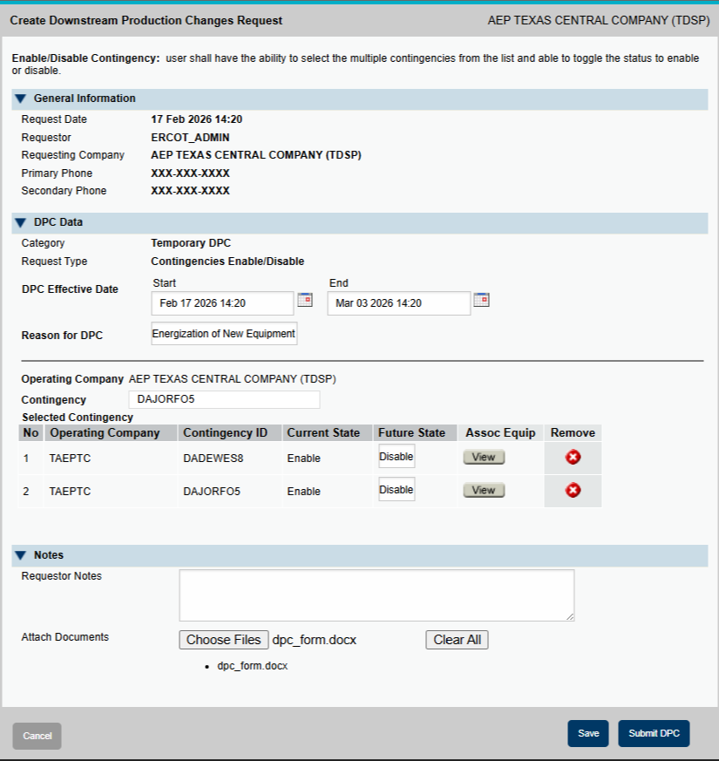
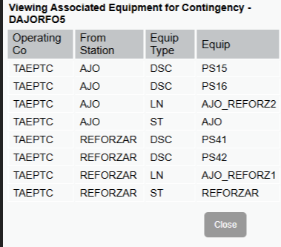
Submitting Temporary DPCs – Contingency Status Changes
For Contingency Status Change DPCs this includes:
Planned start/end, nature of work, operating company
Notes, attachments
Individual contingencies and future state
Associated equipment for each contingency can also be viewed
On submit, a summary of the changes will be presented along with a prompt to confirm

Slide 11
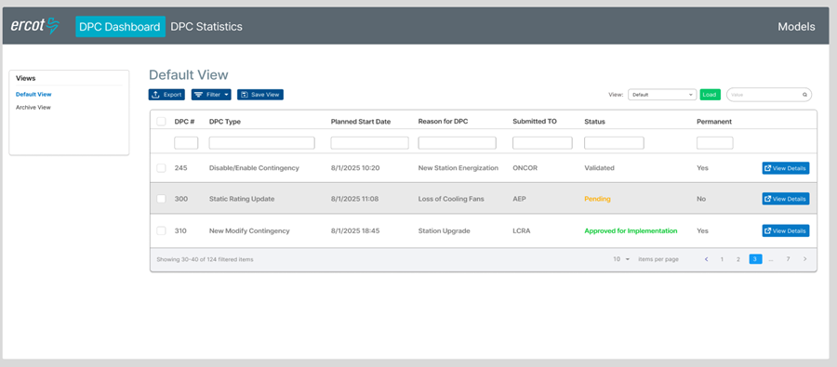
DPC Dashboard- Default View
Displays DPCs pending approval or implementation with general info and link to view full details
Users can apply filters and personalize the view then save and reload it
Other views include the Archive (completed or rejected DPCs).

Slide 12
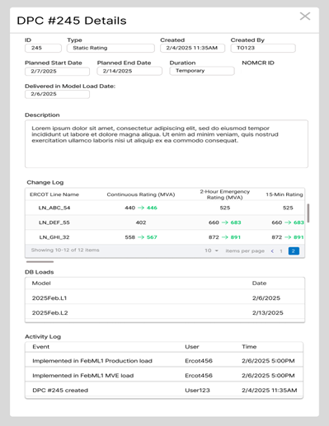
DPC Details Popup
A DPC’s details can be viewed in the DPC Details popup
This includes:
General Information: description, type, creation date, duration, etc.
Change Log: the list of all changes applied in this DPC
DB Loads: the DB Loads the DPC is applied in
Activity Log: key dates and events relating to the DPC (created on, implemented on, etc.)

Slide 13
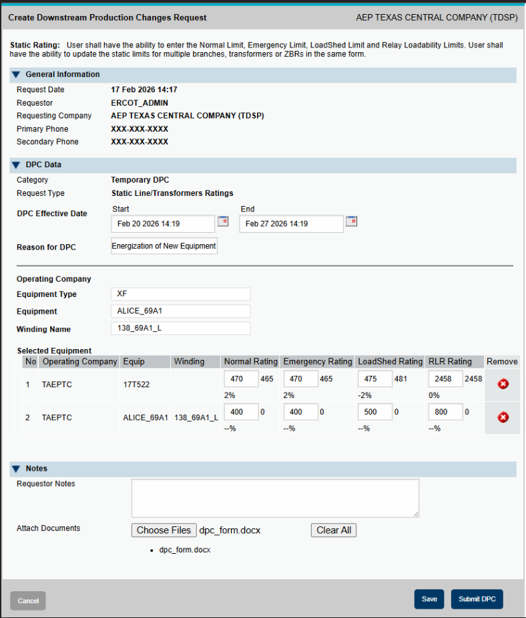
Submitting Temporary DPCs- Static Rating
Static Rating update DPCs form includes:
Planned start/end, nature of work, operating company
Notes, attachments
Can review each specific device ratings and update.
On submit, a summary of the changes will be presented along with a prompt to confirm
Note – If a line/XF is dynamically rated, those lines/XFs will be automatically excluded from the drop down list for temporary DPCs, as this UI is only for Static rating updates.

Slide 14
Handling Schedule Changes for Temporary DPCs
Withdrawal Option
TOs can withdraw a DPC while it is “Submitted” Status , but NOT after it gets to “Approved for Implementation” status.
Use case for Withdraw option is when TOs like to edit effective start/end dates or content of DPC, before it is approved for implementation at ERCOT. If Withdraw option is available, new DPC is not needed to make these modifications.
Effective End Date Modification- Applicable to implemented DPC.
On Implemented status, TOs can modify the effective end date:
Modify Effective end date to earlier date: Ends the DPC sooner.
Modify Effective end date to later date: Extends the DPC duration.
Note- effective end date needs to be greater than current date/time and cannot be 30 days from date of submission for Temporary DPCs.
No conflicting/duplicate DPCs for same elements:
After DPC is implemented in production (Implemented Status, not Closed Status), if TOs want to change the DPC again, then a new DPC needs to be submitted for the same equipment. So, the procedure is to update the effective end date to current date/time and ensure the current DPC is in Closed Status (from DPC Dashboard). After DPC associated with a specific equipment is closed, TOs can submit a new DPC for same equipment with new start/end times.
Closed Status
Once the effective end date is reached, the DPC automatically transitions to Closed status.
Transition to Closed status - It would trigger EMS/Market applications to revert back to Model value/state in production.
After DPC transitions to closed status, no further changes are allowed, and it will be archived for historical reference.

Slide 15
Implementation Timelines - Updates
Development and Testing Timelines
12/09/2025 - Project got into Execution phase and Design Completed.
DPC Tool changes Development and Testing – Q1 and Q2 of 2026 – In Progress
TOs Testing starts from 11th May – using MOTE.- In Progress
https://www.ercot.com/services/comm/mkt_notices/M-A051126-01
Tentative Go Live – July Sep 2026
Next Steps.
Provide periodic updates on implementation progress through TWG.
TOs Testing
Fix defects/implement small enhancements based on TOs testing – Next Patch 05/28/2026.
(Ability to Withdraw, update end date and usability improvement/defects reported by TOs)

Slide 16
DPC Automation Tool - Demo
Demo by Yong and Yugendher

Slide 17
Questions/Comments?
ercotdpcsupport@ercot.com

