Slide 1
Modeling Upgrade to CIM16: Application and Data Products
Joel Koepke
May 2026

Slide 2
Overview – Upgrading from CIM10 to CIM16
ERCOT produces Network Models following CIM standards and in an XML format
Since 2010, the Network Model Management System (NMMS) has produced models using the CIM10 schema (with customizations)
In 2021, a process was developed to translate CIM10 models into CIM16 allowing for downstream systems to upgrade their importers
ERCOT has begun a project to enhance NMMS to natively produce CIM16 model files
Reduces the need for ERCOT-specific legacy code in vendor applications
Officially started execution in August 2024
Project completion is scheduled for Q1/Q2 2027
ERCOT will no longer produce CIM10 models after project completion

Slide 3
CIM-Related Inputs/Outputs of NMMS

Slide 4
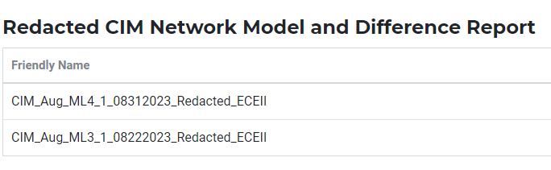
Who/What is Affected?
Any processes utilizing files directly created from NMMS will need to prepare for an updated schema
Files include:
MIS Secure:
Redacted CIM Network Model - EMIL ID: NP3-450-SG
MIS Certified:
TSP Version of the CIM Network Model XMLs (via Citrix)
Incremental CIM Change Requests XMLs (via Citrix/NMMS)

Slide 5
Status Update and Key Events
Now:
Refining CIM10→CIM16 migration script
Regression testing of updated modeling application
Includes code to support SCR813 “NMMS Jointly-Rated Equipment Coordination Confirmation”
Brings additional awareness to model submissions that affect jointly-rated equipment
Updating internal tools and reports
Q3:
Release additional CIM16 test models with additional schema changes
Q4:
Transition NMMS MOTE system to CIM16
Provide TSP training on new system

Slide 6
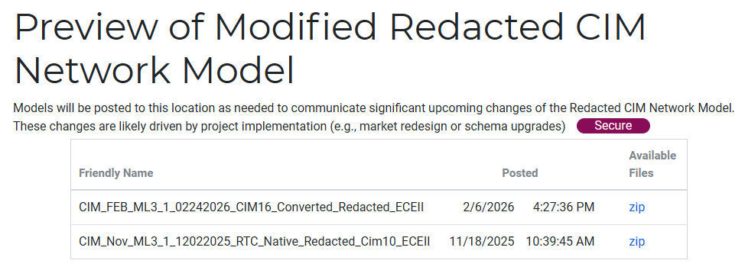
ERCOT CIM16 Project – Test Models
“Representative” previews of CIM16 models are posted ~quarterly to the MIS
“Preview of Modified Redacted CIM Network Model” EMIL NP3-451-SG
Created by converting a CIM10 XML file to a CIM16 XML file
The final CIM16 schema will differ from the representative models
“Native” CIM16 models will be provided in Q3/Q4 2026
To be created with CIM16 modeling application using migrated database
Schema refinements will be incorporated in the file, but additional changes may still be needed prior to go-live
A more precise delivery date will be reported post June testing

