Slide 1
ERCOT Frequency Events
April 2026
ERCOT
Operations Planning
PDCWG Meeting
May 20, 2026

Slide 2
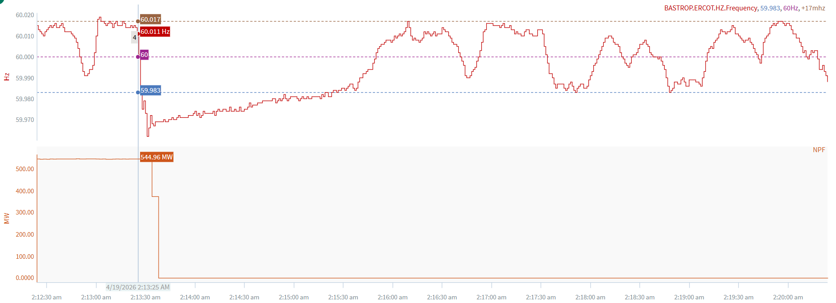
4/19/2026 2:13:25 (Non-FME)
Notes:
The unit tripped for ~543 MW while tripping in steps
Starting Frequency: 60.011 Hz
Minimum Frequency: 59.962 Hz
A-C Time : 6 seconds
Recovery Time(back to deadband): 1 minutes 58 seconds
ECRS Released: 0 MW
Trip Reason: Possible relay issue.
Contextual Information: A total of 281 MW of regulation Up was deployed during the event.
Reason for no selection: C point is 59.962 and trip was not clean

Slide 3
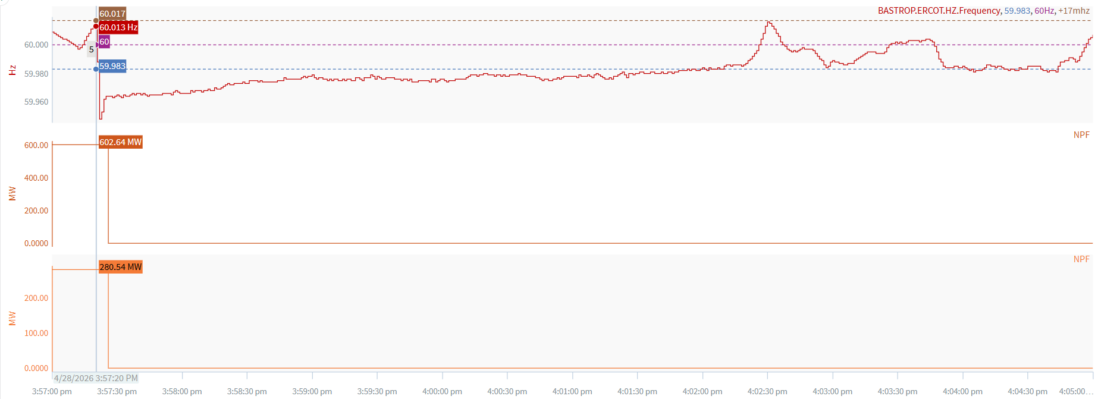
4/28/2026 15:57:20 (Non-FME)
Notes:
Two combine cycles tripped for a total of ~882 MW
Starting Frequency: 60.012 Hz
Minimum Frequency: 59.947 Hz
A-C Time : 2 seconds
Recovery Time(back to deadband): 4 minutes 40 seconds
ECRS Released: 0 MW
Trip Reason: Unknown at this time
Contextual Information: A total of 363 MW of regulation Up was deployed during the event.
Reason for no selection: C point is 59.947

Slide 4
Questions/Comments?

