Slide 1
Batch Zero Readiness Meeting #1
May 15, 2026

Slide 2
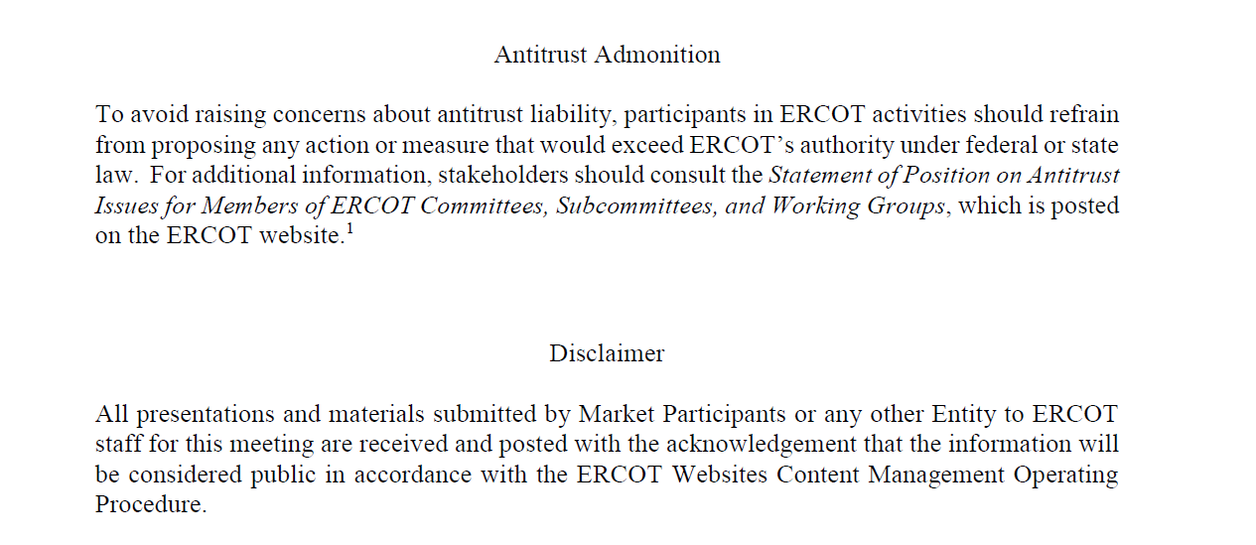

Slide 3
Agenda
  Communications framework
  LLIS Process, Timelines, and Key Dates for Batch Zero
  Dynamic model information for Batch Zero
  Wrap-up and Time for Q&A

Slide 4
Batch Zero Communication

Slide 5
Batch Zero Readiness Discussions
    Friday May 15 (2-3pm): Batch Readiness Workshop #1 WebEx only
Draft topics (60 minutes):
  Key Submission Dates for Batch Zero
  Dynamic model information for Batch Zero
  Q&A
    Thursday May 21 (approx. 10:30-11:30am) LLWG Meeting
Draft topics (90 minutes):
      Key Submission Dates for Batch Zero
      Initial discussion of Forms/Attestations for Batch Zero
      (also discussion of Batch 1+ Initial Concepts and Longer-term Planning)
    Thursday May 28 (1-3pm): Batch Readiness Workshop #2 WebEx only
Draft topics for 2 hours:
  Key Submission Dates
  Discussion of Forms/Attestations
  Q&A
Also:
ERCOT is currently sending weekly emails to TSPs by end of day Tuesday on current LLIS Batch Zero status (final LLIS status is subject to PUCT approval of PGRR145 requirements)
ERCOT will be developing an FAQ to assist with implementation questions

Slide 6
LLIS Process, Timelines, and Key Dates for Batch Zero

Slide 7
Key Deadlines for Batch Zero
July 10
Last day for ERCOT to review and approve LLIS studies
July 24
Deadline for required information for inclusion in Batch Zero to be submitted to ERCOT
August 7
Deadline for ERCOT to notify TSPs and DSPs of Large Load inclusion and classification in Batch Zero
As drafted in PGRR145, the current Large Load Interconnection Study (LLIS) process established by PGRR115 will cease operation after July 10, 2026
This means July 10 is the last day ERCOT is able to review and approve individual LLIS studies
Starting on July 11, the Batch Zero Interconnection Study established by PGRR145 will be the only path to connect a Large Load to the ERCOT system
The inclusion and treatment of Large Loads in Batch Zero will be determined by the status of qualifying studies as they stand at the end of the day on July 10, 2026

Slide 8
Review of PGRR115 Process Timelines – Kick-off and Study Scoping
Per Section 9.3.2 of the current Planning Guide, all LLIS studies must be preceded by a kick-off meeting and defined study scope agreed on by ERCOT, the lead TSP, and any affected TSPs. This meeting is required under the Planning Guide and cannot be waived.
The lead TSP is responsible for scheduling the kick-off meeting. ERCOT does not control when a meeting is scheduled.
ERCOT will continue to attend kick-off meetings and to support the study scoping process through July 10.
As described in the Planning Guide, it can take up to 35 Business Days to finalize a study scope after a kick-off meeting is held.
Key Takeaways
The existing kick-off and scoping process remains in effect.
ERCOT continues to attend kick-off meetings and review study scopes.
However, it may not be possible to scope a LLIS study with a kick-off meeting held after May 21, 2026.

Slide 9
Review of PGRR115 Process Timelines – Study Reviews and Approvals
Per Section 9.4 of the current Planning Guide, all LLIS studies must be submitted to ERCOT for review and approval.
ERCOT will continue to review studies under this process through July 10.
As described in the Planning Guide, it can take up to 30 Business Days for ERCOT to review a submitted study.
ERCOT review is not guaranteed to result in an approval. Any required updates to a submitted study are treated as a new submission, which restarts the timeline for review.
ERCOT does not have visibility into the amount of time needed by TSPs to perform a LLIS study. Please reach out to your lead TSP with questions about the status of a study that has not yet been submitted to ERCOT for review.
Key Takeaways
The existing study review process remains in effect through July 10.
ERCOT continues to review submitted study reports as quickly as possible once submitted.
ERCOT cannot guarantee a new or updated study report submitted after May 28, 2026 will be reviewed by July 10.

Slide 10
Summary of Key Dates
July 10
Last day for ERCOT to review submitted studies under the current LLIS Process
August 7
ERCOT notifies TSPs/DSPs of Batch Zero classifications
May 15
(today)
LLIS study reviews continue
May
June
July
August
May 28
Last day a study submitted to ERCOT is guaranteed a review by July 10
July 24
Batch Zero information for qualifying loads due to ERCOT

Slide 11
Additional notes on base loads in Batch Zero
The design of PGRR145 is intended to allow for loads that qualify as base load in Batch Zero to continue moving toward energization prior to Batch Zero or while Batch Zero is in progress.
For example, base loads are still able to qualify for the quarterly stability assessment (QSA) appropriate for their planned Initial Energization date while Batch Zero is in progress. They are also eligible to be added to the ERCOT Network Operations Model during that time.

Slide 12
Questions on Key Dates topic?

Slide 13
Dynamic Models For Batch Zero

Slide 14
Dynamic Models for the Batch Zero – Key Deadlines
July 10, 2026
July 10, 2026
LL projects not submitting models and required information by this deadline will be excluded from Batch Zero.
ILLE Model Submission Deadline
ILLE Must Submit to ERCOT and the Interconnecting TSP by July 10⁽¹⁾:
August 7, 2026
Dynamic models
Model parameters
Supporting technical documentation
Completed ERCOT Dynamic Working Group Large Load Data Survey⁽²⁾
ERCOT will notify ILLE of any identified deficiencies in submitted models or required information.
August 31, 2026
Any LL projects with incomplete data or unresolved model issues remaining after this date will also be excluded from Batch Zero.
(1). LargeLoadInterconnection@ercot.com
(2). https://www.ercot.com/files/docs/2025/12/19/ERCOT-Dynamics-Working-Group-Large-Load-Data-Survey_v2.docx

Slide 15
Dynamic Models for the Batch Zero – Key Deadlines
July 24, 2026
TSP Determination Deadline
TSP Must Submit to ERCOT by July 24 (if applicable) ⁽¹⁾:
If a dynamic stability study has previously been performed for a Large Load, the interconnecting TSP must submit a written determination indicating whether the submitted dynamic data is expected to adversely impact prior stability study results.
(1). LargeLoadInterconnection@ercot.com

Slide 16
Large Load Dynamic Model Submission Elements
Model Compatibility
Data Survey Completion
All submissions must be compatible with the planning and operations model software version specified in the Dynamic Working Group Procedure Manual in effect on March 4, 2026.
All model submissions must include completion of the latest ERCOT Dynamic Working Group Large Load Data Survey⁽¹⁾.
Updated / Improved Models
ERCOT Defaults
ILLEs are expected to submit updated or improved models that properly represent load behavior — especially where enhanced models are available.
For operational loads not providing dynamic models or updating models, ERCOT will use the available models previously provided or assume minimum ride-through capability where no model is provided.
(1). https://www.ercot.com/files/docs/2025/12/19/ERCOT-Dynamics-Working-Group-Large-Load-Data-Survey_v2.docx

Slide 17
Applicability for Batch-0 Dynamic Model Submission
PGRR 145 Section | Criteria | Submission Required
9.2.1.1(1)(a) | Energized before March 25, 2022 | No⁽¹⁾
9.2.1.1(1)(b) | Energized between March 25, 2022, and July 10, 2026 | No⁽¹⁾
9.2.1.1(1)(c) | Qualified for QSA or included in interim VRT by May 1, 2026 | No⁽¹⁾
9.2.1.1(1)(d) | Included in the 2024 Permian Basin Reliability Plan Study and contributed to transmission needs | Yes⁽¹⁾⁽²⁾
9.2.1.1(1)(e) | Not energized as of July 10, 2026, and meets specified requirements | Yes
9.2.1.1(1)(f) | Not energized as of July 10, 2026, and meets specified requirements | Yes
9.2.1.1(1)(g) | Not energized as of July 10, 2026, and meets specified requirements | Yes
9.2.1.2(1) | Meets criteria (a)-(d) and subject to reliability assessment and allocation | Yes
(1). If an updated model if available, the ILLE should supply a version that more accurately represents the LL.
(2). No submission is needed if meeting criteria in 9.2.1.1(1)(a)-(c).

Slide 18
Model Review
Voltage Ride-Through (VRT) Testing
ERCOT will perform VRT testing for applicable Large Computational Loads (LCLs) subject to NOGRR282.
If a model does NOT meet NOGRR282 requirements:
ERCOT will notify the interconnecting TSP and ILLE
The load remains in Batch Zero with no impact to allocation
The ILLE should coordinate with the TSP to update the model before the completion of Batch Zero

Slide 19
Questions on Dynamic Models topic?

Slide 20
Wrap-Up and General Questions
Next Readiness Update is part of LLWG followed by longer/dedicated meeting Thursday May 28
      Thursday May 21 (approx. 10:30-11:30am) LLWG Meeting
  Draft topics (60-90 minutes):
        Key Submission Dates for Batch Zero
        Initial discussion of Forms/Attestations for Batch Zero
        (also discussion of Batch 1+ Initial Concepts and Longer-term Planning)
      Thursday May 28 (1-3pm): Batch Readiness Workshop #2 WebEx only
  Draft topics for 2 hours:
    Key Submission Dates for Batch Zero
    Discussion of Forms/Attestations
    Q&A
  General questions can be sent to ClientServices@ercot.com
  Specific LLIS questions to LargeLoadInterconnection@ercot.com (LLIS status question should be directed to TSP which receive weekly updates from ERCOT)
  Time now for any Questions……

