Slide 1
CRR Updates
CMWG
Samantha Findley
ERCOT CRR Market Operations
May 18, 2026
Outline:
  LTAS transactions and solution times
  CRR auction limits table – no changes

Slide 2
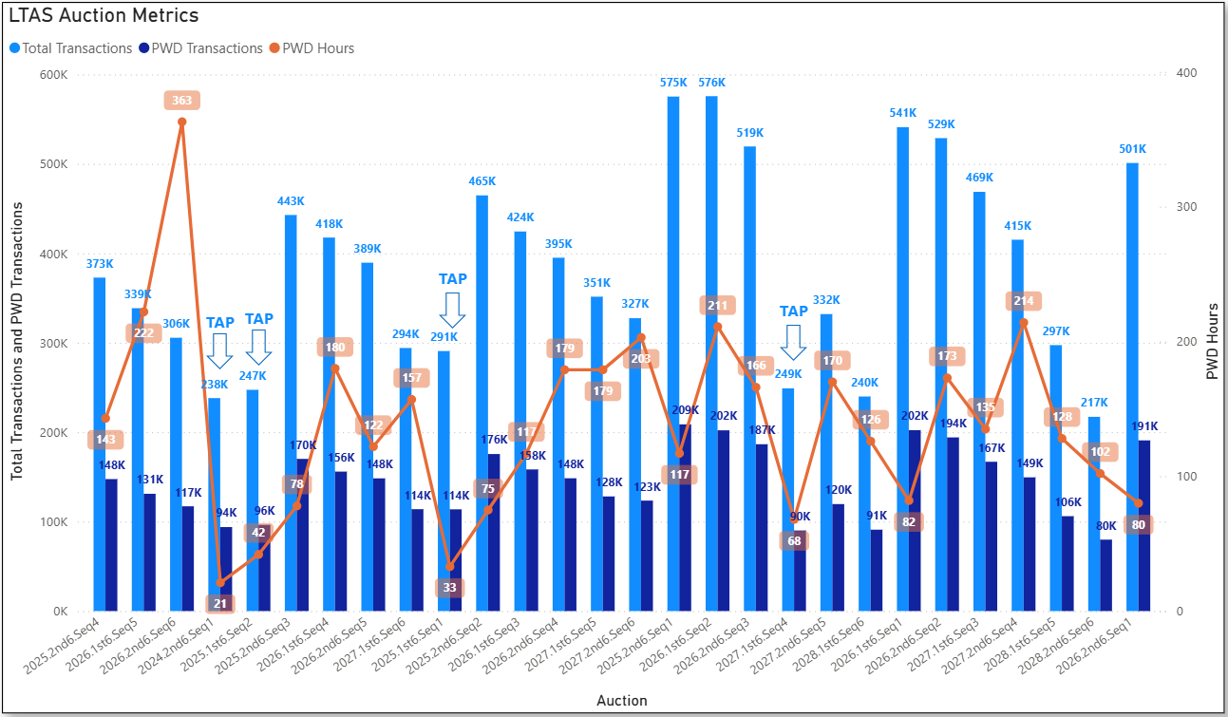
Historical LTAS transactions and solution times

Slide 3
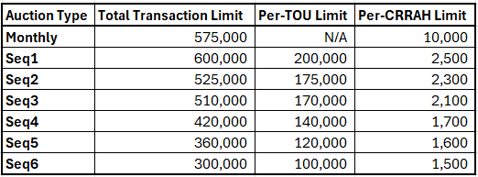
CRR auction transaction limits – no changes

Slide 4
Questions/Comments?
ercotcrr@ercot.com

