Slide 1
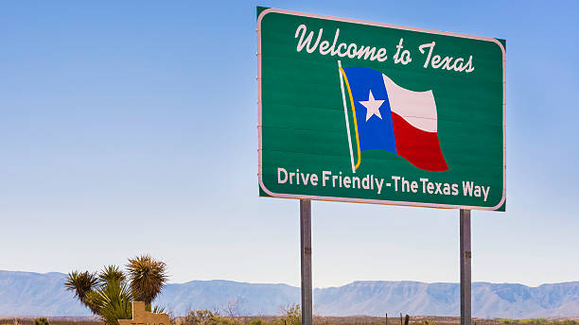
TEXAS SET/LP UPDATE
Retail Market Subcommittee
May 12, 2026

Slide 2

UPDATE
ERCOT Updates:
  Annual Validation Business Update
  Flight
TMTP
  ERCOT updated that NPRR was being drafted
LPGRR
  Finish Revisions/Updates - May 18
  Leadership send draft to ERCOT – May 22-29
  RMS – June 25

Slide 3
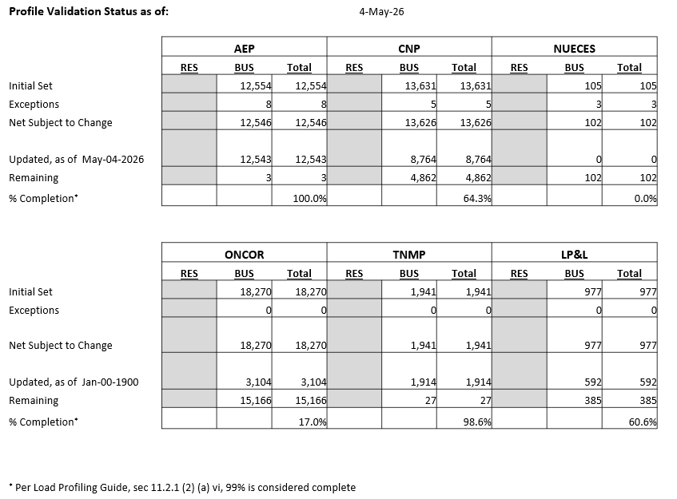
BUSINESS Annual Validation UPDATE
  TDSPs are progressing in submitting their BUS profile changes to ERCOT
  AV is due Sept 30th

Slide 4

Flightrak Workshop
REQUEST: TEXAS SET/LP is requesting a workshop/forum with ERCOT to discuss FlighTrak
REASON: TEXAS SET/LP wants to be clear about what works and does not work well with the FlighTrak tool and wants to provide/suggest requirements to ERCOT in advance of any replacement being selected
Discuss Timeline

Slide 5
NEXT MEETING
May 18
1pm
WebEx Only

