Slide 1
RMTTF
Tomas Fernandez NRG
Debbie McKeever ONCOR
Melinda Earnest AEP Texas

Slide 2
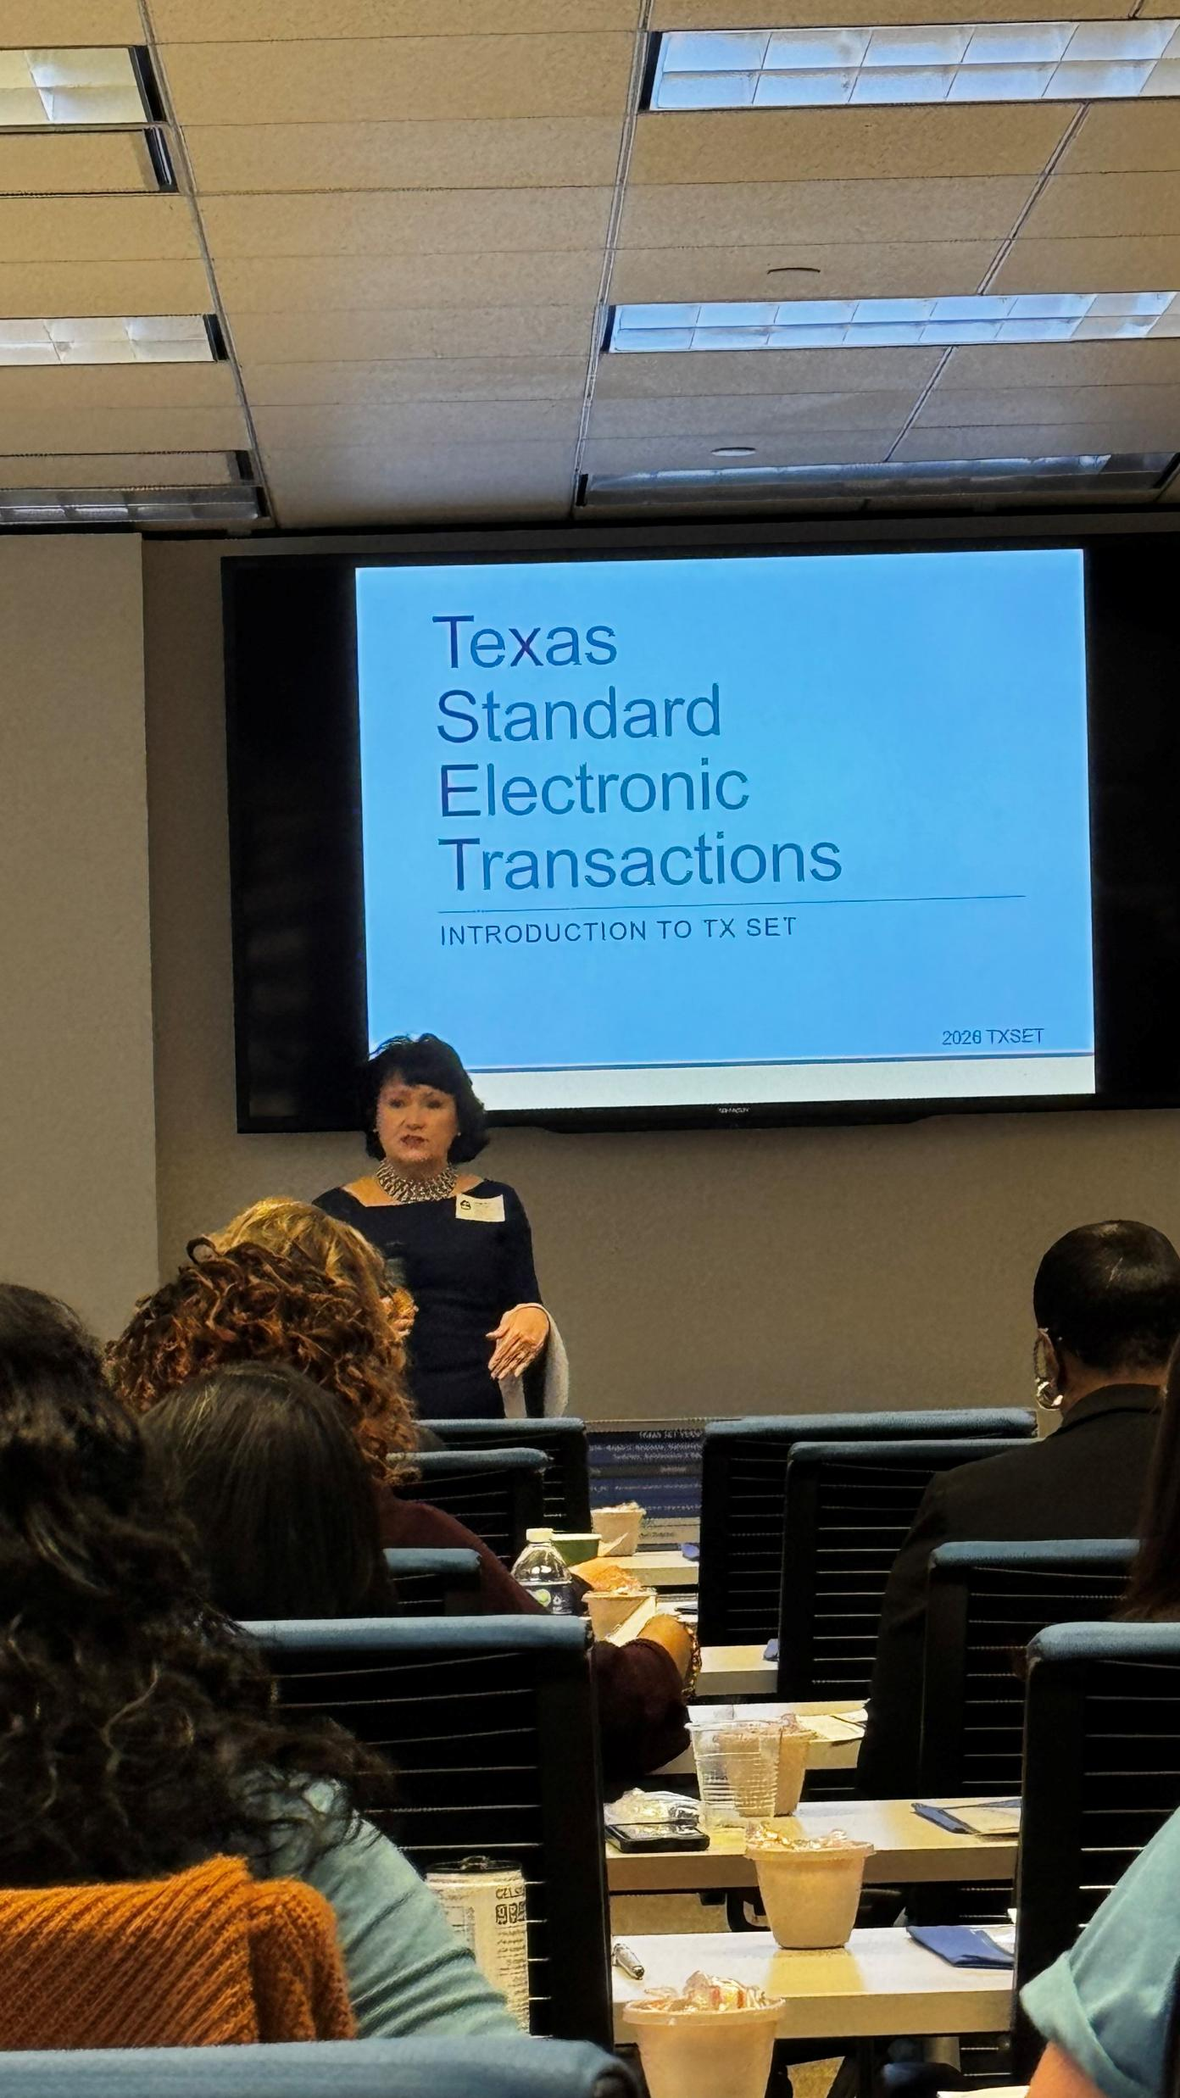
Training Survey Feedback
MarkeTrak Part 1 and Part 2 - WebEx
The presenters seemed very knowledgeable and passionate about the content. The checkpoint questions were excellent addition to verify understanding of the content.
Explain things I was not aware of
Providing ideal and pertinent information throughout the presentation
Good explanations and tips.
TxSet 5.0 – Centerpoint/ Houston
Presented an astonishing amount of info in an engaging and effective manner.
Everything, very passionate when teaching and providing excellent with helping us engage and get into the learning mode. Great hosts and food thank you.
Explanation was so informative and training material is also very comprehensive.
Provided great materials to show flows of transactions. I appreciated the group engagement aswell.

Slide 3
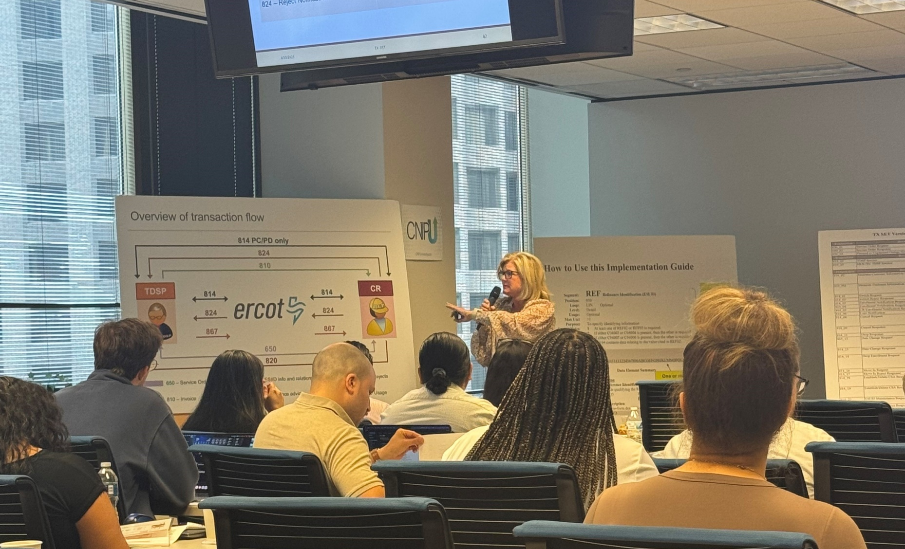
Upcoming Retail Training Opportunities
MarkeTrak Training – 2 Parts
MarkeTrak Part 1-Overview
Wednesday, June 3rd – WebEx only
8:30 AM to 12:30 PM
Open for registration on ERCOT.com
MarkeTrak - Part 1
MarkeTrak Part 2-Switch Holds and IAG
Thursday, June 4th – WebEx only
8:30 AM to 12:30 PM
Open for registration on ERCOT.com
MarkeTrak/IAG - Part 2
TX SET 5.0 Training
Thursday, June 11th – WebEx only
Open for registration on ERCOT.com
Texas SET Standard Electronic Transactions

Slide 4

On-Demand ERCOT Retail Training Modules Available 24/7
MarkeTrak Online Training Modules -
MarkeTraks Overview
Switch Hold Removal
Cancel With/Without Approvals
Inadvertent Gains/Losses & Rescissions
Usage and Billing
Other D2D Subtypes
Bulk Insert
MarkeTrak Admin Functionality
Data Extract Variances (DEV) LSE Subtypes
Data Extract Variances (DEV) Non-LSE Subtypes
Emails and Notifications
Reporting – Background & GUI
Additional Retail Online Training Modules
Retail 101
TXSET
Mass Transition

Slide 5
Upcoming RMTTF Meeting
Wednesday, June 3rd 1:30 PM
WebEx and In-person
Oncor
1616 Woodall Rogers Fwy
Dallas, TX 75202
If you are planning to attend in person, please email Debbie McKeever deborah.mckeever@Oncor.com
If you have questions or suggestions for training, please contact one of the RMTTF co-chairs listed below. Tomas Fernandez, NRG tomas.fernandez@nrg.com Melinda Earnest, AEP mdearnest@aep.com Debbie McKeever, Oncor deborah.mckeever@Oncor.com Thank you!

