Slide 1
PDCWG Report to ROS
Chair: Open
Vice Chair: ERCOT
ROS
May 7th, 2026

Slide 2
Report Overview & Notes
Report Overview
  Meeting Minutes
    Annual Inertia Presentation
    Frequency Control & Regulation Reports
    Texas RE Report
    Analysis of Disturbances
  BAL-001-TRE-2 FMEs and IMFR
    No FMEs in March
  Frequency Control Report

Slide 3
Annual inertia analysis

Slide 4
Annual Inertia Analysis
Key Take Aways
  Lowest system inertia in 2025 was 118.3 GW*s on March 18th 12:00 PM, there was 298 MW FFR available.
  Overall Increase in IRR Penetration in the Spring and Summer months.
  Our lowest hours of inertia have moved from the night hours to the middle of the day due to high growth in solar generation.
  In 2025 and 2026, we are statistically carrying more FFR during the day hours compared to recent years and due to the influence of FFR on Critical Inertia, the resulting Critical Inertia levels are lower during the day hours.
  Our new minimum system inertia of 114.7 GW*s happened March 14th 2026 12:00 PM, there was 430 MW FFR available.

Slide 5
Frequency Measurable Events Performance

Slide 6
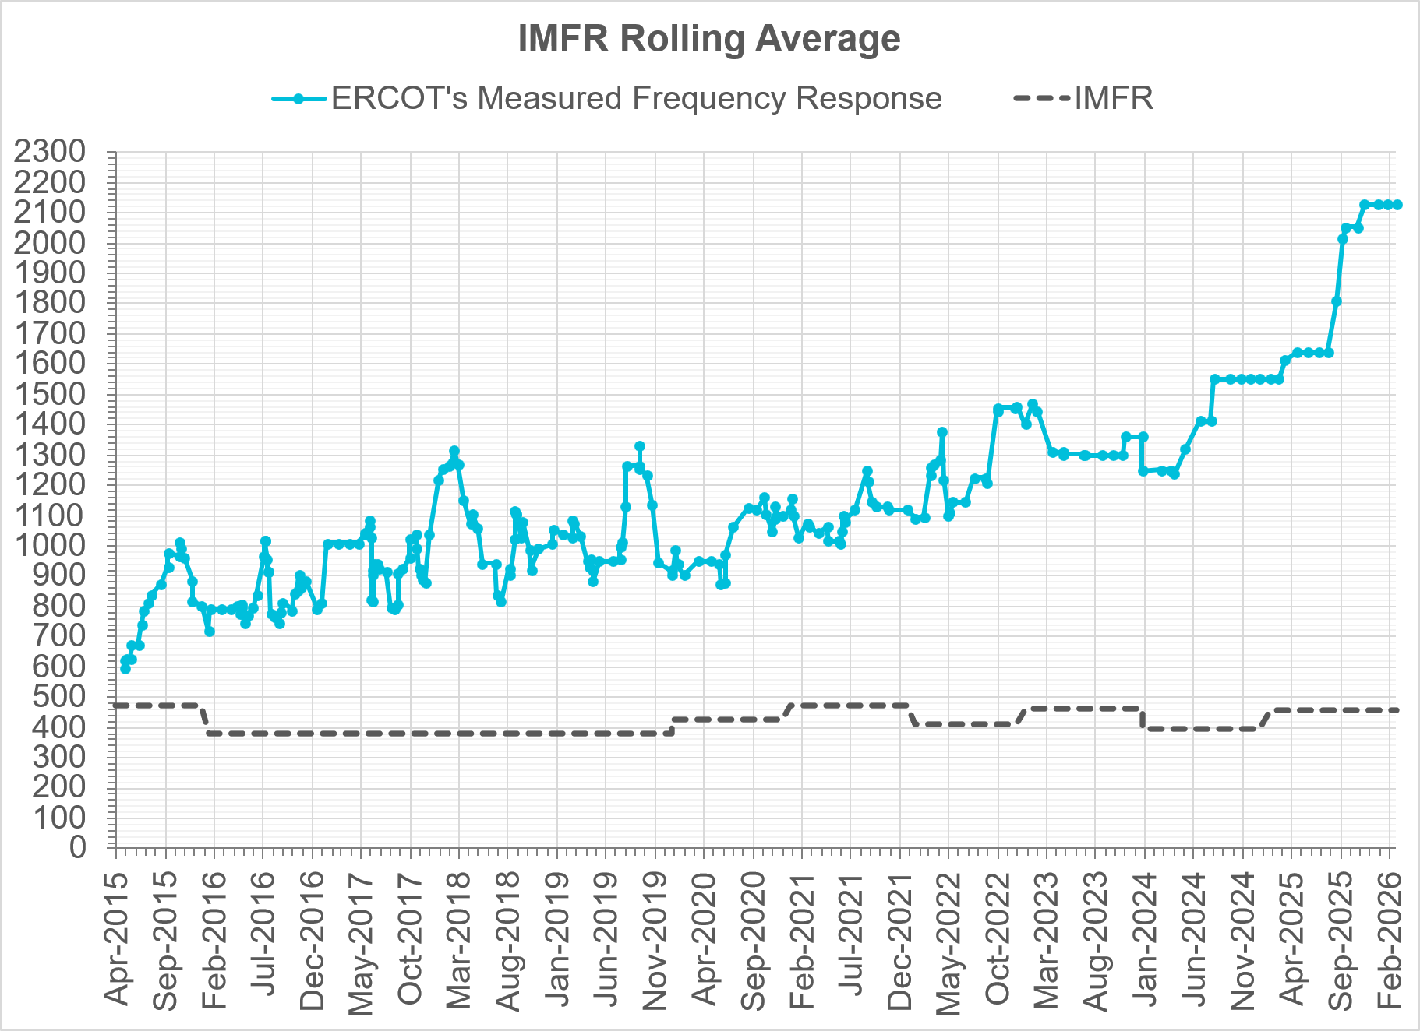
Interconnection Minimum Frequency Response (IMFR) Performance
IMFR Performance currently
2127.33 MW/0.1HZ
Frequency Response Obligation (FRO): 455 MW/0.1 Hz

Slide 7
Frequency Control Report
March 2026

Slide 8
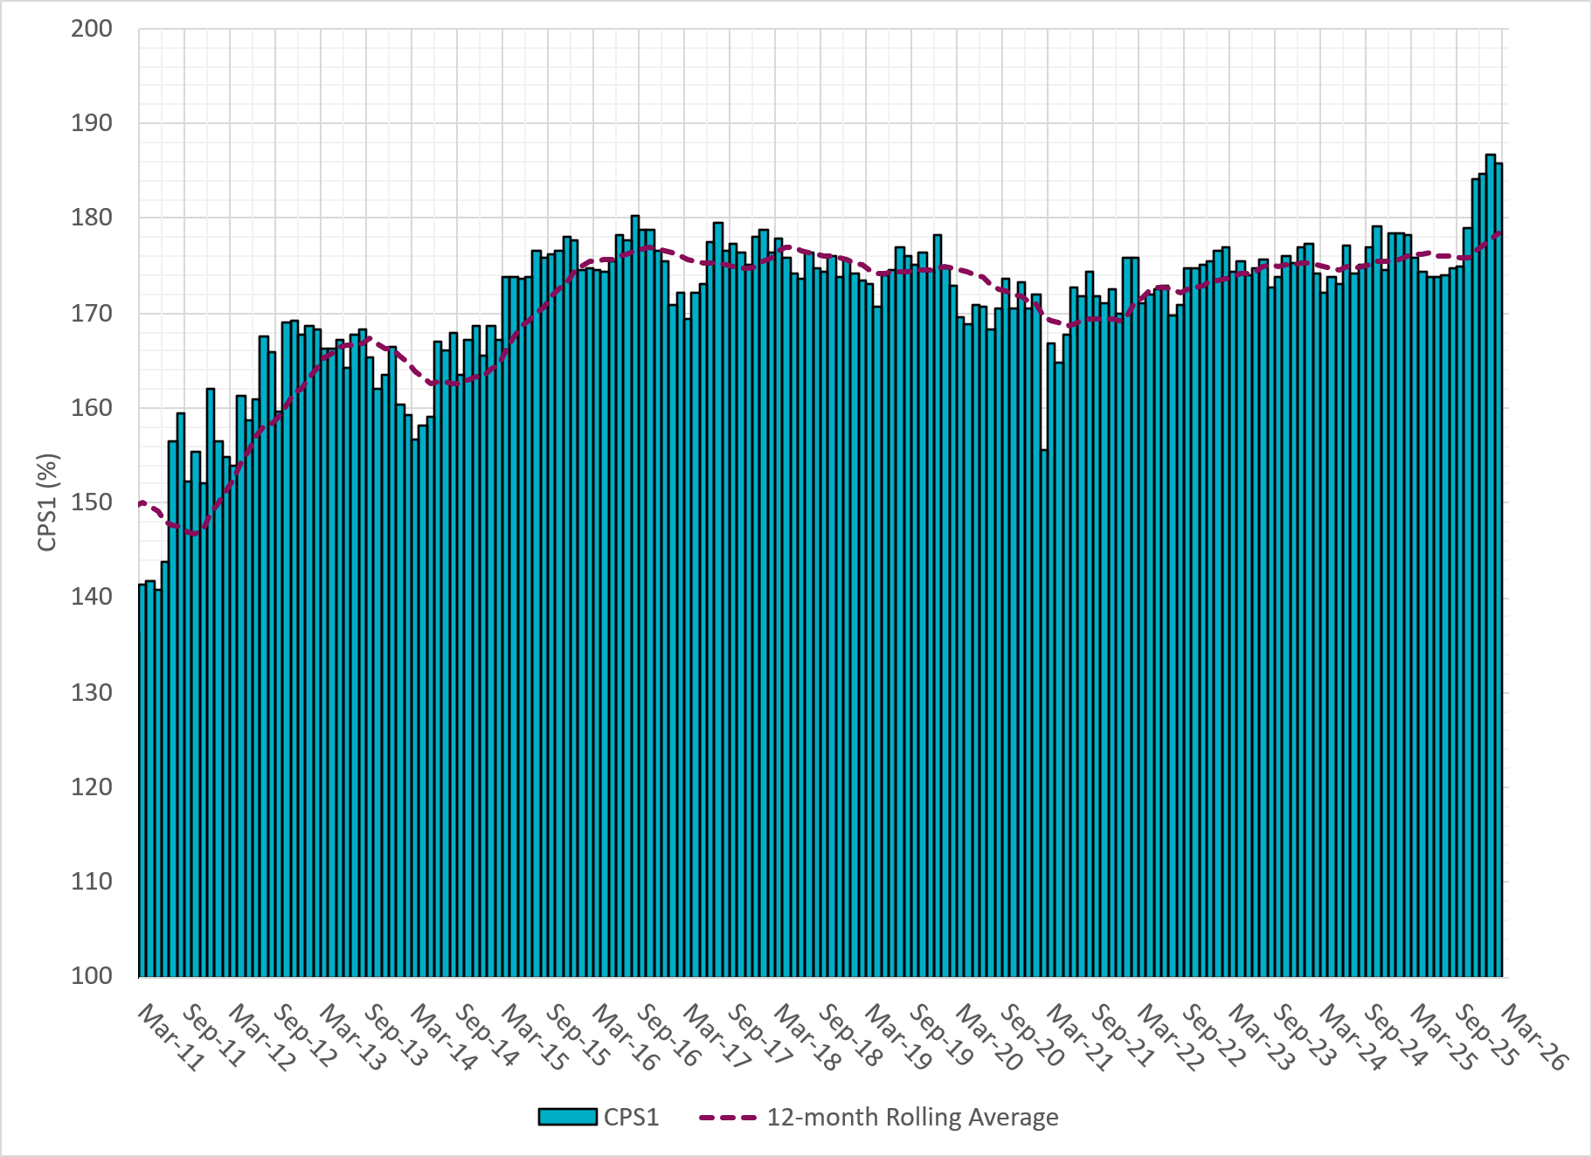
CPS1 Performance
Current 12-Month Rolling Average: 179.26%
Notes:
12 month rolling average CPS1 score is 179.26 which is continuing the increasing trend of CPS1 scores.

Slide 9
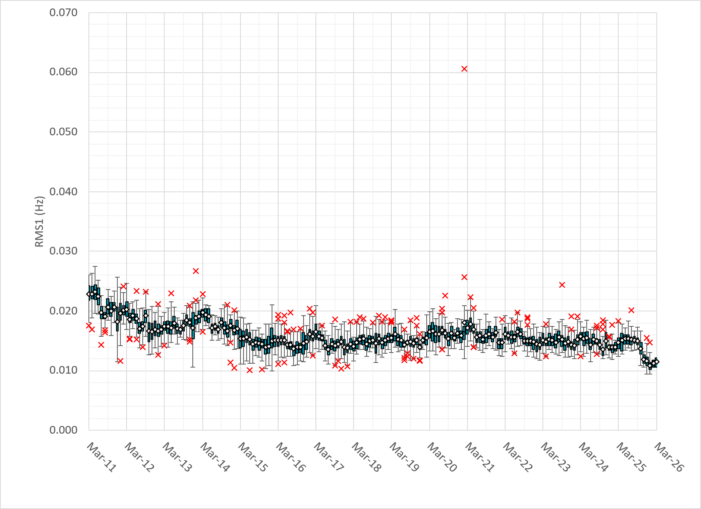
RMS1 Performance of ERCOT Frequency
Notes:
A More granular look at last 15 years of RMS1 by month
11.46 mHz on avg for March 2026

Slide 10
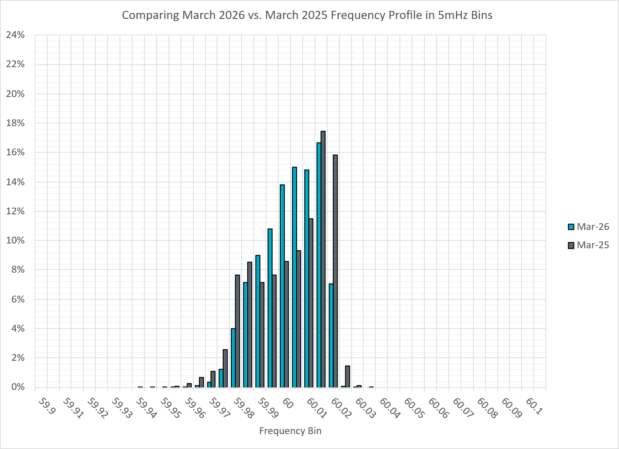
Frequency Profile Analysis
Notes:
Comparison of frequency profile between March 2025 and March 2026. Compared to last year, there are slightly less instances of frequency hovering around the lower dead bands.

Slide 11
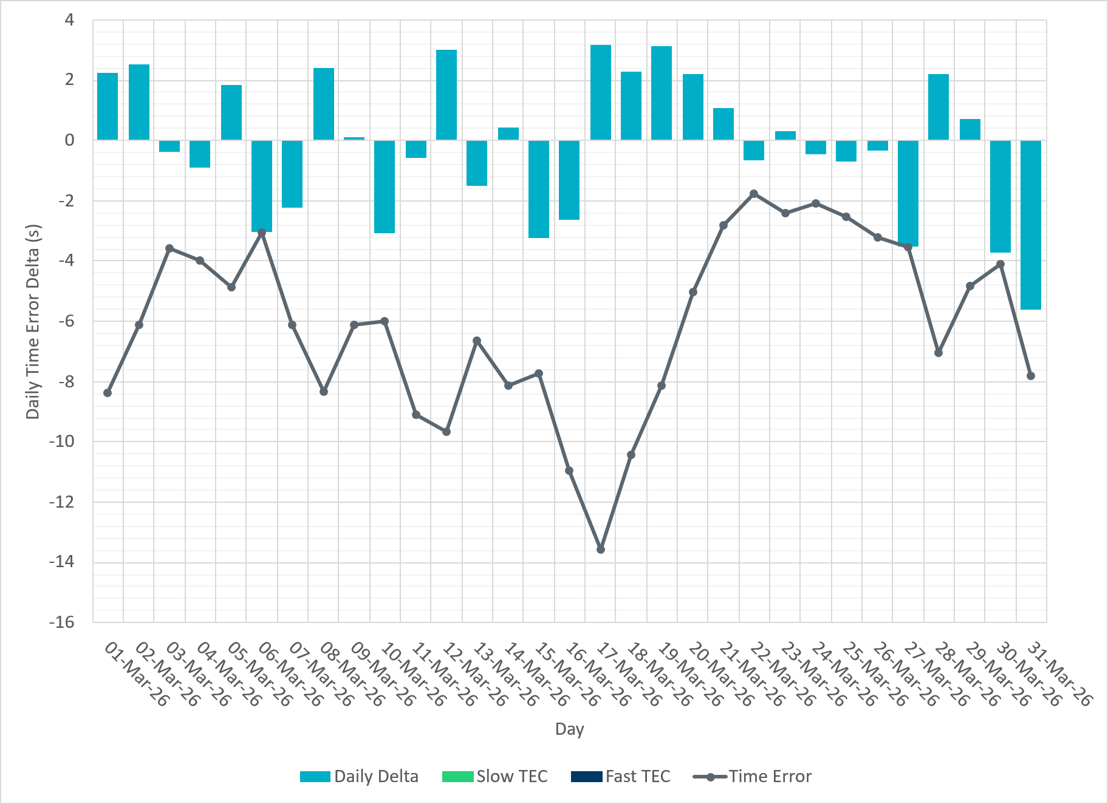
Time Error Corrections
Notes:
No time error corrections in the month of March.

Slide 12
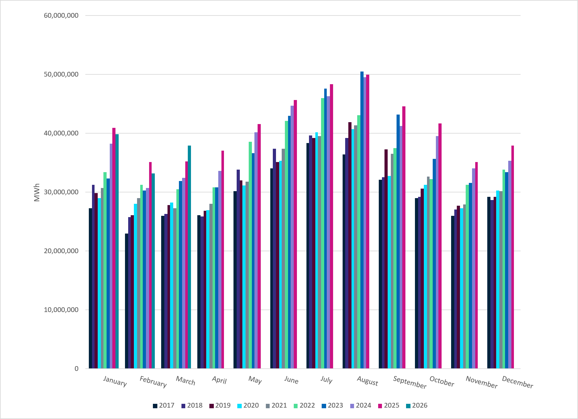
ERCOT Total Energy
Notes:
37,911,606 MWh

Slide 13
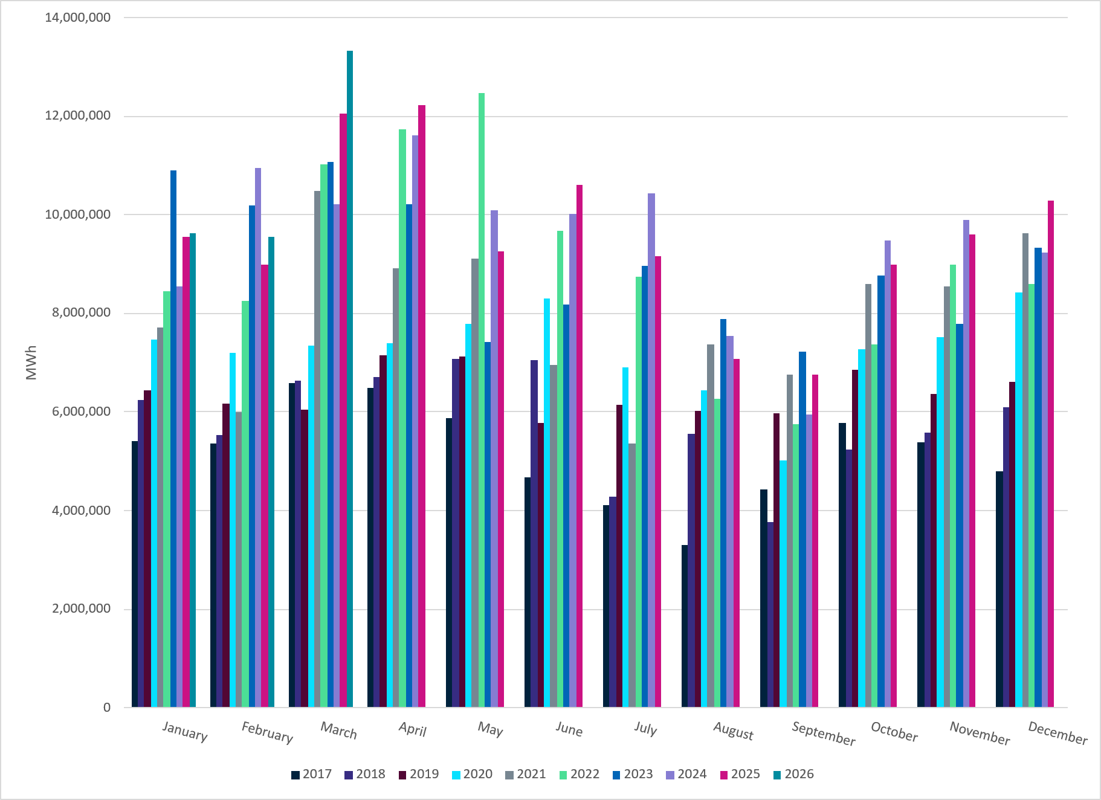
ERCOT Total Energy from Wind Generation
Notes:
13,331,081 MWH

Slide 14
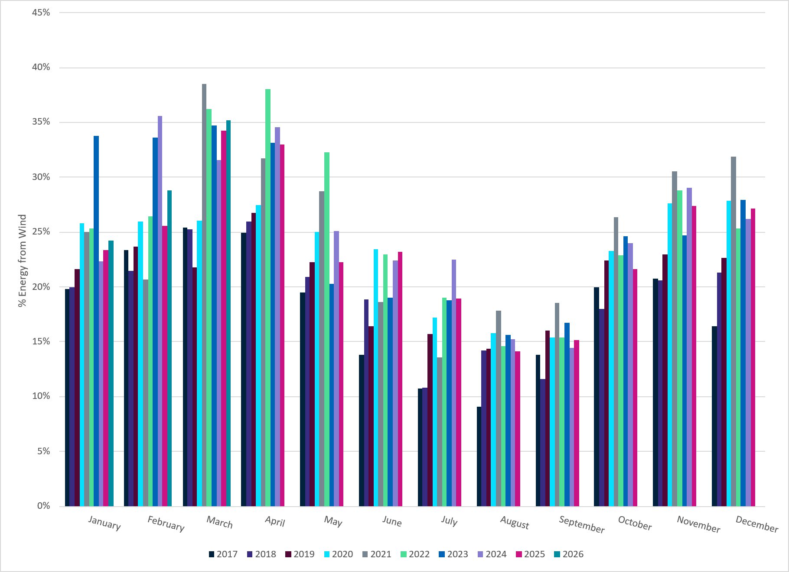
ERCOT % Energy from Wind Generation
Notes:
35.16% of total energy was provided by wind generation

Slide 15
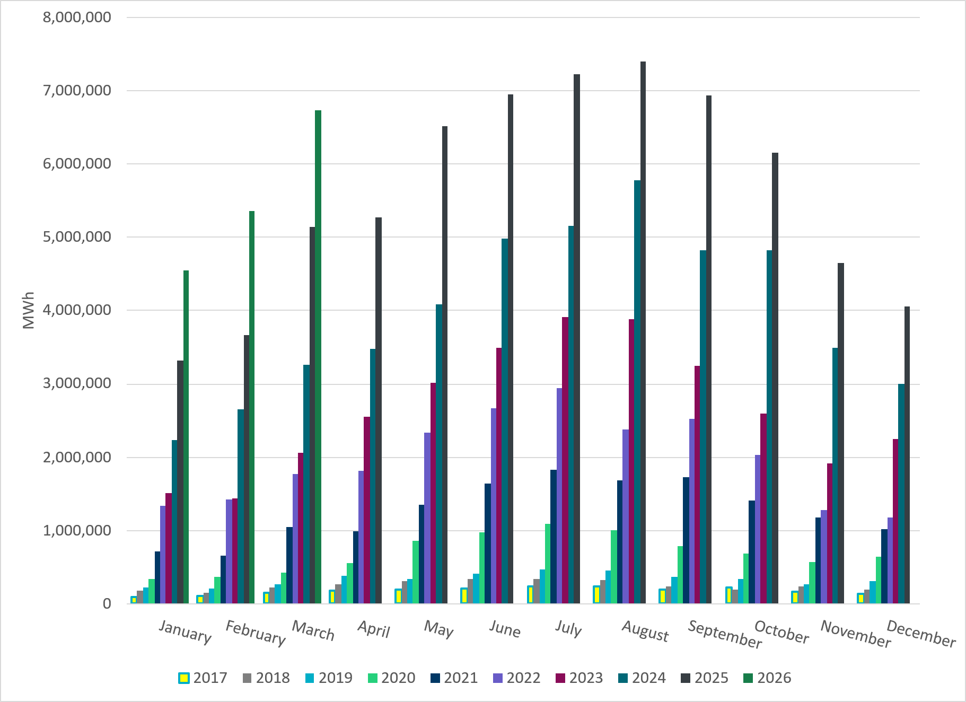
ERCOT Total Energy from Solar Generation
Notes:
6,729,093 MWh

Slide 16
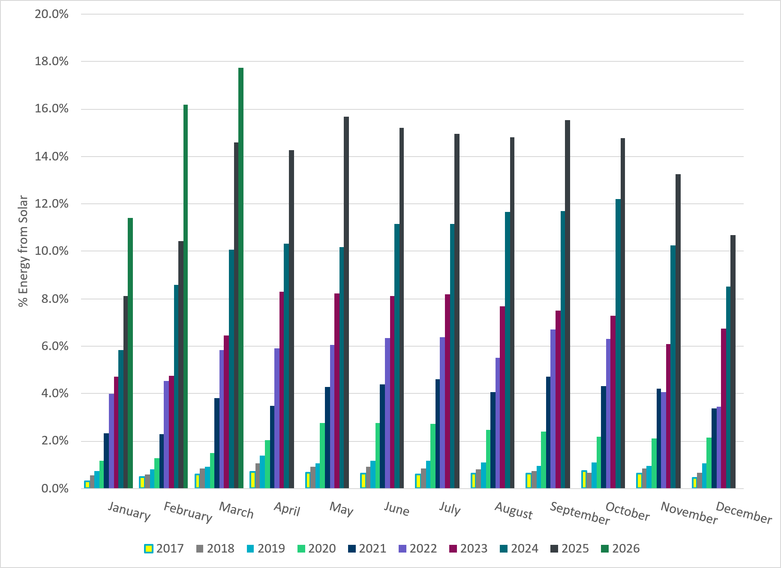
ERCOT % Energy from Solar Generation
Notes:
17.75% of total energy was provided by solar generation

Slide 17
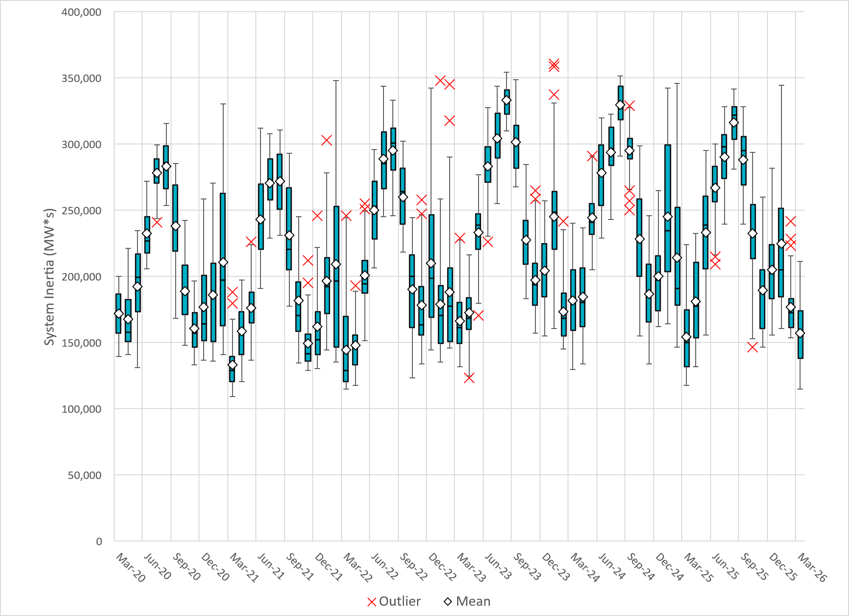
ERCOT Daily Minimum System Inertia
Notes:
Minimum Inertia in March 2026 = 114,642 MW*s on March 14th
Historical Overall Minimum was 109,029 MW*s on 3/22/2021
March Data:
Mean: 157,243 MW*s
Max: 211,645 MW*s on March 8th
Min: 114,642 MW*s on March 14th

Slide 18
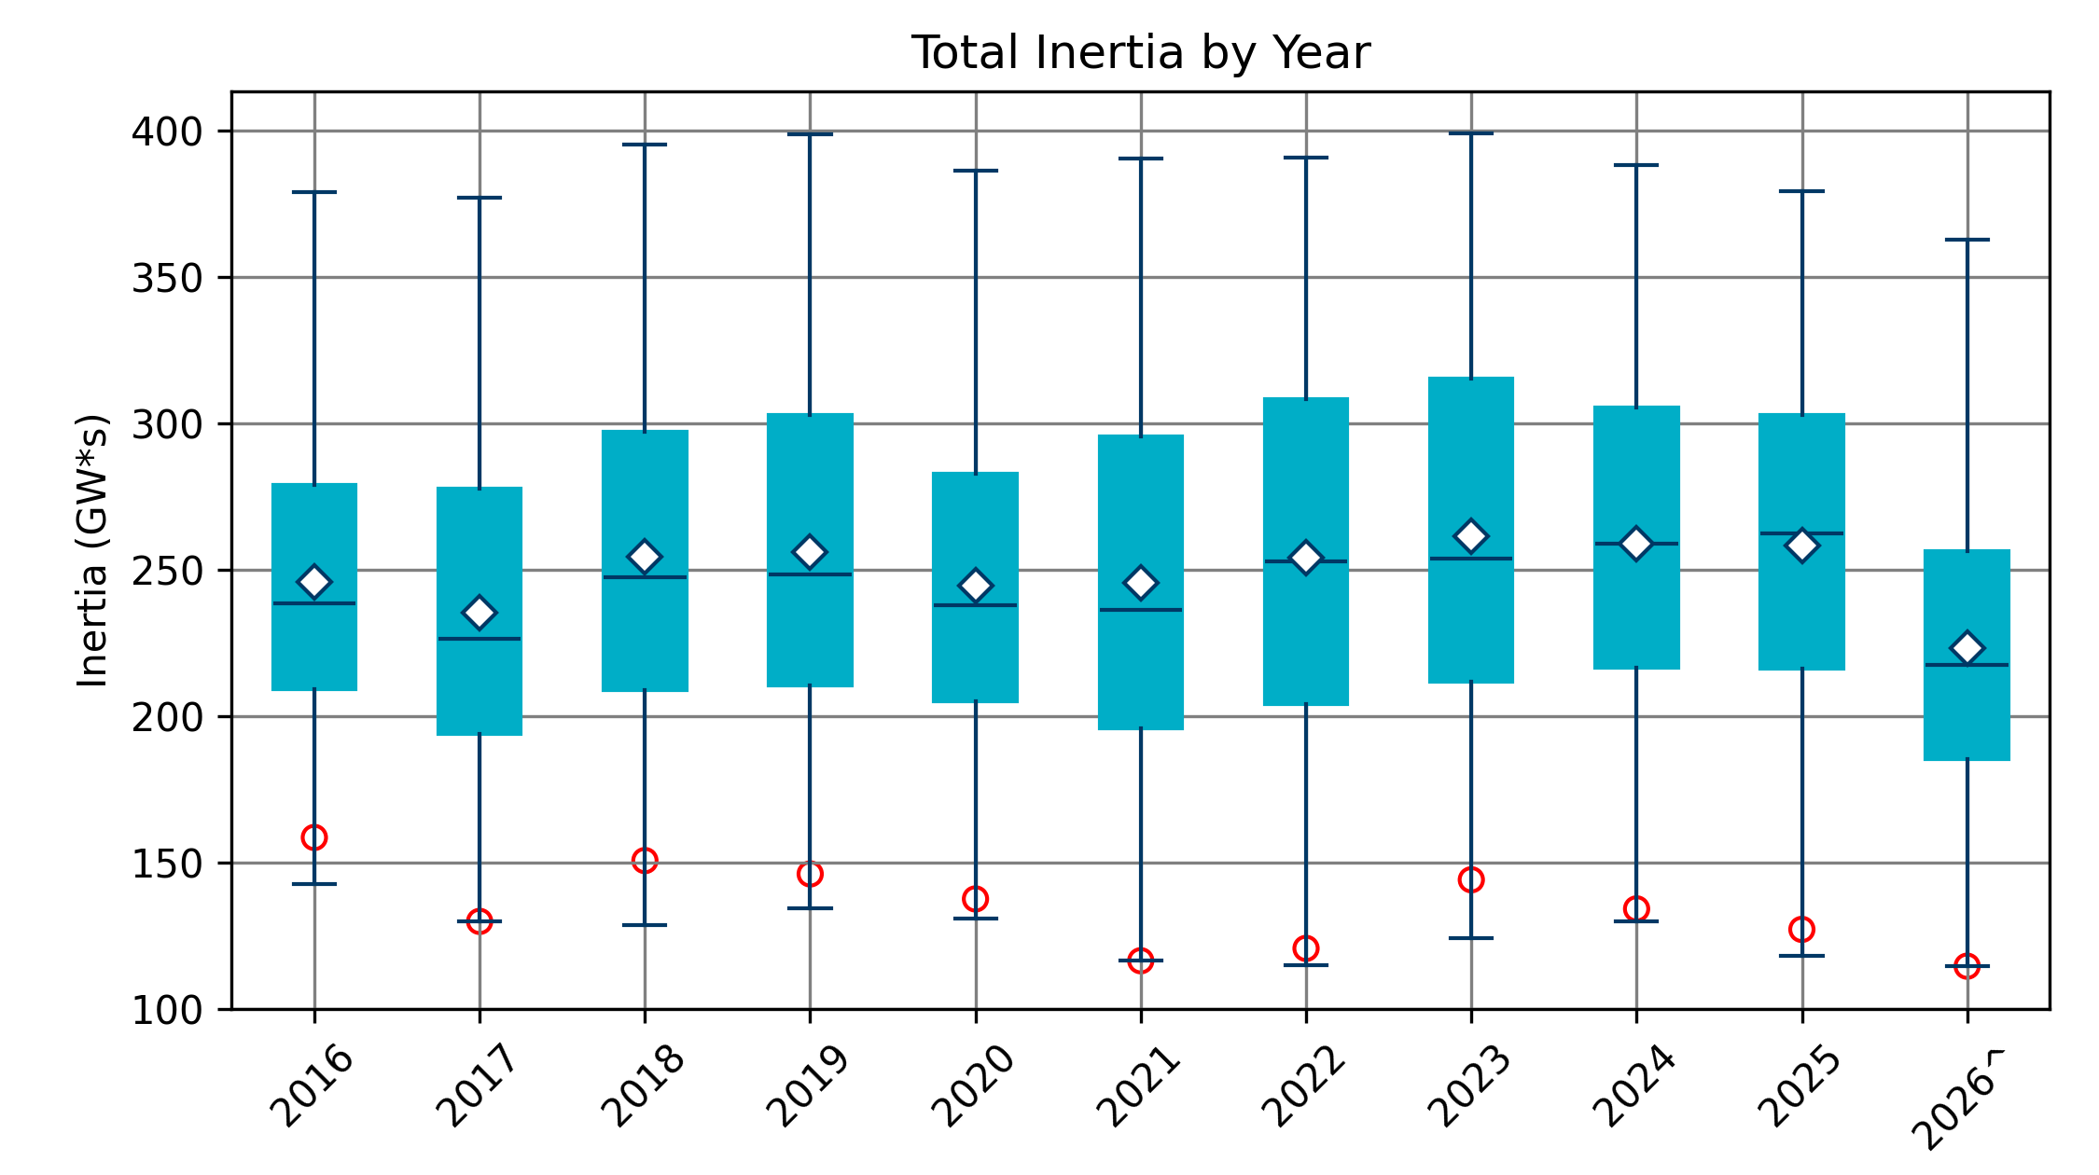
Total Inertia 2016-2026
Date and Time | 2016 4/10 2:00 AM | 2017 10/27 4:00 AM | 2018 11/03 3:30 AM | 2019 3/27 1:00 AM | 2020 05/01 2:00 AM | 2021 03/22 1:00 AM | 2022 03/21 2:00 AM | 2023 04/18 3:00 AM | 2024 03/29 4:00 AM | 2025 03/18 12:00 PM | 2026* 03/14 12:00 PM
Min synch. Inertia (GW*s) | 143 | 130 | 128.8 | 134.5 | 131.1 | 116.6 | 115.0 | 124.3 | 129.9 | 118.3 | 114.7
System load at minimum synch. Inertia (MW) | 27,831 | 28,425 | 28,397 | 29,883 | 30,679 | 31,767 | 33,784 | 35,578 | 37,039 | 49,130 | 48,013
Non-synch. Gen. in % of System Load | 47 | 54 | 53 | 50 | 57 | 66 | 65 | 61 | 68 | 74 | 81
FFR Award | N/A | N/A | N/A | N/A | 0 | 0 | 0 | 0 | 134 | 298 | 430
Critical Inertia (GW*s) | 100 | 100 | 100 | 100 | 100 | 100 | 100 | 100 | 93 | 92 | 87
Red circles denote inertia at max IRR penetration (= IRR Gen/Total Gen)
Notes:
Summary of ERCOT inertia for the previous 10 years. Lowest inertia this year was on March 14th.
For each box, the central mark (red line) is the median, the edges of the box (in blue) are the 25th and 75th percentiles, the whiskers correspond to +/- 2.7 sigma (i.e., represent 99.3% coverage, assuming the data are normally distributed. The corresponding lowest inertia in each year is given in the table.
The circle on each boxplot is showing inertia during time when highest portion of load was served by wind/solar generation in that year.

Slide 19
Questions?

