Slide 1

Large Load Interconnection Batch Study
May 4, 2026

Slide 2
Agenda
1
Timeline and governance recap
Update on timeline and key workshop dates
Outline PRS/ROS/TAC pathways to June Board with key submission dates
2
April 30th / May 1st
ERCOT comments
Summary of updates to Batch Zero Concepts as of April 30th comments
Align on Year 6 study methodology
3
May 2nd ERCOT Comments BYOG/WLPUN
Detailed view on the WLPUN (BYOG) construct
Review Revision Request Language
4
Market Comments filed
[As time allows] stakeholder comments
Review of key open issues

Slide 3
Agenda
Timeline and governance recap
April 30 PGRR 145 ERCOT comments
May 2 WLPUN ERCOT comments
Stakeholder Feedback
3

Slide 4
Batch Zero Revision Request Timeline
Note that TAC leadership is involved in considering options to ensure successful review and approval
2026
Q1
Q2
Q3
Forums
Objective
Feb
Mar
Apr
May
Jun
Jul
Workshops and working groups
Align stakeholders on direction/scope following Commission decision
Workshop #2 Feb 12
Define the scope, boundaries, and intended role of Batch Zero
LLWG Feb 19
Monthly LLWG updates
Preview structure/governing concepts of Batch Zero PGRR before filing
Workshop #3 Feb 26
Workshop #4 Mar 10
Close outstanding design and drafting issues, incorporate vetted stakeholder feedback, and finalize Revision Request language for committee approval
Workshop #5 Mar 24
Workshop #6 Mar 30
Workshop #7 Apr 9
Workshop #9 TBD
PRS (Protocols Review Subcommittee)
File NPRR 1325 for Workshops and PRS review
PRS Update 3/11
Regular PRS 4/15
Workshop #8 May 4
Endorse NPRR 1325 for advancement to TAC
Special PRS 4/22
PRS Vote
5/6
ROS (Reliability and Operations Subcommittee)
File PGRR 145 for Workshops and ROS review
ROS Update 3/5
ROS Update (special) 4/23
Endorse PGRR 145 for advancement to TAC
ROS Update 4/2
ROS Update (special) 4/14
ROS Vote 5/7
TAC
Review/endorse combined NPRR/PGRR package for Board approval
Monthly TAC updates
Regular TAC 4/29
TAC Vote
5/19-20
Consideration of Batch Zero NPRR 1325 and PGRR 145
Board Meeting 4/20
Special TAC Vote 5/13
Board Vote 6/1
ERCOT Board
3/4 ERCOT files Batch Zero Revision Request(s)
4/17 ERCOT files PGRR comments integrating CLR framework
4/30 ERCOT files PGRR comments
5/2 ERCOT files PGRR comments integrating BYOG framework
6/1 Target Board approval date
7/10 Target effective date of NPRR1325 and PGRR145
Source: ERCOT discussions

Slide 5
Reminder of Scope and Priorities
March 4 filings completed for Batch Zero: ERCOT filed the Batch Zero PGRR145 and related NPRR1325 on March 4, initiating the formal governance process and aligning with the May PRS/ROS/TAC sequence and June 1 Board target reflected in the critical path timeline
  March 17 ERCOT comments filed
  April 4 ERCOT comments filed
  April 23 ERCOT comments filed: updated proposal to align with PUCT April 17 Open Meeting guidance
  April 30 ERCOT comments filed: further refined proposal to operationalize framework (standardized financial security methodology, expanded eligibility pathways, enhanced study validation, Year 6/structured study design and allocation mechanics)
ERCOT progressing CLR and BYOG design through parallel comment tracks: Batch Zero comments may include or exclude CLR/BYOG elements, with ERCOT Market Rules managing versioning
  CLR status: April 17 comments filed, formally introducing and detailing PCLR framework (e.g., modular construct, operational treatment, linkage to future market implementation)
  BYOG Status: May 2 comments filed, formally introducing and detailing Withdrawal-Limited PUN (i.e., BYOG) concept
April 29 PUCT Staff comments filed: endorse ERCOT’s April 23 comments; clarify eligibility and study validity, and define financial commitments (non-refundable interconnection costs, tiered refundability for upgrades)

Slide 6
CLR and BYOG frameworks are being integrated into Batch Zero filing, forming a first comprehensive design with further refinement over time
Path of PGRR145 and NPRR1325 towards governance approval
Key takeaways
1
2
3
Modular approach enables speed without locking design: core framework advanced while PCLR and BYOG are developed in parallel
Convergence toward June Board: PGRR145/NPRR1325, PCLR, and BYOG converge into a complete, minimum viable package for decision-making
Minimum viable, not final design: PCLR and BYOG are introduced as initial concepts, with further refinement expected post June Board
Core Batch Zero framework established
PCLR framework integration
BYOG framework integration
PGRR145
PGRR145
PGRR145
PCLR comments
PCLR comments
BYOG comments
NPRR1325
NPRR1325
NPRR1325
PCLR comments
PCLR comments
BYOG comments
March 4: ERCOT files PGRR145 and NPRR1325
Establishes foundational framework for Batch Zero execution and LLI processing
April 17: PCLR introduced as modular enhancement via comments to PGRR145/ NPRR1325
Enables early shaping of controllable load pathway without delaying core filing
May 2: BYOG introduced as modular enhancement via comments to PGRR145 / NPRR1325
Enables integration of generation-backed load pathway without delaying core filing
Source: ERCOT discussion

Slide 7
Scope Mapping
Motion to recommend approval of the RR as amended by the:
Approval options
PGRR145
NPRR 1325
1
Batch Zero ONLY
(no PCLR, no BYOG)
4/30/26 ERCOT comments w/ desktop edits to remove PCLR
5/1/26 ERCOT comments w/ desktop edits to remove PCLR
2
Batch Zero with PCLR (no BYOG)
4/30/26 ERCOT comments
5/1/26 ERCOT comments
3
Batch Zero with PCLR and BYOG
5/2/26 ERCOT comments
5/2/26 ERCOT comments

Slide 8
Agenda
Timeline and governance recap
April 30 PGRR 145 ERCOT comments
WLPUN discussion
Stakeholder Feedback
8

Slide 9
Key updates in April 30 PGRR145 ERCOT comments, including implementation of PUCT guidance
Link to PGRR145 Comments from ERCOT April 30
Introduced detailed financial security framework for system upgrades: established a clear methodology for calculating required security (e.g., cost-per-MW from RPG projects or default $50k/MW), including defined acceptable instruments (cash, LOCs, guarantees)
Refined financial responsibility and cost recovery requirements: clarified obligations for direct interconnection costs (CIAC) and system upgrades, with increased flexibility in how costs can be met and inclusion of net metering (PURA 39.169) requirements
Reinstated and clarified site control requirements: explicitly allowed executed purchase and sale agreements (alongside leases/deeds) as valid evidence of site control, clarifying and slightly expanding proof of project readiness
Clarified and expanded eligibility pathways for Batch Zero inclusion: expanded eligibility pathway to include certain loads studied under the interim Large Load interconnection process
Revised Batch Zero Study scope and methodology: refined study scope (full analysis for 2028/2030/2032 and limited for interim years)
Refined minimum load allocation methodology: added 90% minimum for loads under 200 MW
Clarified roles of TSPs and DSPs in interconnection process: added explicit responsibilities across financial security determination, study validation, and data submission to reduce ambiguity in execution
Source: PGRR145 ERCOT Comments, April 30

Slide 10
April 30th comments/approach: proposed “bookend” allocation
Approach addresses developer ‘gap year’ concerns at the cost of extending the Batch Zero timeline
Example: 1,000 MW data center requiring full capacity by 2032
Studied
Allocated
Illustrative ramp schedule and allocation methodology by year, MW
Key highlights
Adjusted “bookend” study approach: fully study 2028, 2030, and 2032, while allocating 2029 and 2031 using anchored transmission plans
Mitigates key developer concerns on “gap years” by avoiding zero-allocation outcomes:
  Improves project economics and bankability by providing interim MW visibility, reducing delayed revenues/underutilization
  Anchors allocation on years with major planned transmission additions (e.g., backbone upgrades)
Trade-off: additional 10 weeks of steady-state analysis, delaying Batch Zero results publication and potentially pushing the start of Batch 1
700
400
2027
2028
2029
2030
2031
2032
Not studied: based on existing system capacity (no upgrades)
Fully studied (all cases)
Allocated with incremental transmission
Fully studied (all cases)
Allocated with incremental transmission
Fully studied (all cases)
Enablers
Early TSP involvement at study kickoff, with a shared 2032 system case
Parallel development of transmission solutions and cost estimates
Centralized ERCOT coordination, consolidating TSP inputs into a single plan
Advantages
Delivers an actionable 2032 transmission plan within Batch Zero timeline, avoiding reliance on future cycles
Provides full 2027-2032 visibility for customer decisions
Reduces complexity and rework

Slide 11
Batch Zero Adjusted Timelines Comparison
Activity getting extended
Batch Zero report published
Potential Batch 1 start date (case building)
2026
2027
Scenario
Activity
Jul
Aug
Sep
Oct
Nov
Dec
Jan
Feb
Mar
Apr
May
Jun
Jul
Aug
Sep
Oct
Nov
Dec
Old Batch Zero Timeline
Case Build (13 weeks)
Steady State Analysis (15 weeks)
Stability Screening Study + Final Report (16 weeks)
Developer Commitment Deadline
FAC-002 Stability + Batch Refinement Study ((14 weeks)
RPG Comment period and Board approval
April 30th comments
Batch Zero Timeline
Case Build (13 weeks)
Steady State Analysis (25 weeks)
Extra 10 weeks for steady state analysis
Stability Screening Study + Final Report (16 weeks)
Extra 30 days for developer commitment
Developer Commitment Deadline
FAC-002 Stability + Batch Refinement Study ((14 weeks)
RPG Comment period and Board approval
“Rollover” approach
Batch Zero Timeline – if needed
Case Build (13 weeks)
Steady State Analysis (15 weeks)
Stability Screening Study + Final Report (16 weeks)
Extra 30 days for developer commitment
Developer Commitment Deadline
FAC-002 Stability + Batch Refinement Study ((14 weeks)
RPG Comment period and Board approval

Slide 12
Alternative option: "Rollover" approach
Preferred alternative option
Example: 1,000 MW data center requiring full capacity by Year 6
Old PGRR145 Approach
“Rollover” approach to subsequent batch
Illustrative ramp schedule, MW
Automatically set at requested peak Demand
TBD: additional MWs studied in next batch and allocated based on available capacity
TBD
0
0
2027
2028
2029
2030
2031
2032
2027
2028
2029
2030
2031
2032
Years 1-5
Request studied in Batch Zero: initial MWs allocated based on system capability; transmission constraints and required upgrades identified
Request studied in Batch Zero: initial MWs allocated based on system capability; transmission constraints and required upgrades identified
Year 6
Full MW automatically allocated based on Batch Zero results; transmission solutions further defined in the 2027 RTP
Full MW not committed in Batch Zero; additional MWs studied and allocated through a subsequent Batch 1 process
Considerations
Provides certainty by guaranteeing full MWs by Year 6
Creates a potential step-change in MWs between Years 5 and 6, with limited time to develop required transmission
Full MW allocation is aligned with identified transmission upgrades
Requires financial commitment for partial MWs without clear visibility on timing or certainty of full MW delivery

Slide 13
Agenda
Timeline and governance recap
April 30 PGRR 145 ERCOT comments
WLPUN discussion
Stakeholder Feedback

Slide 14
BYOG construct – Summary of key design choices presented at April 23 Special ROS meeting
Design choice
Description
Details
Core concept and objective
Co-located load and generation operate as a coordinated facility to enable self-supplied energization
P. 15
Integrated study framework
Load and generation must be studied together with consistent assumptions across planning and reliability analyses
P. 16
Study separation
Batch, transmission, and generation studies serve distinct roles but together determine final load capability
P. 17-18
Grid import limit
Batch study sets maximum withdrawal from the grid, independent of on-site generation
P. 18, 19
Stability constraints
Stability limits may cap total load below requested levels, regardless of available generation
P. 18, 27
Operational model
Facility operates with self-limited withdrawal: load must adjust to remain within grid and generation limits
P. 19
Monitoring and compliance
Real-time telemetry and enforcement required to ensure adherence to withdrawal and stability limits
P. 30
Timeline and sequencing
BYOG requires coordination across batch, generation, and transmission planning timelines
P. 20

Slide 15
A Bring Your Own Generation (BYOG) approach should help stakeholders to solve some of the issues raised with the LLI process
Presented at 4/23 Special ROS
Intent of BYOG
Potential benefits
Interconnecting Large Load Entities (ILLEs) can co-develop or contract with co-located generation to:
Secure their own path to energization, independent of grid constraints
Align load ramp with generation availability
Reduce reliance on uncertain transmission upgrades
  For the ILLEs
  Greater certainty on energization timing and scale
  Ability to bypass grid-driven delays and curtailment risk
  For the generators
  Direct, contracted demand from day one
  Improved bankability vs. merchant exposure
  Clear role in solving interconnection bottlenecks
  For the system
  Accelerates capacity build where it is needed most
  Reduces congestion and transmission pressure
  Improves resource adequacy through demand-linked generation

Slide 16
A coordinated load–generation study framework is required to enable a viable BYOG construct
Presented at 4/23 Special ROS
Detailed next
Generation Interconnection
(Normal GINR process – Planning Guide Section 5)
Monitoring and compliance
Establishing metering, telemetry, and real-time compliance mechanisms to ensure the facility continuously operates within its defined limits
Study treatment
Defining an integrated study approach where load and generation are modeled as a single facility with consistent assumptions across planning and reliability analyses
BYOG agreement
Operations
Specifying the facility operating envelope (net import/export limits at POI) and dispatch/curtailment behavior for co-located load, generation, and storage
Large Load Interconnection
(PGRR145 process – Planning Guide Section 9)
Registration
Setting the registration model and load commitment requirements, aligning timing, scale, and obligations across generation and load interconnection processes

Slide 17
Study treatment should separate generation, load allocation and transmission planning while capturing full facility impact
Presented at 4/23 Special ROS
New discussion topic
Batch Study
Evaluates load as grid-supplied only (co-located generation not counted) to determine firm load allocation based on system capability
Transmission planning study
Models load and generation together as a single facility to assess full system impact under N-1 (single-contingency) conditions (e.g., generator or transmission outages) and drives upgrades based on worst-case conditions
Generation interconnection study
Studies generation independently under standard GINR assumptions to determine interconnection requirements and export capability

Slide 18
Co-located load and generation are governed by three separate ERCOT evaluation processes
Presented at 4/23 Special ROS
Focus
ERCOT lens
Description
Output
Illustrative scheme
Batch Study (Load Interconnection)
Evaluates large load interconnections to determine the maximum import (withdrawal) capability under steady state conditions from the ERCOT grid, independent of on-site generation
Withdrawal limits¹ and initial load allocation (subject to stability limits from Gen+Load studies)
ERCOT Grid
~
~
600MW
600MW
1,000MW
Transmission planning
Identifies system constraints and determines network upgrades required to reliably support the combined load and generation under normal planning assumptions (e.g., N-1/G-1)
Required transmission upgrades and validation of SLF-exit (full load) conditions for reliable operation in the long-term (post-BYOG) configuration
ERCOT Grid
~
~
600MW
600MW
1,000MW
Generation Interconnection
Assesses generation to determine export capability and interconnection requirements; co-located load is included in the study when it materially affects system performance (e.g., stability, voltage, operations)²
Maximum export (injection) limits, stability constraints, and interconnection requirements
ERCOT Grid
ERCOT Grid
~
~
~
~
600MW
600MW
1,000MW
600MW
600MW
1,000MW
Final allowable load is determined by withdrawal limits (Batch Study) and may be further constrained by stability limits (Gen+Load studies)
Example: Batch study sets a withdrawal limit of 100 MW. Stability studies identify a maximum stable load of 500 MW. Final allowable load = 500 MW, with up to 100 MW from the grid and the remainder supplied by on-site generation. If no stability constraint is identified, load can reach the full 1,000 MW using on-site generation
1. Import (withdrawal) limit applies to total site demand, including co-located load and any storage charging | 2. Where generation and load share a POI, ERCOT/TSP studies may evaluate both independent and combined configurations; combined cases are particularly relevant for stability and system modeling
Source: ERCOT discussions

Slide 19
PUN with Self-Limited Withdrawal (BYOG) – Operational Model
Presented at 4/23 Special ROS
Interim operation (pre-transmission): BYOG agreement in place
Post-transmission operation: BYOG agreement exited
ERCOT Grid
ERCOT Grid
Export: available export (SCED dispatch)
Import: max withdrawal limit (Batch study)
New 400 MW transmission line
~
~
~
~
600MW
600MW
1,000MW
600MW
600MW
1,000MW
Export (injection): determined by SCED based on available surplus generation and dispatched at the resource level via COP/telemetry
Import (withdrawal): determined through batch study as a maximum withdrawal from the ERCOT grid, independent of co-located generation; total load cannot exceed identified stability limits
Operations: facility operates as a PUN with self-limited withdrawal
  Load is primarily served by on-site generation and must reduce load to remain within the withdrawal limit if generation is unavailable, within defined operational response times (e.g., cycles to seconds)
  Injection is governed by standard generation interconnection limits and SCED dispatch
SLF agreement dissolved and normal operations
Transmission upgrades: determined through ERCOT transmission planning studies, which evaluate the combined load and generation under standard reliability criteria (e.g., N-1 / G-1) to identify required network upgrades
Import and export: governed by standard interconnection limits and system constraints (no BYOG-specific caps); fully dispatchable through SCED subject to study results
Operations: transitions to standard ERCOT operation
  Generation and load treated as independent resources
  No self-limiting withdrawal requirement
  Full participation in market dispatch and planning
Source: ERCOT discussions

Slide 20
Sequential BYOG interconnection timeline across Batch, Generation, and Transmission planning processes
Presented at 4/23 Special ROS
July 2026
Jan 2027
Mar 2027
Batch Study
LLIS (meeting Batch Zero eligibility)
Case building
Batch Study
Developer commitment period (60 days)
Output: withdrawal limit
~
~
Focus on load only
Generation study
Gen FIS studies
Includes load FIS studies as applicable
(includes load for stability/operability assessment)
Output: stability limit (if any)
Focus on gen only
Focus on load and gen
Transmission Planning
Upgrade identification
Refinement study
Focus on load and gen
Focus on load and gen
BYOG declaration executed to identify load–generation pairing for studies (pre- PG 6.9 milestone of generation)
Total load allocation = min (Requested Load, Stability Limit – if any)
Source: ERCOT discussions

Slide 21
Summary of May 2 Comments: WLPUN Framework
Defines Withdrawal-Limited Private Use Network (WLPUN)
Establishes interconnection eligibility, study, and commitment requirements for both generation and load
Defines Batch Zero allocation and withdrawal limits for WLPUNs
Provides WLPUN modeling requirements
Creates operating and compliance requirements to ensure WLPUN does not exceed withdrawal limit

Slide 22
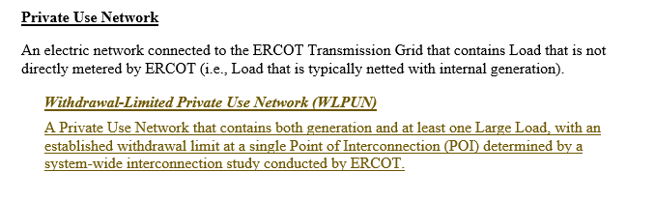
WLPUN Definition

Slide 23
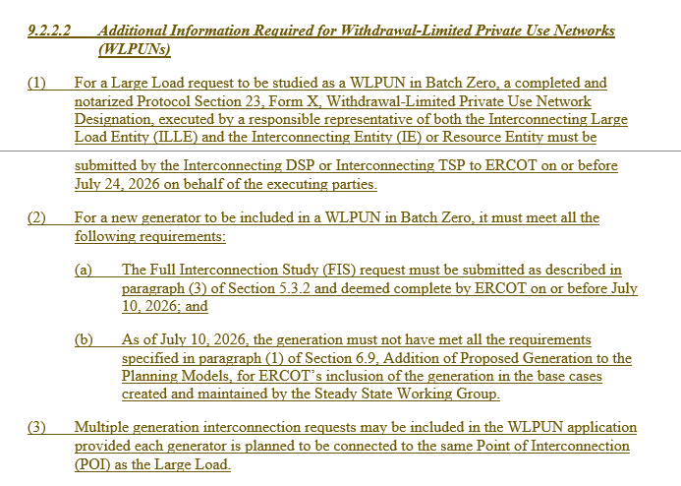
WLPUN Prerequisites
Detailed next

Slide 24
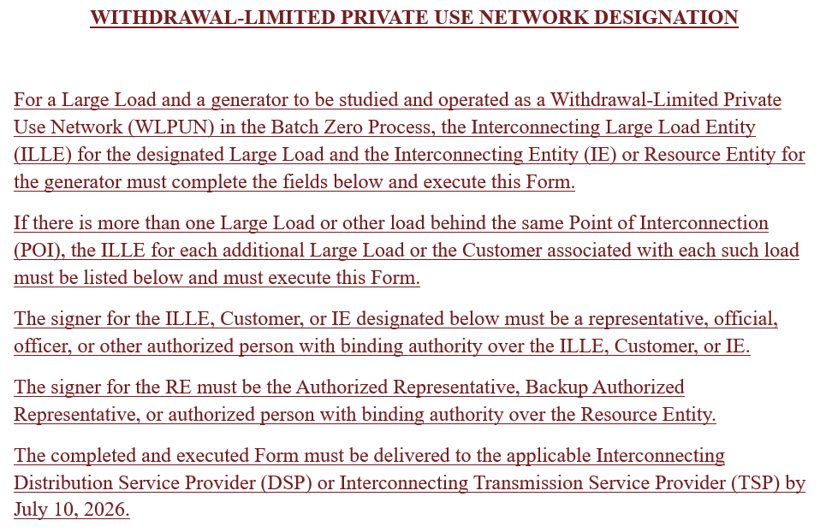
Form X: Withdrawal-Limited Private Use Network Designation (1/2)

Slide 25
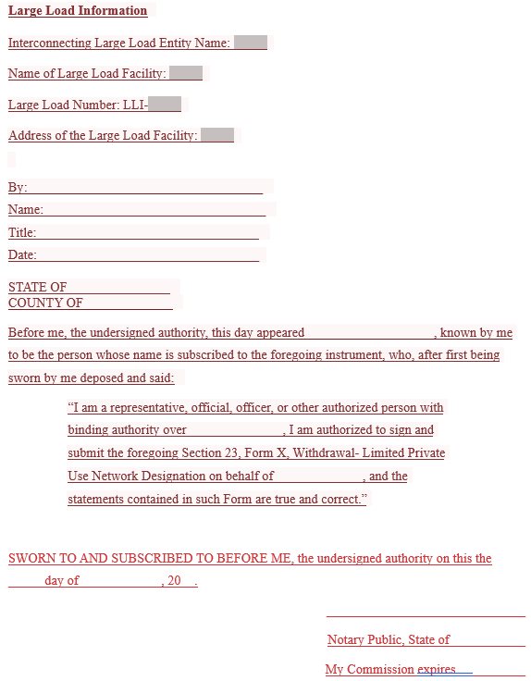

Form X: Withdrawal-Limited Private Use Network Designation (2/2)

Slide 26
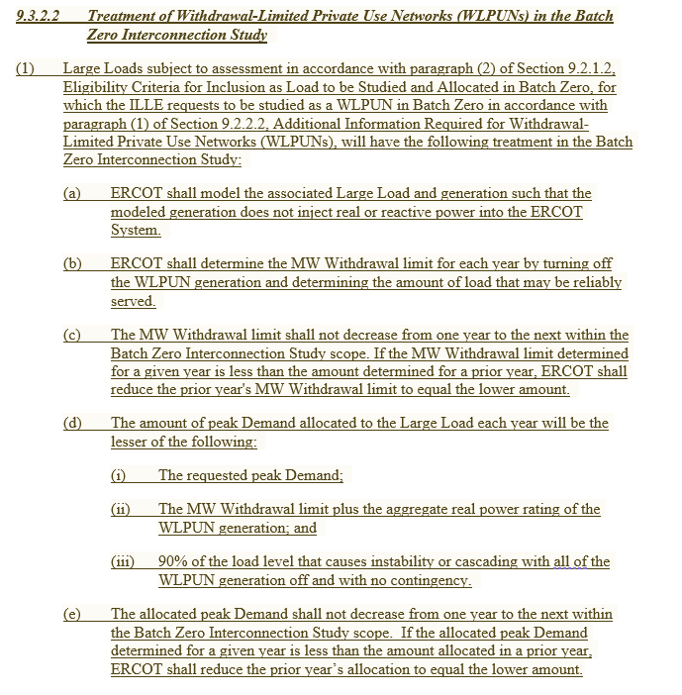
WLPUN Batch Zero Study
Withdrawal Limit
Load Allocation

Slide 27
Stability and cascading constraints may cap load below requested levels – even with excess on-site generation
Scenario: Large Load requesting 1,000MW and bringing 1,200MW of co-located generation (2 x 600MW gen units)
Withdrawal limit, MW
Stability limit, MW
Load served
Scenario
Description
Load served and breakdown by source, MW
Key takeaways
No stability or cascading constraints identified in Batch Study (full utilization)
No stability or cascading constraints are identified, so on-site generation can fully supplement the grid and the project can reach its full requested load
Stability – not generation capacity – may set the true load cap: even with significant on-site generation, load may be capped to maintain system stability under contingencies
Withdrawal limit and stability/ cascading limit play distinct roles: grid supply is capped by the withdrawal limit, while total load is capped by stability constraints
Load may consume up to the full requested amount as long as it stays below the withdrawal limit
Stability or cascading constraint identified in Batch Study
A stability or cascading constraint is identified (e.g., 500MW), which caps the total load that can be reliably served, regardless of available generation
Load may only consume (and be allocated) a portion of the requested amount due to stability limitations
Grid supply (withdrawal limit)
Total load
Total Allowable Load [MW] = Minimum (Requested Load, Stability/Cascading Limit) - with grid supply capped at the withdrawal limit

Slide 28
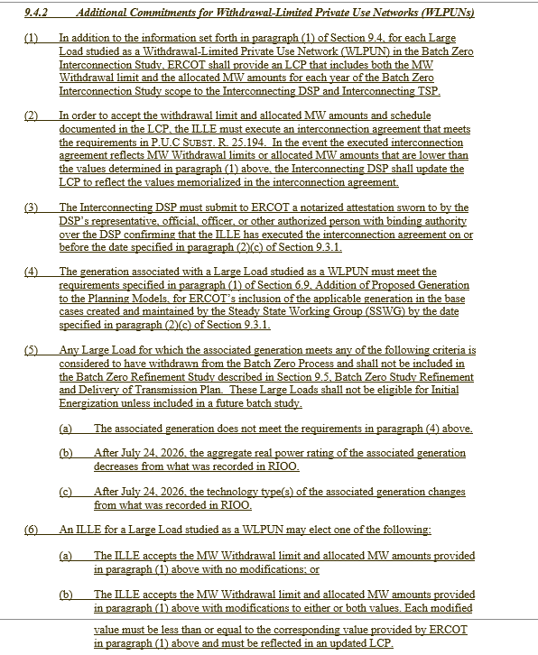
WLPUN Commitment Requirements

Slide 29
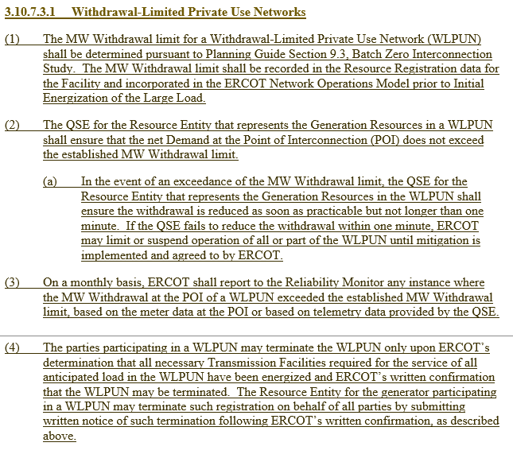
WLPUN Operations

Slide 30
Operational monitoring and control are required to ensure reliable WLPUN integration in Batch Zero
~
Load
~
Generator
Point of interconnection
~
WLPUN
Key operational considerations
ERCOT Grid
Withdrawal limits (net) and stability limits (gross gen / gross load) must be monitored and enforced
Net and gross telemetry available; additional load telemetry can be requested by ERCOT
Additional control room tools and displays required to support real-time operations
Export: available export (SCED dispatch)
Import: max withdrawal limit (Batch study)
~
~
600MW
600MW
1,000MW

Slide 31
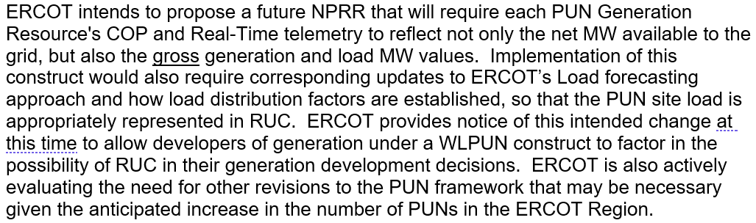
ERCOT will need future NPRR on PUN Telemetry and RUC Requirements

Slide 32
Agenda
Timeline and governance recap
April 30 PGRR 145 ERCOT comments
WLPUN discussion
Stakeholder Feedback
32

Slide 33











Comments Filed after April 23rd, 2026
Company
Date
Author
April 23rd
Arushi Sharma Frank
April 24th, May 2nd
Andrew Schaper
April 27th
Martha Henson
April 27th
Blake Holt / Sandeep Borkar
April 29th
Casey Bell / Susannah Pedigo
April 30th
Haynes Strader
April 30th
Bryn Baker / Eric Goff
April 30th
Tyler Petersen
April 30th
Kevin Boudreaux
May 1st
Cameron Poursoltan
May 1st
Shannon Caraway
Source: ERCOT PGRR145 “Key Documents” section

Slide 34
Key open issues from stakeholder comments
Detailed on next slide
Backdating or prioritizing RPG studies over Large Load Interconnection Studies
  Some stakeholders have proposed backdating RPG studies based on initial expected ERCOT independent review (EIR) completion or ranking Large Loads included in an RPG study ahead of those that have completed the LLI study process
  Other stakeholders have opposed this proposal
  ERCOT opposes this treatment as it breaks the reliability-based, deterministic approach proposed in PGRR145
Allowing otherwise non-qualified LLIs to be included as “studied load” in Batch Zero if they request PCLR or WLPUN treatment
  Multiple stakeholders have proposed allowing LLIs that do not otherwise qualify for inclusion in Batch Zero to be included as studied load if they agree to take on the “transmission risk” of PCLR status or bring their own generation (WLPUN)
  ERCOT opposes this proposal since the complexity involved in introducing non-qualified PCLRs and BYOG in the in Batch Zero process will put the already aggressive timeline at risk
Opposition to certain aspects of PUC guidance from the April 17 Open Meeting
  ERCOT notes that PUC Staff in their April 29 comments affirmed ERCOT’s April 23 comments as appropriately capturing PUC guidance

Slide 35
RPG study validity proposal: Backdating RPG projects breaks deterministic, reliability-based ordering
Dates to be used for ranking
PGRR145 current proposal
Stakeholder proposal
Challenges with proposal
LLIS
LLIS
Breaks reliability-based sequencing: prioritization no longer reflects actual ERCOT validation under real system conditions, but hypothetical timelines
Creates non-deterministic outcomes: backdating introduces case-by-case priority claims, replacing clear milestone-based ordering and introduces uncertainty for developers
Project A
submitted
Apr 10 2024
Project A
validated¹
Apr 10 2026
Project A
submitted
Apr 10 2024
Project A
validated¹
Apr 10 2026
RPG
RPG
Project B
submitted
Apr 10 2025
Project B
endorsed
May 10 2026
Project B
submitted
Apr 10 2025
Project B
expected EIR²
Sep 7 2025
1
1
Project ranking
Project A (Apr 10 2026)
Project ranking
Project B (Sep 7 2025)
2
2
Project B (May 10 2026)
Project A (Apr 10 2026)
Projects are ranked based on actual ERCOT validation milestones, ensuring a deterministic and reliability-based sequencing aligned with real system conditions
Project A (validated April 10, 2026) is ranked ahead of Project B (May 10, 2026)
RPG projects are backdated based on expected timelines (EIR + 150 days (based on assumed study timelines from RPG process), allowing them to be prioritized ahead of projects already validated by ERCOT to preserve capacity for upgrade sponsors
Project B (backdated to September 2025) is ranked ahead of Project A (validated April 10, 2026)
1. Validated refers to ERCOT determination that a project has a complete and valid set of interconnection studies or has received ERCOT approval of LLIS studies (PGRR145 Sections 9.2.1.2 and 9.2.1.4) | 2. ERCOT independent review

Slide 36
Next Steps – Batch Zero Revision Request Timeline
Note that TAC leadership is involved in considering options to ensure successful review and approval
2026
Q1
Q2
Q3
Forums
Objective
Feb
Mar
Apr
May
Jun
Jul
Workshops and working groups
Align stakeholders on direction/scope following Commission decision
Workshop #2 Feb 12
Define the scope, boundaries, and intended role of Batch Zero
LLWG Feb 19
Monthly LLWG updates
Workshop #9 (second half of May):
Batch Zero Details such as Attestations/Forms/Key Dates
Batch 1+ Initial Concepts and Longer-term Planning change considerations
Preview structure/governing concepts of Batch Zero PGRR before filing
Workshop #3 Feb 26
Workshop #4 Mar 10
Close outstanding design and drafting issues, incorporate vetted stakeholder feedback, and finalize Revision Request language for committee approval
Workshop #5 Mar 24
Workshop #6 Mar 30
Workshop #7 Apr 9
Workshop #9 TBD
PRS (Protocols Review Subcommittee)
File NPRR 1325 for Workshops and PRS review
PRS Update 3/11
Regular PRS 4/15
Workshop #8 May 4
Endorse NPRR 1325 for advancement to TAC
Special PRS 4/22
PRS Vote
5/6
ROS (Reliability and Operations Subcommittee)
File PGRR 145 for Workshops and ROS review
ROS Update 3/5
ROS Update (special) 4/23
Endorse PGRR 145 for advancement to TAC
ROS Update 4/2
ROS Update (special) 4/14
ROS Vote 5/7
TAC
Review/endorse combined NPRR/PGRR package for Board approval
Monthly TAC updates
Regular TAC 4/29
TAC Vote
5/19-20
Consideration of Batch Zero NPRR 1325 and PGRR 145
Board Meeting 4/20
Special TAC Vote 5/13
Board Vote 6/1
ERCOT Board
3/4 ERCOT files Batch Zero Revision Request(s)
4/17 ERCOT files PGRR comments integrating CLR framework
4/30 ERCOT files PGRR comments
5/2 ERCOT files PGRR comments integrating BYOG framework
6/1 Target Board approval date
7/10 Target effective date of NPRR1325 and PGRR145
Source: ERCOT discussions

Slide 37
Appendix

Slide 38
Load energization is limited by withdrawal limits and further enabled by co-located generation
ILLUSTRATIVE
Online (available)
xxx
Allowed load energization, MW
xxx
Commercial Operation Date
Jan 1: Load built first, energization is allowed up to withdrawal limit
Jun 1: Load increases beyond the withdrawal limit as gen comes online
Dec 1: Full generation online, full load energization
Key takeaways
ERCOT Grid
ERCOT Grid
ERCOT Grid
Load energization is limited by the withdrawal limit; generation availability enables additional load beyond that level
Energization is staged, not binary: load ramps in line with generation commissioning
At all times (including contingencies), load ≤ (available generation + withdrawal limit), subject to stability limits
This sequencing must be explicitly defined in agreements and Planning Guide language
100MW withdrawal limit
100MW withdrawal limit
100MW withdrawal limit
~
~
~
~
~
~
500MW
500MW
1,000MW
500MW
500MW
1,000MW
500MW
500MW
1,000MW
Jun 1
Dec 1
Jan 1
Jun 1
Dec 1
Jan 1
Jun 1
Dec 1
Jan 1
≤100
≤600
≤1100
Load infrastructure is completed ahead of generation
Load is allowed to energize up to the withdrawal limit (e.g., 100 MW)
Load beyond the withdrawal limit requires on-site generation
First generation unit reaches COD
Load can increase above the withdrawal limit as generation becomes available (up to withdrawal + generation, subject to stability limits)
Total load is limited by available generation plus the withdrawal limit (and stability limits)
Second CT reaches COD, completing generation build-out
Load can now fully energize to planned capacity
Facility transitions to steady-state operation
Source: ERCOT discussions

Slide 39
Clarifications on example configurations and their classification as PCLR and/or BYOG
~
Load
~
Generator
ESR
Point of interconnection
Switch
~
Load and battery, always grid-synchronized
Load and unsynchronized on-site generation
ERCOT Grid
ERCOT Grid
~
~
~
Configuration
  Large load directly connected to ERCOT grid
  Co-located battery electrically synchronous with the grid (AC-coupled or DC behind inverter)
  No ability to island or disconnect from grid in real time
Description
  Load is fully dependent on grid supply at all times
  Battery has no ability to respond to dispatch instructions independently of grid availability
Classification: not a PCLR, might be a BYOG
Configuration
  Large load directly connected to ERCOT grid
  On-site generators not synchronized to grid
  Transfer scheme allows fast disconnection from grid and switching to on-site supply
Description
  Under normal conditions, load consumes from grid
  Under constraint / dispatch, Load can rapidly disconnect from grid and Switch to on-site generation (or curtail)
Classification: PCLR if meeting dispatch instructions (SCED basepoints) and ramping down/up within required timelines
Source: ERCOT discussions

Slide 40
PUN design enables net export while serving large load under defined operating limits
Interconnection model
At steady state (full gen + load)
1000 MW CC Generation in model with telemetry
  COP/ SCED sees 500MW of excess to dispatch
  Reactive support obligation is based on total installed generation capacity at the POI (e.g., full 1000 MW), not net export
  Seen as:
PUN / SLF
500 MW Large Load Interconnection
    LSL = 0
    HSL = 500
  at POI or resource
1000 MW – 500 MW = 500 MW of excess generation

Slide 41
Batch Zero Overview – Two Phases
XXX Changes/Clarification vs. Apr 14th ROS
Study Inputs
Batch Zero Study
Batch Zero Refinement
Transmission Plan to RPG
  Steady state study and dynamic stability screening
  Identify planning criteria violations
  Present study scope and methodology to RPG for stakeholder input
  Work iteratively with TSPs to determine amount of load that can be reliably served in each year and, where feasible, upgrades needed to serve full load request
Work iteratively with TSPs to
  Re-evaluate transmission upgrades based on committed loads only (remove withdrawn projects)
  Review cost estimates and alternative upgrade options
  Develop a transmission plan to serve committed loads
ILLE Commitment Period
~6 months
~3 months
Reference: Batch Zero PGRR145 (April 30, 2026), Sections 9.3.1–9.3.2, 9.4, and 9.5 (Study process, commitment, and refinement)

Slide 42
Batch Zero Study Scope Overview
XXX Changes/Clarification vs. Apr 14th ROS
Key Design Considerations
Scope details
  One consistent, system-wide reliability study: ERCOT evaluates all Batch Zero-eligible Large Loads using a common set of assumptions, criteria, and cases to identify system limitations and needed upgrades
  Clear, year-by-year outcomes: for each assessed Large Load, the study determines the maximum peak MW that can be reliably served each year (2028–2033) and the transmission upgrades needed to increase service toward the requested level
  Stakeholder input on methodology: ERCOT presents study scope and approach to RPG for comment prior to execution
  Study horizon: 2028–2032 (Years 1–5), load amounts not reliably served within 2028-2032 will be set equal to requested load in 2033 (Year 6)
  What ERCOT studies (per year): ERCOT builds study cases based on planning models and approved study methodology and runs reliability assessment across:
    Summer peak load (high load system stress)
    Summer, no solar (sunset, net peak load)
    Fall peak (used to assess maintenance outage conditions consistent with ERCOT Planning Guide criteria)
  Reliability assessment coverage:
    Evaluate planning criteria violations triggered by adding the Batch Zero loads (across scenarios/contingencies ERCOT selects)
    Determine the amount of load that can be served reliably for each load and each year; allocations must be non-decreasing year-over-year (i.e., deliverable load that can be served without violating planning criteria)
    Allocated Demand is subject to a minimum allocation rule
      PCLR loads: minimum allocation = 0 MW
      Loads ≤200 MW: minimum allocation = 90% of requested MW; otherwise set to zero
      Loads >200 MW: minimum allocation = 200 MW; otherwise set to zero
    ERCOT shall determine reliably served peak Demand for each year within the 2028–2032 study scope
  Generation assumptions: if additional generation is needed to serve the modeled load, ERCOT models generation additions consistent with applicable planning methodologies
  Transparency: ERCOT posts study cases and contingencies (interconnection and refinement) used for Batch Zero on the MIS Secure Area once available
Reference: Batch Zero PGRR145 (April 30, 2026), Sections 9.3.1 and 9.3.2 (Batch Zero Study Scope and Methodology)

Slide 43
Batch Zero Study Methodology and Study Elements
XXX Changes/Clarification vs. Apr 14th ROS
Key Design Considerations
Study elements and methodology
  Study must be repeatable and explainable: ERCOT uses transparent study inputs (posted cases), consistent criteria, and a clear link from violations to upgrades to year-by-year reliably served MW
  Actionable coordination: the process enables rapid, iterative ERCOT–TSP alignment on transmission improvements while the study is underway
  Prepare system-wide study cases (ERCOT)
    Develop annual cases for 2028–2032 based on ERCOT planning models and study methodology
    Add Batch Zero-eligible Large Loads per the inclusion criteria and model treatment rules
    Post cases to MIS Secure once available
  System-wide reliability assessment (ERCOT)
    Study scenarios and contingencies ERCOT determines are needed to evaluate reliability impacts
    For each assessed LL, identify planning criteria violations associated with the proposed addition
    Determine the amount of peak load that can be reliably served each year
  Stability screening assessment (ERCOT)
    Perform the stability component of the Batch Zero study
    Perform stability screening as part of the Batch Zero study to assess system reliability impacts
  Identify transmission improvements (ERCOT and impacted TSPs)
    Once violations are identified, ERCOT initiates communication with relevant TSPs
    TSPs provide upgrade recommendations; ERCOT and TSPs iterate through the study period until needed upgrades are identified with ERCOT retaining final determination authority
    Results translate into upgrades resolving violations/enabling higher reliably served MW over time
  Supporting prerequisites (TDSPs/TSPs, as applicable)
    Inputs (pre-study): Interconnecting DSPs/TSPs submit required project data and information prior to study initiation (Section 9.2.2)
    Refinement activities (post-study): Short-circuit analysis performed by the Interconnecting TSP during the refinement phase (Section 9.5.2)
Reference: Batch Zero PGRR145 (April 30, 2026), Sections 9.2.2, 9.3.1, 9.3.2, and 9.5.2

Slide 44
Outputs, Deliverables, and Timeline
XXX Changes/Clarification vs. Apr 14th ROS
Key Design Considerations
Process and outputs
  Actionable outcomes: each Large Load receives a year-by-year Load Commissioning Plan (LCP) and estimated security requirements to support commitment decisions. TSPs receive
  Clear commitment gate to planning certainty: only Large Loads that meet commitment milestones move into the Refinement Study and transmission plan delivered to RPG
  Core timeline
    By July 10, 2026: ILLEs meet eligibility / milestone requirements
    By July 24, 2026: TSPs/DSPs submit complete project information to ERCOT
    By August 7, 2026: ERCOT confirms Batch Zero inclusion and classification of each load
    January 29, 2027: ERCOT issues the Batch Zero Study Report, provides Load Commissioning Plans (LCPs) to ILLEs (via TSPs/DSPs) and notifies TSPs of Batch Zero results
    April 1, 2027 or per P.U.C. Rule 25.194 timelines: TDSPs notify ERCOT which Large Loads have met commitment requirements
    July 1, 2027: ERCOT completes the Batch Zero Refinement Study and delivers the Batch Zero Transmission Plan to RPG
  Primary outputs
    Batch Zero Study Report (summary of reliability impacts, identified planning criteria violations, and proposed transmission upgrades)
    Load Commissioning Plan (LCP) per Large Load
      Maximum reliably served peak MW for each year, subject to non-decreasing allocation rules (2028–2033)
        Loads not reliably served receive full requested allocation for year 2033
    Estimated security requirements and CIAC obligations required to inform ILLE commitment decisions
    Confidential TSP package: detailed upgrade list and associated Large Loads (as applicable)
  Refinement and RPG handoff
    Only Large Loads that meet commitment milestones remain in scope, loads that do not meet commitment are removed from Batch Zero
    MW allocations, financial security, or cost obligations for Large Loads that meet commitment criteria by the deadline are not adjusted during the Refinement Study
    ERCOT re-evaluates whether previously identified upgrades are still needed/modified/no longer required
    Final Batch Zero Transmission Plan is delivered into the RPG process
Reference: Batch Zero PGRR145 (April 30, 2026), Sections 9.3.1, 9.4, and 9.5 (Timeline, Outputs, and Refinement Process)

Slide 45
Batch Zero process flow chart for studied load
XXX Changes/Clarification vs. Apr 14th ROS
ERCOT
T(D)SP
Developer (Interconnecting Large Load Entity – ILLE)
Submit intermediate agreement requirements
Sign intermediate agreement and Send Batch Info to ERCOT
Perform Batch Steady State Study
Post cases and results on MIS Secure and Communicate Results
Build Cases and Post on MIS Secure
Perform Batch Stability Screening Study
Perform transmission improvement analysis
Submit interconnection agreement requirements
Perform supporting studies (as applicable, including refinement phase)
Provide Cost Estimates and supporting inputs
Sign interconnection agreement
Perform Refinement Transmission Plan Study
Submit Refinement Transmission Plan Study for RPG Review
Resolve RPG Comments and Seek BOD endorsement, when necessary
Reference: Batch Zero PGRR145 (April 30, 2026), Sections 9.3.1, 9.4, and 9.5 (Timeline, Outputs, and Refinement Process)

Slide 46
Proposed Batch Zero Timeline
Batch Zero
(Study years 2028-2032)
2026
2027
Jul
Aug
Sep
Oct
Nov
Dec
Jan
Feb
Mar
Apr
May
Jun
Jul
Aug
Sep
1
Case Build
(13 weeks)
Steady State and Stability Analyses:
ERCOT: identification of criteria violations
ERCOT and TSPs: identification of transmission improvement projects and alternatives to resolve violations
TSPs: determination of transmission improvement feasibility and schedule
TSPs: provide transmission improvement cost estimates
ERCOT: determine transmission improvements for study purposes
ERCOT: determine reliably served MW for each load
ERCOT: create load request to transmission improvement mapping
2
Steady State Analysis
(15 weeks)
3
Stability Screening Study (14 weeks)
4
Final Report
(2 weeks)
5
Developer
Commitment Deadline
FAC-002 Stability
6
Batch Refinement Study
(13 weeks)
Batch Refinement Study:
ERCOT: determine which transmission improvements identified in the Batch study are still required based on which loads met the commitment requirements
TSPs: provide cost estimates and refinement of transmission improvement projects and alternatives
ERCOT: refine and confirm transmission improvements for RPG submission
ERCOT: prepare final report and submit to RPG
7
RPG Comment Period
(3 weeks)
8
RPG Study Mode
(4-weeks, if required)
9
TAC
(August 2027)
9
Board
(September 2027)
2026 RTP
2027 RTP

Slide 47
Case Build
1
XXX Changes/Clarification vs. Apr 14th ROS
Key Design Considerations
Details
  Standardized ERCOT intake and deadline
  Clear eligibility and inclusion rules for Batch Zero
  Defined modeling treatment at entry
  Transparent study case development (posted to MIS Secure)
  For Batch Zero, the interconnecting TDSP submits required project information and any required attestations demonstrating required commitment criteria (e.g., site readiness activities, long-lead equipment orders, notice to proceed, power supply arrangements) (per Section 9.2.1.1(e)–(f)) by the applicable deadlines (July 10 for ILLE milestones, July 24 for TDSP submission to ERCOT), including DSP/TSP attestation of end-use customer arrangements, where applicable
  ERCOT applies the Batch Zero eligibility criteria to determine which Large Loads are included and whether they are treated as base load not subject to further evaluation or load subject to reliability assessment and allocation including ERCOTs determination of whether existing interconnection studies are valid, with certain studies deemed complete and valid without further review under Section 9.2.1.4(3) (e.g., studies associated with RPG-endorsed projects or completed legacy interconnection processes per Section 9.2.1.4)
  Projects that do not meet the criteria or fail to submit required information by the deadline are excluded from Batch Zero and evaluated in a future process
  ERCOT develops the 2028–2032 study cases based on planning models and approved study methodology, and posts those cases to the MIS Secure area to provide transparency into study assumptions
Reference: Batch Zero PGRR145 (April 30, 2026), Sections 9.2.1–9.2.2 (Eligibility, Submission, and Study Validation)

Slide 48
2
Steady State Analysis
XXX Changes/Clarification vs. Apr 14th ROS
Key Design Considerations
Details
  Single, system-wide ERCOT study
  Reliability-based contingency analysis
  Identification of planning criteria violations
  Determine the amount of peak demand that may be served reliably for each year, with allocations adjusted to be non-decreasing year-over-year and including the rule that allocations below 200 MW (or requested demand, if lower) are set to zero for that year
  ERCOT performs a singular, system-wide steady-state study for all Large Loads included in Batch Zero using SSWG derived base cases appropriate for the study horizon
  ERCOT studies all scenarios and contingencies necessary to assess reliability with applicable NERC Reliability Standards, ERCOT Protocols, the Planning Guide, and Operating Guides
  As soon as violations are identified, ERCOT begins collaborative, iterative process working with TSPs to identify feasible transmission upgrades with ERCOT making final determinations to serve the Large Loads
  For each Large Load subject to assessment, ERCOT documents planning criteria violations and determines the amount of peak Demand that may be reliably served for each year of the 2028–2032 study period. The amount of load that may be reliably served for 2033 will be set to the requested amount for load not reliably served in 2028–2032
Reference: Batch Zero PGRR145 (April 30, 2026), Sections 9.3.1–9.3.2 (Batch Zero Study Scope and Methodology)

Slide 49
3
Stability Screening Study
XXX Changes/Clarification vs. Apr 14th ROS
Key Design Considerations
Details
  Maintain sufficient stability margin
  Mitigation of identified instability
  Coordination with TSPs
  If stability screening criteria violation is identified, ERCOT and the applicable TSP(s) investigates mitigation measures, including transmission improvements, and incorporates stability screening results into the determination of the amount of peak Demand that may be served reliably for each year reflected in the Load Commissioning Plan
Reference: Batch Zero PGRR145 (April 30, 2026), Sections 9.3.1 and 9.3.2 (Batch Zero Interconnection Study and Methodology)

Slide 50
4
Final Report
XXX Changes/Clarification vs. Apr 14th ROS
Key Design Considerations
Details
  Actionable study outcome
  Clear MW allocations by year
  Identification of required upgrades
  Security visibility
  ERCOT produces the Batch Zero Report summarizing study results and identified transmission upgrades
  For each assessed Large Load, ERCOT updates the originally provided Load Commissioning Plan reflecting the amount of peak Demand that can be reliably served each year and the upgrades required to support each level of Demand.
  The amount of load that may be reliably served for 2033 will be set equal to requested MW for load not achievable in earlier years
  ERCOT includes estimated security requirements in the Batch Zero Report based on TSP cost inputs; TSPs finalize financial security and CIAC obligations in the Interconnection Agreement
  Execution of an Interconnection Agreement (per PUCT Rule 25.194), as confirmed via DSP attestation, is required for the ILLE to accept allocated MW amounts and schedule
Reference: Batch Zero PGRR145 (April 30, 2026), Sections 9.4 and 9.3.1 (Batch Zero Report, ILLE Commitment, and timeline)

Slide 51
5
Developer Commitment Deadline
XXX Changes/Clarification vs. Apr 14th ROS
Key Design Considerations
Details
  Clear commitment gate
  TDSP attestation as trigger
  Removal of non-committed projects
  Planning certainty before refinement
  To accept the allocated MW and schedule documented in the LCP, the ILLE must execute a binding Interconnection Agreement by the commitment deadline. The Interconnection Agreement must meet applicable requirements (e.g., PUCT Rule 25.194), including financial security and CIAC obligations; required disclosures are separately attested per Section 9.7
  The interconnecting DSP must submit formal attestation to ERCOT confirming that the ILLE has executed the Interconnection Agreement by the deadline. This attestation serves as verification that the load has satisfied the commitment requirement for inclusion in the Batch Zero Refinement Study
  Large Loads that do not satisfy the commitment requirement by the deadline are deemed withdrawn from the Batch Zero process and are excluded from the Refinement Study and resulting Transmission Plan
  MW allocations for Large Loads that meet the commitment requirement by the deadline are preserved and are not adjusted during the Refinement Study once commitment requirements are met. The Refinement Study may modify recommended transmission facility improvements but does not revisit committed MW amounts
Reference: Batch Zero PGRR145 (April 30, 2026), Section 9.4 (ILLE Commitment and Refinement eligibility)

Slide 52
6
Batch Refinement Study
XXX Changes/Clarification vs. Apr 14th ROS
Key Design Considerations
Details
  Removal of non-committed loads
  Re-evaluation of identified upgrades
  Right-sizing of transmission scope
  Preparation of Transmission Plan for RPG
  Immediately following the commitment deadline, ERCOT updates the Batch Zero study to include only those Large Loads that met commitment requirements
  ERCOT evaluates whether the remaining loads continue to result in planning criteria violations and whether previously identified transmission upgrades are still needed, need modification, or are no longer required
  ERCOT works iteratively with relevant TSPs during this period and develops the final Transmission Plan to be delivered to RPG
  The Refinement Study may modify recommended transmission improvements but does not adjust MW allocations, financial security or cost obligations for Large Loads that met commitment criteria
  The Refinement Study results in a final report and recommended Transmission Facility improvements submitted for RPG Project Review
Reference: Batch Zero PGRR145 (April 30, 2026), Sections 9.5 (Batch Zero Refinement Study and Transmission Plan)

Slide 53
7
RPG Comment Period
XXX Changes/Clarification vs. Apr 14th ROS
Key Design Considerations
Details
  Stakeholder review and transparency
  Time-bound comment process
  Preservation of governance pathway
  ERCOT submits the final Batch Zero Refinement report, including recommended Transmission Facility improvements, for RPG Project Review in accordance with ERCOT Protocol Section 3.11.4
  Stakeholders have an opportunity to submit comments within a defined review period. RPG review focuses on the recommended Transmission Facility improvements identified in the Refinement Study and the associated technical assumptions
  MW allocations, financial security or cost obligations for committed Large Loads are not adjusted during the Refinement Study and are not subject to change through the RPG review process
update (highlight changes)
Reference: Batch Zero PGRR145 (April 30, 2026), Sections 9.5 and ERCOT Protocol Section 3.11.4 (RPG Project Review Process)

Slide 54
8
RPG Study Mode
XXX Changes/Clarification vs. Apr 14th ROS
Key Design Considerations
Details
  Targeted additional evaluation if necessary
  Focused response to material concerns
  If needed, ERCOT may perform targeted additional analysis to address issues raised during RPG review, any additional study is limited to recommended Transmission Facility improvements and does not reopen MW allocations for committed Large Loads
  This step is intended to provide focused technical clarification rather than a full annual RTP-level re-evaluation
  The scope of additional analysis during RPG review is limited to evaluation of recommended Transmission Facility improvements identified in the Refinement Study
Reference: Batch Zero PGRR145 (April 30, 2026), Sections 9.5 and ERCOT Protocol Section 3.11.4 (RPG Project Review Process)

Slide 55
9
TAC and Board
XXX Changes/Clarification vs. Apr 14th ROS
Key Design Considerations
Details
  Formal governance review
  Recommendation pathway
  Final approval authority
  ERCOT independent review and approval of recommended projects
  Following completion of RPG review and any additional study, if applicable, the Batch Transmission Plan proceeds to TAC for review and comment in accordance with ERCOT governance procedures
  If required under ERCOT governance procedures, the ERCOT Board considers and acts on the recommended Transmission Plan resulting from the Batch Zero process. Board action applies to recommended Transmission Facility improvements identified in the Refinement Study
  MW allocations for Large Loads that meet commitment criteria are not adjusted during the Refinement Study and are not part of the Transmission Plan approval considered by TAC or the ERCOT Board, if applicable
  Approval reflects ERCOT’s independent technical review, TSP coordination, and stakeholder input through the RPG process
Reference: Batch Zero PGRR145 (April 30, 2026), Sections 9.5 and ERCOT Protocol Section 3.11.4 (RPG Project Review Process)

Slide 56
Fundamental Principles for ERCOT's Proposed Batch Zero Criteria
ERCOT’s Reliability Responsibility: Ensure all Large Loads confirmed to be firm in Batch Zero have been studied to show that the load can be served reliably
Senate Bill 6 and PUC Gating Rules: Utilize (and align with) the gating criteria reflected in Project No. 58481 rulemaking (subject to final PUCT direction) to determine which large loads should be confirmed firm and which should be included to be studied in Batch Zero
Pre-Transition Processes: Respect to the extent feasible already granted approvals, including approval to energize and approved studies
Large Load Near-Term Energizations: Assess development activity for large loads that declare 2026 or 2027 energization to evaluate schedule feasibility
ERCOT–TSP Coordination: Incorporate structured consultation with Transmission Service Providers in study validation and transmission planning decisions

Slide 57
Eligibility flowchart: how to assess if a load is included for Batch Zero?
X
Reference tracker
1
Included in Batch Zero as a base load⁵
Yes
Yes
2
Does the load meet baseload eligibility criteria under Section 9.2.1.1, including either pre-qualified pathways (e.g., QSA/IVRT, Permian Basin, net metering) or study-based criteria (i.e., complete and valid interconnection studies and required commitment criteria – financial security, site control etc.)?²
Studied in Batch Zero and will receive load allocation amounts⁶
Yes
3
Has the load achieved Initial Energization as of July 10, 2026?¹
Does the load meet eligibility criteria for inclusion as studied load under Section 9.2.1.2 (e.g., site control, financial security, and required disclosures)?³
Has the load executed an Intermediate Agreement (or Interconnection Agreement) and meets eligibility criteria under Section 9.2.1.2?⁴
Large Load request
5
No
No
No
Yes
4
No
Not included in Batch Zero⁷
1. Batch Zero PGRR145 (April 23, 2026), Section 9.2.1.1(a)–(b) | 2. PGRR145 (April 23, 2026), Section 9.2.1.1(c), (d), and (g) | 3. Batch Zero PGRR145 (April 23, 2026), Section 9.2.1.1(e)–(f) and Section 9.2.1.4 | 4. Batch Zero PGRR145 (April 23, 2026), Section 9.2.1.2(1) | 5. Batch Zero PGRR145 (April 23, 2026), Section 9.2.1.1(2) | 6. Batch Zero PGRR145 (April 23, 2026), Sections 9.2.1.2 and 9.3.2 (Studied Load Eligibility and MW Allocation through Batch Zero Study) | 7. Batch Zero PGRR145 (April 23, 2026), Section 9.2.1.3

Slide 58
Deep-dive: “Included as base load” (1/6)
1
XXX Changes/Clarification vs. Apr 14th ROS
If your Large Load by June 1, 2026 | Treatment in Transitional Process | MW Allocation
Is Operational or Approved to Energize | Included as base load | Loads operational before ERCOT’s interim LLI process will be allocated the MWs modeled in the 2025 RTP Loads operational after ERCOT’s interim LLI process will be allocated the lesser of: MWs modeled in the 2025 RTP less the difference between: The planned MW by December 1, 2025, and the maximum consumed by June 1, 2026 MWs included in their Load Commissioning Plan, if applicable, less the difference between: The planned MW by December 1, 2025, and the maximum consumed by June 1, 2026 MWs in an updated ramp schedule as provided to the DSP by June 1, 2026 Loads not yet operational will be allocated the lesser of: MWs that can be reliably served as indicated in their interconnection studies MWs included in their interconnection agreement and reflected in their financial security
If your Large Load
Treatment in Transitional Process
MW Allocation
  Achieved Initial Energization before March 25, 2022; or
  Achieved Initial Energization between March 25, 2022, and July 10, 2026
  Included as base load and not subject to further reliability assessment
  Large Loads that achieved Initial Energization before March 25, 2022, shall be modeled at the level of peak Demand reported to ERCOT as part of development of the 2026 RTP
  Large Loads that achieved Initial Energization between March 25, 2022, and July 10, 2026, shall be modeled at the lesser of:
    The level of peak Demand reported to ERCOT as part of development of the 2026 RTP; or
    The level of peak Demand indicated in the most recent Load Commissioning Plan (if applicable) provided to ERCOT on or before July 24, 2026
Reference: Batch Zero PGRR145 (April 30, 2026), Section 9.2.1.1(1)(a)–(b) and 9.2.1.1(2)(a)–(b)

Slide 59
Deep-dive: “Included as base load” (2/6)
1
XXX Changes/Clarification vs. Apr 14th ROS
If your Large Load
Treatment in Transitional Process
MW Allocation
  Has NOT achieved Initial Energization as of July 10, 2026 AND meets development readiness criteria under Section 9.2.1.1(1)(e), including:
    Complete and valid interconnection studies
    Site control demonstrated
    Financial security posted (as determined by TSP/DSP; or $50k/MW if upgrade cost unknown)
    CIAC / interconnection costs paid or secured
    Demonstrated development readiness (e.g., NTP issued, long-lead equipment ordered)
    Power supply arrangements in place
    DSP/TSP attestation that required disclosures (Section 9.7) are satisfied
  Included as base load and not subject to further reliability assessment
  Large Loads meeting base load eligibility criteria that are not yet operational will be modeled at the lesser of:
    The level of peak Demand that can be served reliably as indicated in complete and valid existing studies; or
    The level of peak Demand specified in executed agreements or commitments
Reference: Batch Zero PGRR145 (April 30, 2026), Section 9.2.1.1(1)(e) and 9.2.1.1(2)(c)

Slide 60
Deep-dive: “Included as base load” (3/6)
1
XXX Changes/Clarification vs. Apr 14th ROS
If your Large Load
Treatment in Transitional Process
MW Allocation
  Has NOT achieved Initial Energization as of July 10, 2026 AND meets end-use customer commitment criteria, including:
    Complete and valid interconnection studies
    Site control demonstrated
    Financial security posted (as determined by TSP/DSP; or $50k/MW if upgrade cost unknown)
    CIAC / interconnection costs paid or secured
    Confirmed end-use demand (direct customer or contracted off-taker)
    DSP/TSP attestation that required disclosures (Section 9.7) are satisfied
  Included as base load and not subject to further reliability assessment
  Large Loads meeting base load eligibility criteria that are not yet operational will be modeled at the lesser of:
    The level of peak Demand that can be served reliably as indicated in complete and valid existing studies; or
    The level of peak Demand specified in executed agreements or commitments
Reference: Batch Zero PGRR145 (April 30, 2026), Section 9.2.1.1(1)(f) and 9.2.1.1(2)(c)

Slide 61
Deep-dive: “Included as base load” (4/6)
1
XXX Changes/Clarification vs. Apr 14th ROS
If your Large Load
Treatment in Transitional Process
MW Allocation
  Was included in and contributed to transmission needs identified in the Permian Basin Reliability Plan (PBRP)
  Included as base load and not subject to further reliability assessment
  Large Loads included in and contributing to transmission needs identified in the Permian Basin Reliability Plan (PBRP) are modeled at the level of peak Demand reflected in the PBRP study and associated planning assumptions
  The modeled Demand reflects the values included in the approved PBRP study and associated planning assumptions
Reference: Batch Zero PGRR145 (April 30, 2026), Section 9.2.1.1(1)(d) and 9.2.1.1(2)(b)

Slide 62
Deep-dive: “Included as base load” (5/6)
1
XXX Changes/Clarification vs. Apr 14th ROS
If your Large Load
Treatment in Transitional Process
MW Allocation
  Is associated with an SB6 net metering application filed on or before March 4, 2026 and meets disclosure requirements (Section 9.7), as attested by the DSP
  Included as base load and not subject to further reliability assessment
  Large Loads associated with SB6 net-metering applications filed on or before March 4, 2026 are modeled at the level of peak Demand specified in the associated PURA §39.169 proceeding
  The modeled Demand reflects the values submitted and reviewed through the PUCT process
Reference: Batch Zero PGRR145 (April 30, 2026), Section 9.2.1.1(1)(g) and 9.2.1.1(2)(d)

Slide 63
Deep-dive: “Included as base load” (6/6)
1
XXX Changes/Clarification vs. Apr 14th ROS
If your Large Load
Treatment in Transitional Process
MW Allocation
  Met qualification requirements for inclusion in the Quarterly Stability Assessment (QSA) on or before May 1, 2026; OR
  Was included in an interim voltage ride-through (IVRT) assessment on or before May 1, 2026
  Included as base load and not subject to further reliability assessment
  Modeled at the level of peak Demand defined in the 2026 RTP or the most recent Load Commissioning Plan (LCP), whichever is lower
Reference: Batch Zero PGRR145 (April 30, 2026), Section 9.2.1.1(1)(c) and 9.2.1.1(2)(b)

Slide 64
2
Deep-dive: “Studied in Batch Zero”
XXX Changes/Clarification vs. Apr 14th ROS
If your Large Load
Treatment in Transitional Process
MW Allocation
  Meets one of the following study conditions:
    Meets certain base load eligibility criteria but does not satisfy all required conditions;
    Has existing interconnection studies deemed invalid under Section 9.2.1.4;
    Has received ERCOT approval of a steady state or stability study as described in Section 9.8 and 9.9
  AND meets eligibility requirements under Section 9.2.1.2, including:
    Site control demonstrated
    Financial security posted (at $50k/MW of contracted peak demand)
    Required disclosures submitted (Section 9.7, attested by DSP)
    DSP notarized attestation confirming requirements are met
  Studied in Batch Zero
  To be determined during Batch Zero study and reflected in the Load Commissioning Plan (LCP)
Reference: Batch Zero PGRR145 (April 30, 2026), Sections 9.2.1.2 and 9.2.1.4

Slide 65
3
Interconnection Studies – Treatment of complete and valid existing studies
XXX Changes/Clarification vs. Apr 14th ROS
Complete and valid existing studies
  ERCOT, in consultation with the Interconnecting DSP or TSP, determines the completeness and validity of existing interconnection studies in accordance with Section 9.2.1.4
    Studies that met the required criteria on or before March 4, 2026 are deemed to be complete and valid without further review under Section 9.2.1.4(3)
  ERCOT uses the evaluation of existing studies to determine whether a Large Load has valid studies for purposes of eligibility under Sections 9.2.1.1 or 9.2.1.2
  Loads included in the 2024 Permian Basin Reliability Plan Study are treated as having complete and valid studies for purposes of Base Load eligibility (Section 9.2.1.1(1)(d))
Reference: Batch Zero PGRR145 (April 30, 2026), Section 9.2.1.4 (Evaluation of Existing Interconnection Studies)

Slide 66
3
ERCOT sequentially evaluates legacy interconnection studies based on timing to determine eligibility for treatment as base load
XXX Changes/Clarification vs. Apr 14th ROS
Source
Process for evaluating study validity for loads that qualify after March 4
Key takeaways
RPG
LLIS
Step 1: Date ordered list
Step 2: Sequential Evaluation
Loads with a milestone date¹ on or before March 4, 2026 that meet the criteria in Section 9.2.1.4(3) are considered to have valid studies with no additional evaluation
ERCOT orders remaining loads sequentially by milestone date to evaluate legacy interconnection studies
  If two loads share the same date, ERCOT applies pathway-based tie-breakers (e.g., RPG-based loads prioritized over LLIS, then submission timing)
Milestone date depends on interconnection pathway:
  RPG loads - date of RPG endorsement
  LLIS loads - date legacy PG 9.4 and 9.5 satisfied
Earlier loads are validated first; subsequent ones remain valid only if previously validated loads are either outside the study area or included in the study
RPG A – Loads 1&2 (Apr 15, 2026)
✔
RPG A – Loads 1&2 (Apr 15, 2026)
LLIS – Load 1 (Apr 28, 2026)
✔
LLIS – Load 1 (Apr 28, 2026)
1
RPG B – Load 1 (May 3, 2026)
✔
RPG B – Load 1 (May 3, 2026)
1
LLIS – Load 2 (May 3, 2026)
LLIS – Load 2 (May 3, 2026)
✘
LLIS – Load 2 (May 3, 2026)
RPG C – Loads 1, 2, 3 (Jun 10, 2026)
✔
RPG C – Loads 1, 2, 3 (Jun 10, 2026)
LLIS – Load 3 (Jun 22, 2026)
LLIS – Load 3 (Jun 22, 2026)
✘
LLIS – Load 3 (Jun 22, 2026)
LLIS – Load 4 (Jul 8, 2026)
✔
LLIS – Load 4 (Jul 8, 2026)
1. Milestone date reflects the date the load meets the applicable criteria under Section 9.2.1.4 (e.g., RPG endorsement date or date legacy LLIS and interconnection agreement requirements are satisfied)
Reference: Batch Zero PGRR145 (April 30, 2026), Section 9.2.1.4 (Evaluation of Existing Interconnection Studies)

Slide 67
4
Deep-dive: “Not included in Batch Zero”
XXX Changes/Clarification vs. Apr 14th ROS
If your Large Load
Treatment in Transitional Process
MW Allocation
  Does not meet eligibility criteria under Section 9.2.1.1 (base load) or Section 9.2.1.2 (studied load)
  Not eligible for Initial Energization until included in a future study process
  No MW allocation in Batch Zero
  May seek inclusion in a future batch process if eligibility criteria are met
  Fails to provide required information under Section 9.2.2 on or before the required submission deadline (July 10, 2026; T(D)SP notification by July 24, 2026)
Reference: Batch Zero PGRR145 (April 30, 2026), Sections 9.2.1.3 and 9.2.2 (Load Not Included in Batch Zero and Submission Requirements)

Slide 68
5
Demonstrated Development Activity
XXX Changes/Clarification vs. Apr 14th ROS
For Large Loads that have not achieved Initial Energization as of July 10, 2026 and qualify for inclusion as base load under Sections 9.2.1.1(1)(e) or (f), the following requirements apply:
Development readiness pathway (Section 9.2.1.1(1)(e)): Large Loads must demonstrate complete and valid studies and physical development progress, evidenced by:
  Complete and valid interconnection studies (per Section 9.2.1.4)
  Interconnecting DSP submits notarized attestation to ERCOT that Section 9.7 disclosure requirements are satisfied (by July 24, 2026)
  Interconnecting DSP/TSP informs ERCOT that the ILLE has attested that:
    Site preparation and construction activities have commenced sufficient to meet the requested Initial Energization date
    All equipment with ≥18-month lead time has been ordered
    A Notice to Proceed (NTP) has been issued for interconnection facilities
    A contract for power sufficient to meet the Load Commissioning Plan (LCP) is in place
  Interconnecting DSP/TSP informs ERCOT that the ILLE has posted financial security for required system upgrades (or $50k/MW fallback if unknown)
  Interconnecting DSP/TSP informs ERCOT that the ILLE has paid or secured CIAC for interconnection facilities
  Interconnecting DSP/TSP confirms that site control has been demonstrated
End-use customer commitment pathway (Section 9.2.1.1(1)(f)): Large Loads must demonstrate complete and valid studies and commercial commitment, evidenced by:
  Complete and valid interconnection studies (per Section 9.2.1.4)
  Interconnecting DSP submits notarized attestation to ERCOT that Section 9.7 disclosure requirements are satisfied (by July 24, 2026)
  Interconnecting DSP/TSP informs ERCOT that the ILLE has attested that the ILLE is the end-use customer or has a signed contract with an end-use customer for service at the interconnection location
  Interconnecting DSP/TSP informs ERCOT that the ILLE has posted financial security for required system upgrades (or $50k/MW fallback if unknown)
  Interconnecting DSP/TSP informs ERCOT that the ILLE has paid or secured CIAC for interconnection facilities
  Interconnecting DSP/TSP confirms that site control has been demonstrated
NOTE: These requirements apply only to study-based base load categories. Loads qualifying via QSA/IVRT (Section 9.2.1.1(1)(c)) or Permian Basin Reliability Plan (Section 9.2.1.1(1)(d)) are not subject to additional development readiness or commercial commitment requirements
Reference: Batch Zero PGRR145 (April 30, 2026), Section 9.2.1.1(1)(e)–(f) (Baseload Eligibility – Study-Based Categories)

