Slide 1

WMWG update to wms May 8, 2026 Amanda Frazier, WMWG Chair

Slide 2
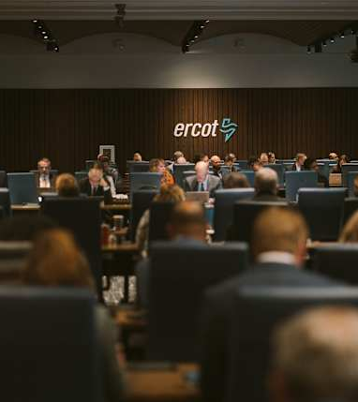
AGENDA
NPRRS ready for WMS vote:
None
NPRRs Still with WMWG
NPRR1278 - Establishing Advanced Grid Support Service as an Ancillary Service
Other Business
January 28, 2026 RUC dispatch review
Development of FPA §202(c) Requests
WMWG Vice-chair role

Slide 3
Discussion of Revision Requests
NPRR1278 - Establishing Advanced Grid Support Service as an Ancillary Service – No discussion at 4-27 meeting but authors flag that they would like to resume discussions promptly.

Slide 4
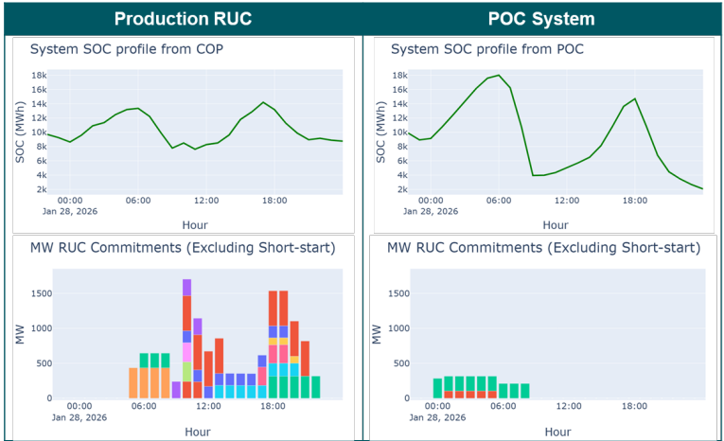
Other Business
January 28, 2026 RUC Dispatch – SOC and Operational Impacts
WMWG discussed ERCOT’s Board-level review of January 28 operations and SOC considerations with a stakeholder request for improved transparency in RUC reporting to identify commitments driven by insufficient SOC. ERCOT will provide additional information on SOC status observed by operations during the 1/28 event at next WMWG meeting
WMWG members also expressed interest in learning more about ERCOT’s plans for developing SOC-related operational triggers for EEA, as discussed in the ERCOT Operations Report to the ERCOT Board.
In ERCOT’s presentation to the Board, it showed this graph, which compares the production RUC results with the indicative RUC results using a multi-interval study tool currently under development (“POC System”). For January 28, the new tool would have identified an energy concern from insufficient SOC and would have recommended actions that could have allowed ESRs to charge in preparation for the morning net-load peak.

Slide 5
Other Business
Development of FPA §202(c) Requests
WMWG gathered stakeholder feedback on ERCOT’s process for requesting emergency orders under FPA 202(c) noting the following:
Need for greater clarity on ERCOT’s current process, including communication of 202(c) actions and associated market impacts
Desire for a standardized, repeatable framework covering notification, operational requirements, and post-event reporting
ERCOT will review stakeholder feedback and report back at the next WMWG meeting
Should WMWG explore development of a guidance document or NPRR to improve transparency and consistency in the FPA 202(c) request process?
WMWG Vice-Chair Role
WMWG Vice-Chair nominee: Cara Sweeney, CPS Energy

Slide 6

THANK YOU

