Slide 1
Settlement Stability Report
2026 Q1 Update to WMS
Settlements Group
ERCOT
05/08/2026

Slide 2
8.2(2)(c)(i) Track number of price changes
Reporting Period: 2026 Q1
Operating Day | # of Corrected Prices |  |  |  |  |  | # of Intervals Affected |  |  |  |  |  | Market Notice
 | DASPP | MCPC | RTSPP | RTRMPR | ORDC Adders | RTESOGPR | DASPP | MCPC | RTSPP | RTRMPR | ORDC Adders | RTESOGPR
- | - | - | - | - | - | - | - | - | - | - | - | - | -
Notes:
There were no price changes in Q1 2026.

Slide 3
8.2(2)(c)(iv) Track number of resettlements due to non-price errors
Reporting Period: 2026 Q1
Operating Day(s) Resettled | Reason for Resettlement | Affected Charge Types | Market Notice Number
12/05/2025 – 12/06/2025 | Software issue impacting Ancillary Service trades | BLTRAMT, ESACAMT, LARTRNAMT, LARTRRAMT, RTEIAMT, RTESOGAMT, RTRRIMBAMT | M-A121225-05

Slide 4
8.2(2)(c)(ii) Track number and types of disputes submitted
8.2(2)(c)(iii) Compliance with timeliness of response to disputes
YEAR | 2026 |  | 100% of dispute resolutions were timely.
CALENDAR QUARTER REPORTED | Q1
Disputed Charge Sub-Type | Submitted | Resolved | Denied | Granted | Granted with Exceptions
Emergency Operations | 0 | 1 | 1 | 0 | 0
Energy-RTM | 12 | 5 | 4 | 1 | 0
Reliability Unit Commitment | 16 | 8 | 0 | 8 | 0
Set Point Deviation | 4 | 4 | 1 | 2 | 1
TOTAL | 32 | 18 | 6 | 11 | 1
Submitted but not resolved disputes may be:
Not started
Open
Rejected
Withdrawn

Slide 5
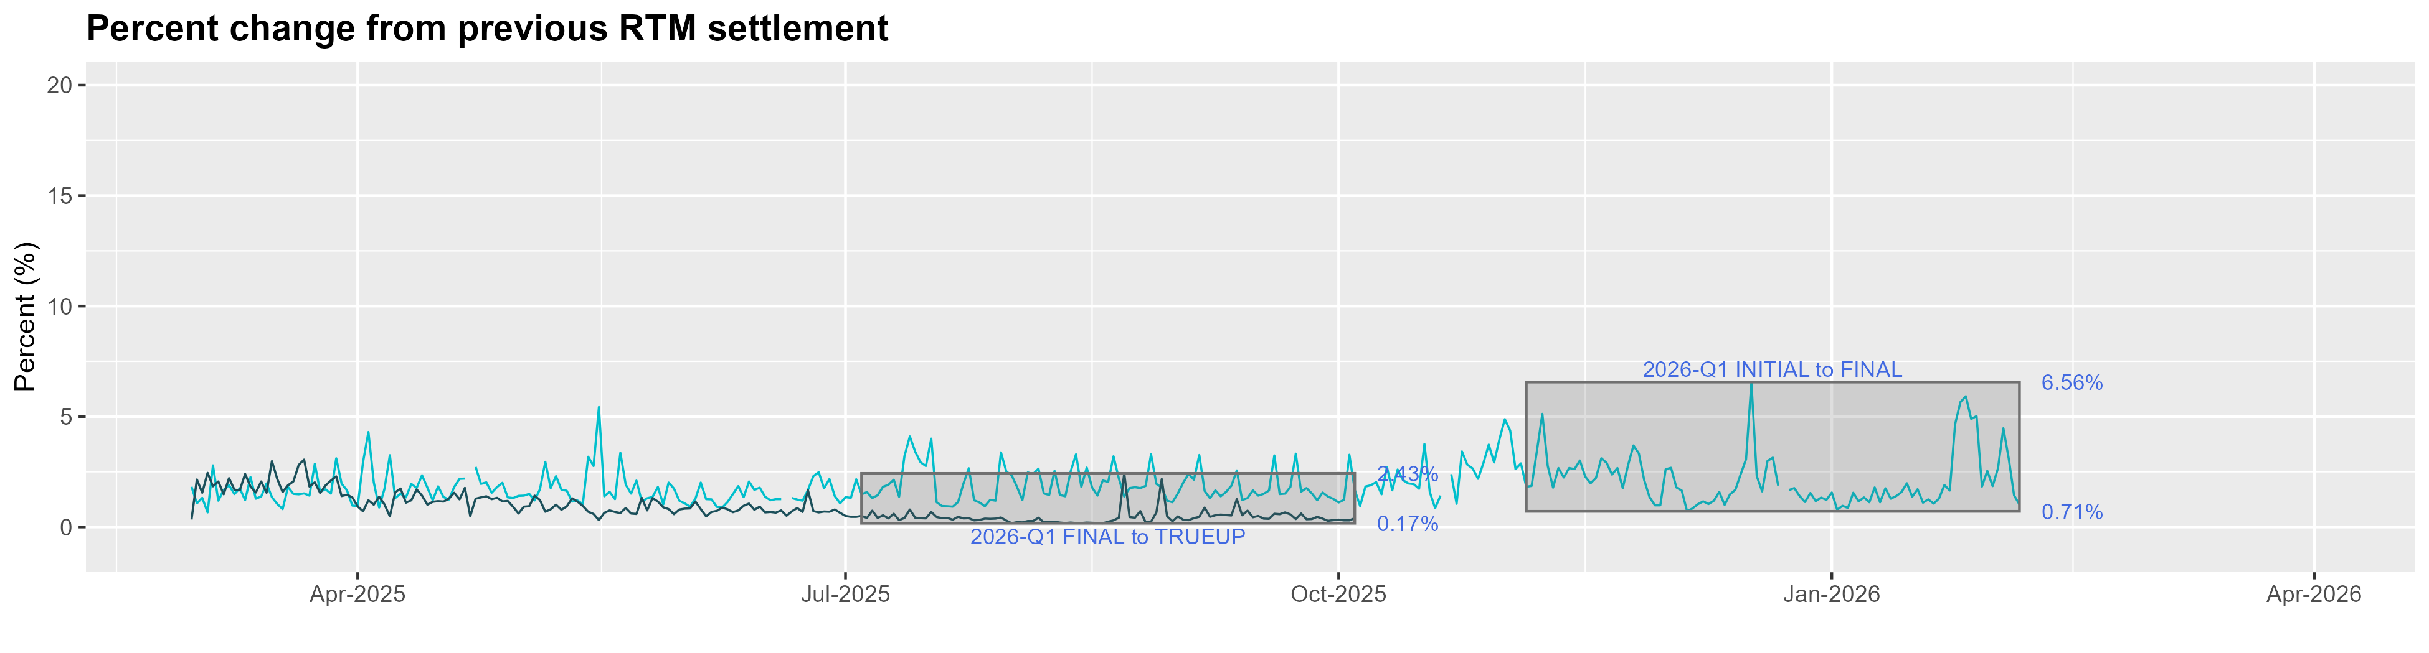
8.2(2)(c)(v) Other Settlement metrics
NOTE: ERS Final settlement OD data is not represented in graph.
Average percent change
 | 2017 | 2018 | 2019 | 2020 | 2021 | 2022 | 2023 | 2024 | 2025 | 2026
FINAL | 3.01 | 2.93 | 2.66 | 3.09 | 3.53 | 3.36 | 2.90 | 2.32 | 1.98 | 2.13
TRUEUP | 0.27 | 0.26 | 0.20 | 0.26 | 0.46 | 0.99 | 0.83 | 0.41 | 0.83 | N/A

Slide 6
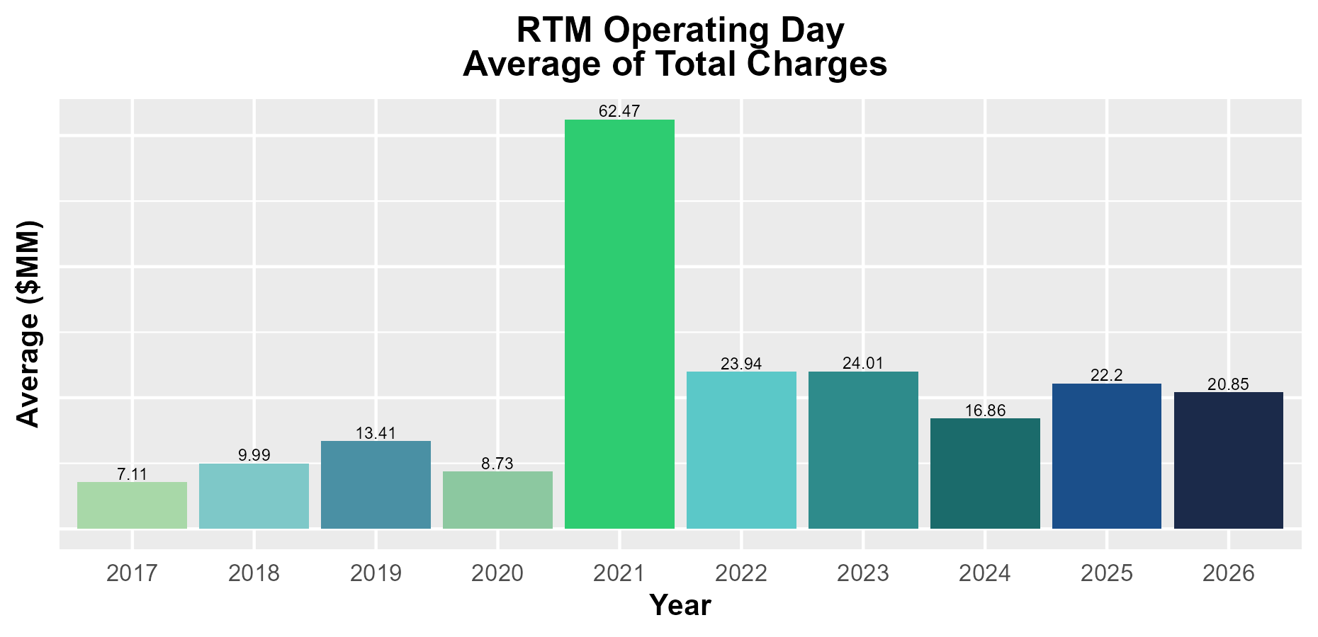
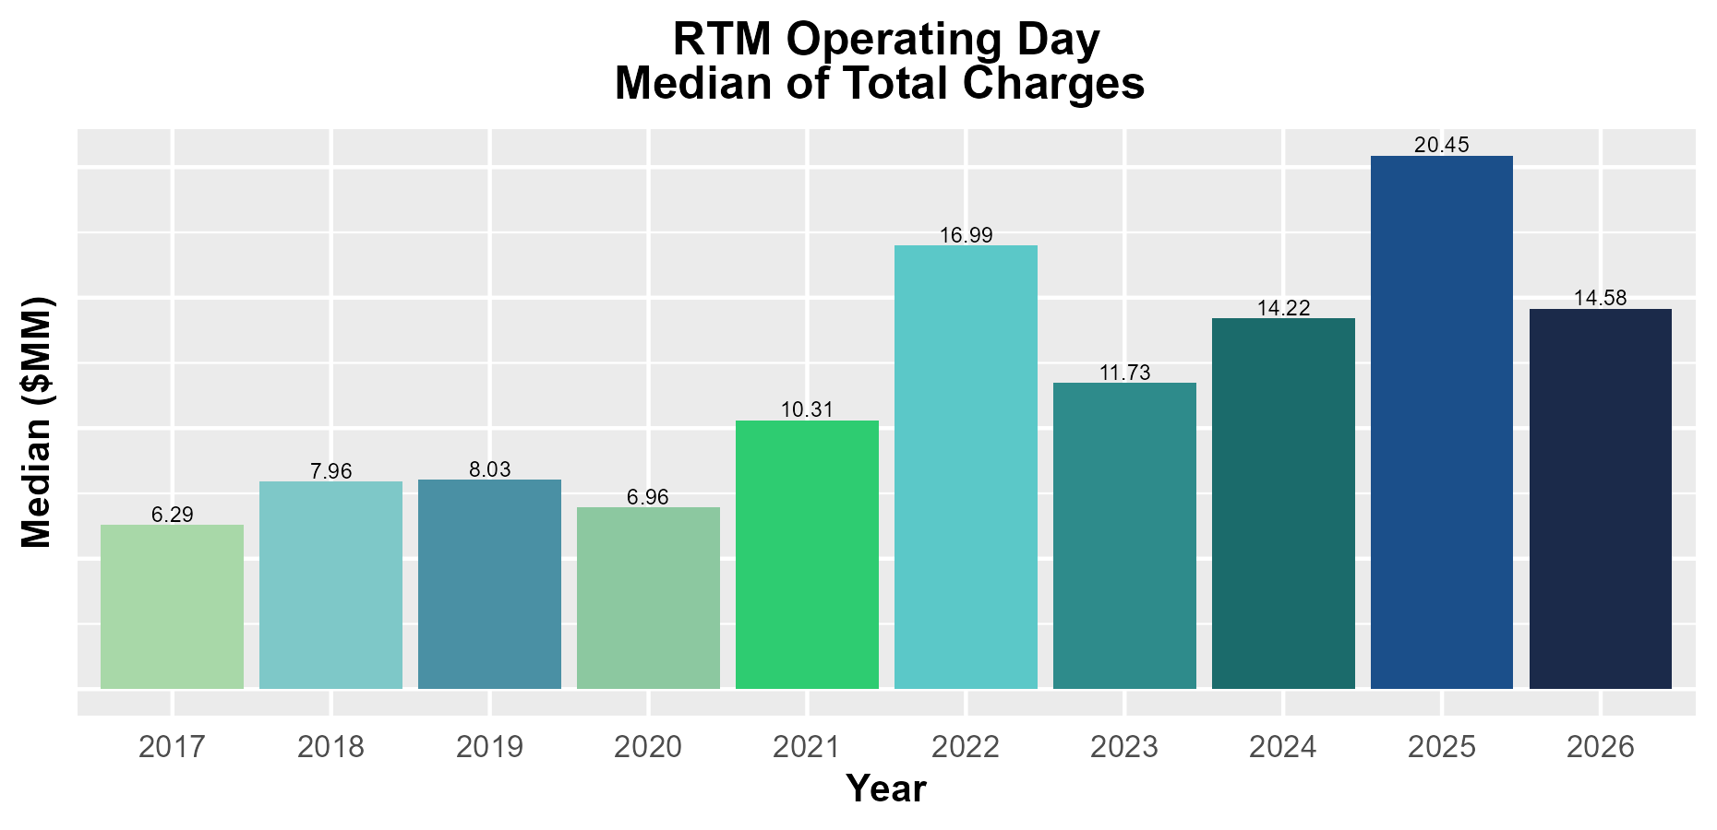
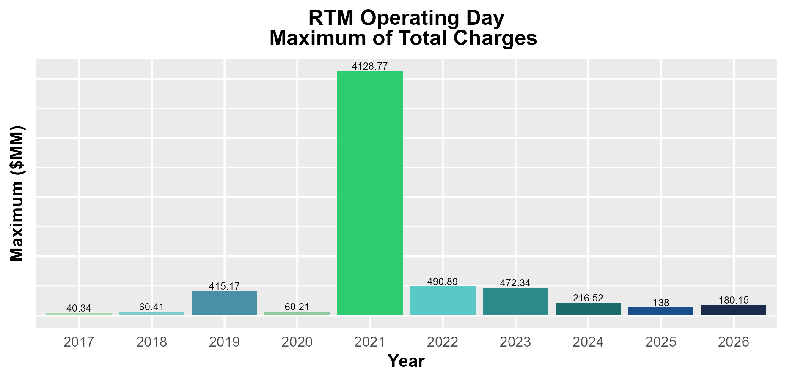
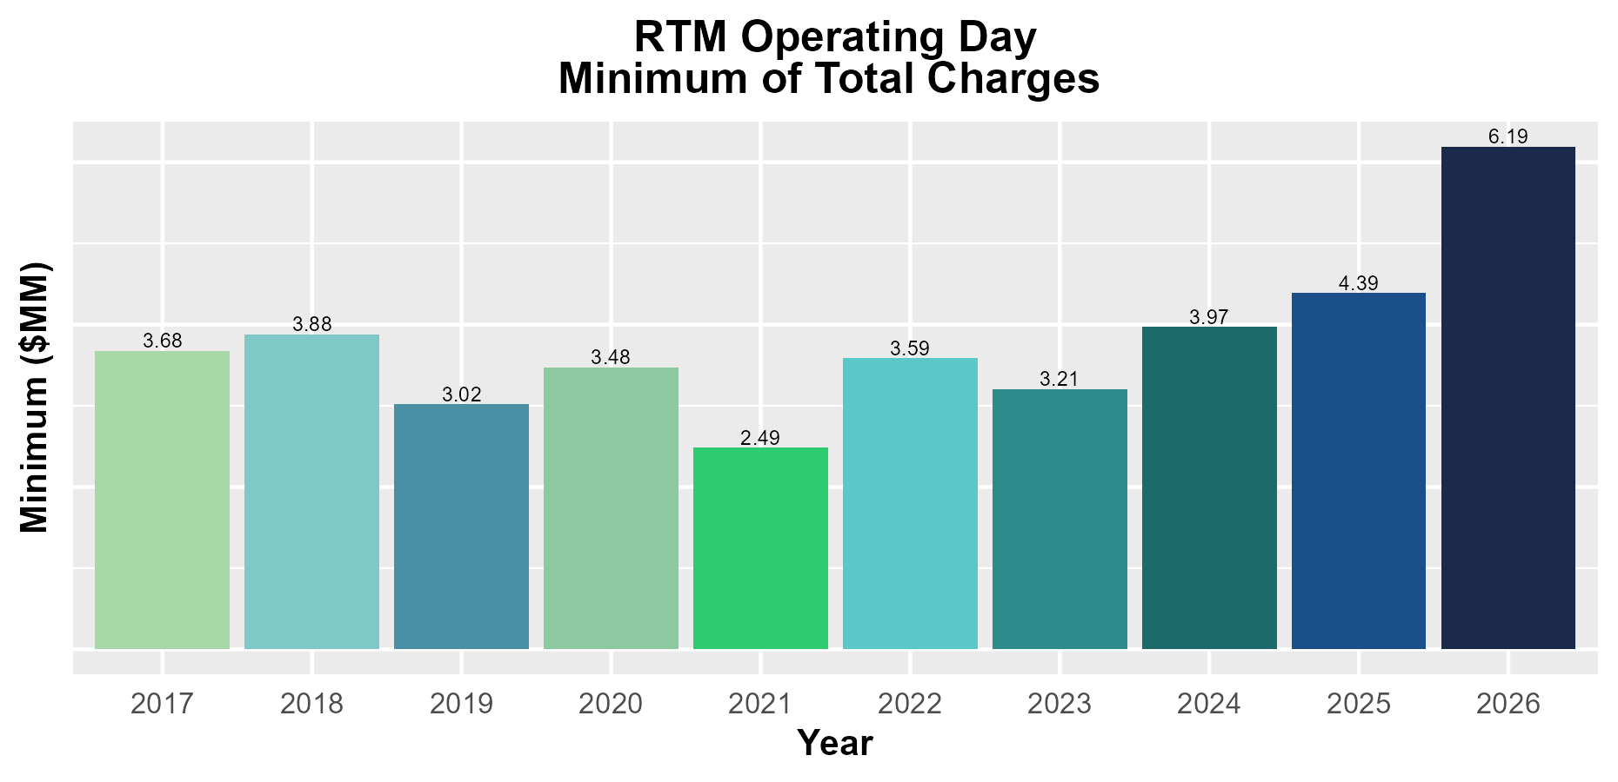
8.2(2)(c)(v) Other Settlement metrics

Slide 7
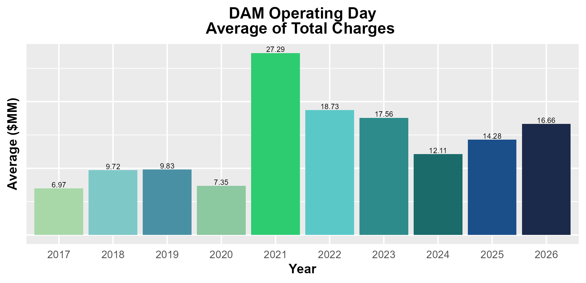
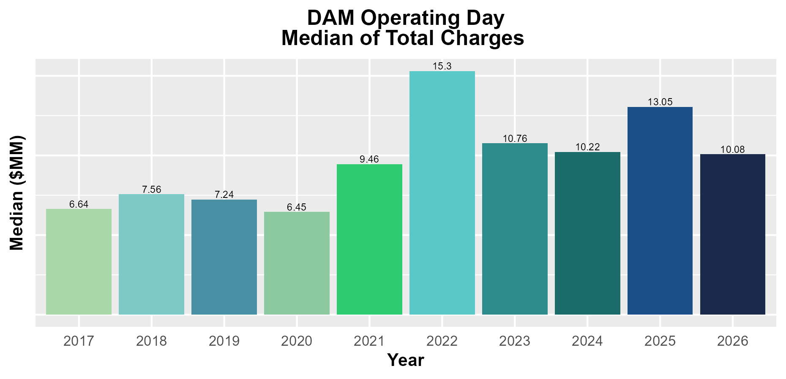
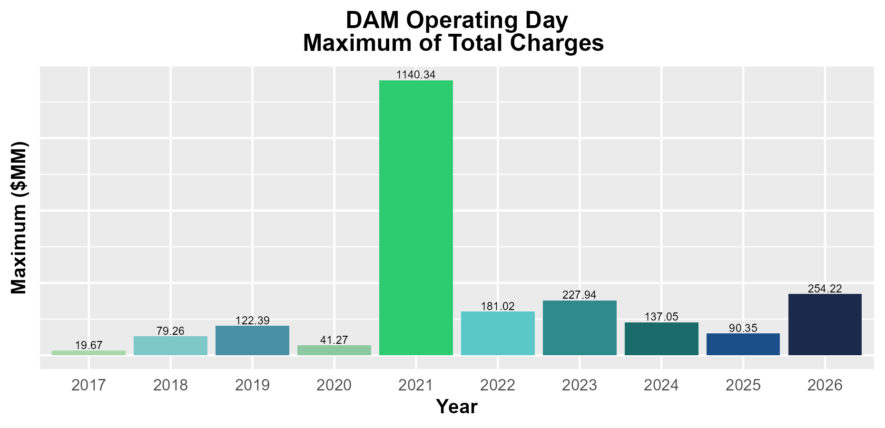
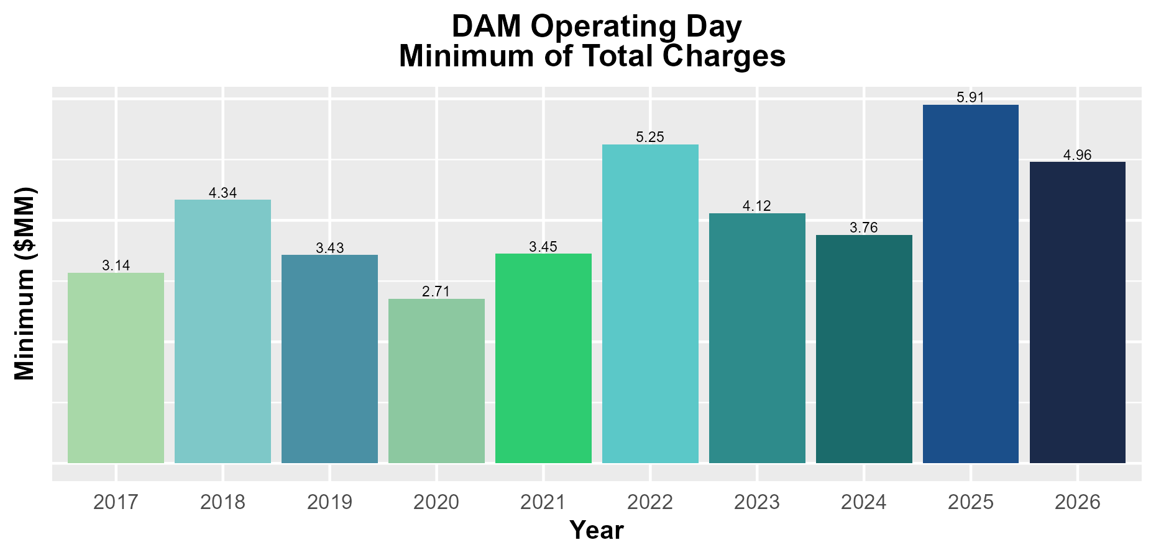
8.2(2)(c)(v) Other Settlement metrics

Slide 8
8.2(2)(c)(vi) Availability of ESIID consumption data

Slide 9
8.2(2)(c)(vi) Availability of ESIID consumption data

Slide 10
8.2(2)(g) Net Allocation to Load - Totals and $/MWh
NET ALLOCATION TO LOAD ($M)
 | Mar 2025 | Apr 2025 | May 2025 | Jun 2025 | Jul 2025 | Aug 2025 | Sep 2025 | Oct 2025 | Nov 2025 | Dec 2025 | Jan 2026 | Feb 2026 | Mar 2026
Balancing Account Payout to Load | -7.5 | -18.4 | -37.0 | -34.7 | -30.5 | -32.4 | -25.2 | -0.3 | -17.2 | -16.4 | -70.3 | -7.6 | 0.0
Base/Set Point Deviation Payments | -0.7 | -0.8 | -0.6 | -0.7 | -0.6 | -0.7 | -0.6 | -0.8 | -0.6 | -1.0 | -1.1 | -0.6 | -0.8
Black Start Service Settlement | 0.7 | 0.6 | 0.6 | 0.6 | 0.6 | 0.6 | 0.6 | 0.6 | 0.6 | 0.6 | 0.6 | 0.6 | 0.6
Block Load Transfer Settlement | 0.0 | 0.0 | 0.0 | 0.0 | 0.0 | 0.0 | 0.0 | 0.0 | 0.0 | 0.0 | 0.0 | 0.0 | 0.0
DAM Ancillary Service Settlement | 14.1 | 15.0 | 49.0 | 14.8 | 10.5 | 10.5 | 6.2 | 10.9 | 15.0 | 21.4 | 41.0 | 7.6 | 8.5
Emergency Energy Charges | 0.1 | 0.0 | 0.0 | 0.0 | 0.0 | 0.0 | 0.0 | 0.1 | 0.0 | 0.1 | 0.0 | 0.0 | 0.0
ERCOT Admin Fee Settlement | 21.9 | 23.0 | 26.0 | 28.5 | 30.2 | 31.2 | 27.8 | 25.9 | 22.5 | 23.9 | 24.4 | 20.3 | 23.2
ERO Pass-Through Fee⁵ | 2.5 | 2.5 | 2.5 | 2.5 | 2.5 | 2.5 | 2.5 | 2.5 | 2.5 | 2.5 | 2.6 | 2.6 | 2.6
ERS Settlement¹ | 8.5 | 1.1 | 1.1 | 7.9 | 7.9 | 7.9 | 7.9 | 1.0 | 1.0 | 0.0 | 0.0 | 0.0 | 0.0
Firm Fuel Service Settlement | 6.2 | 0.0 | 0.0 | 0.0 | 0.0 | 0.0 | 0.0 | 0.0 | 6.9 | 12.8 | 13.0 | 11.9 | 6.4
High Dispatch Limit Override | 0.0 | 0.0 | 0.0 | 0.0 | 0.0 | 0.0 | 0.0 | 0.0 | 0.0 | 0.0 | 0.0 | 0.0 | 0.0
Non-Zonal Auction Distribution | -48.6 | -50.7 | -45.6 | -42.9 | -21.9 | -26.6 | -23.7 | -31.4 | -27.1 | -24.9 | -18.8 | -17.6 | -31.9
ORDC Settlement | 3.7 | 1.3 | 1.1 | 1.4 | 1.0 | 1.1 | 2.2 | 1.5 | 1.4 | 0.7 | 0.0 | 0.0 | 0.0
Real-Time Ancillary Service Revenue Neutrality | 0.0 | 0.0 | 0.0 | 0.0 | 0.0 | 0.0 | 0.0 | 0.0 | 0.0 | 0.2 | -0.2 | 0.0 | -2.2
Real-Time Derated Ancillary Service | 0.0 | 0.0 | 0.0 | 0.0 | 0.0 | 0.0 | 0.0 | 0.0 | 0.0 | 0.0 | 0.0 | 0.0 | 0.0
Revenue Neutrality Total | 14.6 | 12.0 | 13.4 | 13.5 | 12.0 | 10.1 | 9.8 | 7.5 | 7.9 | 8.8 | 7.9 | 7.6 | 11.1
RMR Settlement | 11.0 | 9.1 | 6.3 | 10.7 | 7.7 | 6.3 | 4.6 | 4.4 | 3.1 | 3.1 | 1.2 | 3.0 | 3.1
RUC Settlement | -0.4 | -1.0 | -0.3 | -0.2 | -0.2 | 0.0 | -0.1 | -0.1 | -0.1 | -0.2 | -1.1 | 0.0 | -0.9
Voltage Services Settlement | 0.0 | 0.0 | 0.0 | 0.0 | 0.0 | 0.0 | 0.0 | 0.0 | 0.0 | 0.0 | 0.0 | 0.0 | 0.0
Zonal Auction Distribution² | -117.7 | -108.5 | -116.2 | -126.8 | -138.2 | -138.8 | -110.1 | -124.5 | -110.6 | -107.7 | -123.2 | -120.0 | -135.6
Total Allocation to Load | -91.6 | -114.8 | -99.7 | -125.4 | -119.0 | -128.3 | -98.1 | -102.7 | -94.7 | -76.1 | -124.0 | -92.2 | -115.9
Adjusted Metered Load (TWh) | 34.8 | 36.6 | 41.3 | 45.2 | 47.9 | 49.5 | 44.1 | 41.1 | 35.7 | 37.9 | 40.0 | 33.2 | 38.1
$/MWh³ | -2.6 | -3.1 | -2.4 | -2.8 | -2.5 | -2.6 | -2.2 | -2.5 | -2.7 | -2.0 | -3.1 | -2.8 | -3.0
Note: The Net Allocation to Load amounts provided in this presentation are for informational purposes only and cannot be relied upon for accurate measurements or forecasts of individual QSE charges and payments.
¹The total ERS charges have been evenly allocated across the contract period.
²Zonal Auction Distribution by 2003 Congestion Management Zone, shown below.
³The $/MWh value as calculated per PR 8.2 (2) g
⁴The $/MWh value by 2003 Congestion Management Zone, as calculated per PR 8.2(2) g
⁵Allocated to load from two years prior per the Electric Reliability Organization Fee Assessment and Collection Guide

Slide 11
8.2(2)(g) Net Allocation to Load - Totals and $/MWh
ZONAL AUCTION DISTRIBUTION PER CONGESTION MANAGEMENT ZONE ($M)
 | Mar 2025 | Apr 2025 | May 2025 | Jun 2025 | Jul 2025 | Aug 2025 | Sep 2025 | Oct 2025 | Nov 2025 | Dec 2025 | Jan 2026 | Feb 2026 | Mar 2026
HOUSTON | -10.1 | -12.0 | -12.8 | -11.6 | -12.4 | -10.9 | -8.6 | -10.6 | -7.9 | -7.9 | -9.4 | -8.9 | -9.0
NORTH | -16.6 | -15.5 | -19.8 | -26.3 | -28.3 | -29.9 | -21.3 | -19.4 | -14.6 | -18.2 | -20.9 | -24.5 | -25.1
SOUTH | -33.8 | -33.2 | -33.7 | -38.6 | -44.0 | -44.9 | -32.2 | -31.4 | -27.4 | -28.9 | -32.5 | -34.0 | -37.4
WEST | -57.1 | -47.7 | -50.0 | -50.4 | -53.5 | -53.1 | -48.0 | -63.1 | -60.7 | -52.8 | -60.5 | -52.6 | -64.0
TOTAL | -117.7 | -108.5 | -116.2 | -126.8 | -138.2 | -138.8 | -110.1 | -124.5 | -110.6 | -107.7 | -123.2 | -120.0 | -135.6
REAL-TIME ADJUSTED METERED LOAD BY CONGESTION MANAGEMENT ZONE (TWh)
 | Mar 2025 | Apr 2025 | May 2025 | Jun 2025 | Jul 2025 | Aug 2025 | Sep 2025 | Oct 2025 | Nov 2025 | Dec 2025 | Jan 2026 | Feb 2026 | Mar 2026
HOUSTON | 8.8 | 9.5 | 10.8 | 11.6 | 12.2 | 12.3 | 11.2 | 10.3 | 8.7 | 8.9 | 9.0 | 7.9 | 9.3
NORTH | 10.3 | 10.7 | 12.1 | 14.4 | 15.7 | 15.9 | 13.6 | 12.3 | 10.6 | 12.1 | 13.4 | 10.2 | 11.4
SOUTH | 8.9 | 9.6 | 11.3 | 11.9 | 12.3 | 13.2 | 11.7 | 10.9 | 9.1 | 9.5 | 10.2 | 8.4 | 9.9
WEST | 6.8 | 6.7 | 7.2 | 7.3 | 7.8 | 8.0 | 7.6 | 7.5 | 7.2 | 7.5 | 7.5 | 6.7 | 7.5
TOTAL | 34.8 | 36.6 | 41.3 | 45.2 | 47.9 | 49.5 | 44.1 | 41.1 | 35.7 | 37.9 | 40.0 | 33.2 | 38.1
ZONAL AUCTION REVENUE PER CONGESTION MANAGEMENT ZONE ($/MWh)
 | Mar 2025 | Apr 2025 | May 2025 | Jun 2025 | Jul 2025 | Aug 2025 | Sep 2025 | Oct 2025 | Nov 2025 | Dec 2025 | Jan 2026 | Feb 2026 | Mar 2026
HOUSTON | -1.1 | -1.3 | -1.2 | -1.0 | -1.0 | -0.9 | -0.8 | -1.0 | -0.9 | -0.9 | -1.0 | -1.1 | -1.0
NORTH | -1.6 | -1.4 | -1.6 | -1.8 | -1.8 | -1.9 | -1.6 | -1.6 | -1.4 | -1.5 | -1.6 | -2.4 | -2.2
SOUTH | -3.8 | -3.5 | -3.0 | -3.2 | -3.6 | -3.4 | -2.8 | -2.9 | -3.0 | -3.0 | -3.2 | -4.0 | -3.8
WEST | -8.4 | -7.1 | -6.9 | -6.9 | -6.9 | -6.6 | -6.3 | -8.4 | -8.4 | -7.0 | -8.1 | -7.9 | -8.5
TOTAL | -3.4 | -3.0 | -2.8 | -2.8 | -2.9 | -2.8 | -2.5 | -3.0 | -3.1 | -2.8 | -3.1 | -3.6 | -3.6
NET ALLOCATION TO LOAD PER CONGESTION MANAGEMENT ZONE ($/MWh)⁴
 | Mar 2025 | Apr 2025 | May 2025 | Jun 2025 | Jul 2025 | Aug 2025 | Sep 2025 | Oct 2025 | Nov 2025 | Dec 2025 | Jan 2026 | Feb 2026 | Mar 2026
HOUSTON | -0.3 | -1.5 | -0.8 | -1.0 | -0.6 | -0.7 | -0.5 | -0.5 | -0.5 | -0.1 | -1.0 | -0.3 | -0.5
NORTH | -0.8 | -1.6 | -1.2 | -1.8 | -1.4 | -1.7 | -1.3 | -1.1 | -1.0 | -0.7 | -1.6 | -1.6 | -1.7
SOUTH | -3.0 | -3.7 | -2.6 | -3.2 | -3.2 | -3.2 | -2.5 | -2.4 | -2.6 | -2.2 | -3.2 | -3.2 | -3.3
WEST | -7.6 | -7.3 | -6.5 | -6.9 | -6.5 | -6.4 | -6.0 | -7.9 | -8.0 | -6.2 | -8.1 | -7.1 | -8.0
TOTAL | -2.6 | -3.1 | -2.4 | -2.8 | -2.5 | -2.6 | -2.2 | -2.5 | -2.7 | -2.0 | -3.1 | -2.8 | -3.0

Slide 12
26.2 Securitization Default Charge
27.3 Securitization Uplift Charge
Subchapter M Invoice Month | Reference Month (RTM_FINAL data) | Monthly Uplift ($) (TSDCMA) | SDCMMATOT (MWh)
Mar-25 | Dec-24 | 2,234,826 | 271,342,237
Apr-25 | Jan-25 | 2,234,826 | 269,652,704
May-25 | Feb-25 | 2,393,201 | 245,496,350
Jun-25 | Mar-25 | 2,393,201 | 266,900,167
Jul-25 | Apr-25 | 2,393,201 | 270,472,809
Aug-25 | May-25 | 2,393,201 | 268,649,078
Sep-25 | Jun-25 | 2,226,786 | 266,278,515
Oct-25 | Jul-25 | 2,226,786 | 290,092,789
Nov-25 | Aug-25 | 2,226,786 | 293,689,057
Dec-25 | Sep-25 | 2,226,786 | 300,611,656
Jan-26 | Oct-25 | 2,226,786 | 311,264,186
Feb-26 | Nov-25 | 2,226,786 | 294,353,452
Mar-26 | Dec-25 | 2,226,786 | 309,765,874
Subchapter N¹ Invoice Month | Monthly Uplift ($) (MTSUCDA) | Non-Optout RTAML (MWh) | $/MWh
Mar-25 | 12,139,972 | 19,105,310 | 0.64
Apr-25 | 11,748,360 | 20,201,438 | 0.58
May-25 | 11,780,760 | 22,722,460 | 0.52
Jun-25 | 12,173,452 | 26,566,583 | 0.46
Jul-25 | 12,173,452 | 28,031,431 | 0.43
Aug-25 | 11,180,138 | 27,680,590 | 0.40
Sep-25 | 12,336,704 | 28,160,942 | 0.44
Oct-25 | 11,951,182 | 24,437,821 | 0.49
Nov-25 | 9,872,694 | 17,637,279 | 0.56
Dec-25 | 13,290,165 | 23,749,091 | 0.56
Jan-26 | 11,391,570 | 21,071,235 | 0.54
Feb-26 | 11,046,336 | 19,726,564 | 0.56
Mar-26 | 12,624,384 | 22,225,127 | 0.57
¹The data provided is grouped by the month the amount was invoiced.

