Slide 1
SSWG Report to ROS
May 7, 2026
Chair: Chris Ramirez (cramirez@wettllc.com)
Vice Chair: Weiwei Hu (weiwei.hu@austinenergy.com)

Slide 2
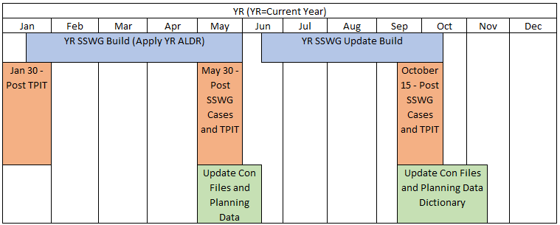
SSWG Report
Key Updates
26SSWG Case Build #1
Currently Ongoing
In-Person Tuning Meeting held April 27th – 29th
Target Posting: May 22nd
Next Business Meeting: June 3rd

Slide 3
SSWG Report
SSWG Procedure Manual Revisions
Section 4.3.3 Generation Dispatch Methodology for Planning Purposes:
Battery Storage Energy Resources updated to Transmission Energy Storage Resources.
Specifying that TESRs are online for VAR support with no real power contributions.
Transmission In-Service Dates added for associated SSWG Cases.
Section 4.3.3.1 Extraordinary Dispatch Conditions:
A rework of extraordinary dispatch to align with PGRR127 (PG Section 6.9).
Description of Zones in SSWG Cases:
Zone 319 added for CNP 765 Auto Tertiaries.
Appendix E – Load ID Prefixes:
Load ID Prefix A# added for generator station loads / auxiliary loads.

