Slide 1
Turbine Availability RFI Proposal for Planned Gas Projects Pete Warnken ERCOT Resource Adequacy Department Supply Analysis Working Group April 30, 2026

Slide 2
RFI Rationale
ERCOT is not confident that all gas-fired projects currently qualified to be included in the CDR report have realistic projected Commercial Operations Dates based on supply chain issues associated with critical component acquisition (gas turbines, transformers, etc.)
Projected CODs in RIOO-IS may reflect obsolete project planning data
An RFI to determine critical component acquisition status and projected COD delay risk would have the following benefits:
Provides a more accurate timing assessment of expected new dispatchable resource capacity for regulators and the market
Can serve as the basis for a CDR planned project delay scenario
The RFI would be sent to generation owners with gas projects that qualify to be in the forthcoming CDR report as well as TEF projects
Responses will be considered Confidential Information with aggregate results made publicly available

Slide 3
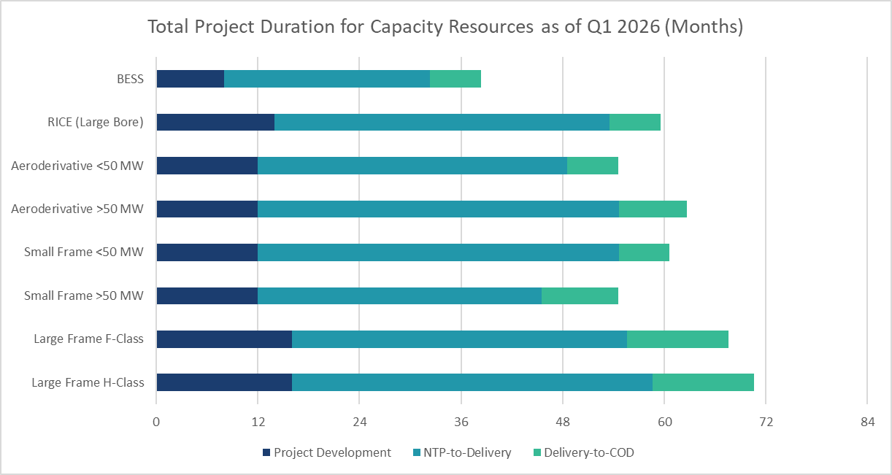
Brattle/Sargent & Lundy Gas Turbine Availability Assessment
CDR-qualified projects that haven’t acquired gas turbines and other critical components are at a high risk of projected COD delays
Sources and Notes Project development and delivery-to-COD durations based on OEM advertisement and S&L project data.
Notice-to-Proceed-to-Delivery (of gen equipment) durations based on Q1 2026 vendor quotes and OEM presentations
Project durations assume multiples of each technology needed to achieve >200 MW capacity.

Slide 4
At-Risk Planned Gas Capacity
Data pulled from RIOO-IS on April 28, 2026

Slide 5
RFI Questions (RESPONSES TREATED AS PROTECTED INFO)
What is the acquisition status of the gas turbine(s)?
The gas turbine(s) have been acquired
The gas turbine(s) have been secured through a reservation agreement
The gas turbines(s) have neither been acquired nor reserved
Based on the turbine acquisition status indicated in Q1 and current supply chain issues affecting turbines and other critical components, what is the likelihood of a significant delay (> 6 months) to the current projected Commercial Operations Date in RIOO-IS?
Near certainty (likelihood > 90%)
High (likelihood 50% ‒ 90%)
Moderate (likelihood 30% ‒ 50%)
Low to moderate (likelihood 10% ‒ 30%)
Low (likelihood < 10%)
If a revised projected Commercial Operations Date is available, please provide it and update RIOO-IS accordingly; revised projected COD: ___/___/_____
Are there any other major components (e.g., main transformers) affected by supply chain issues that may likely delay the projected COD? Please explain: ________________________________________________________________________________________________________________________________________________________________________________________________________________________________________________________________________________________________________________________________________

