Slide 1
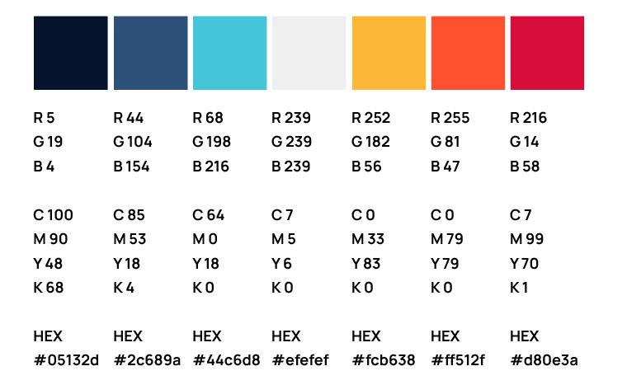


ERCOT IBRWG: Other Industry Updates
Julia Matevosyan, IBRWG chair
Associate Director and Chief Engineer
ESIG
March 27, 2026
Energy Systems Integration Group 2026

Slide 2


DOE i2X Forum for the Implementation of Reliability Standards for Transmission (i2X FIRST)
To facilitate understanding and adoption of new and recently updated standards relevant for existing and newly interconnecting inverter-based resources.
The Forum will convene the industry stakeholders to enable practical and more harmonized implementation of these interconnection standards.
The presentation portion of the meeting will be recorded and posted, and presentation slides will be shared.
Additionally, the leadership team will produce a summary of each meeting capturing:
Recommended best practices
Challenges
Gaps that require future work
A DOE initiative supported by the Office of Critical Minerals and Energy Innovation (CMEI)
Notes:
[DOE]

Slide 3
DOE i2X FIRST Meetings – Season 2
May 27, 2025, 11 a.m. - 1 p.m. ET – Season 2 Kick-Off
June 24, 2025, 11 a.m.- 1 p.m. ET – NERC Milestone 3 Standards
July 22, 2025, 11 a.m.- 1 p.m. ET – IBR Plant Design Evaluation with Applicable Requirements I
August 26, 2025, 11 a.m.- 1 p.m. ET – IBR Plant Design Evaluation with Applicable Requirements II
September 23, 2025, 11 a.m.- 1 p.m. ET – IBR Plant Modeling Requirements and Best Practices
October 21, 2025, 11 a.m.- 1 p.m. ET – Challenges with IEEE2800-2022, Planned Revisions
November 25, 2025, 11 a.m.- 1 p.m. ET – Change Management during IBR Plant Interconnection Process and Commissioning, How to Maintain Conformity
December 16, 2025, 11 a.m.- 1 p.m. ET – IBR Plant Commissioning Best Practices
January 27, 2026, 11 a.m.- 1 p.m. ET – NERC PRC-029 Implementation, Experience, and Recommended Practices
February 24, 2026, 11 a.m. - 1 p.m. ET – IBR Standards – How to Make Sense of it All?
March 16, 2026, hybrid 1-day workshop during ESIG Spring Workshop: Grid Forming IBR Needs, Specifications, Projects – Lessons Learned
Follow ESIG i2X FIRST website https://www.esig.energy/i2x-first-forum/doe-i2x-season-2/ for meeting materials & recordings

Slide 4
DOE i2x FIRST –Grid-Forming Inverter Workshop
Hybrid: In-person and Virtual, Tucson, AZ, March 16th
Presentation Materials, Recording and Summary
Educational tutorial covering GFM fundamentals, including how GFM controls differ from grid-following (GFL) approaches, what capabilities they offer, and where current limitations remain.
Panel Discussion: Why and where grid-forming is being required by some ISOs and utilities, and why others have taken more cautious approaches (MISO, ISO-NE, SPP, SRP)
Emerging grid-forming requirements and standards, including regional implementations and ongoing joint IEEE/IEC efforts (UNIFI, VDE FNN Germany, and Electranix covering HECO/AEMO/MISO/ERCOT)
Real-world project experience from utilities, developers, OEMs, and planners implementing grid-forming inverters in the field (HECO, AEMO, Tesla, Fluence, Zenobe)
The workshop was intended for participants seeking a practical, systems-oriented view of grid-forming inverters, grounded in current experience and forward-looking collaboration.

Slide 5
i2x FIRST –Grid-Forming Inverter Workshop, Key Themes
From concept to deployment:
GFM has matured into a field-proven IBR capability, with large-scale BESS deployments demonstrating real-world stability benefits. It is increasingly treated as an extension of IBR control philosophy, not an experimental solution.
Driven by declining system strength:
High IBR penetration (often ~30–60%) is exposing limits of GFL behavior, particularly in weak grids. GFM provides a scalable, cost-effective means to restore stabilizing characteristics historically supplied by synchronous machines.
Pragmatic, risk-informed adoption:
ISOs and utilities are deploying GFM ahead of full analytical certainty, driven by system needs and low incremental cost. Requirements are focusing on core capabilities, with iterative refinement based on operating experience.
Modeling and validation remain key risks:
Misalignment between models and as-built performance—especially at plant/PPC integration level—persists. Stronger validation using PMU/DFR data and post-event analysis is essential to realizing reliability benefits.
Part of a broader solution set:
GFM complements—not replaces—technologies such as synchronous condensers, STATCOMs, and HVDC. Optimal solutions remain location-specific, driving multi-technology planning approaches.
Economic signals enabling adoption:
Emerging market mechanisms for inertia/stability services and interconnection requirements are aligning technical need with economic incentives, making GFM increasingly attractive for developers.

Slide 6
DOE i2x What’s Next?
I2x FIRST Season 3: Four meetings June through January covering emerging topics, e.g.:
  June 4, 2026, 11 a.m.- 1 p.m. ET – PRC-029 Implementation Process Updates (prior to 01/10/2026 effective date)
  August 6, 2025, 11 a.m.- 1 p.m. ET – NERC Milestone 4 projects and NERC Project 2022—04 EMT Modeling
  October 2026, during ESIG Fall WS – IEEE2800.2 deep dive and adoption pathways
  January 14, 2027, 11 a.m.- 1 p.m. ET – Update on new IEEE 2800 series efforts (including GFM requirements)
https://www.esig.energy/i2x-initiatives/

Slide 7
DOE i2x What’s Next?
NEW THIS YEAR!!!
I2x STITCH (Studies, Tools, and Interconnection Consistency & Harmonization): Nine meetings May through March. Facilitate a forum (similar format to i2x FIRST) to:
  summarize current interconnection studies approaches
  identify opportunities to standardize/harmonize interconnection study methods,
  identify industry best practices, and
  discuss remaining gaps in this focus area.
i2x Technical Assistance Hours - provide technical assistance to interconnection stakeholders focused on adoption of a harmonized and/or comprehensive interconnection requirements or standards. One-one sessions for key interconnection stakeholders.
https://www.esig.energy/i2x-initiatives/

Slide 8
I2x STITCH (Studies, Tools, and Interconnection Consistency & Harmonization) – Kick Off, May 26, 2026, 11 a.m. - 1 p.m. ET
Meeting Introduction: Will Gorman, LBNL
LBNL Queued Up – Relevant Trends: Joe Rand, LBNL
Developer Perspective on Interconnection Studies and Tools: Aaron Vander Vorst, Enel (TBC)
Interconnection Studies Whitepaper - Introduction: Sirisha Tanneeru, Elevate Energy Consulting
i2x STITCH Meeting Format: Julia Matevosyan, ESIG
Audience Q&A and Discussion
  Meeting summary, recording & presentations are posted here: https://www.esig.energy/i2x-initiatives/#i2x-STITCH

Slide 9
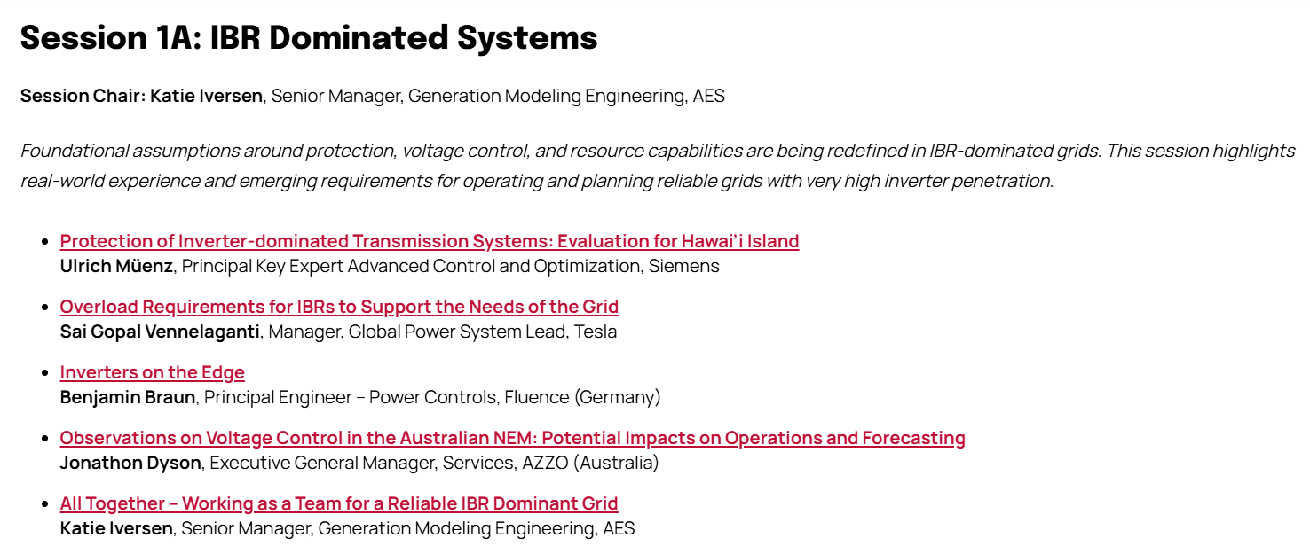
ESIG Spring Technical Workshop, Relevant Sessions for IBRWG
https://www.esig.energy/event/2026-spring-technical-workshop/

Slide 10
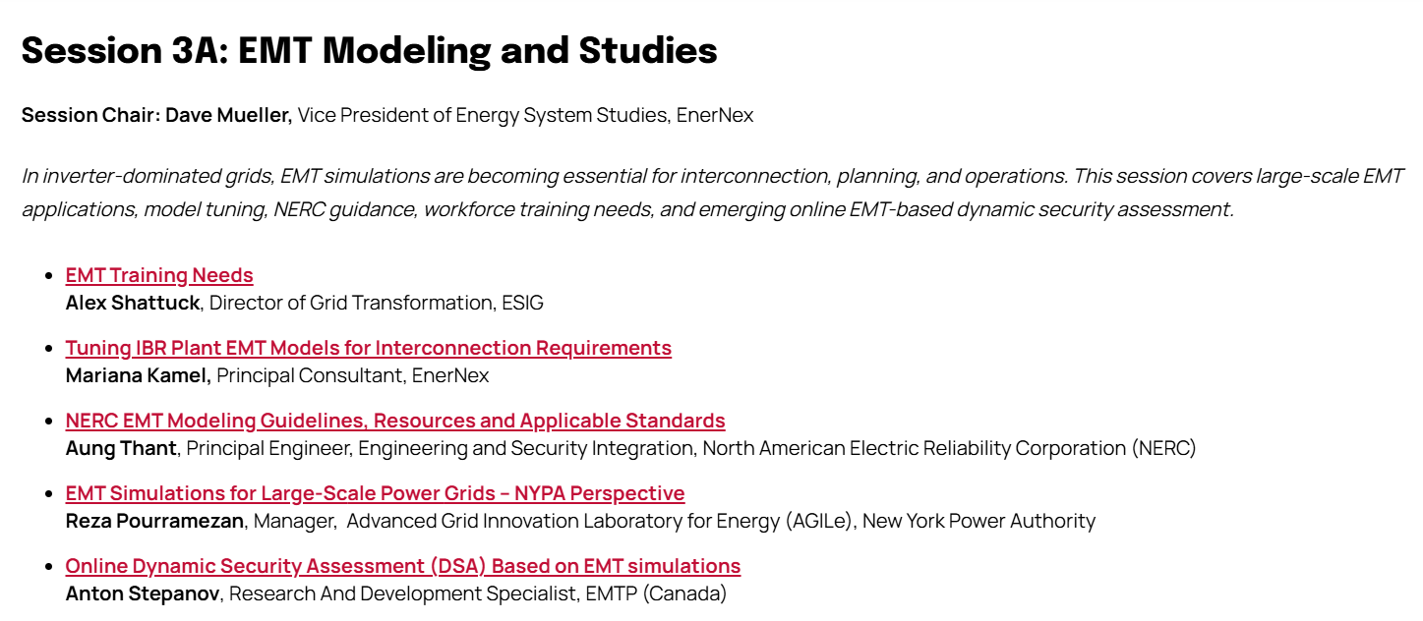
ESIG Spring Technical Workshop, Relevant Sessions for IBRWG
https://www.esig.energy/event/2026-spring-technical-workshop/

Slide 11
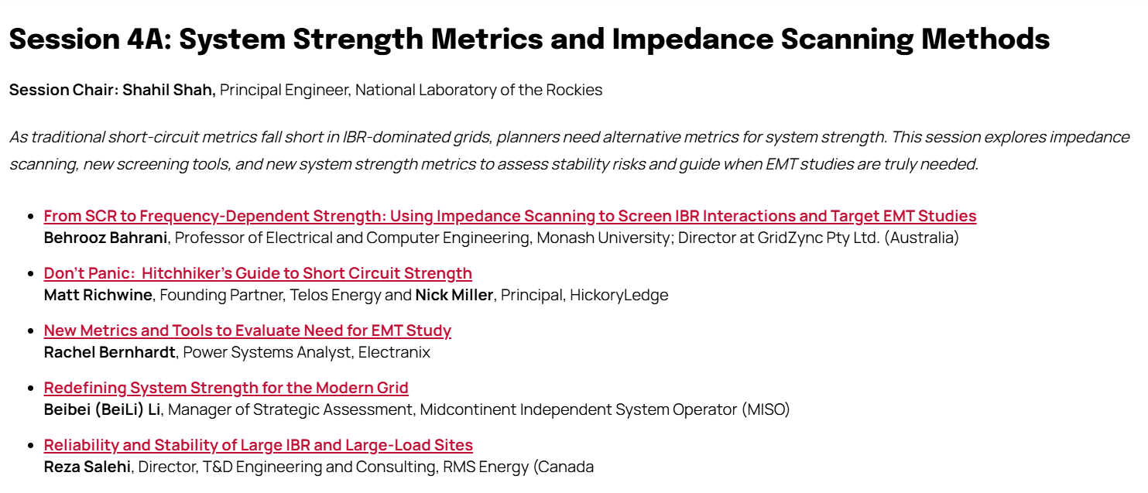
ESIG Spring Technical Workshop, Relevant Sessions for IBRWG
https://www.esig.energy/event/2026-spring-technical-workshop/

Slide 12
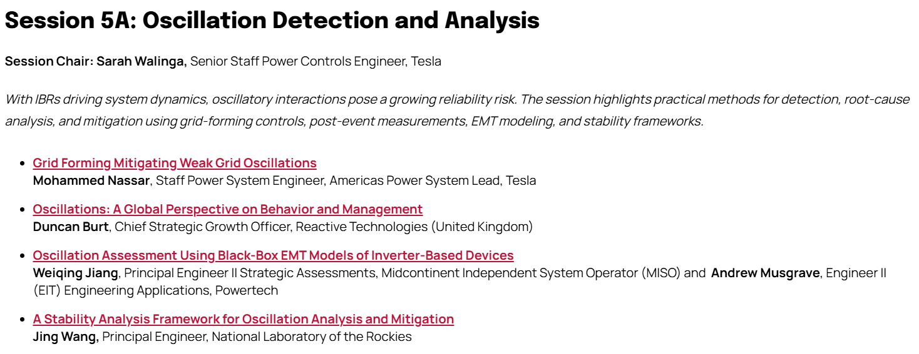
ESIG Spring Technical Workshop, Relevant Sessions for IBRWG
https://www.esig.energy/event/2026-spring-technical-workshop/

Slide 13

julia@esig.energy

