Slide 1
LEL Frequency Limit Study Update Luis Hinojosa Operations Planning April 24, 2026

Slide 2
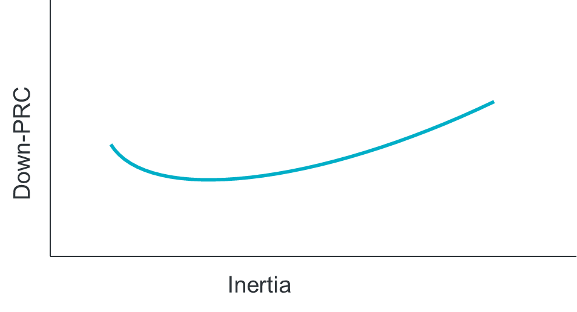
LEL Frequency Limit Study
Questions to Answer:
How do different inertia and down-PRC conditions impact the previously-identified¹ 3,200 MW loss of load frequency stability limit?
What would be the benefit of a down-frequency response Ancillary Service?
Scope:
TSAT snapshot cases for various inertia and down-PRC conditions
Identify load loss level that causes steady-state frequency to exceed 60.4 Hz for each case
Goals:
Identify frequency stability limit for loss of load.
Table showing load loss limit for various inertia and down-PRC conditions
This will serve as input into SOL monitoring criteria (see LL VRT SOL Study)
Identification of amount of down-PRC needed to increase loss of load frequency stability limit at various inertia levels
https://www.ercot.com/files/docs/2025/12/10/Large_Load_Loss_Analysis_121125_LLWG.pptx

Slide 3
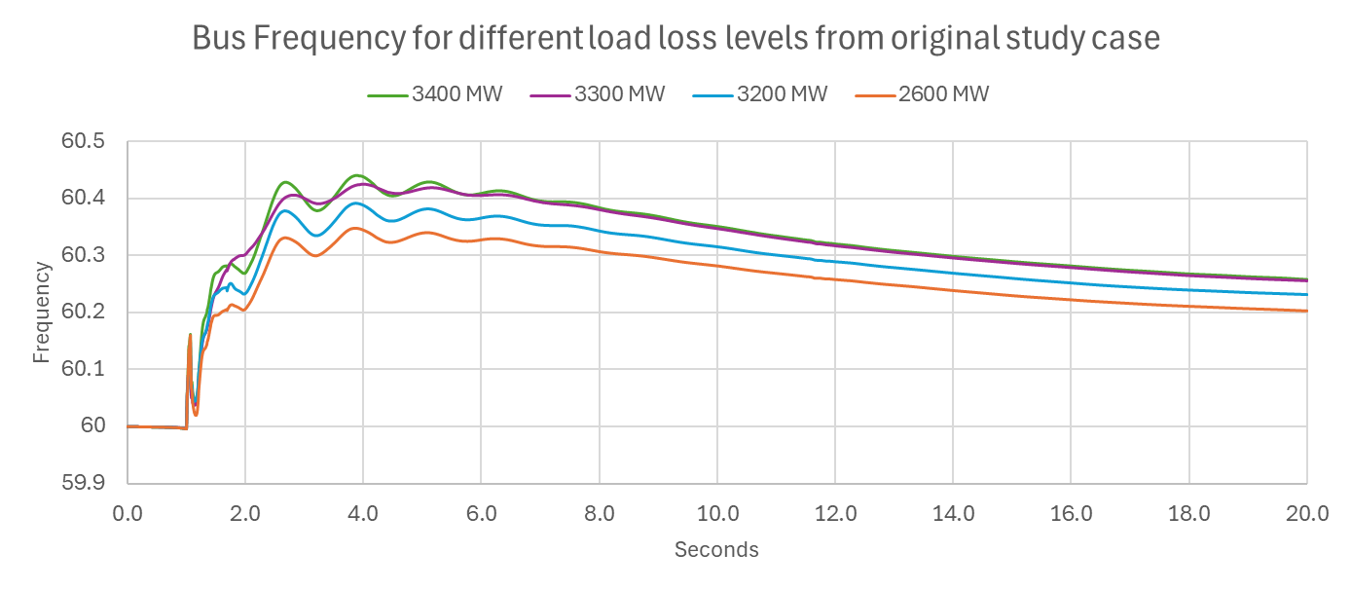
Updated Frequency Study Dec 2025 - (3,200 MW)
MW Load Loss | Frequency Max
~3,400 | 60.43
~3,300 | 60.43
~3,200 | 60.38
~2,600 | 60.21
Key Takeaway: We validated our cases and identified an issue which limited Primary Frequency Response from units sitting near 0 MW output which limited ESRs from providing PFR in the negative direction when idle. We have updated the logic to allow response as expected and identified a new limit of 3,200 MW.
Additionally, we have done some model validation and are doing outreach for models which responded incorrectly.

Slide 4
Fast Frequency Response (FFR) Down Analysis
Scope:
Use the TSAT base case and apply FFR down
Apply different levels of FFR down ranging from 300 MW to 1500 MW for varying load loss scenarios
Identify potential improvements in load loss limits which ensure steady-state frequency does not exceed 60.4 Hz
Identify potential degradation of steady-state frequency due to FFR down response
FFR Down:
FFR down is triggered when frequency hits 60.15 Hz and full response is applied withing 250ms (15 cycles)
This is similar to FFR up implementation today which has a 59.85 Hz trigger condition
Goals:
Identify FFR down influence on the frequency stability limit for loss of load
Identify scenarios where we may see frequency degradation due to overresponse of FFR down

Slide 5
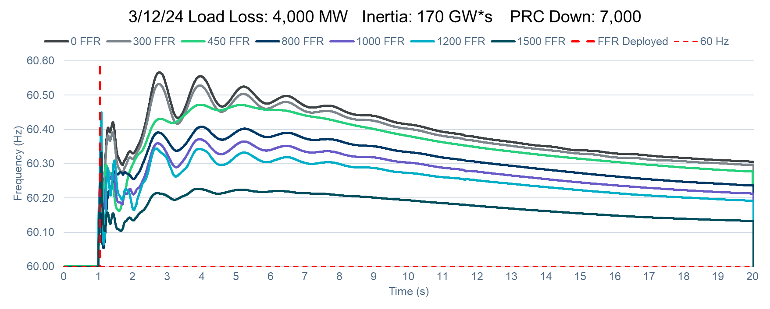
FFR Study: Simulate 4,000 MW Loss
Simulating ~ 4,000 MW load loss with various levels of FFR down applied when frequency hits 60.15 Hz.
As expected, due to load loss levels higher than 3,200 MW, frequency limit, we see frequency peak above 60.4 Hz at low FFR levels.
Additionally, it can be observed FFR levels of 800-1,500 MW may provide an improved steady state frequency after the load loss.
Key Takeaway: From this scenario it can be observed that the ratio of improved load loss limit to FFR MW is about 1MW to 1MW. I.e. this study has an 800 MW increased load loss limit with the inclusion of at least 800 MW of FFR.

Slide 6
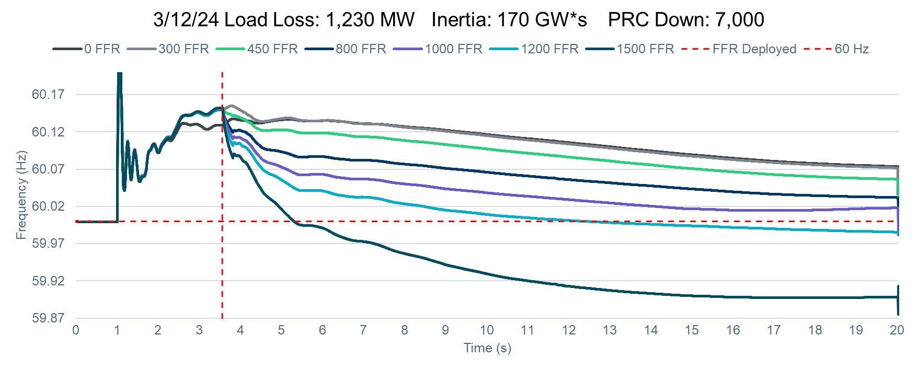
FFR Study: Simulate 1,230 MW Loss
We identified the lowest load loss scenario which would trigger FFR down deployment for this case.
Simulating ~ 1,230 MW load loss we see the effect of various levels of FFR down and potential over response.
We see that 1,500 MW of FFR down for a low load loss scenario may cause frequency to swing significantly in the other direction.
Key Takeaway: In this case we need to ensure we balance the FFR procured to ensure we see the benefit in a limit increase without the negative impact on frequency.

Slide 7
Summary
Key Takeaway:
Effects of FFR down show both a potential improvement on load loss limit and negative impact on frequency after a load loss event.
Utilizing our base case of 170 GW*s inertia we see that the ratio of improved load loss limit to FFR MW is about 1MW to 1MW.
While studying lower load loss scenarios we identified FFR response can cause frequency to swing in the opposite direction which could cause Resources to attempt and respond in both directions which could cause trips.
The amount of FFR down procured should ensure that we see an improved load loss limit without leading to any potential reliability issues.
Next steps:
We continue to work on a table to show load loss limit for various inertia and down-PRC conditions. We will bring this to a future LLWG discussion.

Slide 8
Questions/Feedback?
JoseLuis.Hinojosa@ercot.com

